Slide 1

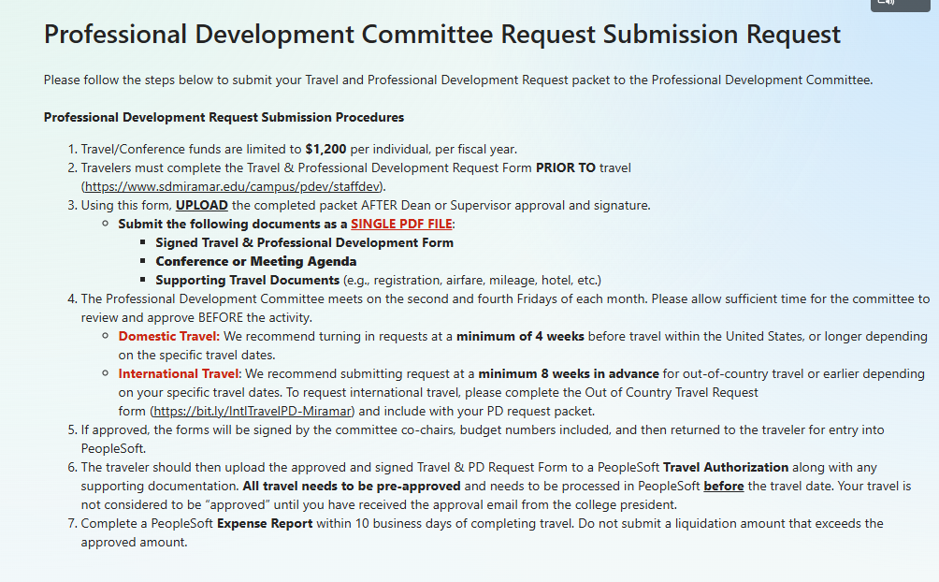

Committee Reports
Professional Development Committee:
(Olivia Flores)
New Process Starting Fall 2026​
Submission Request Form:
https://bit.ly/MiramarPDCrequest​

Slide 2
Committee Reports
Professional Development Request Procedures:
Limited to $1,200 per individual, per fiscal year.​
Complete the Travel & Professional Development Request form PRIOR TO travel.
NEW! SUBMIT: Go to https://bit.ly/MiramarPDCrequest and UPLOAD the completed packet AFTER Dean or Supervisor for approval and signature. Submit the following documents as a single PDF file:
  ​Signed Travel & Professional Development Form​
  Conference or Meeting Agenda ​
  Supporting Travel Documents (e.g., registration, airfare, mileage, hotel, etc.)
Meeting: 2nd & 4th Friday. Please allow sufficient time for the committee to review and approve BEFORE the activity takes place.
  Domestic Travel: Recommend submitting requests at least four weeks in advance ​
  International Travel: Recommend submitting requests at least 2 months in advance​

Slide 3
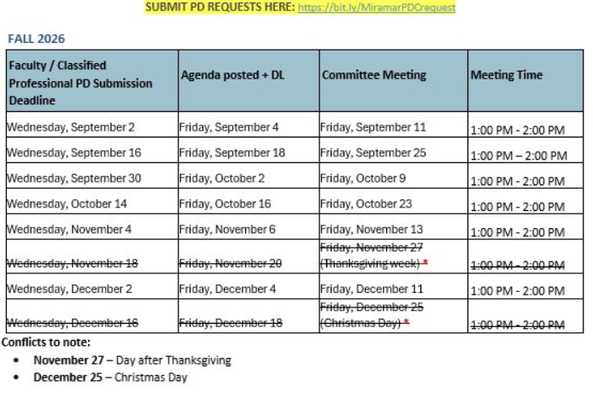
Committee Reports
PDC Fall 2026 Meeting Dates​ and Travel Request Deadlines:

