Slide 1
AP 4235 – Credit for Prior Learning
Revision
Information from 9/23/26 Policies and Procedures
To inform votes at City, Mesa, and Miramar's Curriculum Review Committees

Slide 2
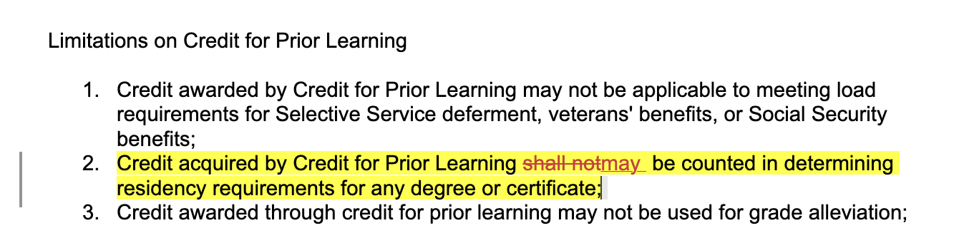
AP 4235 – Credit for Prior Learning
New language from Title 5 no longer forbids CPL from being used to determine residency; California community colleges can now make this choice at the local level

Slide 3
Vote: Shall SDCCD allow 12 unit residency requirement to be fulfilled by CPL?
Yes: Students are not allowed to repeat courses; 12 unit residency requirement may force them to take courses that do not support their goals.
Yes: More completions mean more SCFF funds.
Yes: Research shows students receiving CPL are likely to stay and complete other programs; this shift would be unlikely to negatively impact enrollment numbers.
No: Community colleges should have an emphasis on the "community" element.
No: Counselors may have more work in explaining to more students the potential transfer implications of opting for CPL.

