Slide 1

Academic Senate Meeting
October 6th, 2026 | 26-27 Academic Year
Cultivating Community:
Making the invisible visible
Remember to sign in using today’s log! (See Amy Alsup!)
Quorum Required: (23/43) to get started officially!
(QR Code for A.S. Webpage)
Attending for Flex credit? Email rgomez001@sdccd.edu or jbartolo@sdccd.edu

Slide 2
2. Agenda Overview
Call to Order
Approval of Agenda & Consent Calendar
  DRAFT Minutes 091526
  2026-27 Academic Senate Meetings Calendar
Land Acknowledgement (Updated)
Public Comments
Presentations
  Measure HH Presentation (25 mins)
Action Items
  Second Read: Resolution on Agentic AI: Affirming Faculty Purview and Human Oversight…
Discussion Items
  First Read: AP 4235 – Credit for Prior Learning
  First Read: Resolution to Support Proposal for Title 5 Change (Expansion and Clarification of Ethnic Studies)
  First Read: Resolution to Foster a Positive Campus Climate
  First Read: Student Success Framework (PIER)
  Campus Culture, Free Speech & Safety
Reports:
  Committee Reports
  Special Reports
  Executive Committee Reports
Announcements
Adjournment
A.S. Agenda for 10/06/26
AS Code of Conduct

Slide 3
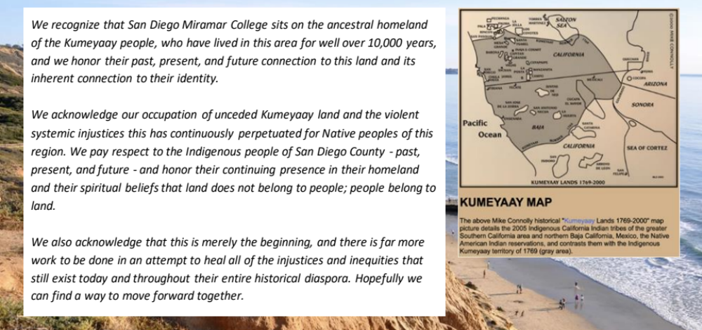
3. Land Acknowledgement
We recognize that San Diego Miramar College sits on the ancestral homeland of the Kumeyaay, Luiseño, Cupeño, and Cahuilla tribes, who have lived in this area for well over 10,000 years, and we honor their past, present, and future connection to this land and its inherent connection to their identity.
We acknowledge our occupation of unceded Kumeyaay land and the violent systemic injustices this has continuously perpetuated for Native peoples of this region. We pay respect to the Indigenous people of San Diego County - past, present, and future - and honor their continuing presence in their homeland and their spiritual beliefs that land does not belong to people; people belong to land.
We also acknowledge that this is merely the beginning, and there is far more work to be done in an attempt to heal all of the injustices and inequities that still exist today and throughout their entire historical diaspora. We commit to moving forward together.
Resources: “Making a land acknowledgment meaningful”; A call for more powerful land acknowledgements

Slide 4

4. Public Comments (10 mins)
(2 mins; limited to 10+1 items NOT on the agenda; time may not be yielded)

Slide 5
5. Presentations
(scheduled prior to senate business)

Slide 6
5.1 Presentation (25 mins w/ Q&A)
5.1 Measure HH Quarterly Senate Updates
(guest presenter)
Ongoing efforts to strengthen communication and transparency regarding districtwide initiatives and projects related to Measure HH activities
Requesting to be included on each Senate agenda every quarter. These in-person presentations, to give updates, answer questions, and discuss current and upcoming initiatives.
Review of Measure HH Project updates prepared by Operations, Enterprise Services, and Facilities during the period of March 31 to April 27, 2026.
    Cover_Memo_HH Updates_051426.docx
    May_Project_Update_FINAL.docx
    May_Project_Update_FINAL.pptx

Slide 7
6. Action Items (Second Reads)

Slide 8
6.1 Discussion Items (First Reads)
6.1 Resolution on Agentic AI: Affirming Faculty Purview and Human Oversight In the Use of Generative and Agentic AI
(Rodrigo Gomez)
Third Reading: no new edits have been made to the draft. We can vote on it as-is; or spend some time editing the wording now prior to a vote.
I recall a focus on the word “materially” so I’ve highlighted that here, but you should go though and comment– and perhaps delay this until the next meeting. Comment directly using this link to Draft Resolution on AI

Slide 9
7. Discussion Items (First Reads)

Slide 10
7.1 Discussion Items (First Reads)
7.1 First Read: AP 4235 – Credit for Prior Learning
(Veronica Hartmann)
AP 4235 Credit for Prior Learning (Link)
  Education Code 78093.1 (Link)
  Education Code 78093.2 (Link)
  Title 5 55050 (Link)
New Language:
Credit acquired by Credit for Prior Learning shall not may be counted in determining residency requirements for any degree or certificate;
Discussion:
Credit for Prior Learning may be counted in determining residency requirements for any degree or certificate (link)

Slide 11
7.2 Discussion Items (First Reads)
7.2 First Read: Resolution to Support Proposal for Title 5 Change (Expansion and Clarification of Ethnic Studies)
(Mara Palma-Sanft)

Slide 12
7.3 Discussion Items (First Reads)
7.3 First Read: Resolution to Foster a Positive Campus Climate
(Amy Alsup)

Slide 13
7.4 Discussion Items (First Reads)
7.4 First Read: Student Success Framework (PIER)
(David Wilhelm)

Slide 14

7.5 Discussion Items (First Reads)
7.5 Campus Culture, Free Speech & Safety
(Rodrigo Gomez)
Chancellor Smith has made campus culture one of his primary agenda items. He was at Miramar last week (during our exec meeting) and spoke towards it, if anyone was there and would like to share what they heard on the subject.
A week ago, you heard about the incidents at City with ICE on Campus. Faculty and students at City College have concerns regarding:
Student feelings of safety and belonging.
Awareness of district procedures related to immigration enforcement.
Communication and training related to campus response protocols.
Access to counseling, legal aid, and student support services.
And, in that climate, I was shocked to learn that Miramar now has a “Turning Point USA” Student Club. And there have already been at least a few reported incidents of students feeling that Miramar is becoming an unsafe campus. There’s growing interest to take this to the board.

Slide 15
8. Reports
(8.1 Committee | 8.2 Special | 8.3 Executive Committee)

Slide 16
8. Reports
8.1 Committee Reports

Slide 17
8. Reports
8.2 Special Reports

Slide 18
8. Reports
8.3.1 President’s Report
I met with Chancellor Smith in N-206 to share our thoughts on the qualities, characteristics, and leadership attributes that are believed to be important for the next President of Miramar College | Friday, October 2nd 4:00 – 5:00 pm.
He was as shocked as I was to hear that Miramar does, in fact, have a TPUSA Student Club on our campus. He had confidently denied that such a club existed here a few days prior. And it has major implications for his own conversations on campus culture.
Notes from College Council:
  The Miramar AI Network had it’s first meeting. This is an interdisciplinary space where folks can learn more about AI. Session 1 covered the basics. Session 2 will cover ethical concerns and frameworks for engaging with AI more critically in the classroom.

Slide 19
8. Reports
8.3.1 President’s Report
Region D Meeting
Region D Area Meeting: Friday, October 9, 2026. This is where area resolutions are discussed and feedback is gathered. [asccc.org]
Fall Plenary Session
November 5-7, 2026
Redwood City (hybrid voting available on Saturday). [asccc.org], [asccc.org]
When Resolutions Become Available
September 25, 2026: Pre-Area Meeting packet available on website
October 16, 2026: Area Meeting packet will be distributed following Region D discussions. [asccc.org]
October 29, 2026: Pre-Plenary packet distributed. This is generally the final major packet for delegate review before voting.

Slide 20
8. Reports
8.3.2 – 8
  Vice President – Olivia Flores
  Secretary – Amy Alsup
  Treasurer – Melissa Wolfson (please see the following slide)
  Contract Member-at-Large – David Mehlhoff
  Contingent Faculty Member-at-Large – Desi Klaar
  Chair of Chairs – Mary Kjartanson

Slide 21
8. Reports
8.3.4: Treasurer (Melissa Wolfson)
Account Balance $700.00
Academic Senate Dues / Voluntary Payroll Deduction
  Please consider enrolling in auto-payroll deduction for a nominal amount per check. Contributions of $2.00 per check make a difference to our students in funding our scholarships and other necessary needs.

Slide 22
9. Announcements
(1 min. time limit each)

Slide 23

9. Announcements (1 min)
Office of Environmental, Health & Safety (OEHS) is kicking off their Fall 2026 Safety Training Series, continuing:
October 2nd October 16th & November 6th

Slide 24

8. Announcements (1 min)
AI Engage Summit Registration
“Higher ed’s next chapter is already taking shape. Join us October 13–14 for bold ideas and practical strategies to help your institution stay ahead by recognizing student needs earlier, equipping staff to act sooner, and using AI to reduce repetitive work.”
Day 1: Student Success: Explore how institutions can anticipate student needs and deliver more connected, proactive support throughout the student journey.
Day 2: Workforce and Continuing Education: Discover how institutions can build flexible learning pathways that meet the evolving needs of adult learners and today’s workforce.

Slide 25

8. Announcements (1 min)
Constance Carroll Trailblazer Scholarship Award
TEN FULL-TUITION
SCHOLARSHIPS to USD!
Spring Deadline: November 1, 2026
Fall Deadline: April 17, 2027
Final Deadline (space permitting): June 15, 2027

Slide 26

8. Announcements (1 min)
The Miramar AI Network, or MAIN, is launching this semester as a campuswide space for faculty and classified professionals interested in developing AI literacy and exploring responsible applications of AI in our work.
Our next session is October 20, with additional sessions and MAIN Studio opportunities throughout the year. I’ll circulate information about participation, and I especially encourage senators to share it with your areas.
Landing Page: https://miramarainetworkpilot2026.my.canva.site/

Slide 27
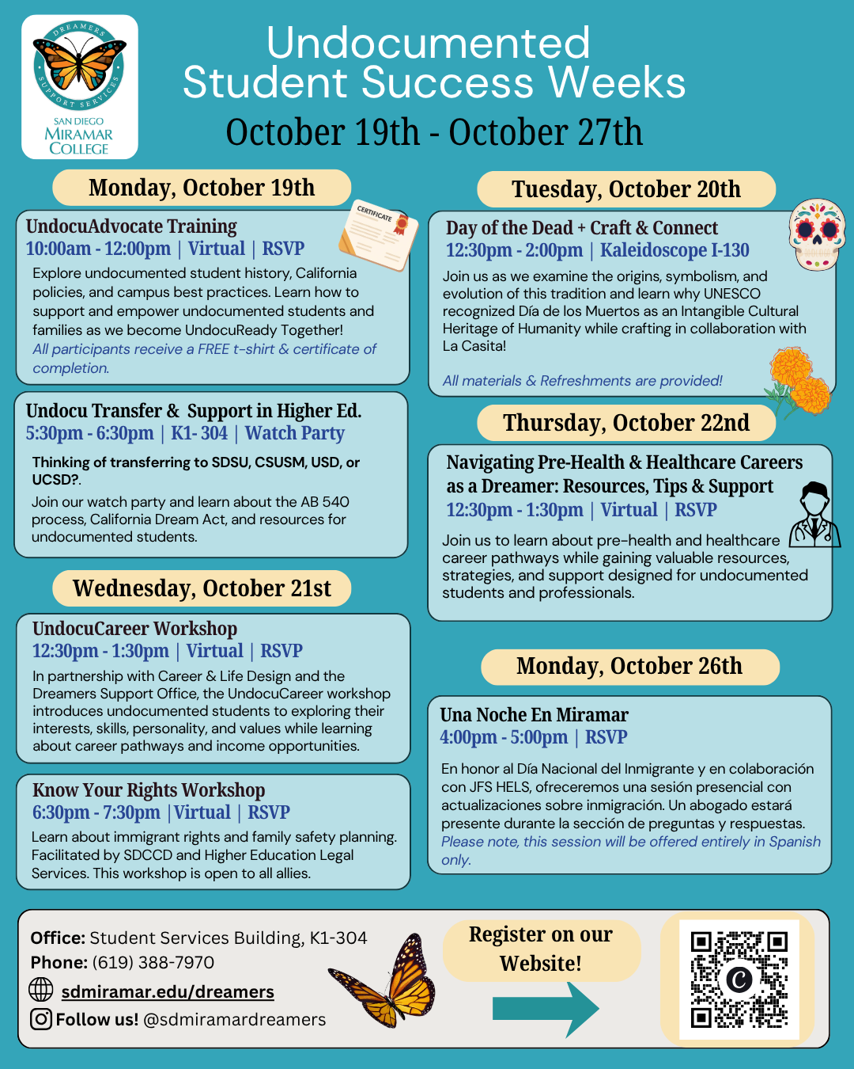
8. Announcements (1 min)
Please share these upcoming opportunities on Campus!

Slide 28
9. Adjournment
If the calendar was approved earlier,
the first meeting of the 2025-26 SDMC Academic Senate is:
Tuesday, October 20th, 2026 from 3:30-5:00 pm in L-301.
Remember that, as of Spring 2026, we’ll be moving to fully in person Senate meetings. Hence, we will be retiring the A.S. Senator Remote Attendance Form

Slide 29
Thanks for your hard work for Miramar College!
If you have any questions, please reach out via email!
rgomez001@sdccd.edu or jbartolo@sdccd.edu

