Slide 1
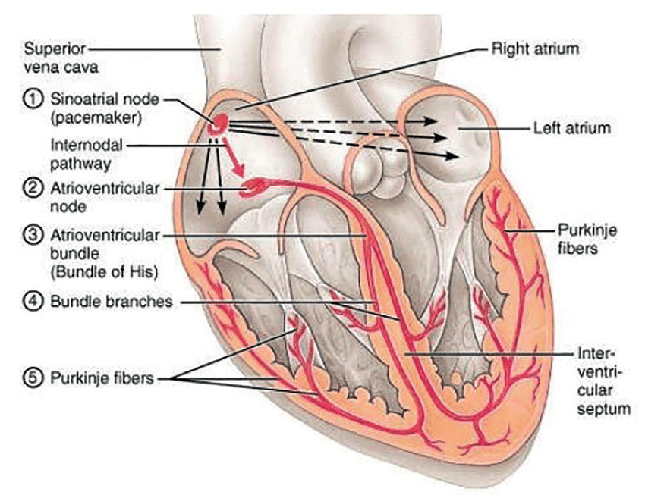
Electrical Conduction System of the Heart
Note: The internodal pathway (a)
Note: The interatrial band (b) (Bachmann’s bundle)
(b)
There are 5 main components (with location) of this conduction system:
1) Sinoatrial (SA) node
Sup. Post. R atrium
2) Atrioventricular (AV) node
Inf. R atrium
3) AV Bundle (of His)
Sup. I.V. septum
4) Left and Right bundle branches
L and R I.V. septum
5) Purkinje fibers
L and R ventricles
(a)
Sinus rhythm = the normal contractile pattern of the heart.
Electrical Conduction Region | Spontaneous Rate of Action Potentials/min
SA Node (sets the pace) | 70 - 80
AV Node | --------
AV Bundle | 40 - 60
R and L Bundle Branches | --------
Purkinje Fibers | 20 - 40

Slide 2
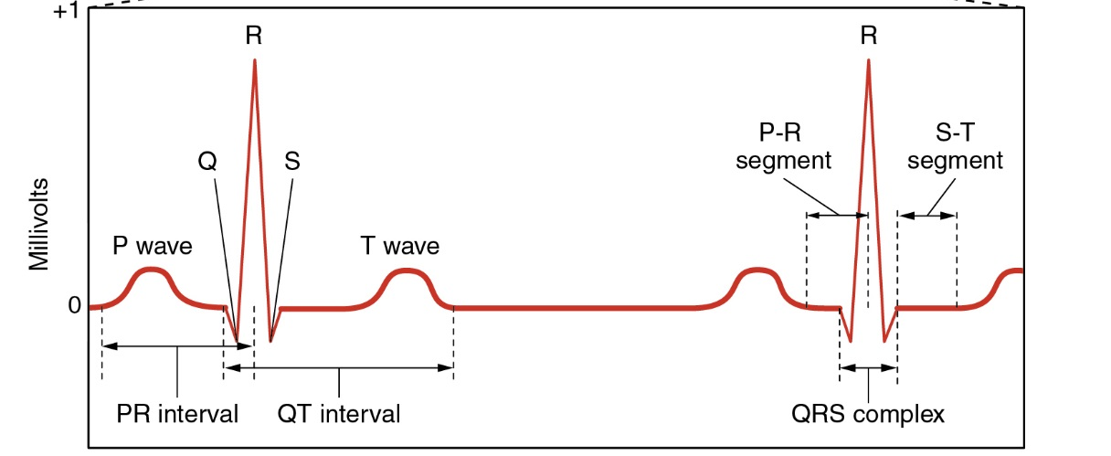
ElectroCardioGram (ECG)
P Wave - Atrial depolarization (electrical signal to contract).
PR Interval - AV nodal delay (to allow ventricles to fill before they contract).
QRS Complex - Ventricular depolarization (electrical signal to contract).
T Wave - Ventricular repolarization (signal to relax).

Slide 3
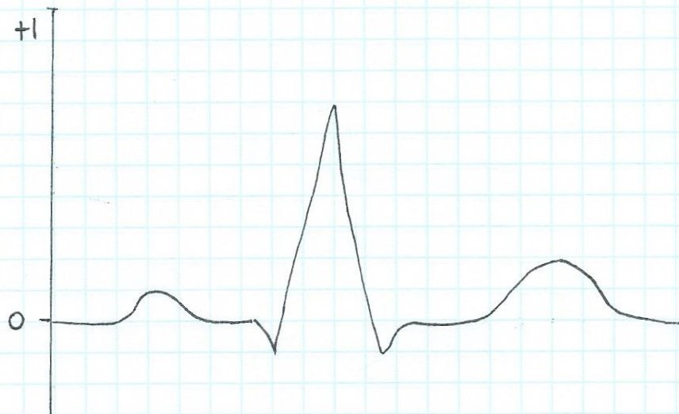
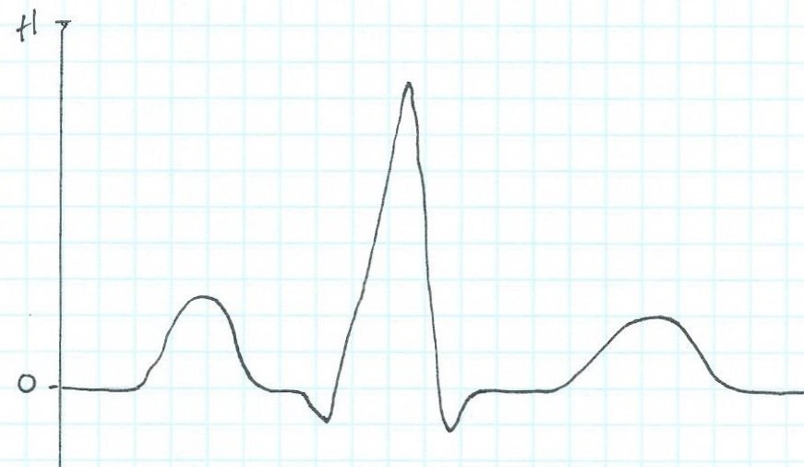
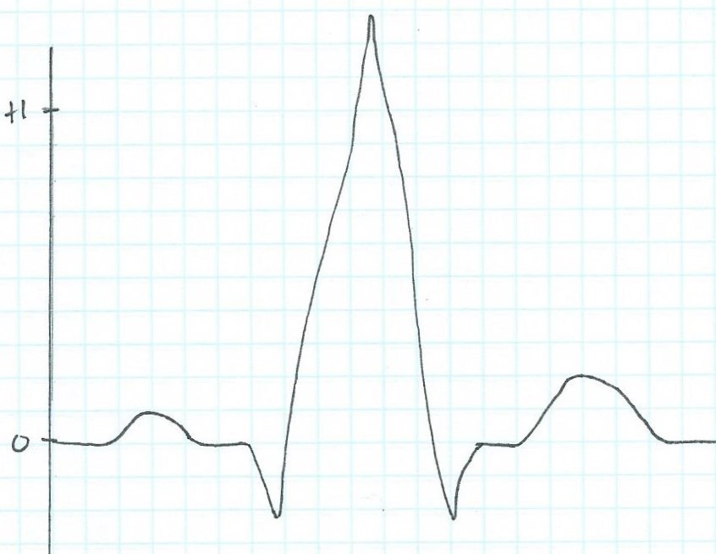
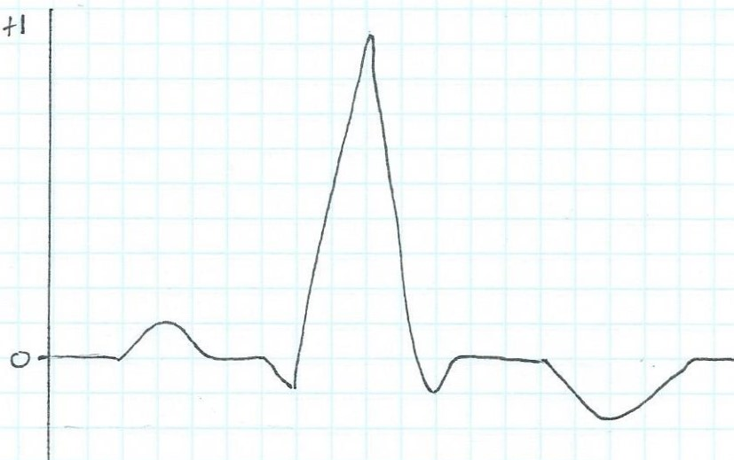
In lab we compared ECG traces, using the Normal ECG trace as a guide to identify the abnormal component on each of these ECG traces a), b) and c) and suggest what they might indicate:
Normal ECG trace
a)
b)
c)

Slide 4
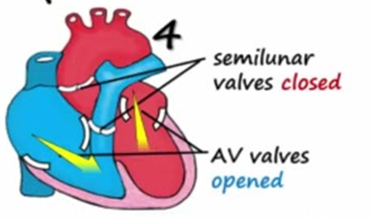

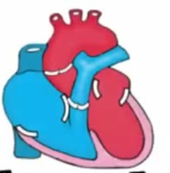
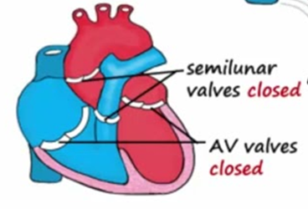
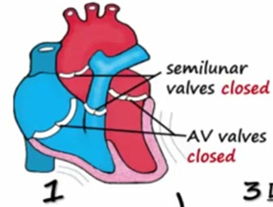
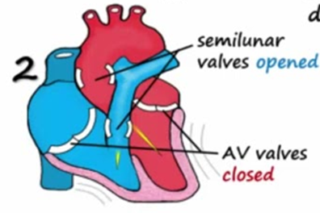
The Cardiac Cycle
Diastole
Systole
②
Atrial Systole
①
Heart in Diastole
(‘Late’ Diastole)
③
Ventricular Systole 1
⑤
Ventricular Diastole
④
Ventricular Systole 2

Slide 5
The Cardiac Cycle:
Mechanical Events of the Heart
Late Diastole: Heart in Diastole, “Heart at rest” all chambers are relaxed and ventricles are filling with blood.
(passive filling of both ventricles, ~ 80% full)
2. Atrial Systole: Atria contract, adds the last 20% of blood to the ventricles (‘top off’ of ventricles).
End Diastolic Volume (EDV) = Maximum ventricular volume*

Slide 6
3. Ventricular Systole (part 1):
Ventricular contraction begins - ↑Pressure (P).
Closure of AV valves = 1st heart sound ("lub").
(now all heart valves are closed)
Ventricles are Sealed Compartments
= Isovolumetric ventricular contraction
(when pressure builds as volume stays the same)

Slide 7
4. Ventricular Systole (part 2):
Ejection phase: ↑P pushes open semilunar valves, blood forced out into the artery leaving ventricle.
Pulmonary Semilunar => 25 mmHg (min pressure to open)
Aortic Semilunar => 80 mmHg (min pressure to open)
End Systolic Volume (ESV) = volume remaining in
heart after ejection (~½)*.
Stroke Volume = EDV - ESV (ml/beat)

Slide 8
5. Ventricular Diastole:
Relaxation of ventricles, artery back flow slams semilunar valves shut = 2nd heart sound ("dup").
(now all heart valves are closed)
Ventricles are Sealed Compartments again
= Isovolumetric ventricular relaxation
(when pressure decreases as volume stays the same)
Finally, the AV valves open again and refilling starts –
back to the start of cardiac cycle.

Slide 9
Cardiac Output
Cardiac Output (C.O.) = volume of blood ejected by ventricles per unit time.
Expressed as minute volume, (liters or ml of blood per minute (L/min or ml/min).
C.O. meets metabolic needs, i.e., is proportional to the tissues need for oxygen (O₂) and nutrients, and removal of carbon dioxide (CO₂) and waste.
C.O. changes with changes in body position.
  e.g., lying down (recumbent) to upright -> HR and SV increase.
At rest healthy adult C.O. is about 5 L/min.
C.O. can increase 50-100% by anxiety/excitement, even to 500% by exercise.

Slide 10

Calculating Cardiac Output
C.O.
Heart Rate
(beats/min)
Stroke Volume
(volume/beat)
Example Calculations:
Below are values for at rest and during exercise. Let’s calculate the C.O., including units, showing all work!
*SV= EDV-ESV
1) At Rest:
HR = 72
EDV = 135
ESV = 65
2) During Exercise:
HR = 121
EDV = 178
ESV = 42

Slide 11
Cardiac Output is Modified by ANS
Para activity decreases heart rate and force of contraction.
Sym activity increases heart rate and force of contraction.
ANS
Multiple Factors Influence Stroke Vole (SV).
1) Length-Tension or Stretch-Force Relationships
When cardiac muscle sarcomere stretches, it goes to optimal length to generates more force. Force is stroke volume (SV), so greater force = greater volume of blood ejected.
2) Venous Return = Blood returning to the heart, = Preload.
Venous return determines EDV, this is related stroke volume (SV)!
Preload = another way of expressing EDV.
The greater the EDV = Greater preload = Greater SV.
Note: Decreased EDV = Decreases preload = Decreases SV.
3) Afterload = the force ventricles must overcome to pump blood against resistance in the vascular system. Any increased in peripheral resistance requires a greater afterload to force open the semilunar valves and pump the blood into the arteries.
If afterload is increased, this decreases SV; if afterload is decreased, this increases SV.

Slide 12
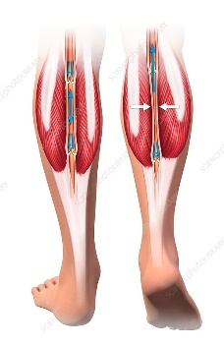
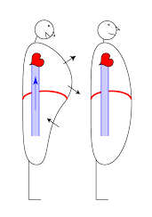
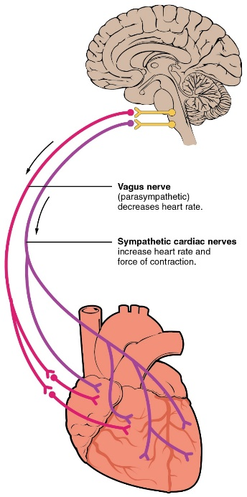
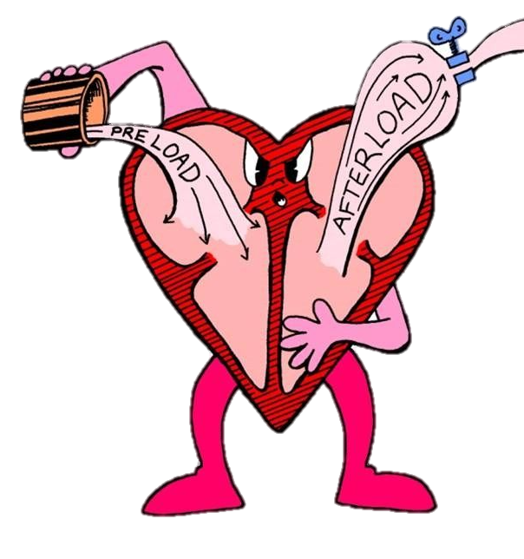
Summary of Impacts on Cardiac Output
Several factors Influence Venous Return:
    The ‘Skeletal Muscle Pump’.
    The ‘Respiratory Pump’.
    Sympathetic Activity.

