Slide 1

Academic Senate Meeting
September 15th, 2026 | 26-27 Academic Year
Cultivating Community:
Making the invisible visible
Remember to sign in using today’s log! (See Juli!)
Quorum Required: (21/40) to get started officially!
(QR Code for A.S. Webpage)
Attending for Flex credit? Email rgomez001@sdccd.edu or jbartolo@sdccd.edu

Slide 2
2. Agenda Overview
Call to Order
Approval of Agenda & Consent Calendar
  DRAFT Minutes 090126
  2026-27 Academic Senate Meetings Calendar
Land Acknowledgement (Updated)
Public Comments
Presentations
  Measure HH Presentation
Action Items
  Reestablish the At-Large Senator Position
  Second Read: Resolution on Agentic AI: Affirming Faculty Purview and Human Oversight…
Discussion Items
  Standing: Curriculum Committee Updates
  Districtwide Distribution List (DL) Email Access & Communication Issues
  Campus Culture, Free Speech & Safety
Reports:
  Committee Reports
  Special Reports
  Executive Committee Reports
Announcements
Adjournment
A.S. Agenda for 9/15/26
AS Code of Conduct

Slide 3
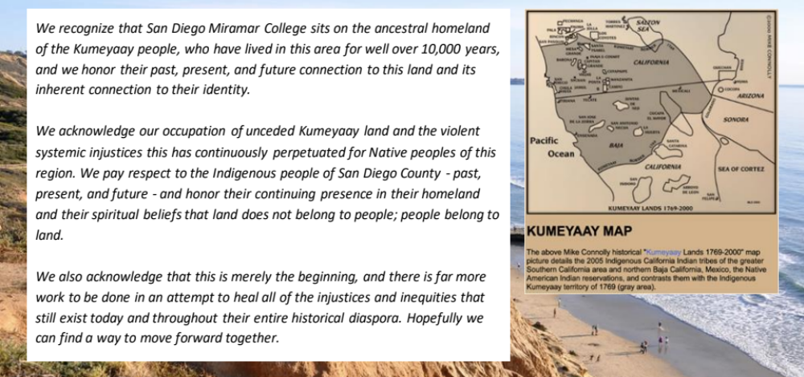
3. Land Acknowledgement
We recognize that San Diego Miramar College sits on the ancestral homeland of the Kumeyaay, Luiseño, Cupeño, and Cahuilla tribes, who have lived in this area for well over 10,000 years, and we honor their past, present, and future connection to this land and its inherent connection to their identity.
We acknowledge our occupation of unceded Kumeyaay land and the violent systemic injustices this has continuously perpetuated for Native peoples of this region. We pay respect to the Indigenous people of San Diego County - past, present, and future - and honor their continuing presence in their homeland and their spiritual beliefs that land does not belong to people; people belong to land.
We also acknowledge that this is merely the beginning, and there is far more work to be done in an attempt to heal all of the injustices and inequities that still exist today and throughout their entire historical diaspora. We commit to moving forward together.
Resources: “Making a land acknowledgment meaningful”; A call for more powerful land acknowledgements

Slide 4

4. Public Comments (10 mins)
(2 mins; limited to 10+1 items NOT on the agenda; time may not be yielded)

Slide 5
5. Presentations
(scheduled prior to senate business)

Slide 6
5.1 Presentation (25 mins w/ Q&A)
5.1 Measure HH Quarterly Senate Updates
(guest presenter)
Ongoing efforts to strengthen communication and transparency regarding districtwide initiatives and projects related to Measure HH activities
Requesting to be included on each Senate agenda every quarter. These in-person presentations, to give updates, answer questions, and discuss current and upcoming initiatives.
Review of Measure HH Project updates prepared by Operations, Enterprise Services, and Facilities during the period of March 31 to April 27, 2026.
    Cover_Memo_HH Updates_051426.docx
    May_Project_Update_FINAL.docx
    May_Project_Update_FINAL.pptx

Slide 7
6. Action Items (Second Reads)

Slide 8
6.1 Action Items (Second Reads)
6.1 Reestablishing the At-Large Senator Position
(Rodrigo Gomez)
The At-Large Senator position previously existed at Miramar; reestablishing it would not create an entirely new category of representation.
Furthermore, it would address representation gaps for contract faculty whose positions do not fit neatly within an existing Academic Senate departmental structure, such as positions in areas like Articulation and Career Services.
The proposed model would allow faculty in these currently unrepresented areas to elect a senator from among themselves so they have a voice and vote within Academic Senate.

Slide 9
6.2 Discussion Items (First Reads)
6.2 Resolution on Agentic AI: Affirming Faculty Purview and Human Oversight In the Use of Generative and Agentic AI
(Rodrigo Gomez)
Second Reading: Is this boundary clear? What should we clarify, narrow, strengthen, or anticipate as agentic AI evolves?

Slide 10
7. Discussion Items (First Reads)

Slide 11
7.1 Discussion Items (First Reads)
7.1 Standing: Curriculum Committee Updates
(Veronica Hartmann)

Slide 12
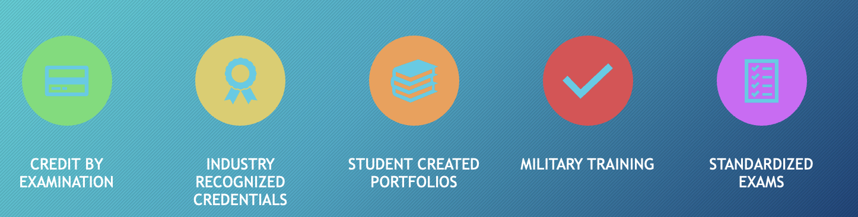
Discussion: Credit for Prior Learning (CPL)
Credit for Prior Learning (CPL) is credit awarded for validated college-level skills and knowledge gained outside of a college classroom – it’s a strategy to grant credit for what they already know and can do.
Source: Credit for Prior Learning PPT Presentation,
Mayram Tartoussia, CPL Coordinator
AP 4025 requires students to complete:
A minimum of 6 semester units in their major in residence within SDCCD for an associate degree to be awarded.
12 associate degree-applicable semester units in residence within SDCCD.
CPL units may now count toward the 12-unit residency requirement for an associate degree.

Slide 13
AP 4235 – CPL Discussion
AP 4235 Credit for Prior Learning (Link)
  Education Code 78093.1 (Link)
  Education Code 78093.2 (Link)
  Title 5 55050 (Link)
New Language:
Credit acquired by Credit for Prior Learning shall not may be counted in determining residency requirements for any degree or certificate;
Discussion:
Credit for Prior Learning may be counted in determining residency requirements for any degree or certificate (link)

Slide 14
7.2 Discussion Items (First Reads)
7.2 Districtwide Distribution List (DL) Email Access & Communication Issues
(Rodrigo Gomez)
Faculty have reported inconsistent access to District distribution lists (DL), creating concerns about whether important communications are reaching all intended recipients.
Communication barriers may affect participation in shared governance, elections, committee work, and other faculty engagement opportunities.
Similar concerns have been raised at other colleges across the District, suggesting this may be a broader systemwide issue rather than an isolated campus problem.
Faculty are invited to share experiences, identify impacts, and discuss what reliable and equitable communication should look like moving forward.

Slide 15
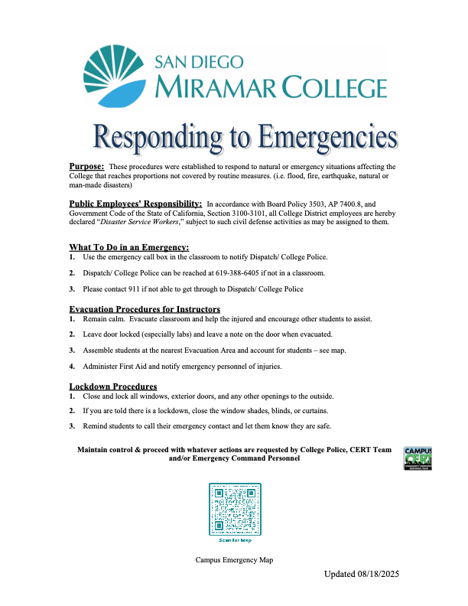
7.3 Discussion Items (First Reads)
7.3 Campus Culture, Free Speech & Safety
(Rodrigo Gomez)
On Sept 8th a significant incident occurred at San Diego City College involving ICE enforcement activity near campus. According to SDCCD communications and multiple local news reports, ICE agents detained an individual identified by district officials as a City College student near the campus perimeter. A second student reportedly ran onto campus, and agents discontinued pursuit when they realized they were entering college property.
District leadership subsequently reiterated SDCCD's policy of non-participation in immigration enforcement activities and emphasized support for affected students and employees.
Faculty and students at City College have since raised concerns regarding:
Student feelings of safety and belonging.
Awareness of district procedures related to immigration enforcement.
Communication and training related to campus response protocols.
Access to counseling, legal aid, and student support services.

Slide 16
7.4 Discussion Items (First Reads)
7.4 College President Search: Faculty Priorities & Desired Qualities
(Rodrigo Gomez)
With Wes' departure, we are entering a period of leadership transition. This presents an opportunity for faculty to reflect on institutional priorities and the qualities we hope to see in future leadership.
Questions for Senate Consideration
What accomplishments or initiatives should be sustained regardless of leadership changes?
What challenges should be addressed during the transition period?
What qualities, experiences, or leadership approaches should the next president bring to Miramar?
What role should faculty governance play during this transition?
What concerns or aspirations should be communicated to district leadership?

Slide 17
7.5 Discussion Items (First Reads)
7.5 ASCCC Fall 2026 Plenary: Resolution & Voting Process
(Rodrigo Gomez)
Region D Meeting
Region D Area Meeting: Friday, October 9, 2026. This is where area resolutions are discussed and feedback is gathered. [asccc.org]
Fall Plenary Session
November 5-7, 2026
Redwood City (hybrid voting available on Saturday). [asccc.org], [asccc.org]
When Resolutions Become Available
September 25, 2026: Pre-Area Meeting packet distributed. This is the first packet senators can review and provide feedback on. [asccc.org]
October 16, 2026: Area Meeting packet distributed following Region D discussions. [asccc.org]
October 29, 2026: Pre-Plenary packet distributed. This is generally the final major packet for delegate review before voting.

Slide 18
8. Reports
(8.1 Committee | 8.2 Special | 8.3 Executive Committee)

Slide 19
8. Reports
8.1 Committee Reports

Slide 20
8. Reports
8.2 Special Reports

Slide 21
8. Reports
8.3.1 President’s Report
Academic Senate invited to meet with Chancellor Smith in N-206 to share our thoughts on the qualities, characteristics, and leadership attributes that are believed to be important for the next President of Miramar College | Friday, October 2nd 4:00 – 5:00 pm
District enrollment and student completion are moving in a positive direction. The Chancellor reported that SDCCD reached 40,000 FTES for the first time since 2018, while associate degrees awarded increased 20% over the previous year. The District also reports a healthy unrestricted general fund and additional instructional support allocations going to the colleges.
Faculty contract negotiations remain open. The Chancellor specifically acknowledged ongoing negotiations. The District will also need to negotiate implementation of the new statewide 14-week paid pregnancy disability leave requirement and address rising healthcare premiums as the previous RAF protections expire.

Slide 22
8. Reports
8.3.2 – 8
  Vice President – Olivia Flores
  Secretary – Amy Alsup
  Treasurer – Melissa Wolfson (please see the following slide)
  Contract Member-at-Large – David Mehlhoff
  Contingent Faculty Member-at-Large – Desi Klaar
  Chair of Chairs – Mary Kjartanson

Slide 23
8. Reports
8.3.4: Treasurer (Melissa Wolfson)
Account Balance $700.00
Academic Senate Dues / Voluntary Payroll Deduction
  Please consider enrolling in auto-payroll deduction for a nominal amount per check. Contributions of $2.00 per check make a difference to our students in funding our scholarships and other necessary needs.

Slide 24
9. Announcements
(1 min. time limit each)

Slide 25

9. Announcements (1 min)
Office of Environmental, Health & Safety (OEHS) is kicking off their Fall 2026 Safety Training Series.
Sept 18th and Sept 24th
With more in October and November.

Slide 26

9. Announcements (1 min)
Grand Opening of The Village! A space designed to be a welcoming home base for students participating in NextUp, CalWORKs, and EOPS/CARE to connect, study, access resources and support, build relationships, and find community.
Date: Thursday, September 17, 2026
Time: 12:00–2:00 p.m.
Location: The Village | K1-308

Slide 27

8. Announcements (1 min)
The 2026 Equity Summit will be on October 2, from 10-2 featuring keynote Dr. Mohammed Soriano Bilal!
Registration Link:
https://bit.ly/2026EquitySummitRegistration
Website:
Annual Equity Summit | San Diego Miramar College

Slide 28

8. Announcements (1 min)
Data Analytics Digital Innovation Regional Convening, CCCCO
Tuesday, September 29 · 9am - 2pm PDT
The San Diego Regional AI and Data Analytics Convening is the first of eight statewide regional convenings supporting California's Vision 2030 initiative. This event brings together faculty, college leaders, and industry partners to launch the regional rollout of a coordinated, multi-technology-provider framework for AI and Data Analytics credentials.
In collaboration with IBM and other leading technology partners, with potential participation from higher-education partners, including UC Berkeley.
Participants will help shape how multi-tech provider content is packaged into courses and curriculum, define certificate and Credit for Prior Learning (CPL) pathways, and address real implementation challenges for the San Diego region. Seating is limited to approximately 100 participants and confirmed on a first-come, first-served basis.

Slide 29

8. Announcements (1 min)
AI Engage Summit Registration
“Higher ed’s next chapter is already taking shape. Join us October 13–14 for bold ideas and practical strategies to help your institution stay ahead by recognizing student needs earlier, equipping staff to act sooner, and using AI to reduce repetitive work.”
Day 1: Student Success: Explore how institutions can anticipate student needs and deliver more connected, proactive support throughout the student journey.
Day 2: Workforce and Continuing Education: Discover how institutions can build flexible learning pathways that meet the evolving needs of adult learners and today’s workforce.

Slide 30

8. Announcements (1 min)
Constance Carroll Trailblazer Scholarship Award
TEN FULL-TUITION
SCHOLARSHIPS to USD!
Spring Deadline: November 1, 2026
Fall Deadline: April 17, 2027
Final Deadline (space permitting): June 15, 2027

Slide 31

8. Announcements (1 min)
The Miramar AI Network, or MAIN, is launching this semester as a campuswide space for faculty and classified professionals interested in developing AI literacy and exploring responsible applications of AI in our work.
Our first session is October 1, with additional sessions and MAIN Studio opportunities throughout the year. I’ll circulate information about participation, and I especially encourage senators to share it with your areas.
Landing Page: https://miramarainetworkpilot2026.my.canva.site/

Slide 32
9. Adjournment
If the calendar was approved earlier,
the first meeting of the 2025-26 SDMC Academic Senate is:
Tuesday, October 6th, 2026 from 3:30-5:00 pm in L-301.
Remember that starting Spring 2026 we’ll be moving to fully in person Senate meetings. Hence, we will be retiring the A.S. Senator Remote Attendance Form

Slide 33
Thanks for your hard work for Miramar College!
If you have any questions, please reach out via email!
rgomez001@sdccd.edu or jbartolo@sdccd.edu

