Slide 1
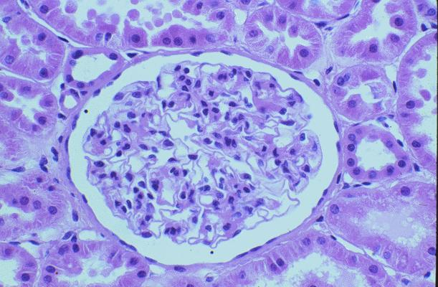
Simple Squamous Epithelium
This is simple squamous epithelial tissue.
The structure is the glomerular capsule, found in the kidney.
glomerulus
There are examples of many different epithelial tissues in the kidney.
Red = simple squamous; Green = simple columnar; Yellow = simple cuboidal.

Slide 2
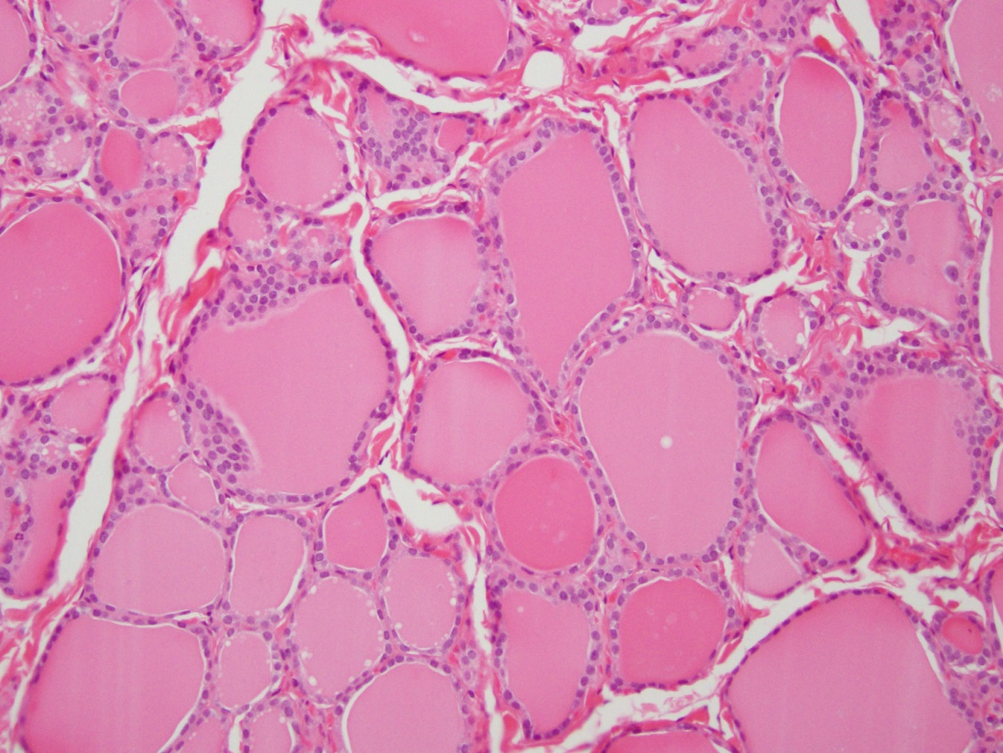
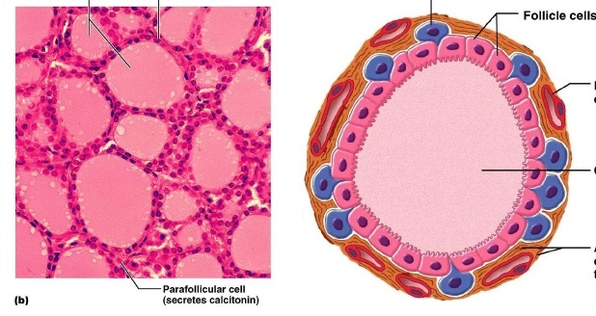
Simple Cuboidal
Epithelium
In our lab slides, simple cuboidal
epithelial tissue is found in the
thecal follicles of the thyroid gland.
Simple cuboidal epithelial
Hormones are stored in the colloid

Slide 3
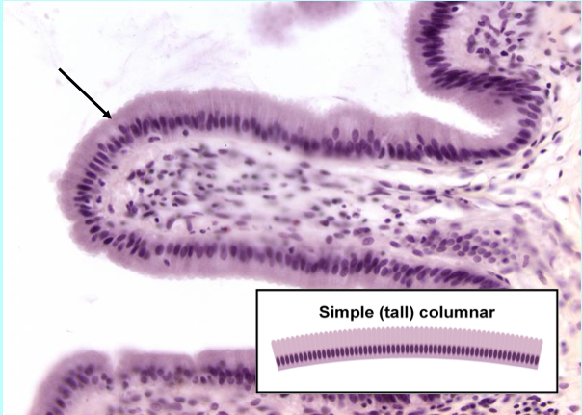
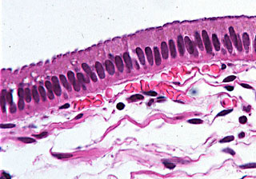
Simple Columnar Epithelium
In our lab slides, simple columnar
epithelial tissue is found in the
Lining of the small intestine.
Notice how the nuclei of the columnar cells are lined up in the single layer.
These are both simple columnar epithelial tissue.

Slide 4
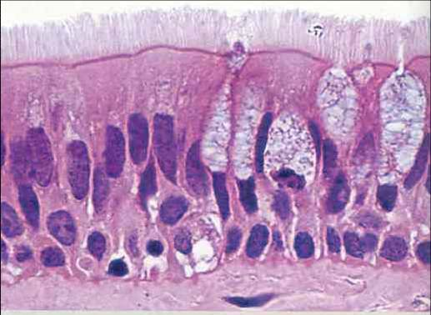
Pseudostratified Ciliated Columnar Epithelium
This is the exposed or apical end of the epithelial tissues!
Cilia
Goblet cell
PSCC
Notice how there
appears to be several
layers of nuclei in this
tissue, but all cells are
attached to the
basement membrane.
All epithelial tissues sits on connective tissue!

Slide 5
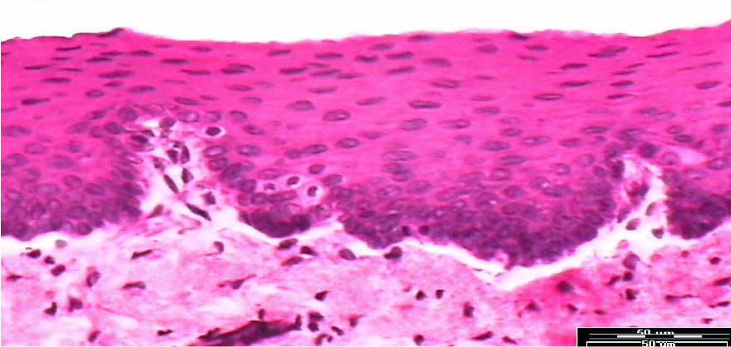
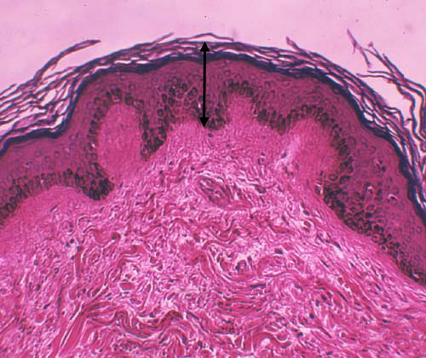
Stratified Squamous Epithelium
This is the stratified
squamous epithelium.
It is non-keratinized, or
wet epithelium. Notice
the flat apical cells.
This is connective tissue supporting epithelium.
Stratified Squamous Epithelium
Keratinized, or dry
Notice how the cells at the apical end are so flat and dry they are flaking off = keratinized!
This is dense irregular connective tissue.

Slide 6
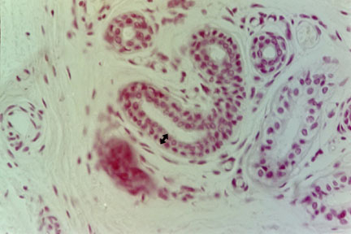
Stratified Cuboidal Epithelium
Outline of
the 2 layers
of cells.
Lumen
of ducts
Notice the 2 layers of
cells lining the duct
of this sweat gland.

Slide 7
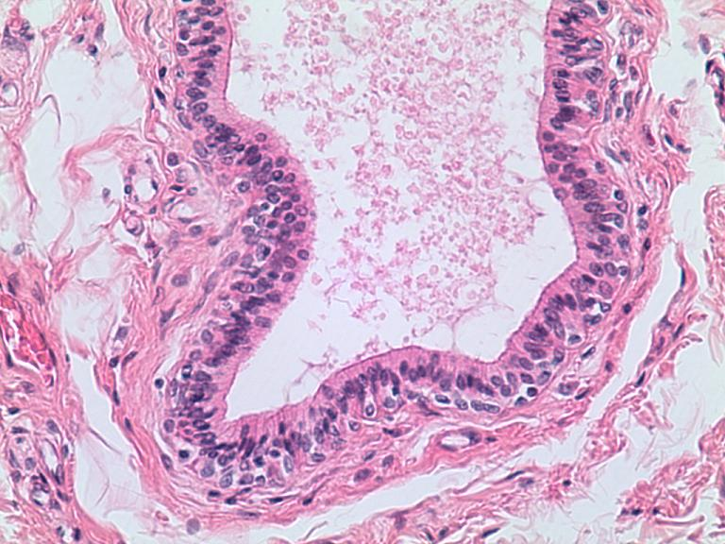
Stratified Columnar Epithelium
Lumen of the
male urethra
There are 2 layers of
cells and the apical,
or exposed cells are
columnar in shape.
Connective tissue is supporting
all of the epithelial tissue.

Slide 8
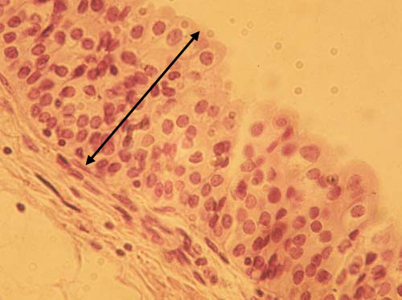
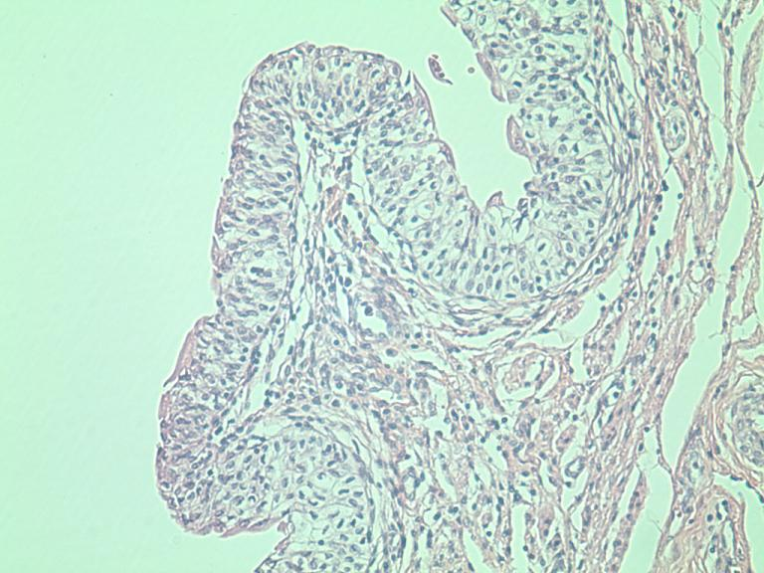
Transitional Epithelium
This tissue lines most of the urinary system.
The examples shown are from the ureter.
There are many layers of
cells in this epithelial tissue and
the shape of the apical cells are
not really flat or defined and also
change, thus are transitional.

Slide 9
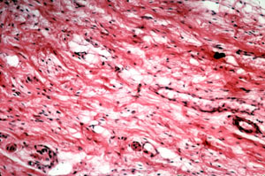
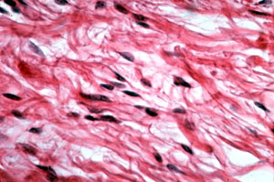
Areolar
Connective
Tissue
Collagen
Fibers (thick pink)
Fibroblast
nuclei
No visible elastic or reticular
fibers in this picture from the web!

Slide 10
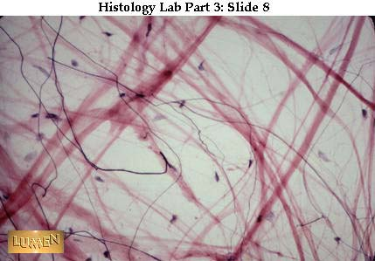
Areolar Connective Tissue
Collagen Fibers
(thick pink)
Fibroblast
nuclei
Elastic fibers
Reticular fibers

Slide 11
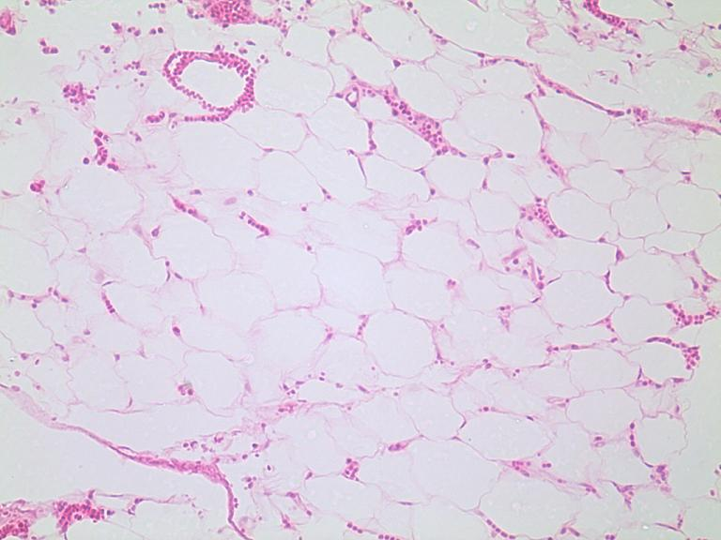
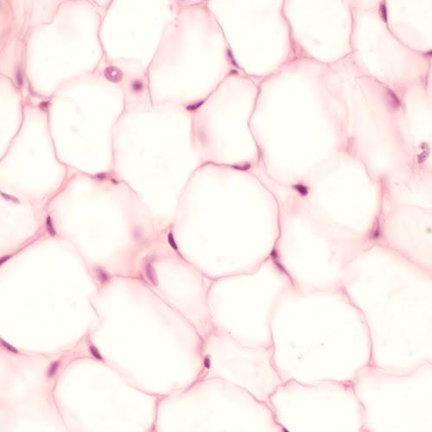
Adipose
Connective Tissue
Adipocytes
Fat vacuole
(inside cell)
Blood Vessels
Adipose tissue is highly vascularized, you can see many blood vessels throughout this tissue.
Adipocyte Nuclei

Slide 12
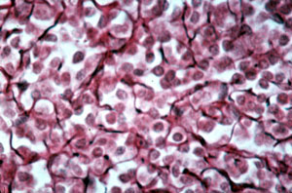
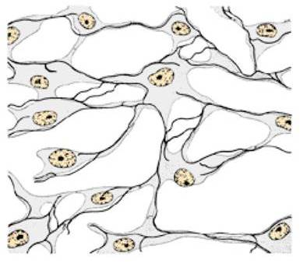
Reticular Connective Tissue
Reticulocytes
Reticular Fibers
(dark staining)
Reticulocytes
Reticular Fibers

Slide 13
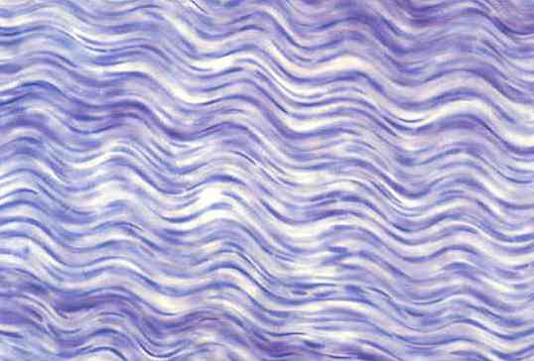
Dense Regular Connective Tissue
Collagen
fibers
Fibroblast
nuclei

Slide 14
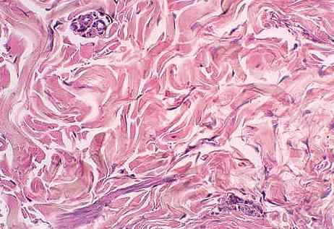
Dense Irregular Connective Tissue
Collagen
fibers
Fibroblast
nuclei

Slide 15
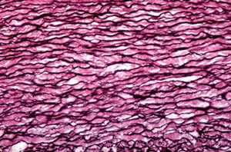
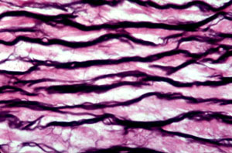
Elastic Connective Tissue
Collagen
Fibers (pink)
Elastic
Fibers (dark)

Slide 16
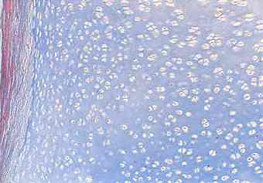
Hyaline Cartilage
Chondrocytes
Chondrocyte
inside lacuna
Perichondrium
(no chondrobasts visible!)
Clear, ‘glassy’ matrix

Slide 17
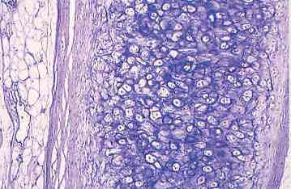
Elastic Cartilage
Chondrocytes
Chondrocyte
inside lacuna
Perichondrium
Chondroblasts
Perichondrium
Elastic fibers (dark)

Slide 18
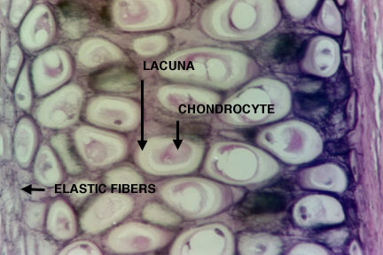
Elastic Cartilage

Slide 19
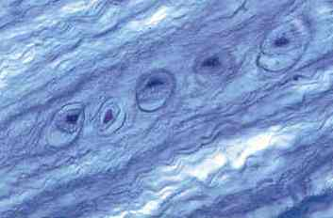
Fibrocartilage
Nucleus of
Chondrocyte
Chondrocytes
Lacunae
Collagen fibers (wavy blue)
Note: There is no perichondrium
in this type of cartilage tissue.

Slide 20
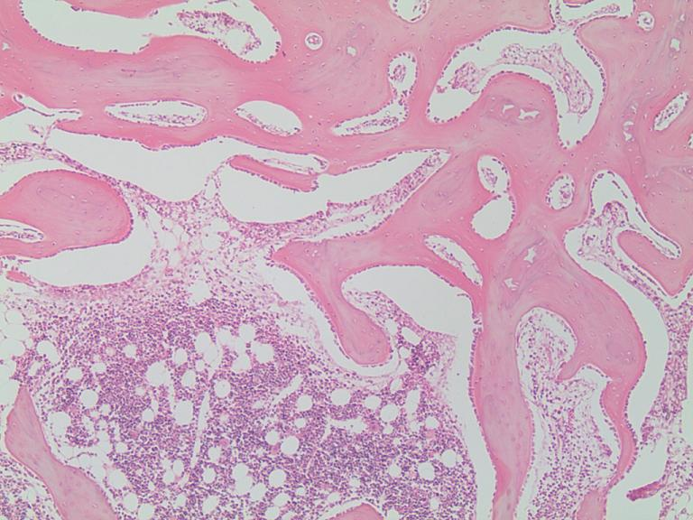
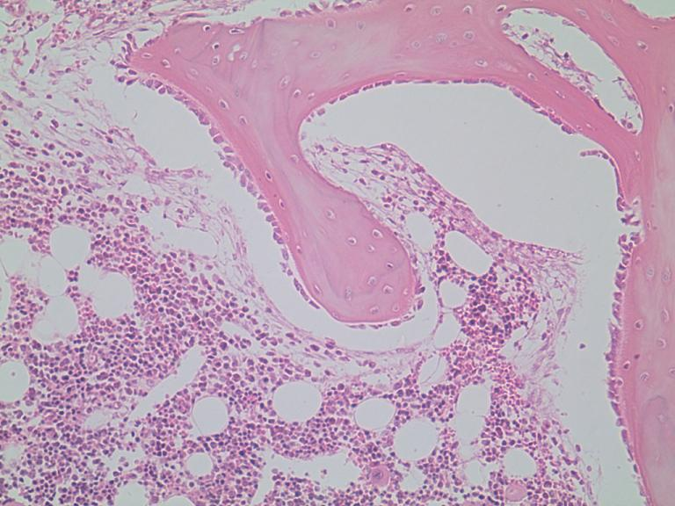
Spongy Bone
Spongy bone is found on the inner aspect of bone
Osteocytes
inside lacunae
Zoon in
Trabeculae
Osteoblasts
on outside of
trabecula lining
the endosteum
Marrow cavity
contains myeloid tissue

Slide 21
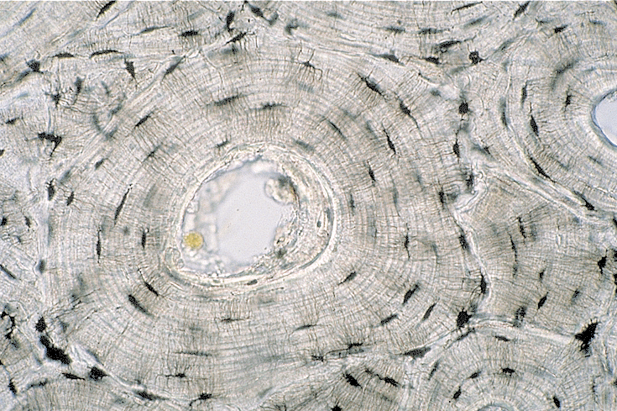
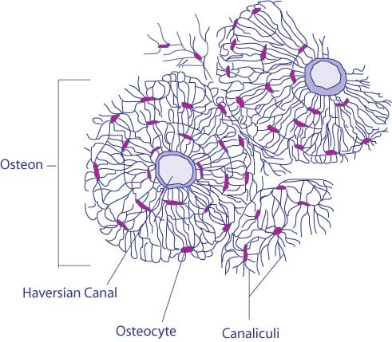
Compact Bone
Compact bone is found on the outer aspect of bone
Central canal
Osteocytes
inside lacunae
Osteon Unit
Canaliculi

Slide 22
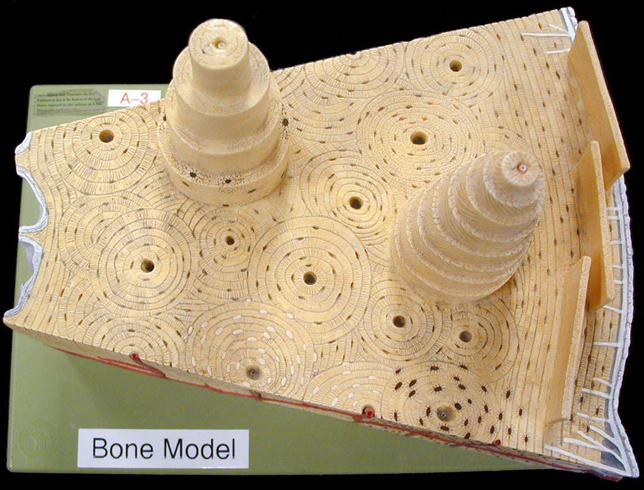
Compact Bone
Interstitial
lamellae
Circumferential
lamellae
Concentric
lamellae
Central canal
Outer fibrous
Endosteum
Periosteum
Osteon
unit
Inner cellular
Perforating
(Sharpey’s)
fibers
Lacunae
Compact Bone Histology Model
Osteocytes

Slide 23
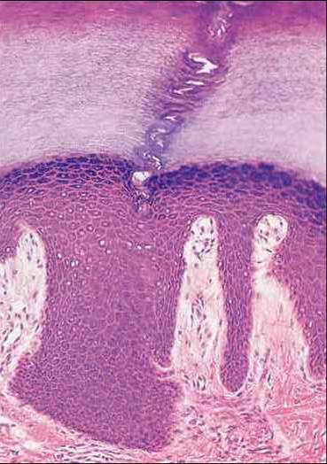
Epidermis of Skin
Stratum
Corneum
Stratified
Squamous
Epithelium
(keratinized)
Stratum
Lucidum
Stratum
Granulosum
Stratum Spinosum
Stratum Basale

Slide 24
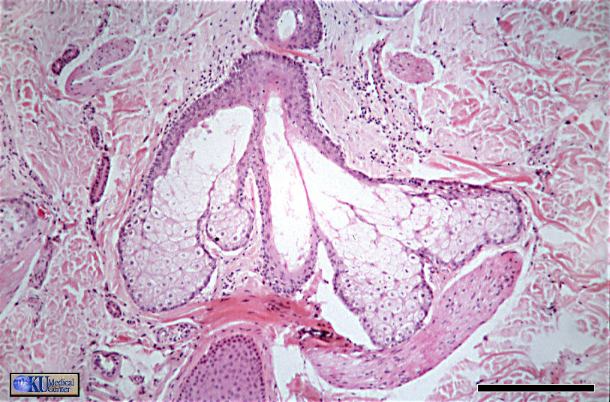
Sebaceous Glands
Sebaceous
glands
Arrector
pili
Hair
follicle

Slide 25
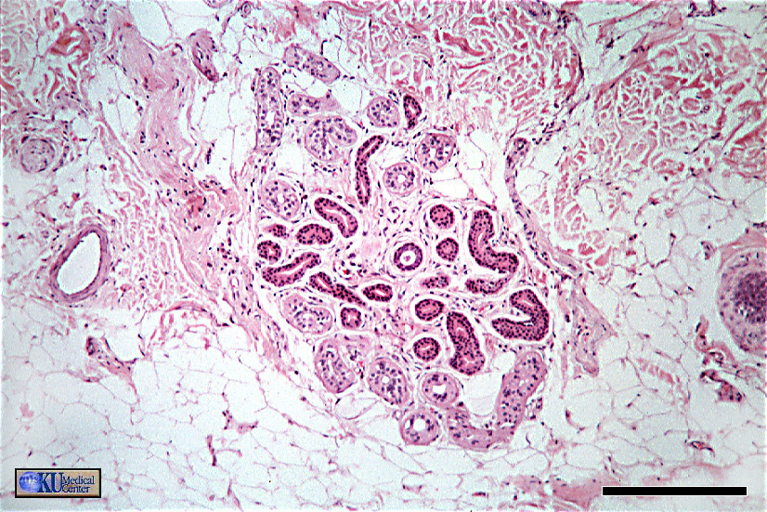
Sudoriferous (Sweat) Gland
dense
irreg
c.t. !
“bundle
of coiled
tubes”
blood vessel!
Adipose tissue!

