Slide 1

#. Discussion Items (Second Reads)
# Student Evaluation of Counseling Faculty
Sierra Hegle & Olivia Flores, Professors/Counselors
Our CBA expires June 30, 2026
Discussion at Miramar Student Services Faculty mtg in Spring 2025
Draft was shared with District Counselors (City, Mesa, and CE) in Aug 2025
This final version was approved by District Counselors in March 2026
This final version is going through the Academic Senate approval process at CE, City, and Mesa.

Slide 2
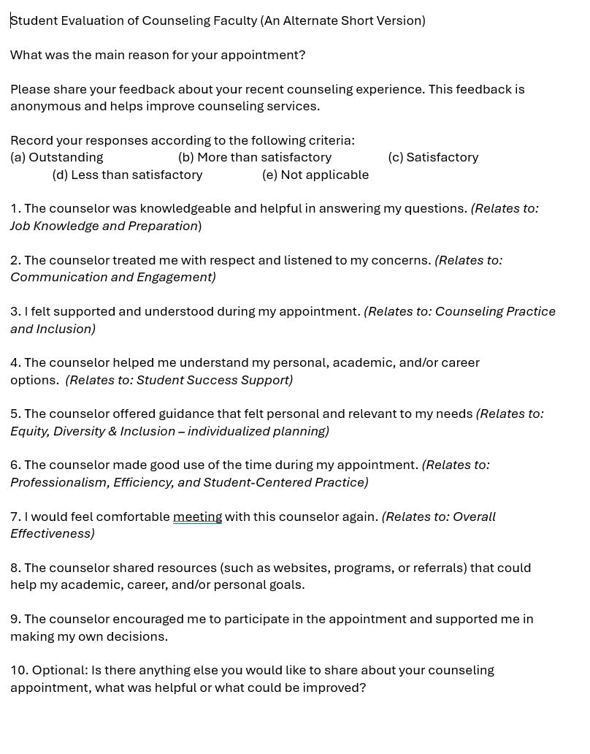
#. Discussion Items (Second Reads)
Proposed version:
Questions are based on “Tenured/Tenure-Track Faculty Appraisal Form” for Counselors (aka Domains/Criteria)
10 questions
NOTE: Current Student Evaluation Form has 27 questions.

Slide 3
#. Discussion Items (Second Reads)
Ask:
First read at April 7th meeting.
Would like a vote today to approve.
Approval vote from all College/CE Academic Senates will allow District Counselors to take this to the Union for negotiations with District to add to our new CBA.

