Slide 1

Academic Senate Meeting
May 19th, 2026
2025-26 Academic Year
Cultivating Community:
Making the invisible visible
Remember to sign in using today’s log! (See Juli!)
Quorum Required: (23/44) to get started officially!
(QR Code for A.S. Webpage)
Attending for Flex credit? Email rgomez001@sdccd.edu or jbartolo@sdccd.edu

Slide 2
2. Agenda Overview
Call to Order
Approval of Agenda & Consent Calendar
  DRAFT Minutes 050526
  2026-27 Academic Senate Meetings Calendar
Land Acknowledgement (Updated)
Public Comments
Action Items
  Second Read: Miramar Zero Waste Resolution
  Second Read: APs and BPs 2026
  Second Read: Miramar College Marketing & Outreach Plan
Discussion Items
  Standing: Curriculum Committee Updates
  Measure HH Quarterly Senate Updates & Communication Structure
  Free Speech and Campus Safety
  Resolution on Agentic AI Workgroup
Reports:
  Committee Reports
  Special Reports
  Executive Committee Reports
Announcements
Adjournment
A.S. Agenda for 5/19/26
AS Code of Conduct

Slide 3
3. Land Acknowledgement
We recognize that San Diego Miramar College sits on the ancestral homeland of the Kumeyaay, Luiseño, Cupeño, and Cahuilla tribes, who have lived in this area for well over 10,000 years, and we honor their past, present, and future connection to this land and its inherent connection to their identity.
We acknowledge our occupation of unceded Kumeyaay land and the violent systemic injustices this has continuously perpetuated for Native peoples of this region. We pay respect to the Indigenous people of San Diego County - past, present, and future - and honor their continuing presence in their homeland and their spiritual beliefs that land does not belong to people; people belong to land.
We also acknowledge that this is merely the beginning, and there is far more work to be done in an attempt to heal all of the injustices and inequities that still exist today and throughout their entire historical diaspora. We commit to moving forward together.
Resources: “Making a land acknowledgment meaningful”; A call for more powerful land acknowledgements

Slide 4

4. Public Comments (10 mins)
(2 mins; limited to 10+1 items NOT on the agenda; time may not be yielded)

Slide 5
4. Public Comments
4.1 Acknowledgement of Community Tragedy
I want to acknowledge the tragic shooting at the Islamic Center of San Diego on May 18, 2026, in which three individuals lost their lives in an attack authorities are investigating as a possible hate crime. The incident occurred at the county’s largest mosque, near an on-site school, and has deeply affected our broader San Diego community.
As a college located only miles from the site, serving students and families from surrounding communities, this tragedy may be felt personally by members of our campus. Violence directed toward places of worship affects not only those immediately impacted, but also the conditions of safety, belonging, and trust that communities depend upon.
I want to extend condolences to those affected, express support for our Muslim students, colleagues, and community members, and reaffirm the importance of inclusion, safety, dignity, and belonging within our educational spaces.

Slide 6
5. Action Items (Second Reads)

Slide 7
5.1 Action Items (Second Reads)
5.1 Miramar College Zero Waste Resolution
(Ashlee Lain)
First Read: 05/05
San Diego Miramar College Zero Waste Resolution

Slide 8
5.2 Action Items (Second Reads)
5.2 APs & BPs (April 2026)
(Veronica Harmann)
First Read: 4/07/26
Our CBA expires June 30, 2026
Discussion at Miramar Student Services Faculty mtg in Spring 2025
Draft was shared with District Counselors (City, Mesa, and CE) in Aug 2025
This final version was approved by District Counselors in March 2026
This final version is going through the Academic Senate approval process at CE, City, and Mesa.

Slide 9
5.3 Action Items (Second Reads)
5.3 Miramar Marketing & Outreach Plan
(Steve Quis)
First Read: 4/07/26 & 4/21 / Second Read: 05/05/26
Approved Marketing Plan 2025-2031_DRAFT_(4/21/26)
The 2025-2031 Miramar College Marketing & Outreach Plan has been approved by the Marketing & Outreach committee.
Sonny & Steve joined us on 4/21 to address questions. They are back to request feedback and a vote from the Academic Senate.

Slide 10
6. Discussion Items (First Reads)

Slide 11
6.1 Discussion Items (First Reads)
6.1 Standing: Curriculum Committee Updates
(Veronica Hartmann)

Slide 12
6.2 Discussion Items (First Reads)
6.2 Measure HH Quarterly Senate Updates & Communication Structure
(Rodrigo Gomez)
Ongoing efforts to strengthen communication and transparency regarding districtwide initiatives and projects related to Measure HH activities
Requesting to be included on each Senate agenda every quarter. These in-person presentations, to give updates, answer questions, and discuss current and upcoming initiatives.

Slide 13
6.2 Discussion Items (First Reads)
6.2 Measure HH Cont.
(Rodrigo Gomez)
15.16 Review of Measure HH Project updates prepared by Operations, Enterprise Services, and Facilities during the period of March 31 to April 27, 2026.
    Cover_Memo_HHUpdates_051426.docx
    May_Project_Update_FINAL.docx
    May_Project_Update_FINAL.pptx

Slide 14

6.3 Discussion Items (First Reads)
6.3 Free Speech & Campus Safety
(Rodrigo Gomez)
Miramar College resources for responding to emergencies & supporting undocumented students and families.
What other ways might we offer support to each other?

Slide 15
6.5 Discussion Items (First Reads)
6.4 Resolution on Agentic AI Workgroup
(Rodrigo Gomez)
How do we ensure that faculty voice remains central in shaping institutional decisions around agentic AI, particularly in alignment with the 10+1 and principles of academic freedom?
What safeguards must be established to protect student data, intellectual property, and faculty autonomy when engaging with agentic AI systems?
What expectations should guide the transparent, ethical, and accountable implementation of agentic AI tools across teaching, learning, and institutional operations?

Slide 16
Reports
(7.1 Committee | 7.2 Special | 7.3 Executive Committee)

Slide 17
7. Reports
7.1 Committee Reports

Slide 18
7. Reports
7.2 Special Reports

Slide 19
7. Reports
7.3.1 President’s Report
7.3.1.1 College Council is forming an AI Workgroup (Pending)
7.3.1.2 AFT Negotiations Update
    67.4% (395 votes) of participating faculty supported proceeding with negotiations without renewing the current RAF; 32.6% (191 votes) opposed.
    Current RAF expires June 30, 2026.
    Ending RAF may increase flexibility for larger compensation proposals but could expose faculty to temporary healthcare premium increases during extended negotiations. Estimated increases discussed: 8–14% (~$100–$300/month depending on plan).
    AFT indicated additional proposals and member votes are forthcoming.

Slide 20

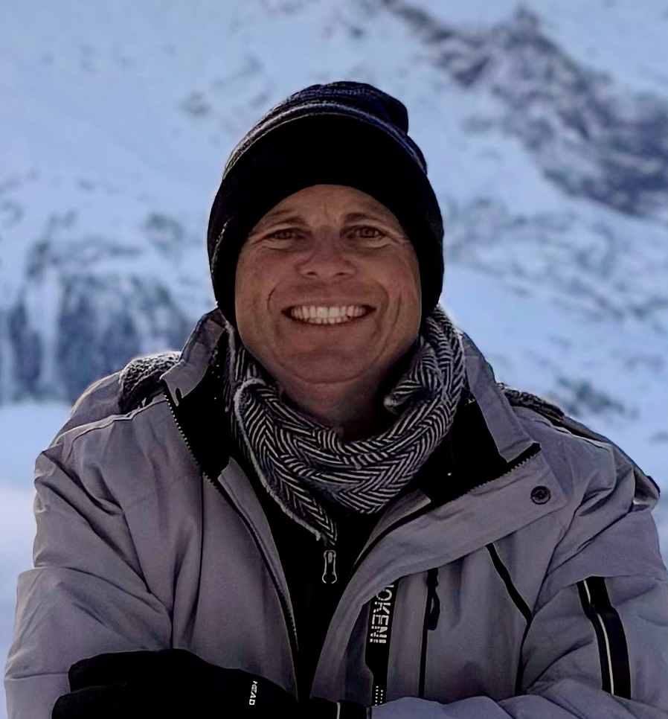
7. Reports
7.3.1 President’s Report
7.3.1.3 Recognizing Spring 2026 winners of the Recognition of Outstanding Work In Online Teaching:
Angela Romero
School of Liberal Arts
Political Science
David Alan Walter
School of BTCWI
Business
Angela’s POLS C1000 course sets the gold standard for DE with exemplary elements of RSI, effective assessment, and accessibility. With years of service to DESC, Angela was a vital contributor to Miramar’s CVC/POCR process; her course is certified & meets every standard of the CVC-OEI rubric.
David’s BUSE 100 and REAL 101 courses, Intro To Business and Real Estate Principles, collectively demonstrate excellence in areas of faculty-to-student interaction, student-to-student interaction, and effective assessment aligned with real-world expectations.

Slide 21
7. Reports
7.3.2 – 8
  Vice President – Carmen Carrasquillo
  Secretary – Olivia Flores
  Treasurer – Dawn Diskin (please see the following slide)
  Contract Member-at-Large – Melissa Wolfson
  Contingent Faculty Member-at-Large – Desi Klaar
  Chair of Chairs – Mary Kjartanson

Slide 22
7. Reports
7.3.4: Treasurer (Dawn Diskin)
Account Balance $607.49
Academic Senate Dues / Voluntary Payroll Deduction
  Please consider enrolling in auto-payroll deduction for a nominal amount per check. Contributions of $2.00 per check make a difference to our students in funding our scholarships and other necessary needs.

Slide 23
Announcements
(1 min. time limit each)

Slide 24
8. Announcements
1 min. time limit each

Slide 25
9. Adjournment
If the calendar was approved earlier,
the first meeting of the 2025-26 SDMC Academic Senate is:
Tuesday, September 1st, 2026 from 3:30-5:00 pm in M-110.
Remember that starting Spring 2026 we’ll be moving to fully in person Senate meetings. Hence, we will be retiring the A.S. Senator Remote Attendance Form

Slide 26
Thanks for your hard work for Miramar College!
If you have any questions, please reach out via email!
rgomez001@sdccd.edu or jbartolo@sdccd.edu

