Slide 1

Academic Senate Meeting
May 5th, 2026
2025-26 Academic Year
Cultivating Community:
Making the invisible visible
Remember to sign in using today’s log! (See Juli!)
Quorum Required: (23/44) to get started officially!
(QR Code for A.S. Webpage)
Attending for Flex credit? Email rgomez001@sdccd.edu or jbartolo@sdccd.edu

Slide 2
2. Agenda Overview
Call to Order
Approval of Agenda & Consent Calendar
DRAFT Minutes 042126
2026-27 Academic Senate Meetings Calendar
Land Acknowledgement (Updated)
Public Comments
Action Items
Second Read: Miramar Strategic Goals & Directions
Second Read: Student Evaluation of Counseling Faculty
Second Read: Miramar College Marketing & Outreach Plan
Discussion Items
Standing: Curriculum Committee Updates
Miramar College Zero Waste Resolution
Free Speech and Campus Safety
Resolution on Agentic AI Workgroup
Reports:
Committee Reports
Special Reports
Executive Committee Reports
Announcements
Adjournment
A.S. Agenda for 5/05/26
AS Code of Conduct

Slide 3
3. Land Acknowledgement
We recognize that San Diego Miramar College sits on the ancestral homeland of the Kumeyaay, Luiseño, Cupeño, and Cahuilla tribes, who have lived in this area for well over 10,000 years, and we honor their past, present, and future connection to this land and its inherent connection to their identity.
We acknowledge our occupation of unceded Kumeyaay land and the violent systemic injustices this has continuously perpetuated for Native peoples of this region. We pay respect to the Indigenous people of San Diego County - past, present, and future - and honor their continuing presence in their homeland and their spiritual beliefs that land does not belong to people; people belong to land.
We also acknowledge that this is merely the beginning, and there is far more work to be done in an attempt to heal all of the injustices and inequities that still exist today and throughout their entire historical diaspora. We commit to moving forward together.
Resources: “Making a land acknowledgment meaningful”; A call for more powerful land acknowledgements

Slide 4

4. Public Comments (10 mins)
(2 mins; limited to 10+1 items NOT on the agenda; time may not be yielded)

Slide 5
4. Public Comments
4.1 Nationwide Security Breach Involving Canvas
May 4, 2026 | 11:18 a.m.
Rutgers Office of Information Technology is aware of a nationwide cybersecurity incident involving Canvas, operated by Instructure.
This is a vendor-driven breach affecting multiple colleges and universities, not a single-campus incident.
Unauthorized access exposed personally identifiable information (PII) such as names, email addresses, and institutional account details tied to Canvas users.
Students, faculty, and staff across impacted institutions may be affected.
While core systems remain operational, the breach raises concerns about data privacy, phishing risks, and third-party access to academic data systems.

Slide 6
5. Action Items (Second Reads)

Slide 7
5.1 Action Items (Second Reads)
5.1 Miramar Strategic Goals Document
(David Wilhelm)
First Read: 4/21/26
SDMC Strategic Goals and Directions 2027-2034 (Updated Draft 04.27.26)

Slide 8
5.2 Action Items (Second Reads)
5.2 Student Evaluation of Counseling Faculty
(Sierra Hegle & Olivia Flores, Professors/Counselors)
First Read: 4/07/26
Our CBA expires June 30, 2026
Discussion at Miramar Student Services Faculty mtg in Spring 2025
Draft was shared with District Counselors (City, Mesa, and CE) in Aug 2025
This final version was approved by District Counselors in March 2026
This final version is going through the Academic Senate approval process at CE, City, and Mesa.

Slide 9
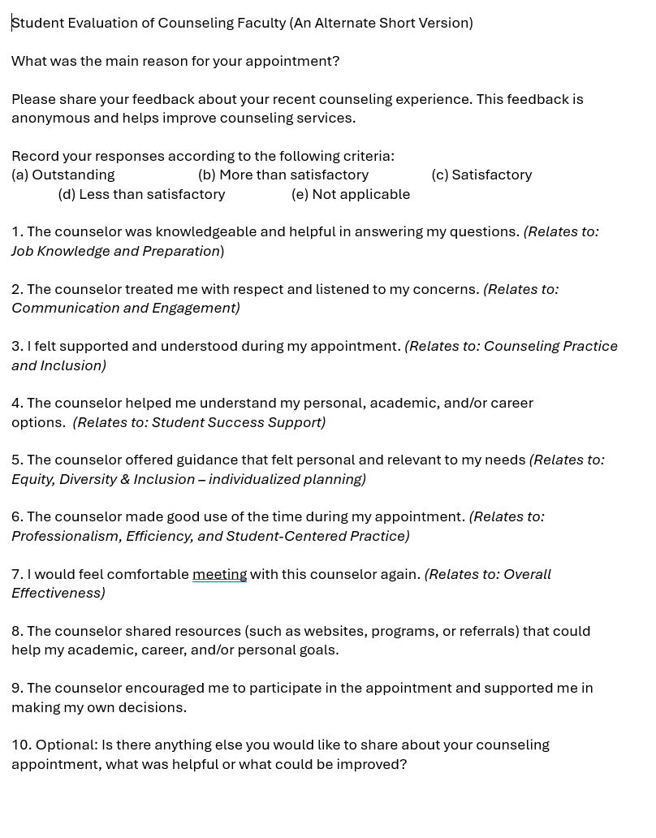
5.2 Continued…
Proposed version:
Questions are based on “Tenured/Tenure-Track Faculty Appraisal Form” for Counselors (aka Domains/Criteria)
10 questions
NOTE: Current Student Evaluation Form has 27 questions.

Slide 10
5.3 Action Items (Second Reads)
5.3 Miramar Marketing & Outreach Plan
(Steve Quis)
First Read: 4/07/26 & 4/21
Approved Marketing Plan 2025-2031_DRAFT_(4/21/26)
The 2025-2031 Miramar College Marketing & Outreach Plan has been approved by the Marketing & Outreach committee.
Sonny & Steve joined us on 4/21 to address questions. They are back to request feedback and a vote from the Academic Senate.
There was some confusion about which document to evaluate, but the correct draft was made available 4/07 & 4/21

Slide 11
6. Discussion Items (First Reads)

Slide 12
6.1 Discussion Items (First Reads)
6.1 Standing: Curriculum Committee Updates
(Veronica Hartmann)
Second Read:
AP and BPs April 2026.pdf

Slide 13
6.2 Discussion Items (First Reads)
6.2 Miramar College Zero Waste Resolution
(Ashlee Lain)
First Read: 05/05
San Diego Miramar College Zero Waste Resolution

Slide 14

6.3 Discussion Items (First Reads)
6.3 Free Speech & Campus Safety
(Rodrigo Gomez)
Miramar College resources for responding to emergencies & supporting undocumented students and families.
What other ways might we offer support to each other?

Slide 15
6.5 Discussion Items (First Reads)
6.4 Resolution on Agentic AI Workgroup
(Rodrigo Gomez)
How do we ensure that faculty voice remains central in shaping institutional decisions around agentic AI, particularly in alignment with the 10+1 and principles of academic freedom?
What safeguards must be established to protect student data, intellectual property, and faculty autonomy when engaging with agentic AI systems?
What expectations should guide the transparent, ethical, and accountable implementation of agentic AI tools across teaching, learning, and institutional operations?

Slide 16
Reports
(7.1 Committee | 7.2 Special | 7.3 Executive Committee)

Slide 17
7. Reports
7.1 Committee Reports

Slide 18
7.1 Committee Report
7.1.1 Professional Development Committee: Olivia Flores
Committee Purpose/Charge
Develop and promote a professional development program which supports the educational mission of the Institution to include activities that enhance and improve the college atmosphere and cultivate a positive culture on campus; oversee the disbursement of professional development funds for faculty, classified professionals, and administrators.
AFT Budget FY 2025-26 (Faculty only): $36,425
Available Balance as of 4/10/26: $4,891.10

Slide 19
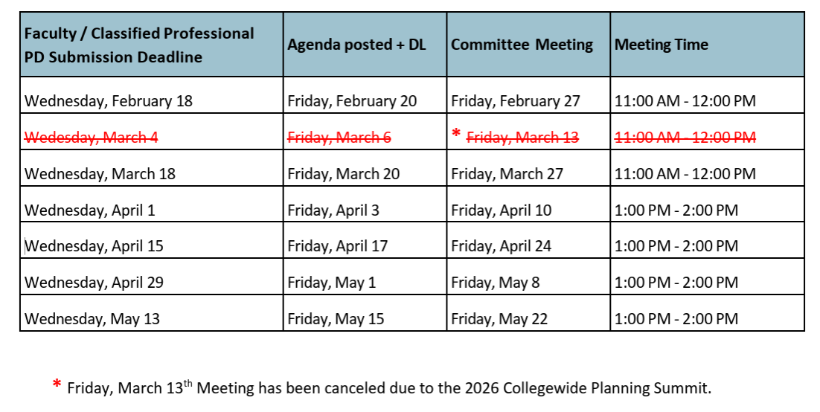
7.1 Committee Report
Friendly Reminder: Committee does not meet during the summer.
Last Spring 2026 meeting: Friday, May 22.
Deadline to submit request: Wednesday, May 13
Requests for travel during Summer, should be submitted by May 13

Slide 20
7.1 Committee Report
Friendly Reminder: Committee does not meet during the summer
Reimbursement funds are first come first serve.
Maximum request amount is $1,200
Requests for travel from July 1 – Sept 11, 2026, submit by May 13, to be reviewed before summer.
Request for travel from July 1 – Sept 11, 2026, will be part of the 2026-2027 budget.
Request for Fall 2026 and Spring 2027 semesters will not be reviewed until after the first fall meeting (Sept 11, 2026).

Slide 21
7. Reports
7.2 Special Reports

Slide 22
7. Reports
7.3.1 President’s Report
7.3.1.1 College Council is forming an AI Workgroup (Pending)
7.3.2 Vice President’s Report

Slide 23
7. Reports
7.3.3 – 8
Secretary – Olivia Flores
Treasurer – Dawn Diskin (please see the following slide)
Contract Member-at-Large – Melissa Wolfson
Contingent Faculty Member-at-Large – Desi Klaar
Chair of Chairs – Mary Kjartanson

Slide 24
7. Reports
7.3.4: Treasurer (Dawn Diskin)
Account Balance $607.49
Academic Senate Dues / Voluntary Payroll Deduction
Please consider enrolling in auto-payroll deduction for a nominal amount per check. Contributions of $2.00 per check make a difference to our students in funding our scholarships and other necessary needs.

Slide 25
Announcements
(1 min. time limit each)

Slide 26
8. Announcements
1 min. time limit each

Slide 27
9. Adjournment
If the calendar was approved earlier, the first meeting of the 2025-26 SDMC Academic Senate is: Tuesday, May 19th, 2026 from 3:30-5:00 pm in M-110. Remember that starting Spring 2026 we’ll be moving to fully in person Senate meetings. Hence, we will be retiring the A.S. Senator Remote Attendance Form

Slide 28
Thanks for your hard work for Miramar College!
If you have any questions, please reach out via email!
rgomez001@sdccd.edu or jbartolo@sdccd.edu

