Slide 1
The Female Reproductive System
Ovaries
Uterine tubes
  All 3 enclosed within broad ligament.
Uterus
Vaginal canal and vagina
External genitalia

Slide 2
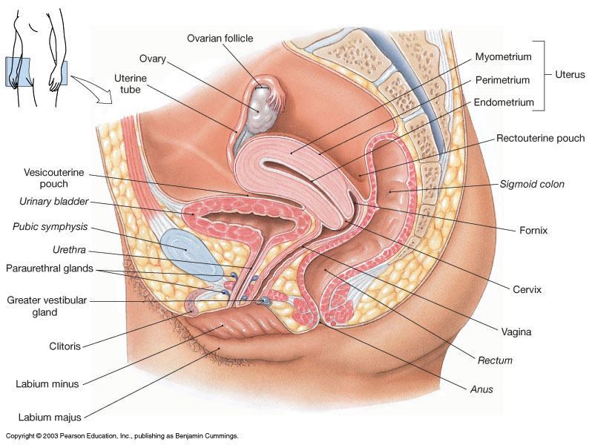
Female Reproductive System

Slide 3
The Ovaries
  Ovaries -> eggs, estrogens and progesterone.
Held in position by ovarian ligament and suspensory ligaments.
Ovarian artery and vein enter at ovarian hilus.
Has tunica albuginea.
Ovarian cycle and follicular development.
(dictates uterine cycle)

Slide 4
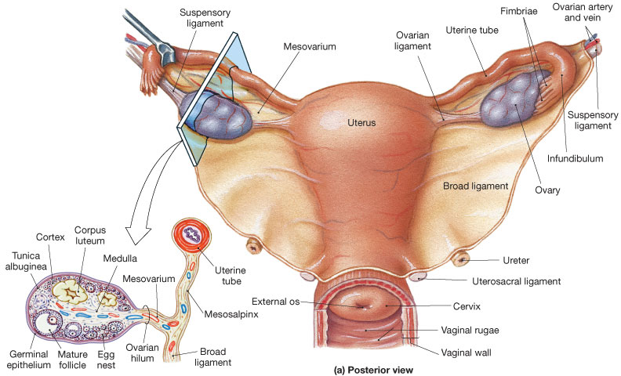

Slide 5
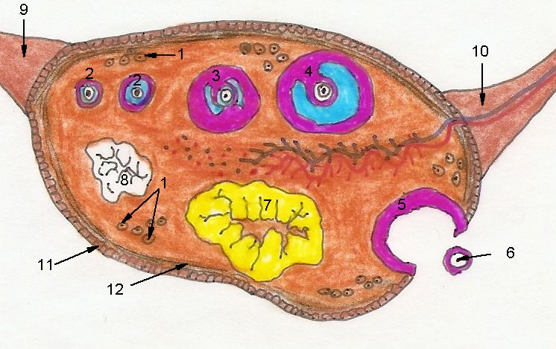
Frontal section of the Ovary

Slide 6
The Uterine Tubes
Infundibulum (with fimbriae)
Ampulla
Isthmus
Opens into uterine cavity.
Lined with ciliated and non-ciliated simple columnar epithelium - aids in cell’s transport.

Slide 7
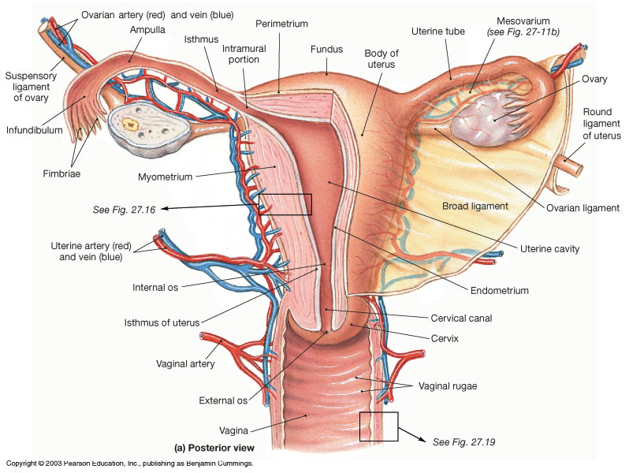

Slide 8
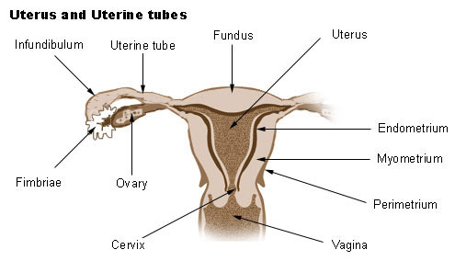
Gross Divisions of the Uterus
Fundus
Body (largest portion)
  Uterine cavity
Cervix
  Internal os
  Cervical canal
  External os

Slide 9
Uterine Wall (Layers)
Endometrium - innermost layer.
  Contains endometrial (uterine) glands.
  Functional layer, top 2/3 (sheds).
  Basal Layer, bottom 1/3 (remains).
Myometrium – muscular (thickest ~90%).
Perimetrium – outermost (superficial).

Slide 10
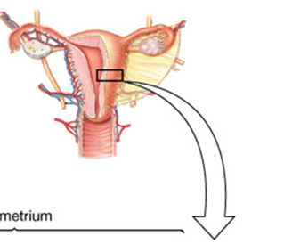
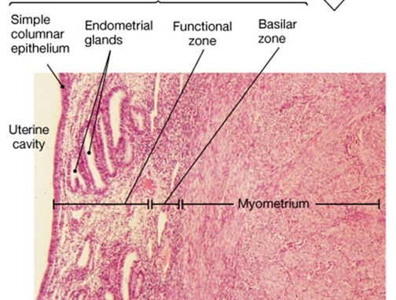
Histology of
the Uterine Wall

Slide 11
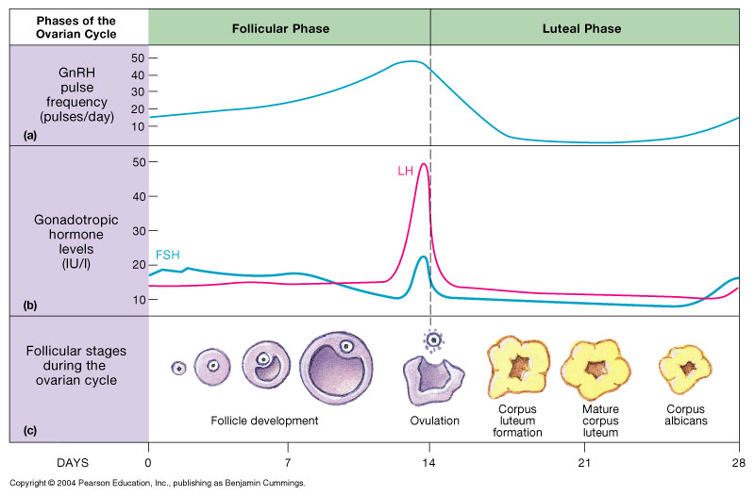
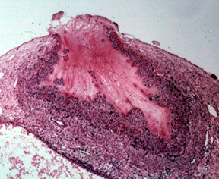
Ovarian Cycle

Slide 12
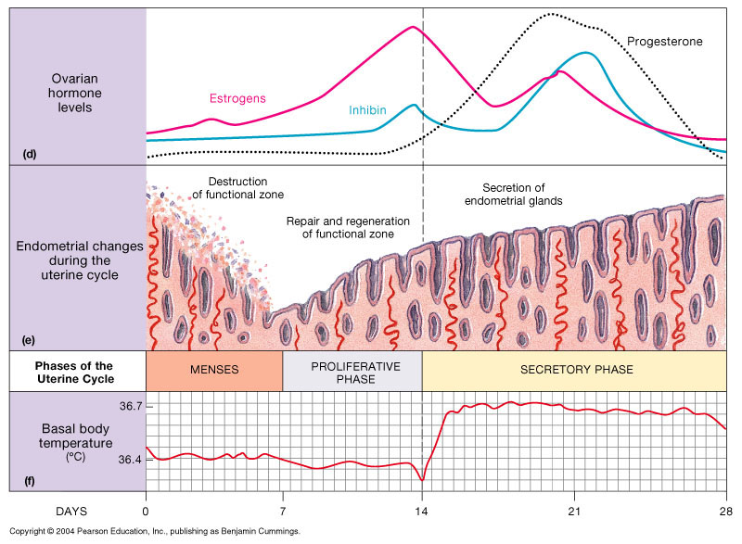
Uterine Cycle

Slide 13
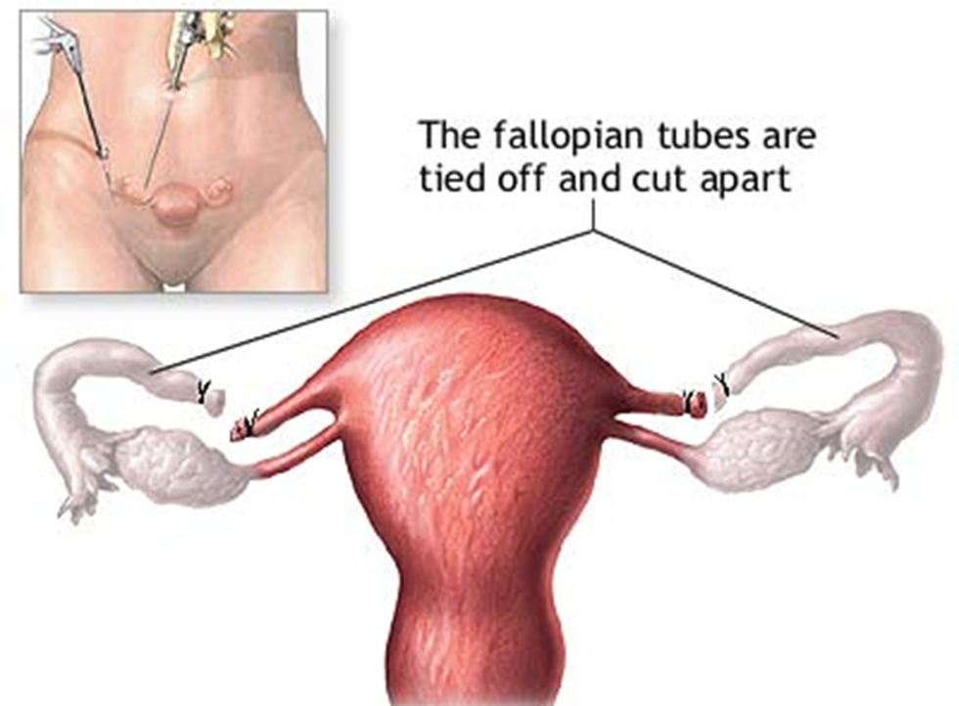
The Vagina
Elastic muscular tube from uterus to external genitalia (has rugae).
Passageway
Forms lower portion of birth canal.
Lined by stratified squamous epithelium.
Typical pH ranges from 3.8 to 4.5 (highly acidic).
Tubal
Ligation

Slide 14
The External Genitalia
Vulva (pudendum)
  Labia majora – outer (larger)
  Labia minora – inner (smaller)
  Clitoris – erectile tissue (spongiosum)
  - Prepuce (hood, foreskin of clitoris)
  Vestibule (created by labia minora)
Greater vestibular (Bartholin’s) gland.
Mons pubis

Slide 15
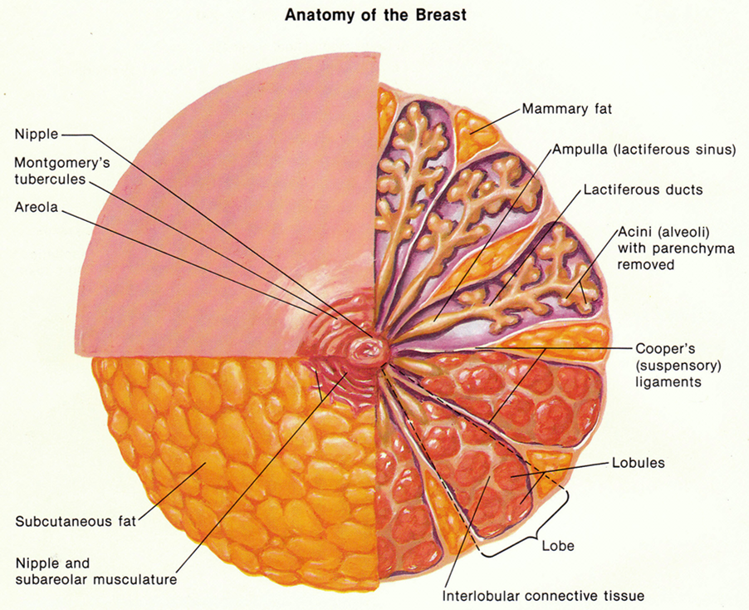
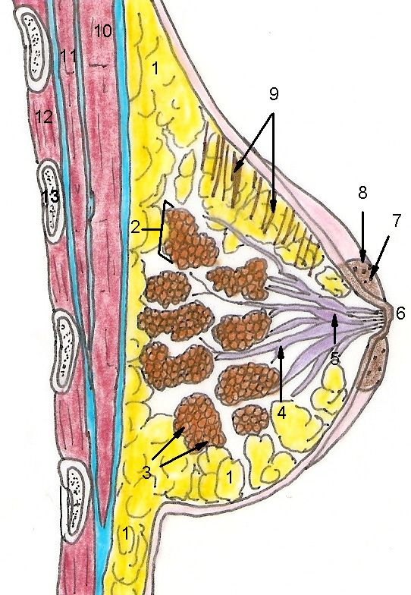
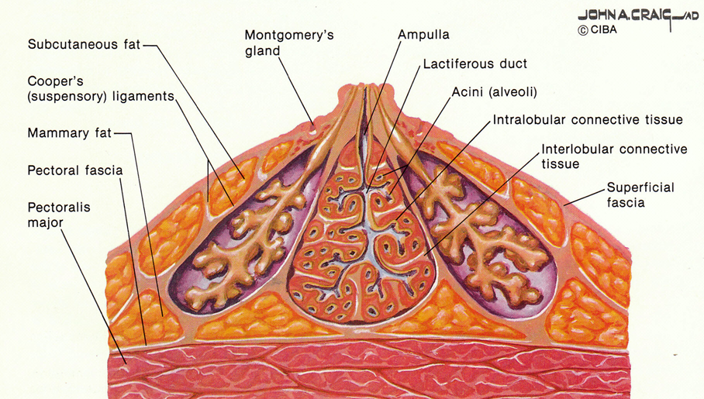
The Breast and
Mammary Gland

Slide 16
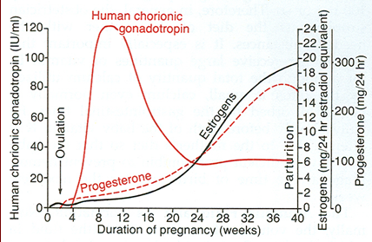
Implantation of Fertilized Egg Cell into
Endometrium Triggers Signal to Ovaries

Slide 17
2º Sexual Characteristic
Differences in anatomy and physiology between males and females
= sexual dimorphism. Determined by genotype (XX and XY) and by phenotype (mostly directed by testosterone levels).
Characteristic | Males | Females
Bone mass/density | More massive and dense, thicker, more prominent. | Less massive and dense, less prominent features.
- Pubic Angle - Q Angle - Finger digit ratio | - Smaller: acute, less than 90º - Smaller: Q = ~12º - 4th longer than 2nd | - Larger, obtuse, greater than 90º - larger: Q = ~18º - 4th same/shorter to 2nd
Muscle mass | More muscle mass, higher % average of 40% body Wt. | Less muscle mass, lower % average of 32% body Wt.
Hair growth pattern | More hairy, facial hair, male pattern baldness. | Less hairy, no facial hair.
Distribution of body fat | Less body fat, 14% body Wt. Visceral fat stores. | More body fat, 24% body Wt. Subcutaneous fat stores.
Larynx Voice (pitch) | Larger Larynx, longer, thicker vocal folds – deeper pitch. | Smaller larynx, shorted, thinner vocal folds – higher pitch.

Slide 18
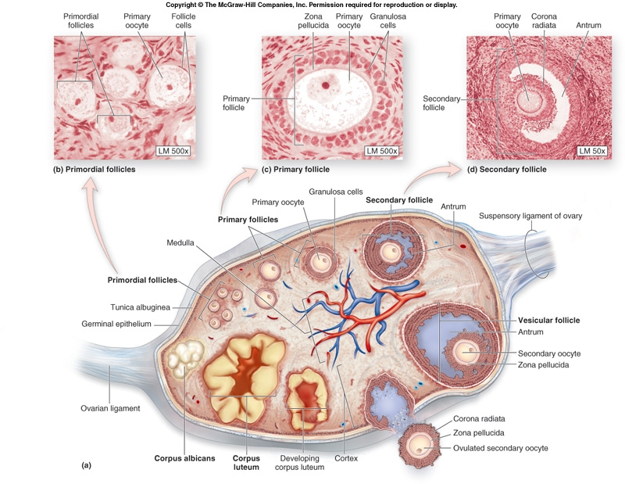

Slide 19
