Slide 1
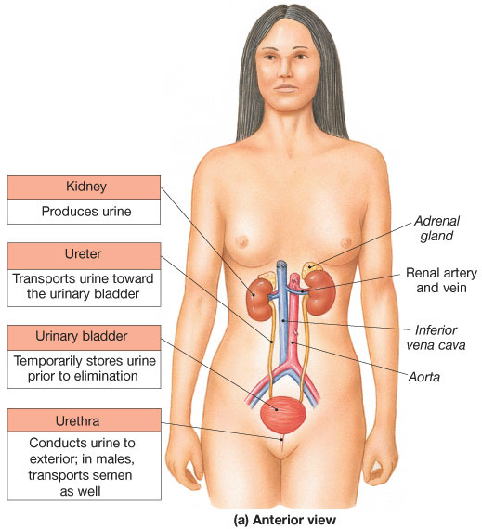
The Renal System
2 Kidneys
  - Produces urine
2 Ureters
- transports urine
1 Urinary bladder
- stores urine
1 Urethra
- conducts urine
to outside

Slide 2
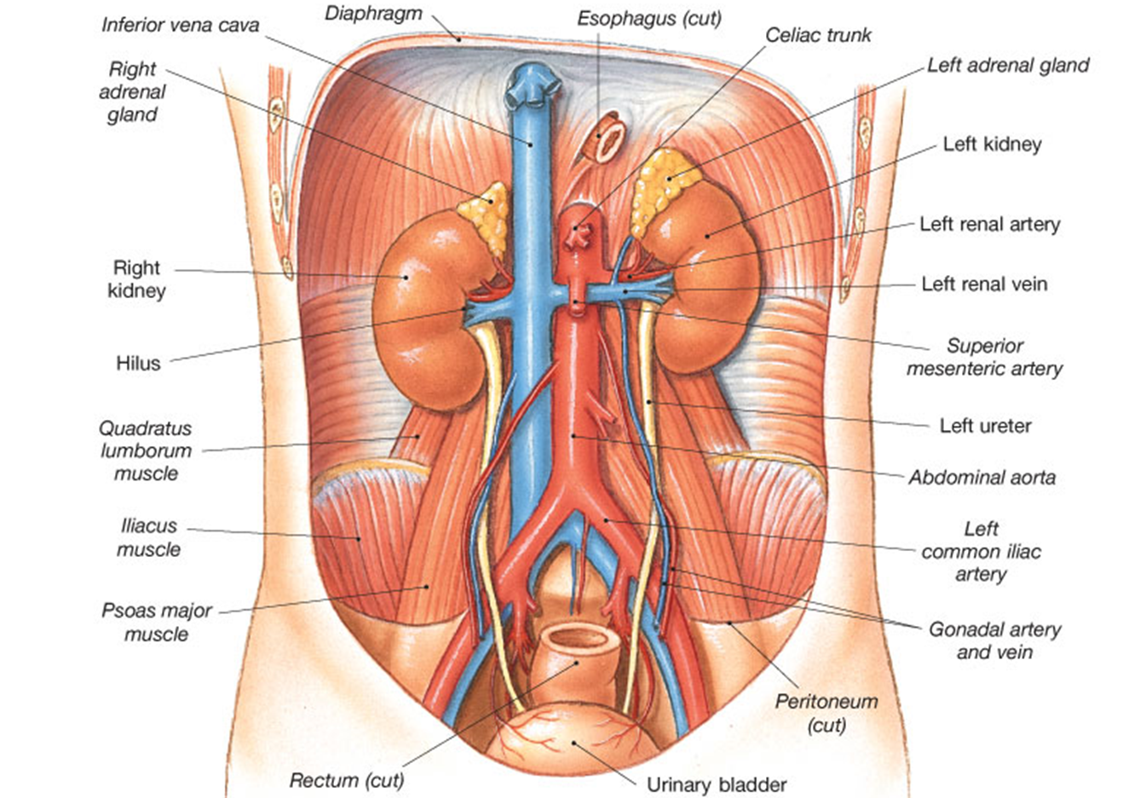
The Kidneys are Located Retroperitoneally

Slide 3
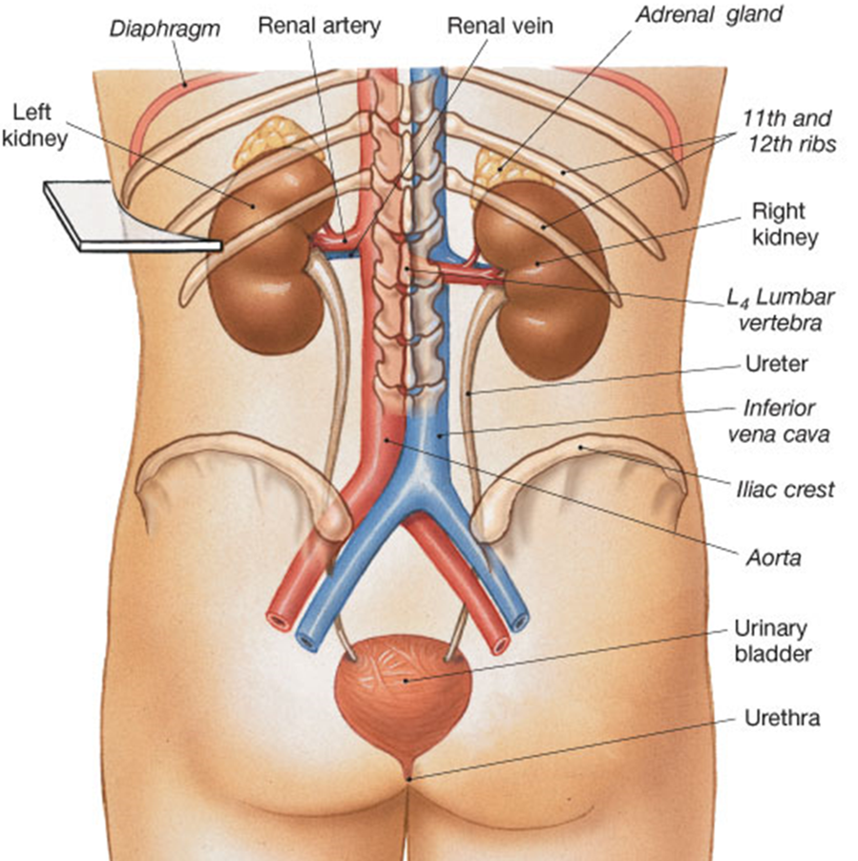
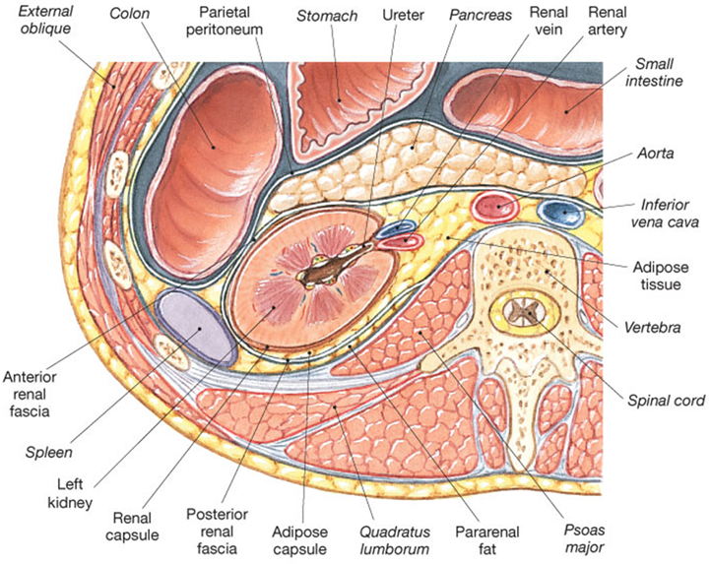
Posterior view
of Kidneys
Transverse Section of
Abdomen showing Kidneys

Slide 4
3 Layers Surrounding the Kidney
(to protect and hold the kidneys in place)
Renal Capsule
  - inner layer (outer surface of kidney)
Adipose Capsule
- fat padding around kidney
Renal Fascia
- outermost layer

Slide 5
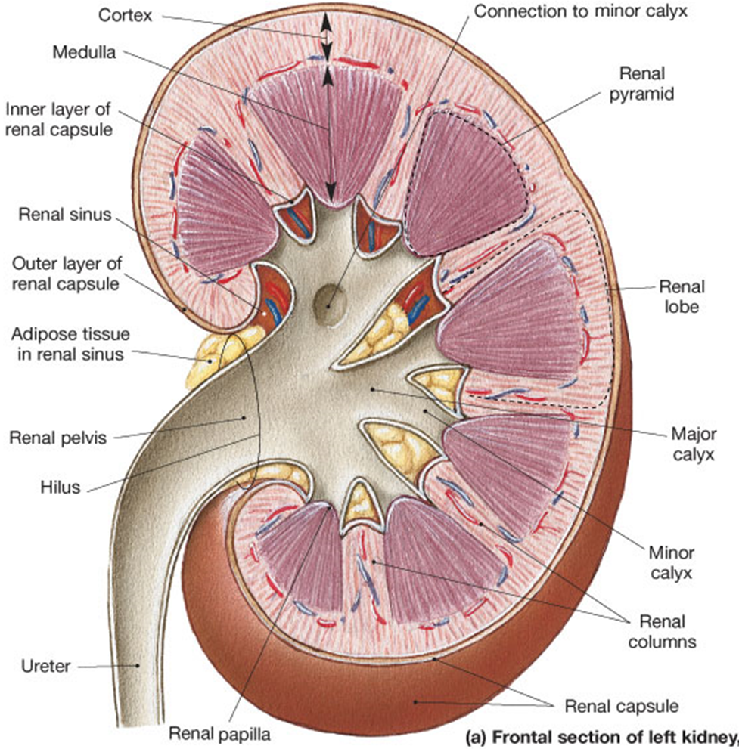
Structures
of the Kidney
Renal cortex (outer)
Renal medulla (inner)
Renal pyramid
Renal columns
Renal papilla
Minor calyx
Major calyx
Renal pelvis
Ureter

Slide 6
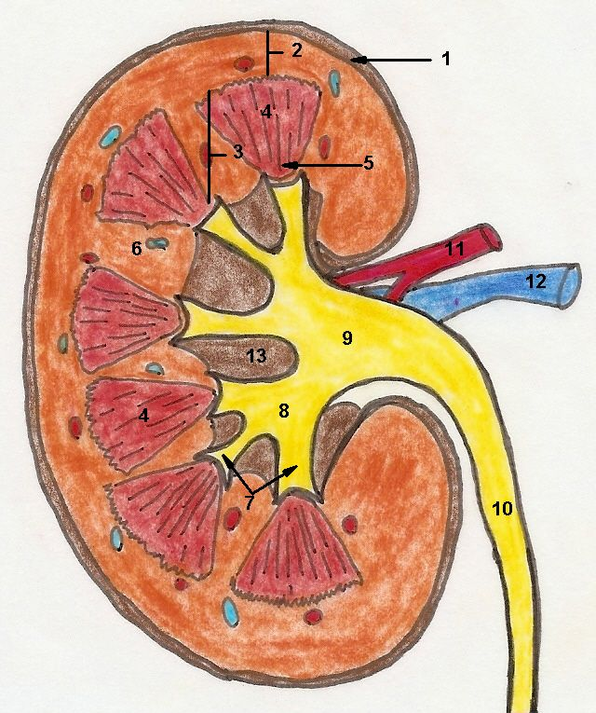
Calyx = ‘cup’
Pelvis = ‘basin’
Calyx (singular)
Calyces (plural)
14

Slide 7
There are 4 Processes in the kidneys:
1. Filtration: net movement of substances from the glomerulus to Bowman’s space.
2. Reabsorption: net movement of substances from renal tubules and collecting duct into peritubular & vasa recta capillaries.
3. Secretion: net movement of substances from peritubular & vasa recta capillaries into renal tubules.
4. Excretion: elimination of urine from body.

Slide 8
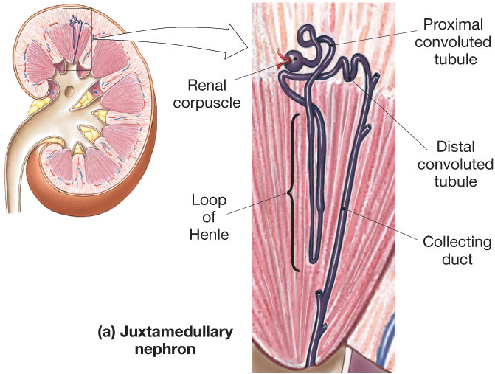
The Nephron – Functional Unit
1.25 million/kidney

Slide 9
The Nephron has 2 parts:
1. Renal Corpuscle
a) Glomerulus
b) Bowman’s Space
c) Bowman’s Capsule
2. Renal Tubule
a) Proximal convoluted tubule (PCT)
b) Loop of Henle (nephron loop)
c) Distal convoluted tubule (DCT)

Slide 10
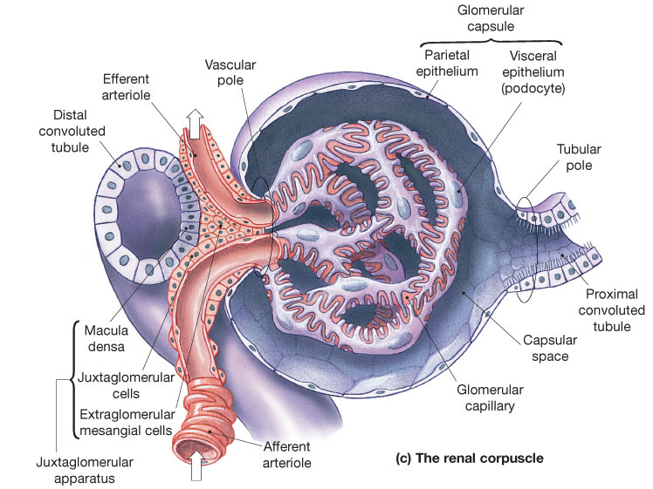
Glomerulus Details

Slide 11
Juxtaglomerular Apparatus
Macula Densa – specialized portion of DCT.
Sits in between afferent and efferent arteriole
– for communication regarding renal function.
Juxtaglomerular (JG) Cells – specialized
cells, mostly surrounding afferent arteriole.
For changing diameter of afferent arteriole.

Slide 12
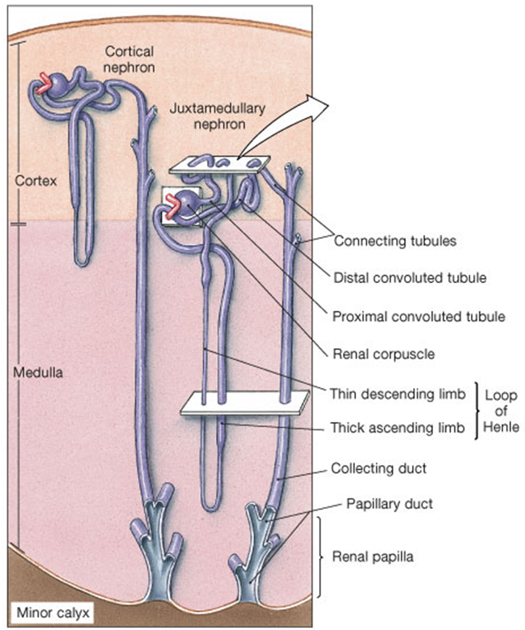
~85% Cortical Nephrons
Short loop of Henle.
Efferent arteriole
becomes peritubular
capillaries.
15% Juxtamedullary
Closer to medulla.
Loop of Henle deeper.
Efferent arteriole
becomes vasa recta.

Slide 13
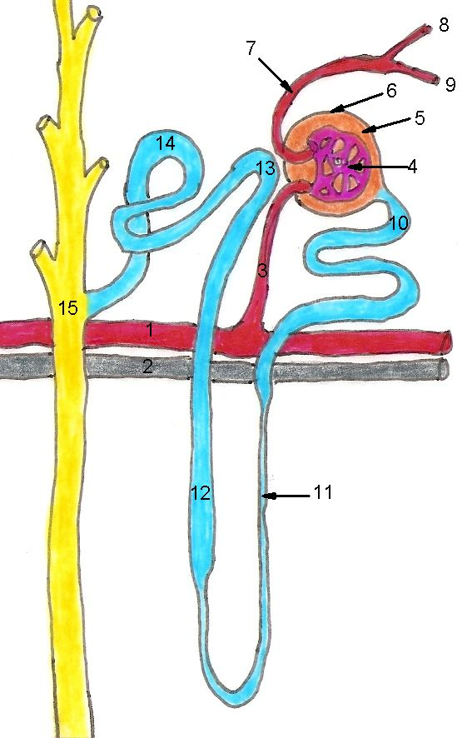

Slide 14
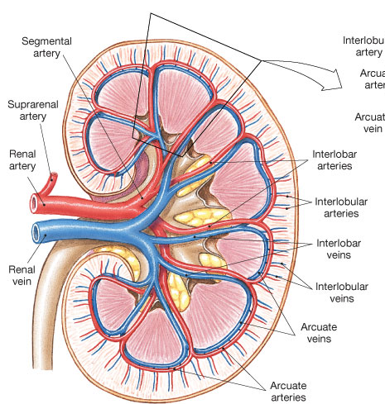
Renal Blood Supply
Renal a.
Segmental a.
Interlobar a.
Arcuate a.
Cortical radiate a.
Afferent
arteriole

Slide 15
Blood arrives at afferent arteriole.
Filtrate is “filtered” at Glomerulus.
(a fenestrated capillary bed)
Blood departs via efferent arteriole.
a) Peritubular or b) Vasa recta
capillaries capillaries
(cortical nephrons)
(juxtamedullary nephrons)
Venules

Slide 16
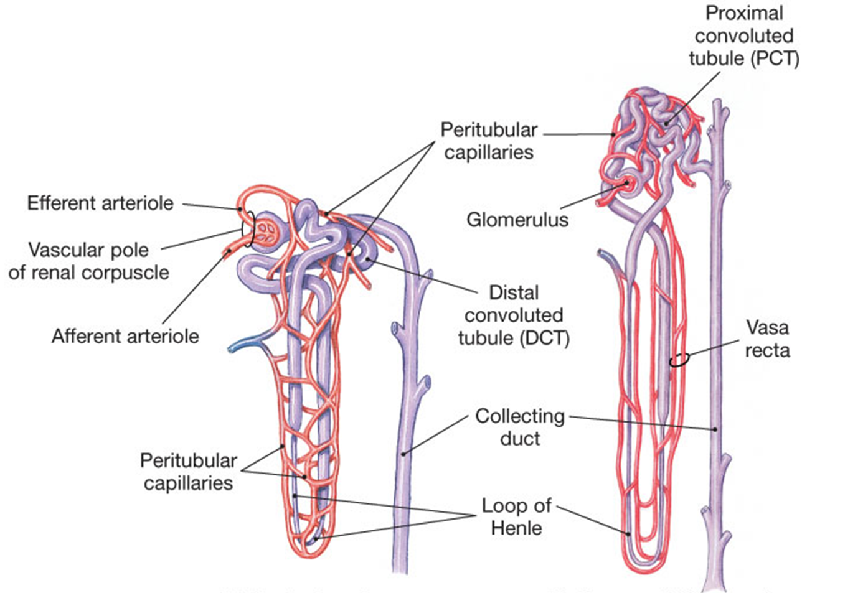
Nephrons with:
peritubular capillaries (cortical)
b) vasa recta (juxtamedullary)
Cortical nephron Juxtamedullary nephron

Slide 17
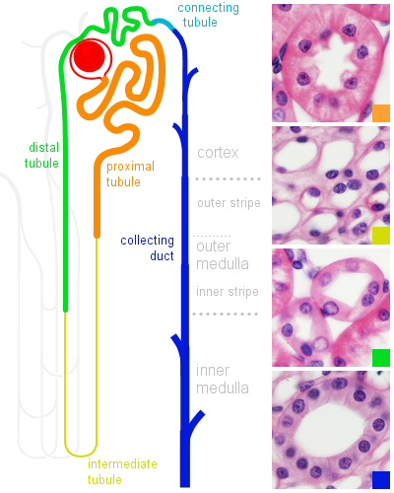
The Renal Tubules
a) Proximal
Convoluted Tubule
Lined with simple cuboidal epi
  With microvilli (brush border)
  (= large surface area)
Main Role: Actively reabsorbs (brings back into the body) most of the “filtrate”, e.g., nutrients (glucose, amino acids), ions (Na⁺, Ca²⁺, etc.), vitamins, lipids, water…

Slide 18
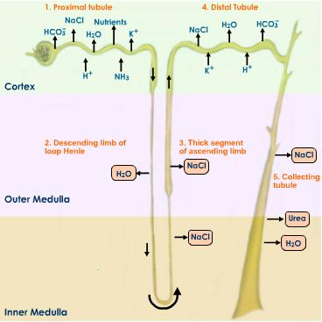
b) Loop of Henle
  Has Descending and
  Ascending limbs for reabsorption (going back into the body) of water and salt.
    Main Role: Water balance
    Thin seg. - simple squamous epi.
    Thick seg. - simple cuboidal epi (has no microvilli)

Slide 19
c) Distal Convoluted Tubule
Actively secretes ions
and other materials back into the renal tubules.
This means it will be eliminated as Urine unless it is reabsorbed.
Lined with simple
cuboidal epi.

Slide 20
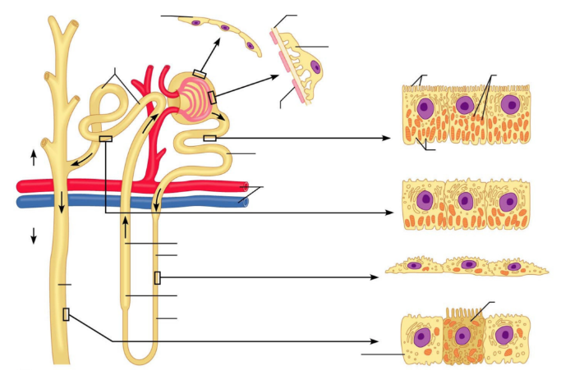
Collecting Ducts
This region is not part of the nephron.
It is lined with simple cuboidal epi. This changes to simple columnar epithelium
deeper in medulla.
Antidiuretic Hormone (ADH) acts here to conserves H₂O

Slide 21
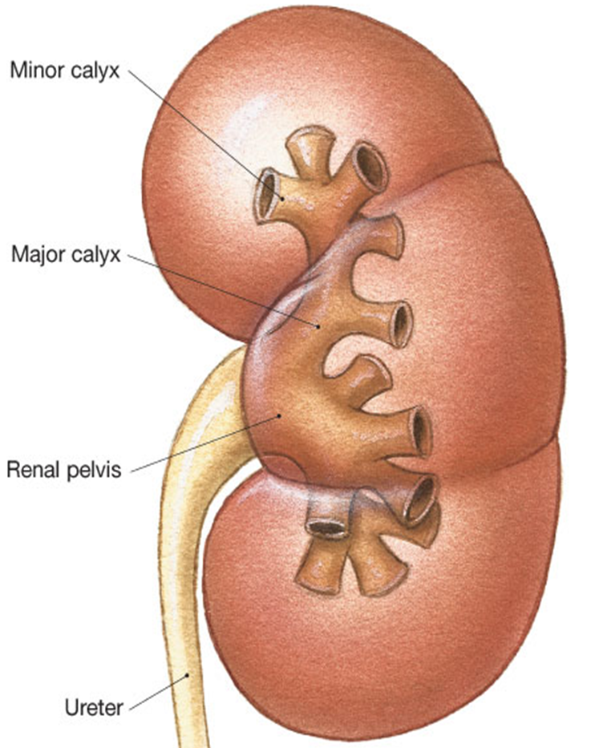
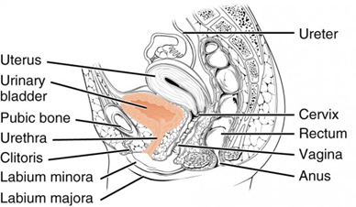
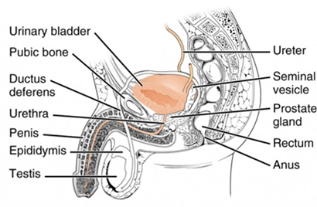
  Collection and Direction of Urine Flow
  in the Renal Systems
to Bladder

Slide 22
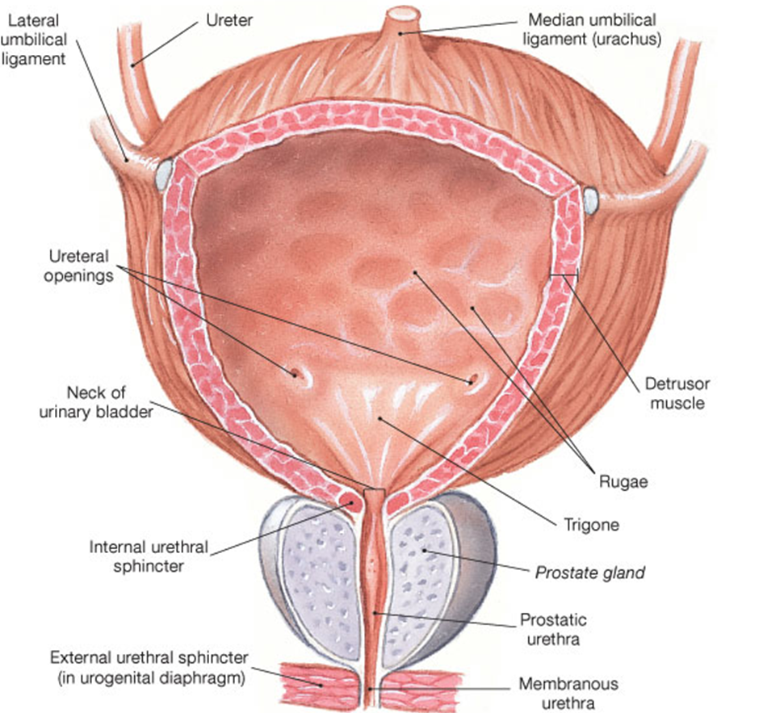
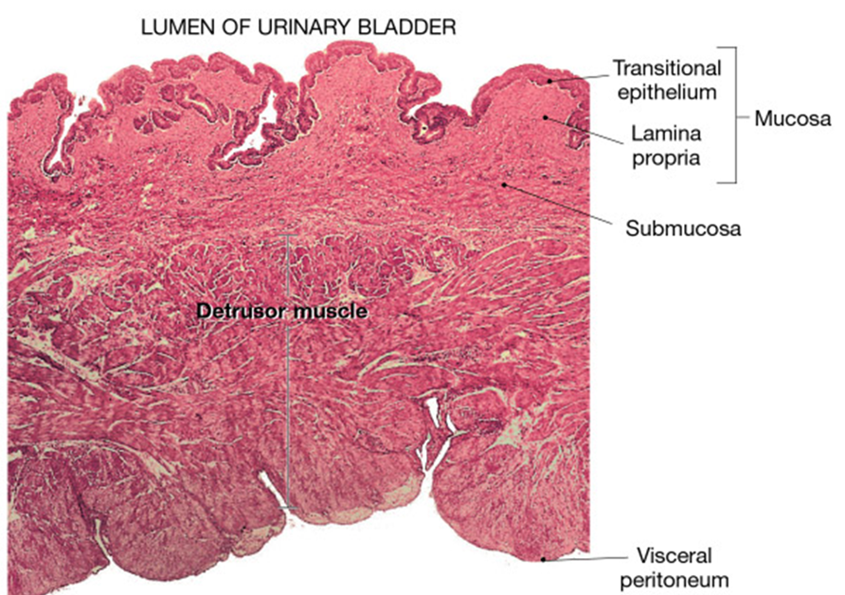
Bladder is lined with . . .
Transitional epithelium

Slide 23
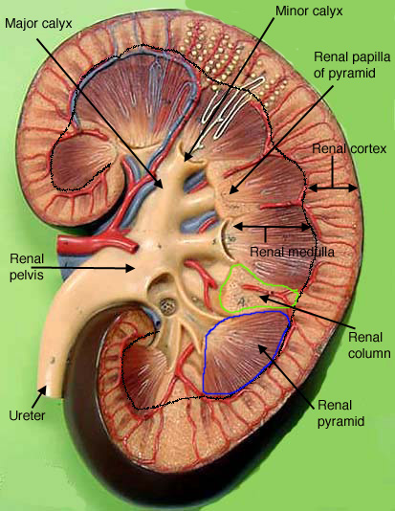




Slide 24
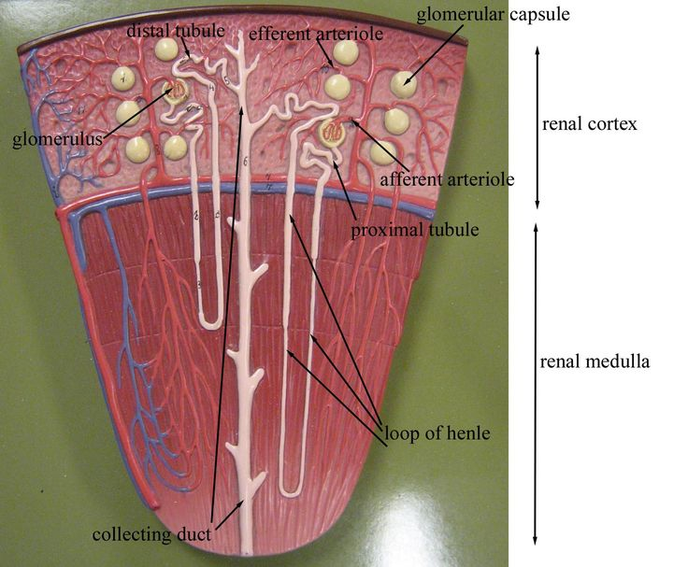
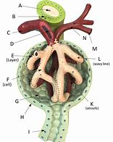

Slide 25
