Slide 1
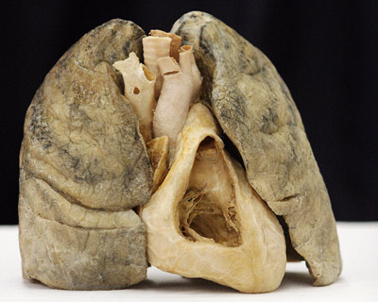
There are 2 Lungs
(tri before you bi)
Right
Lung
Left
Lung

Slide 2
Functions of Respiratory System
Ventilation - moves air to and from alveoli.
Provides large surface area for gas exchange.
Regulates pH of body fluids.
Permit vocal sounds (communication).

Slide 3
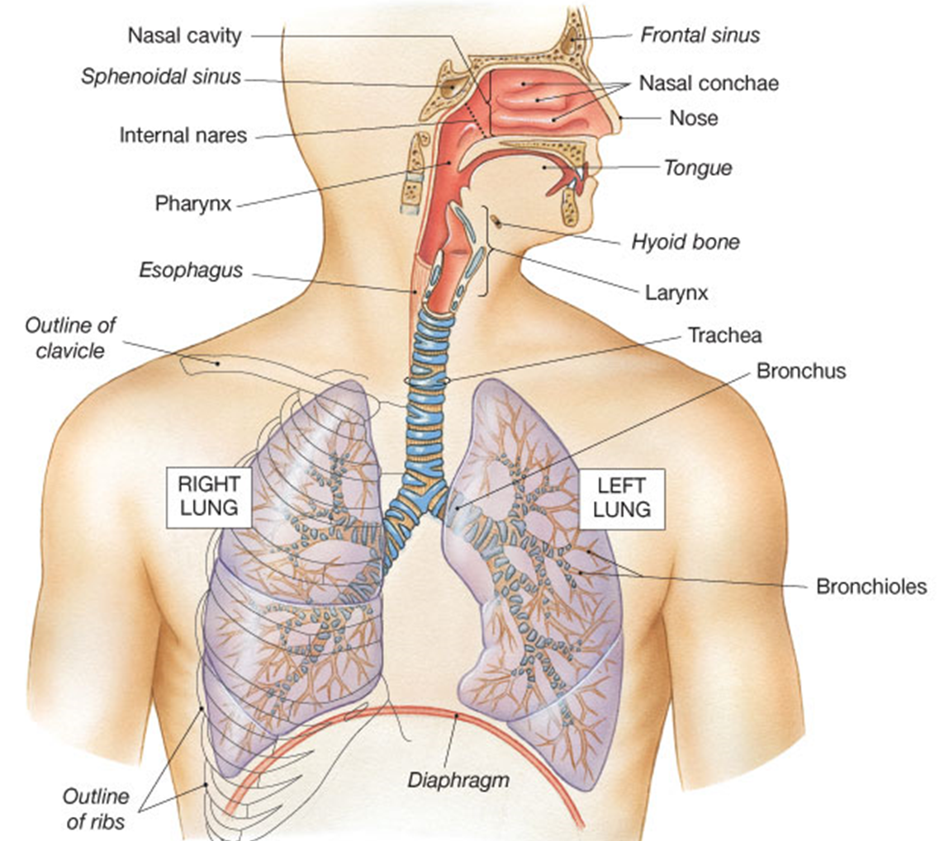
Respiratory Tract
From nose to alveoli
External nares

Slide 4
Respiratory Tract (Passageway)
External nares > vestibule of nose > nasal cavity >
pharynx (naso-, oro- laryngo-) > larynx >
trachea > 1º bronchi > 2º bronchi > 3º bronchi >
bronchioles > terminal bronchioles >
respiratory bronchioles > alveolar duct >
alveolar sac > alveoli (end).

Slide 5
Upper Respiratory Tract
  Nose
  Nasal cavity
  Pharynx (3 parts)
Functions: Conditions inspired air
Warms, Filters and Humidifies incoming air.
Lower Respiratory Tract
- Larynx
- Trachea
- Bronchi
- Bronchioles
- Alveoli
Functions:
Conducts air and exchange gases.

Slide 6
There are 2 Zones of this tract
The Respiratory Tract is divided into the:
  1) Conducting Zone
  2) Respiratory Zone

Slide 7
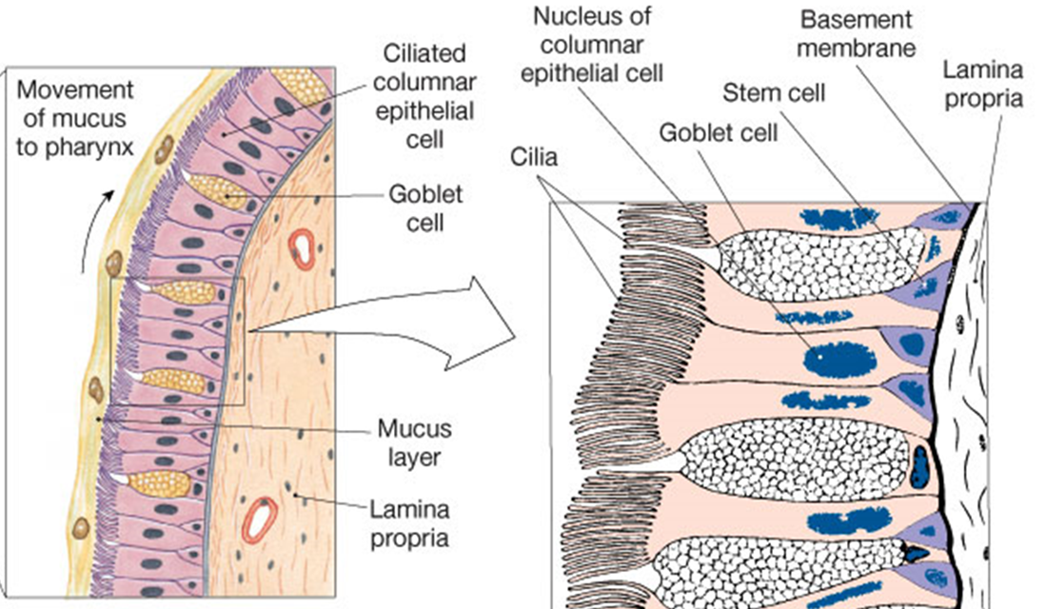
“Respiratory Epithelium”
= Pseudostratified ciliated columnar (PSCC) epithelium
Goblet cells make mucus to trap foreign particles
Epithelial cells sitting on lamina propria = mucus membrane

Slide 8
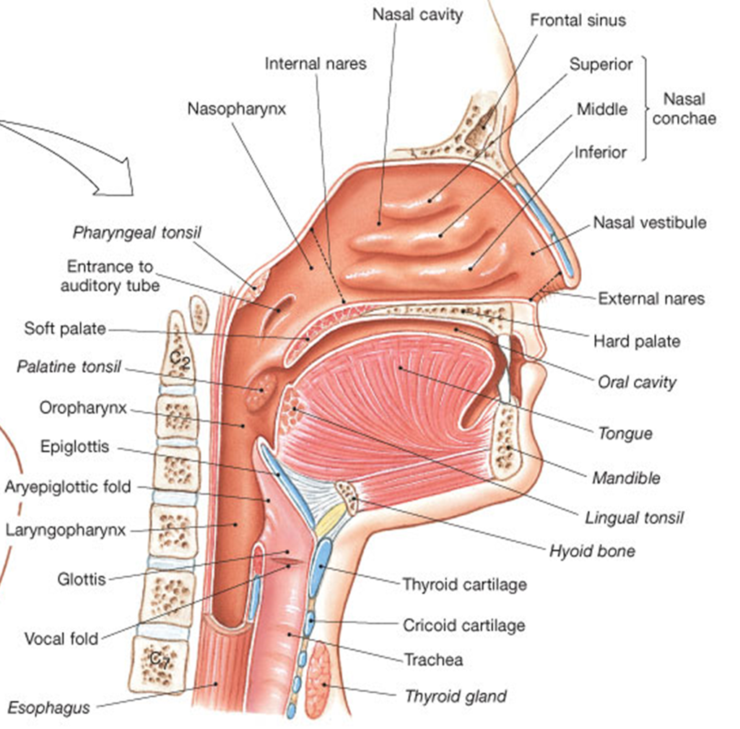
The Pharynx has 3 Parts
1. Nasopharynx
Superior to food entry – for air only. Uvula closes off when swallowing.
Pharyngeal tonsil (adenoids) that are
located on posterior wall.
Has the opening to the
auditory tube.

Slide 9
3. Laryngopharynx
Shared passageway: respiratory and digestive
Stratified squamous epi., continuous with the esophagus/larynx
2. Oropharynx
From soft palate to the epiglottis, lined with stratified squamous epi.
Two tonsils in oropharynx:
  Lingual tonsils – covers posterior surface of tongue.
  Palatine tonsils – in the lateral walls of fauces.
Next region = The Larynx! The ‘Box” is created by:
3 Large Unpaired Cartilages:
3 Small Paired Cartilages:

Slide 10
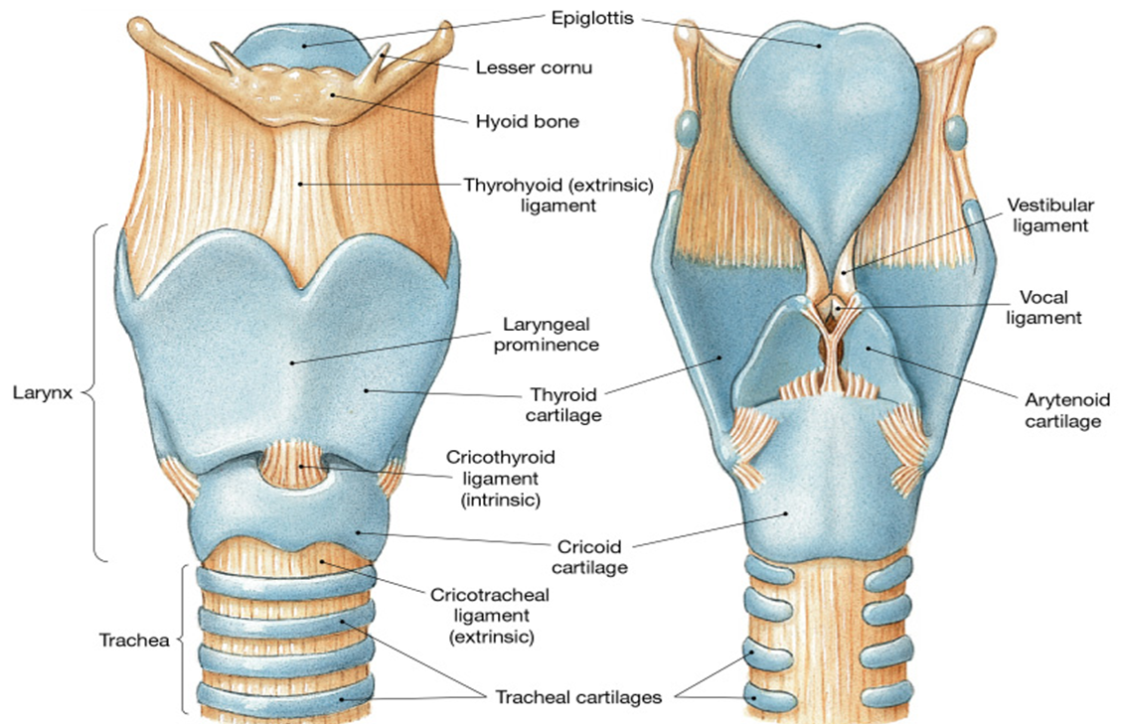
The Larynx
Surrounds glottis –> Glottis is area around vocal cords (middle part of larynx).
Epiglottis – cartilage that prevents solids from entering respiratory system.
Anterior Posterior
Elevation of larynx folds epiglottis over glottis when swallowing.

Slide 11
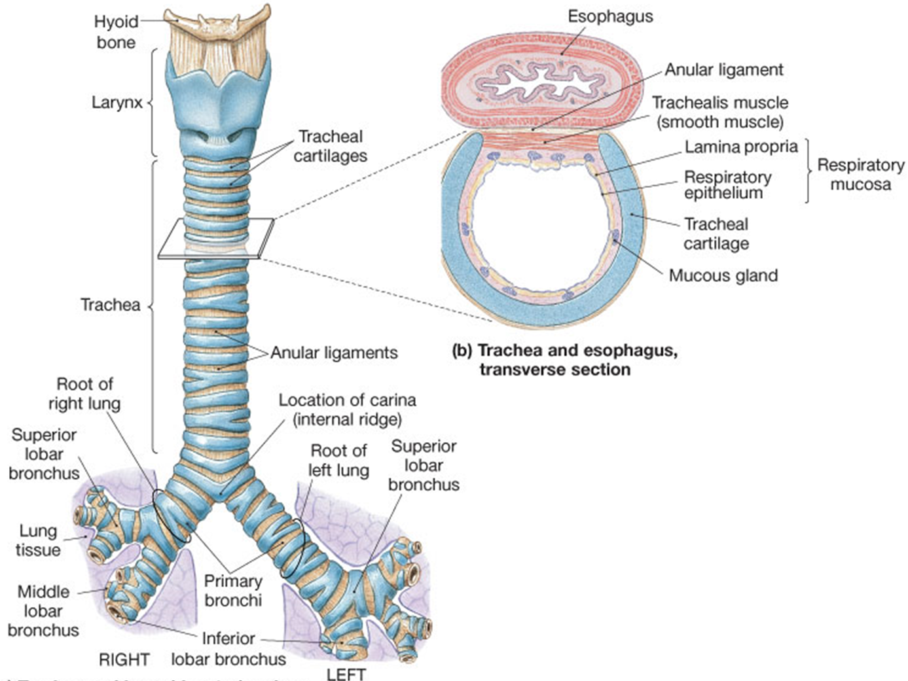
Trachea
~ 4.5 inches long
~ 1 inch in diameter
“C” cartilage rings (submucosa)
Trachealis is posterior wall – allows
food passage in esophagus.

Slide 12
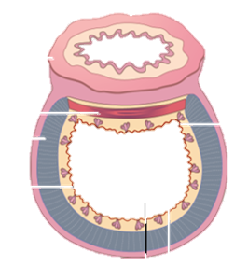
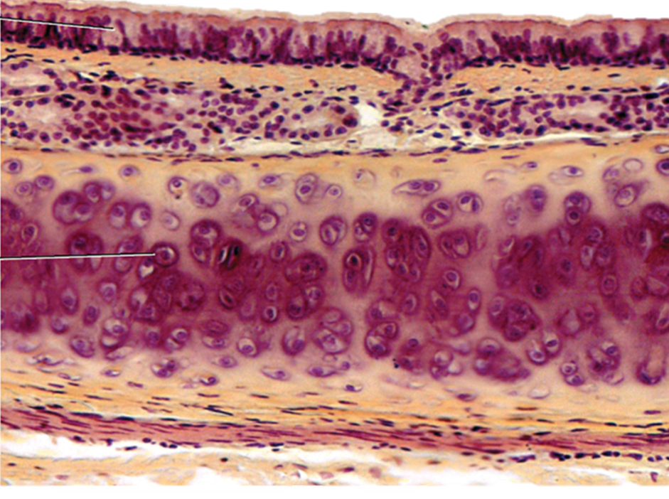
Histology of the Trachea
5
1
2
3
4

Slide 13
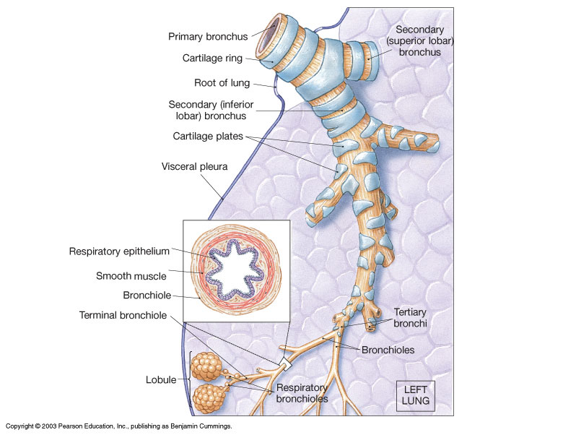
Bronchi and
Bronchioles
Bronchioles
Do not contain cartilage
Have smooth muscle
Are Innervated by ANS
    Parasympathetic
    Constricts airways
    This decreases air flow
    Sympathetic
    Dilates airways
    This increases air flow

Slide 14
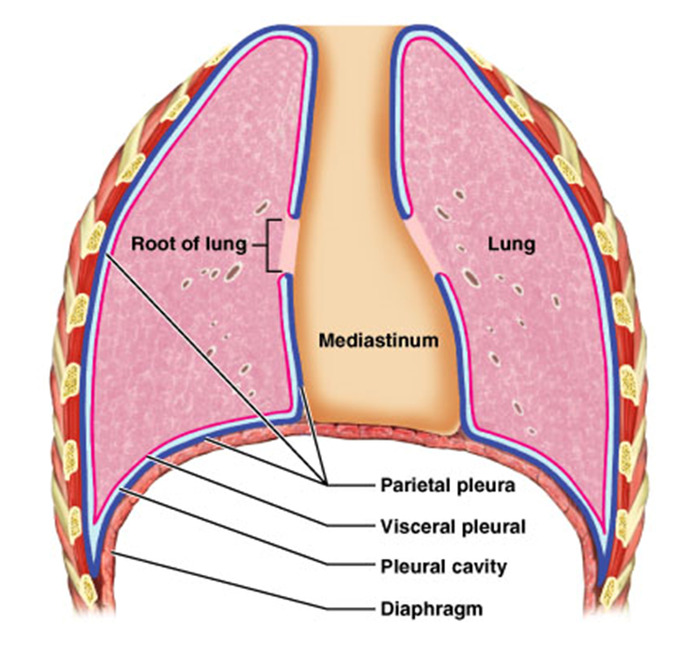
Each Lung is in a ‘Bag’
Visceral pleura
Parietal pleura
Pleura Cavity
The serous membranes of the lung reduces
friction of the 2 surfaces moving across each other.

Slide 15
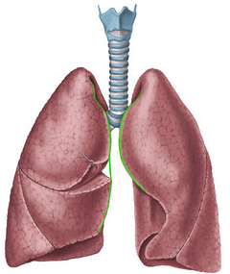
The Lobes of Lungs
Lobes are Separated by Fissures
  Right lung has three lobes (tri).
  Left lung has two lobes (bi).
Costal Surface of Lungs
  Anterior surface
  Follows contours of rib cage
Mediastinal Surface of Lungs
  Contains hilus of lungs (entry/exit)
    Aortic Groove - Left lung
    Groove for Esophagus – Right Lung

Slide 16
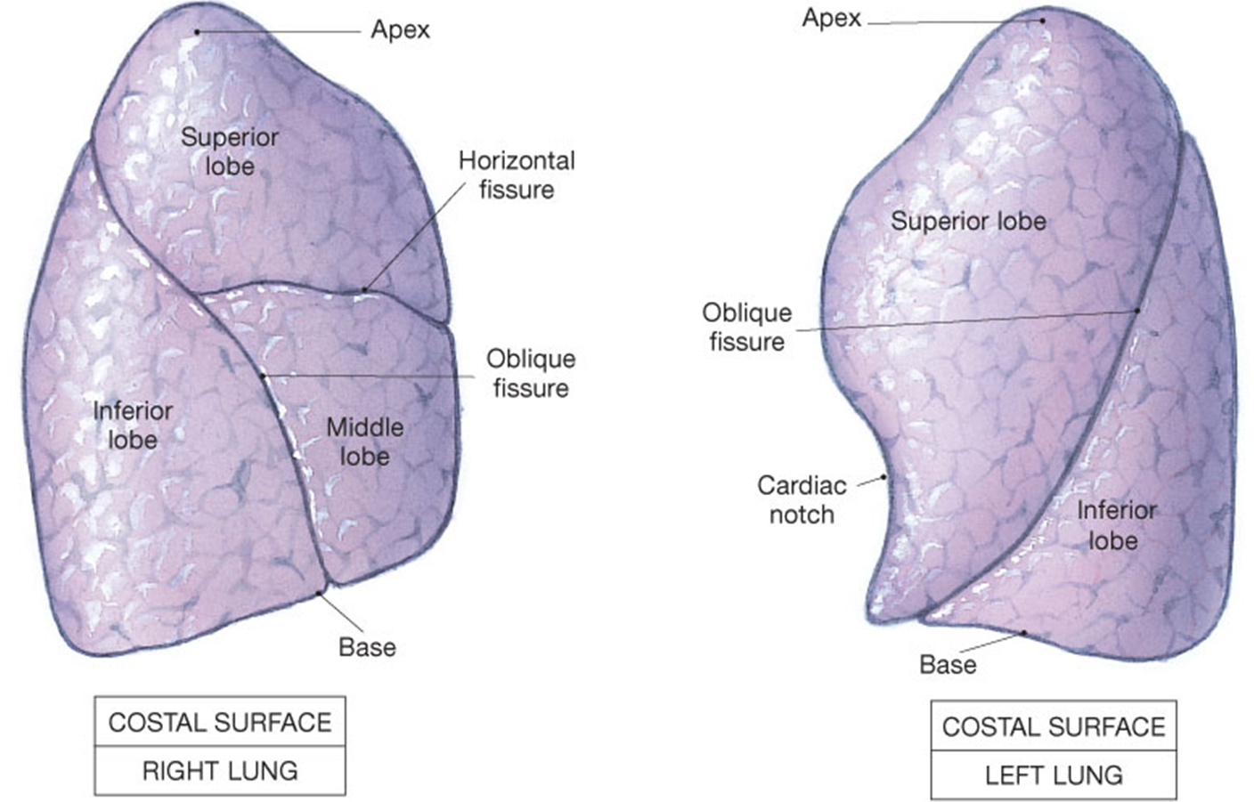
Right Lung
Left Lung

Slide 17
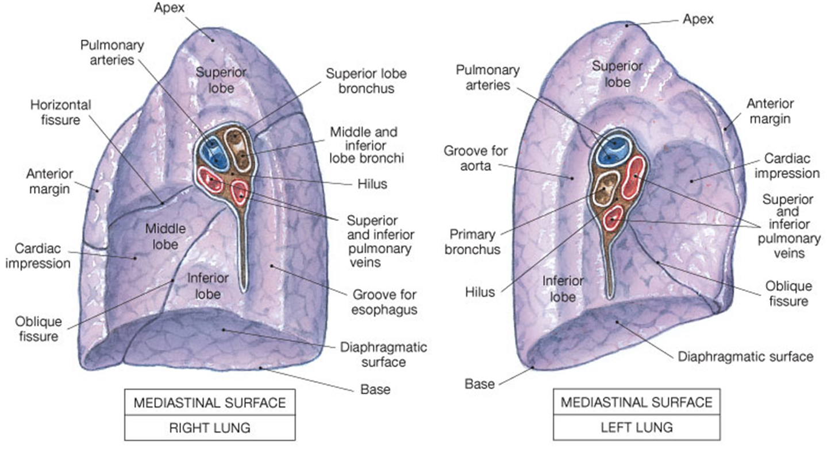
Medial aspect of each Lung

Slide 18
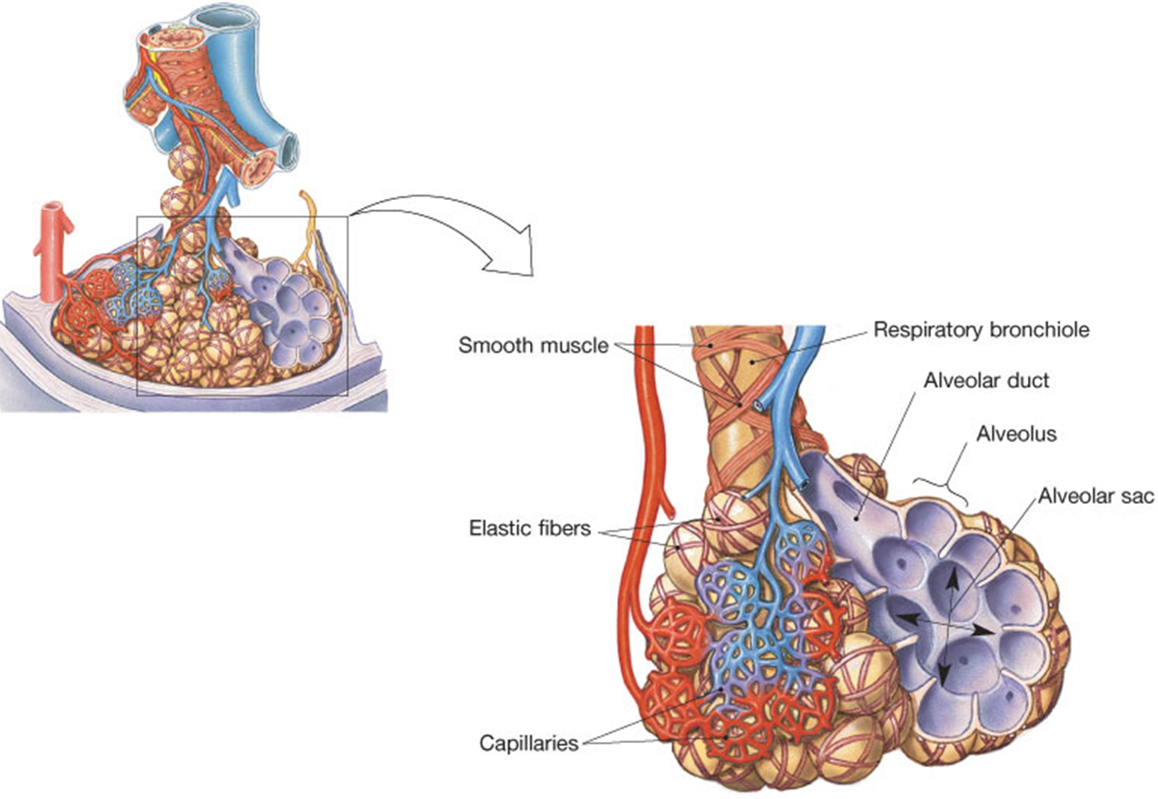
The Alveoli -> for Gas Exchange!
~ 150 million alveoli
in each Lung
The alveoli is the site of gas exchange with the pulmonary capillaries.
Where Blood:
Picks up O₂
Drops off CO₂

Slide 19
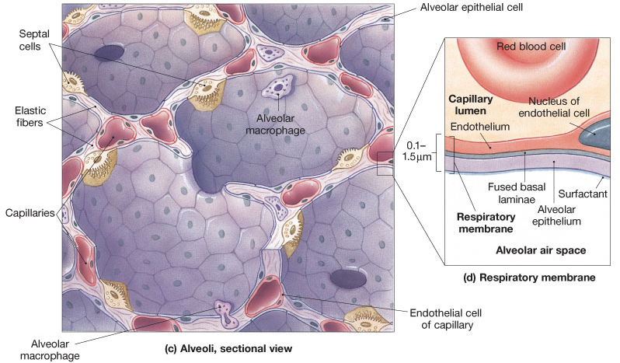
The Cells of the Alveoli - 3 Types

Slide 20
1) Alveolar Type I cells - thin (simple squamous epithelium) cells; makes the ‘walls’ of alveoli, provides surface area for gas exchange.
2) Alveolar Type II cells - releases surfactant which makes lungs more Compliant (‘septal’ cells).
3) Alveolar Macrophages - for protection of alveolar surface. Release trypsin –enzyme that degrades proteins.
*Alveoli also contain Elastic fibers. These give the lungs elastic recoil, can push air out (assists ventilation).
Capillaries cover 90% of surface

Slide 21
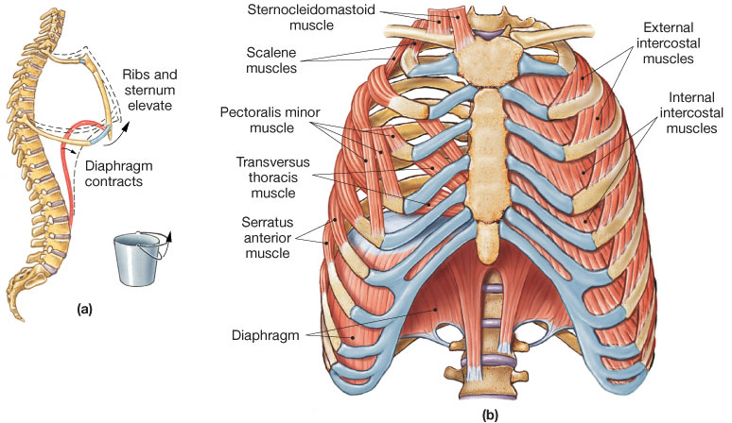
Respiratory Muscles
Ventilation - movement of air into and out of lungs.

Slide 22
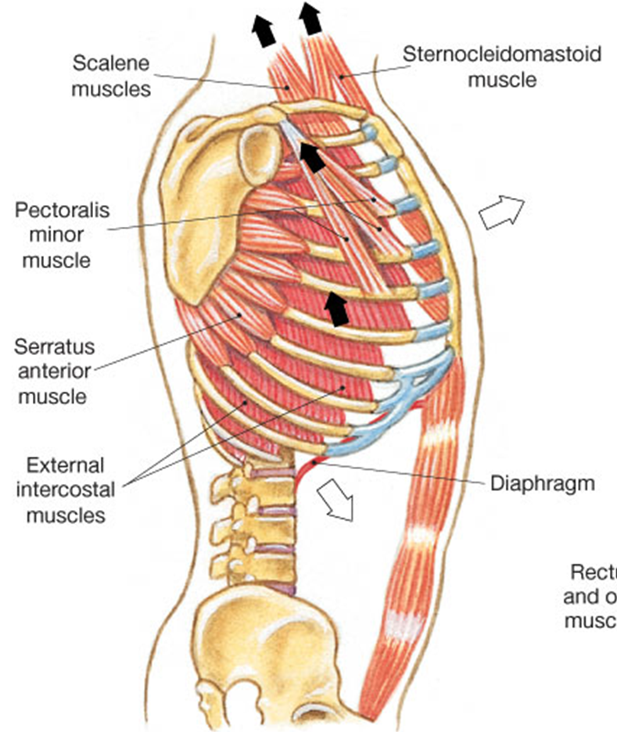
Breathing
Eupnea = normal quite
breathing at rest.
For Inspiration
Muscle activity required:
Diaphragm
External Intercostals
Sternocleidomastoid
Scalenes
Accessory
muscles

Slide 23
Expiration in Eupnea:
No Muscular activity required!
Restful Breathing ~ 10% Basal Metabolic Rate (BMR) normally
What is Emphysema?
With emphysema this increases to ____ %

Slide 24
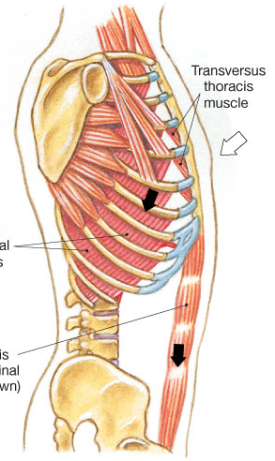
Forceful breathing
(hypereupnea):
Same muscles (+) required
as in Eupnea.
Note: Expiration requires:
Internal Intercostals
Rectus abdominis
Transverse abdominis,
Internal and External obliques.

Slide 25
Sensory Receptors - regulate respiration.
Mechanoreceptors
detect changes in lung volume or arterial blood pressure
Chemoreceptors
Changes in P_{CO2}, pH, P_{O2} of blood and CSF
Central chemoreceptors - located in medulla
Peripheral chemoreceptors - located in:
1) Aortic bodies (in aortic arch)
2) Carotid bodies (in carotid sinus)

Slide 26
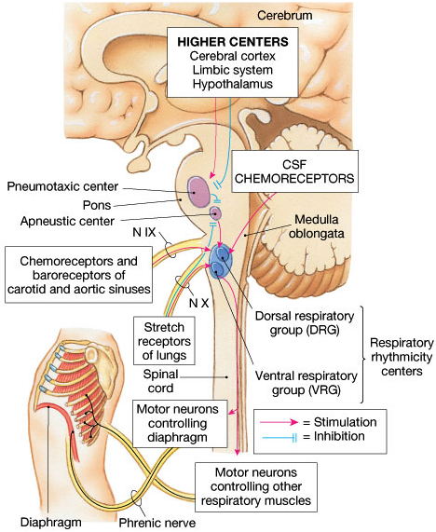
Locations of the control centers of Breathing
in the Brain
The major respiratory centers are in the
MO and the Pons.
MO = DRG and VRG
Pons = Apneustic and Pneumotaxic Centers
Other important factors also influence respiratory control found in the higher centers of the brain.

Slide 27
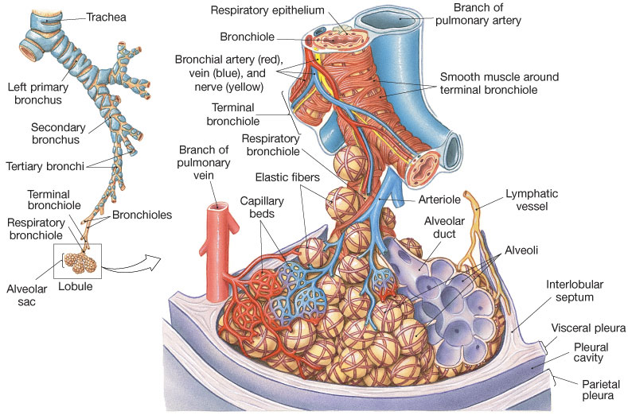
Bronchi and Bronchioles

