Slide 1
Blood Vessels
Arteries
Arterioles
Ventricles
Heart!
Capillaries
Atria
Venules
Veins

Slide 2
Structure of Arteries and Veins
Composed of 3 layers (tunics)
  Tunica Intima – simple squamous epithelium
  Called endothelium! (plus basement membrane C.T.)
  2. Tunica Media – sheets of smooth muscle
    Contraction – vasoconstriction
    Relaxation – vasodilation
  3. Tunica Externa – connective tissue
* Lumen – central blood-filled space of a vessel

Slide 3
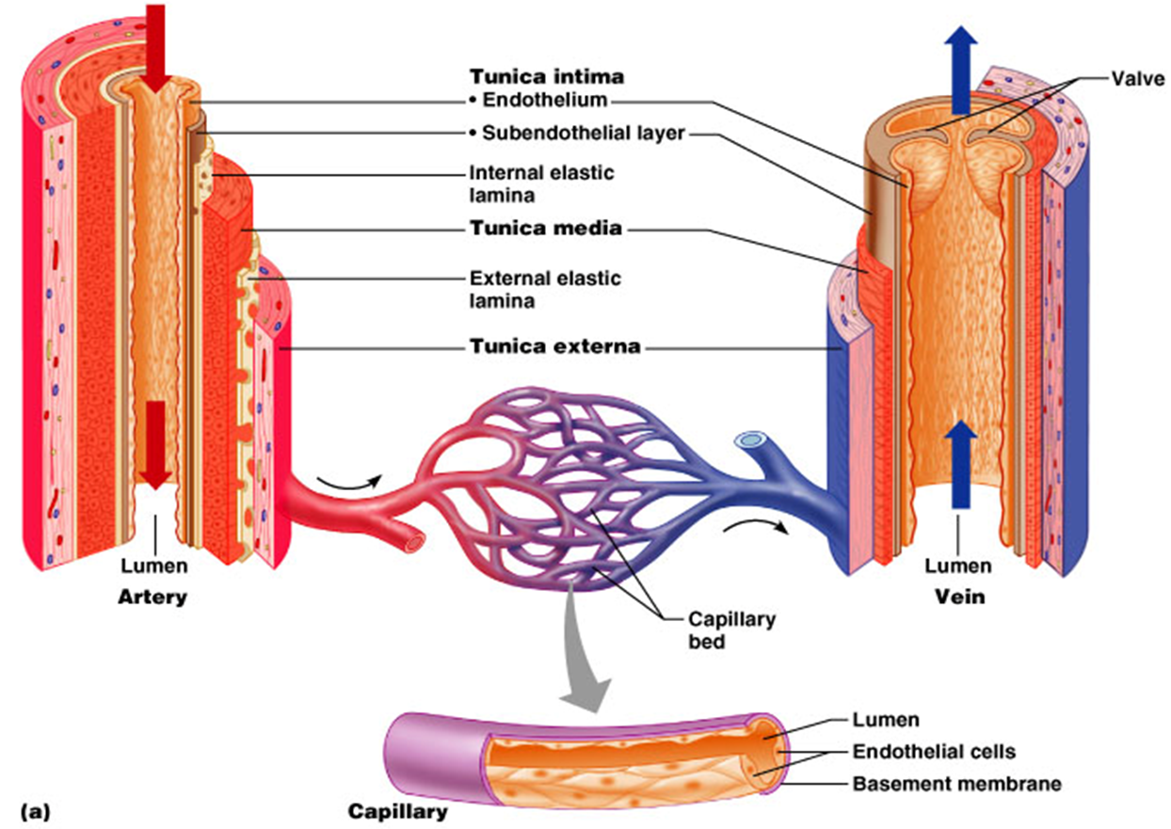

Slide 4
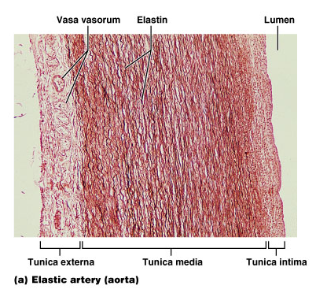
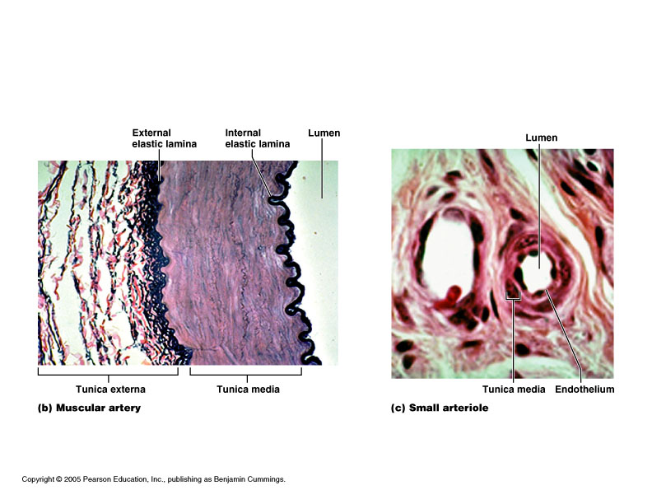
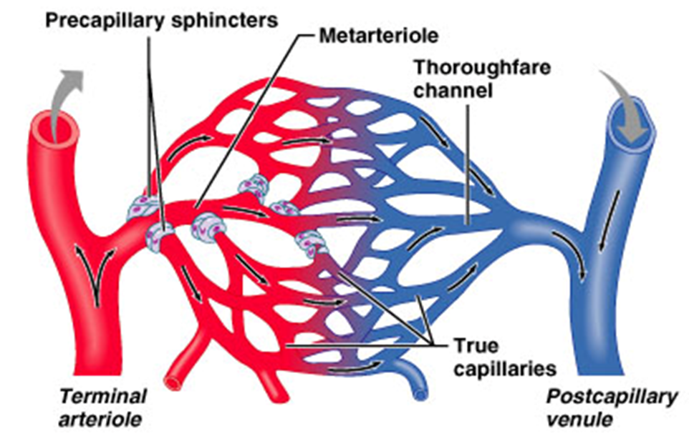

Slide 5
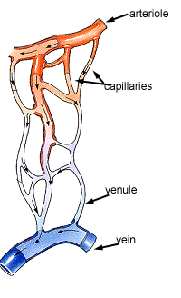
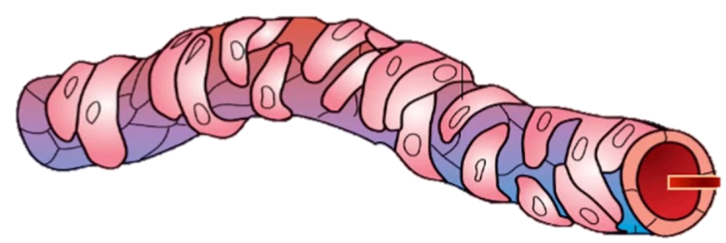
Arterioles control flow into Capillary Beds
Two layers to arterioles:
Inner endothelium
Outer smooth muscle
precapillary sphincters
Endothelial cells
Vascular Smooth Muscle (VSM)

Slide 6
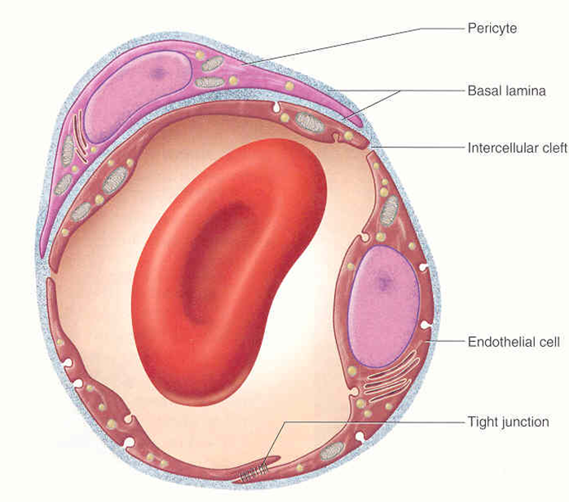
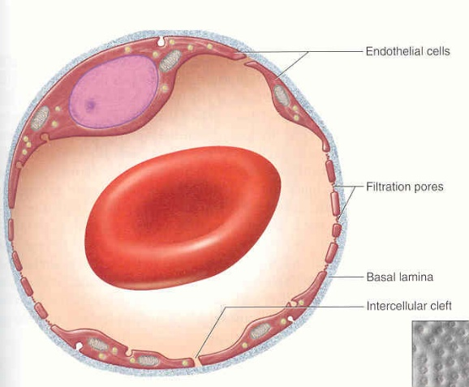
3 Types of Capillary Beds
1. Continuous Capillary Bed
- most common type in the body.
- have tight junctions
- ‘leaky’ capillaries
2. Fenestrated Capillary Bed
- have ‘pores’ or fenestrations.
- more ‘leaky’ than continuous.
- specific locations in body:
e.g., kidney, synovial joints,
hypothalamus.

Slide 7
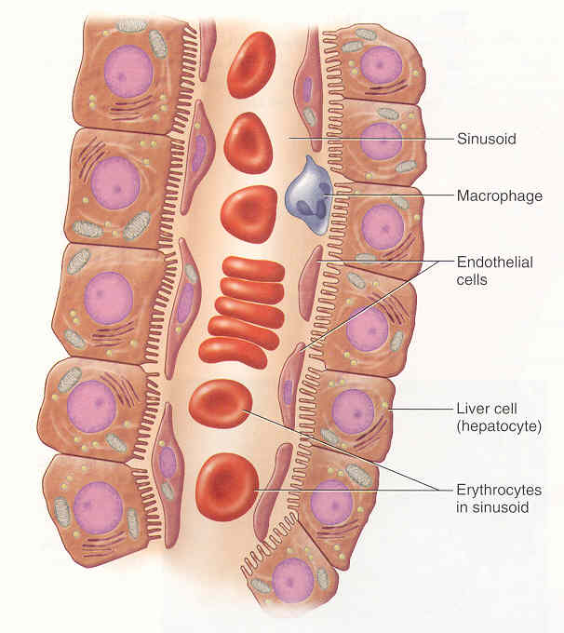
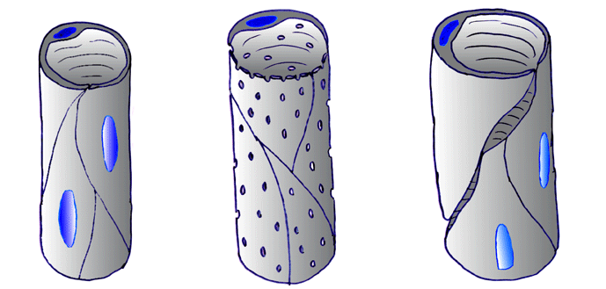
3. Sinusoidal Capillary Bed
- open ‘flaps’ in adjacent endothelial cells.
- ‘leakiest’ capillary bed.
- high degree of exchange.
- highly convoluted (twisting).
- least common in body:
e.g., liver, spleen, and red bone marrow.
Summary of the 3 types
of capillary beds

Slide 8
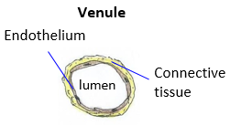
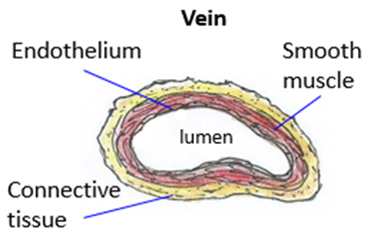
4. Venules
“Small veins” that drain and collect the blood from capillary beds to large veins.
Low pressure vessels.
Vessel wall has 2 layers:
1) Endothelium.
2) Connective Tissue (see image).
5. Veins
Carries blood back toward the heart. Veins are diametrically the larger type of vessel (have the largest lumen).
Vessel wall has 3 layers:
1) Endothelium.
2) Vascular smooth muscle (VSM).
3) Connective Tissue.

Slide 9
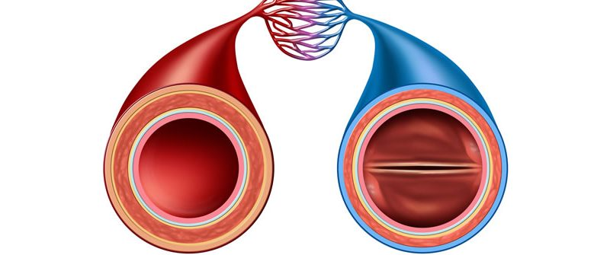
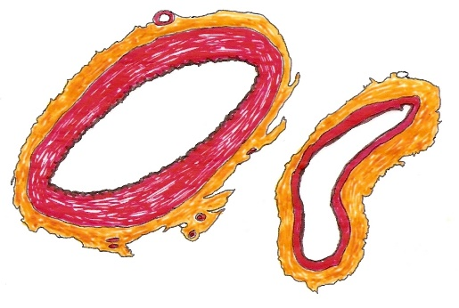
List 5 important Anatomica differences Between Arteries and Veins
1.
2.
3.
4.
5.

Slide 10
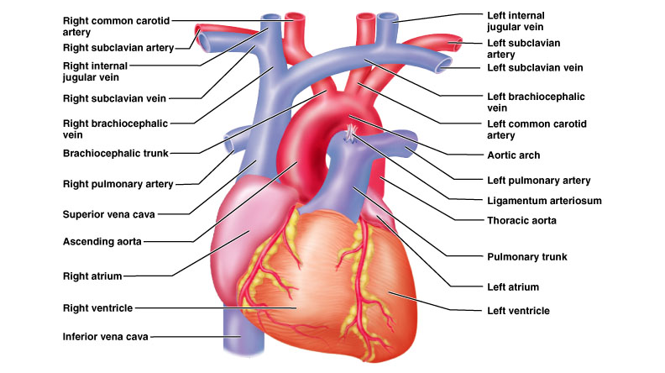
Vessels of the Heart

Slide 11
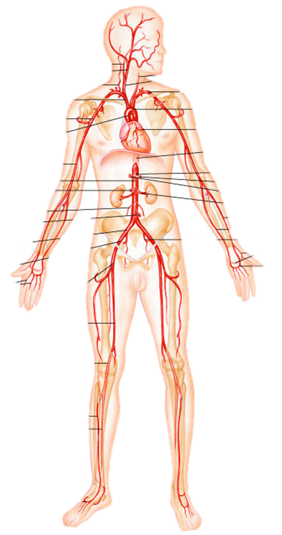
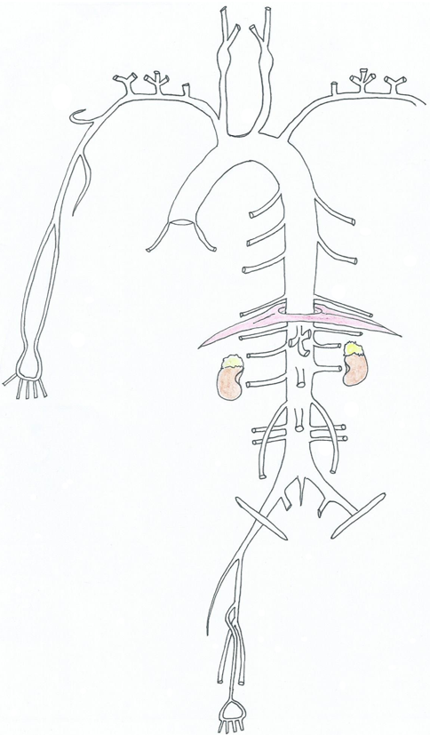
Arteries of the
Systemic Circuit

Slide 12
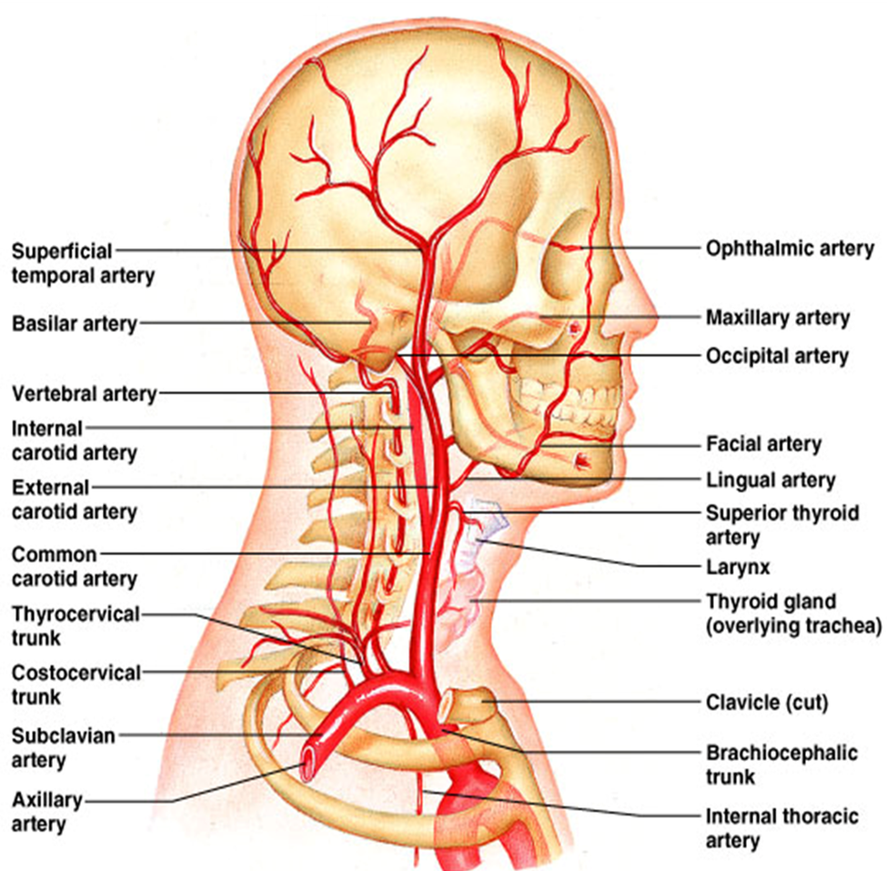
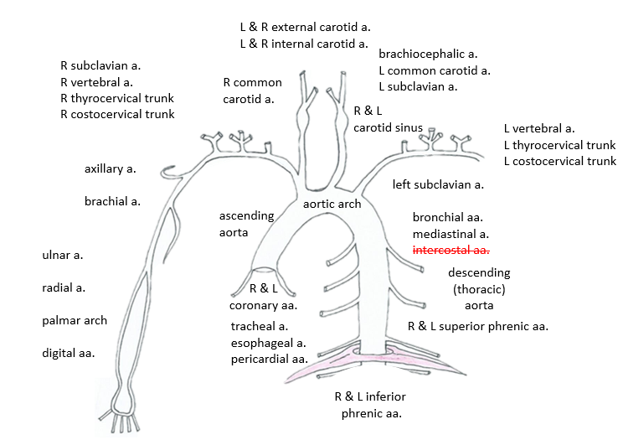
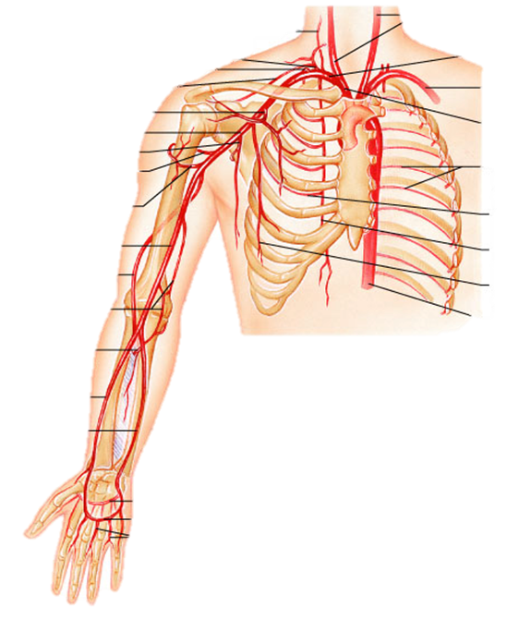
Arteries of the thorax, neck,
brachium, antebrachium and palm.

Slide 13
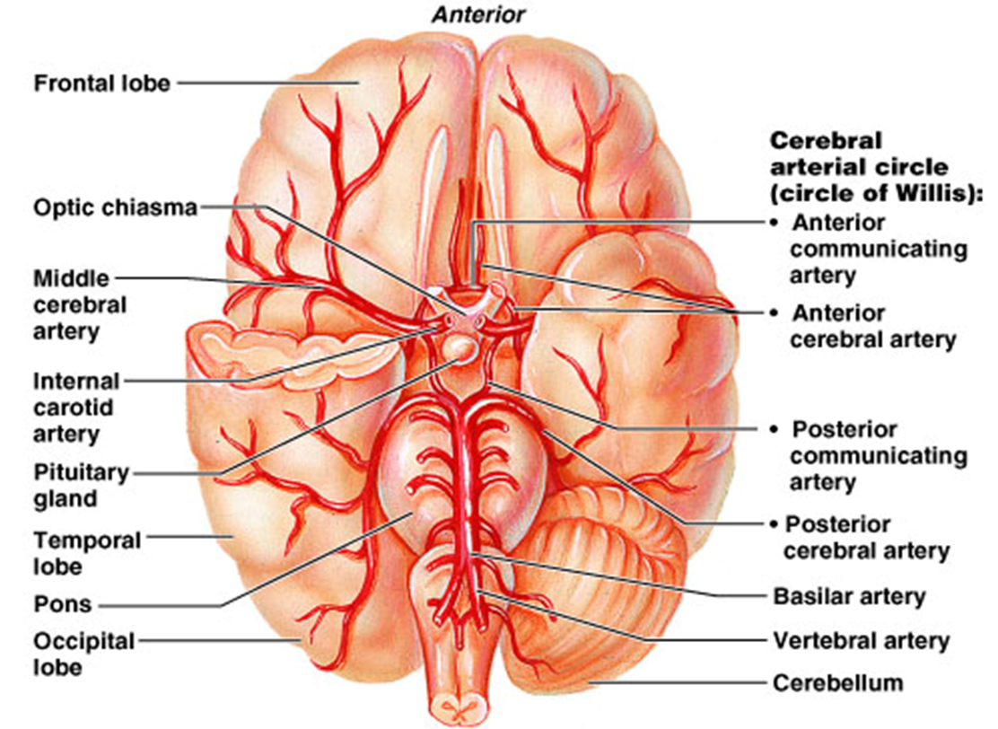
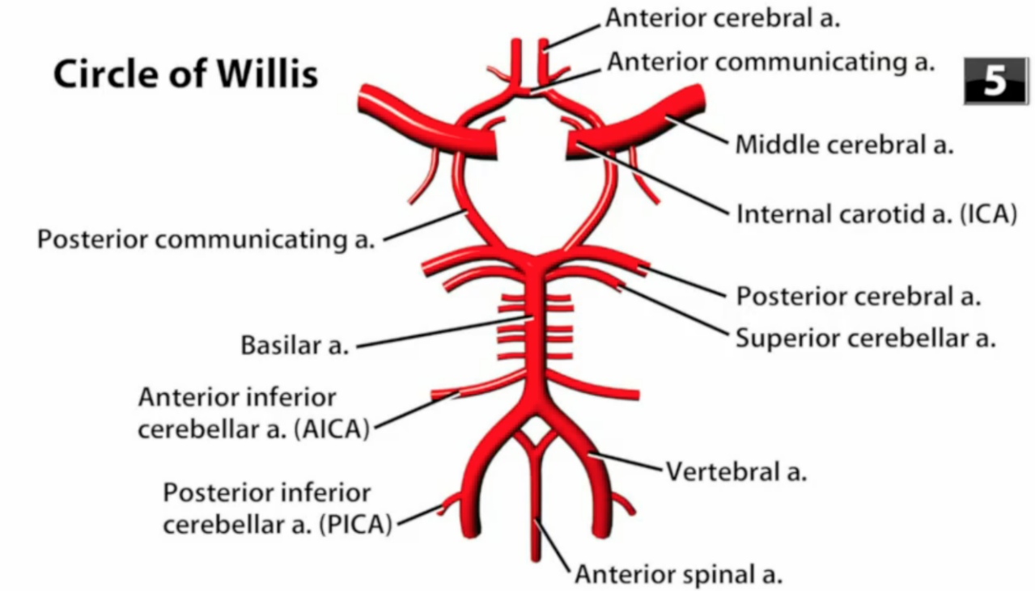
Arteries of the Brain and the Circle of Willis
Circle of Willis (or cerebral arterial circle) is a network of arteries at the base of the brain.
This circular arrangement has 2 major artery systems:
1) internal carotids
2) vertebrobasilar (vertebral and basilar) arteries
It provides a collateral and alternate blood flow to the anterior and posterior of the brain, plus the R and L cerebral hemispheres.

Slide 14
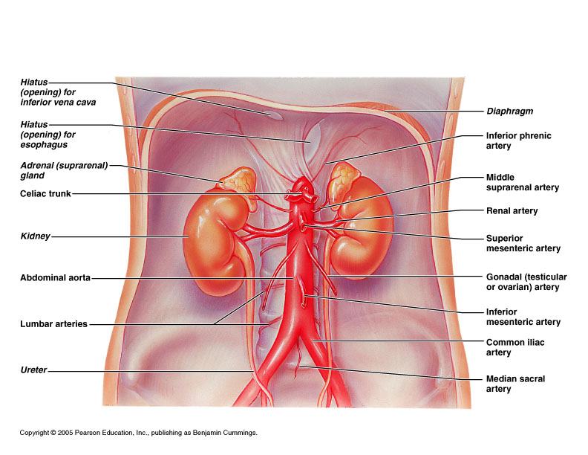
Arteries of the Abdomen

Slide 15
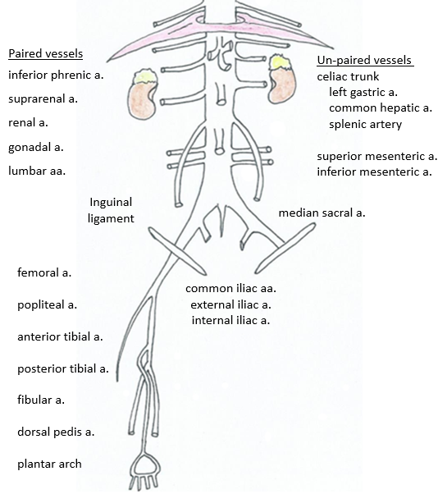
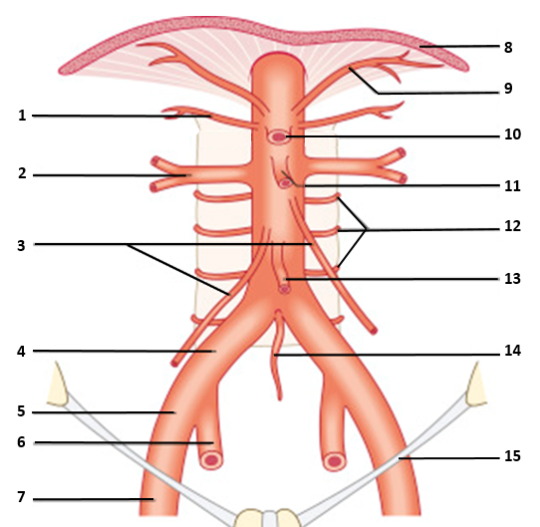
Arteries branching off the
Abdominal Aorta.
Arteries of
Lower Limb.

Slide 16
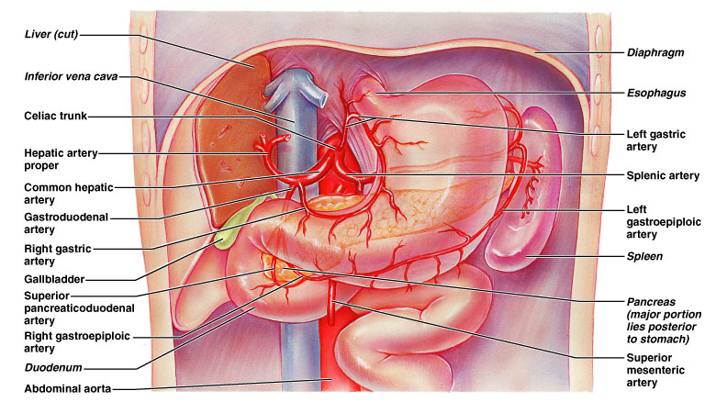
The Celiac Trunk

Slide 17
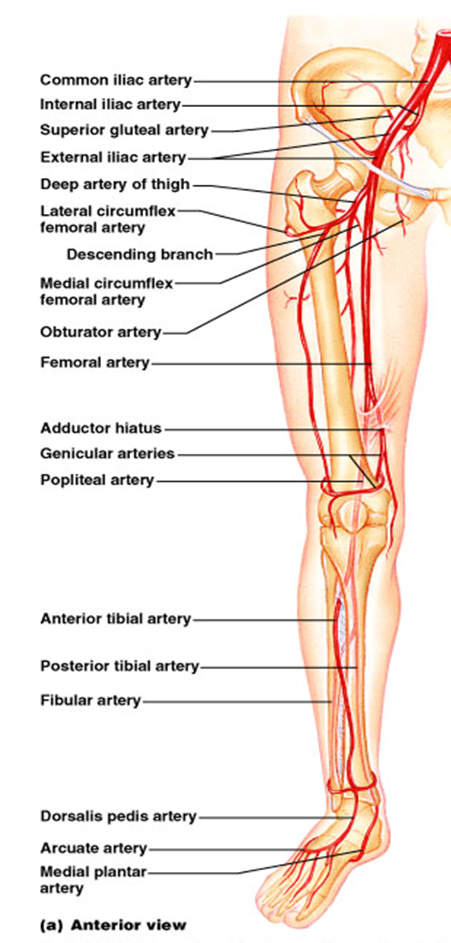
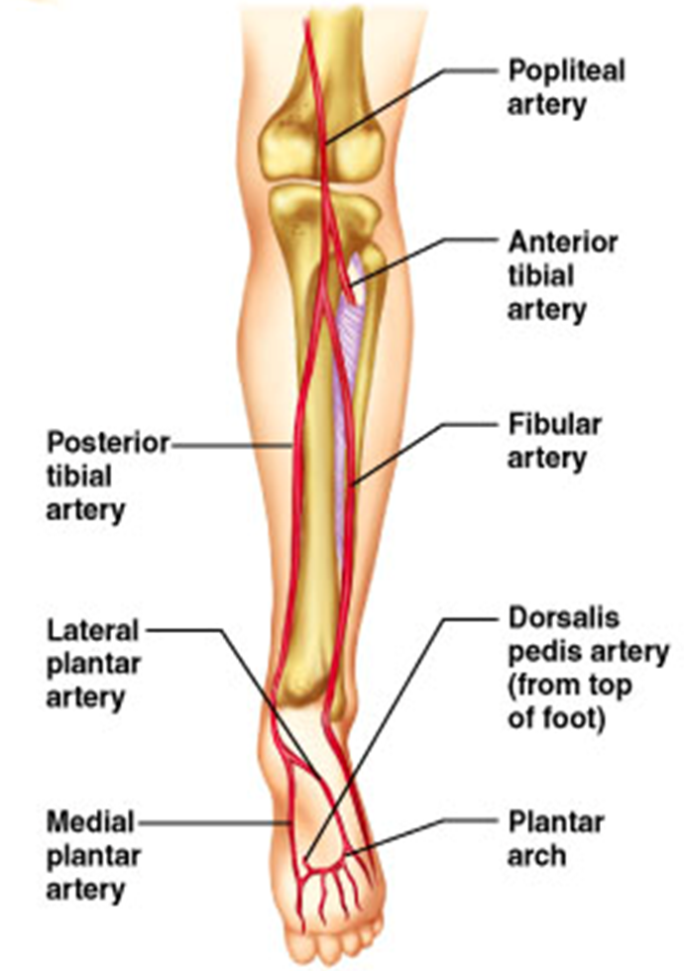
Arteries of the Hip, Thigh, Leg and Foot
Anterior view
Posterior view

Slide 18
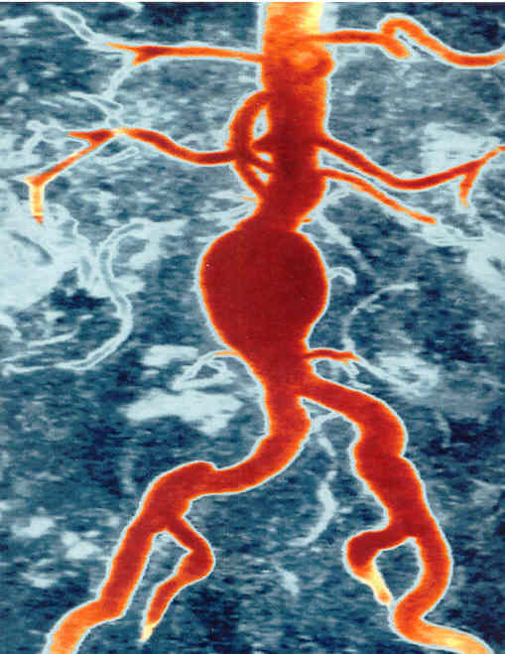
Aortic
Aneurysm
Aneurysm:
Weakening of
A vessel wall;
Results in
bulging due
to pressure in
vessel.
Poses threat of
hemorrhage.

Slide 19
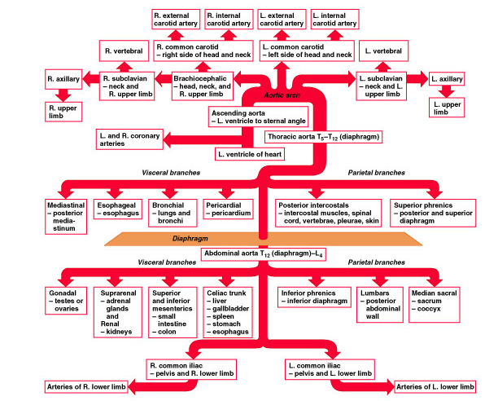

Slide 20
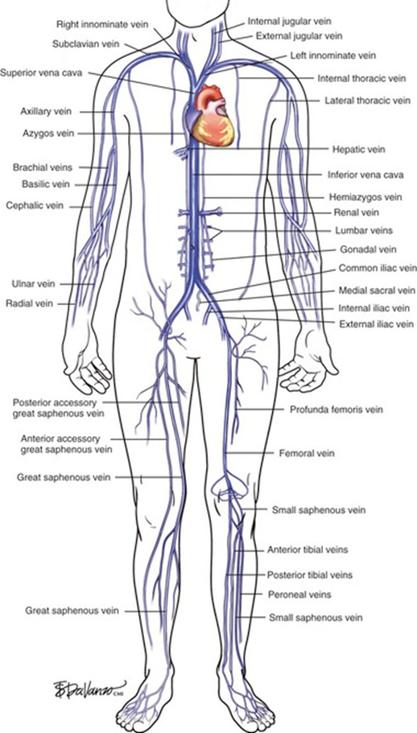
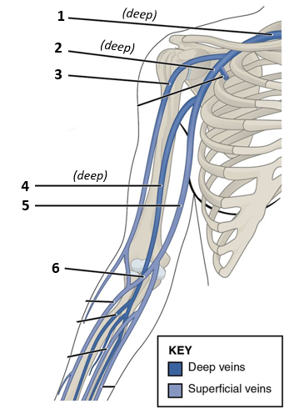
Veins of the Body
There are 2 Sets of Veins:
Deep (parallel with companion arteries).
Superficial (unique, no arterial pair).

Slide 21
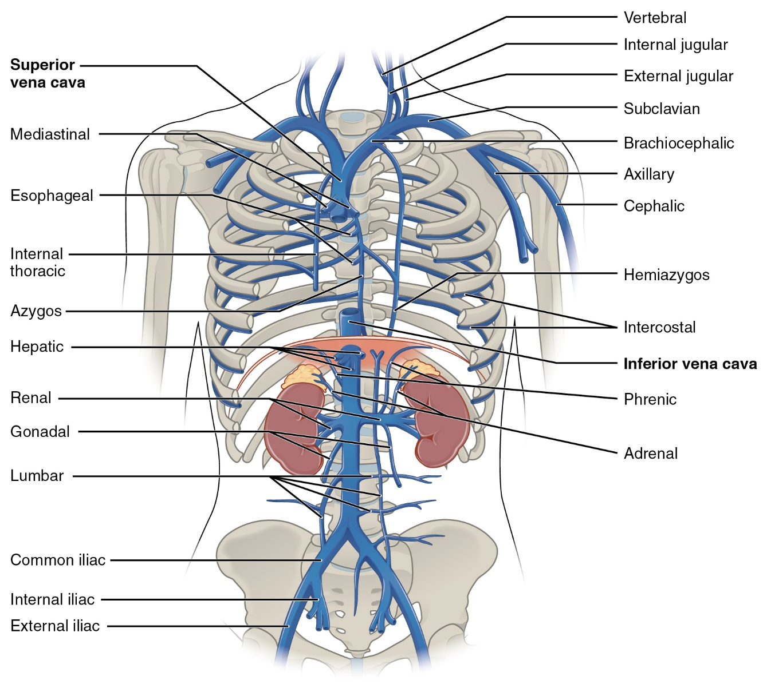
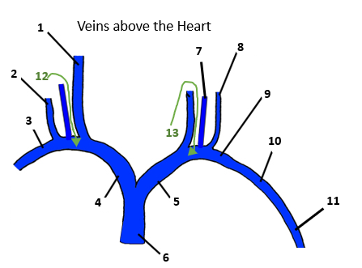
Veins of Neck, Chest, and Abdomen

