Slide 1
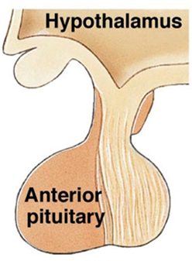
The Pituitary Gland
The hypothalamus significantly influences the pituitary gland
Posterior
pituitary
Hypothalamic releasing
and inhibiting hormones
are delivered to the
anterior pituitary
The hypothalamus makes and releases
the 2 hormones of
posterior pituitary

Slide 2
Pituitary (Hypophysis)
Posterior Pituitary – “neurohypophysis”
Anterior Pituitary – “adenohypophysis”
Posterior Pituitary – 2 hormones
①
Oxytocin (OXT)
②
Antidiuretic Hormone (ADH)
①
②

Slide 3
Anterior Pituitary – synthesizes 6 hormones.
①
Growth Hormone (GH)
(also called Somatotropin)
②
Adrenocorticotropic Hormone (ACTH)
(also called corticotropin)
③
Thyroid Stimulating Hormone (TSH)
③④⑤
⑥⑦⑧
④
Follicle Stimulating Hormone (FSH)
⑤
Luteinizing Hormone (LH)
⑥
Prolactin (PRL)

Slide 4
①
GH – is the primary hormone that regulates overall body growth, also important in general metabolism. Stimulates growth of bone, cartilage, muscle, glands, vessels, …
This hormone is also known as somatotropin.
②
ACTH – stimulates cortisol secretion from the adrenal cortex,
it is known as the ‘stress’ hormone. Also promotes growth of the adrenal cortex.
③
TSH – stimulates thyroid gland to secrete thyroxine (T₃ and T₄) and growth of the thyroid gland. An important regulator of metabolic activity in entire body, sets basal metabolic rate (BMR).

Slide 5
④
FSH – a) Females: stimulates growth and development of
ovarian follicles and thus development of the egg cell. Also
promotes estrogen secretion.
b) Males: it is required for spermatogenesis, the
production of sperm cells (spermatozoa).
⑤
LH – a) Females: responsible for ovulation, and luteinization. Regulates estrogen and progesterone levels.
b) Males:* stimulates interstitial cells (in testes) to
secrete testosterone.
*in males called ‘interstitial cell stimulating hormone’ (ICSH)
⑥
PRL – a) Females: enhances breast development & milk production
for the process of lactation.
b) Males: it enhance LH - receptors in interstitial cells increasing (testosterone) thus increasing spermatogenesis.

Slide 6
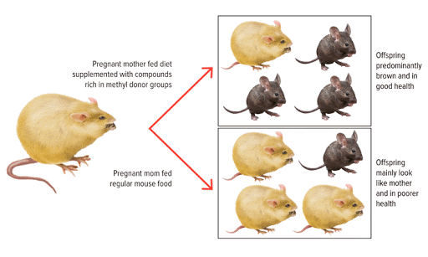
For Normal Growth and Repair
Need adequate levels of growth hormone, and other hormones.
An adequate Diet (vitamins/minerals)
Absence of Stress
Agouti Mice
Genetics can be Changed
Genotype
Phenotype

Slide 7
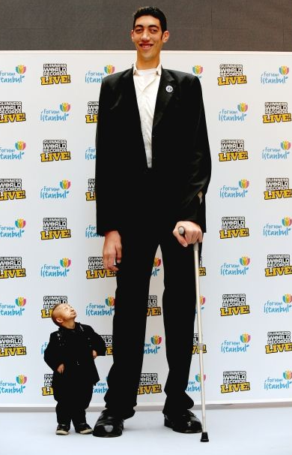
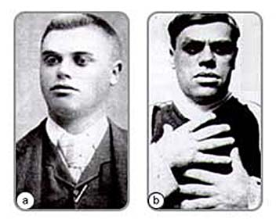
Growth Hormone
Severe GH deficiency
leads to dwarfism
(2 ft, 5.4 in)
Over secretion of GH in children leads to gigantism
(8 ft, 1 in)
Over secretion of hGH in adults leads to acromegaly

Slide 8
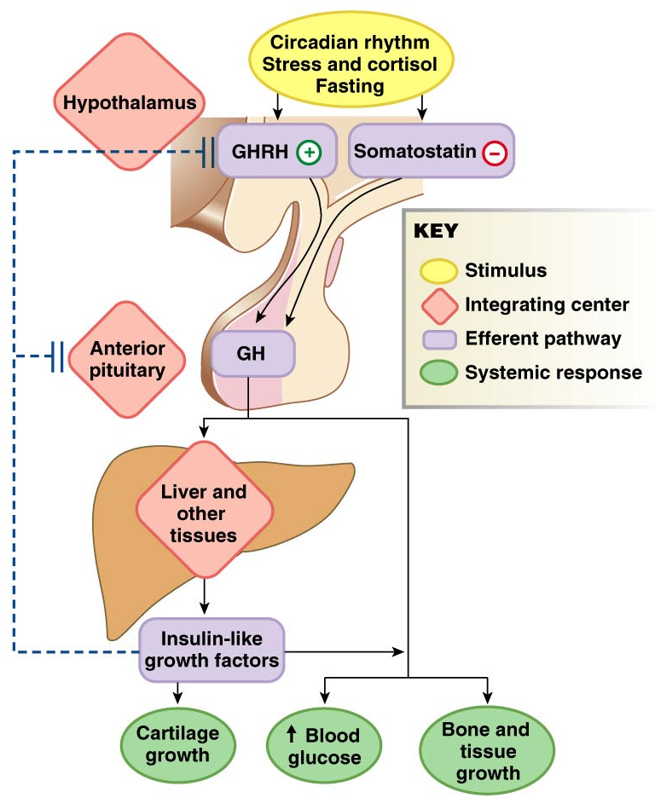
Pathway of Growth Hormone Control

Slide 9
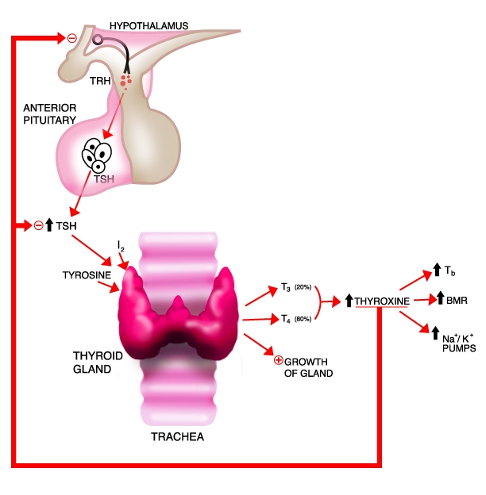
Negative Feedback Loop of
Hypothalamic-Adenohypophysis
and the Thyroid Gland
Hypothyroidism
Hyperthyroidism

Slide 10
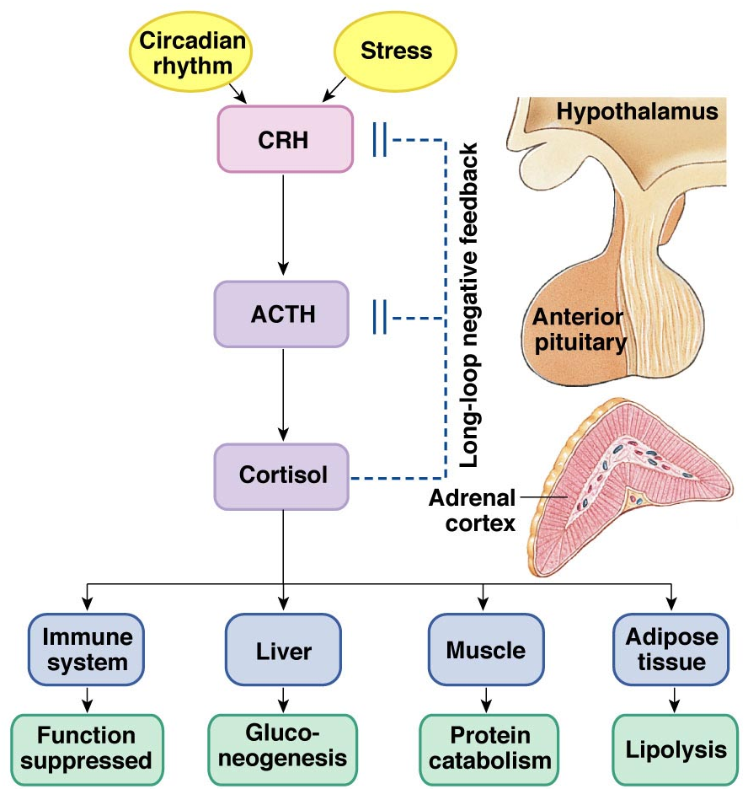
The
Cortisol
Connection
The Hypothalamus-Pituitary-Adrenal Axis
(HPA)

Slide 11
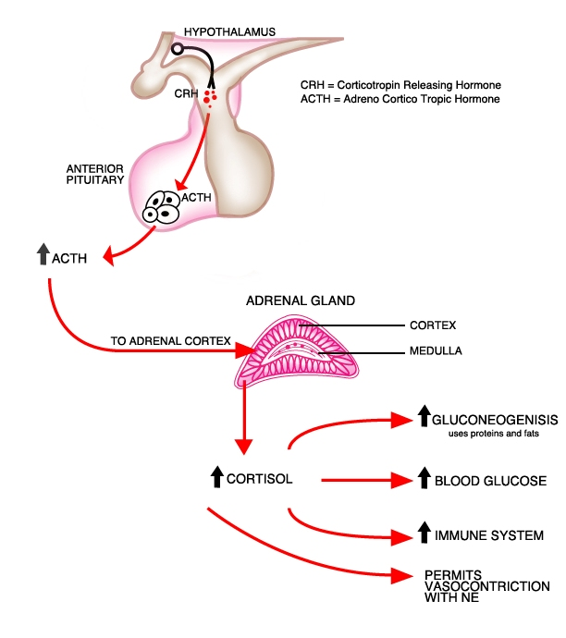
CRH = Corticotropin Releasing Hormone
ACTH = Adrenocorticotropic Hormone
GLYCOGENOLYSIS
The many functions of cortisol in the body

Slide 12
Cortisol
Promotes Gluconeogenesis
  Breakdown of skeletal muscle proteins (for fuel)
  Enhances lipolysis (‘glucose sparing’)
Elevates Blood Glucose
Permissive – needed for NE vasoconstriction
Suppresses the immune response
Response to stressors – protective?

Slide 13
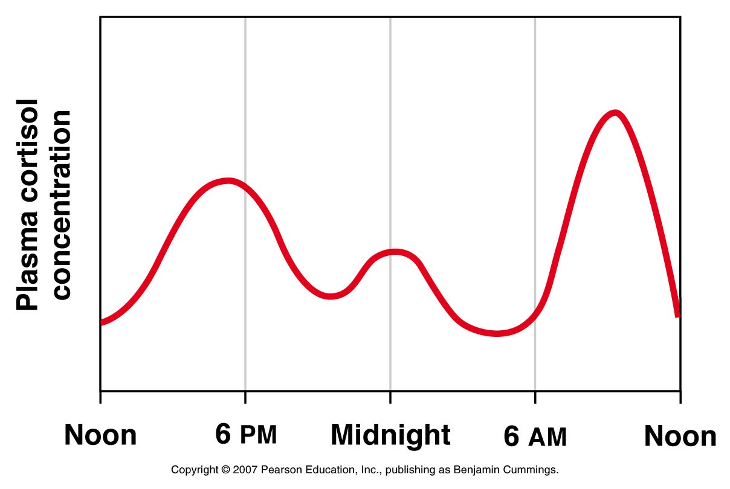
Circadian Rhythm of Cortisol Secretion

Slide 14
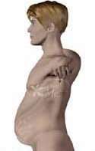
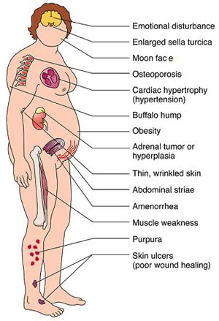
Hyper-Cortisolism
Over secretion of cortisol or ACTH.
Pituitary disorder = ↑ ACTH
Adrenal disorder = ↑ cortisol
Called Cushing’s Disease
Characterized by:
↑ Glucose and ↓ Protein
Loss of Muscle mass
Characteristic Fat deposits

Slide 15
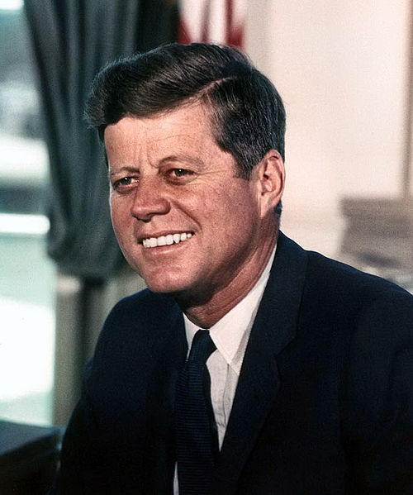
Hypo-Cortisolism
  Under secretion of adrenal steroid hormones
  e.g., Autoimmune destruction of adrenal cortex
Called Addison’s Disease
Characterized by:
↓ Glucose (hypoglycemia)
Lack of Vasoconstriction
Causes Low Blood Pressure
(Orthostatic Hypotension)
Poor response to stress
Fatigue and muscle weakness
Increased Melanocyte-Stimulating Hormone (MSH)
(darkens specific areas skin)

Slide 16
Hormone Interactions Discussed
Antagonistic – one hormone having the opposite effect of another.
e.g. Insulin and glucagon
Parathyroid Hormone and Calcitonin
Parathyroid hormone increases blood calcium (by stimulating osteoclasts).
Calcitonin (released by the thyroid gland) decreases blood calcium (by stimulating osteoblasts).
Synergistic – two or more hormones having greater effect together than their sum separately.
e.g. Testosterone and FSH
Prolactin and Oxytocin
Testosterone and follicular stimulating hormone (FSH) promote spermatogenesis (sperm production). Prolactin promotes milk production (synthesis). Oxytocin facilitates milk ejection via myoepithelial cell contractions in mammary glands, thus they work together for lactation.
Permissive – one hormone enhances the effect of another hormone secreted later.
e.g. Estrogen and Progesterone
Cortisol and Norepinephrine
Estrogen prepares the uterus by thickening the endometrium and increase the number of receptors for progesterone. Progesterone then further increases this thickness, making the uterus receptive to implantation.

Slide 17
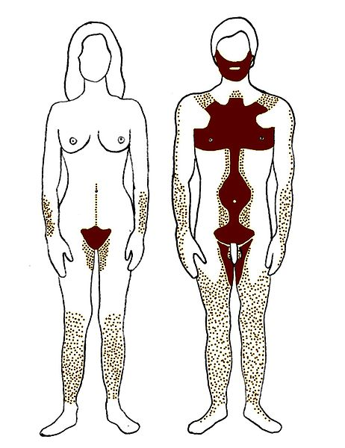
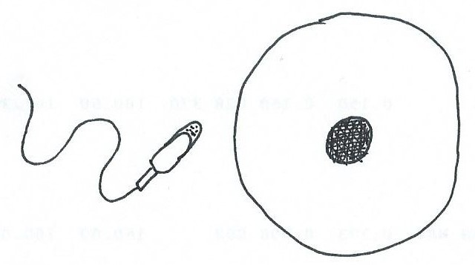
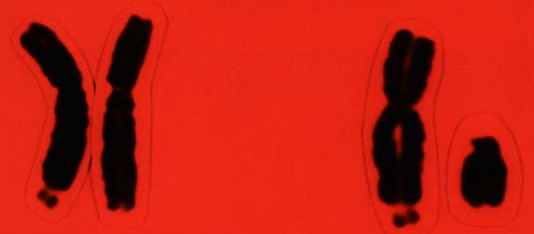
Human Reproductive System
  Produces, stores, nourishes and transports functional gametes (egg and sperm cells)
The 1º Reproductive Organs are the Gonads
  Gonads Gametes Hormones .
  Ovaries Egg cells Estrogens
  Progesterone
  Testes Sperm Testosterone
egg cell
+
sperm cell
XX XY
Female Male
When egg cell is fertilized = a zygote

Slide 18
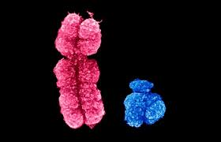

The Sex Chromosomes
  There are 22 pairs of autosomal chromosomes +
  1 pair of sex chromosomes (the X and Y).
Sex Chromosomes
XX or XY
Female Male
X chromosome has about 1,100 genes on it.
Y chromosome has about 80 genes on it.

Slide 19
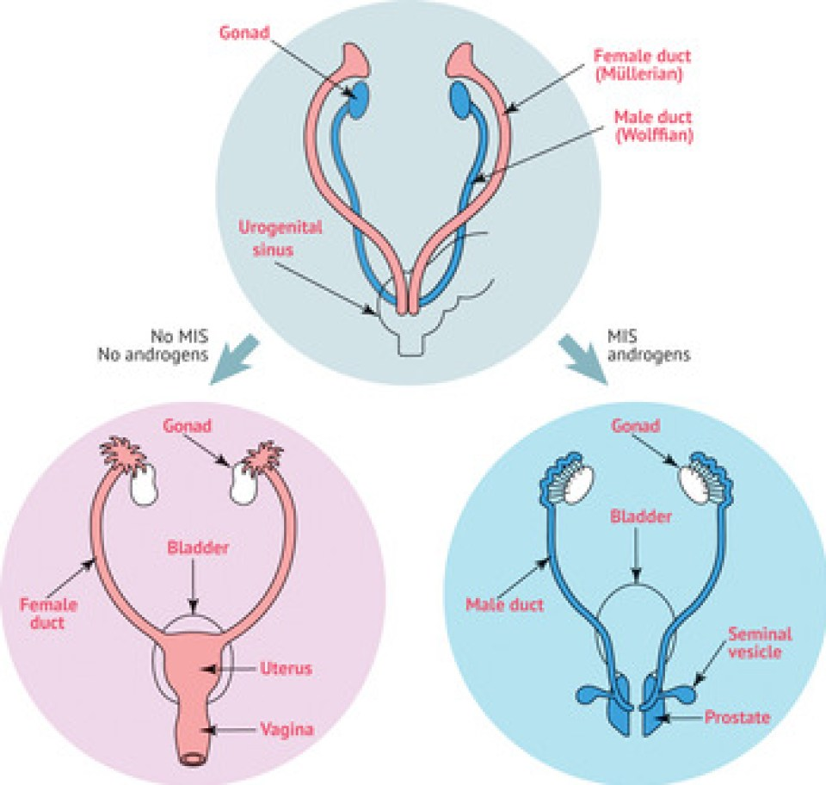
Genotype is an organism's genetic makeup (genome)
Phenotype is the physical expression of a gene code.
  If person with XY genotype has testes that fail to
  differentiate and secret testosterone, what is the result?
  = Genetic male, Phenotypic (anatomical) female.
No Testosterone
Testosterone
  If person with XY has normal testosterone levels but target tissue lacks receptors for it, what is the result? = Genetic male, Phenotypic (anatomical) female. (testicular feminization syndrome)

Slide 20
Endocrine Regulation of Reproduction
Gonadotropin-releasing hormone (GnRH)
From the Hypothalamus, stimulates FSH and LH release.
FSH:
↑ follicular development, ↑ estrogen (females). Required for sperm production (males).
  LH (ICSH in men):
  Ovulation in females.
  Regulates estrogen and progesterone (females).
  ↑ Testosterone (males).

Slide 21
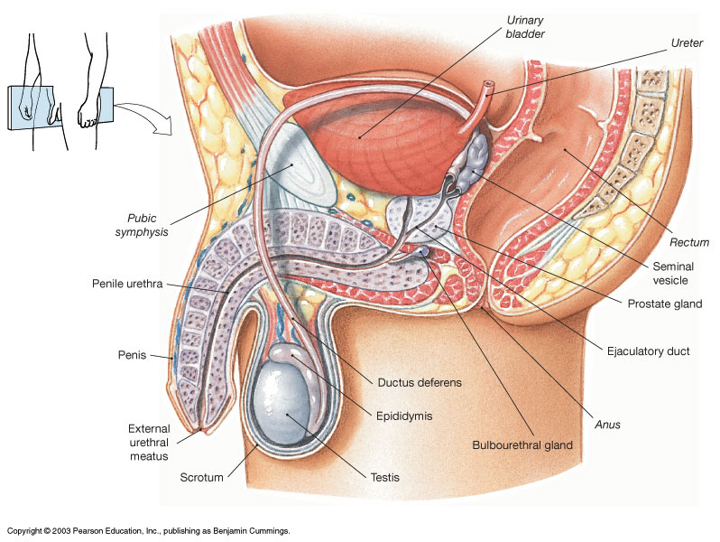
Male Reproductive System

Slide 22
The Testes
Held ‘outside’ body in scrotum to keep cooler.
Dartos and Cremaster muscles regulate temperature.
Make the Gametes = sperm cells (seminiferous tubules).
Make the Sex Hormones = Testosterone (interstitial cells).
*Sperm count typically 50 - 100 million per ml.
If below 20 million/ml, considered “infertile”.
Accessory Organs Secrete Semen
1. Seminal vesicles (60%)
2. Prostate gland (30%)
3. Bulbourethral glands (5%)

Slide 23
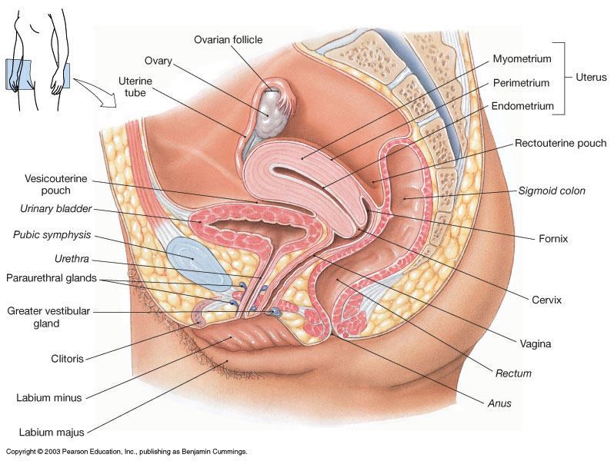
Female Reproductive System

Slide 24
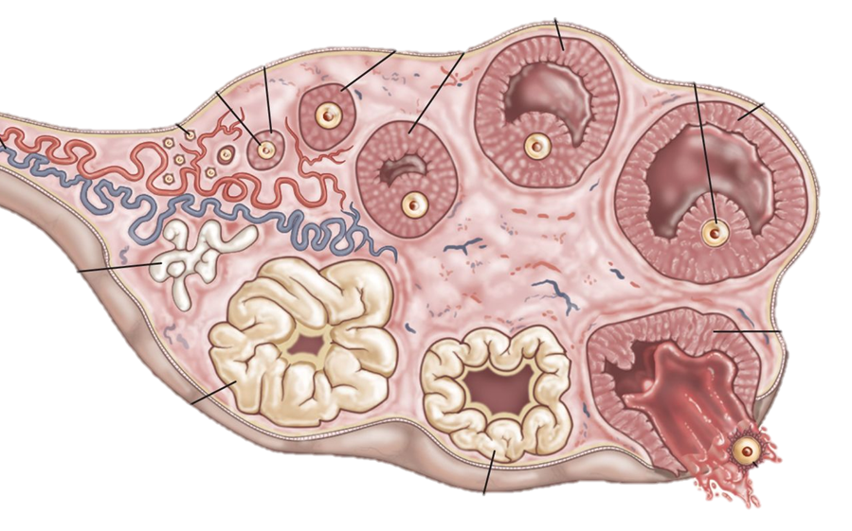
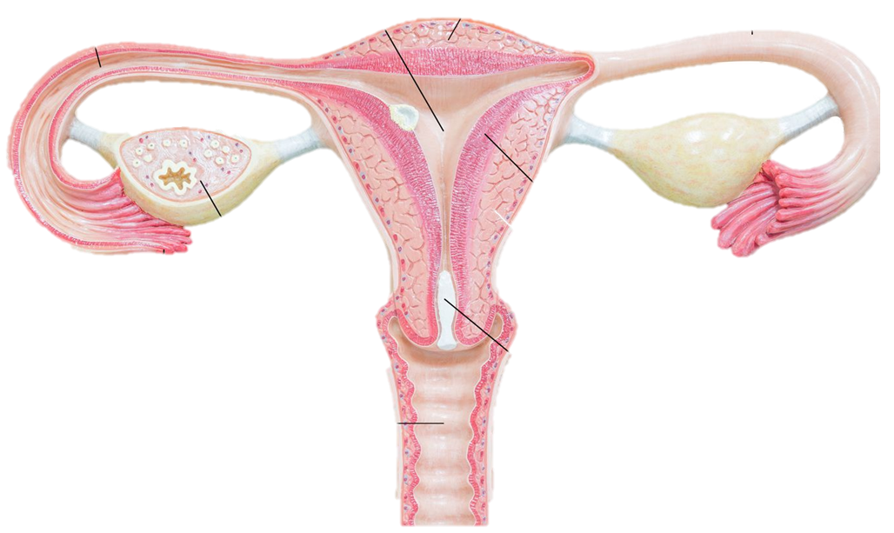
The Ovaries
Held within the pelvic cavity.
Make the Gametes = egg cells (oocyte/ova).
Make the Sex Hormones = Estrogens and Progesterone.
*Females have about 400,000 egg cells in ovary at birth.
Uterus
  Endometrium - innermost layer
  a) Functional layer, top 2/3 (sheds).
  b) Basal Layer, bottom 1/3 (remains).
  Myometrium – smooth muscular (90%). Perimetrium – outermost covering.

Slide 25
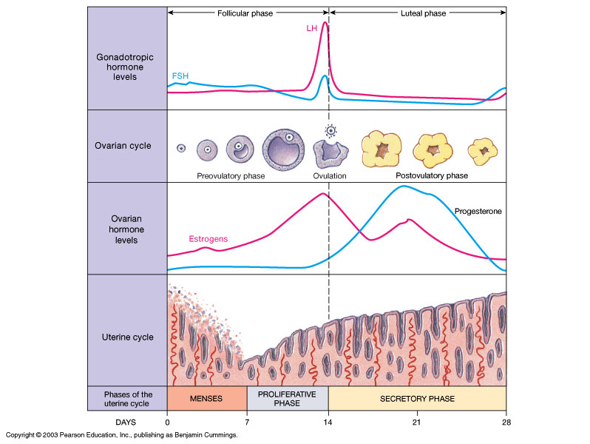

Slide 26
