Slide 1
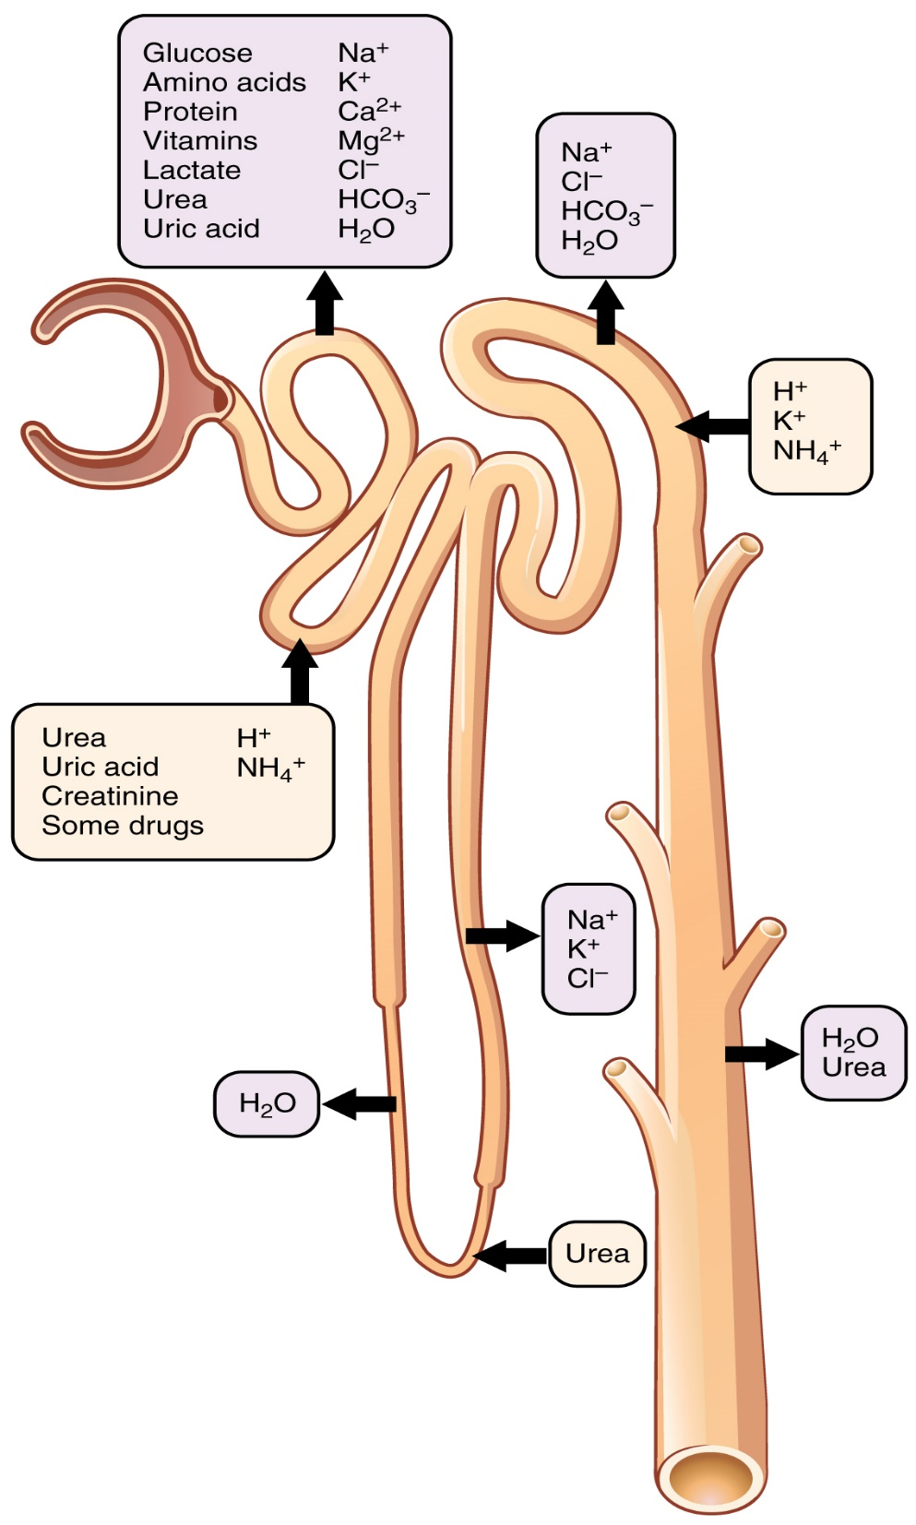
Overview of Tubular:
Reabsorption
Note: Most of the essential materials (Water, Glucose, Amino Acids, Vitamins, Lipids, small Pro⁻s, Ions, and nitrogenous waste Urea and Uric acid) are all immediately reabsorbed into the body!
Secretion
Each tubule region has specific substances that are secreted. Note: Urea and Uric Acid are both reabsorbed and secreted. Creatinine is only secreted (never reabsorbed).
Excretion
By the end of the Collecting Ducts, Filtrate is no longer modified and it becomes Urine, it is transported to and stored in the bladder.

Slide 2
Proximal Convoluted Tubule
Active Reabsorption
  Nutrients (glucose, amino acids, vitamins, lipids)
  Water and Ions (K⁺, Na⁺, Cl⁻, Ca²⁺, Mg²⁺, HCO₃⁻…)
  Small plasma proteins
  Some urea and uric acid
~___% of Filtrate is
reabsorbed in PCT
Question: How are these Reabsorbed?

Slide 3
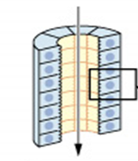
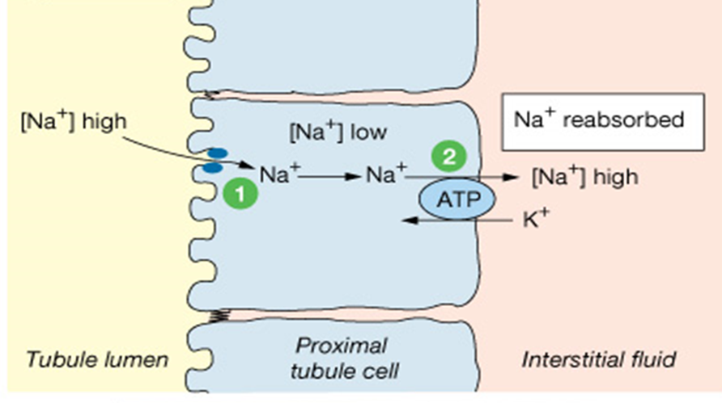
Na⁺ is Actively Reabsorbed
Reabsorption of Na⁺:
Filtrate inside PCT
First – simple diffusion:
Then – 1º active transport:
1) Na⁺ enters cell via open channels going down its gradient (diffusion).
2) Then the Na⁺ is pumped out cell at other end via the Na⁺/K⁺ pump.

Slide 4
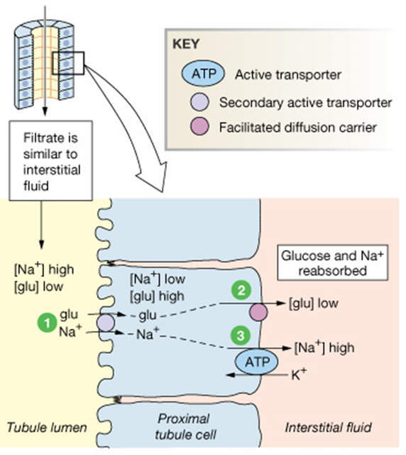
Na⁺ linked 2º Active Transport
Symport with:
  Glucose
  Amino acids
  Ions (e.g., Ca²⁺, Mg2⁺…)
1) Na⁺ going down its gradient pulls glucose into cell, against glu gradient.
2) As usual, Na⁺ is pumped out at the other end via the Na⁺/K⁺ pump.
3) Glucose diffuses out of cell (down its gradient) via carrier the pro-carriers at the other end of the cell.

Slide 5
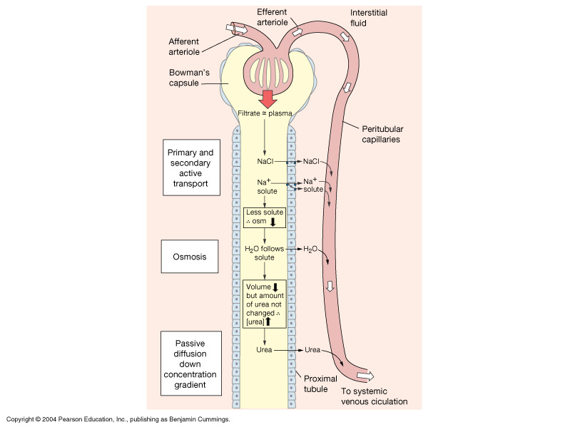
Passive Transport of:
Water - as Na⁺ pumped out,
H₂O follows by osmosis.
Urea - as other solutes
leave lumen, the [urea]
is higher than ECF, thus it diffuses into ECF.
Note:
About ___% of the Urea
filtered is Reabsorbed.
Urea is also Secreted into the
Loop of Henle and plays a major
role in maintaining the Osmotic
(Saline) Gradient in the medulla.

Slide 6
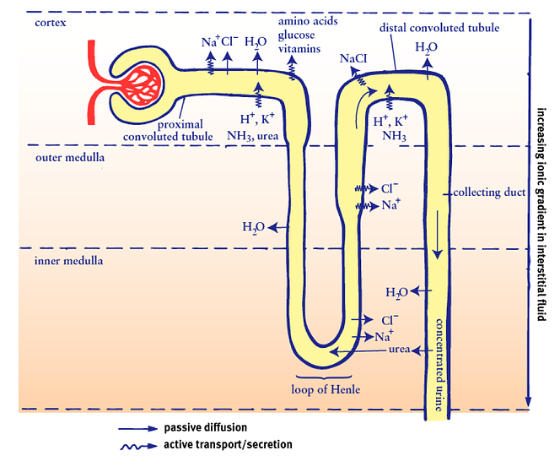
All important substances the Body needs
are Reabsorbed from Filtrate
Transcytosis of Proteins:
Small proteins are pushed into the filtrate but are then reabsorbed via vesicular transport.
Glucose, Amino Acids,
and some Vitamins are reabsorbed via protein carrier transporters

Slide 7
Protein Carrier Transporter Characteristics
  Specificity:
glucose, fructose, tyrosine, valine, etc., all have own carriers.
  Competition:
maltose binds instead of glucose – takes a seat but not transported.
This leads to the inhibition of transport of the original substrate.
  Saturation:
limited # of carriers to transport solutes back into body.
There is a limit to how fast a substance be transported. The amount of a substance can exceed renal threshold, e.g., glucosuria without diabetes mellitus.

Slide 8
H₂O Reabsorption – Loop of Henle
Much of Na⁺ is already transported out of the filtrate.
Osmolarity of ECF gets higher deeper into the renal medulla (counter current). More H₂O is drawn out of filtrate heading toward the hair-pin loop.
Filtrate becomes Very concentrated at hair-pin loop!
The ascending thick segment is impermeable to H₂O – thus now filtrate gets more and more dilute heading toward the DCT.
*Collecting duct also a key site for H₂O reabsorption (via ADH).

Slide 9
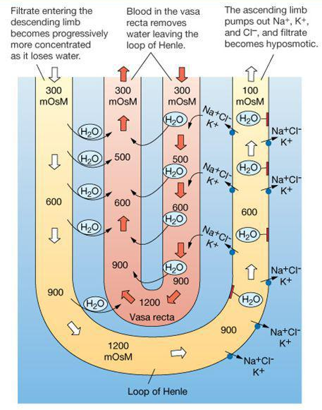
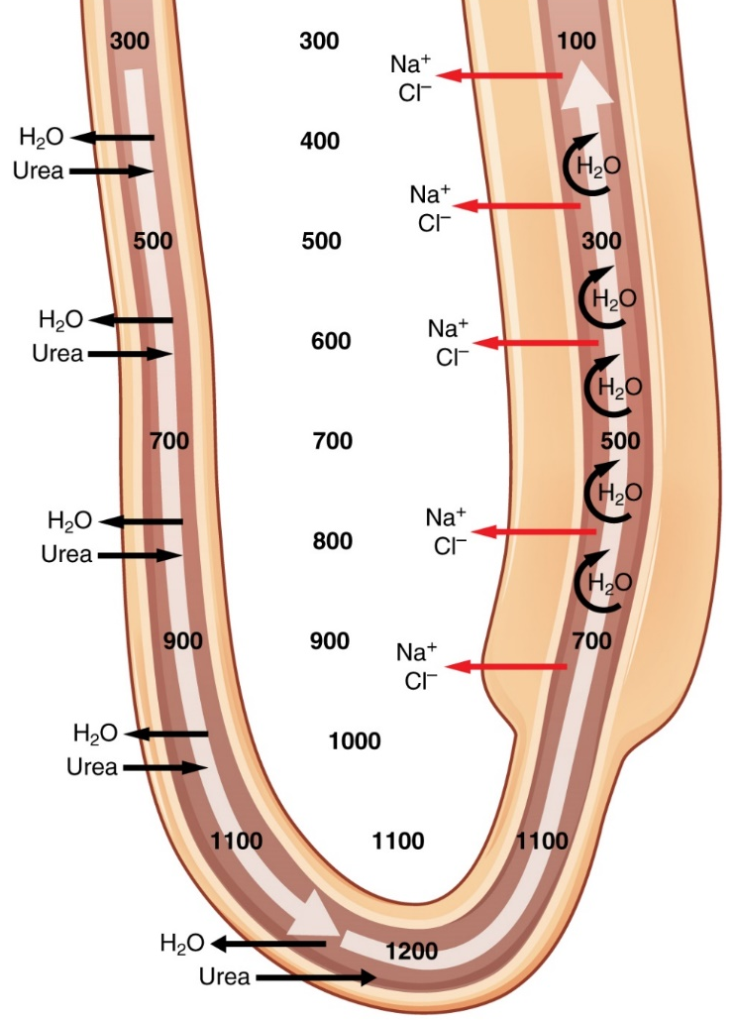
Countercurrent Multiplier System
The hair pin Loop of Henle creates the steep osmotic gradient in the renal medulla – as the concentrations of urea and NaCl multiply deep in the medulla. The adjacent loops have fluid flow in opposite (countercurrent) directions.
Ascending thick segment is impermeable
to H₂O!
Countercurrent Exchanger
Is the vasa recta arrangement which can reabsorb both H₂0 and NaCl yet can still maintain the osmotic gradient.

Slide 10
Secretion – DCT a key site.
Secretion is the active transport of thigns into the nephron tubules.
e.g., K⁺, H⁺ and NH₄⁺
Fine-tuning - eliminate unwanted items. For example, creatinine* is secreted at the PCT.
Filtrate in tubules is destined to be urine
unless reabsorbed in collecting ducts.

Slide 11
Final Modification: Collecting Ducts
Reabsorption of Na⁺.
Reabsorption of H₂O.
Under Endocrine Control – ADH (vasopressin).
After passing through the collecting duct, the
filtrate is no longer modified, now called urine.

Slide 12
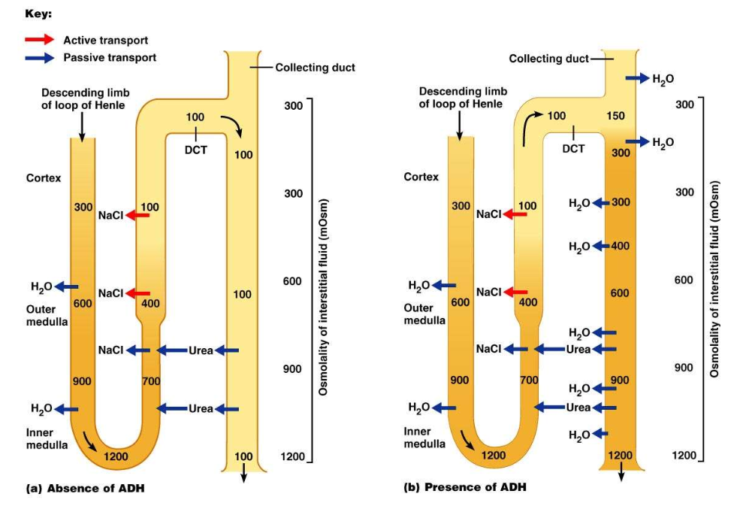

Slide 13
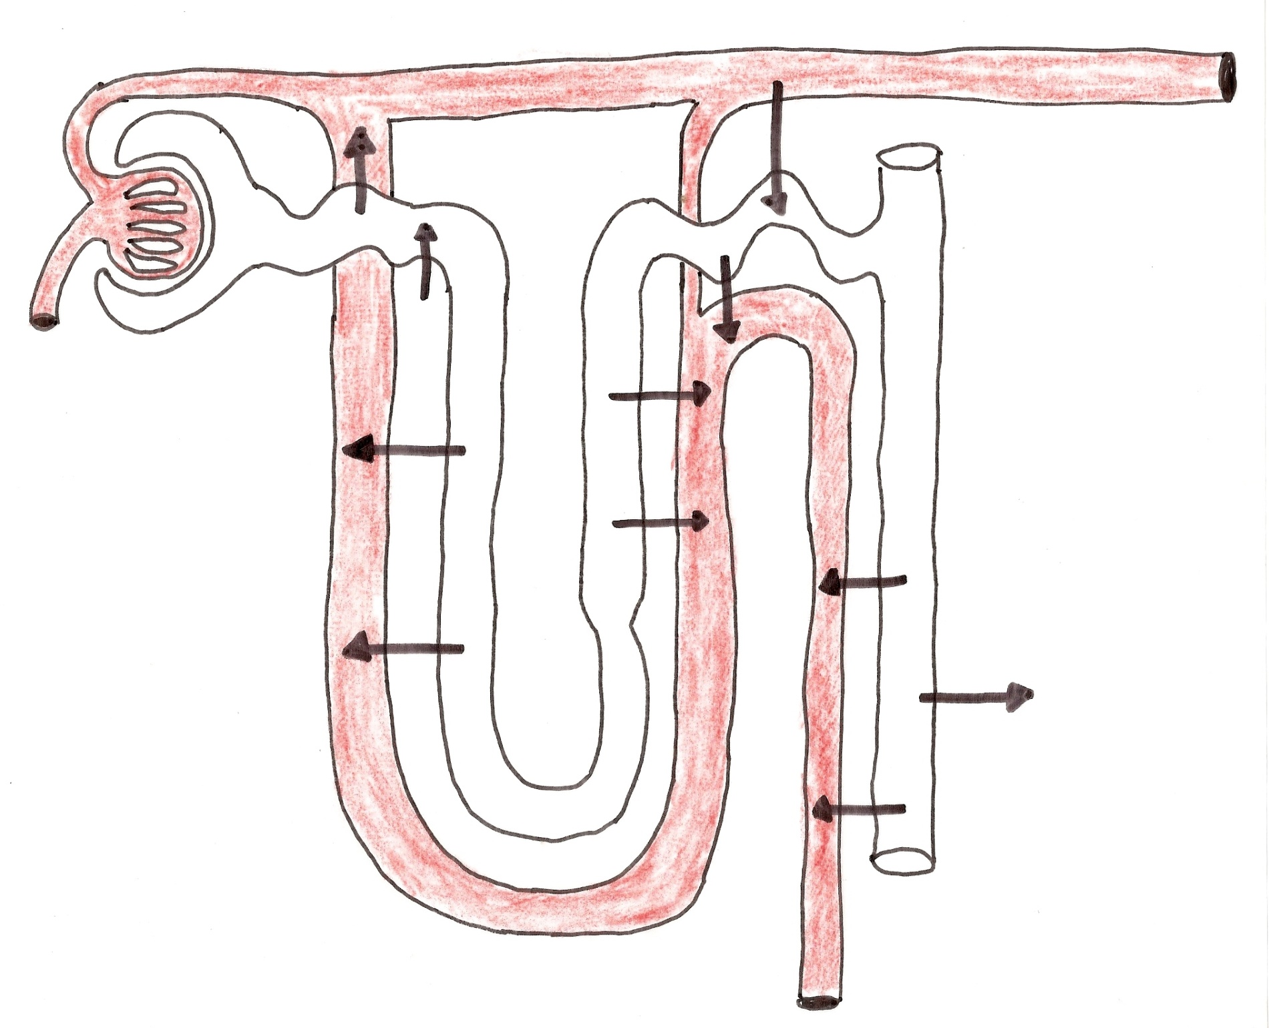
Review Overall Processes of the Nephron

Slide 14
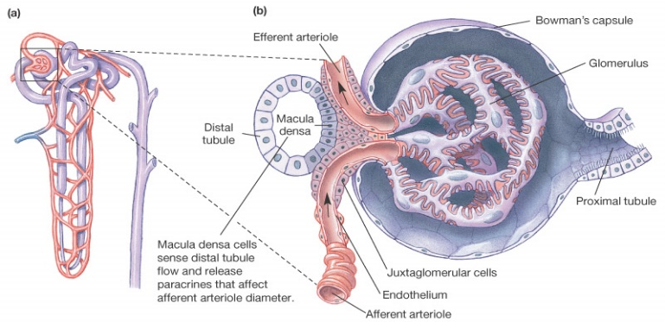
Autoregulation of Renal System
Renin-Angiotensin-Aldosterone

Slide 15
Liver
Kidneys
Lungs
Adrenal
Cortex
___________
___________ ____________ __________
_____
______________
(inactive)
____________
(activated)
_______________
(active)
Kidneys
_______________________
(_____________)
Na⁺ _______
Vasoconstriction
Reabsorption of H₂O
Thirst Stimulation
H₂O _______

Slide 16
Liver
Kidneys
Lungs
Adrenal
Cortex
Aldosterone
Angiotensin Converting Enzyme (ACE)
Renin
Angiotensinogen
(inactive)
Angiotensin I
(activated)
Angiotensin II
(active)
Kidneys
Anti Diuretic Hormone (ADH)
(Vasopressin)
Na⁺ retention
Vasoconstriction
Reabsorption of H₂O
Thirst Stimulation
H₂O retention

Slide 17
Substances Filtered and Reabsorbed by the Kidney per 24 Hours
Water | 180 L | 179 L | 1 L
Substance | Amount Filtered (grams) | Amount Reabsorbed (grams) | Amount in Urine (grams)
Proteins | 10–20 | 10–20 | 0
Chlorine | 630 | 625 | 5
Sodium | 540 | 537 | 3
Bicarbonate | 300 | 299.7 | 0.3
Glucose | 180 | 180 | 0
Urea | 53 | 28 | 25
Potassium | 28 | 24 | 4
Uric acid | 8.5 | 7.7 | 0.8
Creatinine | 1.4 | 0 | 1.4

Slide 18
Comparison of Fluids
Substance (parameter) | Blood | Plasma | Filtrate | Urine
Volume | 5.0 L | 3.0L
Rate |  |  | 180L/day | 1-2 L/day
pH | 7.35 – 7.45 | 7.35 – 7.45 | Varies | 5.5 - 7.5
Osmolarity | 295 – 310 mOsM | 295 – 310 mOsM | 100 – 1,200 mOsM | 50 – 1,200 mOsM
Cells | Yes | No | No | No
Na⁺, K⁺ | Yes | Yes | Yes | Yes
Glucose | Yes | Yes | Yes | No
Large Proteins | Yes | Yes | No | No
Small Proteins | Yes | Yes | Yes | No
Urea | Yes | Yes | Yes | Yes
Creatinine | Yes | Yes | Yes | Yes

Slide 19
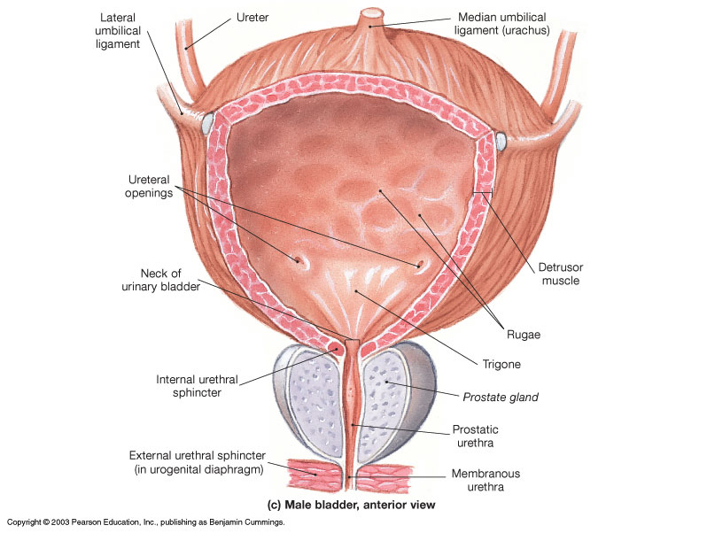
Micturition is coordinated between the central, autonomic, and somatic nervous systems. Brain centers involved are the pontine micturition center and cerebral cortex.

Slide 20
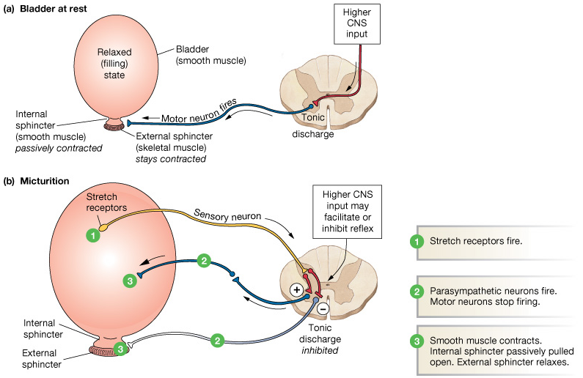
Micturition Reflex
Voiding urine mostly Para (ANS).
Stretch (mechano-) receptors detect bladder wall tension and send signals that ascend via the spinal cord projecting up to the Pons where the micturition center is located.
Cerebral integration (conscious decision to urinate) activates neurons of the pontine micturition center, excites sacral neurons (preganglionic) activating Para pelvic nerves (S₂₋₄) a releasing ACh which binds to M₃ receptors on detrusor muscle causing contraction of bladder & increased pressure.
Combined with conscious relaxation of the external urethral sphincter (cerebrum), this allows voiding of urine.
*In males, the pons inhibits Sym innervation of internal urethral sphincter causing relaxation.

Slide 21
Renal Failure
When kidney function is disrupted to the point they are unable to perform their normal regulatory and excretory functions sufficient to maintain homeostasis.
Acute – sudden onset with rapid reduction in urine formation
(less than 500ml/day minimum being excreted).
Chronic – slow, progressive, insidious loss of renal function.
Up to ___% of function can be lost before detected.

Slide 22
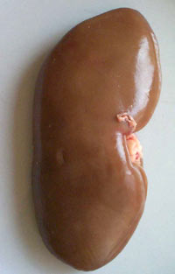
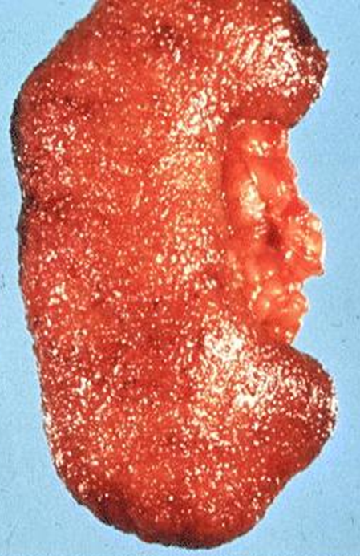
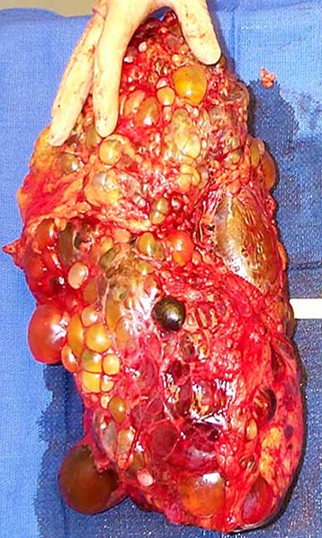
Normal
Healthy
Kidney
Polycystic
kidney
Enlarged
Polycystic
kidney

Slide 23
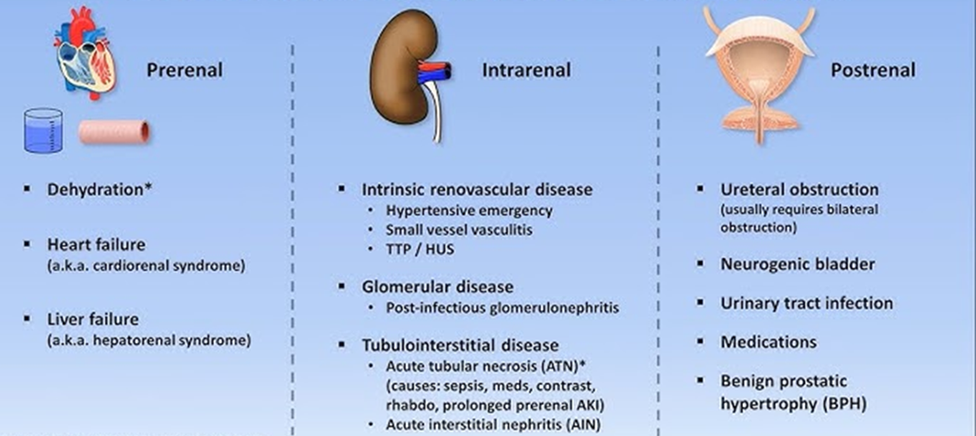
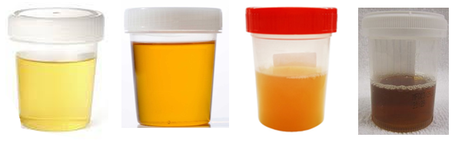
Acute Kidney Failure
Pre-renal: decreased renal perfusion (often from hypovolemia) leading to a decrease in GFR;
From dehydration,heart failure; liver cirrhosis. Reversible.
Intra-renal: intrinsic kidney damage; most common due to ischemic or nephrotoxic injury (nephritis). Also from medication damage.
Post-renal: extrinsic/intrinsic obstruction (e.g., kidney stone) of the urinary collection system.
Before During After
Can be Caused by:
Dehydration
Heart failure
(cardiorenal syndrome)
Liver failure, or cirrhosis.
(hepatorenal syndrome)
Can be Caused by:
Small vessel vasculitis
Glomerulonephritis
Medication damage
Acute tubular necrosis
Can be Caused by:
Kidney stone
Ureteral obstruction (bilateral)
Urinary tract infection (UTI)
Benign prostatic hypertrophy (BPH)
BUN = Blood Urea Nitrogen.
Normal range 6 to 20 mg/dL (1.8 to 7.1 mmol/L). BUN indication of renal health. Blood tests also check creatinine or a BUN-to-creatinine ratio.

Slide 24
Variety of Causes of Renal Failure:
1. Infectious organisms.
- Blood borne microbes
- UTI’s
2. Toxic agents.
- lead, arsenic, pesticides, additives, medications
- long-term exposure to high aspirin doses
3. Inflammatory immune response (allergic).
- glomerulonephritis, sepsis
- e.g., after strep throat (streptoccocus)

Slide 25
Variety of Causes:
4. Obstruction of urine flow.
- Kidney stone (calcium oxalate, uric acid crystals)
- Tumors
- Enlarged prostate gland
All create back pressure, decreasing GFR
5. Insufficient renal blood flow.
- 2º to heart failure
- Hemorrhage (e.g. shock)
Leads to inadequate
Filtration pressure
- Atherosclerosis

Slide 26
Potential Ramifications:
1. Uremic Toxicity
- Caused by retention of toxins/waste products in blood.
2. Metabolic Acidosis
- From inability of kidneys to secrete H⁺.
3. Potassium (K⁺) Retention
- Inability to secrete K⁺ (effects RMP).

Slide 27
4. Na⁺, Ca²⁺ and phosphate and Imbalances
- Inability of kidneys to regulate ion reabsorption
and secretion.
5. Loss of plasma proteins
- Result of increased leakiness of glomerulus.
6. Anemia
- Inadequate erythropoiten production.
7. Depressed Immune system
- Increased toxic waste and acidic conditions.

Slide 28
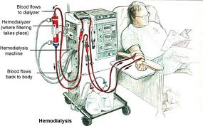
Possible Treatments for Renal Failure:
Stop or Treat the Cause
Dialysis
Kidney Transplant

