Slide 1
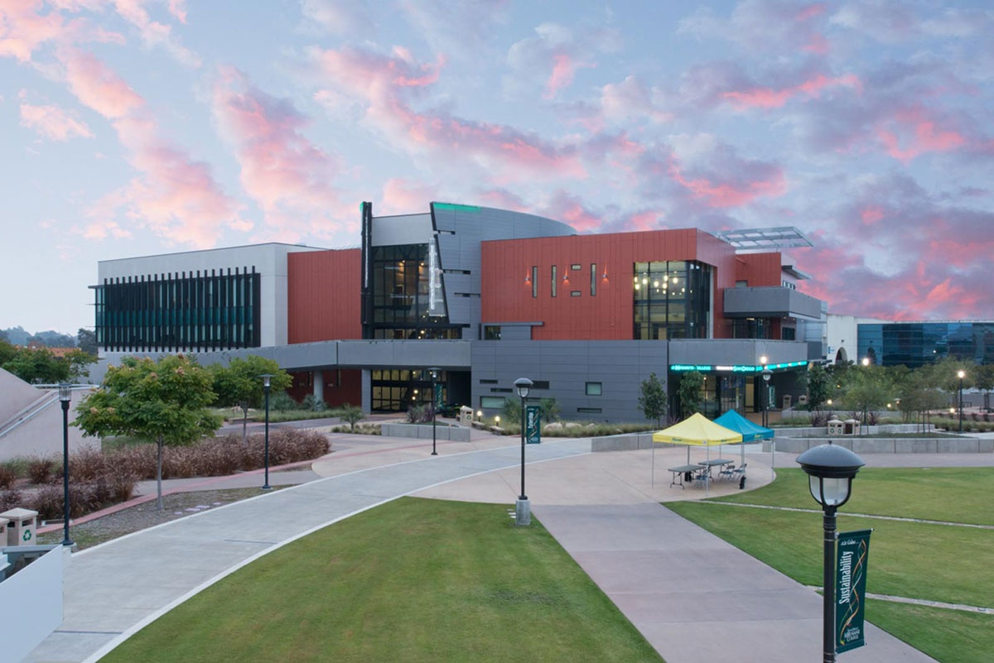
Vision 2030
and
Work-Based Learning
at Miramar College

Slide 2
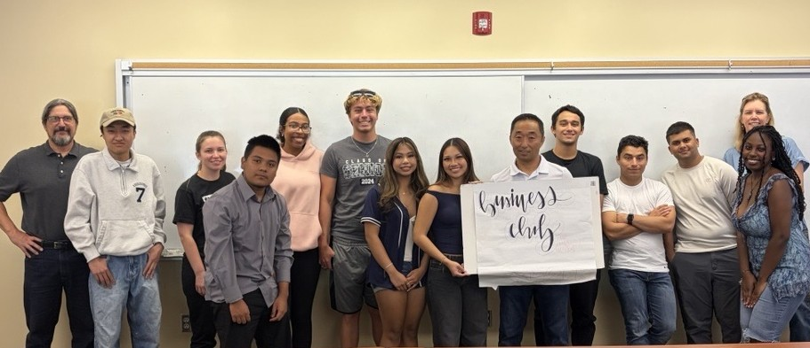
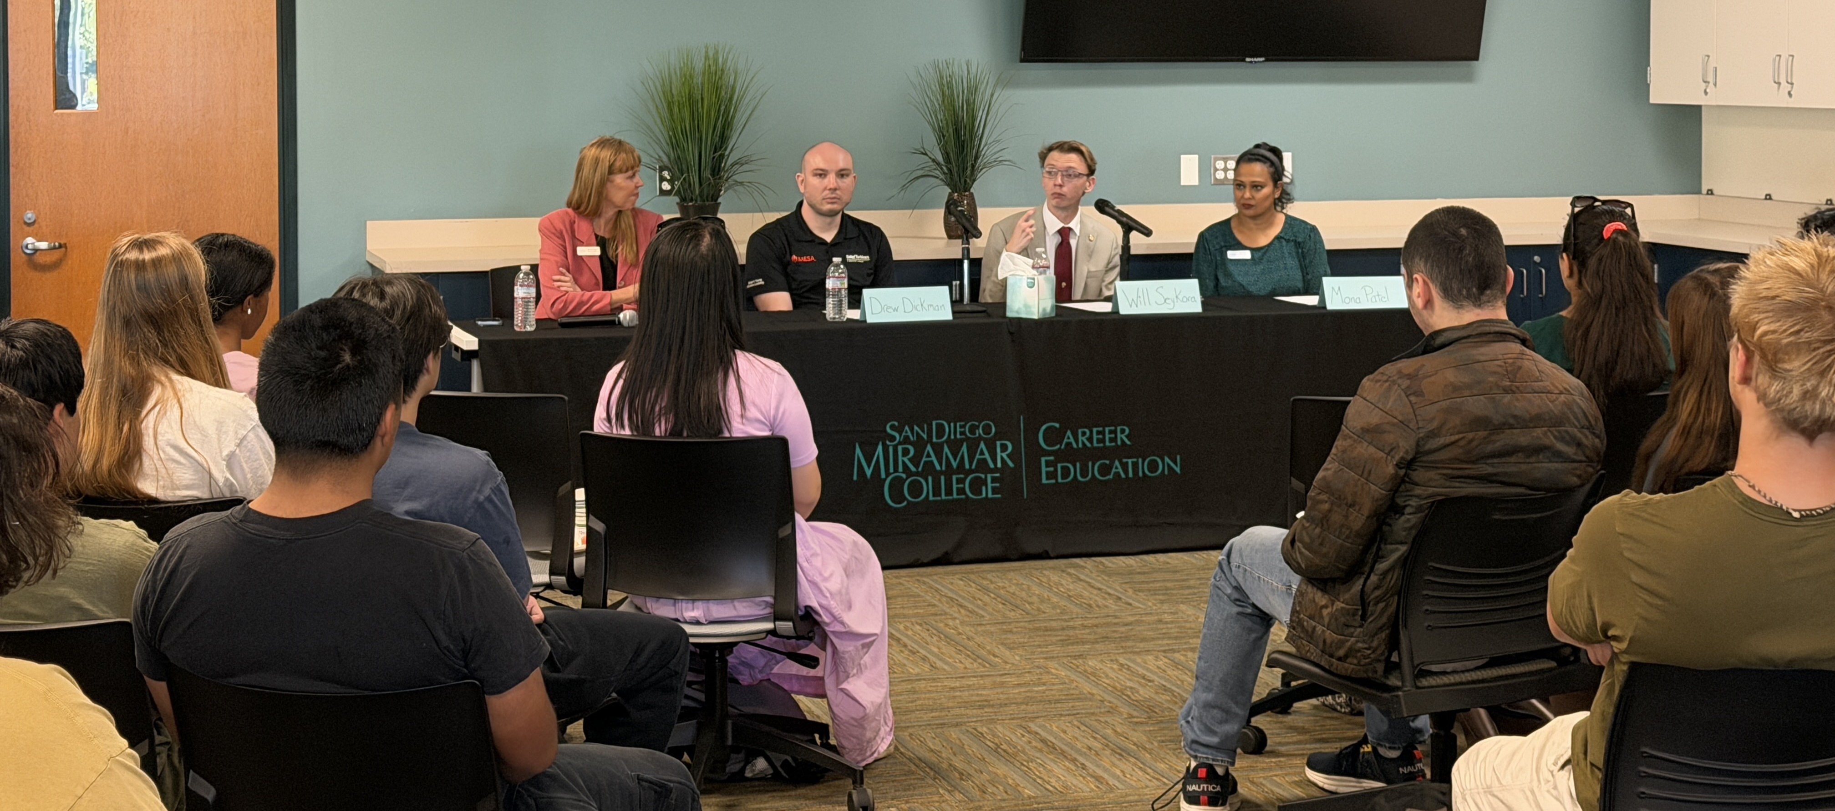
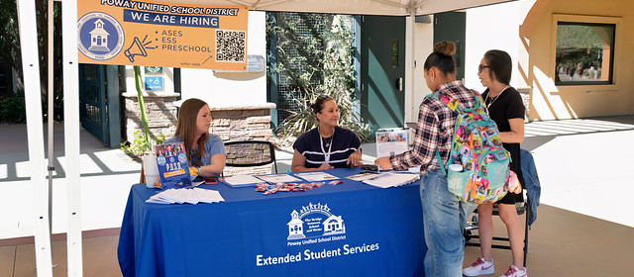
Work-Based Learning – WHAT?
Work-Based Learning (WBL) is any structured learning experience, inside or outside the classroom, that connects academic content to real-world work, helping students build career skills, explore career pathways, and prepare for future employment.

Slide 3
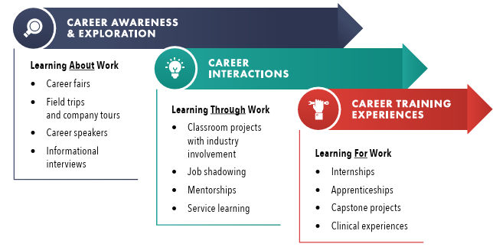
Work-Based Learning – Examples

Slide 4
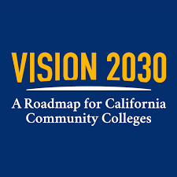
Vision 2030 & Work-Based Learning
Advancing Equity and Access
Connecting Education to Careers
Expanding Economic Mobility
Embedding Career Readiness in Pathways

Slide 5
WBL Coordinator
Institutionalize WBL & Celebrate Success
Identify & Close WBL Gaps
SG21 Reporting - New Technology
Innovative Programming
Faculty Collaboration

Slide 6
2021-2025 WBL Dashboard Data

Slide 7
Let’s Continue to Build WBL Together
“Every student should have access to work-based learning experiences that connect education to careers.”
California Community Colleges – Vision 2030
What we need from you
WBL Reporting Process
Institutional Support
Support Faculty Participation
Celebrate WBL Success Stories

Slide 8
Vision 2030
and
Work-Based Learning
at Miramar College

