Slide 1
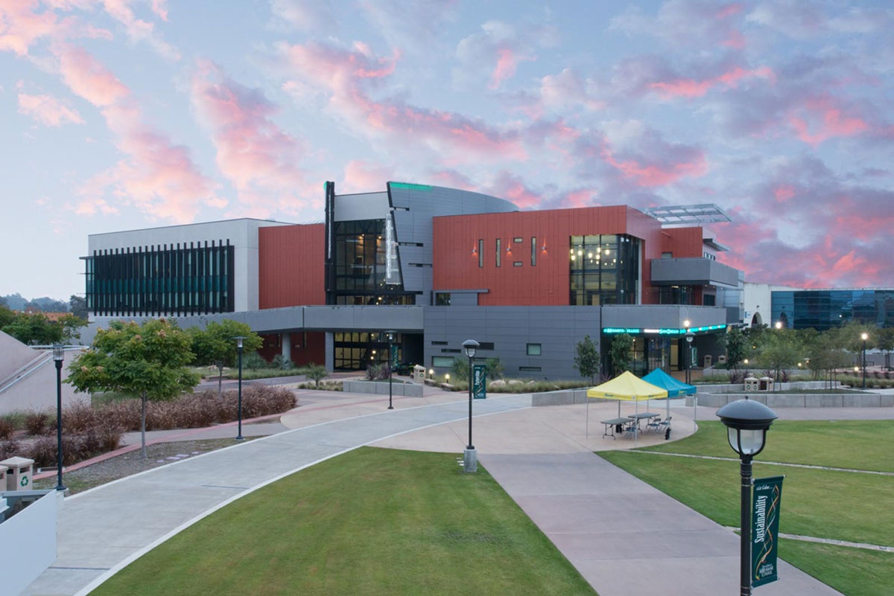
Work-Based Learning
at Miramar College

Slide 2
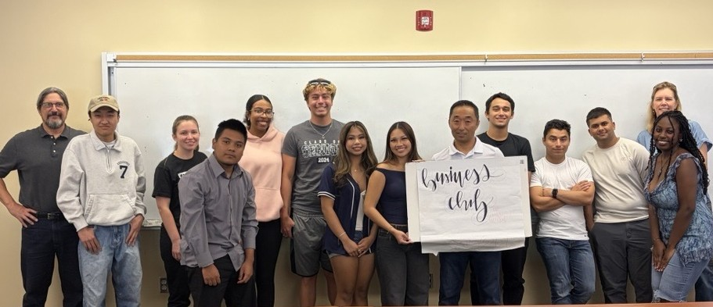
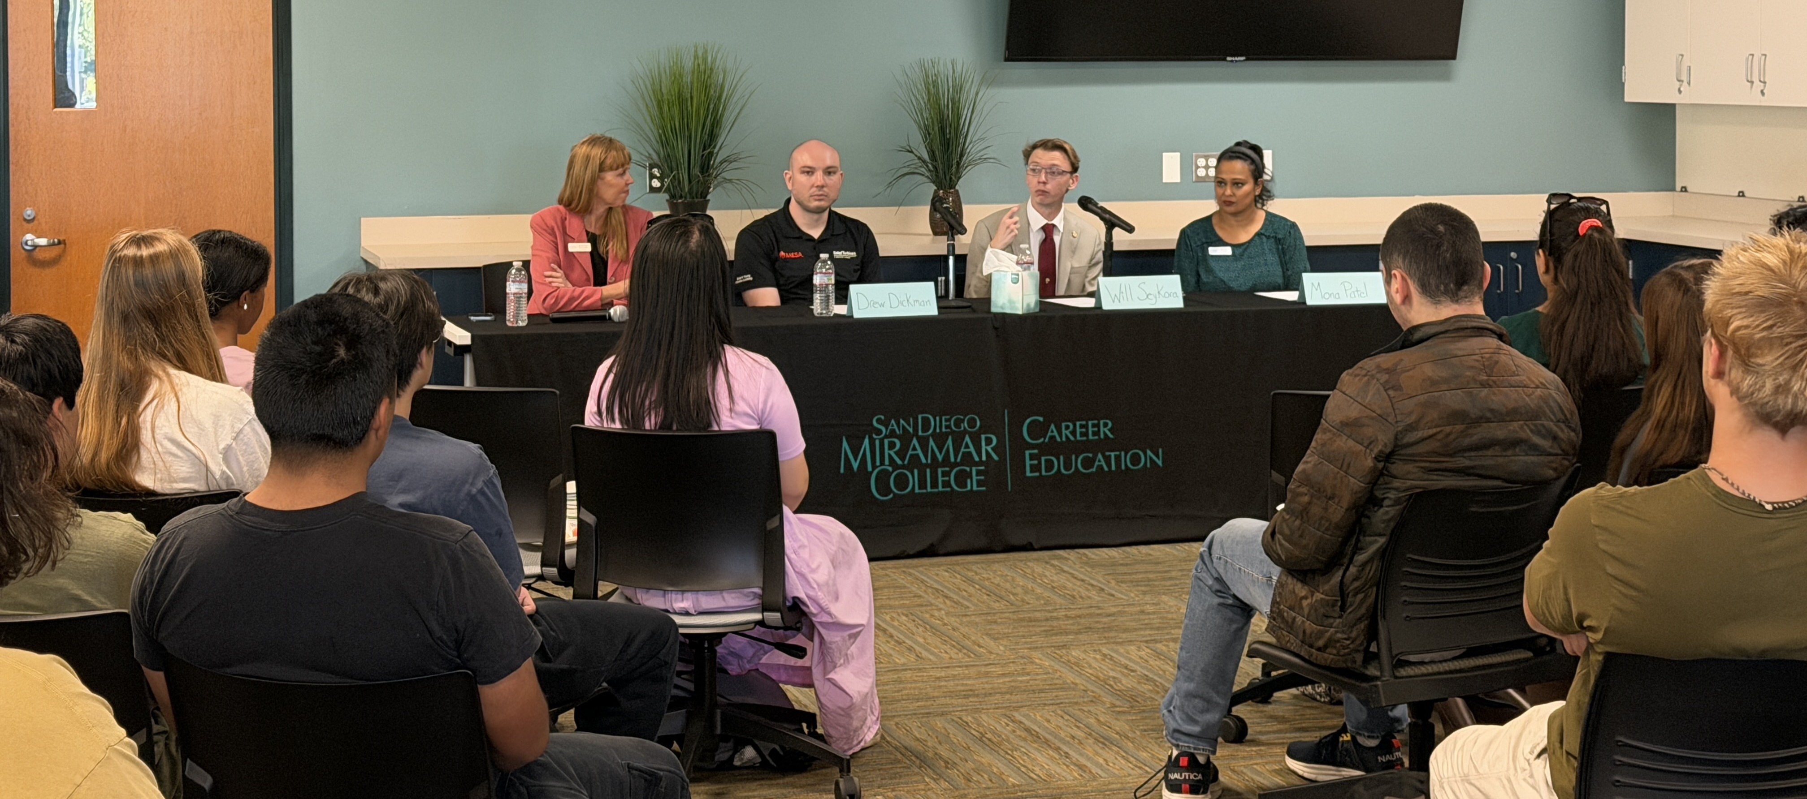
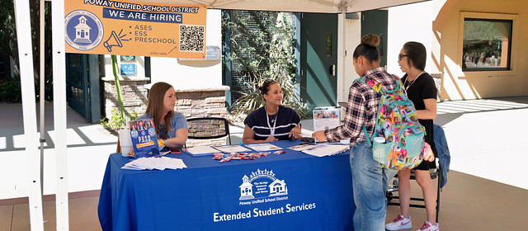
Work-Based Learning – WHAT?
Work-Based Learning (WBL) is any structured learning experience, inside or outside the classroom, that connects academic content to real-world work, helping students build career skills, explore career pathways, and prepare for future employment.

Slide 3
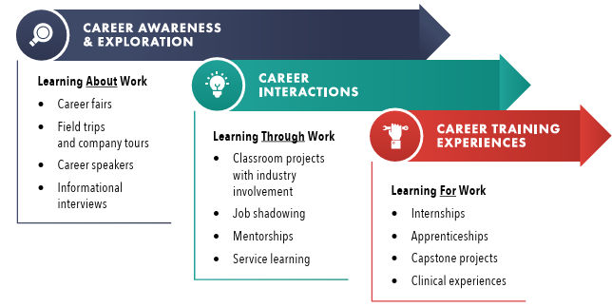
Work-Based Learning – Examples

Slide 4
Work-Based Learning
Higher completion rates: WBL students achieve 92% completion rate. That is a 5% advantage.
65% of WBL participants identity as students of color.
Student headcount in WBL more than doubled (+130%) in the past year.
Impact at Miramar College

Slide 5
Work-Based Learning – Your role
How You Can Support Student Success
Share and promote WBL opportunities
Offer ideas for WBL activities
Refer students to C&LDS
Help spread the word with colleagues
“Every student should have access to work-based learning experiences that connect education to careers.”
California Community Colleges – Vision 2030

Slide 6
Q & A
Work-Based Learning

