Slide 1
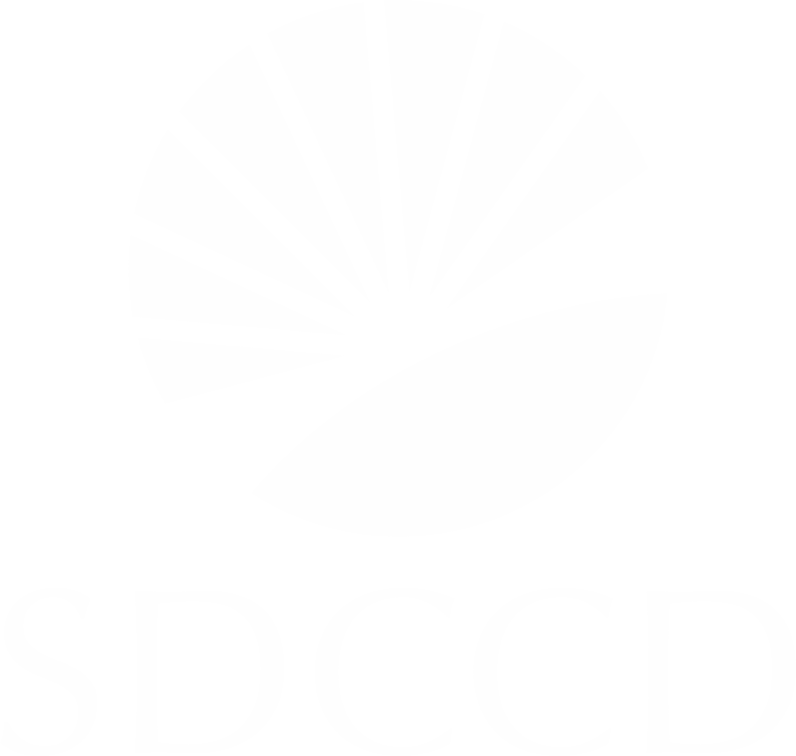

#. Discussion Items (First Reads)
# Student Evaluation of Counseling Faculty
Olivia Flores, Counselor
Our CBA expires June 30, 2026
Discussion at Miramar Student Services Faculty mtg in Spring 2025
Draft was shared with District Counselors (City, Mesa, and CE) in Aug 2025
This final version was approved by District Counselors in March 2025
This final version is going through the Academic Senate approval process at City, Mesa, and CE.

Slide 2
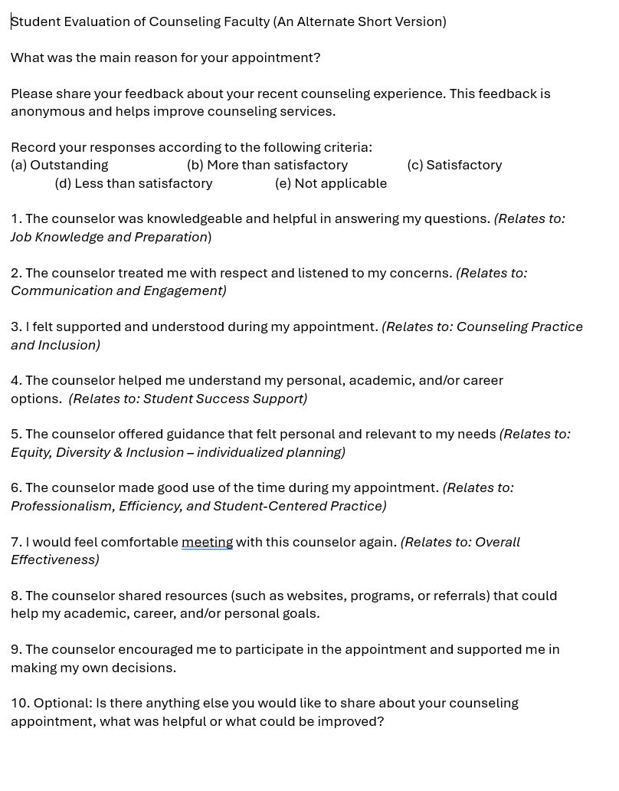
#. Discussion Items (First Reads)
Proposed version:
Questions are based on “Tenured/Tenure-Track Faculty Appraisal Form” for Counselors (aka Domains/Criteria)
10 questions
NOTE: Current Student Evaluation Form has 27 questions.

Slide 3
#. Discussion Items (First Reads)
Ask:
Questions and comments can be sent to Olivia (oflores@sdccd.edu)
Vote to approve at the April 21st meeting
Approval vote from all College/CE Academic Senates will allow District Counselors to take this to the Union for negotiations with District to add to our new CBA.

