Slide 1

#.7.1 Committee Report
#7.1.1 Professional Development Committee: Olivia Flores
Committee Purpose/Charge
Develop and promote a professional development program which supports the educational mission of the Institution to include activities that enhance and improve the college atmosphere and cultivate a positive culture on campus; oversee the disbursement of professional development funds for faculty, classified professionals, and administrators.
AFT Budget FY 2025-26 (Faculty only): $36,425
Available Balance as of 4/10/26: $4,891.10

Slide 2
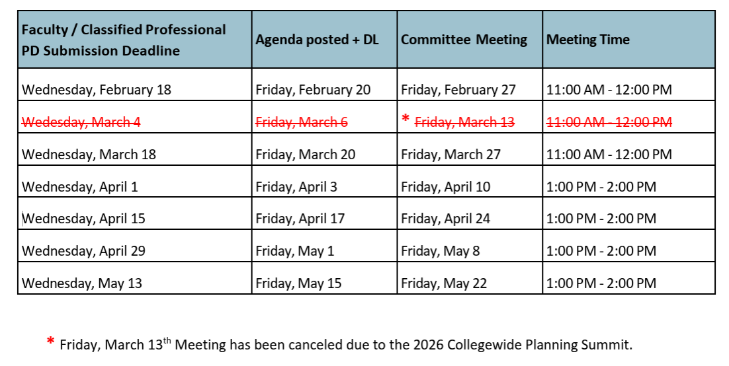
#.7.1 Committee Report
Friendly Reminder: Committee does not meet during the summer.
Last Spring 2026 meeting: Friday, May 22.
Deadline to submit request: Wednesday, May 13
Requests for travel during Summer, should be submitted by May 13

Slide 3
#.7.1 Committee Report
Friendly Reminder: Committee does not meet during the summer
Reimbursement funds are first come first serve.
Maximum request amount is $1,200
Requests for travel from July 1 – Sept 11, 2026, submit by May 13, to be reviewed before summer.
Request for travel from July 1 – Sept 11, 2026, will be part of the 2026-2027 budget.
Request for Fall 2026 and Spring 2027 semesters will not be reviewed until after the first fall meeting (Sept 11, 2026).

