Slide 1

Academic Senate Meeting
April 7th, 2026
2025-26 Academic Year
Cultivating Community:
Making the invisible visible
(QR Code for A.S. Webpage)
Attending for Flex credit? Email rgomez001@sdccd.edu or jbartolo@sdccd.edu

Slide 2
April 7th, 2026
2025-26 Academic Year
Please remember to sign in physically using the sign-in sheet! (See Juli!)
When we reach quorum (23/44) we can get started officially!

Slide 3
2. Agenda Overview
Call to Order
Approval of Agenda & Consent Calendar
DRAFT Minutes 031726
Land Acknowledgement (Updated)
Public Comments
Action Items
AP 5500.1 – Honest Academic Conduct
Discussion Items
New Buildings and Associated Programs
Standing: Curriculum Committee Updates
Student Evaluation of Counseling Faculty
Proposed Ethnic Studies ASCCC Resolution
Miramar College Marketing & Outreach Plan
Free Speech & Campus Safety
Position Statement Regarding Re-naming of Cesar Chavez to Dolores Huerta (San Diego Unified)
Resolution on Agentic AI
Reports:
Committee Reports
Special Reports
Executive Committee Reports
Announcements
Adjournment
A.S. Agenda for 4/7/26
AS Code of Conduct

Slide 4
3. Land Acknowledgement
We recognize that San Diego Miramar College sits on the ancestral homeland of the Kumeyaay, Luiseño, Cupeño, and Cahuilla tribes, who have lived in this area for well over 10,000 years, and we honor their past, present, and future connection to this land and its inherent connection to their identity.
We acknowledge our occupation of unceded Kumeyaay land and the violent systemic injustices this has continuously perpetuated for Native peoples of this region. We pay respect to the Indigenous people of San Diego County - past, present, and future - and honor their continuing presence in their homeland and their spiritual beliefs that land does not belong to people; people belong to land.
We also acknowledge that this is merely the beginning, and there is far more work to be done in an attempt to heal all of the injustices and inequities that still exist today and throughout their entire historical diaspora. We commit to moving forward together.
Resources: “Making a land acknowledgment meaningful”; A call for more powerful land acknowledgements

Slide 5

4. Public Comments
(10 Mins)
Limited to 10+1 items that are not on the agenda
Public Comments on agenda items will take place before the A.S. body discussion begins but after any relevant presentations.
2 min. per speaker, 10 mins. per topic
Individual speakers may not yield their time to another speaker or spokesperson
To be continued at the end of the meeting if necessary

Slide 6
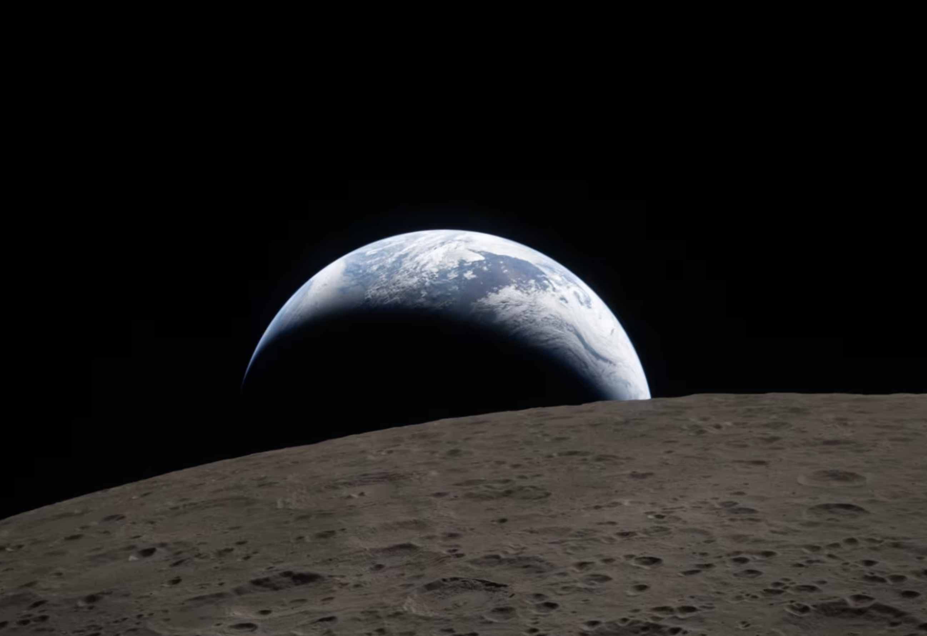
4. Public Comments
4.1 NASA – Earth from “Artemis ii”
NASA releases new ‘Earthset’ and eclipse images taken during historic flyby of the moon
While soaring aboard their Orion capsule beyond the far side of the moon, the crew also reached an estimated 252,756 miles from Earth, breaking Apollo 13’s record for the farthest humans have traveled into space.

Slide 7

4. Public Comments
4.2 NASA Photo of the Day – “Caught in the Web”
The featured image shows an illustration that combines a simulation of a black hole binary system in its final "death-dance" with an astrophotography image of the Tarantula Nebula in the background. Note: We can’t see black holes—but we can predict their fingerprints so precisely that we can visualize them with confidence.

Slide 8

4. Public Comments
4.3 Reclaiming Joy
Human-First Teaching
In the AI Era
Friday, April 17th
8:45 am - 3:00 pm
Miramar Campus Watch Party! or Online Attendance

Slide 9
5. Action Items (Second Reads)

Slide 10
5. Action Items (Second Reads)
5.1 AP 5500.1 – Honest Academic Conduct
(Rodrigo Gomez)
Plagiarism: The act of incorporating ideas, words, or specific substance of another, whether purchased, borrowed, or otherwise obtained, and submitting the same as one’s own work to fulfill academic requirements without giving credit to the appropriate source. Examples of plagiarism include but are not limited to the following:
7) Authorized use of Artificial Intelligence (AI) tools is determined by each instructor. Use of AI tools to complete, in whole or in part, an academic assignment without authorization from the instructor could be treated as plagiarism or cheating under this procedure. This includes submitting AI-generated work as one’s own or using AI tools in a manner that replaces the student’s independent effort or intended learning outcomes of the course.
Link to AP 5500.1

Slide 11
6. Discussion Items (First Reads)

Slide 12
6. Discussion Items (First Reads)
6.1 New Buildings and Associated Programs
(Wes Lundburg)
How it started:
People have expressed interest in discussing details about the new program
Questions about “Viability Review of Instructional Programs” and whether that had been followed.
Today is for clearing up any questions related to this subject.

Slide 13
6. Discussion Items (First Reads)
6.2 Standing: Curriculum Committee Updates
(Veronica Hartmann)

Slide 14
6. Discussion Items (First Reads)
6.3 Student Evaluation of Counseling Faculty
(Olivia Flores)
Our CBA expires June 30, 2026
Discussion at Miramar Student Services Faculty mtg in Spring 2025
Draft was shared with District Counselors (City, Mesa, and CE) in Aug 2025
This final version was approved by District Counselors in March 2025
This final version is going through the Academic Senate approval process at City, Mesa, and CE.

Slide 15
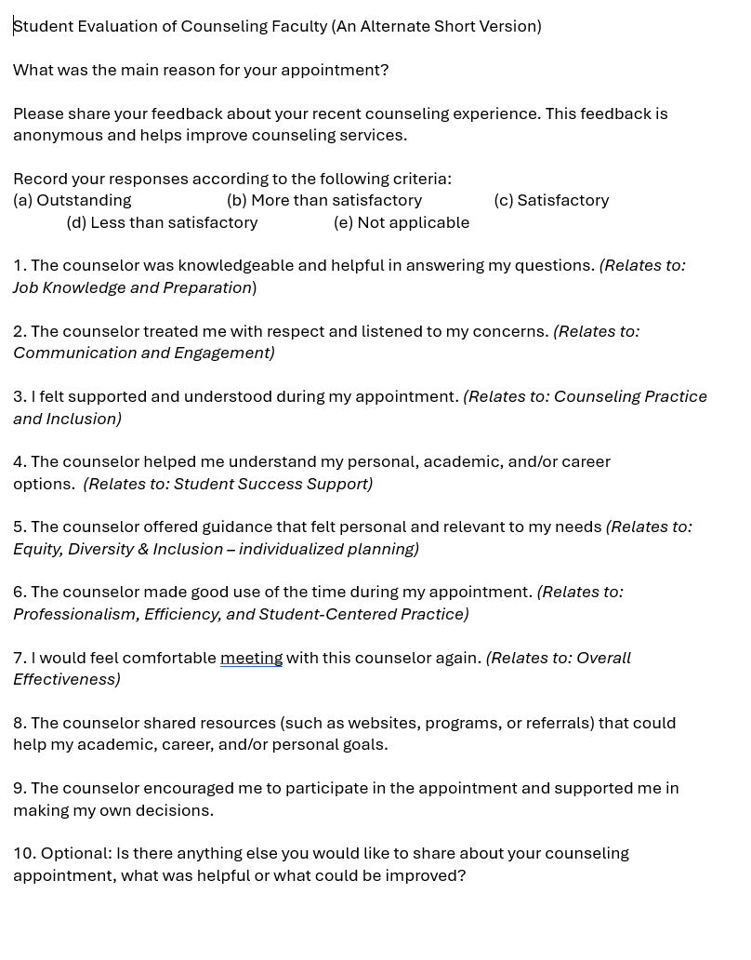
6.3. Discussion Items (First Reads)
Proposed version:
Questions are based on “Tenured/Tenure-Track Faculty Appraisal Form” for Counselors (aka Domains/Criteria)
10 questions
NOTE: Current Student Evaluation Form has 27 questions.

Slide 16
6.3 Discussion Items (First Reads)
Ask:
Questions and comments can be sent to Olivia (oflores@sdccd.edu)
Vote to approve at the April 21st meeting
Approval vote from all College/CE Academic Senates will allow District Counselors to take this to the Union for negotiations with District to add to our new CBA.

Slide 17
6. Discussion Items (First Reads)
6.4 Proposed Ethnic Studies ASCCC Resolution
(Mara Palma-Sanft)
AB 1460: Ethnic Studies =
African American Studies,
Asian American Studies,
Native American/Indigenous Studies
Chicana/o/x & Latina/o/x Studies.
Does not currently credit distinct cultural designators that reflect their historical and community-based origins.
This resolution is about protecting long-standing ethnic studies courses that were developed before AB 1460 and ensuring they continue to be recognized within the four core disciplines and continue to count as legitimate ethnic studies courses for transfer and GE purposes.
It affirms that these culturally specific designators—such as Filipino American (FILI) Studies or Kumeyaay Studies (KUMY)—already belong within those disciplines and should retain their articulation and transfer status.
Link to Docs

Slide 18
6. Discussion Items (First Reads)
6.5 Miramar Marketing & Outreach Plan
(Steven Quis / Rodrigo Gomez)
The 2025-2031 Miramar College Marketing & Outreach Plan has been approved by the Marketing & Outreach committee.
It is now ready for review and approval by the constituency groups. They are requesting feedback from the Academic Senate. Please prepare any feedback for our next official meeting, where Steven will join us to go over questions.
Link to Docs

Slide 19

6. Discussion Items (First Reads)
6.6 Free Speech & Campus Safety
(Rodrigo Gomez)
Miramar College resources for responding to emergencies & supporting undocumented students and families.
What other ways might we offer support to each other?

Slide 20
6. Discussion Items (First Reads)
6.7 Position Statement Regarding Re-naming of Cesar Chavez Campus to Dolores Huerta (SD Unified)
(Carmen Carrasquillo)
GAIA Statement: “We Stand with Dolores Huerta”
Link to Slides

Slide 21
7.Reports
7.1 Committee Reports
7.2 Special Reports
7.3 Executive Committee Reports

Slide 22
7. Reports
7.1 Committee Reports

Slide 23
7. Reports
7.2 Special Reports

Slide 24
7. Reports
7.3.1 President’s Report
7.3.1.1 Special Thanks to our Scholarship Application Readers!
7.3.1.2 College Council is forming an AI Workgroup (Pending)
7.3.1.2 2026 Spring Plenary Session Resolutions
Feedback Desired by: April 10, 2026
7.3.2 Vice President’s Report

Slide 25
7. Reports
7.3.3 – 8
Secretary – Olivia Flores
Treasurer – Dawn Diskin (please see the following slide)
Contract Member-at-Large – Melissa Wolfson
Contingent Faculty Member-at-Large – Desi Klaar
Chair of Chairs – Mary Kjartanson

Slide 26
7. Reports
7.3.4: Treasurer (Dawn Diskin)
Account Balance $529.99
Academic Senate Dues / Voluntary Payroll Deduction
Please remember to set it up!
Reach out if you’d like some assistance.

Slide 27
8. Announcements
1 min. time limit each

Slide 28
9. Adjournment
If the calendar was approved earlier, the first meeting of the 2025-26 SDMC Academic Senate is: Tuesday, April 21st, 2026 from 3:30-5:00 pm in M-110. Remember that starting Spring 2026 we’ll be moving to fully in person Senate meetings. Hence, we will be retiring the A.S. Senator Remote Attendance Form

Slide 29
Thanks for your hard work for Miramar College!
If you have any questions, please reach out via email!
rgomez001@sdccd.edu or jbartolo@sdccd.edu

