Slide 1

Academic Senate Meeting
April 21st, 2026
2025-26 Academic Year
Cultivating Community:
Making the invisible visible
(QR Code for A.S. Webpage)
Attending for Flex credit? Email rgomez001@sdccd.edu or jbartolo@sdccd.edu

Slide 2
April 21st, 2026
2025-26 Academic Year
Please remember to sign in physically using the sign-in sheet! (See Juli!)
When we reach quorum (23/44) we can get started officially!

Slide 3
2. Agenda Overview
Call to Order
Approval of Agenda & Consent Calendar
DRAFT Minutes 040726
Land Acknowledgement (Updated)
Public Comments
Action Items
Academic Senate Elections
Second Read: Miramar Technology Plan
Second Read: Miramar College Marketing and Outreach Plan
Discussion Items
Standing: Curriculum Committee Updates
Miramar Strategic Goals Document
Work-Based Learning at Miramar College
Free Speech and Campus Safety
Resolution on Agentic AI Workgroup
Reports:
Committee Reports
Special Reports
Executive Committee Reports
Announcements
Adjournment
A.S. Agenda for 4/21/26
AS Code of Conduct

Slide 4
3. Land Acknowledgement
We recognize that San Diego Miramar College sits on the ancestral homeland of the Kumeyaay, Luiseño, Cupeño, and Cahuilla tribes, who have lived in this area for well over 10,000 years, and we honor their past, present, and future connection to this land and its inherent connection to their identity.
We acknowledge our occupation of unceded Kumeyaay land and the violent systemic injustices this has continuously perpetuated for Native peoples of this region. We pay respect to the Indigenous people of San Diego County - past, present, and future - and honor their continuing presence in their homeland and their spiritual beliefs that land does not belong to people; people belong to land.
We also acknowledge that this is merely the beginning, and there is far more work to be done in an attempt to heal all of the injustices and inequities that still exist today and throughout their entire historical diaspora. We commit to moving forward together.
Resources: “Making a land acknowledgment meaningful”; A call for more powerful land acknowledgements

Slide 5

4. Public Comments
(10 Mins)
Limited to 10+1 items that are not on the agenda
Public Comments on agenda items will take place before the A.S. body discussion begins but after any relevant presentations.
2 min. per speaker, 10 mins. per topic
Individual speakers may not yield their time to another speaker or spokesperson
To be continued at the end of the meeting if necessary

Slide 6

4. Public Comments
4.3 Reclaiming Joy
Human-First Teaching
In the AI Era
Friday, April 17th
8:45 am - 3:00 pm
Hope you enjoyed it!

Slide 7
5. Action Items (Second Reads)

Slide 8

5.1 Action Items (Second Reads)
5.1 Miramar Elections
(Josh Alley / Carmen Carrasquillo)

Slide 9
5.2 Action Items (Second Reads)
5.2 Miramar Technology Plan
(Rodrigo Gomez)
The 2025-2031 Miramar College Marketing & Outreach Plan has been approved by the Marketing & Outreach committee.
It is now ready for review and approval by the constituency groups. They are requesting feedback from the Academic Senate. Please prepare any feedback for our next official meeting, where Steven will join us to go over questions.
Link to Docs

Slide 10
5.3 Action Items (Second Reads)
5.3 Miramar Marketing & Outreach Plan
(Rodrigo Gomez)
The 2025-2031 Miramar College Marketing & Outreach Plan has been approved by the Marketing & Outreach committee.
It is now ready for review and approval by the constituency groups. They are requesting feedback from the Academic Senate. Please prepare any feedback for our next official meeting, where Steven will join us to go over questions.
Link to Docs

Slide 11
6. Discussion Items (First Reads)

Slide 12
6.1 Discussion Items (First Reads)
6.1 Standing: Curriculum Committee Updates
(Veronica Hartmann)
Second Read:
Administrative Procedures and Board Policies
Link to Docs

Slide 13
#. Discussion Items (Second Reads)
# Student Evaluation of Counseling Faculty
Sierra Hegle & Olivia Flores, Professors/Counselors
Our CBA expires June 30, 2026
Discussion at Miramar Student Services Faculty mtg in Spring 2025
Draft was shared with District Counselors (City, Mesa, and CE) in Aug 2025
This final version was approved by District Counselors in March 2026
This final version is going through the Academic Senate approval process at CE, City, and Mesa.

Slide 14
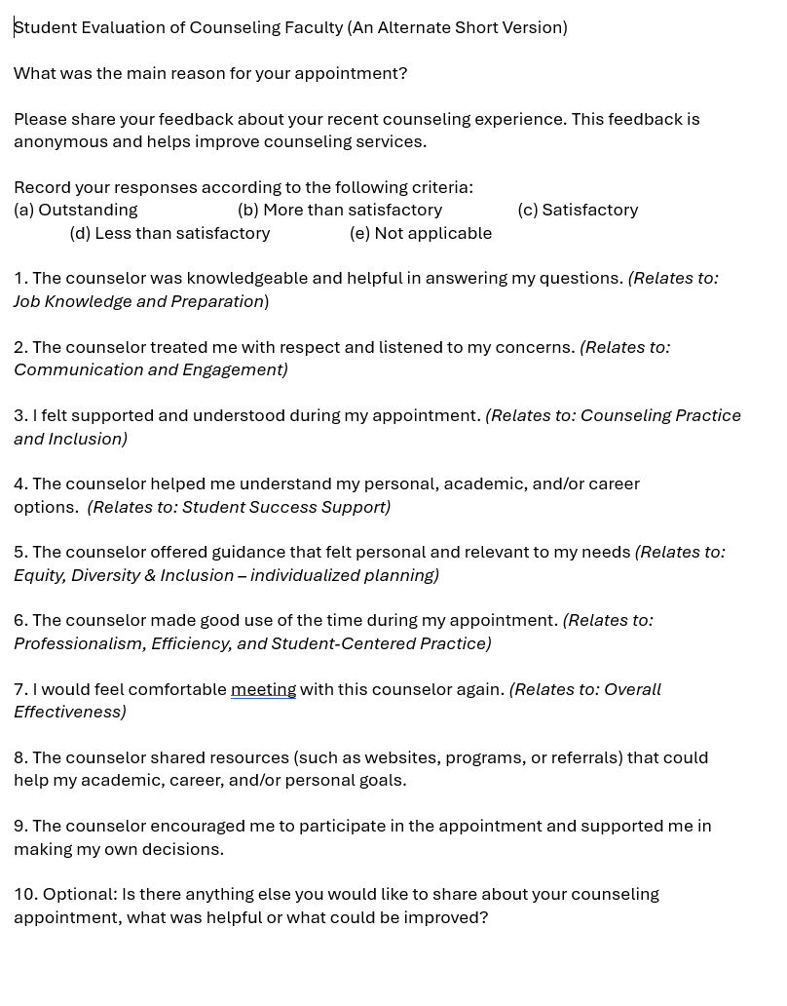
#. Discussion Items (Second Reads)
Proposed version:
Questions are based on “Tenured/Tenure-Track Faculty Appraisal Form” for Counselors (aka Domains/Criteria)
10 questions
NOTE: Current Student Evaluation Form has 27 questions.

Slide 15
#. Discussion Items (Second Reads)
Ask:
First read at April 7th meeting.
Would like a vote today to approve.
Approval vote from all College/CE Academic Senates will allow District Counselors to take this to the Union for negotiations with District to add to our new CBA.

Slide 16
6.2 Discussion Items (First Reads)
6.2 Miramar Strategic Goals Document
(David Wilhelm)
Link to Docs

Slide 17
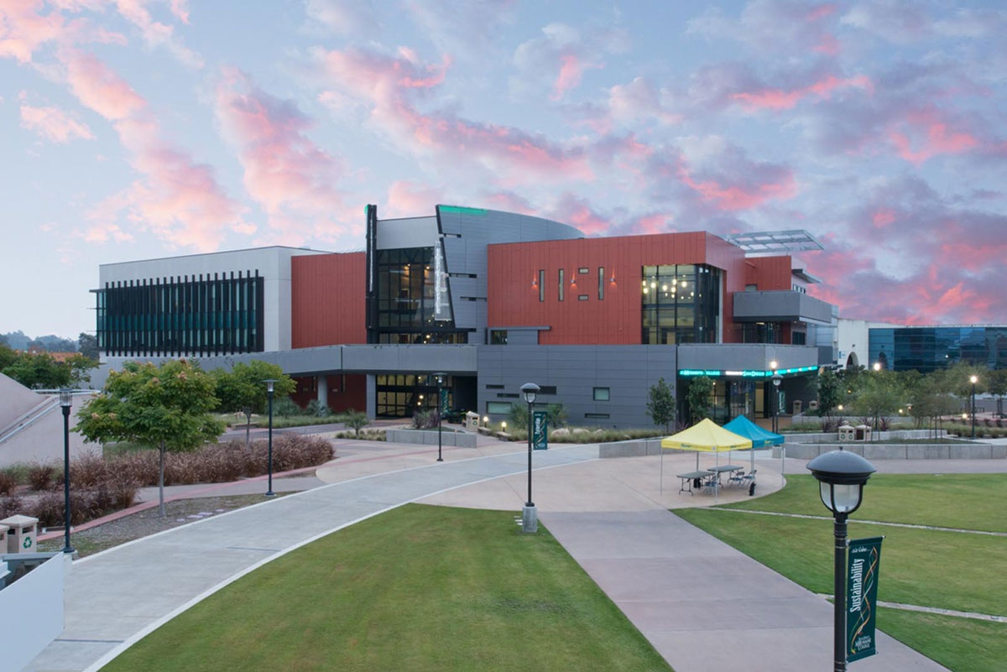
6.3 Discussion Items (First Reads)
6.3 Work-Based Learning at Miramar College
(Beverly Garcia)
Work-Based Learning (WBL) is any structured learning experience, inside or outside the classroom, that connects academic content to real-world work, helping students build career skills, explore career pathways, and prepare for future employment.
Link to Docs

Slide 18

6.4 Discussion Items (First Reads)
6.4 Free Speech & Campus Safety
(Rodrigo Gomez)
Miramar College resources for responding to emergencies & supporting undocumented students and families.
What other ways might we offer support to each other?

Slide 19
6.5 Discussion Items (First Reads)
6.4 Resolution on Agentic AI Workgroup
(Rodrigo Gomez)
How do we ensure that faculty voice remains central in shaping institutional decisions around agentic AI, particularly in alignment with the 10+1 and principles of academic freedom?
What safeguards must be established to protect student data, intellectual property, and faculty autonomy when engaging with agentic AI systems?
What expectations should guide the transparent, ethical, and accountable implementation of agentic AI tools across teaching, learning, and institutional operations?

Slide 20
7.Reports
7.1 Committee Reports
7.2 Special Reports
7.3 Executive Committee Reports

Slide 21
7. Reports
7.1 Committee Reports

Slide 22
#.7.1 Committee Report
#7.1.1 Professional Development Committee: Olivia Flores
Committee Purpose/Charge
Develop and promote a professional development program which supports the educational mission of the Institution to include activities that enhance and improve the college atmosphere and cultivate a positive culture on campus; oversee the disbursement of professional development funds for faculty, classified professionals, and administrators.
AFT Budget FY 2025-26 (Faculty only): $36,425
Available Balance as of 4/10/26: $4,891.10

Slide 23
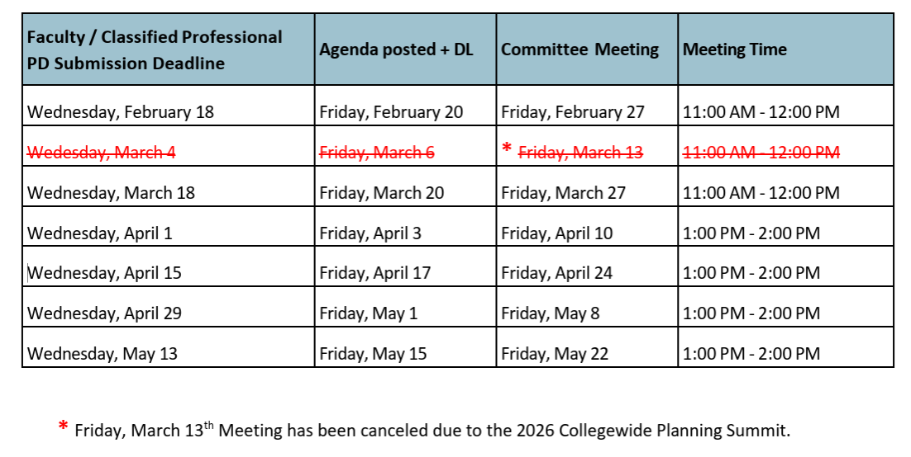
#.7.1 Committee Report
Friendly Reminder: Committee does not meet during the summer.
Last Spring 2026 meeting: Friday, May 22.
Deadline to submit request: Wednesday, May 13
Requests for travel during Summer, should be submitted by May 13

Slide 24
#.7.1 Committee Report
Friendly Reminder: Committee does not meet during the summer
Reimbursement funds are first come first serve.
Maximum request amount is $1,200
Requests for travel from July 1 – Sept 11, 2026, submit by May 13, to be reviewed before summer.
Request for travel from July 1 – Sept 11, 2026, will be part of the 2026-2027 budget.
Request for Fall 2026 and Spring 2027 semesters will not be reviewed until after the first fall meeting (Sept 11, 2026).

Slide 25
7. Reports
7.2 Special Reports

Slide 26
7. Reports
7.3.1 President’s Report
7.3.1.1 2026 Spring Plenary Session Resolutions
7.3.1.2 Special Thanks to our Scholarship Application Readers!
7.3.1.2 College Council is forming an AI Workgroup (Pending)
7.3.2 Vice President’s Report

Slide 27
7. Reports
7.3.3 – 8
Secretary – Olivia Flores
Treasurer – Dawn Diskin (please see the following slide)
Contract Member-at-Large – Melissa Wolfson
Contingent Faculty Member-at-Large – Desi Klaar
Chair of Chairs – Mary Kjartanson

Slide 28
7. Reports
7.3.4: Treasurer (Dawn Diskin)
Account Balance $529.99
Academic Senate Dues / Voluntary Payroll Deduction
Please remember to set it up!
Reach out if you’d like some assistance.

Slide 29
8. Announcements
1 min. time limit each

Slide 30
9. Adjournment
If the calendar was approved earlier, the first meeting of the 2025-26 SDMC Academic Senate is: Tuesday, May 5th, 2026 from 3:30-5:00 pm in M-110. Remember that starting Spring 2026 we’ll be moving to fully in person Senate meetings. Hence, we will be retiring the A.S. Senator Remote Attendance Form

Slide 31
Thanks for your hard work for Miramar College!
If you have any questions, please reach out via email!
rgomez001@sdccd.edu or jbartolo@sdccd.edu

