Slide 1
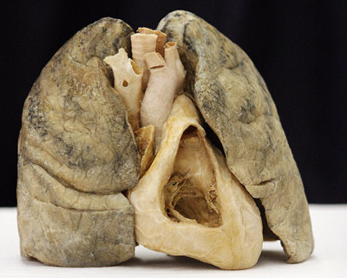

Slide 2
Functions of Respiratory System
Ventilation - moves air from the atmosphere to and from alveoli in the lungs.
Provides enormous Surface area for gas exchange between alveoli and circulating blood.
Helps regulate pH of body fluids.
Permits vocal sounds.

Slide 3
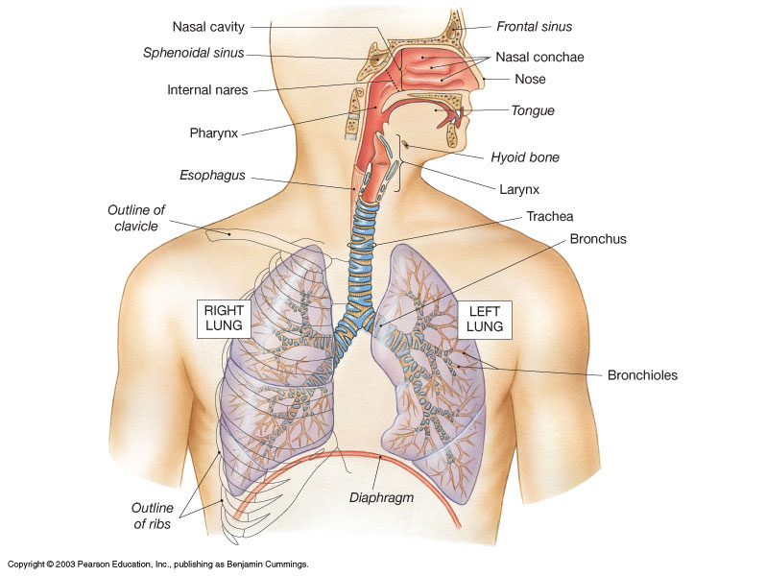
External nares

Slide 4
Upper Respiratory System
Nose
Nasal cavity
Pharynx (throat)
Larynx
Conditions inspired air:
Filter
Warm
Humidify
Lower Respiratory System
Trachea
Bronchi
Bronchioles
Alveoli – gas exchange!
Functions to conduct air
to site of gas exchange.

Slide 5
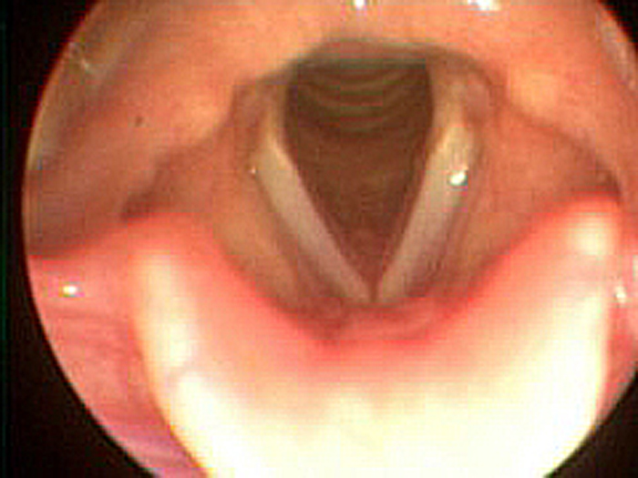
Vocal Folds
Interesting video on how VOCAL CORDS work for Speech and Singing:
https://www.youtube.com/watch?v=ZLgAQTMgZ6g

Slide 6
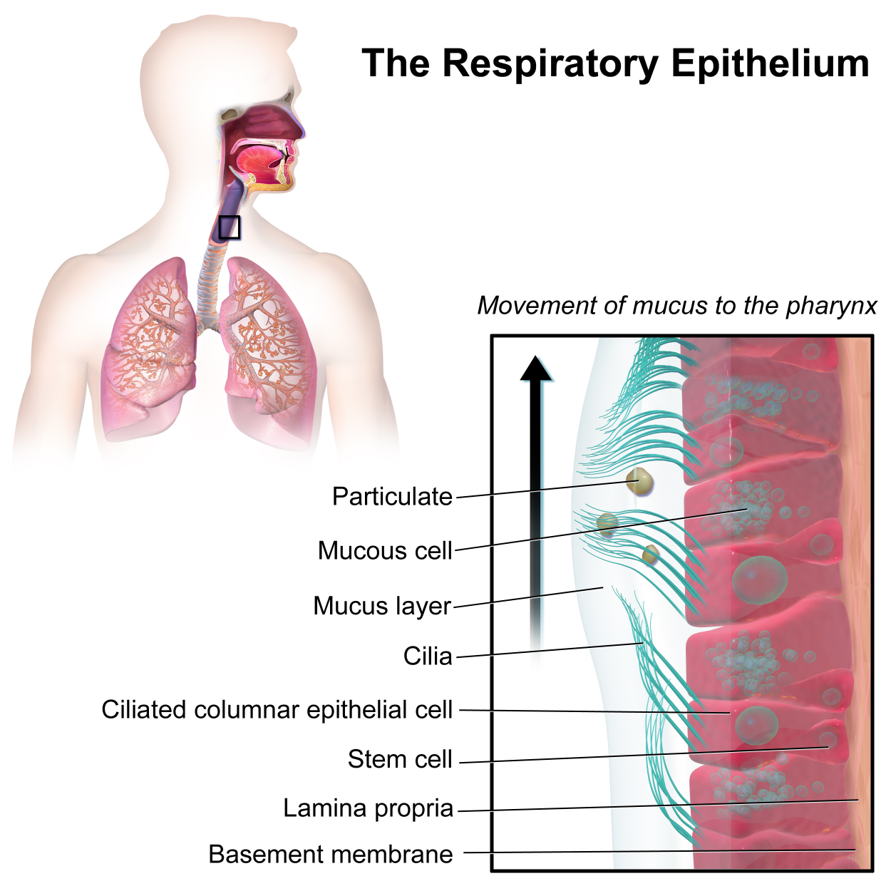
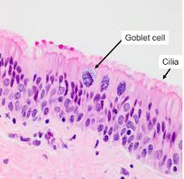
is Pseudostratified Ciliated Columnar
(PSCC) epithelium
Respiratory Epithelium is a wet, sticky, protective surface covering most of the respiratory tract The cilia (‘hair’) beat rhythmically creating a motion/current that sweeps mucus along with debris/particulates up from the lower bronchi and trachea toward the pharynx.

Slide 7
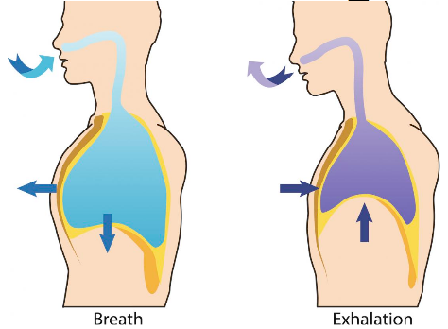
Air Moves Down its Pressure Gradient
Inspiration – Air moves from outside into lungs as volume in the thoracic cavity increases (thus, pressure decreases).
Expiration – Air moves from lungs to outside as volume in the thoracic cavity decreases (thus, pressure increases).
The Volume and Pressure Differences for Breathing

Slide 8
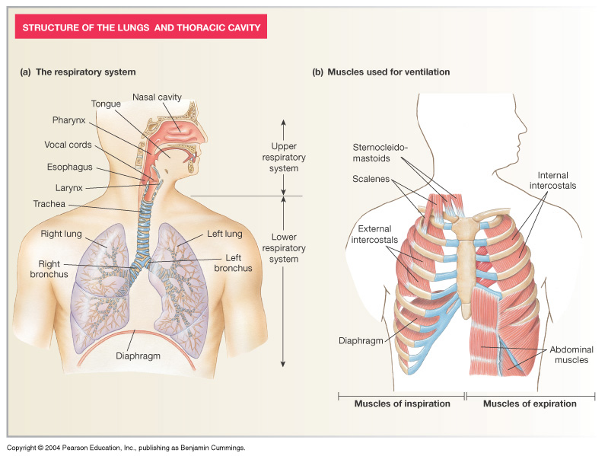
Muscles of Ventilation

Slide 9
Muscles of Ventilation
Eupnea – Quiet normal breathing at rest.
Inspiration: Diaphragm and
External intercostals.
increases
volume
elastic
recoil
Expiration: No Muscle Contraction!
*Metabolic cost of breathing normally ~ 3% of basal metabolic rate (BMR)

Slide 10
Muscles of Ventilation
Forceful Breathing – e.g., during exercise.
Inspiration: Diaphragm & External intercostals
(scalenes and sternocleidomastoid also involved)
Expiration: Internal intercostals and
Abdominal muscles.

Slide 11
3 Important Pressures
1. Atmospheric Pressure
2. Alveolar Pressure
3. Intrapleural Pressure

Slide 12
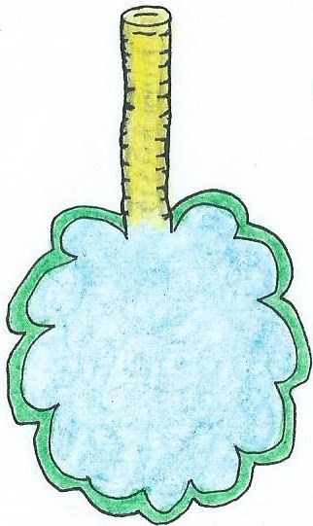
Respiratory System Pressures
1. Atmospheric Pressure (P_{ATM}): This is the weight of the column of air above you. This remains relatively constant. At sea level this value is 760 mmHg. The pressure in the lungs must be higher or lower than atmospheric pressure for air flow to be created.
2. Intra-Alveolar Pressure (P_{ALV}): The pressure inside the alveoli, where gas is exchanged. This normally oscillates between 758 mmHg (inspiration) to 762 mmHg (expiration).
3. Intra-Pleural Pressure (P_{PLU}): This is the pressure inside the pleural cavity, which is filled with pleural fluid. This pressure is always less than alveolar pressure and normally oscillates between 754 mmHg (inspiration) to 758 mmHg (expiration).
Transmural Pressure Gradient
(trans = across, mural = wall)
Since the air in the alveoli always has a higher pressure than the fluid in pleural cavity, it exerts force across the wall of the lung tissue – this force keeps the lungs stretched (even when exhaling).
This force opposes (or balances) the elasticity within the lungs that tend to cause lung to collapse.
The red area and arrow in the diagram above indicates this transmural force.
Atmospheric Pressure
(Pressure of the air out here!)
Intra-Pleural Pressure
(Pressure inside the fluid filled space!)
Intra-Alveolar Pressure
(Pressure of air inside alveoli of lungs!)

Slide 13
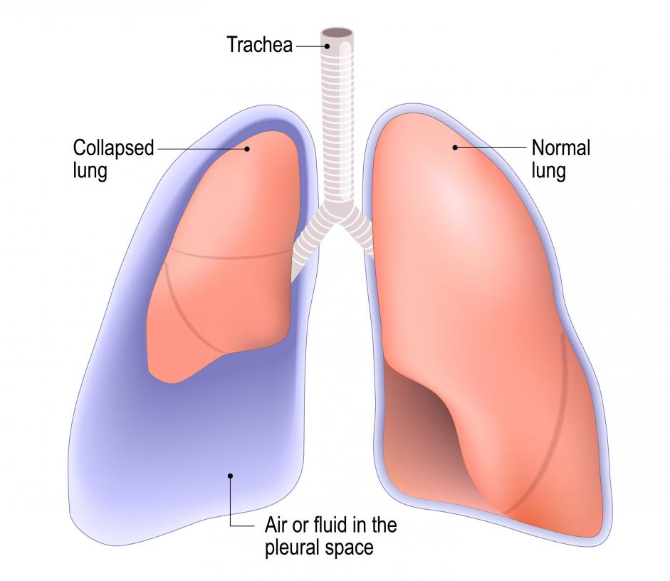
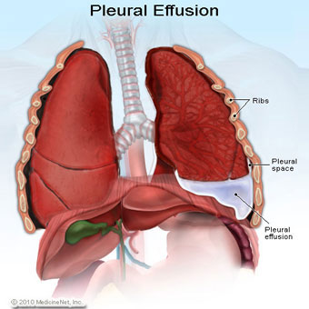
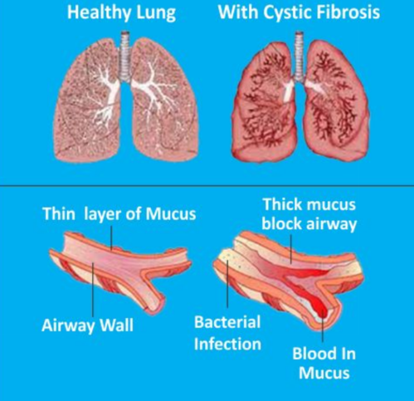
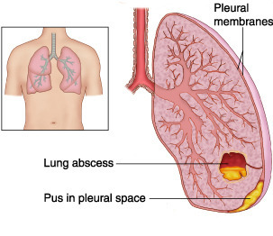

Slide 14
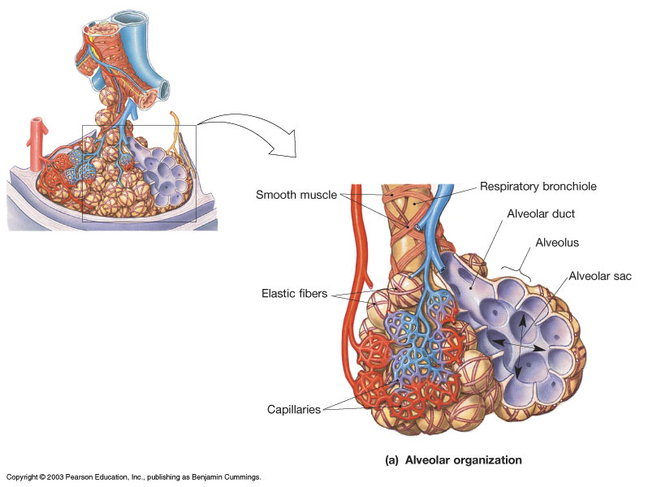
The Alveolus

Slide 15
Alveoli consist of 3 types of cells
1) Alveolar Type I cells – thin (simple squamous epithelium) that makes the ‘walls’ of alveoli for gas exchange.
2) Alveolar Type II cells – release surfactant which make lungs more Compliant.
3) Alveolar Macrophages – protects the alveolar surface. Releases digestive enzyme trypsin.

Slide 16
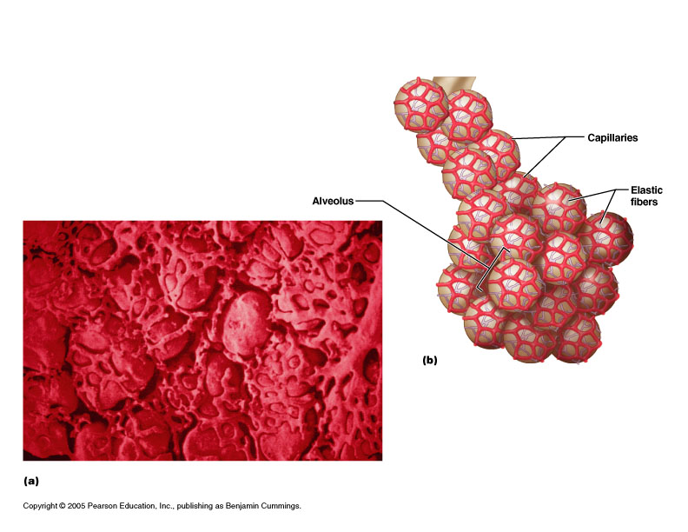
Alveoli also have elastic fibers
Elastic recoil - pushes air out (assists ventilation).
Capillaries cover 90% of alveolar surface.

Slide 17
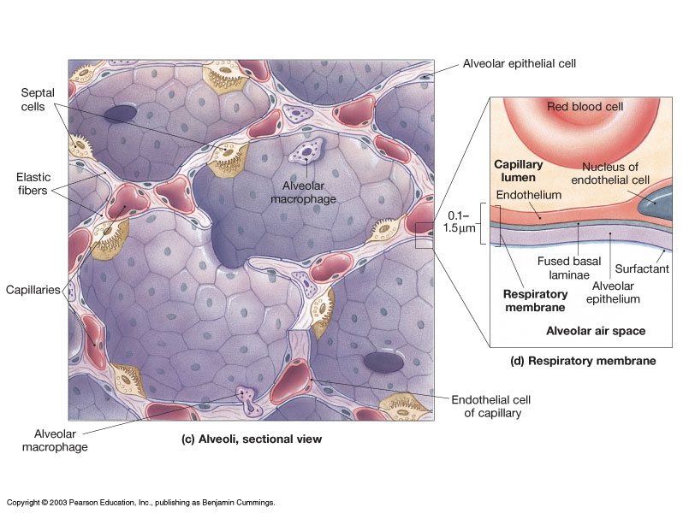

Slide 18
Pulmonary Elasticity and Compliance
Pulmonary Elasticity gives lungs the ability to recoil, allowing lungs to compress to their original shape after the force stretching them is removed. This property comes from two elements: 1) the elastin in the elastic fibers of lungs; and 2) from the surface tension on the internal surfaces of the alveoli generates by water.
Pulmonary (Lung) Compliance is a measure of the lung's ability to stretch and expand. It’s related to the ‘ease’ with which a person can breathe in (expand the lungs). The less work required to stretch the lungs, the more compliant they are. Pulmonary surfactant made by type II alveolar cells promotes pulmonary compliance and stabilizes lung tissue.
Compliance is balanced by the elasticity and surface tension of the lungs, and compliance is inversely related to pulmonary elasticity.
Decrease in elastic fibers will increase lung compliance.
Thickening of lung tissue will decrease lung compliance.
Decreases in pulmonary surfactant will decrease lung compliance.

Slide 19
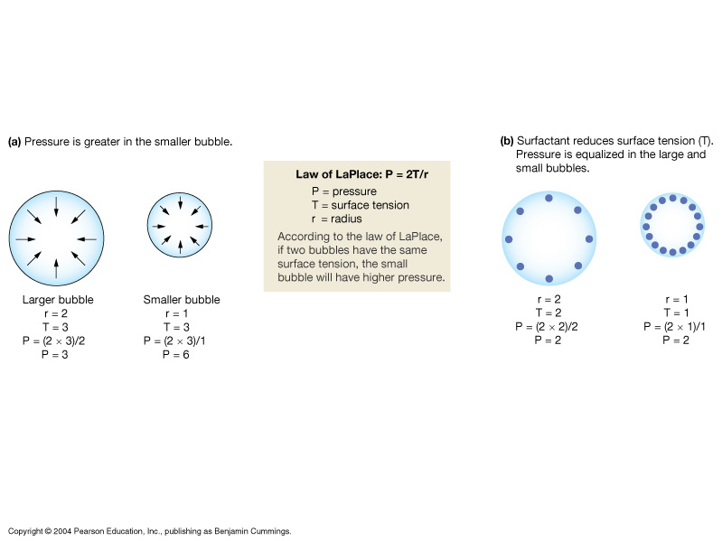
Pulmonary Elasticity and Compliance

Slide 20
How Surfactant Stabilizes Alveolar Size

Slide 21
Partial Pressure Gradients
Partial Pressure, pressure of a single gas in a mixture of gases.
Air is mixture of Gases
N₂
O₂
CO₂
= 79%
= 21%
= 0.03%
Q: What is the P_{O2} if P_{ATM} is 760 mmHg? P_{CO2}?
Q: Calculate the P_{O2} if P_{ATM} is 380 mmHg?

Slide 22
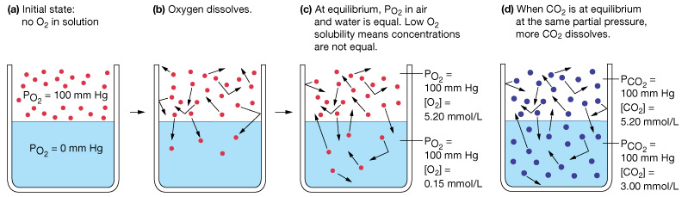
Factors influencing how a gas dissolves in liquid
Partial Pressure gradient:
Temperature:
Solubility:

Slide 23
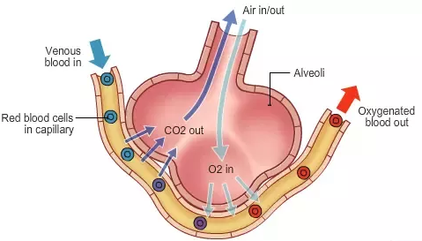
An individual gas in a mixture of gases moves down its… Partial Pressure Gradient
Exchange of O₂ and CO₂ in the alveoli:
The CO₂ moves into the alveoli from the blood.
The O₂ moves into the blood from the alveoli.

Slide 24
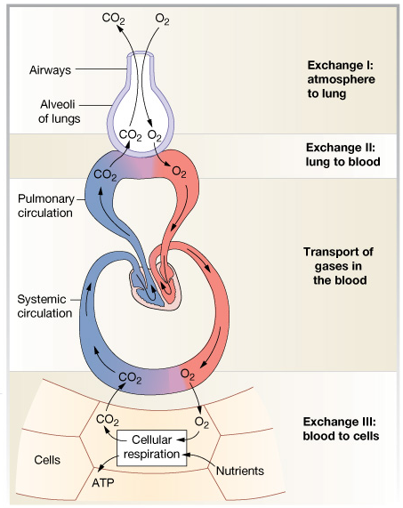
An individual gas in a
mixture of gases moves
down its…
Partial
Pressure
Gradient
O₂ Movement:
Air to blood
Blood to cells
CO₂ Movement:
Cells to blood
Blood to air

Slide 25
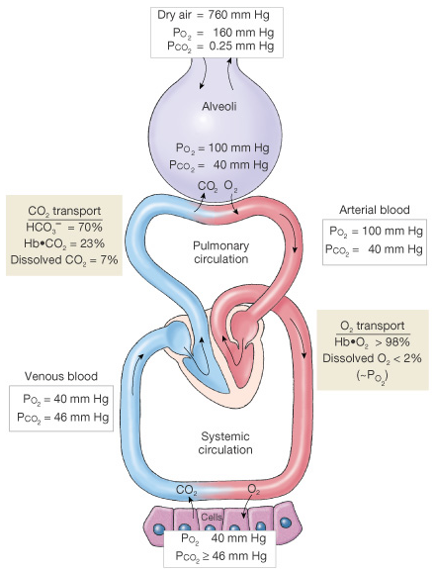

Slide 26


Slide 27
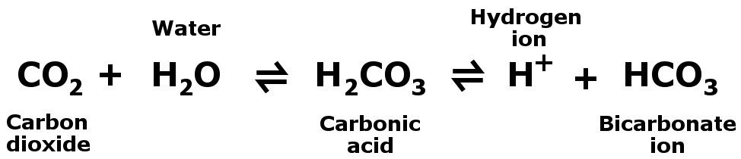
The Bicarbonate Buffer System
A weak acid that resists changes in pH, and thus acts to stabilize the pH in body fluid. Directly linked to the Respiratory System.
The reversible equation for this buffer (shown below) obeys the
Law of Mass Action (Le Châtelier's principle).
_
*
*
The forward direction in this equation is also referred to as going to the Right (as written here), and the reverse direction is going to the Left.
*Both the forward and reverse reaction requires carbonic anhydrase. The ionization of carbonic acid occurs spontaneously and requires no enzyme.

Slide 28
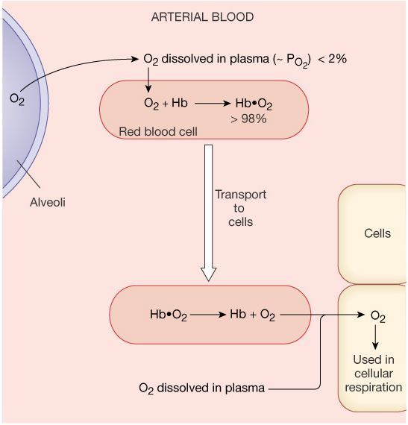
How is O₂ Transported ?
2% is dissolved
in plasma.
98% in carried
on Heme portion
of hemoglobin (Hb).

Slide 29
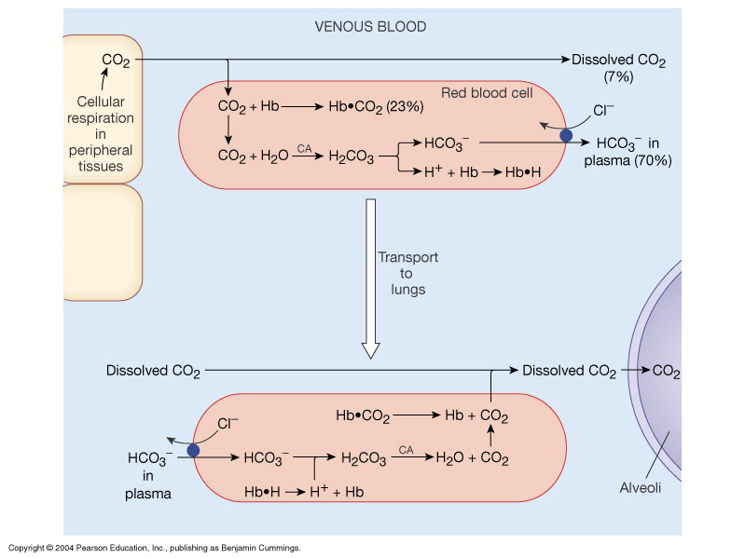
How is CO₂ Transported ?
~ 10% dissolved
in plasma.
~ 30% bound to
globin portion
of Hb.
~ 60% as HCO₃⁻,
(bicarbonate buffer)

Slide 30
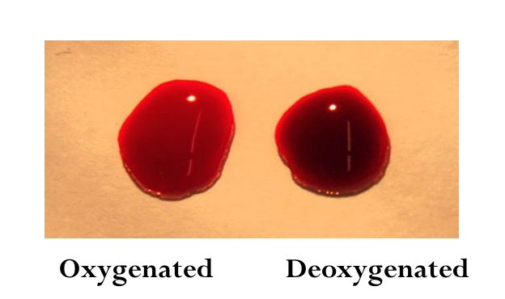
The Colors of Arterial and Venous blood differ due to how much O₂ is loaded onto Hemoglobin.
Hb exists in 2 forms:
Deoxyhemoglobin = Hb
Oxyhemoglobin = HbO₂
Systemic Circuit:
Arterial blood highly oxygenated and is bright red.
Venous blood is less oxygenated (deoxygenated) and is dark reddish-purple and can also be seen in the body as blue.
Over 95% of arterial blood is HbO₂
About 40-80% of venous blood is HbO₂

Slide 31
More Info on Hb and Gas Transportation in the Body
The heme portion of Hb reversibly binds to O₂.
The very same heme portion of Hb also bind to CO (carbon monoxide), thus CO and O₂ compete for binding the same site.
Note: CO binds with about 200 times the affinity! Therefore, if there is even a small amount of CO it will displace binding of O₂.
The globin portion of the Hb reversibly binds CO₂.
Note: The CO₂ and the O₂ do not compete for the same binding site on the Hb. However, when one is bound to Hb, it decreases the affinity for the other to bind!

Slide 32
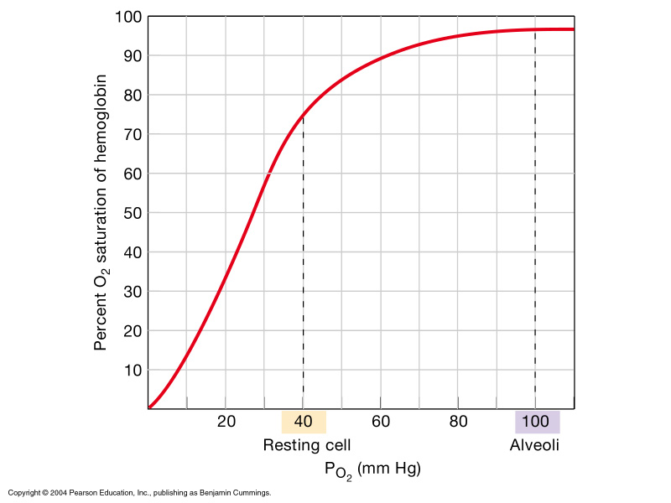
O₂-Hb Saturation Curve

Slide 33
Factors that Shift the Hb-O₂
Saturation Curve
* pH of surroundings:
* Temperature:
* P_{CO2}:
* 2,3-DPG:

Slide 34
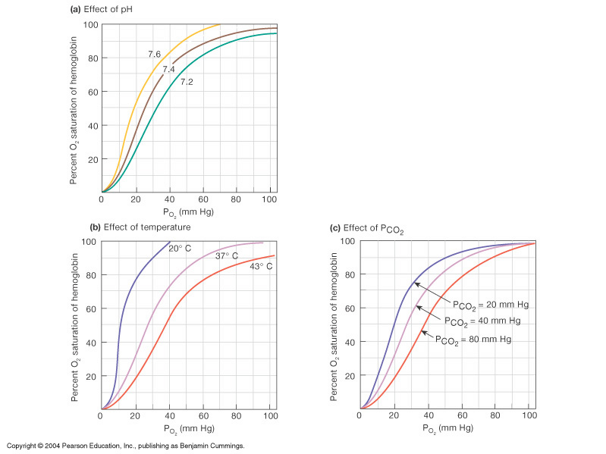

Slide 35
Fetal Hb
Fetal Hemoglobin (HbF) is different from Adult Hb.
Structurally the subunits for HbF are:
2 α-subunits and
2 γ-subunits (gamma, not beta!)
Functionally HbF binds to O₂ with greater affinity than adult Hb. In this way it advantages the capturing of O₂ by the developing fetus from the mother's bloodstream.
Typically, by about 6 months old the newborn’s HbF is virtually completely replaced by the adult form of Hb.

Slide 36
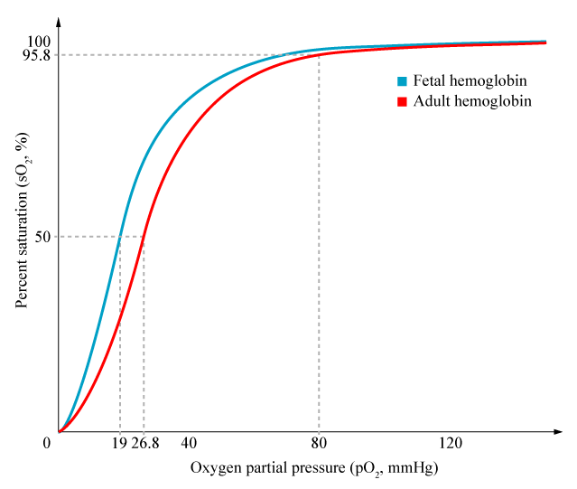
Fetal Hb
The difference in O₂ affinity is due to the gamma subunits, which are different to beta by only a single amino acid (#143): HbF has serine instead of histidine, giving it a greater affinity for O₂.
The HbF does not interact 2,3-DPG.
As we already know, in adults, the 2,3-DPG made by RBCs decreases the affinity of Hb for O₂.

Slide 37
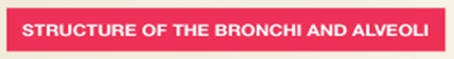
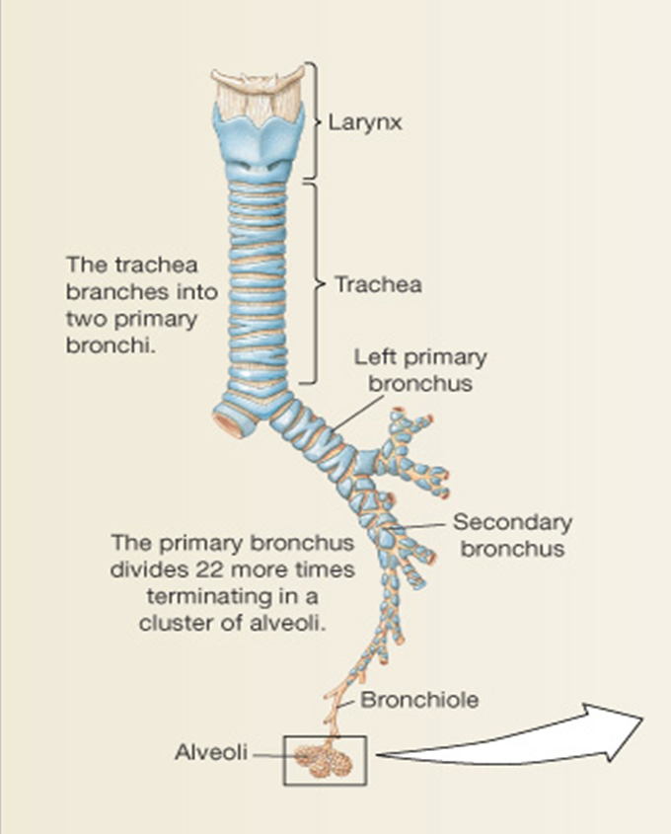
Air Flow = ΔP/R
∆P is?
R is?
Branching of Airways
Airway Resistance
Diameter
Bronchodilation
Bronchoconstriction
Tertiary
bronchi
Terminal bronchioles
Respiratory bronchioles
Blockage (e.g., mucous)
Alveolar ducts

Slide 38
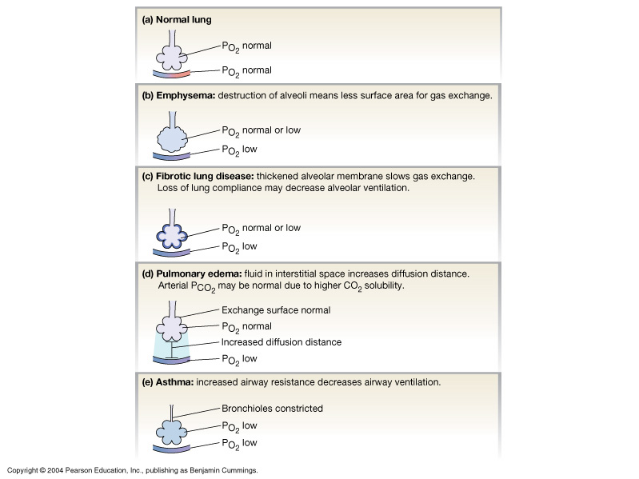
For best gas exchange need:
- Wet surface
Thin epithelia
- Large surface area
- Little ECF
Some Diseases:
Emphysema
Fibrotic Lung
Pulmonary edema
Asthma
Bronchitis

Slide 39
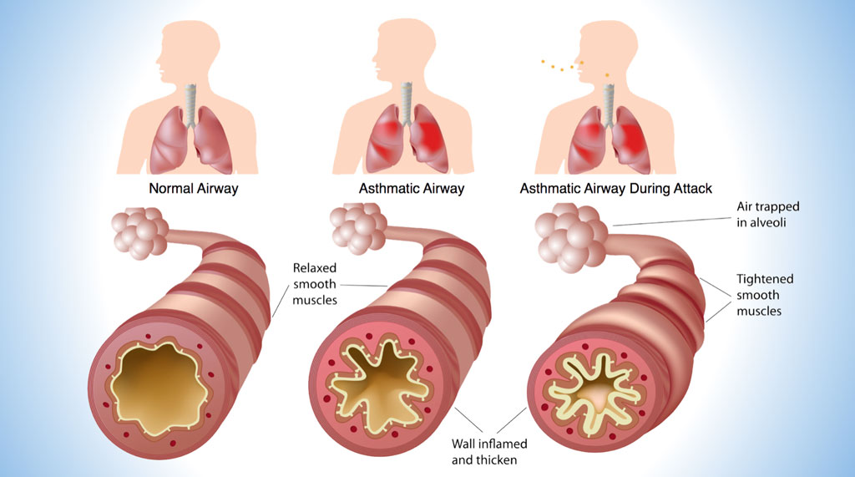

Slide 40
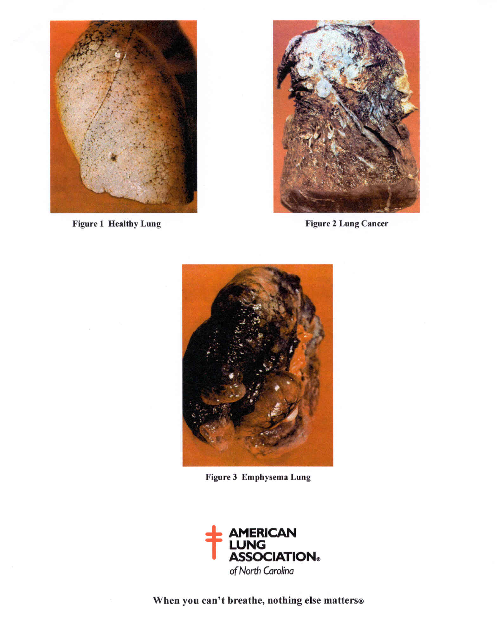

Slide 41
Common Lung Diseases
Asthma Chronic Bronchitis
Collapsed Lung
Pneumonia
Tuberculosis
Cystic Fibrosis
Emphysema
Pulmonary Hypertension
Allergies
Lung Cancer
COPD
Restrictive Lung Diseases

Slide 42
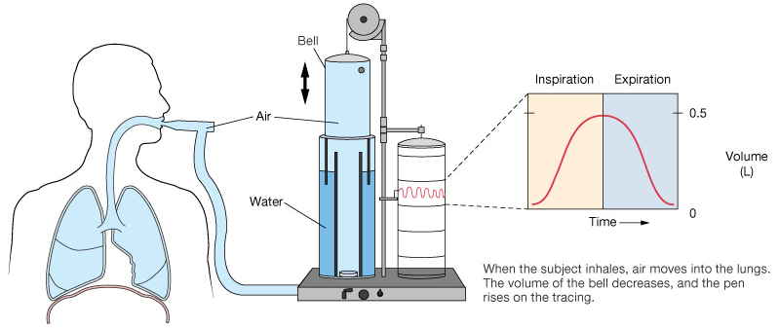
Volumes
Capacities
Tidal volume
Inspiratory reserve volume
Expiratory reserve volume
Residual volume
Vital capacity
Inspiratory capacity
Total Lung capacity

Slide 43
