Slide 1
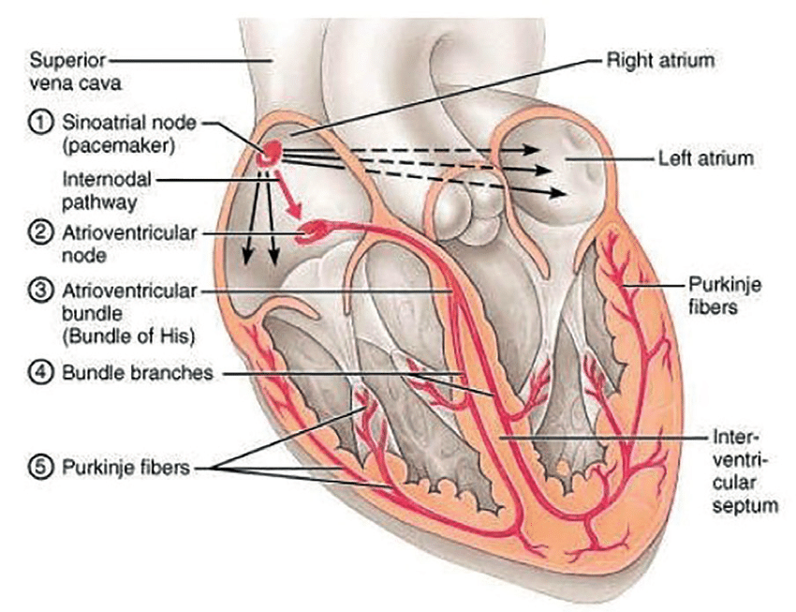
Electrical Conduction System of the Heart
(b)
Note: The internodal pathway (a)
Note: The interatrial band (b) (Bachmann’s bundle)
(a)
There are 5 main components (with location) of this conduction system:
1) Sinoatrial (SA) node
2) Atrioventricular (AV) node
3) AV Bundle (of His)
4) Left and Right bundle branches
5) Purkinje fibers
Sinus rhythm = the normal contractile pattern of the heart.
Electrical Conduction Region | Spontaneous Rate of Action Potentials/min
SA Node (sets the pace) | 70 - 80
AV Node | --------
AV Bundle | 40 - 60
R and L Bundle Branches | --------
Purkinje Fibers | 20 - 40

Slide 2
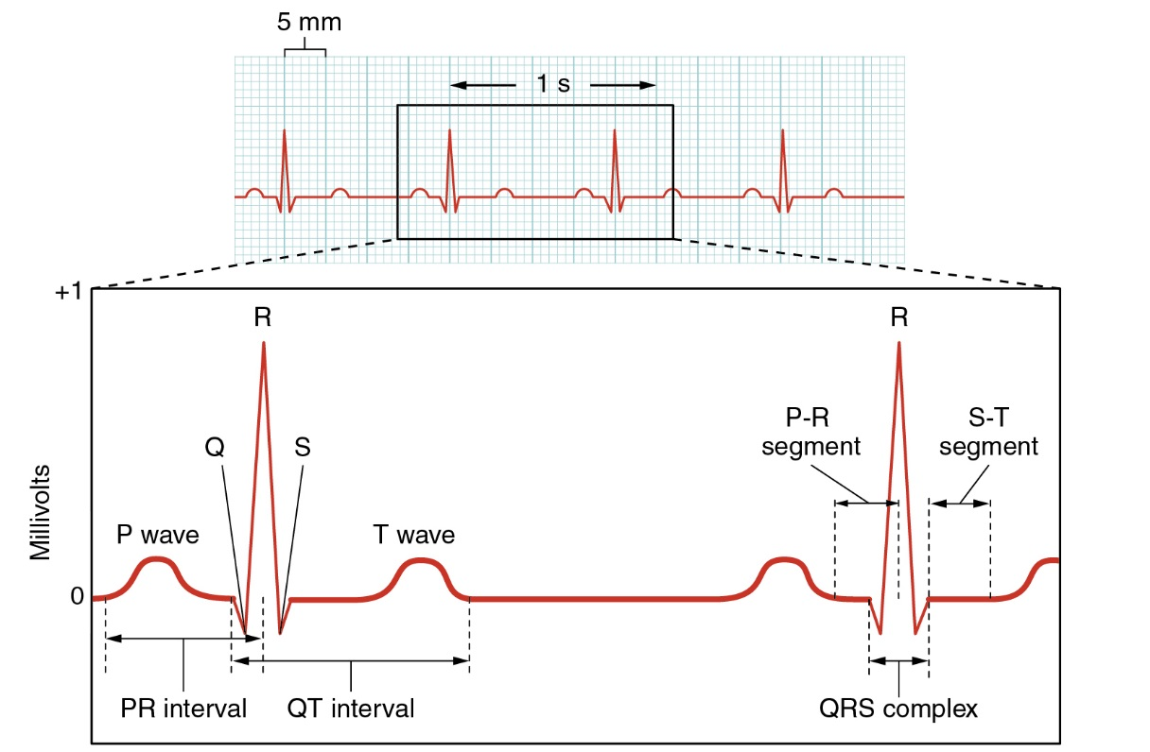
Trace of an ElectroCardioGram (ECG)
General Features of ECG
Wave – Deflection from baseline (+ or - direction).
Segment - A line between waveforms.
Interval - A waveform and a segment.
Complex - Consists of several waveforms.

Slide 3
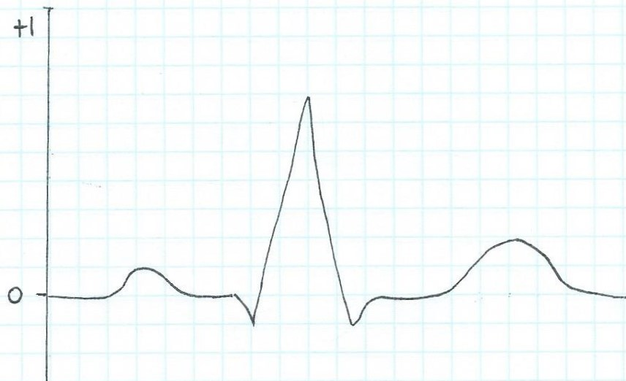
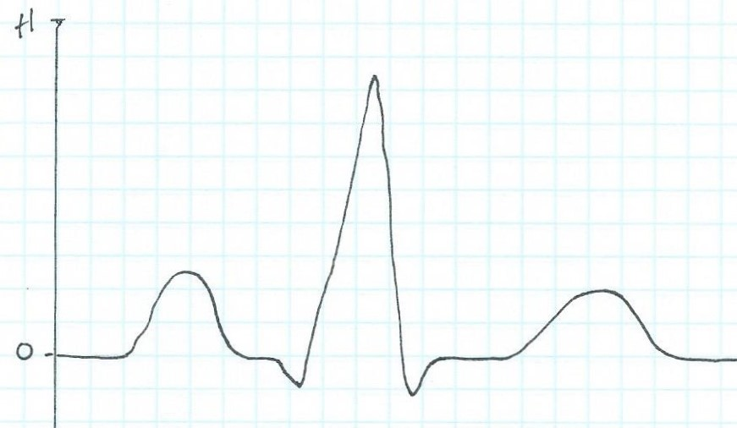
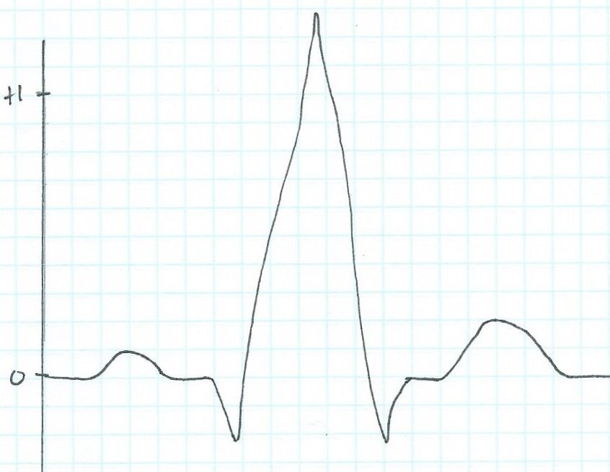
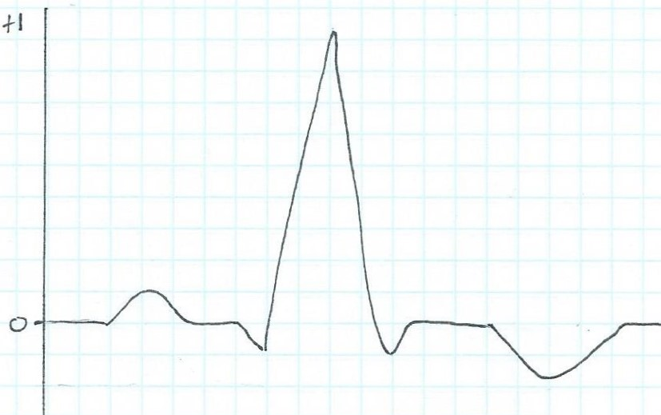
In lab we examine ECG traces, using the Normal ECG trace as a guide to identify the abnormal component on each of these ECG traces a), b) and c) and suggest what they might indicate:
Normal ECG trace
a)
b)
c)

Slide 4
Cardiac Output
Cardiac Output (C.O.) is the volume of blood ejected by ventricles per unit time.
Expressed as minute volume, or liters of blood per minute (L/min)
C.O. meets metabolic needs, i.e., is proportional to the tissues need for oxygen (O₂) and nutrients, and removal of carbon dioxide (CO₂) and waste.
C.O. changes with changes in body position.
e.g., from recumbent (lying down) to upright -> HR and SV increase.
At rest healthy adult C.O. is about 5 L/min.
C.O. can increase 50-100% by anxiety/excitement, even to 500% by exercise.

Slide 5
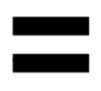
Calculating Cardiac Output
C.O.
Heart Rate
(beats/min)
Stroke Volume
(volume/beat)
Factors Affecting Heart Rate
ANS
Hormones
Physical Activity
Emotional State
Factors Affecting Stroke Volume
ANS
Amount of Ca²⁺
Preload (EDV) and Afterload (Resistance)
Physical Activity/Emotional State
Example Calculations:
Below are values for at rest and during exercise. Let’s calculate the C.O., including units, showing all work!
*SV= EDV-ESV
1) At Rest:
HR = 72
EDV = 135
ESV = 65
2) During Exercise:
HR = 121
EDV = 178
ESV = 42

Slide 6
Cardiac Output is Modified by ANS
Para activity decreases heart rate and force of contraction.
Sym activity increases heart rate and force of contraction.
Multiple Factors Influence Stroke Vole (SV).
SV directly related to the force generated by cardiac muscle during contraction.
Greater force of contraction means greater SV, and lesser force means lower SV.

Slide 7
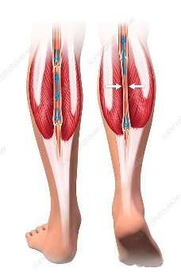
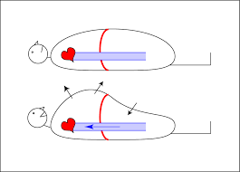
Things that Influence SV:
Length-Tension or Stretch-Force Relationships
As cardiac muscle sarcomere length increases, tension generated contracting muscle increases = SV.
More force, greater amount of blood ejected.
b) Venous Return or Cardiovascular Preload
Blood returning to the heart is termed 'venous return'.
Greater venous return = stretch cardiac muscle, and they contract more forcefully.
Venous return determines EDV and this determines stroke volume (SV)!
Several factors affecting venous return:
The ‘Skeletal Muscle Pump’.
The ‘Respiratory Pump’.
Sympathetic Activity.
Preload = another way of expressing EDV. The greater the EDV = Greater preload = Greater SV.
Note: Decreased EDV = Decreases preload = Decreases SV.
Afterload = the force ventricles must generate to pump blood against resistance in vascular system.
Any increased resistance requires a greater afterload to force open the semilunar valves and pump the blood into the arteries. Increased afterload decreases SV; decreased afterload increases SV.

Slide 8
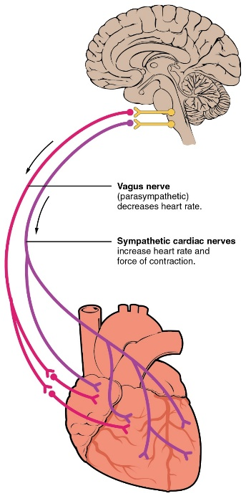

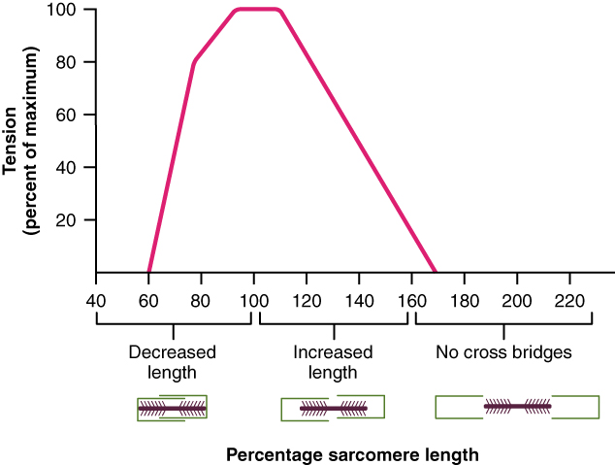
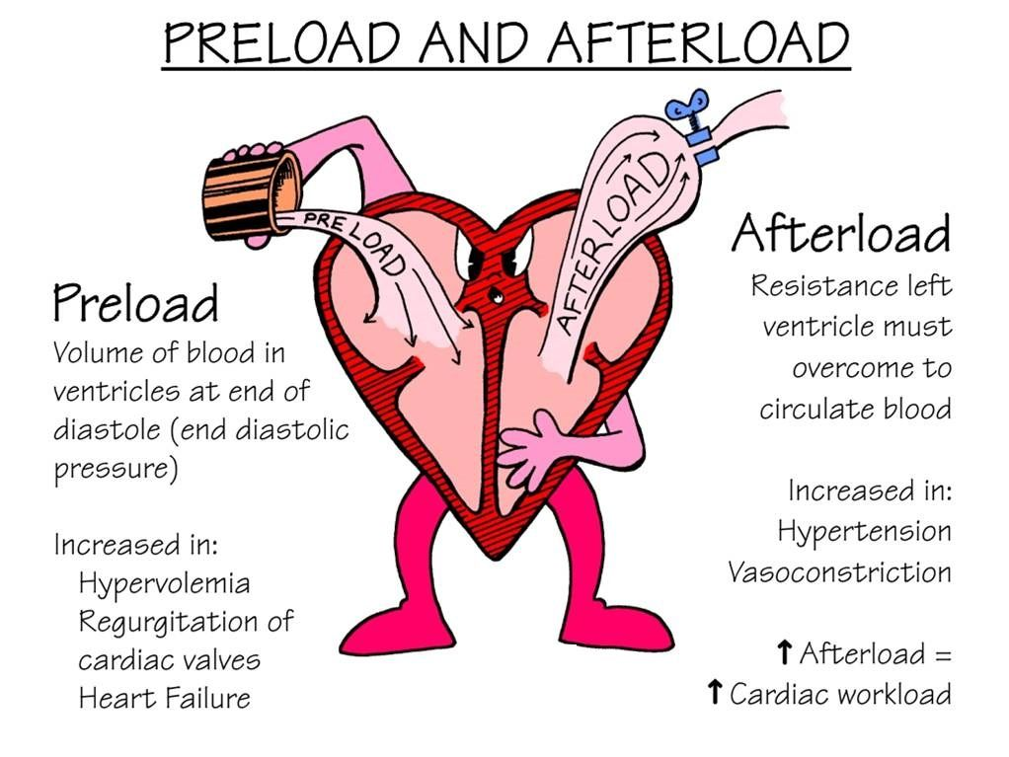
Summary of Impacts on Cardiac Output
❶
❶
Parasympathetic activity decreases heart rate and force of contraction.
Sympathetic activity increases heart rate and force of contraction.
❷
Optimal Length of Sarcomere = Most Force
Note: At rest, cardiac sarcomeres are short, thus stretching heart chambers (with increased volume) makes heart contract with more force, this will increase SV.
❸
Preload and Afterload effect Stroke Volume!
❷
❸

Slide 9
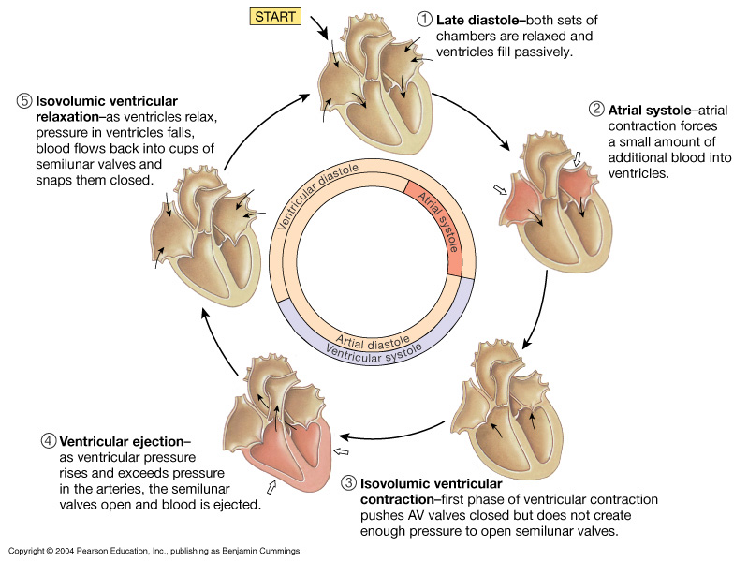
Diastole
Systole
The Cardiac Cycle

Slide 10
The Cardiac Cycle:
Mechanical Events of the Heart
Late Diastole: “Heart at rest” all chambers are relaxed and ventricles are filling with blood.
(passive filling, both ventricles ~ 80% full)
2. Atrial Systole: Atria contract, adds the last 20% of blood to the ventricles (‘top off’ of ventricles).
End Diastolic Volume (EDV) = Maximum ventricular volume*

Slide 11
3. Ventricular Systole (part 1):
Ventricular contraction begins - ↑Pressure (P).
Closure of AV valves = 1st heart sound ("lub").
(now all heart valves are closed)
Ventricles are Sealed Compartments
= Isovolumetric ventricular contraction
(when pressure builds as volume stays the same)

Slide 12
4. Ventricular Systole (part 2):
Ejection phase: ↑P pushes open semilunar valves, blood forced out into the artery leaving ventricle.
Pulmonary Semilunar => 25 mmHg (min pressure to open)
Aortic Semilunar => 80 mmHg (min pressure to open)
End Systolic Volume (ESV) = volume remaining in
heart after ejection (~½)*.
Stroke Volume = EDV - ESV (ml/beat)

Slide 13
5. Ventricular Diastole:
Relaxation of ventricles, artery back flow slams semilunar valves shut = 2nd heart sound ("dup").
(now all heart valves are closed)
Ventricles are Sealed Compartments again
= Isovolumetric ventricular relaxation
(when pressure decreases as volume stays the same)
Finally, the AV valves open again and refilling starts –
back to the start of cardiac cycle.

Slide 14
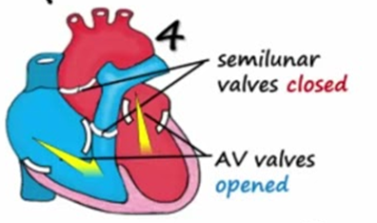

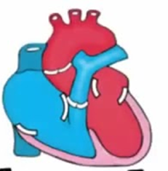
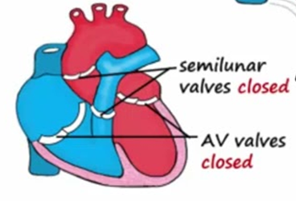
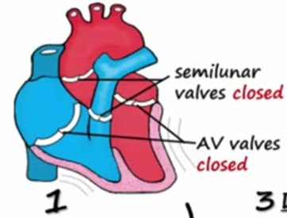
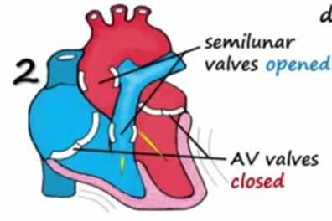
The Cardiac Cycle
②
Atrial Systole
①
Heart in Diastole
③
Ventricular Systole 1
⑤
Ventricular Diastole
④
Ventricular Systole 2

