Slide 1


CRM Implementation Update
Institutionalizing Element451 at Miramar College
Notes:
Good Morning – so there is a lot going on with this project, and I’m happy to be sharing an update with you all. There has been a lot of progress and some developments, so we want to really make sure everyone is aware of the work being done, as well as the challenges.

Slide 2


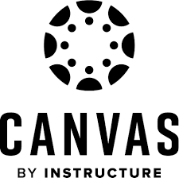
Implementation Update
Element451 Functionality
Communication & Engagement
Agentic AI
CANVAS Integration
Notes:
It is important that we understand the primary functions of the CRM:
Engagement and Communication Tool
Agentic AI
LMS Integration

Slide 3
Implementation Update
Functionality for
Miramar College
We are here !
Admissions and Enrollment Nurturing
Event Management
Student Journey Management
Student Data Capturing
Reduce the Noise!
Replace Chatbot Vendor (Ocelot)
Department Level AI Teammates
Proactive Jobs functionality
Monitor Grades
Monitor attendance & class engagement
Early Alert (Retention / Persistence)
Notes:
Important to note:
Let’s remember that Communication and Engagement is where we are right now with this project. Agentic AI and CANVAS integration are updated components of the CRM, and while we are beginning some work in those areas, the initial implementation is centered around communication and engagement tools within the CRM.

Slide 4
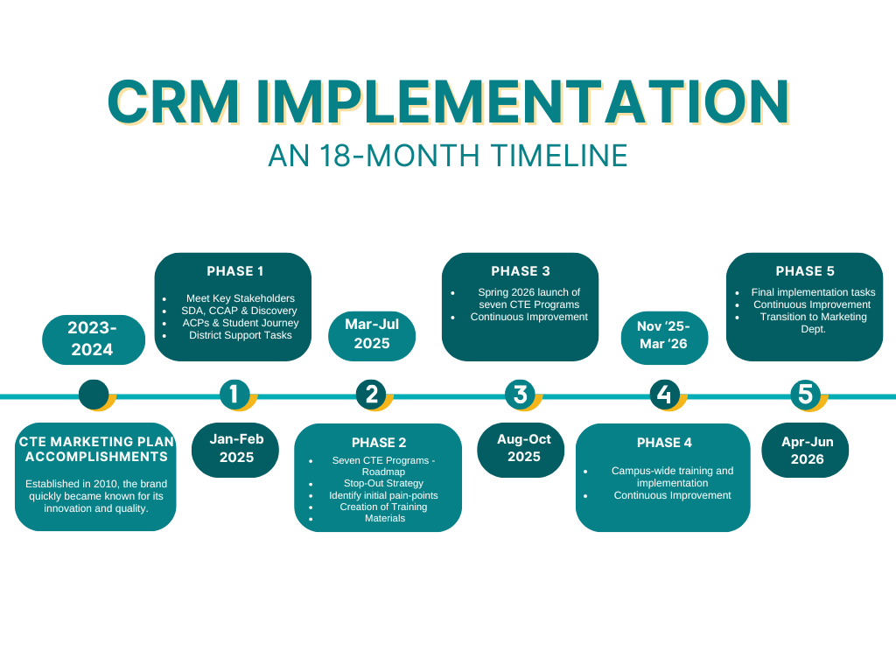
Implementation Update
Notes:
To refresh everyone’s memories – or to perhaps provide context for those who are unaware, this project has an 18-moth timeline. Phase 3 & 4 has centered around work with Counseling, CLDS, Vet Affairs, DSPS, Fin Aid, EOPS, Admissions, Basic Needs, Promise, Graduation and LEAD have commenced. To be 100% transparent, I had presented a plan for training back in November at Join Deans Council. This opened up a robust conversation around what should be rolled out in the way of training, to whom it should be available to, and how we should institutionalize the day-to-day use of the CRM. As is often the case with a large project with this, it gave folks some pause….

Slide 5

Implementation Update
Notes:
…to the point where leadership needed a moment to discuss. Ultimately, this is not a bad thing. The tool continues to evolve and offer more than anyone opportunities to address gaps than anyone had originally thought. It wasn’t until we returned from break before we could agree on what institutionalizing the CRM would look like for us at Miramar College.

Slide 6
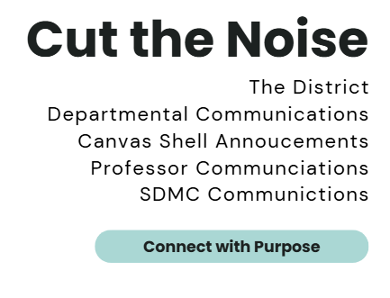
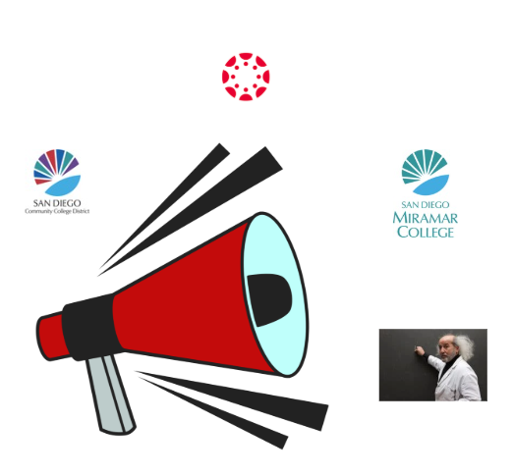
Implementation Update
Notes:
As we look ahead past the initial implementation, we should work to expand the use of all three components of the CRM Platform, having them work in concert to provide personalized, targeted communications toward our Student Success goals such as increasing persistence metrics and capturing student data for VAR; addressing equity gaps for our DI populations; and doing so more efficiently through a Student Hub App we can make available to all our students.

Slide 7
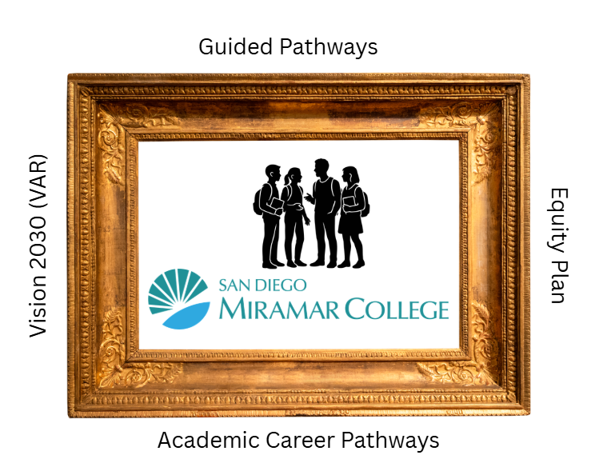
Implementation Update

Slide 8
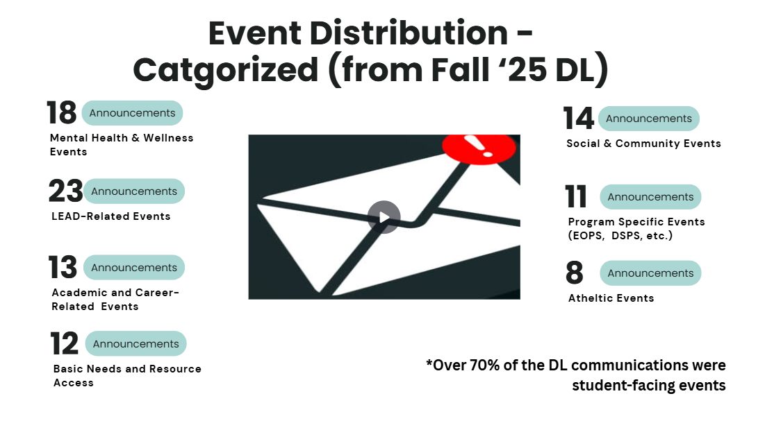
Implementation Update

Slide 9
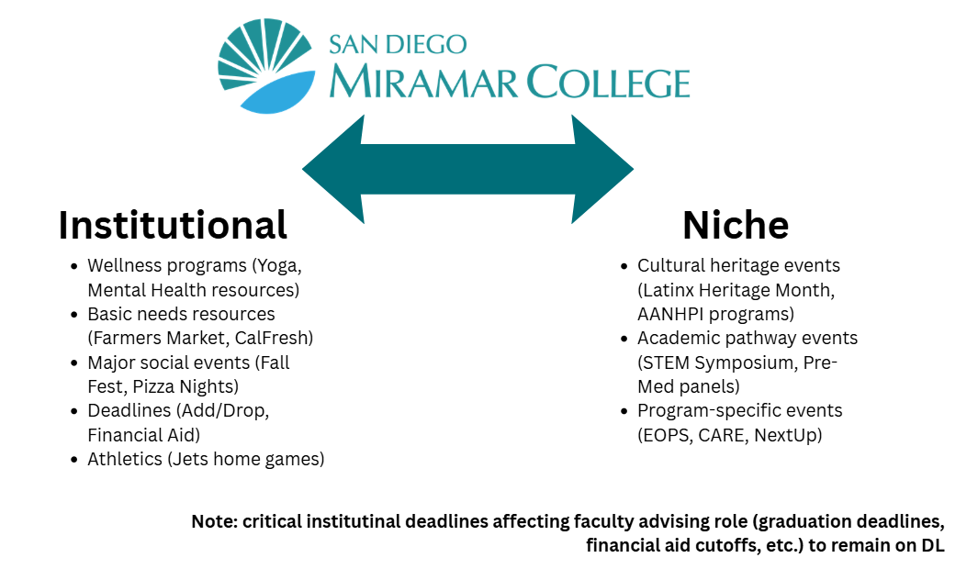
Implementation Update

Slide 10
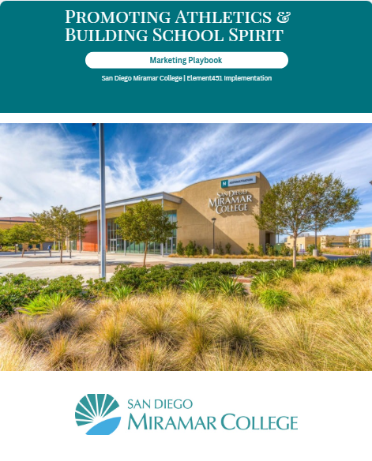
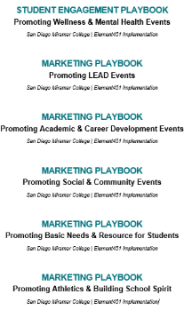
Implementation Update

Slide 11
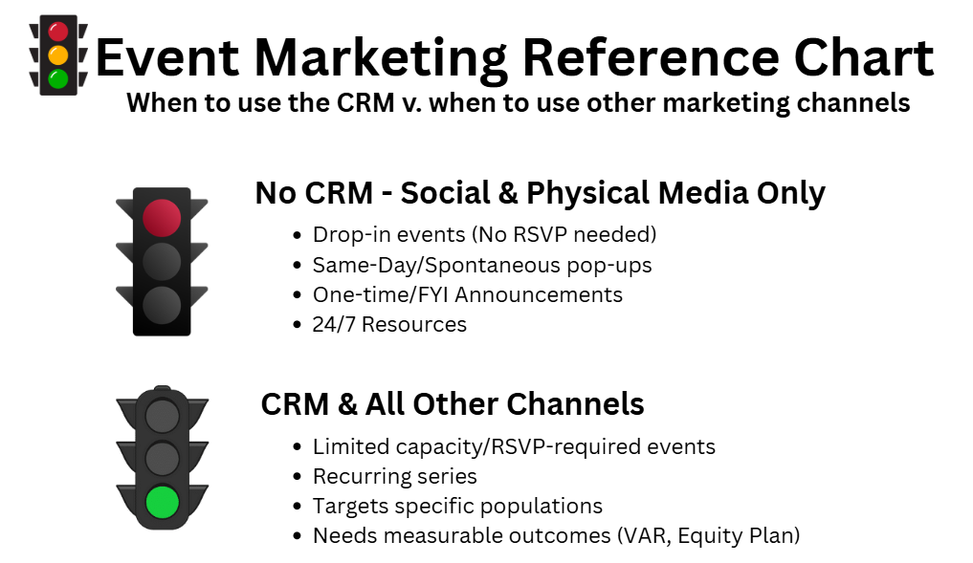
Implementation Update

Slide 12
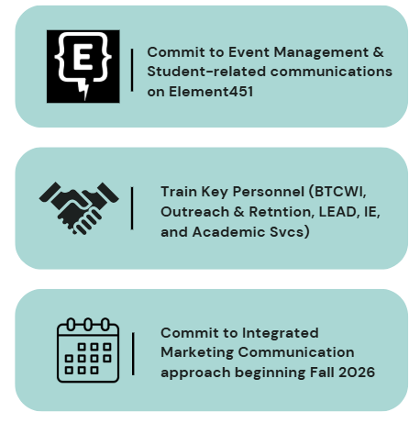

Implementation Update
Formalized Training
Notes:
In addition to the continued departmental expansion, formalized training will begin in November with representatives from the previously mentioned Phase 3 areas. We have an 80-page and growing resource guide that I will be utilizing during training, but participants will of course be keeping them as they begin the adoption process in their areas. I am looking at Friday mornings as a designated time, and still ironing out location.

Slide 13
Implementation Update
Super
User
Special Project Manager
Power User
16 Individuals
Instructional & Student Service Deans
Standard
User
16 Individuals
Instructional & Student Service Deans
Start small, scale up: Power users from BTCWI, Lead, IE, Outreach & Retention, Academic Affairs
Training Focus: Marketing Communications & Event Management
Required: Full-time employee

Slide 14
Implementation Update
How does that translate?
Counseling
First AI Agent in place (Cora) and replacement of OCELOT with CRM for Quick Connect appointments
Career & Life Design
Workshops Campaigns/Events (Alumni); Job Placement Case Management System (Fall 2026)
Veteran Affairs
Campaign: Priority Registration; Veterans Week
Financial Aid
Scholarship Ceremony & related communications; Six Campaigns formed; final revision work pending
DSPS
Dine with DSPS Event promotion
Admissions
Early work has begun on an AI Agent to answer top 15 FAQ inquiries
Basic Needs
An ongoing campaign for the Really, Really FREE Farmer’s Market
Graduation/Commencement
Collaboration between Admissions/Evaluations and Student Affairs
LEAD
Equity Plan Metrics – DI Populations; Supporting PEARL-MindArch grant work
Plus – Replaced OCELOT Chatbots with CRM Agents
Notes:
To give everyone an idea of the things being worked, I will point to just a couple of items in this list:
-Counseling: 34% increase in 1-hour Ed Plan appts (fully booked)
-Collaborating between Admissions and Student Affairs to bring the graduation and commencement on board with the CRM
-We are also looking to help clear out the Admissions inbox through the use of an AI Agent to answer top 15 most common email inquiries

Slide 15
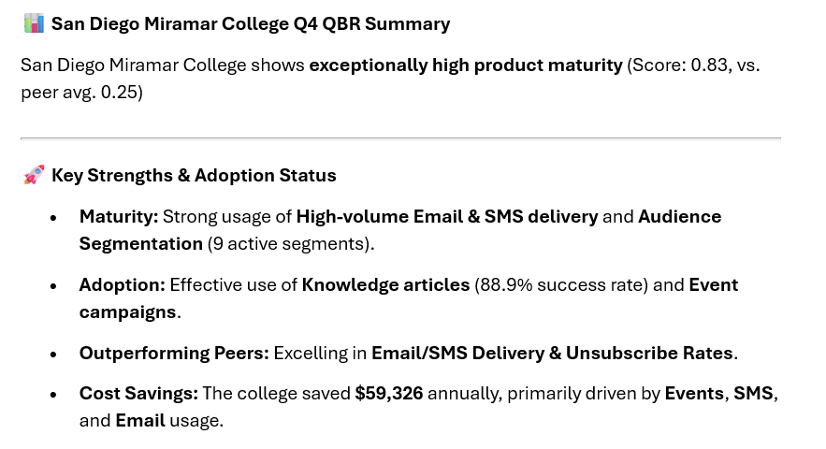
Implementation Update
Initial ROI
Notes:
So let me give the breakdown here:
Agent & Conversation/Chat tool (75 hours saved)
Event tool (52 quarterly hours saved) - SMS campaigns (20 hours saved) - Email automation (17 hours saved)
Element then takes the number of hours saved and multiply by the national average hourly rate of an admissions representative of approximately $25/hour – coincidentally, not all that outrageous considering the minimum wage increase for hospitality workers in San Diego going up to $25/hour.

Slide 16
Implementation Update
Initial ROI
Element 451ROI | Q2 | Q3 | Q4
Total Hours Saved | 115 | 164 | 164
Annual Savings * | $11,200 | $16,400 | $16,400
Ocelot Contract Ended Dec. 2025: $62,250 Annually
$122,650
Annual Savings*
* Only two departments at +75% Adoption
Notes:
Between the savings through marketing automation and the expiration of the Ocelot contract, will see an ROI of $78k

Slide 17
Implementation Update
Engagement &
Primary Term Persistence
Semester | Miramar Students* | Jets JumpStart Attendees**
Fall 2024 | 49% | 90%
Spring 2025 | 39% | 75%
*Source: Public PREDD 2024-2025
**Source: Miramar College Office of Institutional Effectiveness
Fall 2024 = 361 Students
Spring 2025 = 97 Students
Notes:
We can also start to see the impact in other ways … I had the office of IE put together a comparison of the Primary Term Persistence of our Jets Jumpstart attendees v. the general college student population. Students who attend the event are persisting at double the rate of the overall student population. While this does represent just a small sample, the results do align with what we all know: when students are engaged, when they build connections and learn about the support available to them, they are more likely to return the next semester. One idea that we could explore is creating a campaign targeting non-attendees to provide them with the information such as campus events, basic needs, ACP success coaches, ASC and include the Resource Guide to potentially raise the Primary Term Persistence for all students?

Slide 18
Implementation Update
Scratching the Surface
We are (still) here !
Communication & Engagement
Agentic AI
CANVAS Integration
Notes:
Remember – we are primarily taking advantage of about a third of this platform’s capabilities. Imagine when we are able to utilize the entire functionality of the platform, we would have the ability to impact a number of areas here at Miramar College. From the Equity Plan to VAR, Guided Pathways, ACPs and even reduce administrative bottlenecks. But nothing is more enticing than the prospect of instituting an Early Alert system through the use of all three functions of Engagement, Agentic AI and Canvas Integration.

Slide 19
Questions?
Need to know more?
droberts001@sdccd.edu
Notes:
In the meantime, I am trying to increase the level of communication I am providing around the project. I feel like all I am doing is talking about the project – but I have learned that no matter how I feel about it, there are still folks here who state they do not know enough about the project. If you hear a member of the Miramar College community state as much, contact me. I am now addicted to caffeine and a coffee meeting to discuss the project will always be welcomed.

