Slide 1


Academic Senate Meeting
March 17th, 2026
2025-26 Academic Year
Cultivating Community:
Making the invisible visible
(QR Code for A.S. Webpage)
Attending for Flex credit? Email rgomez001@sdccd.edu or jbartolo@sdccd.edu

Slide 2
March 17th, 2026
2025-26 Academic Year
Please remember to sign in physically using the sign-in sheet! (See Juli!)
When we reach quorum (23/44) we can get started officially!

Slide 3
2. Agenda Overview
Call to Order
Approval of Agenda & Consent Calendar
  DRAFT Minutes 030326
Land Acknowledgement (Updated)
Public Comments
Action Items
  Academic Standards Subcommittee Changes
Discussion Items
  Standing: Curriculum Committee Updates
  Free Speech and Campus Safety
  New Miramar Technology Plan
  CRM (Element 451) Implementation Update
  AP 5500.1 – Honest Academic Conduct
Reports:
  Committee Reports
  Special Reports
  Executive Committee Reports
Announcements
Adjournment
A.S. Agenda for 3/17/26
AS Code of Conduct

Slide 4
3. Land Acknowledgement
We recognize that San Diego Miramar College sits on the ancestral homeland of the Kumeyaay, Luiseño, Cupeño, and Cahuilla tribes, who have lived in this area for well over 10,000 years, and we honor their past, present, and future connection to this land and its inherent connection to their identity.
We acknowledge our occupation of unceded Kumeyaay land and the violent systemic injustices this has continuously perpetuated for Native peoples of this region. We pay respect to the Indigenous people of San Diego County - past, present, and future - and honor their continuing presence in their homeland and their spiritual beliefs that land does not belong to people; people belong to land.
We also acknowledge that this is merely the beginning, and there is far more work to be done in an attempt to heal all of the injustices and inequities that still exist today and throughout their entire historical diaspora. We commit to moving forward together.
Resources: “Making a land acknowledgment meaningful”; A call for more powerful land acknowledgements

Slide 5

4. Public Comments
(10 Mins)
Limited to 10+1 items that are not on the agenda
  Public Comments on agenda items will take place before the A.S. body discussion begins but after any relevant presentations.
2 min. per speaker, 10 mins. per topic
  Individual speakers may not yield their time to another speaker or spokesperson
To be continued at the end of the meeting if necessary

Slide 6

4. Public Comments
4.1 March is Women’s History Month!
Women's History Month had its origins as a national celebration in 1981 when Congress passed Pub. L. 97-28 which authorized and requested the President to proclaim the week beginning March 7, 1982 as “Women’s History Week.”
In 1987 after being petitioned by the National Women’s History Project, Congress passed Pub. L. 100-9 which designated the month of March 1987 as “Women’s History Month.”

Slide 7
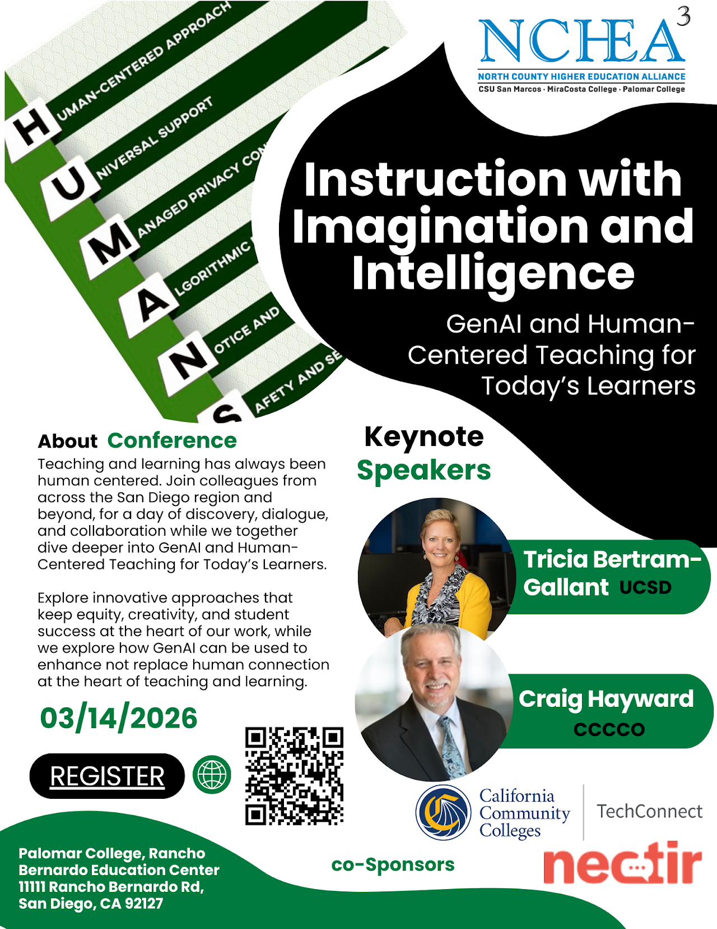
4. Public Comments
4.2 SD Regional AI Conference 2026
Instruction with Imagination and Intelligence
Saturday, March 14th, 8:00 a.m. - 4:00 p.m.
At Palomar College
Hosted by NCHEA
Great Turnout / SDCCD & Miramar well-represented

Slide 8
5. Action Items (Second Reads)

Slide 9
5. Action Items (Second Reads)
5.1 Second Read: Academic Standards Subcommittee Changes
(Mara Palma-Sanft)

Slide 10
6. Discussion Items (First Reads)

Slide 11
6. Discussion Items (First Reads)
6.1 Standing Curriculum Committee Updates
(Veronica Hartmann)

Slide 12
6. Discussion Items (First Reads)
6.2 Free Speech and Campus Safety
(Adrian Gonzales / Rodrigo Gomez)
Ongoing tense political climate. Resources are in demand for better ways to support students and faculty against ICE, especially should they not comply.
Safety Concerns over campus security; can they can intervene to support us
Safety Concerns extend to Free Speech & Campus Safety
  Concerns over “Turning Point USA” tabling
  ASG has voiced similar concerns

Slide 13
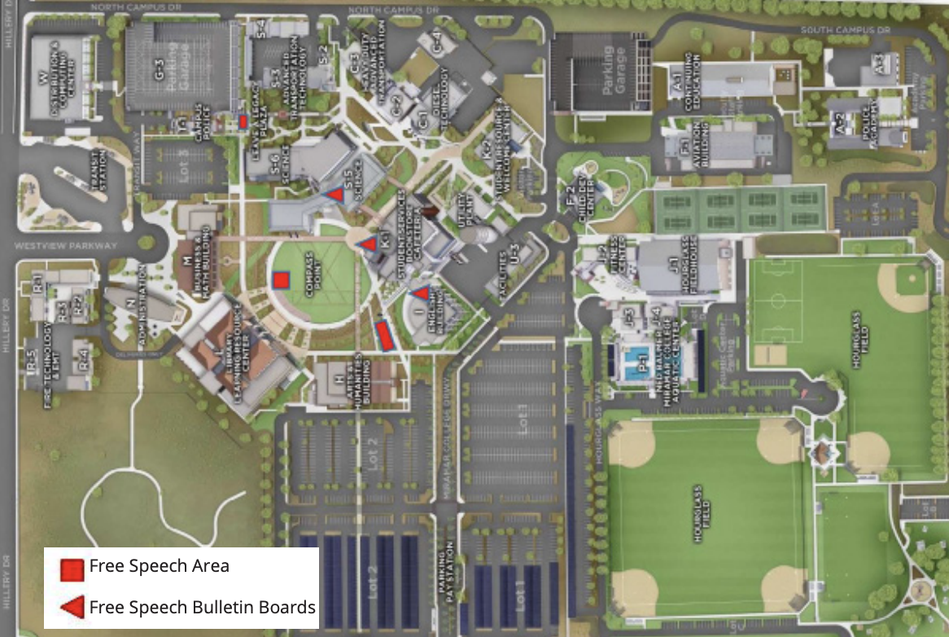
6. Discussion Items (First Reads)
6.2 Free Speech & Campus Safety
“Miramar College has recommended areas for a variety of free speech activities, i.e., speeches/presentations, rallies, distribution of literature, posting, and voter registration. The map on the back of this brochure identifies the recommended free speech areas. If you have any questions or need clarification, contact the Office of Student Affairs.”
  Link to BP 3900

Slide 14
6. Discussion Items (First Reads)
6.3 New Miramar Technology Plan
(Kurt Hill / Jeff Orgera)
Previous Technology Plan was approved by this Senate & College Council
Now, work is beginning on the new tech plan

Slide 15


6. Discussion Items (First Reads)
6.4 CRM Implementation Update (Element 451)
(Dan Roberts)
  Link to Slides

Slide 16
6. Discussion Items (First Reads)
6.5 AP 5500.1 – Honest Academic Conduct
(Rodrigo Gomez)
Plagiarism: The act of incorporating ideas, words, or specific substance of another, whether purchased, borrowed, or otherwise obtained, and submitting the same as one’s own work to fulfill academic requirements without giving credit to the appropriate source. Examples of plagiarism include but are not limited to the following:
7) Authorized use of Artificial Intelligence (AI) tools is determined by each instructor. Use of AI tools to complete, in whole or in part, an academic assignment without authorization from the instructor could be treated as plagiarism or cheating under this procedure. This includes submitting AI-generated work as one’s own or using AI tools in a manner that replaces the student’s independent effort or intended learning outcomes of the course.
  Link to AP 5500.1

Slide 17
7.Reports
7.1 Committee Reports
7.2 Special Reports
7.3 Executive Committee Reports

Slide 18
7. Reports
7.1 Committee Reports

Slide 19
7. Reports
7.2 Special Reports

Slide 20
7. Reports
7.3.1 President’s Report
7.3.1.1 Call for Scholarship Application Readers
7.3.1.2 College Council is forming an AI Workgroup
7.3.1.2 AI Day Professional Development
7.3.2 Vice President’s Report

Slide 21
7. Reports
7.3.3 – 8
  Secretary – Olivia Flores
  Treasurer – Dawn Diskin (please see the following slide)
  Contract Member-at-Large – Melissa Wolfson
  Contingent Faculty Member-at-Large – Desi Klaar
  Chair of Chairs – Mary Kjartanson

Slide 22
7. Reports
7.3.4: Treasurer (Dawn Diskin)
Account Balance $464.49
Academic Senate Dues / Voluntary Payroll Deduction
  Please remember to set it up!
  Reach out if you’d like some assistance.

Slide 23
8. Announcements
1 min. time limit each

Slide 24

8. Announcements
8.1 Gender Equity in the Age of ICE
presented by GAIA + LEAD
Wednesday, March 18th | 12:45 – 2:00 p.m.
I-101 A/B (English Building)
Lunch provided

Slide 25

8. Announcements
8.2 AFT Mini Conference & CFP 4/10/26
(Amy Alsup)
At all times, but especially in our current time, community is crucial to improving, building and sustaining institutions that serve our students, our colleagues, and ourselves. Research shows that creating inclusive spaces with diverse perspectives and experiences increases successful outcomes.
Conference Goal: to give our members a chance to connect and learn from one other. Example prompts:
A panel discussion of instructors who have worked on building community in online classes. What's worked? What hasn't? What are they trying?
A panel or short presentation on how departments build community with/between their full-time and part-time colleagues. What worked? What are they trying?
A short presentation on building community for a special population (e.g. LGBTQI, Umoja, Puente, Veterans, Athletes...)

Slide 26
8. Announcements
8.3 AI InnovAItion Day 2026
Friday, March 20th, 8:00 – 4:00 p.m.
  Free
  District-wide
  Faculty Led / Student Panel / Industry Panel
  Registration Link

Slide 27

8. Announcements
8.4 ASCCC AI and Academia 2026
Friday – Sunday, March 19 – 21st, 8:00 - 4:00 p.m.
  Registration Link

Slide 28
9. Adjournment
If the calendar was approved earlier,
the first meeting of the 2025-26 SDMC Academic Senate is:
Tuesday, April 7th, 2026 from 3:30-5:00 pm in M-110.
Remember that starting Spring 2026 we’ll be moving to fully in person Senate meetings. Hence, we will be retiring the A.S. Senator Remote Attendance Form

Slide 29
Thanks for your hard work for Miramar College!
If you have any questions, please reach out via email!
rgomez001@sdccd.edu or jbartolo@sdccd.edu

