Slide 1

Academic Senate Meeting
March 3rd, 2026
2025-26 Academic Year
Cultivating Community:
Making the invisible visible
(QR Code for A.S. Webpage)
Attending for Flex credit? Email rgomez001@sdccd.edu or jbartolo@sdccd.edu

Slide 2
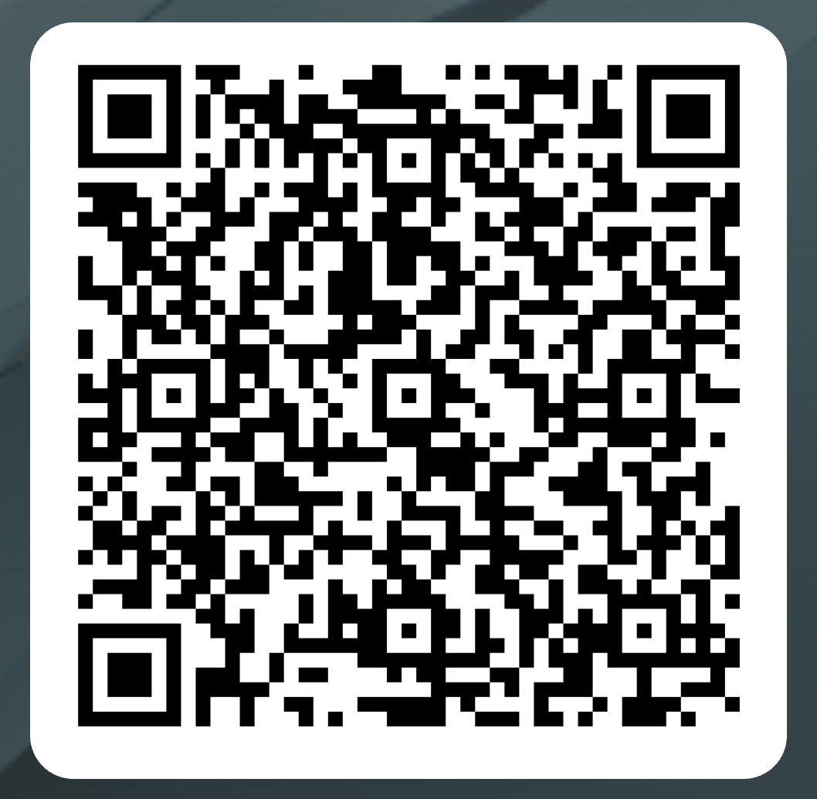
Attendance Log: March 3rd
Please remember to sign in physically using the sign-in sheet! (See Juli!)
When we reach quorum (23/44) we can get started officially!
(QR Code for A.S. Attendance)

Slide 3

2. Agenda Overview
Call to Order
Approval of Agenda & Consent Calendar
  DRAFT Minutes 021726
Land Acknowledgement (Updated)
Public Comments
Action Items
Discussion Items
  Standing: Curriculum Committee Updates
  NASSSP & PEARL Updates
  Outcomes Disaggregation
  New Drama Program
  Campus Safety at Miramar
Reports:
  Committee Reports
  Special Reports
  Executive Committee Reports
Announcements
Adjournment
A.S. Agenda for 3/03/26
AS Code of Conduct

Slide 4
3. Land Acknowledgement
We recognize that San Diego Miramar College sits on the ancestral homeland of the Kumeyaay, Luiseño, Cupeño, and Cahuilla tribes, who have lived in this area for well over 10,000 years, and we honor their past, present, and future connection to this land and its inherent connection to their identity.
We acknowledge our occupation of unceded Kumeyaay land and the violent systemic injustices this has continuously perpetuated for Native peoples of this region. We pay respect to the Indigenous people of San Diego County - past, present, and future - and honor their continuing presence in their homeland and their spiritual beliefs that land does not belong to people; people belong to land.
We also acknowledge that this is merely the beginning, and there is far more work to be done in an attempt to heal all of the injustices and inequities that still exist today and throughout their entire historical diaspora. We commit to moving forward together.
Resources: “Making a land acknowledgment meaningful”; A call for more powerful land acknowledgements

Slide 5

4.
Public Comments
(10 Mins)
Limited to 10+1 items that are not on the agenda
  Public Comments on agenda items will take place before the A.S. body discussion begins but after any relevant presentations.
2 min. per speaker, 10 mins. per topic
  Individual speakers may not yield their time to another speaker or spokesperson
To be continued at the end of the meeting if necessary

Slide 6
4. Public Comments
4.1 AFT Tenure-Track Bootcamps (Amy Alsup)
Workshops will be held on the following dates:
Friday, March 6th - 2:00-4:00 p.m. : The Application Panel - Grossmont College, 26-220
Friday, March 13th - 9:00 a.m. - 3:30 p.m. : The Interview & Teaching Demo - City College, MS 123
Friday, March 27th - 2:00-4:00 p.m. - The 2nd Interview - Mesa College, G101

Slide 7

4. Public Comments
4.2 AI Professional Development
SD Regional AI Conference 2026
  Saturday, 3/14/26, 8:00 am – 4:00 pm.
  Registration Link

Slide 8
4. Public Comments
4.3 AI Professional Development
SDCCD Innovaition Day 2026
  Friday, 3/20/26, 8:00 am – 4:00 pm.
  Registration Link

Slide 9

4. Public Comments
4.2 AI Professional Development
ASCCC AI and Academia 2026
  Friday - Sunday 3/19/26 – 3/21/26
  Registration Link

Slide 10
5.
Action Items (Second Reads)
No Action Items

Slide 11
6.
Discussion Items
(First Reads)
6.1 Standing Curriculum Committee Updates
Veronica Hartmann (10 mins)
6.2 NASSSP & PEARL Updates
Nessa Julian (10 mins)
6.3 New Miramar Technology Plan
Kurt Hill (10 mins)

Slide 12
6.
Discussion Items
(First Reads)
6.5 Outcomes Disaggregation
Patti Manley (10 mins)
6.6 New Drama Program
Rodrigo Gomez (10 mins)
6.7 Campus Safety at Miramar
Rodrigo Gomez (10 mins)

Slide 13
6. Discussion Items (First Reads)
6.1 Standing Curriculum Committee Updates
(Veronica Hartmann)
Feedback on Administrative Procedures and Board Policies
Updates on Title 5 revisions to Credit for Prior Learning (CPL)
Updates to professional development opportunities, common course numbering timelines, and the new attendance accounting method

Slide 14
6. Discussion Items (First Reads)
6.2 NASSSP & PEARL Updates
(Nessa Julian)
Information on Resource Centers
Promoting educational achievement, retention & leadership
Foundation grants
  Link to Slides

Slide 15
6. Discussion Items (First Reads)
6.3 Miramar Technology Plan Updates
(Kurt Hill)
Previous Technology Plan was approved by this Senate & College Council
Now, work is beginning on the new tech plan

Slide 16
6. Discussion Items (First Reads)
6.4 Outcomes Disaggregation
(Patti Manley)
2024 ACCJC requirements now include disaggregating outcomes assessment data to seek to identify and close equity gaps
Course and term will be emphasized; not individual instructor or section
  Link to Slides

Slide 17
6. Discussion Items (First Reads)
6.5 New Drama Program
(Rodrigo Gomez)
People have expressed interest in discussing details about the new program
Questions about “Viability Review of Instructional Programs”

Slide 18
6. Discussion Items (First Reads)
6.6 Campus Safety at Miramar
(Rodrigo Gomez)
Acknowledging the tense political climate, our campus should be aware of specific ways our campus and district are supporting students against ICE.
Resources have never felt more important
Concerns shared over ICE not complying, and what we can do
Concerns over campus security; can they can intervene to support us

Slide 19
7.
Reports
7.1 Committee Reports
7.2 Special Reports
7.3 Executive Committee Reports

Slide 20
7. Reports
7.1 Committee Reports

Slide 21
7. Reports
7.2 Special Reports

Slide 22
7. Reports
7.3.1 President’s Report
7.3.1.1 College Council is forming an AI Workgroup
7.3.2 Vice President’s Report
7.3.2.1 UMOJA Update

Slide 23
7. Reports
7.3.3 – 8
  Secretary – Olivia Flores
  Treasurer – Dawn Diskin (please see the following slide)
  Contract Member-at-Large – Melissa Wolfson
  Contingent Faculty Member-at-Large – Desi Klaar
  Chair of Chairs – Mary Kjartanson

Slide 24
7. Reports
7.3.4: Treasurer (Dawn Diskin)
Account Balance $463.47
Academic Senate Dues / Voluntary Payroll Deduction
  Annual student scholarships & Basic Needs Donations
Update from Miramar College Foundation

Slide 25
8. Announcements
1 min. time limit each

Slide 26
9. Adjournment
If the calendar was approved earlier,
the first meeting of the 2025-26 SDMC Academic Senate is:
Tuesday, March 17th, 2026 from 3:30-5:00 pm in M-110.
Remember that starting Spring 2026 we’ll be moving to fully in person Senate meetings. Hence, we will be retiring the A.S. Senator Remote Attendance Form

Slide 27
Thanks for your hard work for Miramar College!
If you have any questions, please reach out via email!
rgomez001@sdccd.edu or jbartolo@sdccd.edu

