Slide 1
NASSSP & PEARL
LEAD OFFICE

Slide 2
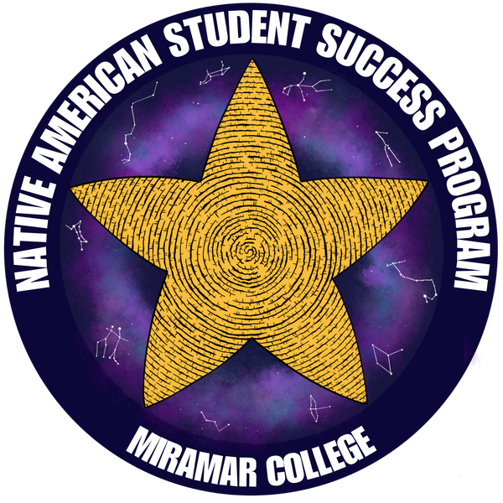

RESOURCE CENTERS
These spaces are housed on the Second Floor of the I-Building (English) and are part of the Kaleidoscope Spaces. Students have access to:
  Academic Counselors
  Career Counselors
  Mental Health & Wellness Counselors
  Student Success Workshops
  Study Space
  Library/Resources
  Tutoring (Future)
  Programs/Events
  Community Connections
  Snacks, Merch, and Supplies
I-126
I-123
NASSP
Native Resource Center
PEARL/AANHPI
PEARL Resource Center

Slide 3
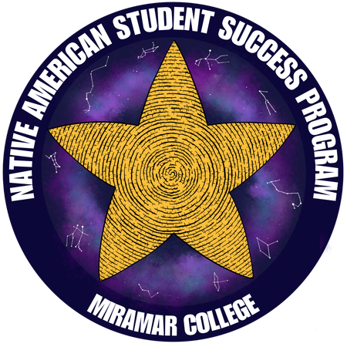



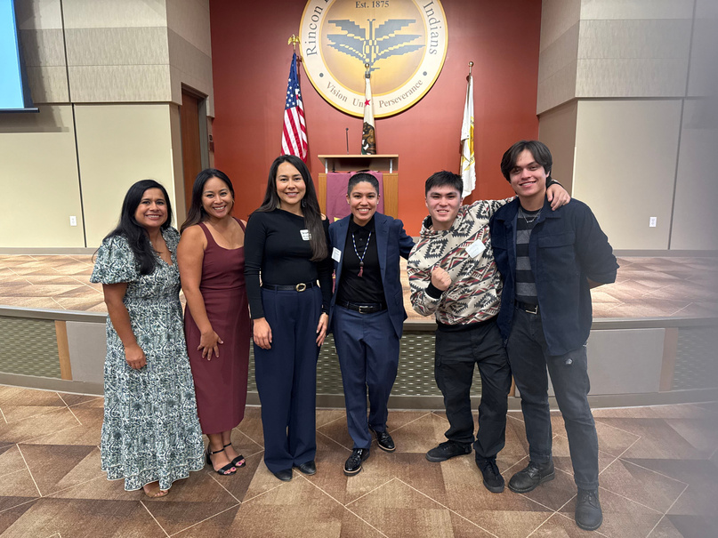
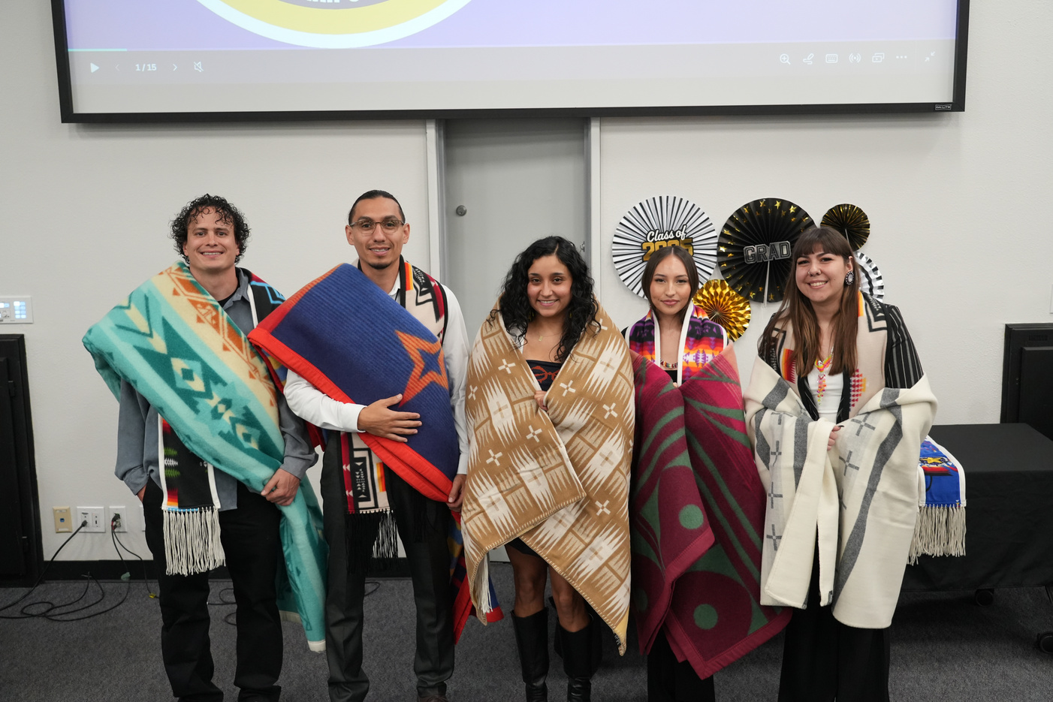
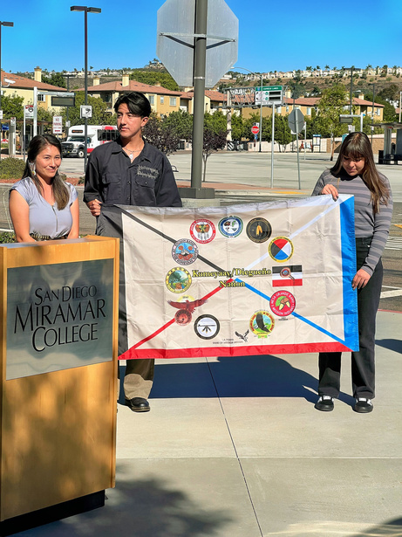
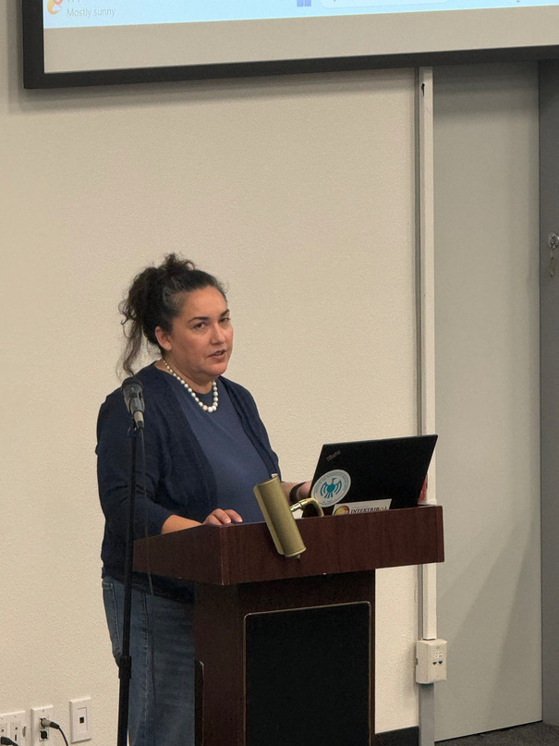
NATIVE AMERICAN STUDENT SUCCESS PROGRAM
About the Program
The Native American Student Success Program (NASSP) at Miramar College is a state-funded initiative established under Assembly Bill 183 and implemented across 20 California Community Colleges. The program supports American Indian and Alaskan Native students though culturally responsive services that promote access, retention and academic success and leadership development.
I-126 (2nd Floor of the I-Building)
  Financial Assistance and Scholarship Opportunities
  Leadership and Mentorship Opportunities
  Participate in Native Cultural Activities and Programs
  Create a Student Educational plan with NASSP counselor
  Native American Graduation Blanket Ceremony
  Support for Transfer to UC and CSU Application
Program Includes
miramar-nassp@sdccd.edu
@nassp.miramar
(619) 388-7691
https://bit.ly/MiramarNASSP
AIR Banquet
Native Graduation
Flag Raising
Tribal Youth Court

Slide 4

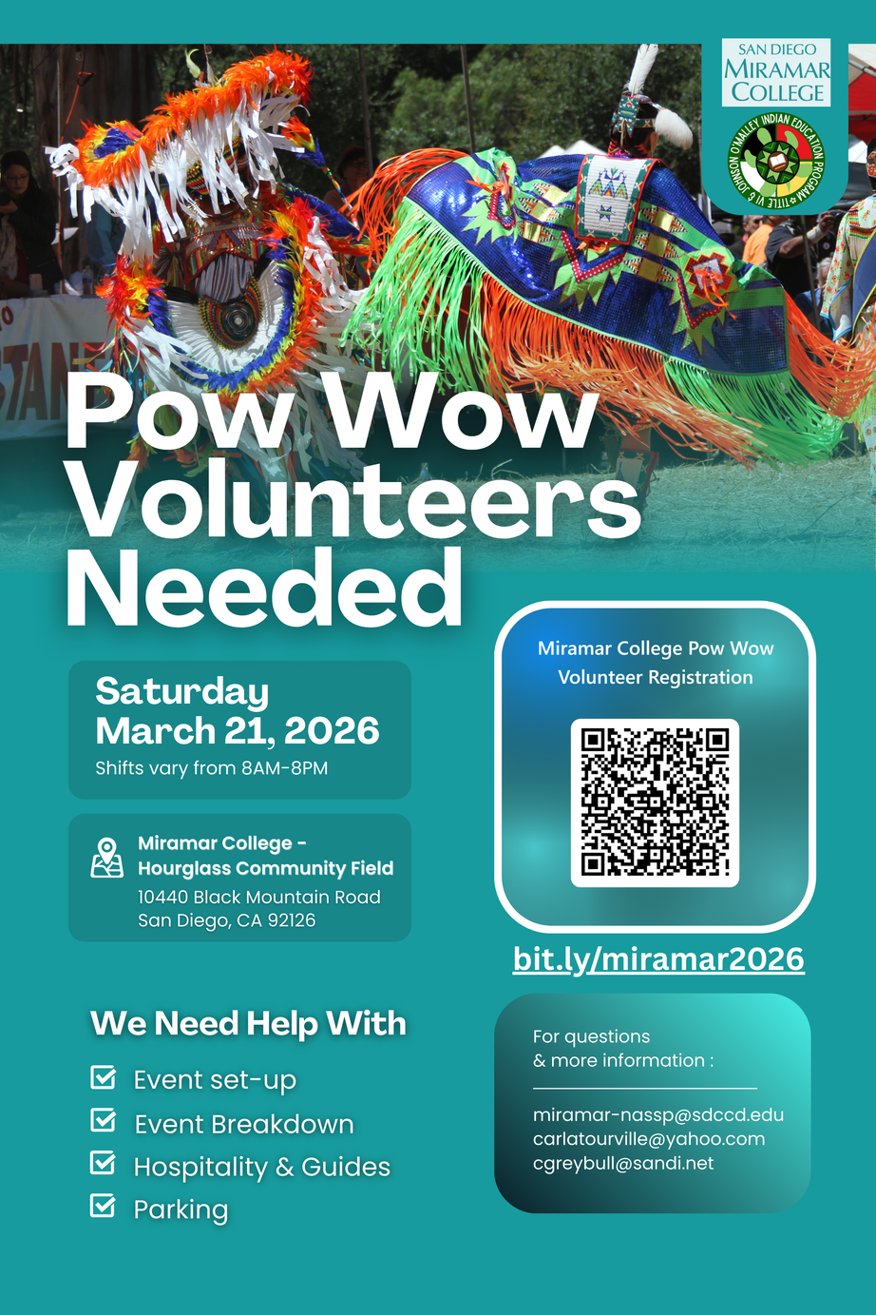
MIRAMAR COLLEGE POWWOW
SATURDAY MARCH 21ST 2026
10:00AM - 6:00PM
Join us for the second annual Miramar College Pow Wow hosted on our campus this Spring semester.
What is a Pow Wow?
Pow Wows are intertribal gatherings that include singing, dancing, food, crafts, and reconnecting with community.
Pow Wows are important because they showcase traditional regalia and cultural dances.
All community members are welcome to partake in the celebration. This event is open to the public.

Slide 5

PROMOTING EDUCATIONAL ACHIEVEMENT, RETENTION & LEADERSHIP
About the Program
Miramar College is one of 51 colleges in the California Community College system identified to participate in the Asian American Native Hawaiian Pacific Islander Student Achievement Program (AANHPI SAP) designed to empower students, unlock their potential, and advocate for the success of underserved students in accordance with Education Code 79511.
Program Outcome Areas
  Culturally Responsive Learning Communities
  Academic Advising & Counseling
  Mental Health Awareness
  Career Development & Readiness
  Supplemental Instruction & Tutoring
  AAPI Courses & Curriculum
  Leadership Development & Mentoring
I-123 (2nd Floor of the I-Building)
miramarPEARL@sdccd.edu
@miramar_pearl
(619) 388-7900
bit.ly/MiramarPEARL

Slide 6
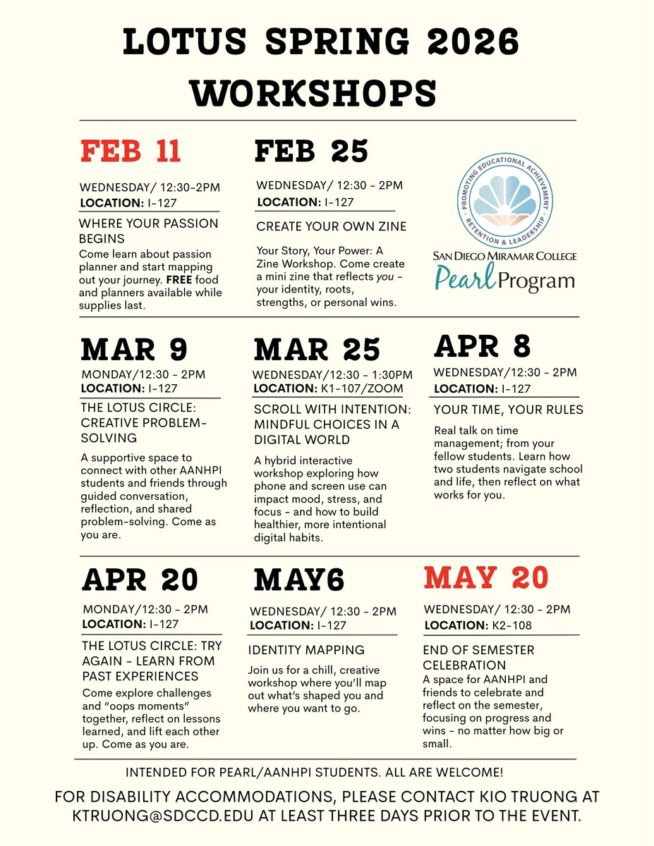
LOTUS FUND (SAN DIEGO FOUNDATION GRANT)
Supporting initiatives that celebrate AANHPI heritage and community success
About the Program
San Diego County has the 7th largest AANHPI community in the country. According to the San Diego Economic Equity Report, the AANHPI population in San Diego has increased 20% since 2020.
The San Diego Foundation Lotus Fund is partnering with organizations to expand culturally responsive mental services for San Diego County youth, including AANHPI youth ages 15-24 to connect the community with the following:
  Screenings, counseling and school-based supports
  Intergenerational and peer support programs
  Mentorship and leadership development
  Stigma-reducing education for families
Focus of the Miramar Lotus Fund in collaboration with Mental Health & Wellness and the PEARL Program:
Providing wellness support for Asian American, Native Hawaiian, Pacific Islander (AANHPI) students at Miramar College in a de-colonizing and de-stigmatizing way by moving away from a one-size-fits-all reactive approach of mental health and toward a proactive, culturally responsive, strength-based model that honor individual agency, lived experience, and self-defined wellbeing.

