Slide 1
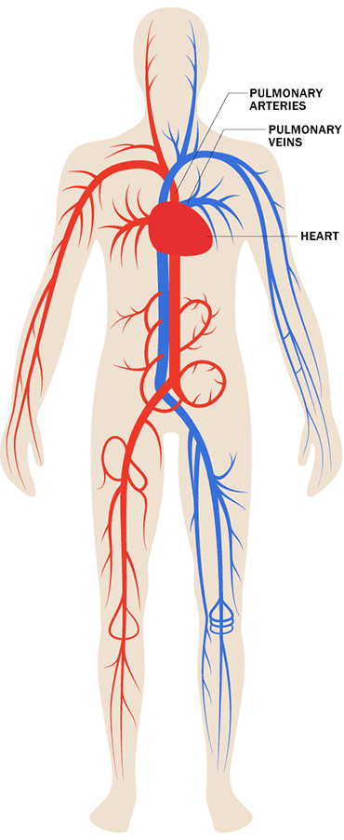
The Cardio-
(Heart)
Vascular
(Vessels)
A Closed
System
Total Blood
Volume
This means that blood is always contained
within the heart and blood vessels
The total volume of blood is about 5.0 L that continually circulate in our bodies

Slide 2
Functions of the Cardiovascular System
Transport around the body of:
O₂ from the lungs to body the tissues.
CO₂ from body the tissues to the lungs.
Delivery of Nutrients to cells (glucose, amino acids)
Removal of Waste (+ toxins) from cells
Hormone circulation (communication, growth, cycles)
Defense healing and repair of body tissues
Thermoregulation – Blood is the warmest material in the body; delivery of it warms a region, absences cools it.

Slide 3
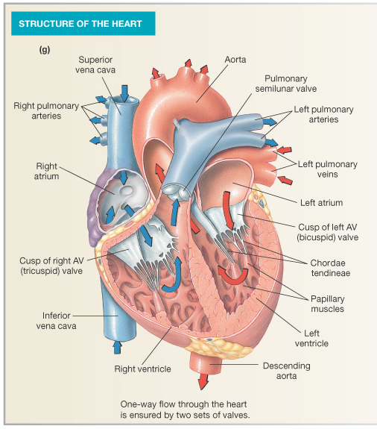
The Heart
Circuits
Chambers
Valves (one-way-flow)
Myocardiocytes
Pulmonary
Systemic
Pulmonary
Trunk
3
1
2
4

Slide 4
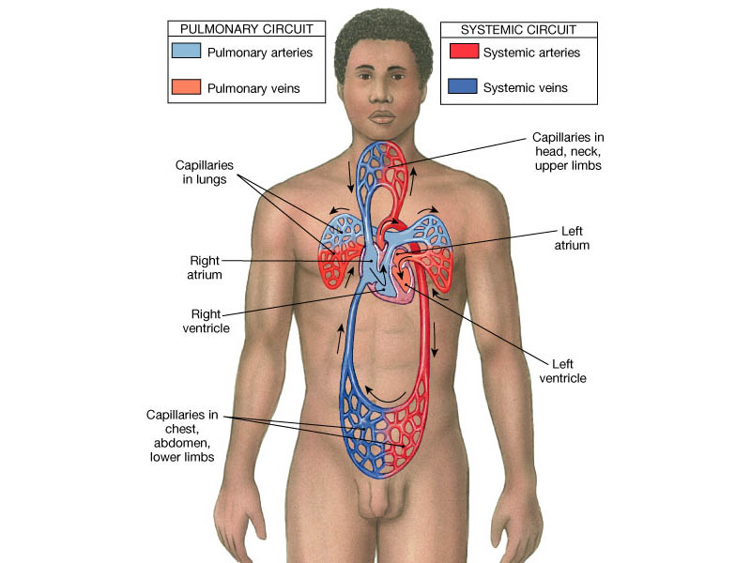
Volumes?
Pressures?
heart –> lungs –> heart
(from RV to LA)
heart –> body –> heart
(from LV to RA)
Artery =
Vein =

Slide 5
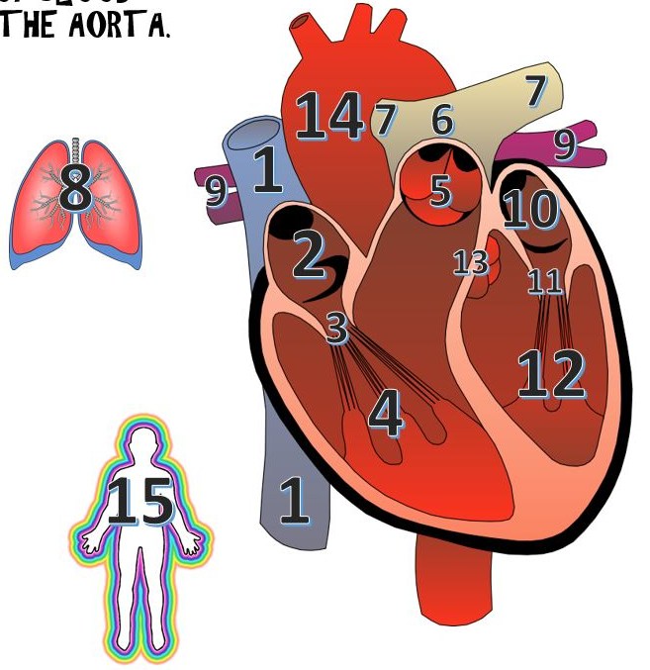

Trace the Journey of a RBC

Slide 6
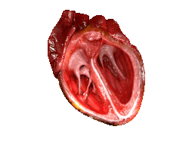
The Heart has 4 Valves
Purpose of Valves: To prevent retrograde Blood Flow
Here are 4 valves within the Heart:
The 2 atrioventricular valves (AV) are between the atria and ventricles.
1) Right AV (tricuspid) valve
2) Left AV (bicuspid/mitral) valve

Slide 7
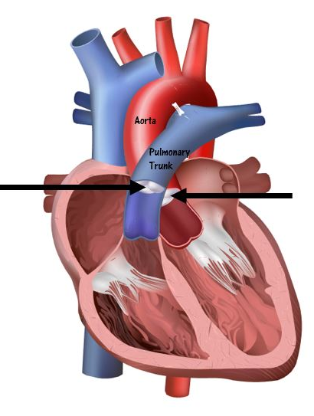
The 2 semilunar valves of the heart
3) Aortic semilunar valve
(located between the LV and the aorta)
4) Pulmonary semilunar valve
(located between the RV and the pulmonary trunk)
Two Heart Sounds: “Lub” and “Dup”
A healthy heart usually has two audible heart sounds: S₁ and S₂.
The 1st heart sound S₁, the “lub” sound.
The 2nd heart sound, S₂, the “dup” sound.

Slide 8
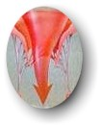



Disorders of Heart Valves
Normal
Heart Valves
Problem
Heart Valves
Problems Opening:
Stenosis – narrowing of valve,
when a valve doesn't open
completely.
Turbulence = noise = murmur.
Problems Closing:
Prolapse –overlapping or when
valve doesn't close tightly. Also
termed valvular insufficiency
(regurgitation)
Retrograde flow = noise = murmur.

Slide 9
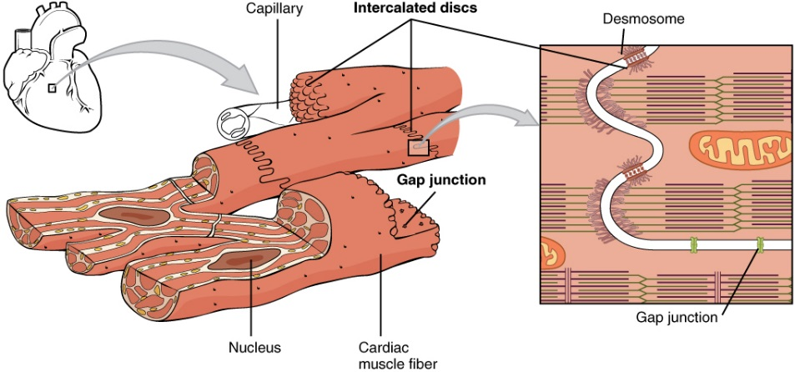
There are 2 types of Cardiac Muscle Cells
1. Autorhythmic Myocardiocytes:
2. Contractile Myocardiocytes:
Both of these myocardiocytes have Action Potentials (AP’s) that differ from one another as will be seen in the graphs of the AP’s that follow.

Slide 10
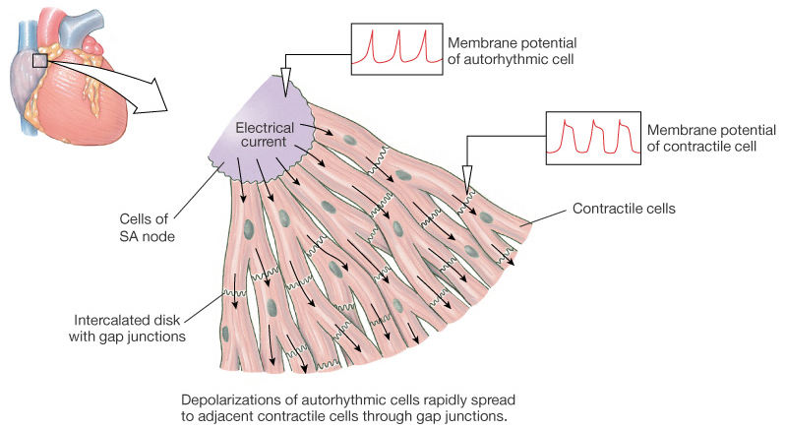
Myocardiocytes:
1) Autorhythmic
2) Contractile

Slide 11
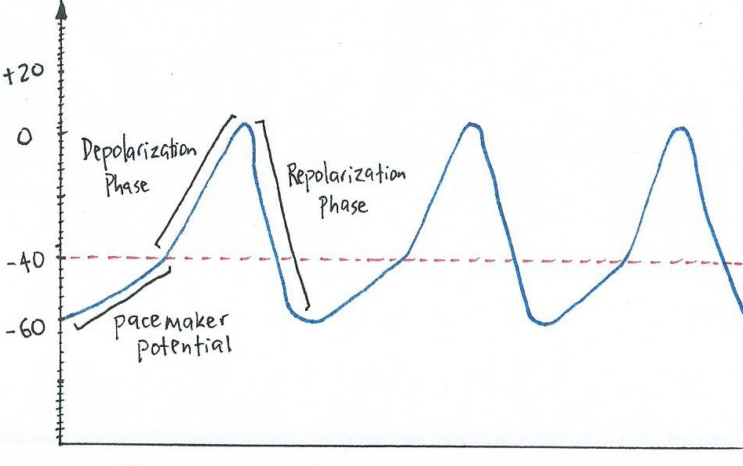
Action Potentials for Autorhythmic Myocardiocytes
Membrane Potential (mV)
Time (msec)
Additional things to Notice about this AP and Graph:
Typically, no Hyperpolarization phase.
*Parasympathetic innervation (via _________ nerve) can pull the membrane voltage below -60 mV.
*Sympathetic innervation (via __________ nerve) truncates the repolarization phase to about -50 mV.

Slide 12
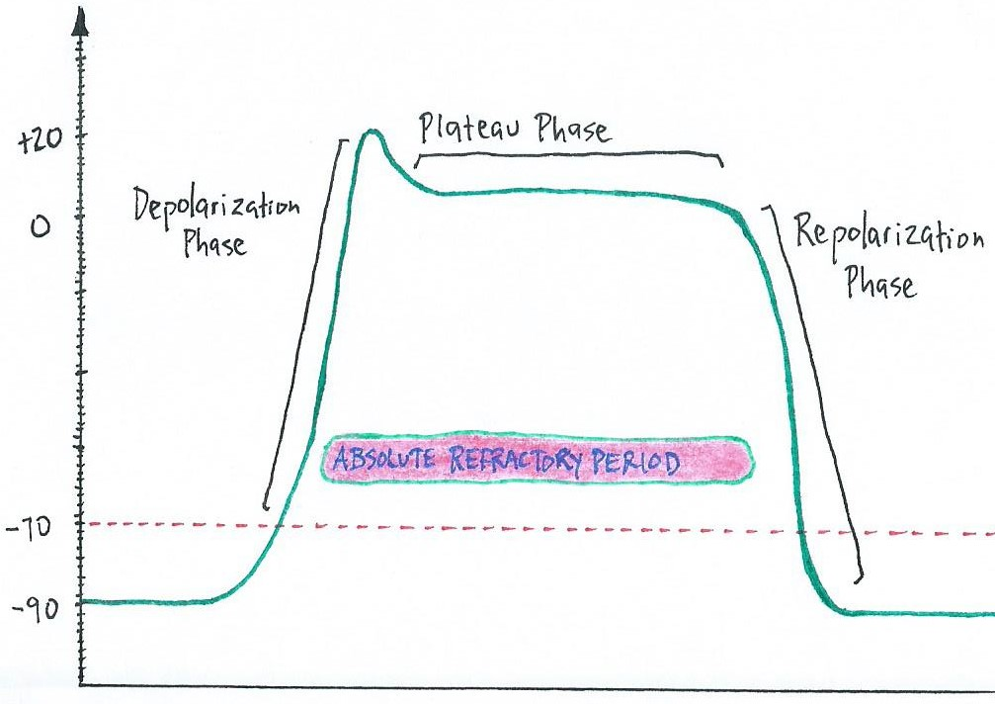
Action Potentials for Contractile Myocardiocytes
Membrane Potential (mV)
stimulus
Time (msec)
Things to Notice about this AP and Graph:
Plateau Phase and what causes it.
There is no real hyperpolarization phase in these cells.
The absolute refractory period is almost all of the Plateau phase (about 250 msec, is very long!).
What is the purpose pf the long absolute refractory in cardiac muscle?
If tetanus were possible the heart could not fill, because that occurs during diastole, or relaxation.

Slide 13
Exercise
Draw by hand (with all units, values, phases, which channels are open, closed):
a) The action potential for an autorhythmic myocardiocyte; and
b) The action potential for a contractile myocardiocyte.
You need to know those graphs like the back of your hand! So, take a blank piece of paper and draw them until you can do it all without looking at the graphs as a reference.
Then go and test your understanding by answering Q’s about them!

Slide 14
“Calcium Induced Calcium Release” in Myocardiocytes
There are 2 Sources of Ca²⁺ in Myocardiocytes:
1) Ca²⁺ from the EFC ~10%. This must enter myocardiocytes first to release 2nd source.
2) Ca²⁺ release from the SR. This accounts for ~90% of the total Ca²⁺.
It’s called “Ca²⁺- Induced Ca²⁺ Release” because Ca²⁺ needed from outside to release internal stores!
The Ca²⁺ from ECF triggers release of Ca²⁺ from SR. Without ECF Ca²⁺, no Ca²⁺ released from SR.
The Ca²⁺ enters cell from ECF by voltage gated Ca²⁺ channels (triggered by AP).
Incoming Ca²⁺ binds ryanodine receptors on SR, opens Ca²⁺ channels on SR.
Once Ca²⁺ released from SR it diffuses through cytosol to bind troponin!
Ca²⁺ causes usual regulatory protein changes to allow cross-bridge cycling and contraction to occur.
The 2 Sources of Ca²⁺ are put back from where they came!
When signal for contraction stops, the Ca²⁺ goes back from to the 2 places it came from
Back into the SR
Back out into the ECF
See figure on next slide.

Slide 15
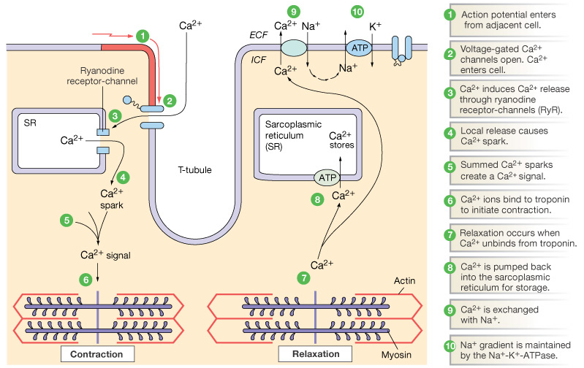
“Calcium Induced Calcium Release” in Myocardiocytes

Slide 16
How is Graded Contraction of Heart achieved?
3 ways to Generate More Force in myocardiocytes:
1. Proportional to amount of Calcium ions (Ca²⁺)
↑ [Ca²⁺]_{i} => more crossbridges, more force & speed.
2. Modulated by Autonomic N.S.
=> Sym ↑ HR and ↑Force
=> Para ↓ HR and ↓ Force
3. Stretch-Length-Tension Relationship
↑ stretch, => ↑ Ca²⁺ entering => ↑ contraction force

Slide 17
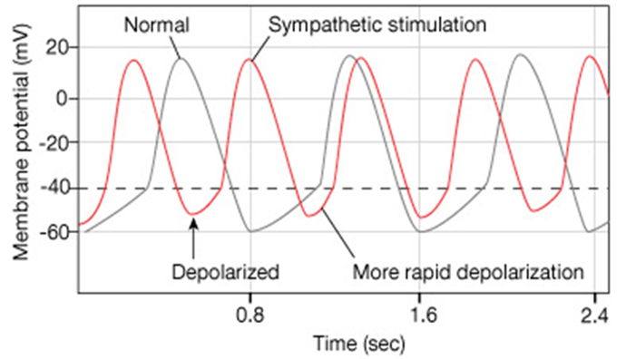
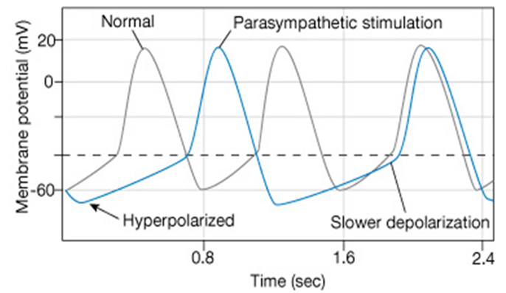
2. The influence of the ANS
Sympathetic – speeds heart rate by ↑ Ca²⁺ influx. Shortens repolarization the phase, faster depolarization.
Parasympathetic – slows rate by ↑ K⁺ efflux, ↓ Ca²⁺ influx. Lengthens the repolarization phase, creating hyperpolarization and slows depolarization.

Slide 18
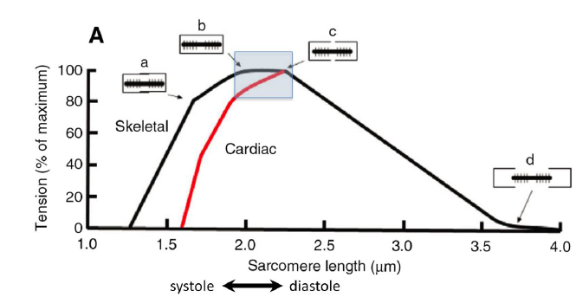
3. Sarcomere Stretch-Length-Tension Relationship
When resting Cardiac Muscle is stretched, it contracts more forcefully!
Due to the degree of overlap between thick and thin filaments of the sarcomere in cardiac muscle, just as in skeletal muscle (see graph).
In addition, stretching myocardial cells opens stretch-sensitive (mechanically gated) Ca²⁺ channels, allowing more Ca²⁺ into the cell = stronger contraction.
Comparison of Varying the Force | Skeletal Muscle | Cardiac Muscle
Temporal Summation | Yes | X
Spatial Summation | Yes | X
Length of Sarcomere | Yes | Yes
[Ca²⁺]_{i} Levels | X | Yes
The ANS (Para/Sym) | X | Yes

