Slide 1
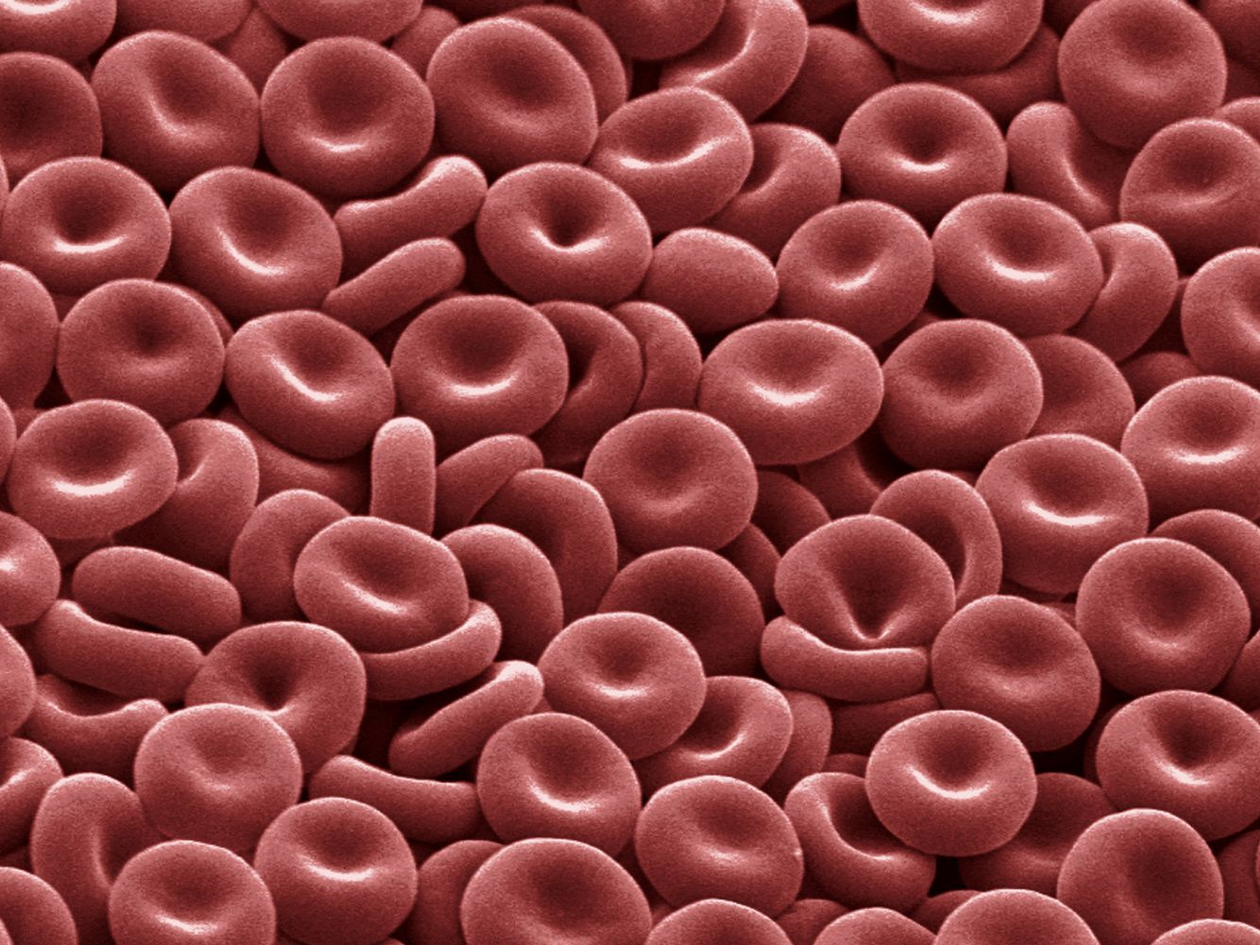
Blood is
a fluid
Connective Tissue

Slide 2
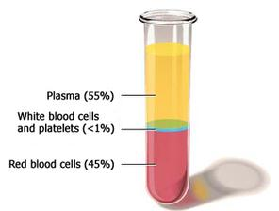
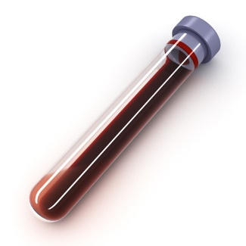
Blood has *2 parts: 1) Plasma (fluid)
2) Formed elements (cells)
Ultimately everything you need is in your Blood
*When blood is spun at high
speeds, it separates into the two
main components as shown.
Glucose, Amino acids, Proteins, Hormones
Fatty acids, Triglycerides, Cholesterol, Vitamins
Ions/Electrolytes (Na⁺, K⁺, Cl⁻, Ca²⁺, H⁺, HPO₄²⁻Mg²⁺…SO₄²⁻, Zn²⁺, HCO₃⁻…)
Urea, Uric acid, Creatinine, Bilirubin, ammonia
Gases O₂ and CO₂ (dissolved in plasma)
The pH of Blood is 7.35 to 7.45
Note: Arterial blood has a higher pH (ave ~7.41) thus is more basic than venous blood, which has a lower pH (ave ~7.35), and is more acidic. However, the range of pH for blood is still 7.35 to 7.45.
Blood brings Warmth
Blood is slightly warmer than normal T_{b}, about 38°C (or 100.4 °F), compared to 37.1°C (or 98.6 °F) which is the average internal T_{b} reading. Blood flowing in vessels causes friction and resistance, producing heat.
Blood Viscosity
This is the density (thickness) of a fluid which gives resistance to flow. Blood is __________ compared to water.

Slide 3
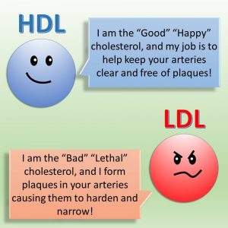
Blood = Plasma + Formed (Cellular) Elements
Facts about Plasma
~55% blood volume
~92% of plasma is water
Has high level of O₂ and CO₂ content dissolved in it
Many Dissolved Proteins (COP)
Nutrients and Wastes (listed)
The Cells in Blood
~45% blood volume
RBCs (~99% of cells)
WBCs (~1% of cells)
Note: *Lipids, including cholesterol are critical to good health. They need special ‘carriers’ in the blood transport them to tissues!
Do not vilify any of them, they are not “good” or “bad”, they are all necessary.
Things Dissolved in Plasma
Large Plasma Proteins
Glucose, Amino acids, Hormones, Vit.
Fatty acids, Triglycerides, Cholesterol*
Ions/Electrolytes
Urea, Uric acid, Creatinine, Bilirubin

Slide 4
Proteins in Plasma*
Albumins
__% of plasma proteins (forms lipoproteins).
transport binding for insoluble lipids; big contributor to COP.
Globulins
__% of plasma proteins: alpha, beta, and gamma subgroups.
alpha & beta made by liver transport iron, Vit A, D, E, and K.
gamma* = antibodies (immunoglobulins) made by ______?
Fibrinogen
__% of plasma proteins. When activated forms fibrin for clotting reaction. Plays a role in Hemostasis (stopping blood loss).
Regulatory Proteins
- Less than 1%, these are enzymes, proenzymes and hormones.
*serum = plasma without clotting proteins

Slide 5
Lipids in Plasma
Lipids are hydrophobic, so they require special mechanisms for transport through the blood to the tissues.
Free Fatty Acids – 2 are ‘essential’ for humans:
alpha-linolenic acid, an omega-3 fatty acid
linoleic acid, an omega-6 fatty acid.
Important nutrients that must be obtained from diet!
The various Lipoproteins transport lipids in the Blood
1. Very Low Density Lipoproteins (VLDL) made in liver, mostly triglycerides (~50%). These travel in the body and return triglycerides to liver. They can be converted into LDLs…

Slide 6
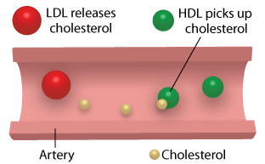
Lipids in Plasma
2. Low Density Lipoprotein (LDL)
These carry mostly cholesterol (~50%). These circulate in the body and release lipids to body cells, 100% required for membranes, hormones, etc. The Liver removes LDL from circulation.
3. High Density Lipoprotein (HDL)
This transports cholesterol from cells back to the liver for recycling or disposal.
This is where the function of HDL in picking up ‘excess cholesterol’ has become the focus of it being the “good”. It is neither good or bad, it is essential, just like LDL!
Note: HDLs and LDLs are not cholesterol: They are Carriers of Cholesterol.

Slide 7
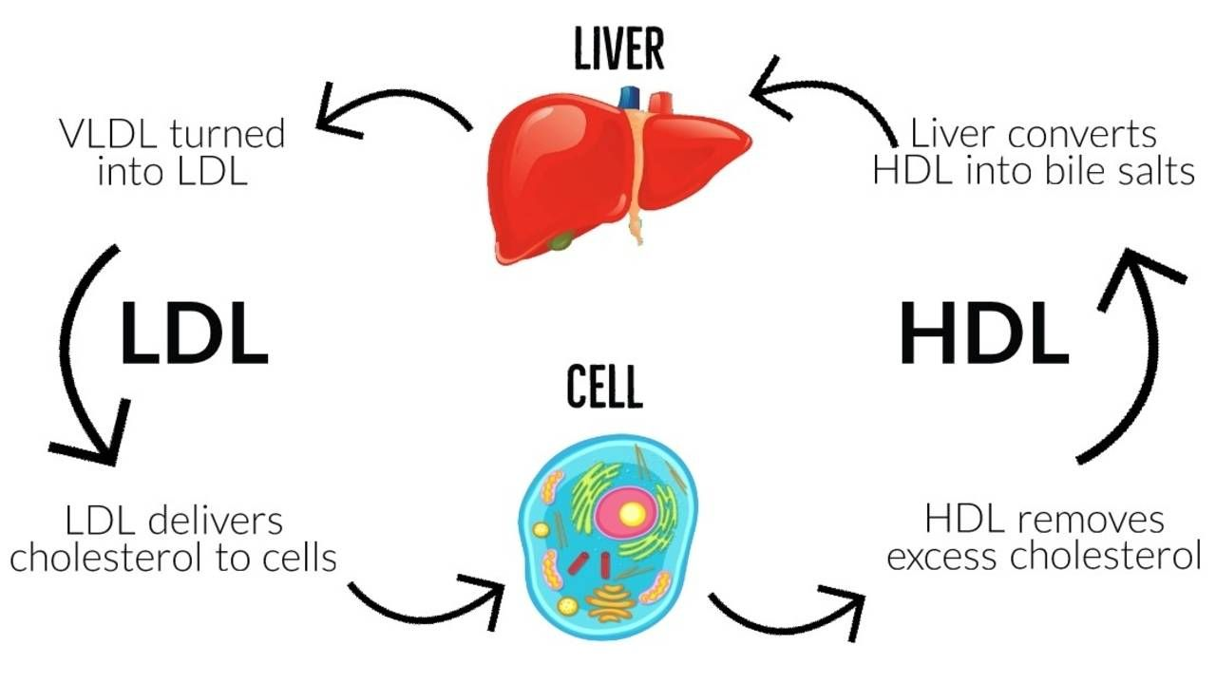
Here is a nice summary of the roles of HDLs and LDLs
The liver is the great detoxifier, cleanser and recycler
Traveling in bloodstream
Traveling in bloodstream
Yay, thanks I needed those lipids
Here, please take what I don’t need
In summary, LDLs and HDL’s are both carries of Cholesterol and
other lipids, which are 100% vital to Life!

Slide 8
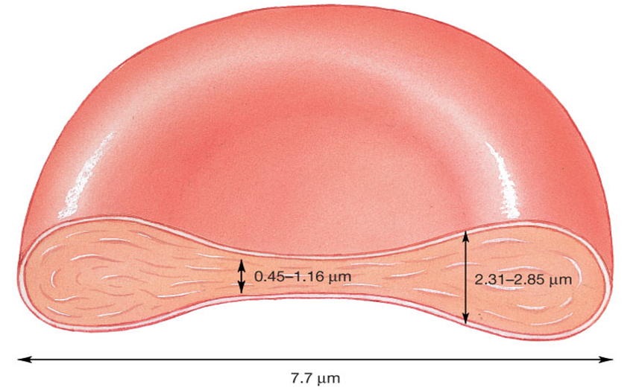
Cellular Components of Blood
The RBCs (erythrocytes) ~99% of all cells.
Hematocrit = % of blood occupied by cellular components.
(packed RBC volume)
Smallest blood cell
Biconcave disc (large surface area)
Super flexible (elastic pro⁻)
Lacks: nuclei, ribosomes,
and mitochondria.
Anaerobic metabolism
(uses glycolysis)
Life span = ~120 days

Slide 9
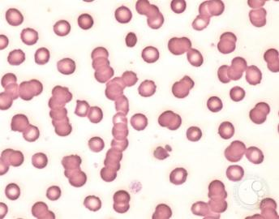
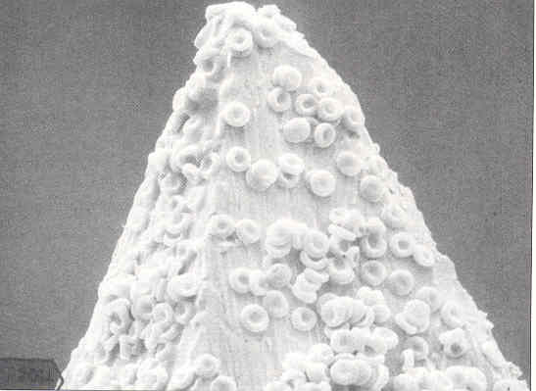
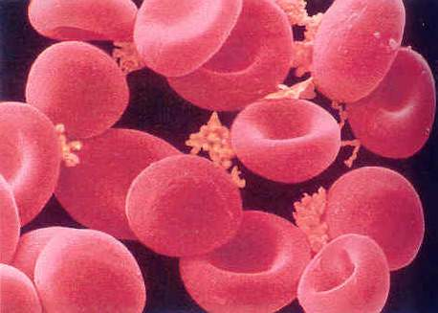
a)
b)
c)
a) Image from a Light Microscope (LM) of erythrocytes or red blood cells (RBCs) that are seen free, and some that are stacked in rouleau (plural rouleaux), circled in blue. b) Scanning Electron Micrograph (SEM) image of RBCs on the tip of a hypodermic needle. c) Showing up-close normal biconcave disc RBCs with clusters of the very small platelet cells also present.
Facts about RBC’s
The red bone marrow makes all blood cells, including RBCs. There are about __________ RBCs per sec produced and released into the circulation.
RBCs are small cells ( ______ µm) in diameter, and are very flexible (due to the protein _________ in their membrane), thus they can squeeze through the smallest blood vessels.
RBC’s contain enzymes in cytosol for glycolysis, so they can make limited ATP w/out using O₂ .
With limited repair capability, RBCs have a limited life span (_____ days). Worn, older and damaged RBCs are removed from the circulation by macrophages in the spleen (esply) and the liver.
If more RBCs are needed, the kidneys release the hormone erythropoietin to stimulate RBC production in the red bone marrow.

Slide 10
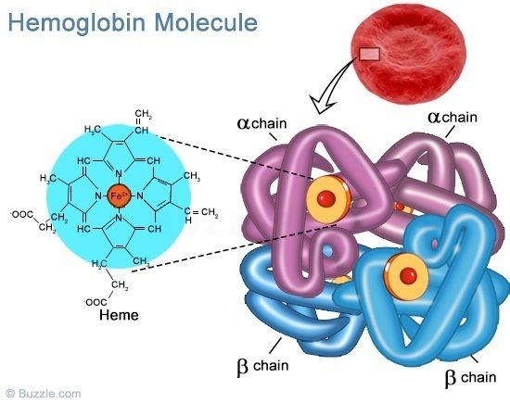
There are millions of Hb inside each RBC
RBCs have so few organelles to make more room for hemoglobin (Hb) => ________ Hb/cell!
Hb binds and transports Oxygen (O₂) and some Carbon Dioxide (CO₂) in the body.
The Hb molecule contains 4 globin portions (2 α and 2 β chains).
At the center of each globin is an iron (Fe) containing Heme molecule.
The globin portions (α and β)
CO₂ binds here.
The heme portions (in center of each globin). The O₂ binds here. Each Hb molecule binds 4 O₂ molecules maximum.

Slide 11
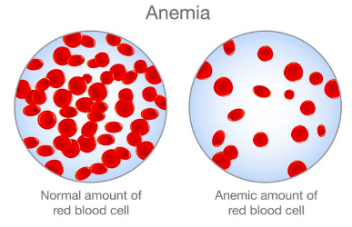
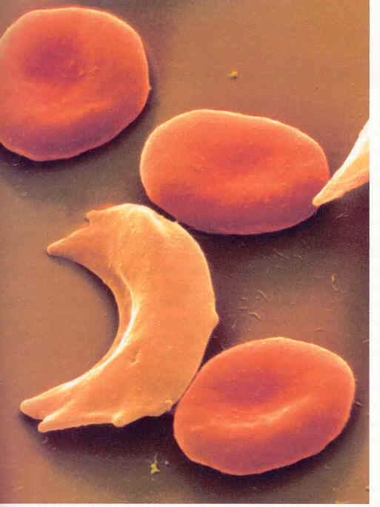
Anemia
Deficient O₂ carrying capacity of blood (esply lower RBCs or Hb). Results in pallor (paleness), weariness.
There are 3 basic categories of Anemia:
Inadequate erythropoiesis = low hematocrit
Normal
RBC
Hemolytic anemia = abnormal breakdown
Sickle
Cell
Hemorrhagic anemia = loss of blood volume
Sickle Cell Anemia
(from a genetic disorder)

Slide 12
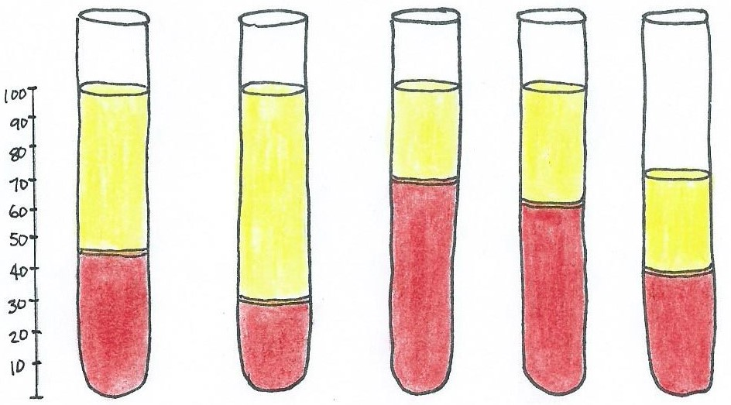
Normal Hematocrit and Variations from Normal
Polycythemia
Dehydration
Normal
Fetal
blood
Anemia
% RBC
of
blood
70% of Volume
Hematocrit:
45%
30%
70%
60%
40%
Note
Males: Normal hematocrit range: 42-52% (Ave 47%)
Females: Normal hematocrit range: 37-47% (Ave 41%)

Slide 13
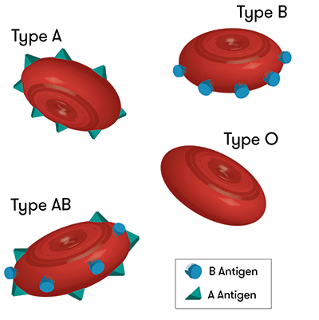
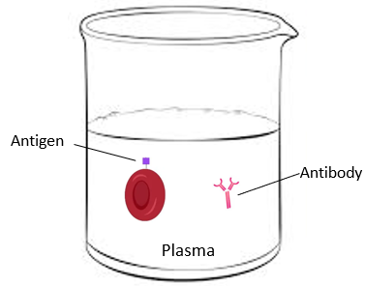
ABO Blood Grouping (Types)
A blood type (group) classification is based on the presence or absence of genetically determined cell markers on surfaces of RBCs called antigens (agglutinogens). The plasma of blood contains antibodies (agglutinins) that are ‘complementary’ to the antigens.
The Antigens determine Blood Type.
The ABO blood group based on two antigens, A and B
If RBC displays only antigen A = blood type A.
If RBC displays only antigen B = blood type B.
If RBC displays both A and B antigens = blood type AB.
If RBC displays no antigens = blood type O.
The antibodies (in the plasma) need to be the opposite of the antigens (A and B) on the blood cell.
If an antigen mixes with the same antibody, agglutination or ‘clumping’ of blood would occur, can cause hemolysis (rupture of RBC).

Slide 14
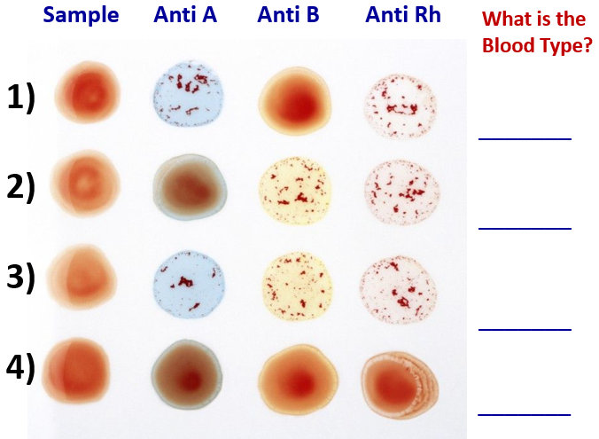
The Rh factor is another RBC marker: The RBC either has it (+), or not (-).
1) Rh antigen present = Rh⁺
2) No Rh antigen present = Rh⁻
In the lab, we will see visual results as below.
Determine the blood types shown:
A +
Additional Questions:
Q: The “universal donor” = _______.
Q: The “universal recipient” = _______.
Q: Most common type (USA) = ________.
Q: Least common type (USA) = ________.
Q: Your blood type = __________.
O -
B +
AB +
AB +
O +
AB -
O -

Slide 15
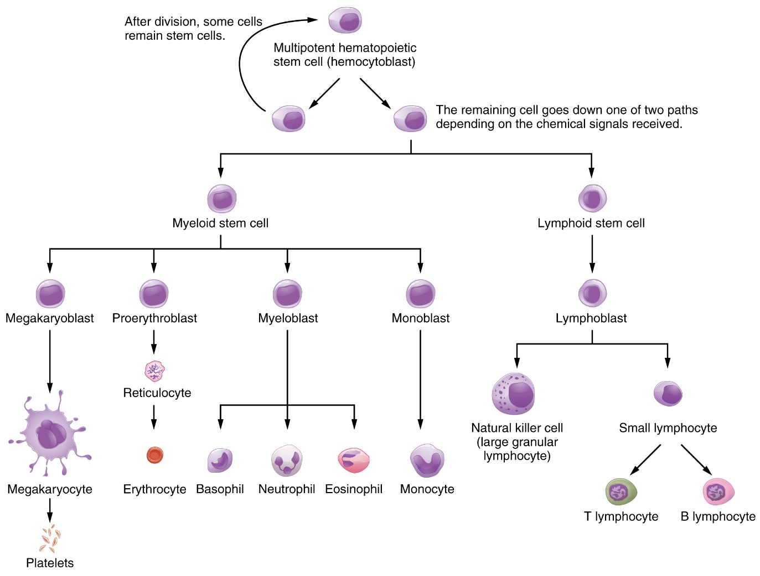
Hematopoiesis
Blood Cell Formation
Macrophage
Plasma cells

Slide 16
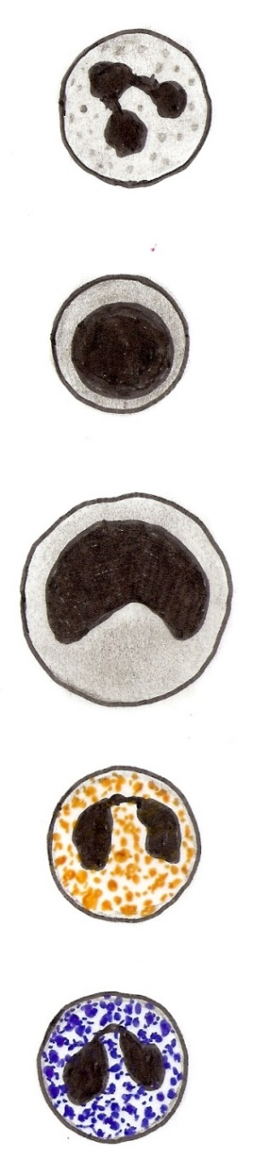
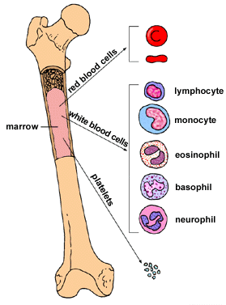
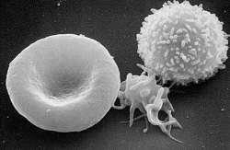
All Blood cells come from Red Bone Marrow!
Order of Abundance of WBC in Healthy person
Never
Let
Monkeys
Eat
Bananas
50-70%
20-30%
2-8%
?
?
2-4%
?
Remember: Normal healthy WBC #’s in blood are less than 1% of total cells. The %’s shown under each WBC are %’s for that 1%!
< 1%

Slide 17
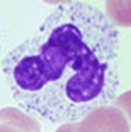

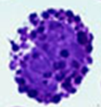
White Blood Cells (Leukocytes)
There are 2 categories of Leukocytes (WBCs):
Granular and Agranular
Granular Leukocytes
Have granules in cytoplasm containing powerful enzymes & substances for defense.
Neutrophils 70% of circulating leukocytes (most numerous)
Highly mobile phagocytes, multi-lobed nucleus (3 or more lobes)
Eosinophils less common
Bi-lobed nucleus, ‘orange’ staining granules. They’re attracted to foreign compounds reacted with antibodies. Associated w allergies
Basophils least common
Bi-lobed, dark staining granules, release histamine and heparin. Migrate to damaged tissue.
All of these cells make and release toxic materials by ‘degranulation’. This is in order to aid in the destruction and ingestion of necrotic tissue and microorganisms. This is their function.

Slide 18
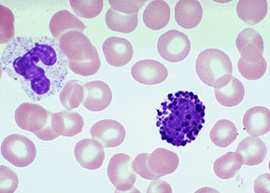
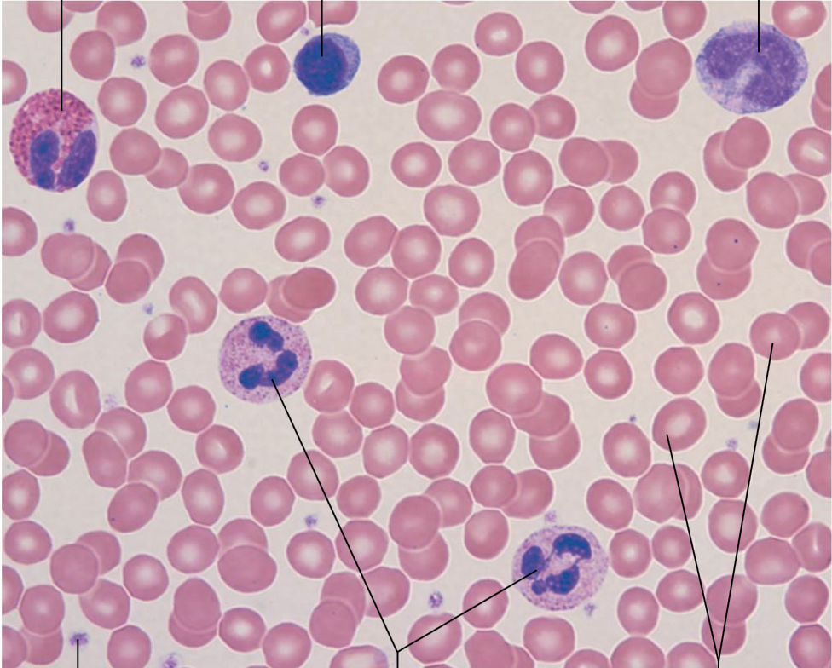
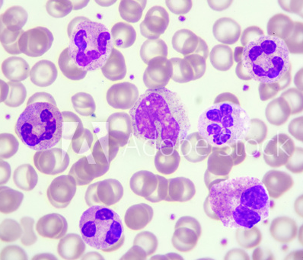
Lymphocyte
Monocyte
Eosinophil
Basophil
Neutrophils
Erythrocytes

Slide 19
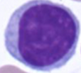
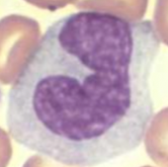
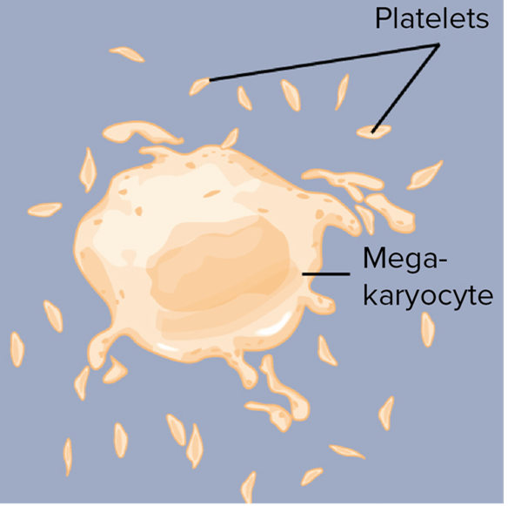
Agranular Leukocytes
These cells do not contain granules in cytoplasm.
Lymphocytes primary cell of lymphatic system
Natural killer cells cytotoxic response to infected cells.
T-cells attack foreign cells directly.
B-cells produce Plasma cells which produce antibodies.
Monocytes
Large ‘dimpled’ nucleus. They migrate into tissues and differentiate into Macrophages - highly mobile phagocytes.
Platelet cells (Thrombocytes)
Fragments of cells (Megakaryocytes) for clotting.
Mast cells (honorable mention): These are connective tissue cells that migrant to the site of injury. They contains granules of histamine and heparin.

Slide 20
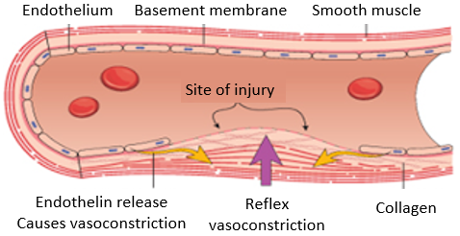
Hemostasis = stopping blood (loss). Prevents hemorrhage (excessive bleeding).
(hemo = blood; stasis= stationary)
3 Steps of Hemostasis
Vascular spasm
Platelet plug formation
Coagulation (blood clotting)
1) Vascular Spasm
Vascular smooth muscle (VSM) in walls of ruptured/damaged blood vessel contract! Pain receptors trigger endothelial cells to release endothelin, a vasoconstrictor! This reduces blood flow/loss.
2) Platelet Plug
A damaged vessel exposes collagen – this triggers platelet cell accumulation and adherence at injury site.
Platelet cells stick to damaged vessel, then platelets degranulate their contents releasing:
Serotonin - here it acts as a vasoconstrictor.
Thromboxane A2, attracts more platelets, and acts as a vasoconstrictor.
ADP - attracts and degranulates more platelets.
This causes platelet cell aggregation, cycle continues until it is broken when the small vessel is sealed.
3) Coagulation (blood clotting)
Involves conversion of plasma fibrinogen into insoluble fibrin, a net-like gel for blood clotting to occur. Pro-coagulants (clotting factors) activate the steps to form a complex reaction cascade.

Slide 21
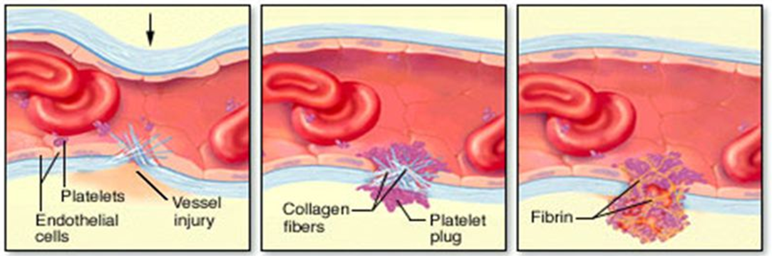
Summary overview of the 3 Steps of Hemostasis
1) ____________________ 2) ____________________ 3) ____________________

Slide 22
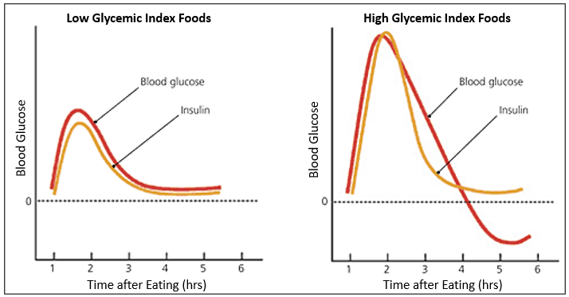
Blood Glucose Levels
Glycemic Index (GI) indicates how quickly a certain food turns into glucose in a person’s body.
Glycemic Load (GL) indicates the total amount of glucose in the food.
The total amount of glucose in an average serving can be calculated. Blood Glucose graphs below show typical pattens for lor low and high glycemic index meals.

Slide 23
The Control of Blood Glucose Levels
Glucose in blood is used as fuel for cellular activities. Blood glucose levels are homeostatically controlled by a negative feedback loop with two opposing hormones.
Insulin (made by beta cells in Pancreas)
If blood glucose gets too high, it is decreased by the actions of insulin.
Glucagon (made by alpha cells in Pancreas)
If blood glucose gets too low, it is increased by the actions of glucagon.

Slide 24
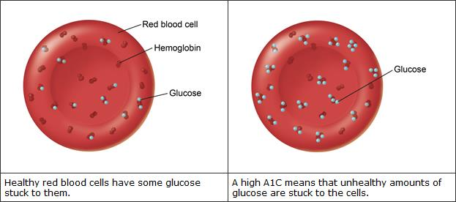
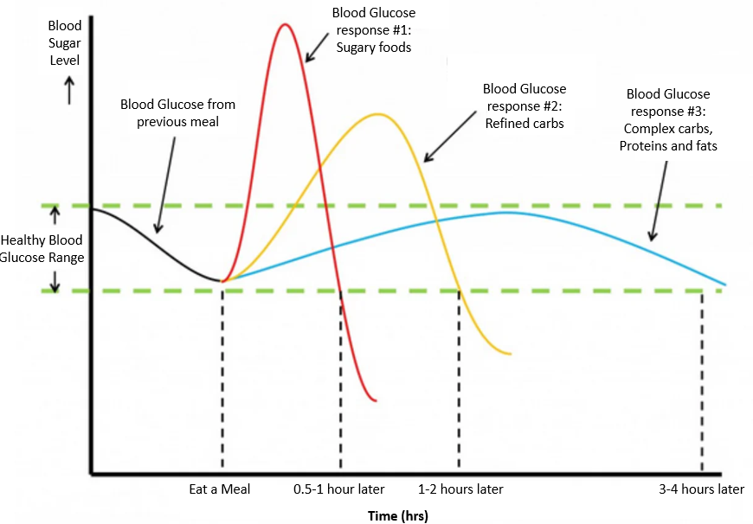
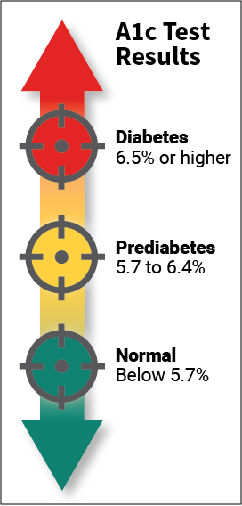
The A1C Test for Glycated Hemoglobin (Hb) - provides average blood glucose levels over the past 3 months! It is used to diagnose Type 2 diabetes mellitus and prediabetes.
Also called hemoglobin A1C, HbA1c or *glycated hemoglobin test b/c Glucose attaches non-enzymatically to hemoglobin (Hb) in RBCs. Higher the blood glucose, more glucose attached to Hb.
A1C test measures the % of Hb with attached glucose.
Higher the % the higher your blood glucose levels have been over last 3 months.
*Related to Advanced Glycation End-Products (AGE’s) in diabetes mellitus (DM).
The Oral Glucose Tolerance Test (OGTT) measures the body's ability to use and clear excess glucose from blood. Can diagnose diabetes mellitus.

Slide 25
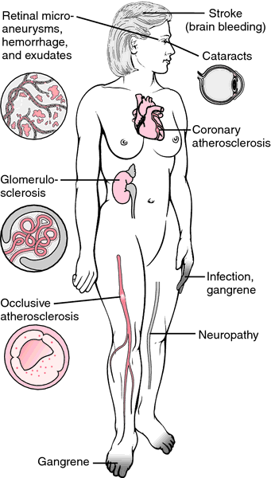
Consequences of Chronic Diabetes
Eye Problems
Retinopathy:
Blood vessels leak & bleed,
become blocked; Risks:
Cataracts
Glaucoma
Heart Disease
Chronically elevated
blood glucose => coronary plaques (atherosclerosis).
Diabetics have 2 times the risk of Heart Disease.
Chronic Kidney Disease
& Kidney Failure
Diabetes => kidney failure
From Glomerulosclerosis
Neuropathy
Hands and feet tingling, burning, numbness or loss of feeling. Slows digestion, constipation,
decreased sexual response.
Peripheral Arterial Disease
Atherosclerosis in extremities,
leg pain, poor circulation.
Gangrene.

