Slide 1
Neurotransmitters
4 major Categories
  1) Acetylcholine (ACh)
2) Amino Acids
  3) Biogenic Amines
  4) Neuropeptides

Slide 2
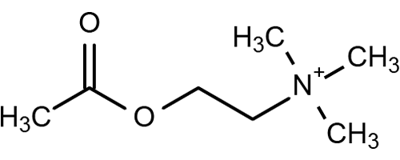
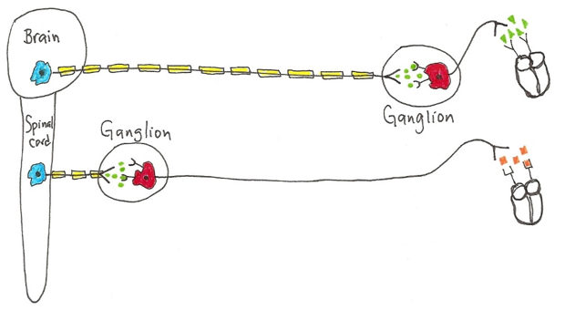
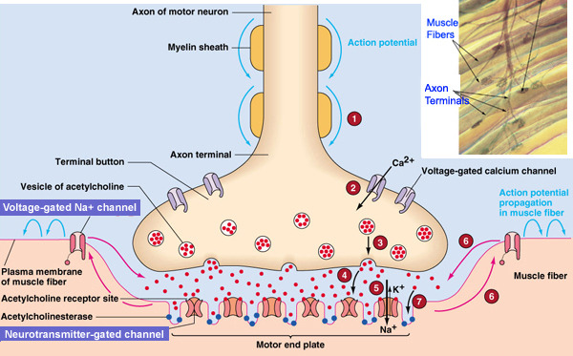
1) ACh
C.N.S. Memory, Learning, Relay.
Autonomic N.S.
- Parasympathetic
- Sympathetic
Acetylcholine
(is ubiquitous)
Somatic N.S.
The Neuromuscular Junction
Acetylcholine esterase (AChE)
Degradative enzyme for ACh.
Summary: Memory, regulation of attention, learning, sleeping,
voluntary motor control and ‘automatic’ control of viscera.
Neurons that release ACh
are "Cholinergic“ Neurons

Slide 3
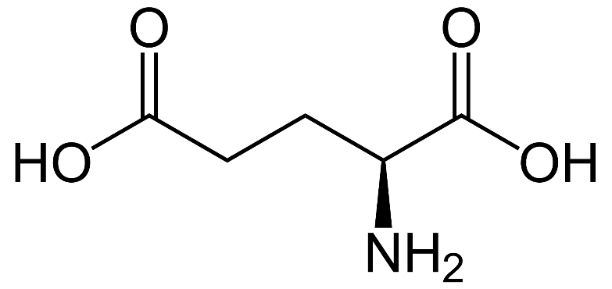
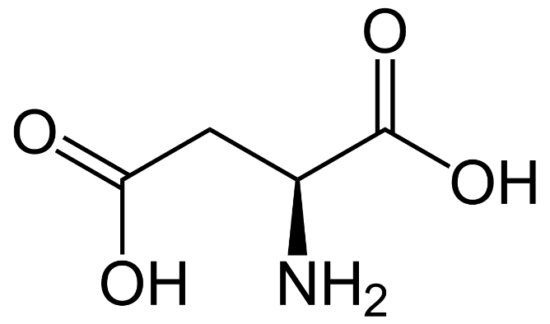
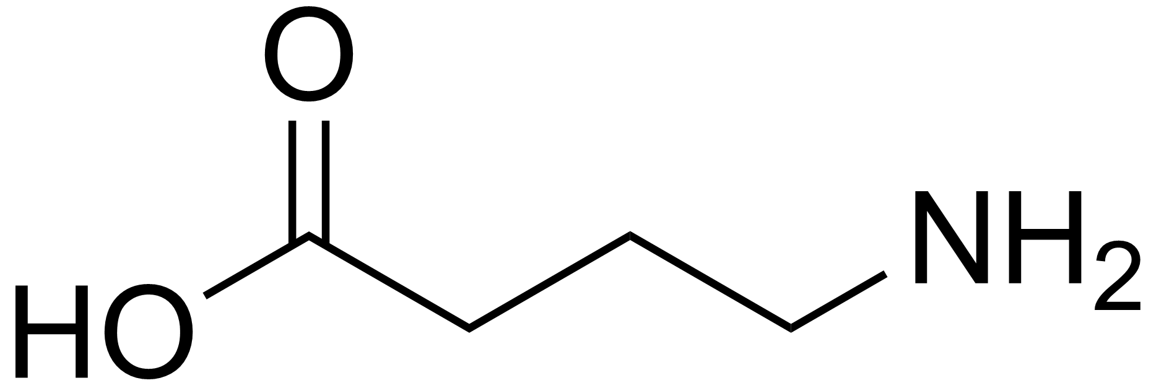
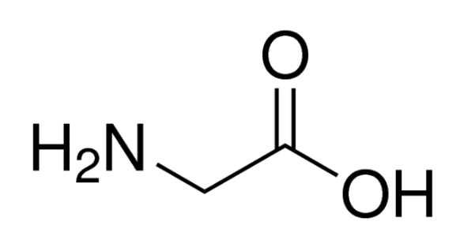
Glutamate and Aspartate
2) Amino Acids
GABA (Gamma Aminobutyric Acid) and Glycine
Glutamate
Most common Excitatory NT
in the Brain
Aspartate
Excitatory NT in the Spinal Cord
GABA
Most common Inhibitory NT
in the Brain
Glycine
Inhibitory NT in Spinal Cord

Slide 4
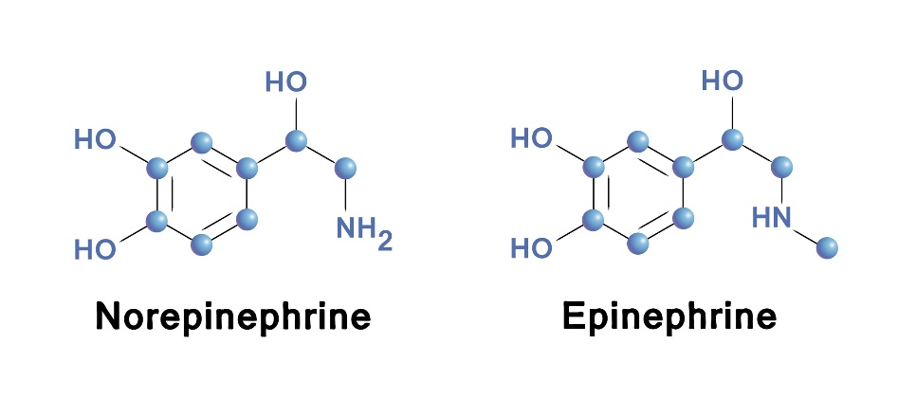
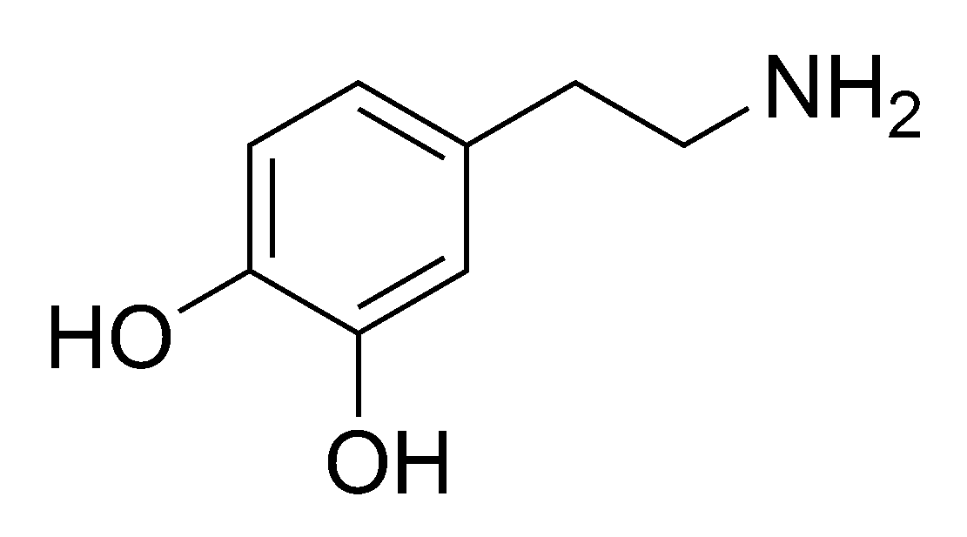
3) Biogenic Amines
Norepinephrine (NE) and Epinephrine (E)
A) Catecholamines
(from which AA?)
NE and E involved in mood, dreaming, wake and alertness levels (mostly excitatory in CNS).
Neurons that release NE or E are termed "Adrenergic“ Neurons
Dopamine
In brain, involved in reward, motivation, memory, attention, e.g. limbic system involved in elevation of mood and emotional responses.
Involved with voluntary motor control.
Has a role in the pleasure center…
These are called "Dopaminergic" Neurons.

Slide 5
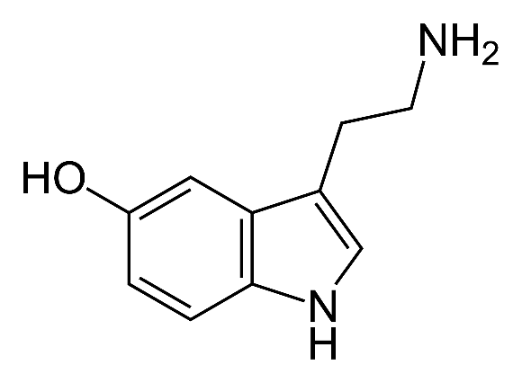
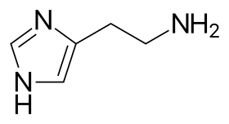
3) Biogenic Amines
Serotonin (5-HT)
B) lndolamines
(from which *AA?)
Found in your gut (digestion) and platelet cells (wound healing). A natural mood stabilizer, associated eating and digesting. Plays a role in sleepiness, alertness, mood and thermoregulation.
Histamine
*An essential amino acid, must be obtained from diet (found in nuts, cheese, and red meat). *Less tryptophan => lower serotonin => can result in anxiety or depression.
In hypothalamus. Also released by mast cells and basophils. Paracrine effects are vasodilation (redness and heat) and increased vascular permeability (puffiness)
Monoamine Oxidase (MAO)
Is the degradative enzyme
for all Biogenic Amines
Q: What would MOA Inhibitors do?

Slide 6
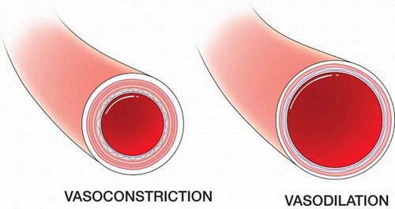
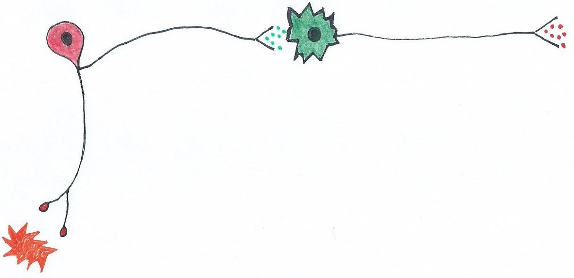
4) Neuropeptides
Substance P
Involved in the pain perception pathway; causes vasodilation; and is also a trigger for nausea and vomiting
Pain perception
in the Brain
Substance P
Pain
Receptors
Ouch! This is unpleasant
Pain
Chemicals released
from damaged tissue

Slide 7
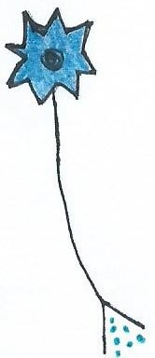
Enkephalins and Endorphins (β)
Both are opioid peptides and act
as the body's natural painkillers
4) Neuropeptides
Enkephalins block pain signals in the spinal cord, e.g., involved in
blocking pain during child birth.
Endorphins* – triggered in multiple ways and act by reducing pain
perception in the brain. These neurons engage in pre-synaptic
inhibition of Substance P transmission.
Pain perception
in the Brain
Presynaptic Inhibition
*Generate euphoric feeling
after intense physical or
emotional challenges, pain
endurance, or stress.
Pain

Slide 8
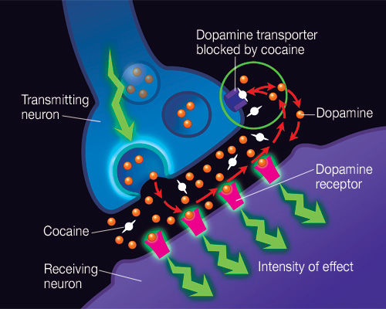
Effects of Drugs on a Synapse

Slide 9
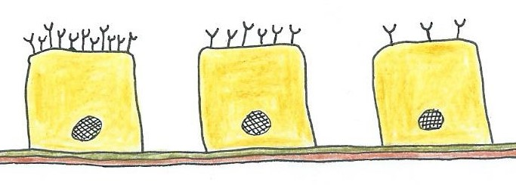
The Effects of Neurotransmitters
Note: The same neurotransmitter can have opposing effects on tissues. For example, the effects of ACh on skeletal muscle and smooth muscle are different.
Why? This is due to…
The Type of Receptors
on the target Tissue!
Also remember that the cell responds and adapts to changes in signals, and this changes the intensity of the effect on the target tissue.
Upregulation of receptors =>
When the cell increases receptor density in response to reduced stimulus. Cell becomes super-sensitive.
Downregulation of receptors
< = When a cell decreases receptor density in response to an excessive stimulus. Cell becomes desensitized.

Slide 10
The Road Ahead
Central Nervous System
  Brain
  Spinal cord
Peripheral Nervous System
  Autonomic N.S.
  Somatic N.S.

Slide 11
Divisions of the Brain
1. Cerebrum
2. Diencephalon
3. Midbrain
4. Cerebellum
5. Pons
6. Medulla Oblongata

Slide 12
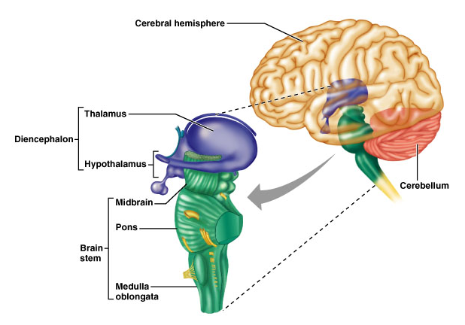
Central Nervous System: The Brain
Parietal Lobe
Frontal Lobe
Occipital
Lobe
Temporal
Lobe

Slide 13

Functions of the Cerebrum
In General - our conscious mind enables us to:
  Be aware of ourselves and sensations.
  Initiate and control voluntary movements.
Cerebrum has 5 Lobes
Frontal Lobe - memory, behavior, personality, movement.
Parietal Lobe - somatic sensory perception.
Temporal Lobe - auditory and olfactory perception.
Occipital Lobe - visual perception.
Insula Lobe - visceral perception.

Slide 14
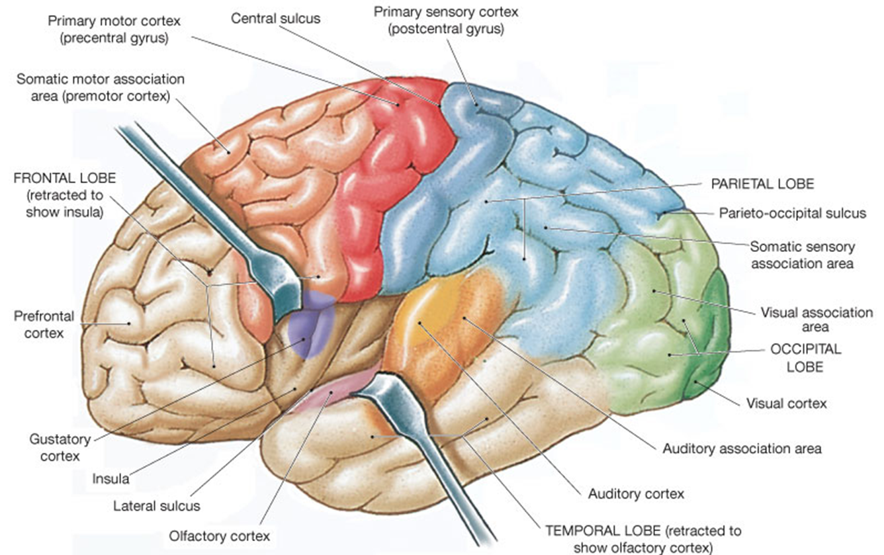
Cerebral Lobes

Slide 15
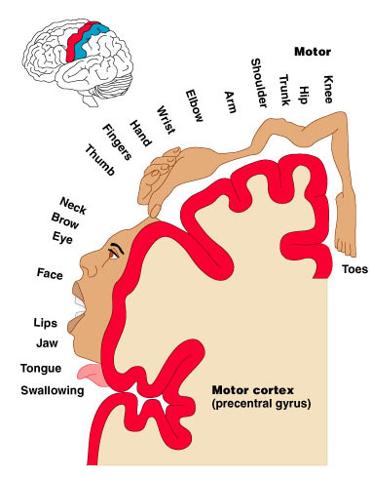
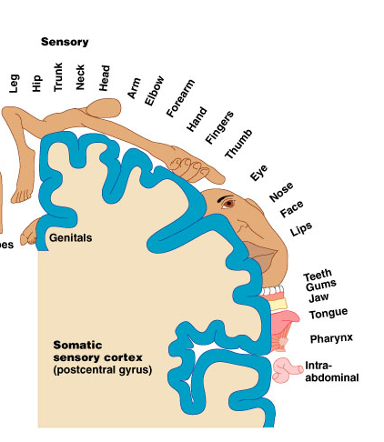
Homunculus - Motor and Sensory
Frontal Lobe
Parietal Lobe

Slide 16
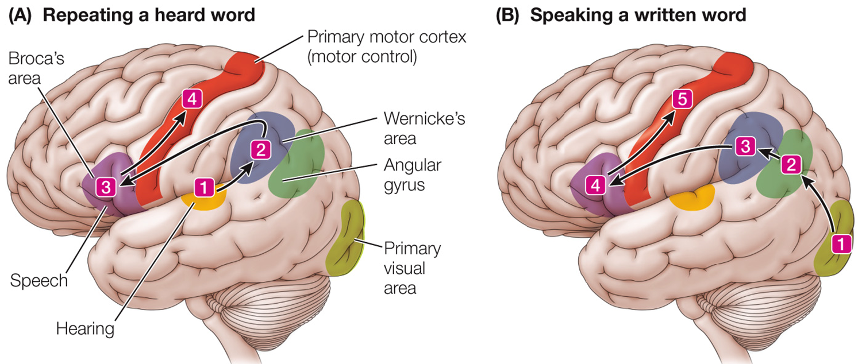
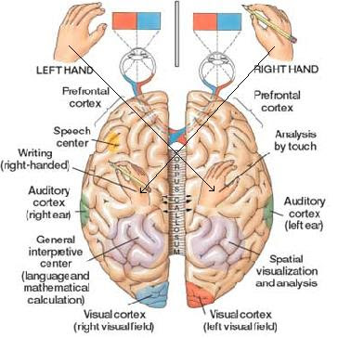
Broca’s
area
Wernike’s
area

Slide 17
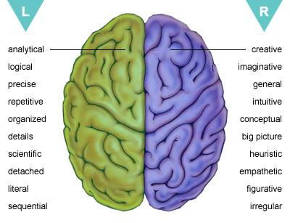

Slide 18
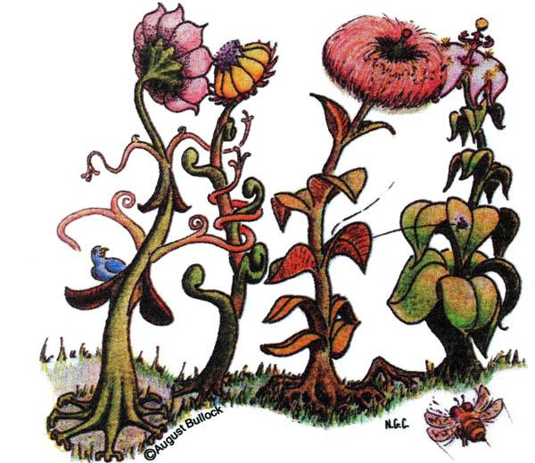
Can you see
what I see?
Hypnotized people can read reversed, mirrored and upside-down text at a normal rate. That is, the subconscious mind decodes any text, no matter how it's written. Recognition of images are even more powerful!

Slide 19

The Power of the Subconscious Mind

Slide 20


Conscious
Mind
Subconscious
Mind

Slide 21
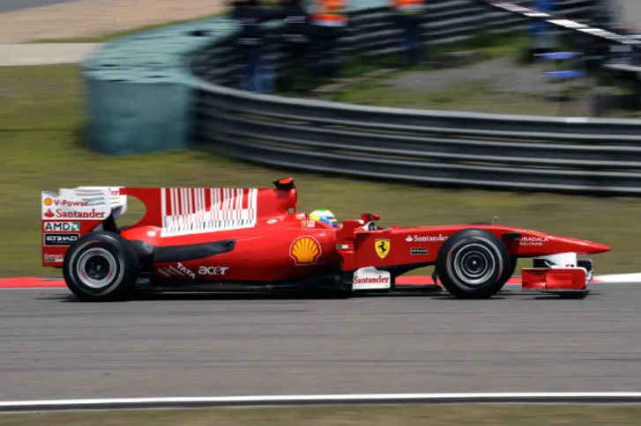



Slide 22
Taste Test
(Montague, 2005)
A
B
50% - 50% split!
Coke
Other
85% chose coke!
Pepsi
Other
50% - 50% split!

Slide 23
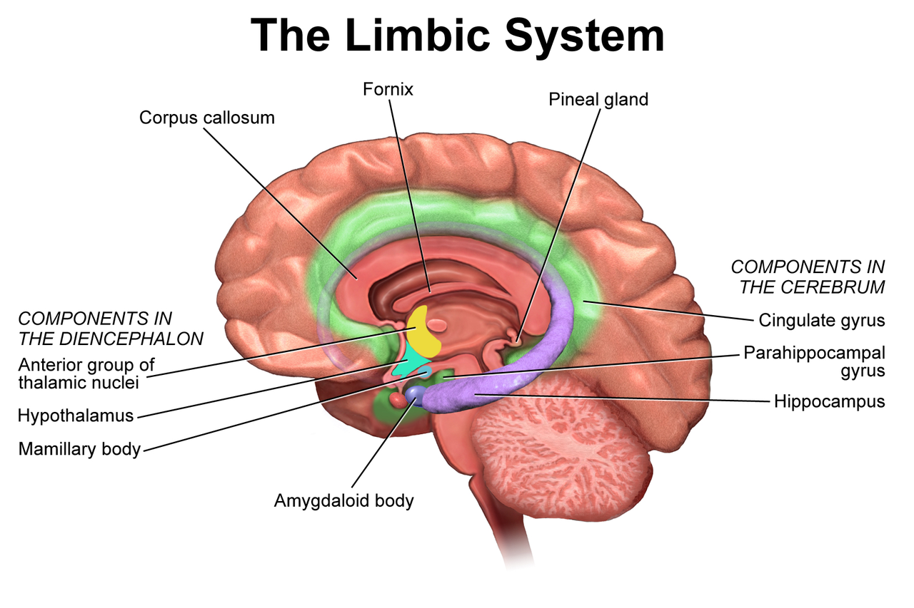
The Limbic System = “Emotional Brain”
A disparate anatomical group with critical functions interconnecting structures (cortices and nuclei) within cerebrum and diencephalon.
Regulating autonomic and endocrine function (esply response to emotional stimuli). Set levels of arousal, involved in motivation, reinforcing behaviors.

Slide 24
The Limbic System = “Emotional Brain”
  e.g., Cingulate gyrus
    Info processing for decision making, planning, allows us to shift between thoughts.
    Interprets pain as unpleasant.
  e.g., Hippocampus
    Processing of spatial relationships and memories.
    Consolidating memories during sleep, transfer to long term memory.
  e.g., Amygdala
    Detects menacing glances from others.
    Emotional recognition of faces.

Slide 25
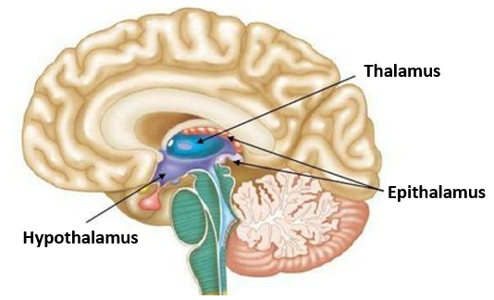
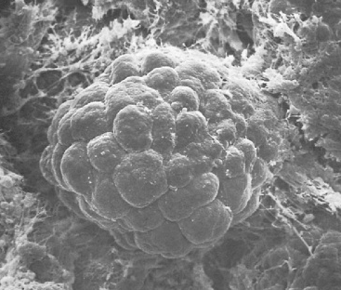

Diencephalon
= 1) Epithalamus, 2) Thalamus and 3) Hypothalamus
Scanning Electron Micrograph
of the Pineal gland
1) Epithalamus
Includes the pineal gland (the ‘pinecone’).
The pineal gland secretes hormones melatonin and serotonin
under influence of the hypothalamus.
*Dimethyl-tryptamine (DMT) is also released from Pineal gland.

Slide 26
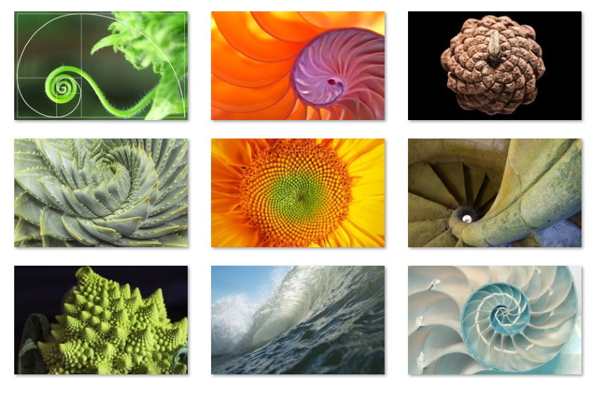
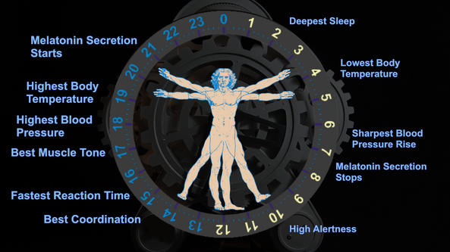
Fibonacci Sequence:
Each number is the sum of the previous two as follows: 1, 1, 2, 3, 5, 8, 13, 21, 34, 55, 89, 144 to infinity. Ratio between numbers = 1.618034 called the Golden Ratio
Melatonin and
Sleep/Wake Cycle

Slide 27
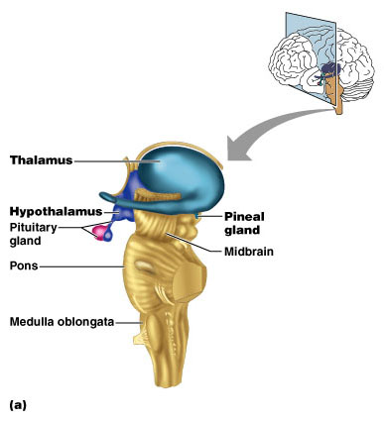
2) Thalamus
* Makes up 80% of
the diencephalon.
* Acts as the “gateway”
to cerebral cortex.
* Acts as a filter:
Tone down/Amplify
* Interconnects a cortex
with sensory information
(4 of the 5 senses).
… What's the exception?

Slide 28
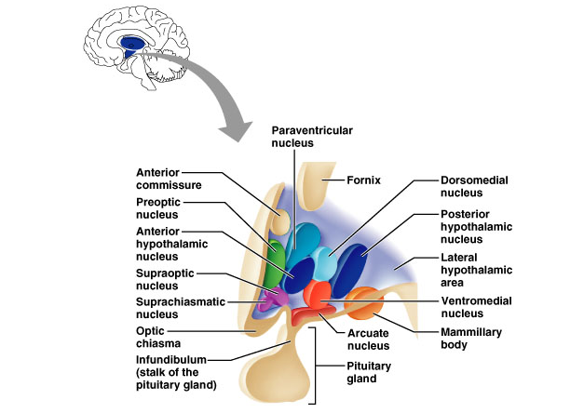
3) Hypothalamus
Main visceral control center of the body
Adrenal gland
T_{b} and Sexual
Dimorphism
Heart Rate and BP
Shivering
Sweating
Thirst and
Hunger
Posterior
Pituitary
Satiety
Circadian
rhythms
Olfaction and
Memory
Feeding

Slide 29
Hypothalamus
Major Functions include the following:
1. Regulation of body temperature (T_{b})
2. Regulation of hunger and thirst sensations
  Control of
  behavior
3. Regulation of sleep-wake cycles
4. Control of the Autonomic Nervous System
and Limbic System
  Control of
  emotional
  responses
5. Control of the Endocrine System

Slide 30
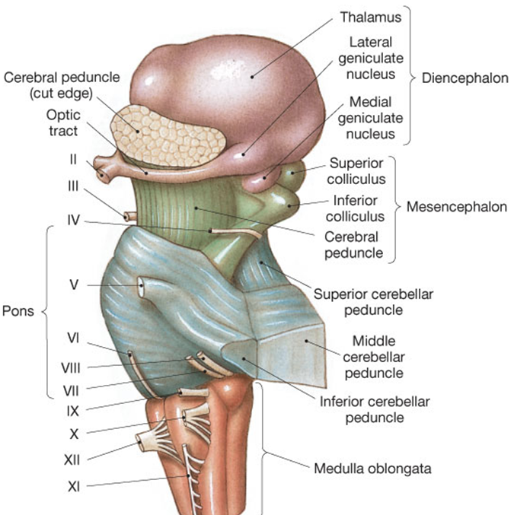
The Brain Stem
Midbrain:
Vision, hearing, motor control
(substantia nigra located here).
Pons:
Respiration, bladder control, facial expressions, facial sensation, posture, and eye control.
Medulla:
Contains 3 vital centers:
Cardiac
Respiratory
Vasomotor
Also regulates many reflexes.

Slide 31
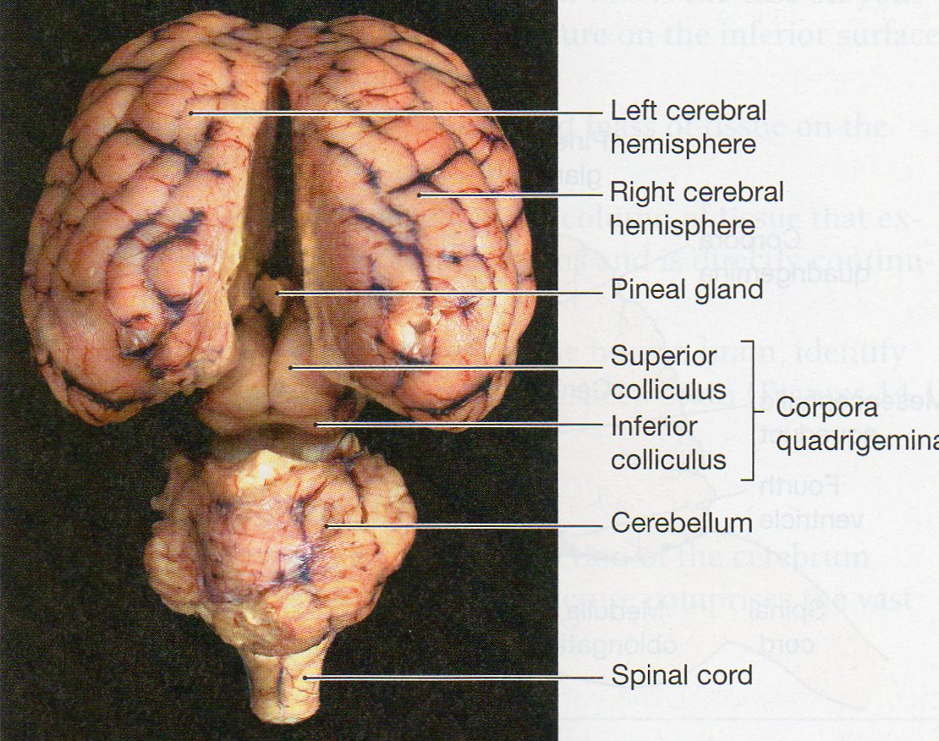
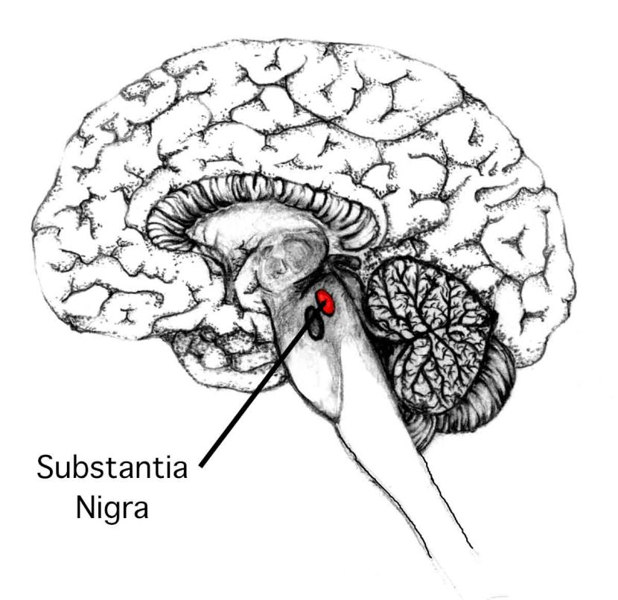
Midbrain

Cranial Reflexes
e.g., visual reflexes.
e.g., auditory reflexes.
Muscle Tone and Movement

Slide 32
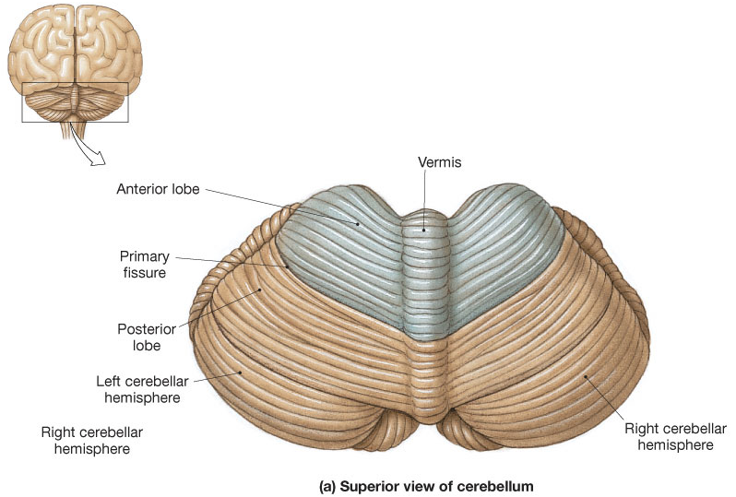

The Cerebellum
Folia

Slide 33
Functions of Cerebellum
1) Controls Postural Reflexes:
- coordinates rapid, automatic adjustments of
muscles in body to maintain equilibrium.
2) Produces Skilled Movements:
- implements routines for fine tuned movements.
Refines learned skills until action becomes routine.

Slide 34
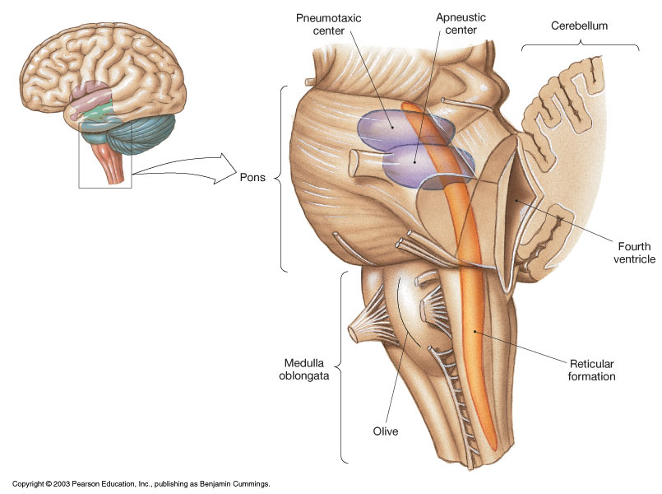
Pons
* Contains the pontine
respiratory centers.


Slide 35
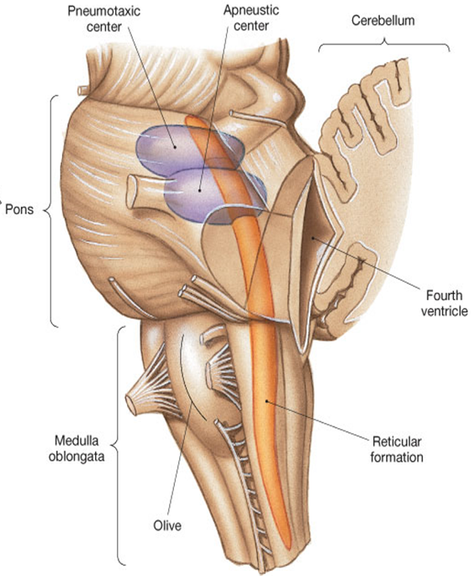
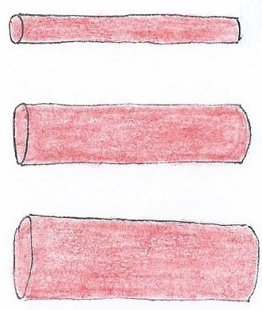

Medulla Oblongata
Vital Centers in the MO include:
Cardiac Control Center
Respiratory Center (Medullary)
Vasomotor Center
Vasoconstriction
(Increases BP and Decreases Blood Flow)
Controls Blood Vessel Diameter
(in between)
Vasodilation
(Decreases BP and Increases Blood Flow)
  *Also contains centers for hiccupping, sneezing, swallowing, vomiting & coughing.

Slide 36
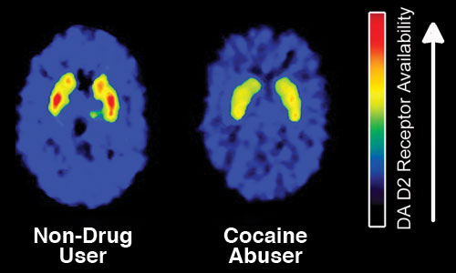
Neurons controlling breathing have µ receptors, to which
opiates, like heroin bind. This accounts for suppressive
effect of opiates on breathing.
Images show decreased dopamine (D₂) receptors in the brain of a
person addicted to cocaine (vs. non-drug user control).
*Can result in changes to motivation and diminish sensitivity to natural rewards

Slide 37
Peripheral Nervous System
Central Nervous System
(Brain and Spinal Cord)
(Nerves and Ganglion)
Somatic N.S.
Autonomic N.S.
Skeletal
Muscle
Parasympathetic
Division
Sympathetic
Division
Cardiac, Smooth Muscle and Glands

