Slide 1

Academic Senate Special Meeting
February 17th, 2025
2025-26 Academic Year
Cultivating Community:
Making the invisible visible
(QR Code for A.S. Webpage)
Attending for Flex credit? Email rgomez001@sdccd.edu or jbartolo@sdccd.edu

Slide 2
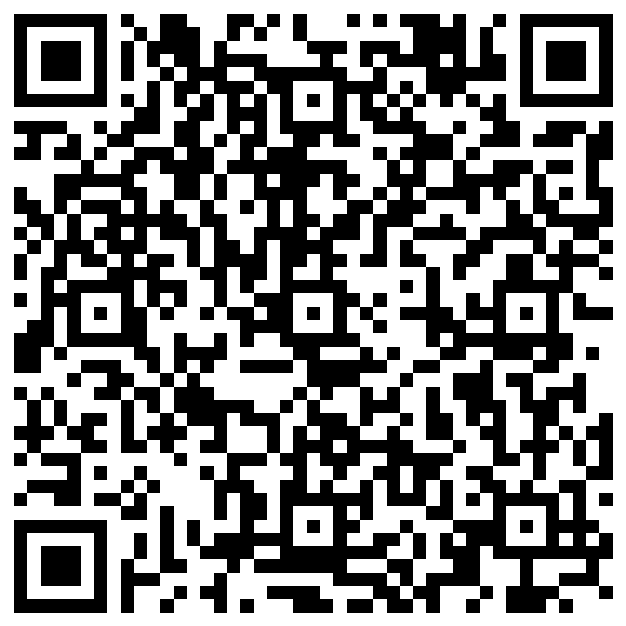
Attendance Log: February 17th
Please remember to sign in using the QR Code! The sign-in sheet is a secondary option (See Olivia!)
When we reach quorum (23/44) we can get started officially!
(QR Code for A.S. Attendance)

Slide 3

2. Agenda Overview
Call to Order
Approval of Agenda & Consent Calendar
DRAFT Minutes 110425
Land Acknowledgement (Updated)
Public Comments
Action Items
Second Read: Resolution on Defining AI Literacy
Discussion Items
Academic Standards Subcommittee Changes
Responding to Ice on Campus
Reports:
Committee Reports
Special Reports
Executive Committee Reports
Announcements
Adjournment
A.S. Agenda for 2/17/26
AS Code of Conduct

Slide 4
3. Land Acknowledgement
We recognize that San Diego Miramar College sits on the ancestral homeland of the Kumeyaay, Luiseño, Cupeño, and Cahuilla tribes, who have lived in this area for well over 10,000 years, and we honor their past, present, and future connection to this land and its inherent connection to their identity.
We acknowledge our occupation of unceded Kumeyaay land and the violent systemic injustices this has continuously perpetuated for Native peoples of this region. We pay respect to the Indigenous people of San Diego County - past, present, and future - and honor their continuing presence in their homeland and their spiritual beliefs that land does not belong to people; people belong to land.
We also acknowledge that this is merely the beginning, and there is far more work to be done in an attempt to heal all of the injustices and inequities that still exist today and throughout their entire historical diaspora. We commit to moving forward together.
Resources: “Making a land acknowledgment meaningful”; A call for more powerful land acknowledgements

Slide 5

4.
Action Items (Second Reads)
5.1 Second Read: Resolution on Defining AI Literacy Rodrigo Gomez (10 mins)

Slide 6
4. Action Items (Second Reads)
4.1 Resolution on Defining AI Literacy (Rodrigo Gomez)
The ASCCC passed a new resolution defining “AI Literacy” at the Fall Plenary 2025. Link to resolution: 102.04 “Support for AI Literacy Integration”
Because this resolution provides a neutral starting point for supporting students and faculty in addressing AI in education, I proposed that Miramar College’s Academic Senate pass a resolution to accept and use this definition.
I issued an email follow up requesting feedback on the language in the resolution from all departments.

Slide 7
5.
Discussion Items
(First Reads)
5.1 Academic Standards Subcommittee Changes Mara Palma-Sanft (10 mins)
5.2 Responding to Ice on Campus
Rodrigo Gomez (10 mins)

Slide 8
5. Discussion Items (First Reads)
5.1 Academic Standards Subcommittee Changes
(Mara Palma-Sanft)

Slide 9
5. Discussion Items (First Reads)
5.2 Responding to Ice on Campus
We recognize that the current political climate has created heightened anxiety for many students and employees
Our responsibility as a public institution is to ensure a safe, lawful, and supportive learning environment for all
SDCCD has clear policies to protect student privacy and promote transparency
Our role is not to escalate the fear — but to ensure clarity, preparedness, and student safety. We already have some tools in place. Are we educating our community well enough about them?

Slide 10
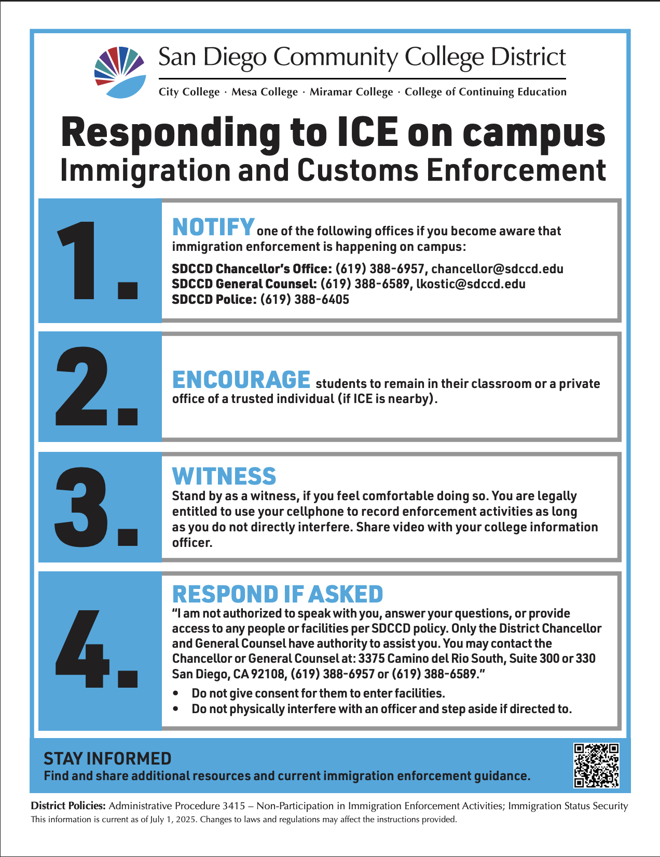
5. Discussion Items (First Reads)
5.2 Responding to Ice on Campus
District Policy – Administrative Procedure 3415
SDCCD “restricts cooperation with immigration enforcement on campus”. It explicitly states that SDCCD staff and faculty should not interact with ICE agents, except to direct them to the District Office.
SDCCD will support and protect undocumented and immigrant students to the fullest extent of California law.

Slide 11

5. Discussion Items (First Reads)
5.2 Responding to Ice on Campus
SDCCDsafe App
The app allows each one of our community members across 10 campuses and the District Office to be proactive about their safety and help keep themselves, as well as their classmates and colleagues, safer.
With the app, users can invite a trusted friend or family member to remotely monitor as they travel from point A to point B, on or off campus. In case of any issues, your safety monitor can alert emergency services. (Download the App here: SDCCD SAFE Link)
Easy Emergency Communication
Let Your Network Know You’re OK
Send Anonymous Tips

Slide 12

5. Discussion Items (First Reads)
5.2 Responding to Ice on Campus
“Know Your Rights” Workshop 2/18
Learn about immigrant rights and family safety planning. Facilitated by SDCCD and Higher Education Legal Services. This educational workshop is open to all allies.
Each spring 2026 workshop will be held at a new time of 6:30 p.m. to 7:30 p.m. Presented in English with live translation services in Spanish, and Haitian Creole, Dari, and Somali. FLEX Available!

Slide 13
6.
Reports
6.1 Committee Reports
6.2 Special Reports
6.3 Executive Committee Reports

Slide 14
6. Reports
6.3.1 President’s Report
6.3.1.1 College Council is forming an AI Workgroup
6.3.1.2 AP 5500.1 Honest Academic Conduct
6.3.1.3 Know Your Rights! Emergency Preparedness 2/18
6.3.1.4 Safe App
6.3.2 Vice President’s Report
6.3.2.1 UMOJA

Slide 15
6. Reports
6.3.1 President’s Report
6.3.1.2 AP 5500.1 Honest Academic Conduct

Slide 16
6. Reports
6.3.3 – 8
Secretary – Olivia Flores
Treasurer – Dawn Diskin
Contract Member-at-Large – Melissa Wolfson
Contingent Faculty Member-at-Large – Desi Klaar
Chair of Chairs – Mary Kjartanson

Slide 17
7. Announcements
1 min. time limit each

Slide 18
8. Adjournment
If the calendar was approved earlier, the first meeting of the 2025-26 SDMC Academic Senate is: Tuesday, March 3rd, 2026 from 3:30-5:00 pm in M-110. Remember that starting Spring 2026 we’ll be moving to fully in person Senate meetings. Hence, we will be retiring the A.S. Senator Remote Attendance Form

Slide 19
Thanks for your hard work for Miramar College!
If you have any questions, please reach out via email!
rgomez001@sdccd.edu or jbartolo@sdccd.edu

