Slide 1
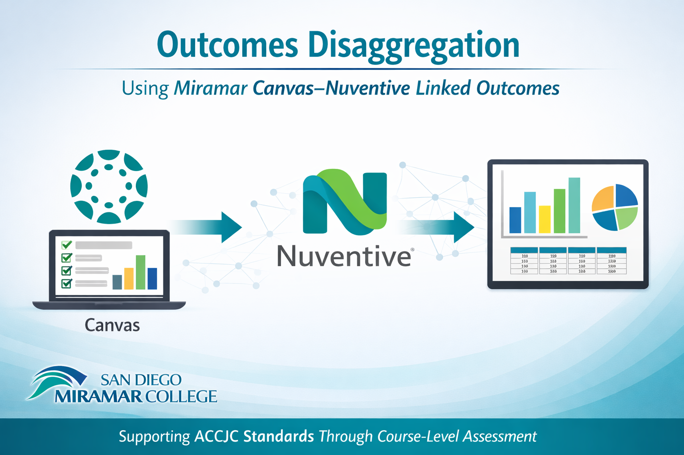

Slide 2
ACCJC Outcomes Assessment Requirement
2024 ACCJC requirement - now requires Colleges to disaggregate outcomes assessment data to identify, analyze, and close equity gaps
Assessment data will show disaggregated outcomes findings by course and term – not individual instructor or section.

Slide 3
Standardized Outcome Naming Conventions:
Reason: Standardized naming allows outcomes to be imported into Canvas efficiently.
Outcome Canvas format: [Course Number] & [Outcome Title]
Example: HIST 109 - Primary Source Analysis
Miramar Nuventive Linked Course Outcomes in Canvas:
Miramar Nuventive “Institution” Course outcomes were added to Canvas.

Slide 4
Outcomes(SLO) Naming Convention Standardization
Outcome names in Nuventive are being updated to match those uploaded into Canvas
All references such as SLO, SLO#1, Outcome #1, etc., are being removed.
Outcomes without a title were given a temporary title
Canvas Nuventive Outcome Naming Convention:
Example: HIST 109 - Primary Source Evidence

Slide 5
Canvas Nuventive outcomes assessment Pilot Program Spring 2026
Canvas Outcomes Assessment Training:
Faculty training on Assessing in Canvas using rubrics (with Course Outcomes added) on assignments, quizzes, and discussion forums to measure assessment data.
Nuventive Data Import:
Canvas Outcomes data imported into Nuventive by overall course and term (not by instructor or section)
Displayed in tables & charts for Departments to easily review and analyze.

Slide 6


