Slide 1
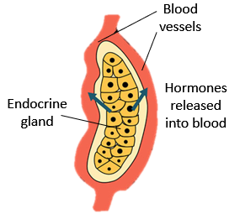
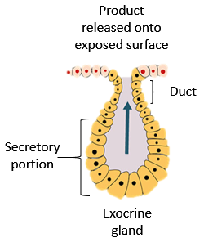
Glandular Epithelia
Endocrine Glands
  Secretes hormones directly into interstitium then into blood stream. These glands have no ducts. Hormones travel via blood stream all over body, only have effect on tissues with receptors for that hormone = “target tissue”.
Exocrine Glands
  Secretions made by cells and discharged through ducts onto an exposed surface.
Exocrine Glands can be Classified by:
  1) Structure of gland.
  2) Mode of secretion.
  3) Type of secretion produced.

Slide 2
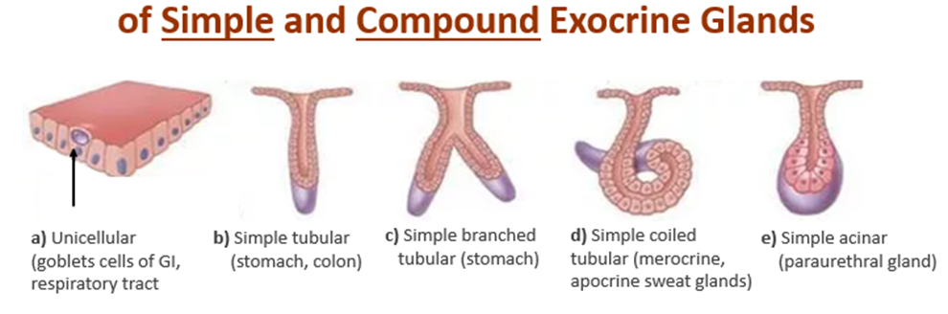
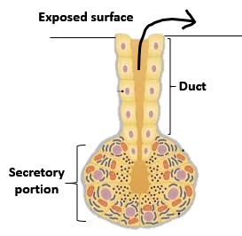
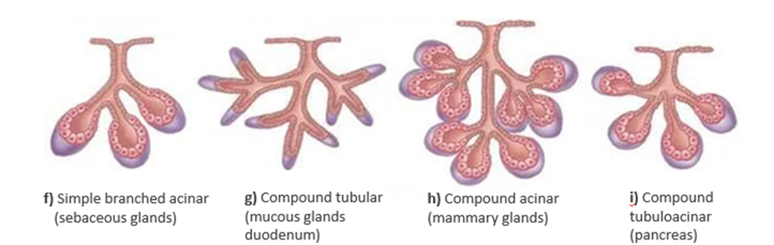
1) Structure of Exocrine Glands
How many cells? One cell = Unicellular. Many cells = Multicellular.
1) Structure (of multicellular) glands:
1: Simple (one duct) or Compound (many ducts).
2: Shape of Secretory portion: Tubular (tube shaped) or Acinar (round shaped).

Slide 3
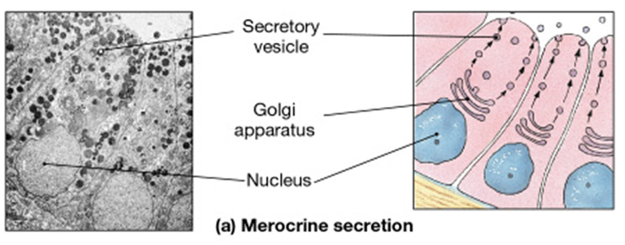
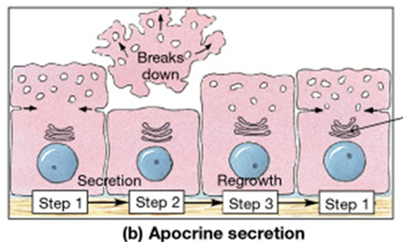
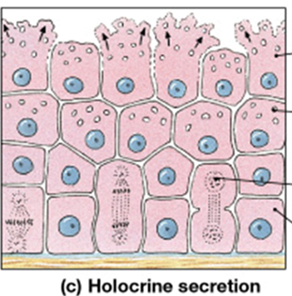
2) Modes of Secretion
Merocrine (eccrine) Secretion
  Exocytosis (vesicles fuse with PM and release contents from cell).
  Most common mode of secretion.
Apocrine Secretion
  Exocytosis, but lipid rich content and signal molecules that can function as pheromones (‘scent glands’).
Holocrine Secretion
  Involves entire cell, as it fills with vesicles and
  bursts, destroying the cell. Cellular debris is part of
  product.

Slide 4
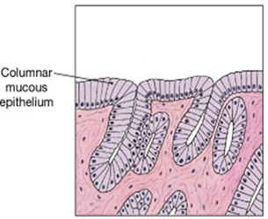
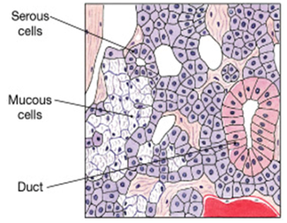
3) Type of Secretion
Mucous – thick, sticky, viscous protective solution.
Serous – watery, slippery, thin solution.
Mixed – contains both mucous and serous solutions.

Slide 5
Tissue Membranes
= Epithelial Tissue
Connective Tissue
Membranes function to cover and protect body areas.
3 Types of Epithelial Membranes
  Mucous Membrane
  Serous Membrane
  Cutaneous Membrane

Slide 6
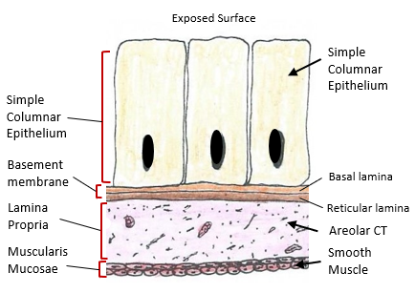
Mucous Membranes
Line passageways that open to exterior.
Moistened by mucous (mucin + H₂O).
Has 3 Layers (Components):
  1) Epithelium (simple or stratified)
  2) Areolar CT (called ‘Lamina Propria’)
  3) Smooth Muscle (called ‘Muscularis Mucosae’)
Roles
  Protection
  Absorption
  Secretion

Slide 7
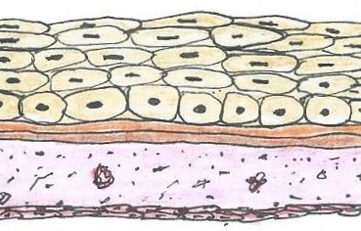
Look for the 3 Components that are in a Mucous Membrane
①
②
③
Now, identify all the structures of this
mucous membrane
-
-
-
-

Slide 8
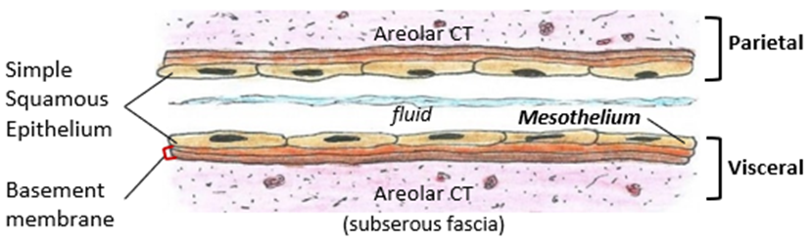
Serous Membranes
Lines internal body cavities.
Thin, watery, serous fluid (transduate) produced.
2 layers:
  Simple Squamous Epithelium (called ‘Mesothelium’).
  Thin areolar C.T. (called ‘subserous fascia’).
Role
Reduce friction of two surfaces moving across
each other.
1) Pleura, 2) Pericardium and 3) Peritoneum

Slide 9
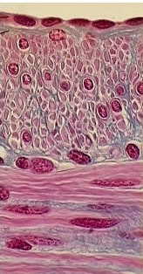
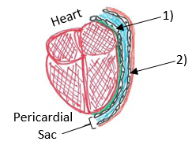
Serous Membrane
Lines internal body cavities (not exposed to external environment). Membrane produce serous secretions.
Simple
Squamous
Epithelium
Exposed Surface (Internal)
1) Visceral
2) Parietal
Areolar C.T.
Various
deeper
tissues

Slide 10
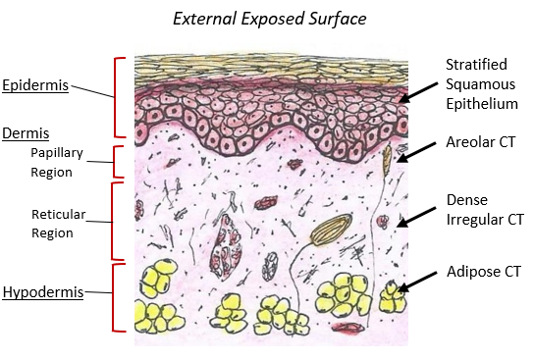
Cutaneous Membranes
Covers the external surface of the body.
A “dry” membrane, preventing dehydration.
2 Main Layers:
  Epithelium (Keratinized Stratified Squamous), this is called the Epidermis.
  Areolar and Dense Irregular CT make up the Dermis.
Roles
Physical protection
Prevents water loss
Detection of sensations
Thermoregulation
Production of vitamin D

Slide 11
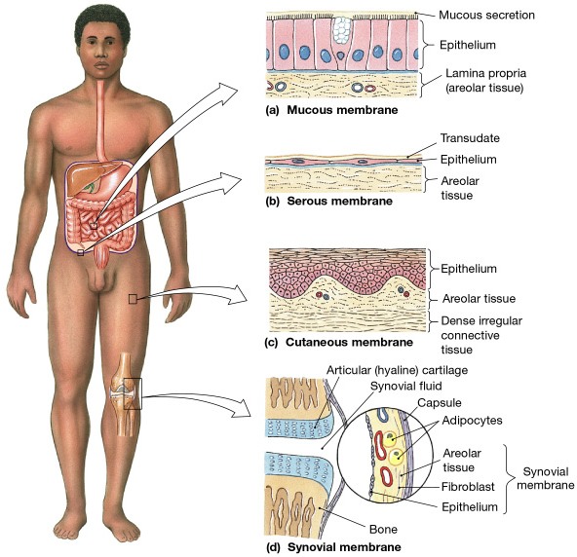


Mucous
Serous
Cutaneous
Connective Tissue
Synovial
Membrane
(Later!)

Slide 12
Fasciae
Composed of Layers of fibrous C.T. in between various tissues.
Roles:
1) Provides stability, maintains relative positions of organs.
2) Allows for distribution of blood vessels, lymph vessels and nerves.

Slide 13
All organ systems are interconnected
There are 3 types of Fasciae
1. Superficial Fascia
2. Deep Fascia
3. Subserous Fascia

Slide 14
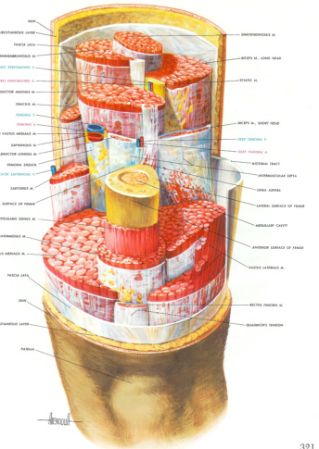
Superficial Fascia (Hypodermis)
  Subcutaneous layer (adipose and dense irregular CT).
  Insulation, padding, allows movement.
  Collagen fibers run through the adipose tissue.
Deep Fascia
  Dense connective tissue, lots of collagen.
  Many layers with varying orientations.
  Creates compartments for structural support of muscles.
  Provides access for blood vessels, lymphatics and nerves.
Subserous Fascia (Visceral fascia)
  A layer of areolar connective tissue.
  In between deep fascia and epithelium of serous membrane.
  Acts to suspend organs within body cavities.

Slide 15
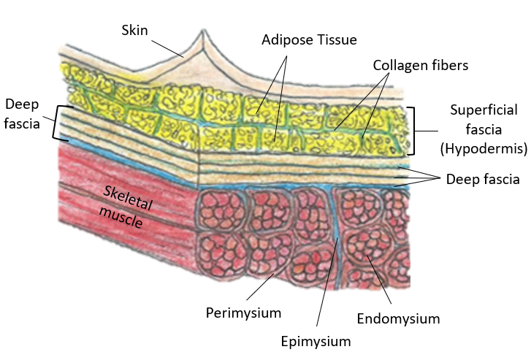
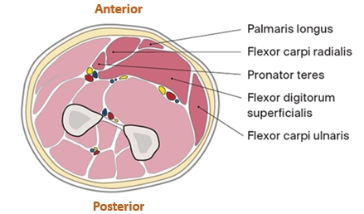
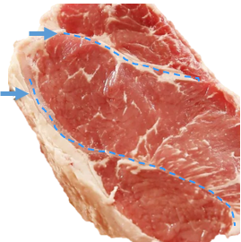
Fasciae is the
Connective Tissue
Framework
of the body
Deep Fascia Creates Anatomical Fascial
Compartments
The blue arrows show the connective tissue fascia as white streaks on the steak’s surface, effectively dividing one muscle group from another.

Slide 16
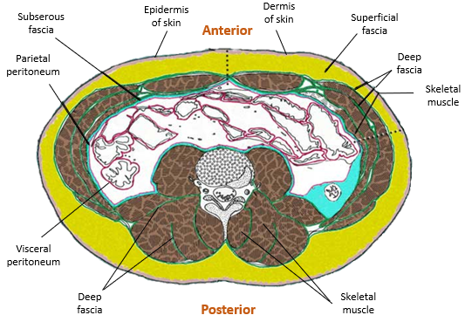
Locations of the 3 Fasciae
Transverse Section of Abdomen

