Slide 1

Academic Senate Meeting
December 2nd, 2025
2024-25 Academic Year
Cultivating Community:
Making the invisible visible
(QR Code for A.S. Webpage)
Attending for Flex credit? Email rgomez001@sdccd.edu or jbartolo@sdccd.edu

Slide 2
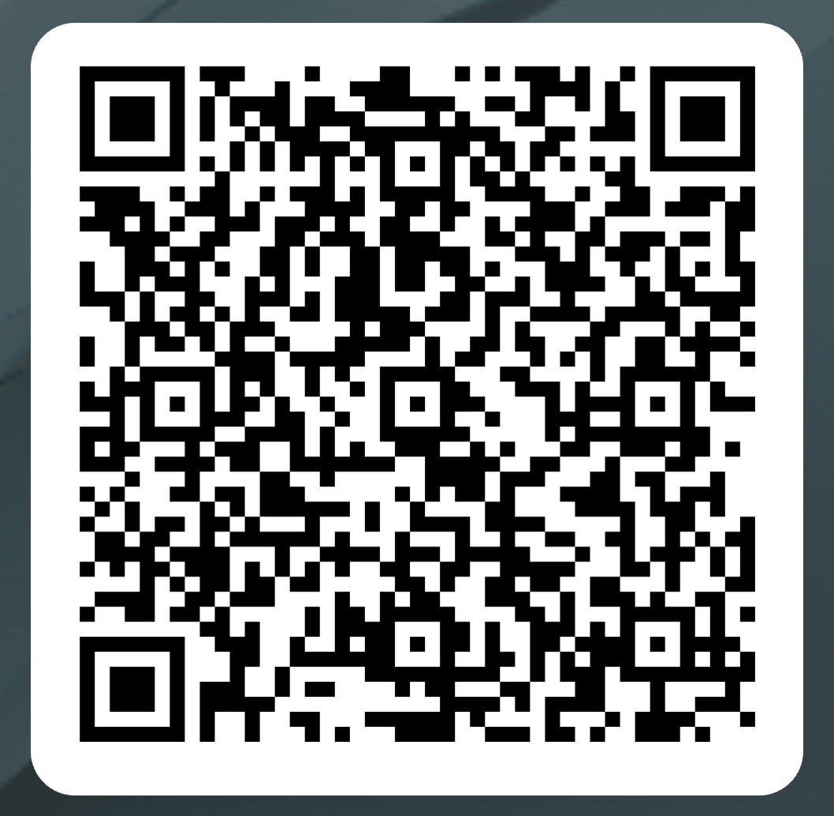
Attendance Log: December 2nd
Please remember to sign in using the QR Code! The sign-in sheet is a secondary option (See Olivia!)
When we reach quorum (23/44) we can get started officially!
(QR Code for A.S. Attendance)

Slide 3

2. Agenda Overview
Call to Order
Approval of Agenda & Consent Calendar
DRAFT Minutes 110425
Land Acknowledgement (Updated)
Public Comments
Action Items
Miramar Technology Plan
Donation to EOPS
Reimbursement for Giving Donation for Basic Needs
Discussion Items
Standing: Curriculum Committee Updates
Miramar ASPEN Nomination
Early Alert System
Resolution on Defining AI Literacy
Senate Recording Protocol
Reports:
Committee Reports
Special Reports
Faculty Technology Liaison Report
Executive Committee Reports
Announcements
Adjournment
A.S. Agenda for 12/02/25
AS Code of Conduct

Slide 4
3. Land Acknowledgement
We recognize that San Diego Miramar College sits on the ancestral homeland of the Kumeyaay, Luiseño, Cupeño, and Cahuilla tribes, who have lived in this area for well over 10,000 years, and we honor their past, present, and future connection to this land and its inherent connection to their identity.
We acknowledge our occupation of unceded Kumeyaay land and the violent systemic injustices this has continuously perpetuated for Native peoples of this region. We pay respect to the Indigenous people of San Diego County - past, present, and future - and honor their continuing presence in their homeland and their spiritual beliefs that land does not belong to people; people belong to land.
We also acknowledge that this is merely the beginning, and there is far more work to be done in an attempt to heal all of the injustices and inequities that still exist today and throughout their entire historical diaspora. We commit to moving forward together.
Resources: “Making a land acknowledgment meaningful”; A call for more powerful land acknowledgements

Slide 5

4.
Public Comments
(10 Mins)
Limited to 10+1 items that are not on the agenda
Public Comments on agenda items will take place before the A.S. body discussion begins but after any relevant presentations.
2 min. per speaker, 10 mins. per topic
Individual speakers may not yield their time to another speaker or spokesperson
To be continued at the end of the meeting if necessary

Slide 6
5.
Action Items (Second Reads)
5.1 Miramar Technology Plan Pablo Martin (5 mins)
5.2 Donation to EOPS
Dawn Diskin (5 mins)
5.3 Reimbursement for Giving Donation for Basic Needs
Dawn Diskin (5 mins)

Slide 7
5. Action Items (Second Reads)
5.1 Miramar Technology Plan
After having ample time to review the technology plan, the time has come to vote to approve it.
Here it the plan once more for reference: 2024-2027 Technology Plan
Please remember that approval of this plan, as-is, is required before we can proceed to making any updated plans about Miramar’s technology needs.

Slide 8
5. Action Items (Second Reads)
5.2 Donation to EOPS
(Dawn Diskin)
Miramar’s AS contributed $600 which were matched by the Foundation, doubling that to $1,200 available for scholarships this cycle
Today we need to determine how we want to award the $1,200 (e.g., six $200 scholarships, or four $300, etc.)
Once we’ve decided, I’ll send the updated information to Lisa and Vincent to launch the application process.

Slide 9
5. Action Items (Second Reads)
5.3 Reimbursement for Giving Donation for Basic Needs
(Dawn Diskin)
During ”Jets Give”, the Academic Senate contributed $250 to Basic Needs, which—because of the donor match—became $500 in direct student support.
That donation was originally paid upfront and now needs to be formally reimbursed from the Senate account to the individual who covered the cost.

Slide 10
6.
Discussion Items
(First Reads)
6.1 Standing Curriculum Committee Updates
Veronica Hartmann (10 mins)
6.2 Miramar ASPEN Nomination Daniel Miramontez (10 mins)
6.3 Early Alert System
Mary Kjartanson (5 mins)

Slide 11
6.
Discussion Items
(First Reads)
6.4 Resolution on Defining AI Literacy
Rodrigo Gomez (10 mins)
6.5 Senate Recordings Protocol
Rodrigo Gomez (5 mins)

Slide 12
6. Discussion Items (First Reads)
6.1 Standing Curriculum Committee Updates
(Veronica Hartmann)
Feedback on Administrative Procedures and Board Policies
Updates on Title 5 revisions to Credit for Prior Learning (CPL)
Updates to professional development opportunities, common course numbering timelines, and the new attendance accounting method

Slide 13
6. Discussion Items (First Reads)
6.2 Miramar ASPEN Nomination
(Daniel Miramontez)
The Aspen Institute recognizes the top community colleges in the nation based on student success, equitable outcomes, completion, and transfer excellence.
Miramar’s nomination places us among the top-performing colleges in the country and signals strong institutional performance across key metrics.
This stage is a nomination–but a significant recognition; we’ll need to submit a comprehensive data packet to proceed further.

Slide 14
6. Discussion Items (First Reads)
6.3 Early Alert System
(Mary Kjartanson)

Slide 15
6. Discussion Items (First Reads)
6.4 Resolution on Defining AI Literacy
(Rodrigo Gomez)
The ASCCC has update its website to include the new resolutions passed at the Fall Plenary 2025. Link to resolution 102.04 “Support for AI Literacy Integration”
This resolution provides a neutral starting point for supporting students and faculty in addressing AI in education.
Therefore, I propose that Miramar College’s Academic Senate pass a resolution to accept and use this definition.

Slide 16
6. Discussion Items (First Reads)
6.5 Senate Recordings Protocol
(Rodrigo Gomez)
To ensure our practices remain consistent with shared governance bodies across the district, and to align with standards already used by College Council and the Board of Trustees, we are updating our approach to meeting recordings—which will be deleted once the minutes are approved
We have confirmed that this practice is fully compliant with Brown Act requirements and meet the district expectations for public record retention.

Slide 17
7.
Reports
7.1 Committee Reports
7.2 Special Reports
7.3 Executive Committee Reports

Slide 18
7. Reports
7.1 Committee Reports

Slide 19
7. Reports
7.2 Special Reports
7.2.1 FTL Report on the Technology Survey Results
(Pablo Martin)
Faculty Technology Survey Final

Slide 20
7. Reports
7.3.1 President’s Report
7.3.2 Vice President’s Report

Slide 21
7. Reports
7.3.3 – 8
Secretary – Olivia Flores
Treasurer – Dawn Diskin (please see the following slide)
Contract Member-at-Large – Kristin Everhart
Contingent Faculty Member-at-Large – Melissa Wolfson
Chair of Chairs – Mary Kjartanson

Slide 22
7. Reports
7.3.4: Treasurer (Dawn Diskin)
Account Balance $311.07
Academic Senate Dues / Voluntary Payroll Deduction
Annual student scholarships & Basic Needs Donations
Update from Miramar College Foundation

Slide 23
8. Announcements
1 min. time limit each

Slide 24
9. Adjournment
If the calendar was approved earlier, the first meeting of the 2025-26 SDMC Academic Senate is: Tuesday, February 3rd, 2026 from 3:30-5:00 pm in M-110. Remember that starting Spring 2026 we’ll be moving to fully in person Senate meetings. Hence, we will be retiring the A.S. Senator Remote Attendance Form

Slide 25
Thanks for your hard work for Miramar College!
If you have any questions, please reach out via email!
rgomez001@sdccd.edu or jbartolo@sdccd.edu

