Slide 1
The slideshow for this week is still
UNDER CONSTRUCTION

Slide 2
San Diego Miramar College Academic Senate Meeting
November 4th, 2025
2024-25 Academic Year
Cultivating Community:
Making the invisible visible
Attending for Flex credit? Email rgomez001@sdccd.edu or jbartolo@sdccd.edu
(QR Code for A.S. Webpage)

Slide 3
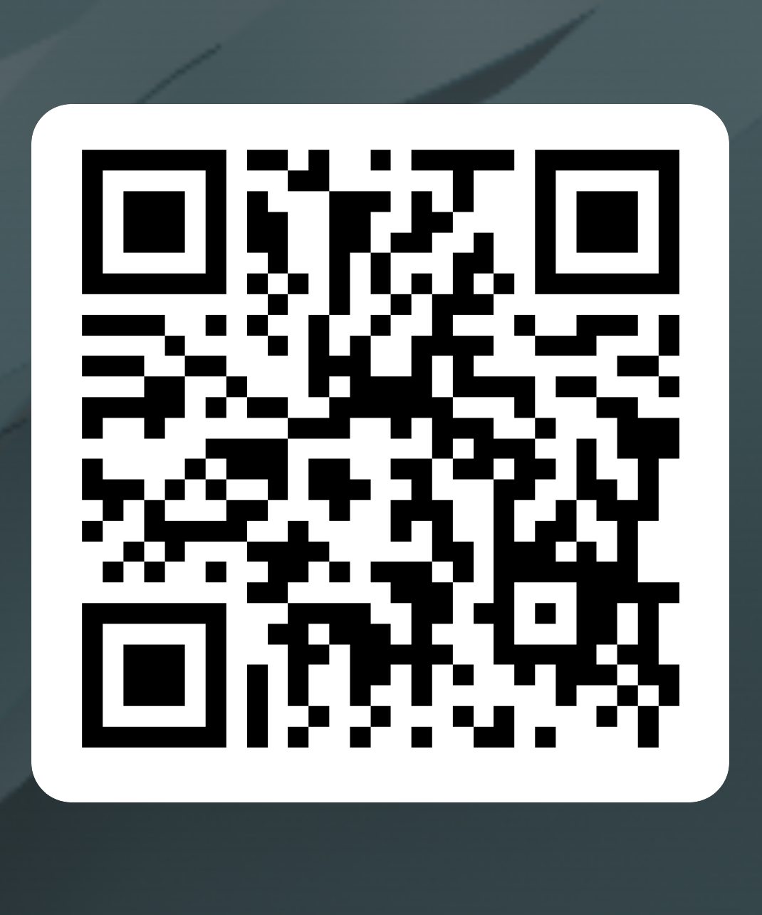
Academic Senate Attendance
November 4th, 2025
2024-25 Academic Year
Please remember to sign in using the QR Code! The sign-in sheet is a secondary option (See Olivia!)
When we reach quorum (23/44) we can get started officially!

Slide 4
2. Agenda Overview
Call to Order
Approval of Agenda & Consent Calendar
DRAFT Minutes 102125
Land Acknowledgement (Updated)
Public Comments
Action Items
Updating College Mission & Vision Statements
Discussion Items
Standing: Curriculum Committee Updates
School of Academic Services Priorities & Goals
FTL Technology Report
AS Treasury Report & Food Pantry Donation
Potential AS Meeting Day/Time Change
Miramar AI Working Group – AI Policies & Guidelines
Reports:
Committee Reports
Special Reports
Faculty Technology Liaison Report
Executive Committee Reports
Announcements
Adjournment
A.S. Agenda for 11/04/25 AS Code of Conduct

Slide 5
3. Land Acknowledgment (Updated)
We recognize that San Diego Miramar College sits on the ancestral homeland of the Kumeyaay, Luiseño, Cupeño, and Cahuilla tribes, who have lived in this area for well over 10,000 years, and we honor their past, present, and future connection to this land and its inherent connection to their identity.
We acknowledge our occupation of unceded Kumeyaay land and the violent systemic injustices this has continuously perpetuated for Native peoples of this region. We pay respect to the Indigenous people of San Diego County - past, present, and future - and honor their continuing presence in their homeland and their spiritual beliefs that land does not belong to people; people belong to land.
We also acknowledge that this is merely the beginning, and there is far more work to be done in an attempt to heal all of the injustices and inequities that still exist today and throughout their entire historical diaspora. We commit to moving forward together.
Resources: “Making a land acknowledgment meaningful”; A call for more powerful land acknowledgements
Notes:
Beginning with the Spanish invasion of 1769, continuing through the Mexican Period of 1826 to 1848, and on through the American Period, the Kumeyaay were forced off their ancestral lands. Nearly all of the Kumeyaay lands were taken into private ownership or made U.S. government holdings. Treaties negotiated with 18 California tribes in 1850 to set aside 8.5 million acres in specific tribal lands were never ratified by the United States Senate as a result of opposition by the state of California.

Slide 6
4. Public Comments (10 min)
Limited to 10+1 items that are not on the agenda
Public Comments on agenda items will take place before the A.S. body discussion begins but after any relevant presentations.
2 min. per speaker, 10 mins. per topic
Individual speakers may not yield their time to another speaker or spokesperson
To be continued at the end of the meeting if necessary

Slide 7
5. Action Items (Second Reads)
5.1. Updating College Mission & Vision Statements
David Wilhelm / Rodrigo Gomez (10 mins.)
San Diego Miramar College, in keeping with this vision, supports and emphasizes the following guiding values:
Access to learning and support services, for all students to successfully achieve their educational and career goals
A culture that breaks down barriers, embraces, promotes and respects community through equity, inclusion, civility, responsibility and sustainability, from a global perspective
A reflection and respect of our diverse community of our students, classified professionals, faculty and administrators.
A reflection of our community through the diversity of our students, classified professionals, faculty, and administrators.

Slide 8
5. Action Items (Second Reads)
5.1. Updating College Mission & Vision Statements
David Wilhelm / Rodrigo Gomez (10 mins.)
The Classified Senate met today and discussed bullets 3 & 4 on the Mission and Vision statement.
We came up with the following recommendation to combine these bullets:
“A commitment to respect and reflect the diversity of our local community.”
I wanted to ensure you had this ahead of your meeting this afternoon, in case you would like to include it in your discussion.

Slide 9
5. Action Items (Second Reads)
5.1. Updating College Mission & Vision Statements
David Wilhelm / Rodrigo Gomez (10 mins.)
Option 1 – Keep both but rewrite for distinct purposes
• #3 – Respect for Diversity: Commitment to respecting and honoring the diverse backgrounds and perspectives of our students, classified professionals, faculty, and administrators.
• #4 – Representation and Inclusion: Commitment to ensuring that our programs, services, and institutional practices reflect and serve the diversity of our college community.
Option 2: Merge #3 and #4 into a single clear value
• A culture that breaks down barriers and promotes community through equity, inclusion, civility, respect, responsibility, and sustainability, from a global perspective — one that reflects and celebrates the diversity of our students, classified professionals, faculty, and administrators.

Slide 10
6. Discussion Items (First Reads)
6.1. Curriculum Committee Updates
Veronica Hartmann (10 mins.)
6.2. School of Academic Services Priorities & Goals
Jeff Orgera (10 mins.)
6.3. FTL Technology Report
Pablo Martin (10 mins.)
6.4 AS Treasury Report & Food Pantry Donation
Dawn Diskin / Rodrigo Gomez (10 mins.)

Slide 11
6. Discussion Items (First Reads)
6.5. Potential AS Meeting Day/Time Change
Rodrigo Gomez (5 mins.)
6.6. Miramar AI Working Group
Rodrigo Gomez (10 mins.)

Slide 12
6. Discussion Items (First Reads)
6.1. Curriculum Committee Updates
Veronica Hartmann (10 mins.)

Slide 13
6. Discussion Items (First Reads)
6.2. School of Academic Services Priorities & Goals
Jeff Orgera (10 mins.)
Academic Services Slides (Powerpoint)

Slide 14
6. Discussion Items (First Reads)
6.3. FTL Technology Report
Pablo Martin (10 mins.)
FTL Slides (Powerpoint)
Technology Plan (Committee Approved)

Slide 15
6. Discussion Items (First Reads)
6.4. AS Treasury Report & Food Pantry Donation
Dawn Diskin / Rodrigo Gomez (10 mins.)
Report & Dues

Slide 16
6. Discussion Items (First Reads)
6.5. Potential AS Meeting Day/Time Change
Rodrigo Gomez (5 mins.)

Slide 17
6. Discussion Items (First Reads)
6.6. Miramar AI Working Group
Rodrigo Gomez (10 mins.)
MAIN Community of Inquiry/Practice Slides
Miramar College has been a leader in the AI in Education conversation since it started. We are the only college currently with an AI Resolution. In the absence of specific professional development related to AI, I propose the creation of a Miramar working group on AI.
AI Policies & Guidelines City College AS Position Paper
Miramar AI Guidelines Draft

Slide 18
7. Reports
7.1. Committee Reports

Slide 19
7. Reports
7.2. No Special Reports

Slide 20
7.3: Executive Committee Reports
7.3.1: President’s Report
If you have questions that you don’t ask today, I’m available for further discussion via email, face-to-face, or Zoom meetings.
You can also invite me to your department meetings. (Past resource documents can be found on the specific web page created for each A.S. meeting.)

Slide 21
7.3: Executive Committee Reports
7.3.1.2: President’s Report
1. Adjunct Faculty Shared Governance Funds:
Working with and upon the recommendation of AFT President Jim Mahler, the four A.S. Presidents agreed that each college would receive 110 hours for the fall 2025 semester at the rate of $50/hour.
The rate of pay will increase if the total number of hours submitted is less than 440 hours across the district.
I’ve reviewed my options and created a document that I’ve shared with Adjunct Senators to track the hours that will go to AS & other adjunct governance roles at Miramar. I’ve returned a few forms sent already.

Slide 22
7.3.1.2: President’s Report (cont.)
2. AP7211 – Voted down at Miramar College. However, Mesa College has requested an update on our position and looking for the edits that we would like to see to approve it.
The issue had to do with “Chairs” specifically. Original | Updated Version
Faculty Discipline Expert Committee (FDEC) language:
Each college will establish its own Faculty Discipline Expert Committee (FDEC) on an as needed basis. The FDEC will include at least two discipline experts with adequate academic and/or professional experience. The Department Chair and/or Area Dean may also be part of the committee. Upon receipt of an applicant’s Application for Equivalency Determination, the FDEC shall review the submission.

Slide 23
7.3.1.3: President’s Report (cont.)
State:
Fall Plenary 2025 is coming up (La Jolla)
AI Regional representatives have been selected to lead on AI across California. Miramar is well represented in these conversations.

Slide 24
7.3.2-7 Executive Committee Reports
Vice-President – Carmen Carrasquillo
Secretary – Olivia Flores
Treasurer – Dawn Diskin (please see the following slide)
Contract Member-at-Large – Kristin Everhart
Contingent Faculty Member-at-Large – Melissa Wolfson
Chair of Chairs – Mary Kjartanson

Slide 25
7.3.4: A.S. Treasurer
Please considering enrolling in auto-payroll deduction for a nominal amount per check. Contributions of $2.00 per check make a difference to our students in funding our scholarships and other necessary needs.
Current Balance = $1,101.07

Slide 26
8. Announcements
1 min. time limit each

Slide 27
8.2 Executive Committee
Your 2025-26 A.S. Executive Committee
President –Rodrigo Gomez
Vice-President – Carmen Carrasquillo
Secretary – Olivia Flores
Treasurer – Dawn Diskin
Contract Member-at-Large – Melissa Wolfson
Contingent Faculty Member-at-Large – Kristen Everhart
Curriculum Chair – Veronica Hartmann
Chair of Chairs – Mary Kjartenson

Slide 28
If the calendar was approved earlier, the next meeting of the 2025-26 SDMC Academic Senate is: Tuesday, December 2nd, 2025 from 3:30-5:00 pm in M-110 and on Zoom. Senators wishing to attend remotely can learn more via the A.S. Senator Remote Attendance Form. Senators wishing to change their attendance to in person should contact rgomez001@sdccd.edu.
9. Adjournment

