Slide 1
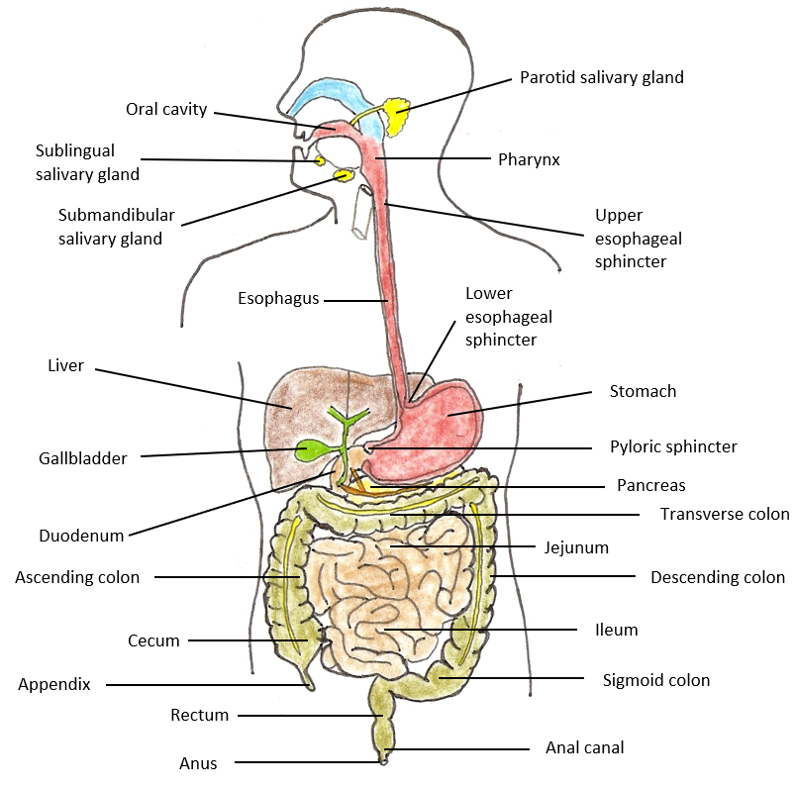
The Digestive System

Slide 2
The Digestive System is Composed of 2 Parts:
① The Gastrointestinal (G.I.) tract (Alimentary Canal)
  A hollow, compartmentalized, continuous and specialized tube, starts at oral cavity and ends at the anus.
  Start of Tract: Oral cavity -> oropharynx -> laryngopharynx -> esophagus -> stomach -> small intestine -> large intestine -> rectum -> anal canal -> anus. End of Tract
② Accessory Structures of the Digestive System
Structures, glands and organs that contribute to the processes of digestion along various regions of G.I. tract.
These Include: Teeth, tongue, salivary glands, mucous glands, gastric glands, intestinal glands, liver, gallbladder and pancreas.

Slide 3
Digestive Processes
Ingestion – taking food/drink into mouth.
Propulsion – movement through alimentary canal (swallowing, peristalsis).
Mechanical Digestion – Physical breakdown of food (chewing, churning).
Chemical Digestion – Enzymatic breakdown of food (from complex to simple building blocks).
Absorption – transport of digested products from lumen of G.I. tract to blood and lymph (inside body).
Defecation – elimination of indigestable and waste products from body (feces).

Slide 4
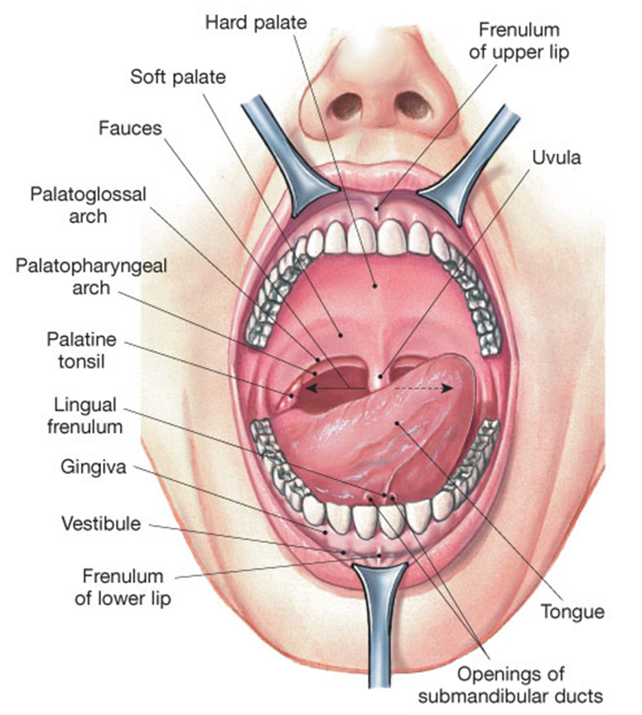
The Start: Mouth and the Oral Cavity
The mouth = the buccal cavity.
This region with intrinsic salivary glands, is where the ducts parotid extrinsic salivary gland secretes saliva aiding in chewing and mixing food, and speech.
The oral cavity is the anatomical region that occurs inside the mouth. This cavity contains the tongue, teeth, gums, tonsils, and papillae of tongue.

Slide 5
Salivary Glands
Intrinsic (inside oral cavity) e.g., lips & cheeks.
Extrinsic (outside oral cavity):
“Mumps”
Parotid (largest) - a serous gland.
2) Submandibular - a mucus & serous gland.
3) Sublingual (smallest) - a mixed gland!
Lingual amylase (breaks down starch).
Lysozyme – antibacterial agent in saliva.

Slide 6
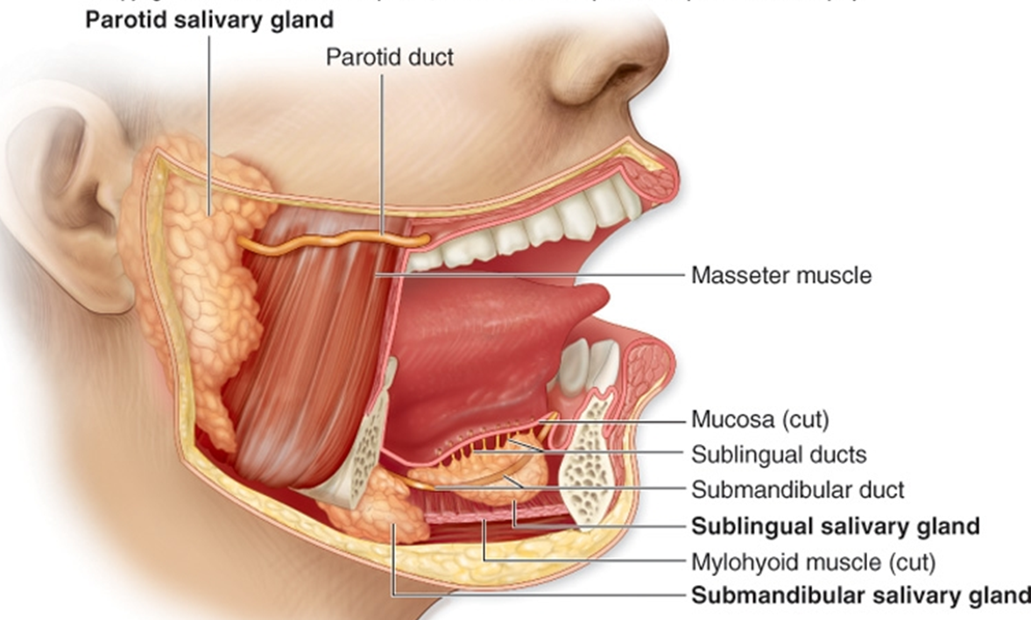
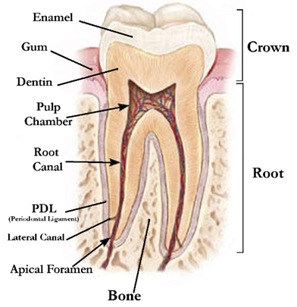
The Oral
Cavity
Typical Adult Teeth
(in one quadrant)
Incisors 2
Canines 1
Premolars 2
Molars 3
= 8
Times 4 quadrants:
Total: 4 x 8 = 32
Specific Names of Teeth
Incisor (Central)
Incisor (Lateral)
Canine (Cuspid)
Bicuspid (1st)
Bicuspid (2nd)
Molar (1st)
Molar (2nd)
Molar (3rd Wisdom tooth)

Slide 7
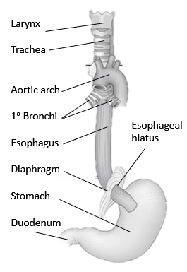
The Esophagus - is a Muscular tube.
– ~ 10 inches long.
– Transitions from skeletal to smooth muscle
(hence voluntary to involuntary)
– Mucous glands in tela submucosa (layer) function to lubricate bolus as it travels to down to the stomach.
– Outermost layer is Adventitia or Serosa.
outside
peritoneal
cavity
inside
peritoneal
cavity

Slide 8
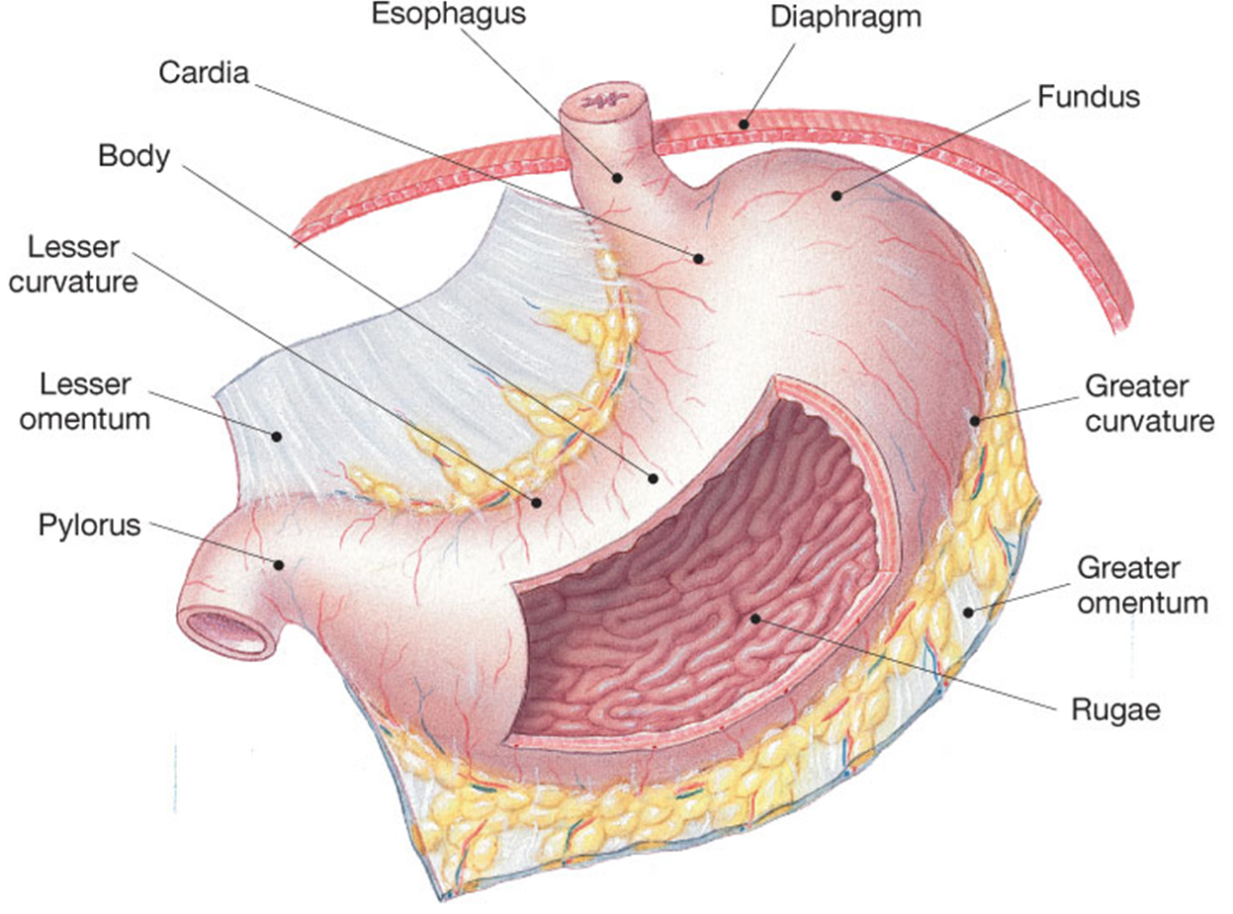
Esophagus goes through the hole in diaphragm called the esophageal hiatus

Slide 9
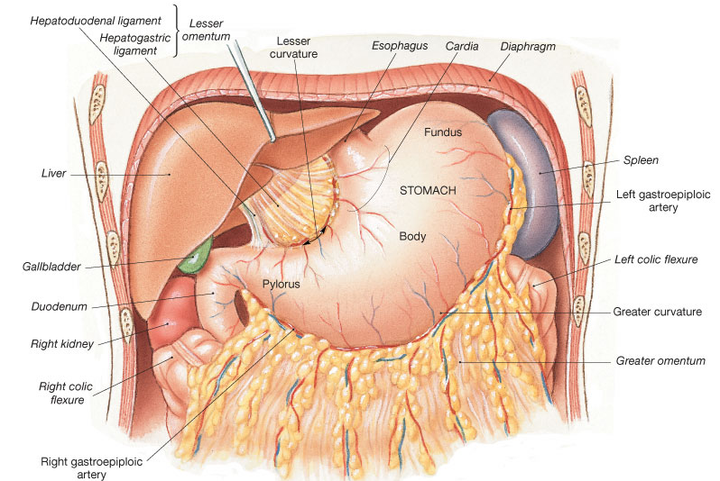
The Stomach - an acidic storage area.

Slide 10
Stomach – acidic (pH 2) storage of chyme (meaning juice).
Mechanical Digestion continued (churning).
The stomach has 3 muscle layers for churning chyme.
Enzymatic Digestion of proteins occurs here (Pepsin breaks down proteins).
Rugae (‘wrinkles’) on inner surface allows for expansion when volume of contents increase.
Produces/secrets gastric juices controlled by CNS.
Mostly via Vagus nerve
Parietal cells: make Hydrochloric acid (HCl) in gastric glands.
Chief cells: make Pepsinogen, cleaved to pepsin, digests proteins.

Slide 11
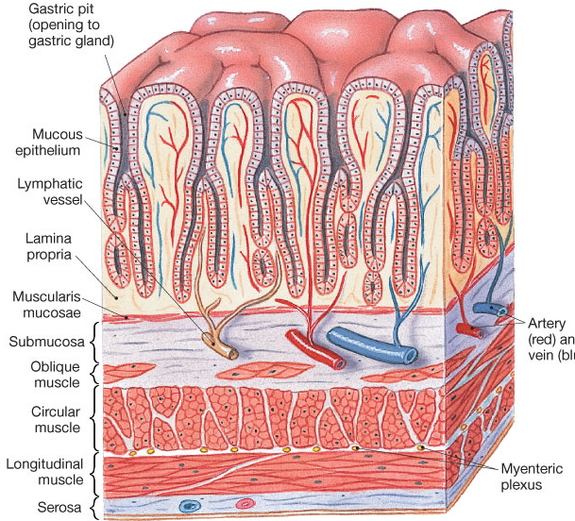
Can you identify the 4 Tunics of this region?
Unique in the GI tract,
the stomach
has 3 muscle
layers:
①
②
③

Slide 12
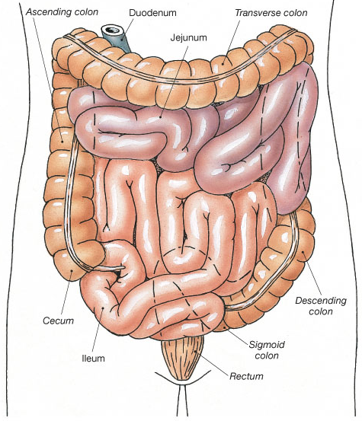
The Small Intestine: Chemical Digestion/Absorption
Duodenum
Jejunum
Ileum
Increase Surface Area for Absorption
1) Plicae Circulares
2) Villi (Intestinal)
3) Microvilli
  Lacteals absorption lipids
Intestinal glands
Goblet cells
Stem cells

Slide 13
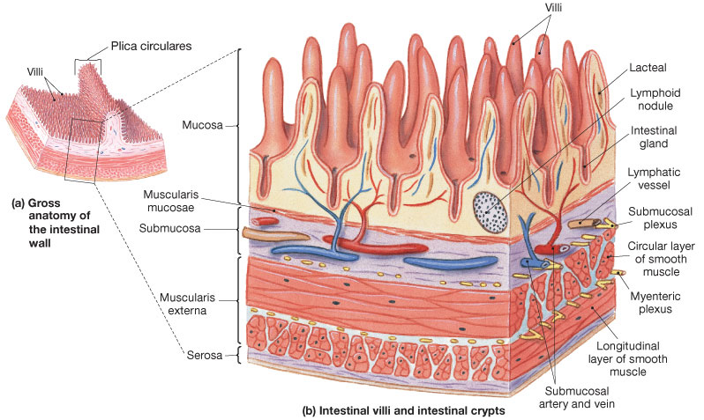
The Small Intestine

Slide 14
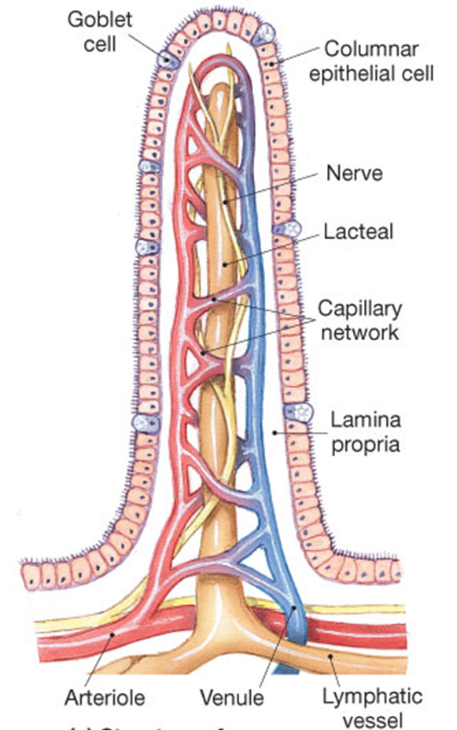
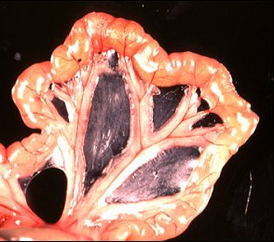
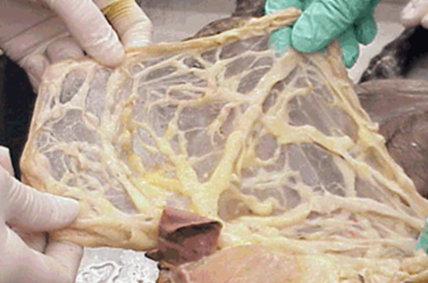
Villi of Small Intestine
Vascular Arcade
(comes from superior mesenteric a.)
Mesentery Proper - is a double layered serous membrane attached to the small intestine.
Mesenteries Support - branches of blood vessels.
  - lymphatics of jejunum and ileum.
  - nerves of jejunum and ileum.
The Greater Omentum

Slide 15
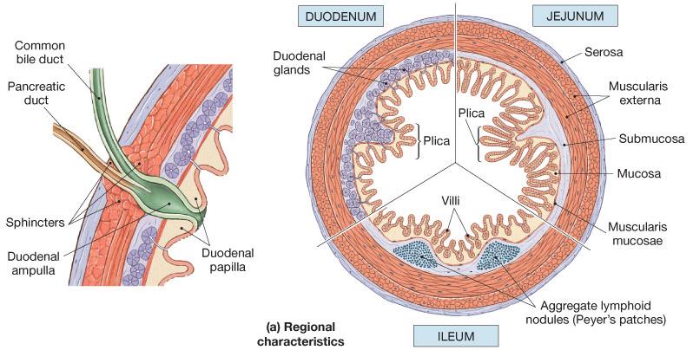
Distinguishing features of each region of
the Small Intestine

Slide 16
The Large Intestine
Begins as pouch inferior to end of ileum
Ends at anus.
Functions of Large Intestine:
1) Reabsorb water and compact feces.
  2) Absorb vitamins (helps make Vit K) electrolytes.
  3) Stores fecal matter.
The Cecum:
  Contains the Ileocecal valve and connected to appendix.
The Colon:
– Ascending, Transverse, Descending, Sigmoid.

Slide 17
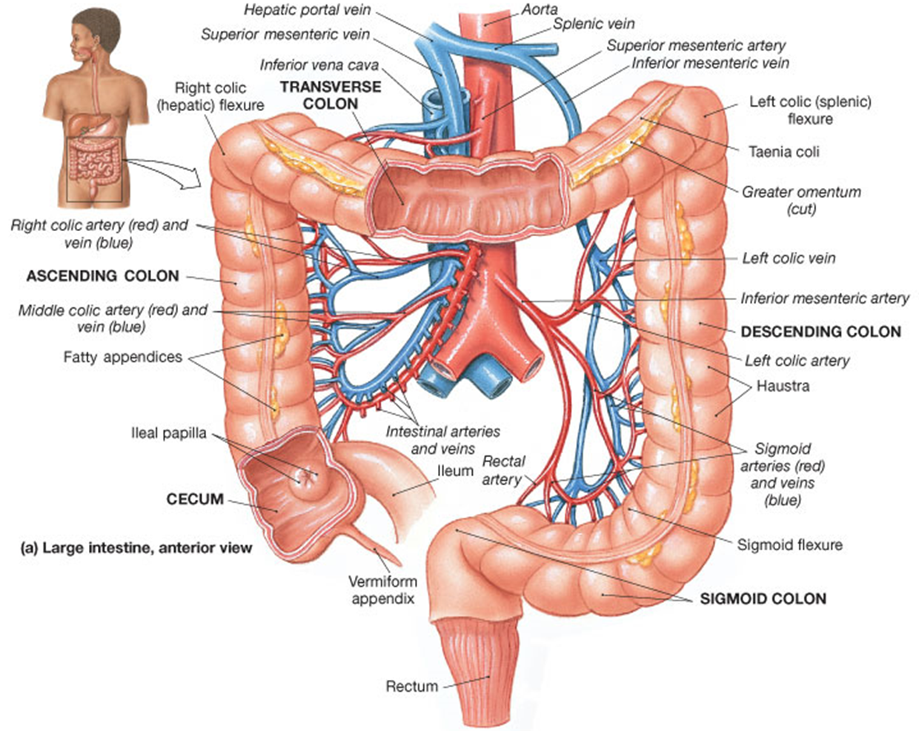
The Large Intestine
is shown below
The region within the large intestine called the colon
has the term ‘colon’ in it!
- Ascending colon
- Transverse colon
- Descending colon
- Sigmoid colon

Slide 18
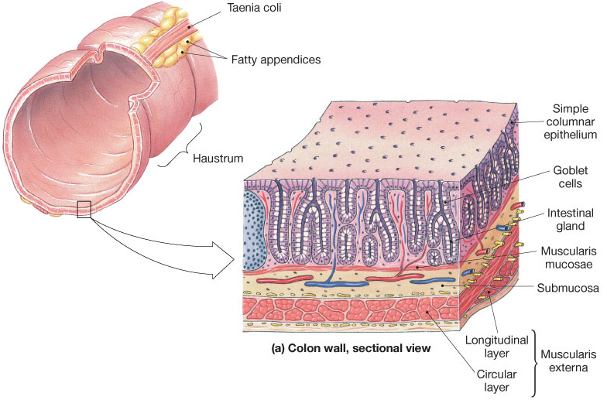
The Colon
(of the Large Intestine)
Characteristics
Lack of villi
Abundance of goblet cells
Abundance of mucous-secreting intestinal glands

Slide 19
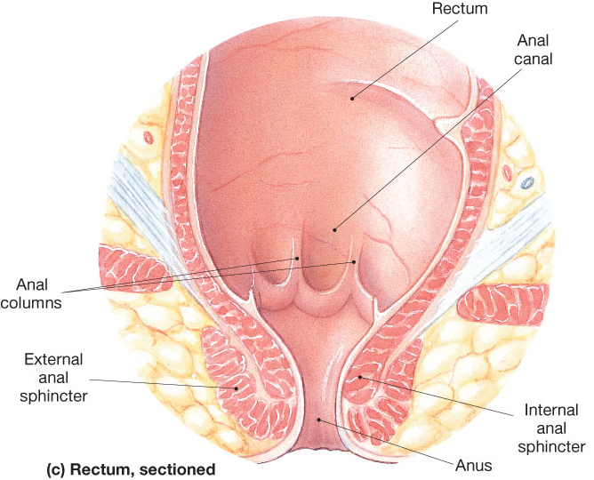
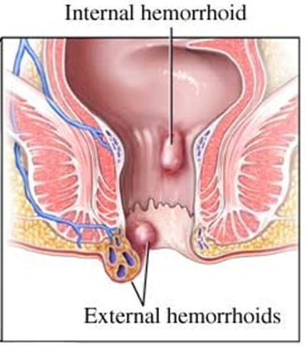
The Rectum and Anus

Slide 20
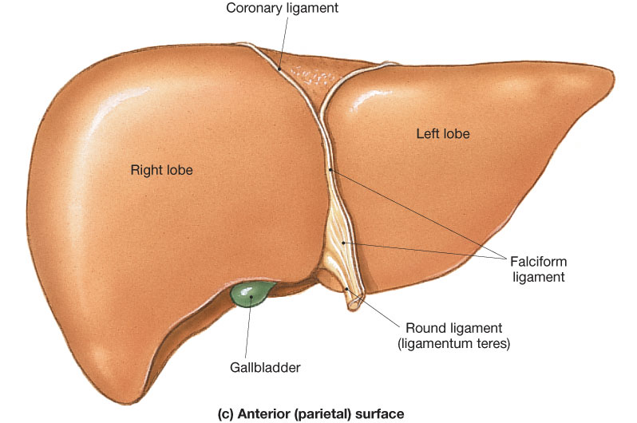
The Liver
Anterior

Slide 21
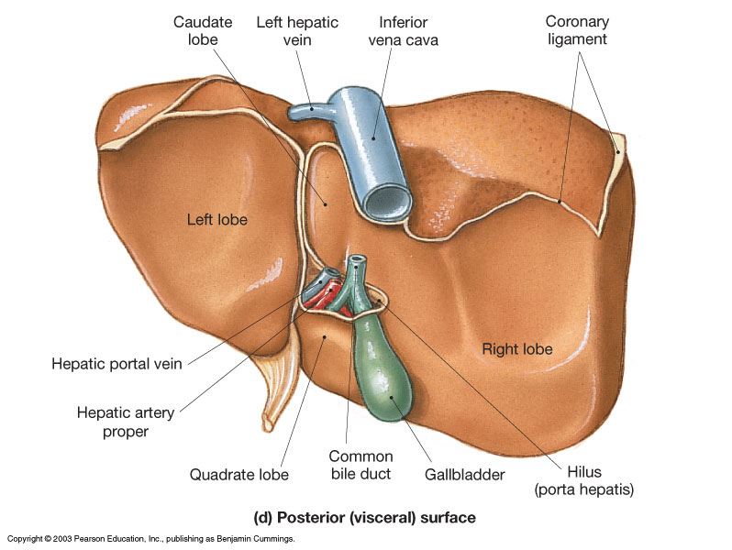
Posterior

Slide 22
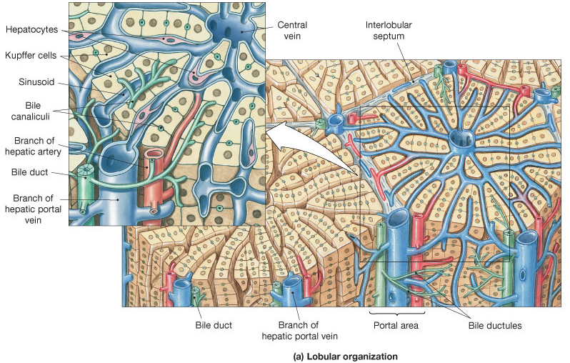
Diagrammatic view of Liver lobular organization.
Kupffer cells
Hepatocytes

Slide 23
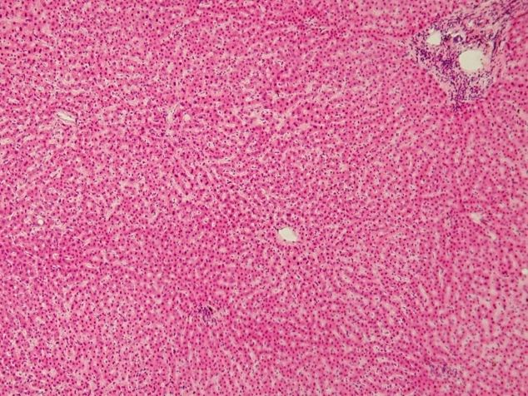
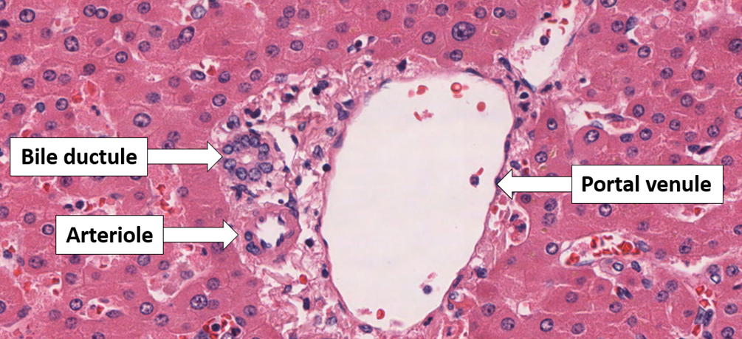
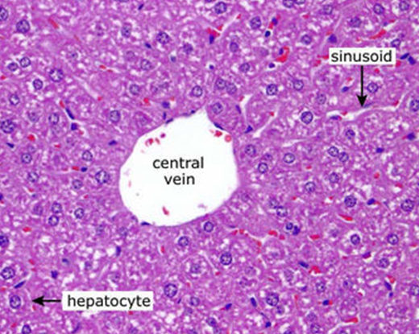
Histology of the Liver
The 3 Friends
The Central Vein
= Hepatic vein
Hepatic artery
Hepatic portal vein
Bile ductule

Slide 24
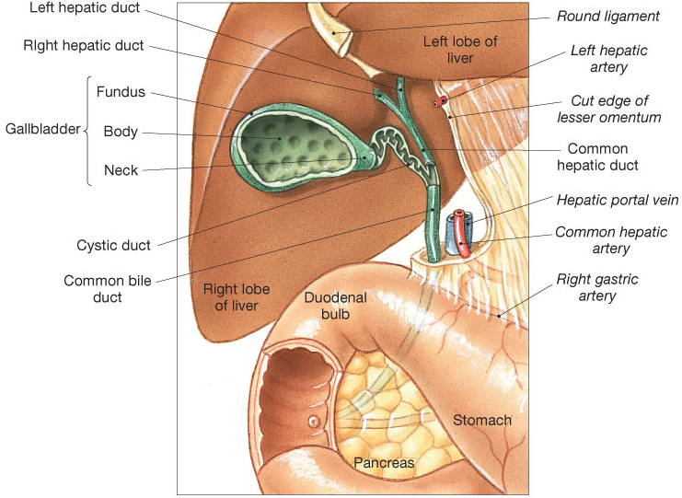
Anatomy between the Liver (makes Bile), the Gallbladder (stores and concentrates bile), and the Pancreas (makes/releases pancreatic juices) into the Duodenum.

Slide 25
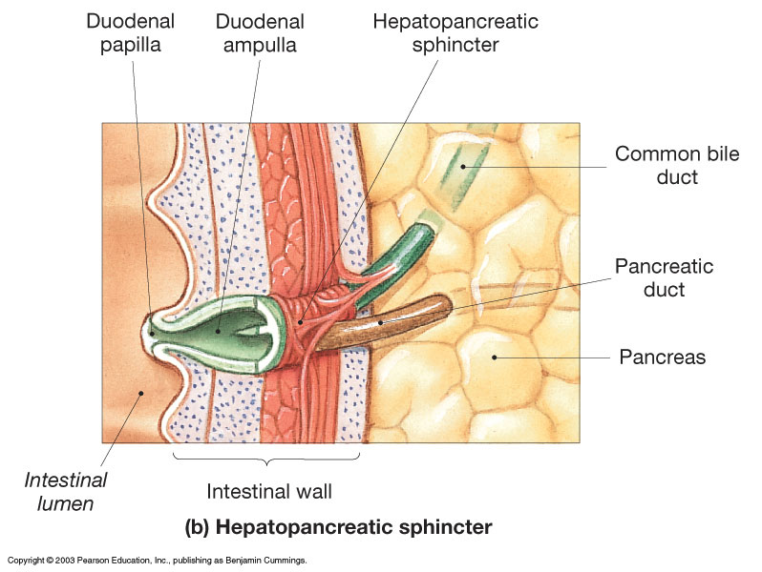
The roles of the Greater and Lesser Duodenal Papillae

Slide 26
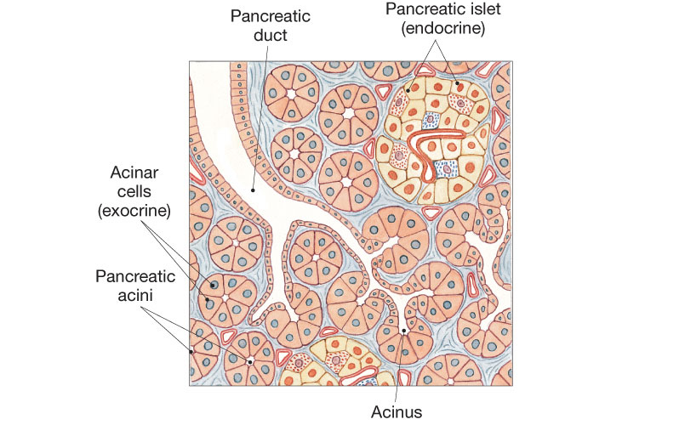
Histology of the Pancreas
Exocrine Gland:
Pancreatic Juices
Amylases
Proteases
Lipases
Endocrine Gland:
Makes Hormones
Insulin
Glucagon
Somatostatin
Gastrin

Slide 27
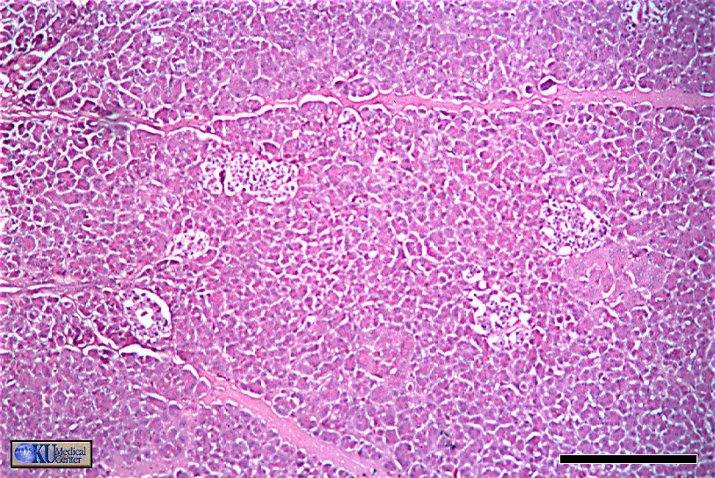
Histology of the Pancreas
Pancreatic islets
Pancreatic acini

Slide 28
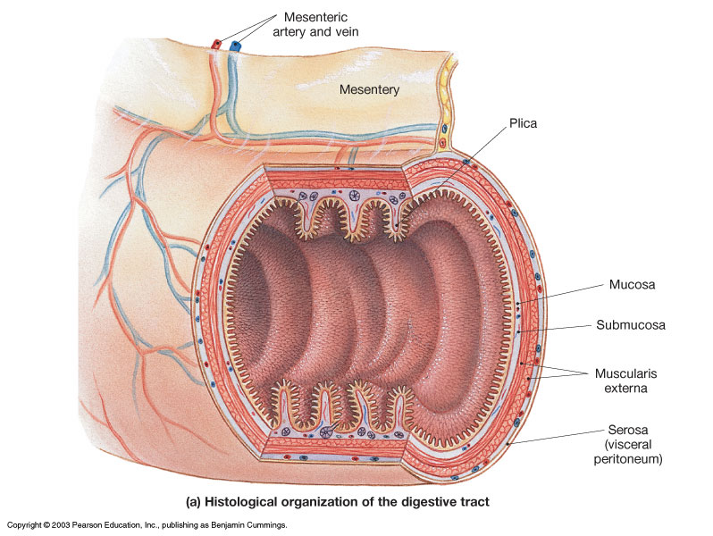
Histology of the G.I. Tract

Slide 29
The Mucous Membrane of the GI Tract
Lines entire digestive tract
Moistened by glandular secretions
Simple or stratified depending on area of tract
Pleated for expansion (↑Surface Area)

Slide 30
These are the 4 Layers!
1. Tunica Mucosa
is a Mucous Membrane (wet, absorbs, protects)
  1) Epithelium
  2) Lamina propria
  3) Muscularis mucosae
2. Tela Submucosa
  Areolar Connective Tissue
  Contains:
  Submucosal plexus (nervous innervation)
  Blood and Lymphatic Vessels

Slide 31
3. Tunica Muscularis Externa
  Smooth muscle layers
  1) Inner Circular Layer
  2) Outer Longitudinal Layer
What are some exceptions?
  Myenteric Plexus (nervous innervation for Muscles)
4. Tunica Serosa (or Adventitia*)
Serous membrane – aka visceral peritoneum
* Name depends on the location:
Inside peritoneal cavity = serosa
Outside peritoneal cavity = adventitia

Slide 32
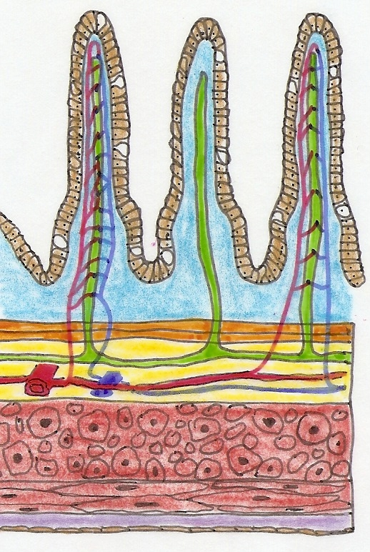
Identify the 4 Layers (Tunics)
In the drawing of the small intestine (left) identify the 4 tunics, and any of the individual the structures that are shown within these 4 layers.

Slide 33
The Peritoneum has 2 Layers
  Visceral peritoneum (a.k.a. serosa)
  Parietal peritoneum - Lines inner surfaces of body wall.
Mesenteries: These are fused double sheets of peritoneal membrane to suspend portions of digestive tract:
  Greater omentum
  Lesser omentum
  Mesentery proper
  Mesocolon
Retroperitoneal Structures – these are attached to posterior abdominal wall and are not actually in the peritoneal cavity.
  Most of the Duodenum
  Ascending colon
  Descending colon
  Pancreas

Slide 34
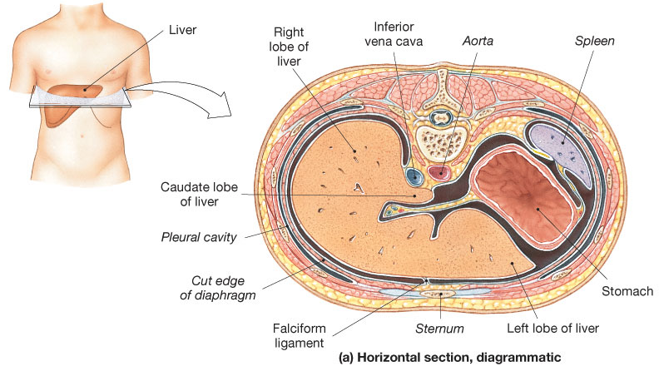
Horizontal section through the upper abdomen showing the position of the liver relative to other visceral organs.

Slide 35
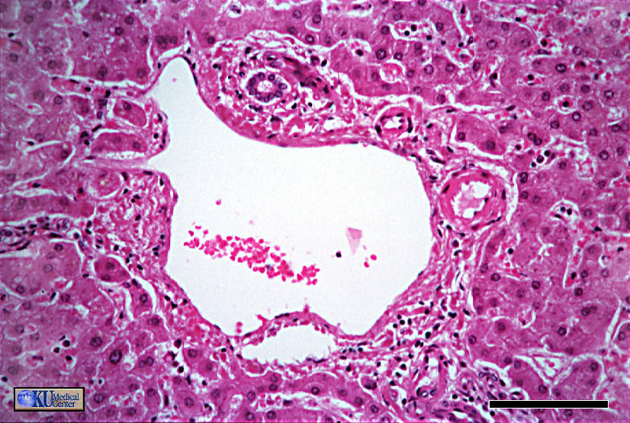
3 Hepatic Friends!

