Slide 1
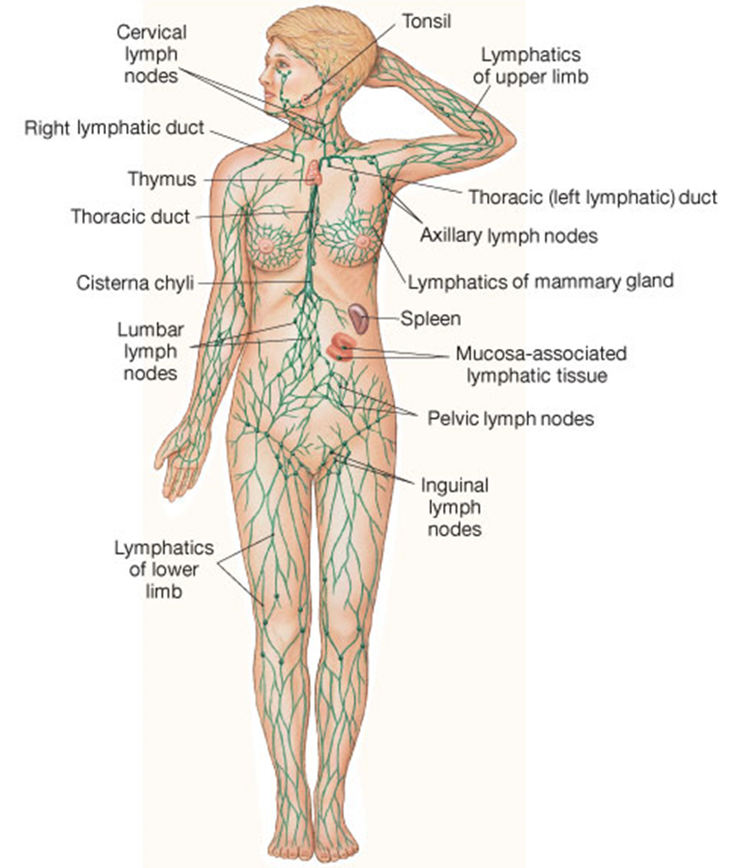
The
Lymphatic
System
Roles of Lymphatic System:
One-way drainage system.
Lipid Absorption from Small Intestine.
Produce & Circulates Defense cells.

Slide 2
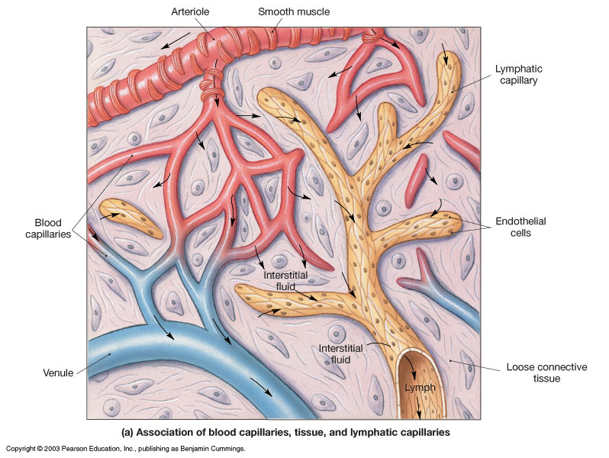
Lymphatic Vessels are a component of the Circulatory System

Slide 3
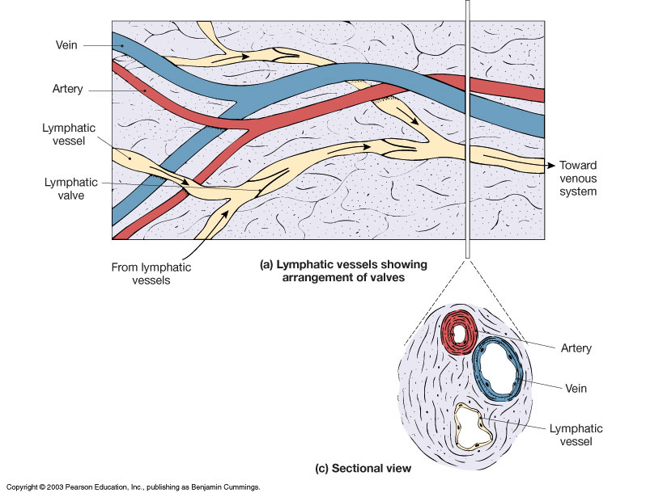
Comparison of Arteries, Veins and Lymphatic Vessels
*Lymphatic vessels are
most similar to veins
Valves in collecting lymphatics prevent backflow of lymph as it is transported toward the heart from the tissues.
*

Slide 4
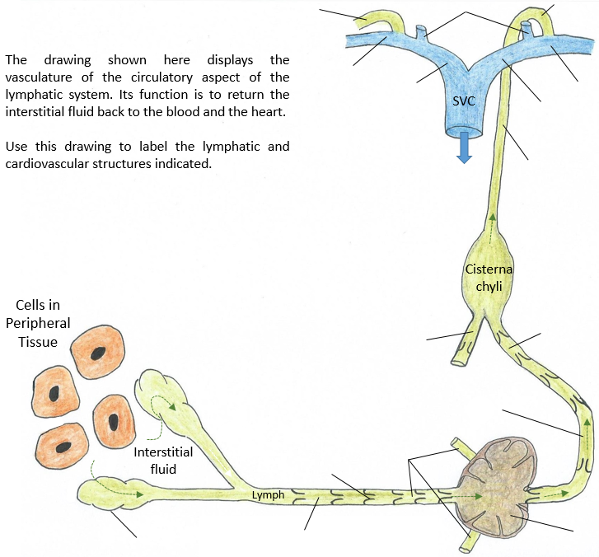
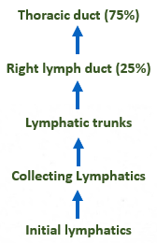
The order of the return Journey
R. and L. Internal jugular veins
Thoracic duct entrance into L. subclavian vein
Right lymph
duct
R. Subclavian vein
L. Subclavian
vein
Lymphatic Vessels
These vessels return tissue fluid (which becomes lymph once inside a lymphatic vessel) from the periphery of the body to the Cardiovascular System.
R.
Brachiocephalic
vein
L. Brachiocephalic
vein
Thoracic duct
Intestinal and inguinal trunks
Lumbar trunks
Collecting lymphatics
Afferent
lymphatic
vessels
Lymphatic
valve
Initial lymphatics
Collecting lymphatics
Lymph node

Slide 5
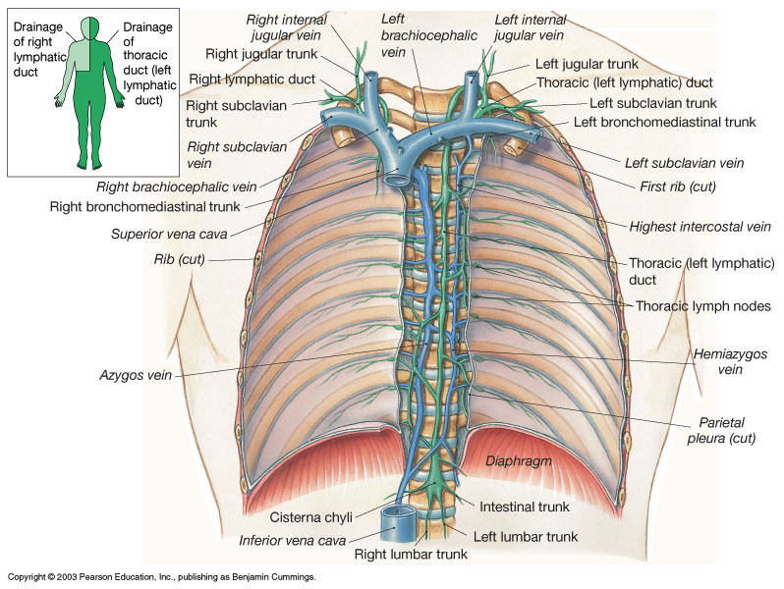
Location of Lymph Return to L. and R. Subclavian Veins
Right
Lymphatic
Duct
Thoracic
Duct
About ¼ of lymph is returned by Right Lymphatic duct.
Cisterna chyli
About ¾ of lymph is returned by the Thoracic duct.

Slide 6
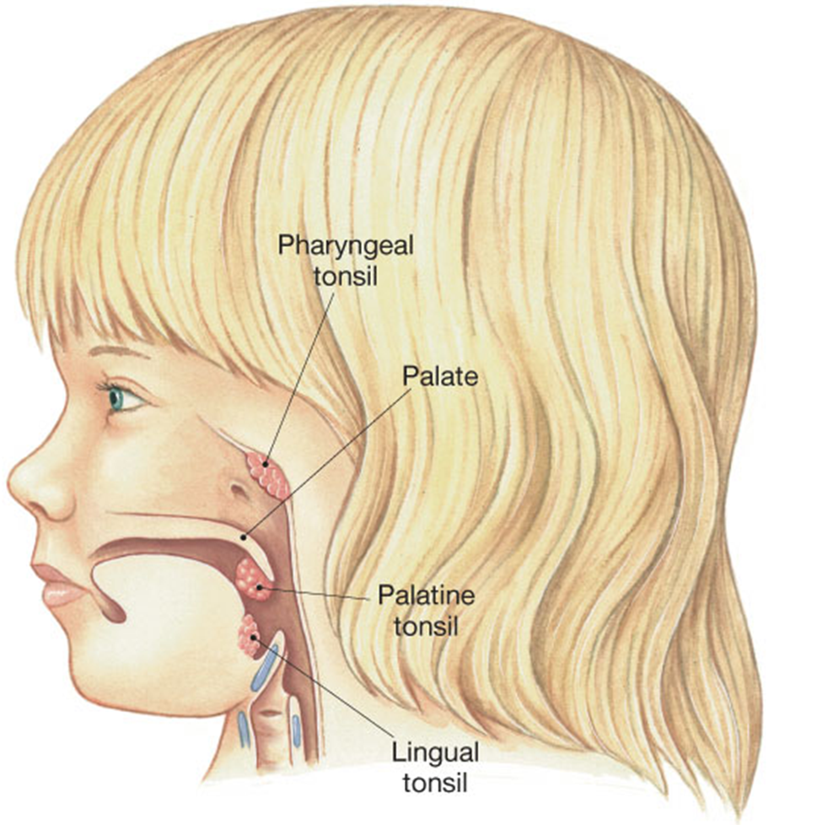
The Tonsils
Un-encapsulated lymphoid tissues:
1) Pharyngeal (single)
in nasopharynx
2) Palatine (paired)
in oropharynx
3) Lingual (paired)
in oral cavity
1)
2)
3)

Slide 7
Lymphoid Organs:
Surrounded by fibrous capsule (encapsulated)
Lymph Nodes
Thymus
Spleen

Slide 8
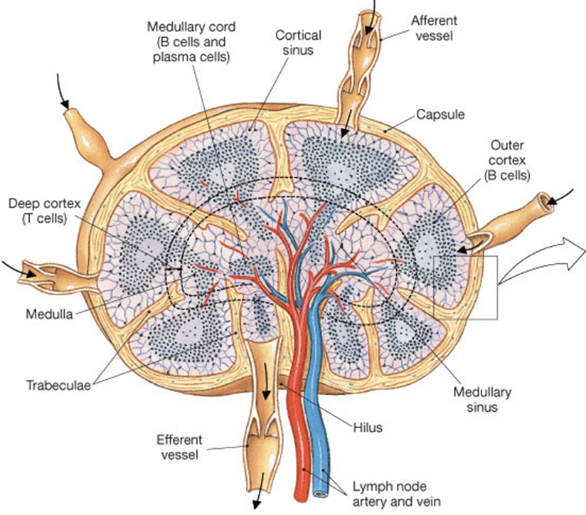
Structure of a Lymph Node
They are encapsulated lymphoid tissue, so the afferent (incoming) lymph vessels go through the capsule into node, and the lymph leaves via the efferent (outgoing) vessel.
Main role of lymph nodes is to filter the lymph as it moves from the periphery toward the heart.
Resident T cells and B cells can act on any pathogens and can also be circulated within lymph.
The hilus is the ‘dimpled’ region that is a point of entry/exit.

Slide 9
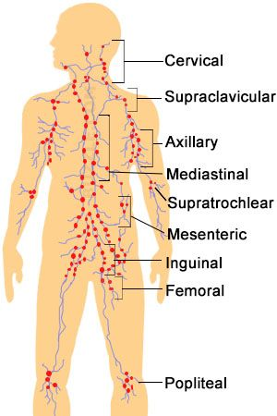
Find the Various Lymph Nodes in the Body
Cervical lymph nodes
Supraclavicular lymph nodes
Axillary lymph nodes
Supratrochlear lymph nodes
Mediastinal & Thoracic lymph nodes
Lumbar lymph nodes
Pelvic lymph nodes
Inguinal lymph nodes
Femoral lymph nodes
Popliteal lymph nodes

Slide 10
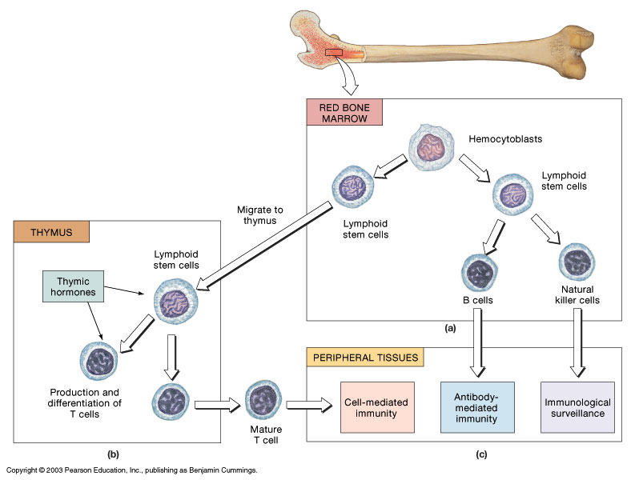
B-cells
Derivation and Distribution of Lymphocytes: T- cells and B-cells
T-cells

Slide 11
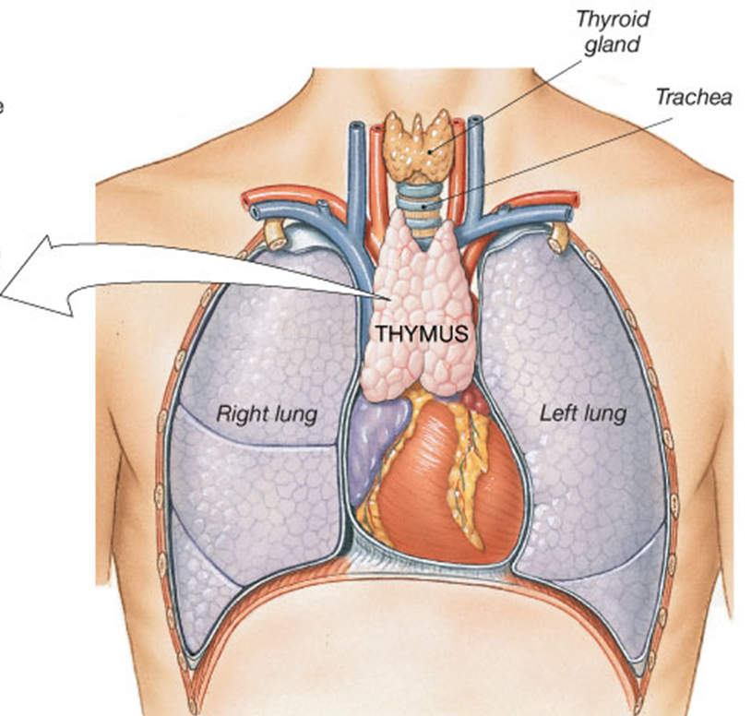
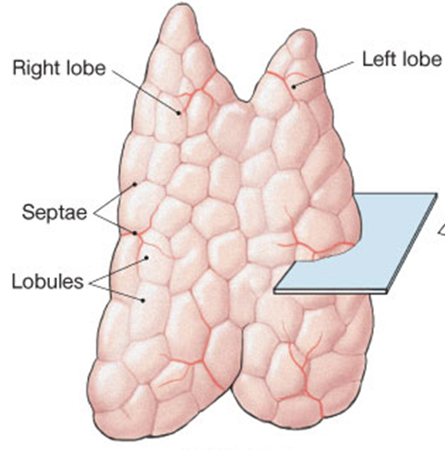
The Thymus
Located behind the sternum, on top of the heart (in mediastinum).
Where T cells Differentiate.

Slide 12
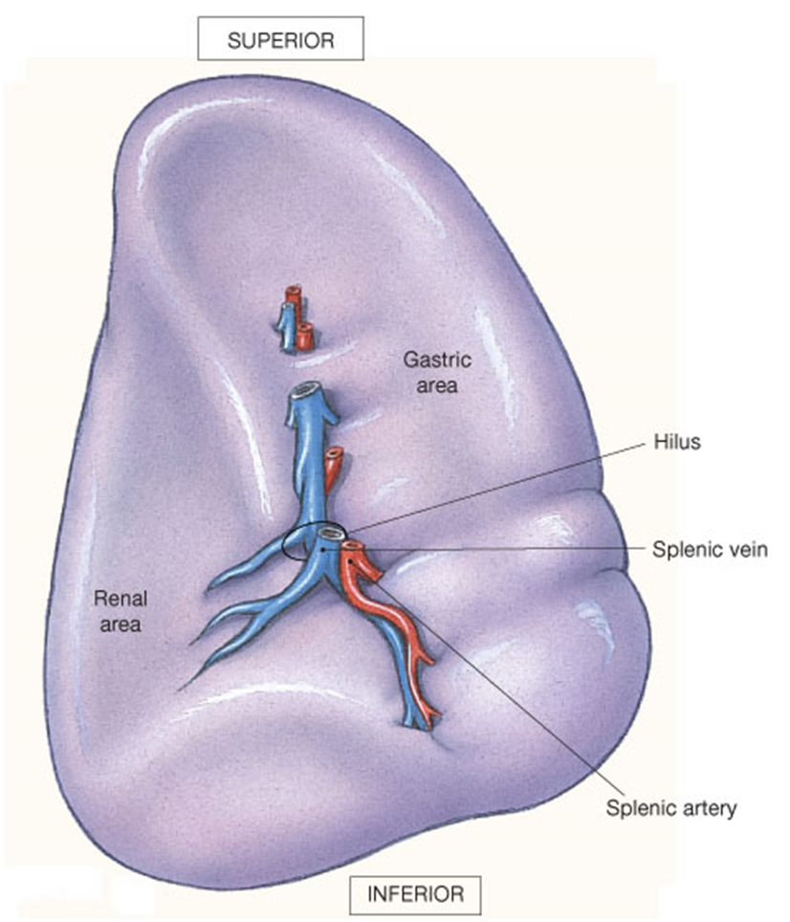
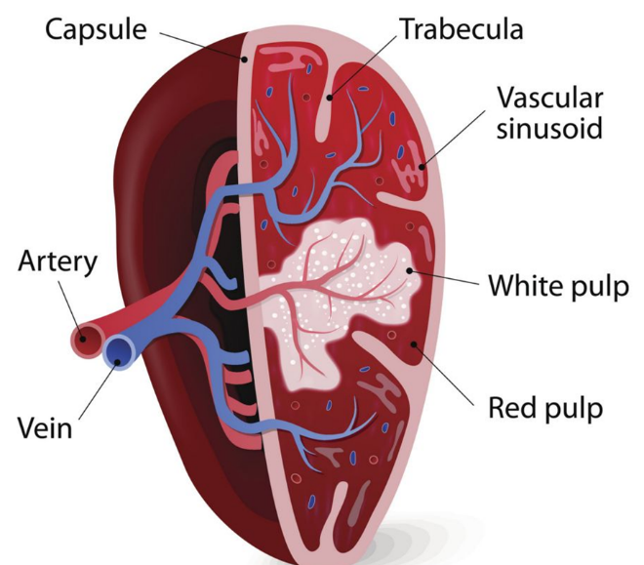
The Spleen
Spleen made of 2 tissues:
1) Red pulp (outer) – filled with blood and phagocytic cells.
2) White pulp (inner) where the lymphocytes reside.
*Largest
lymphoid
tissue in
the body
Spleen cleans the blood,
Liver detoxifies, makes proteins and organizes.

Slide 13
Functions of the Spleen:
Removes (‘culls’) old & abnormal blood cells from circulation (erythrocyte graveyard).
It stores Iron (Fe) from the recycled RBCs.
Can initiate defensive action (via T-cells and B-cells).
Hematopoietic organ – meaning it can store ~30% of RBC volume for emergency release.
Stores platelet cells to create clots (stop blood loss).

