Slide 1
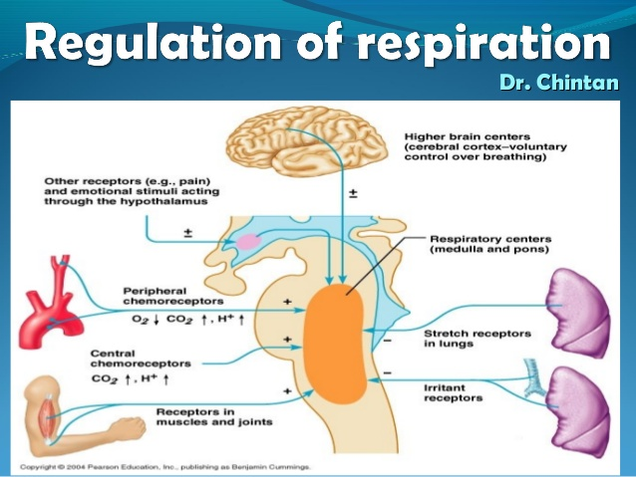
The Control of Respiration
Medulla Oblongata - sets rhythmic pace of ventilation rates to ensure body has sufficient O₂ and adequately removes CO₂.
Pons - fine tuning and protective responses to prevent injury to the lungs.
Other regions can modify breathing: Cerebral cortex and limbic system.
Higher
Brain
Centers
Emotions
and Pain
Pons
&
MO

Slide 2
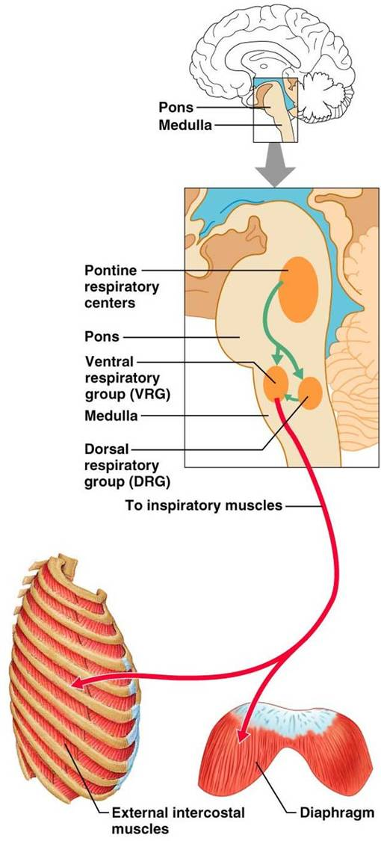
Control of Respiration
1. Medulla Oblongata
Sets the rhythmic pace of respiration.
a) Dorsal Respiratory Group (DRG)
For inspiration, maintains rhythm breathing via diaphragm and external intercostal muscles.
b) Ventral Respiratory Group (VRG)
For forced breathing (V for ‘Vrooom’)
Stimulates additional muscles required for
forced inspiration.
Also, stimulates muscles involved for
forced expiration.

Slide 3
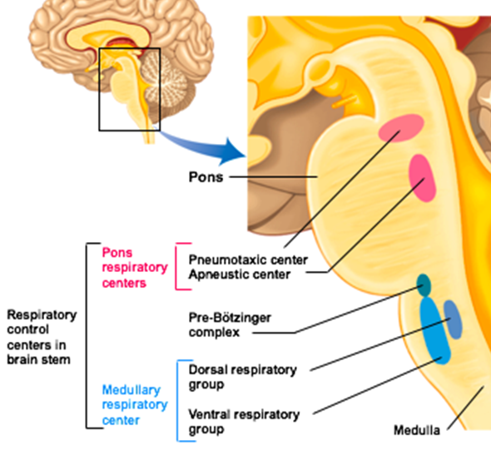
2. Pons (the Pontine respiratory centers)
For ‘fine tuning’ and protection of respiration.
Apneustic center
For strong, sustained inspiration ‘overdrive’.
Acts to delay the off-switch signal that ends inspiration. Stimulates and prolongs inspiration.
b) Pneumotaxic center
Inhibits apneustic and inhibits inspiratory centers.
Prevents over inflation of lungs (via Mechanoreceptors).

Slide 4
Sensory Receptors - regulate respiration.
Mechanoreceptors
Detect changes in lung volume (inflation of lungs)*.
*Hering–Breuer reflex – to protect the lungs against over-inflation.
Chemoreceptors
Detect changes in P_{CO2}, pH, P_{O2} of blood and CSF.
Changes Rate, Depth and Patterns of Breathing – to meet needs of the body.

Slide 5
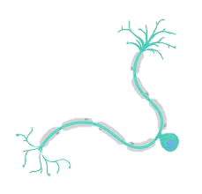
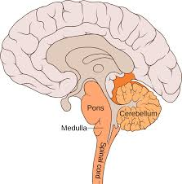
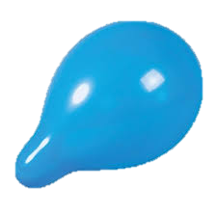

Sensory Receptors - regulate respiration.
Mechanoreceptors
Detect and Prevent Over-inflation of lungs.
To Pneumotaxic Center (Pons)
Over
Inflated
Lungs
Pons
Mechanoreceptor
(Stretch Receptors)
Inhibits Apneustic Center
and VRG to prevent
overinflation of Lungs

Slide 6
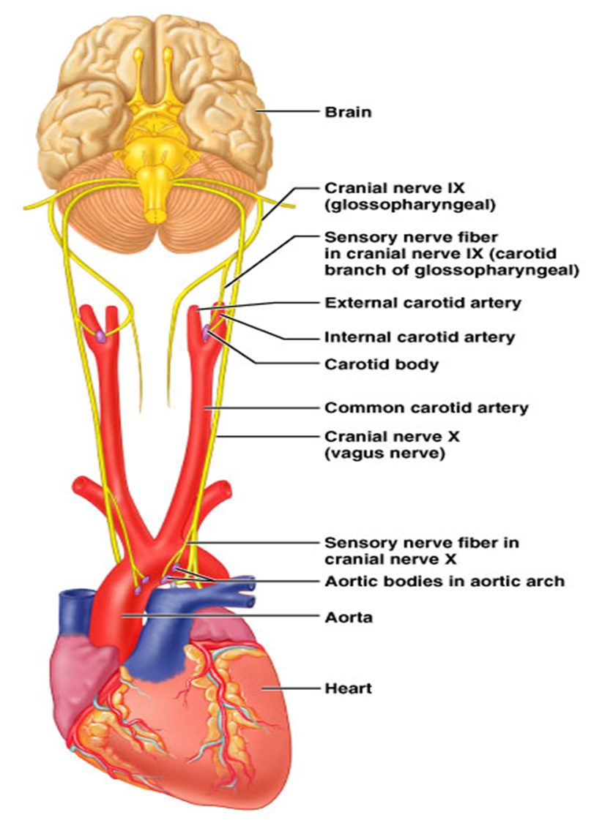
Sensory Receptors
Chemoreceptors
1. Peripheral Chemoreceptors
(Located in arterial blood vessels)
a) Aortic bodies (in aorta) for Body
b) Carotid bodies (in carotids) for Brain
Carotid and Aortic bodies detect changes
in arterial blood in this order:
P_{CO2}
[H⁺]
P_{O2}

Slide 7
Peripheral N.S.
Central N.S.
Medulla
Oblongata
1.
↑ P_{CO2}
2.
↓ pH
Carotid and Aortic Bodies
(specialized endings of sensory neurons)
3.
↓ P_{O2}
Diaphragm
↓P_{CO2}
↑ Ventilation
↑ pH
↑ Ventilation
↑ P_{O2}
↑ Ventilation

Slide 8
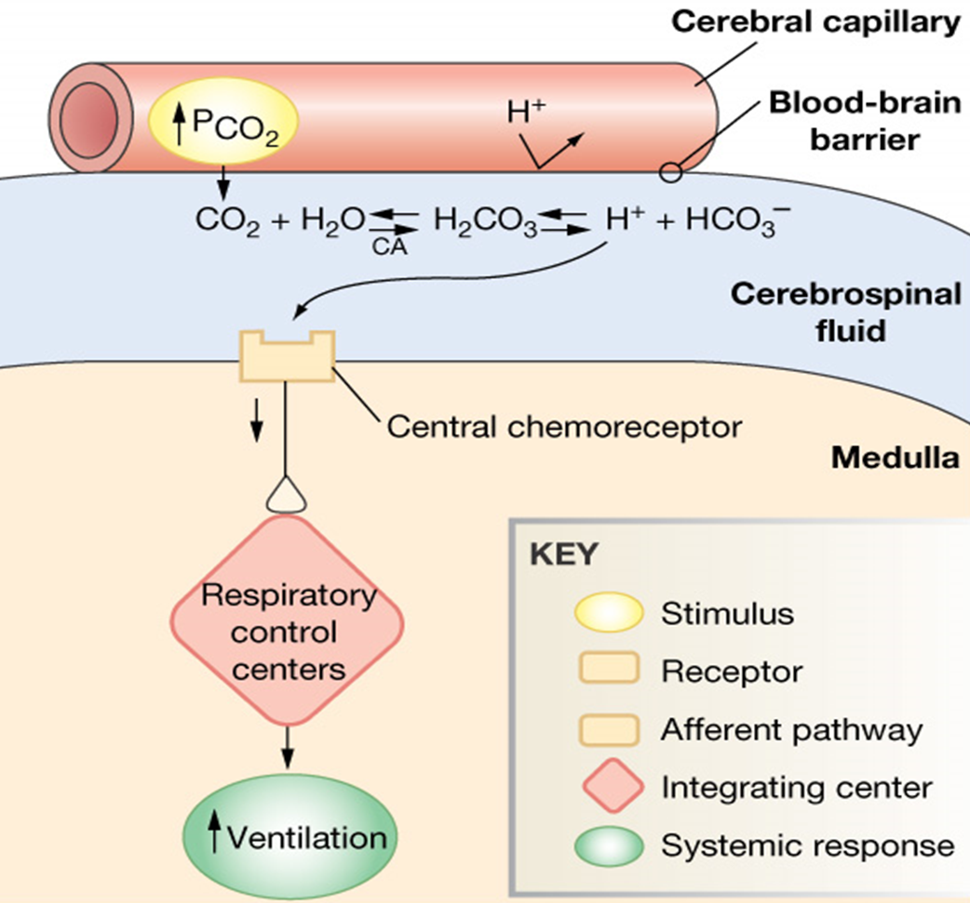

2. Central Chemoreceptors
(in medulla oblongata)
These detect changes in
P_{CO2} levels in CSF indirectly*…
Detect changes in H⁺ of CSF (in MO), e.g., from increased P_{CO2} of arterial blood.
If P_{CO2} of blood increases -> leads to acidosis in CSF, which = an increase in H⁺ in CSF.
This increase in H⁺ stimulates central chemoR’s.
This signals respiratory control centers in the MO.
Effect => an increase in respiratory rate/depth.
Response => decreased P_{CO2} blood (decreased H⁺).
*By way of the [H⁺] in CSF.
Medulla
Oblongata

Slide 9
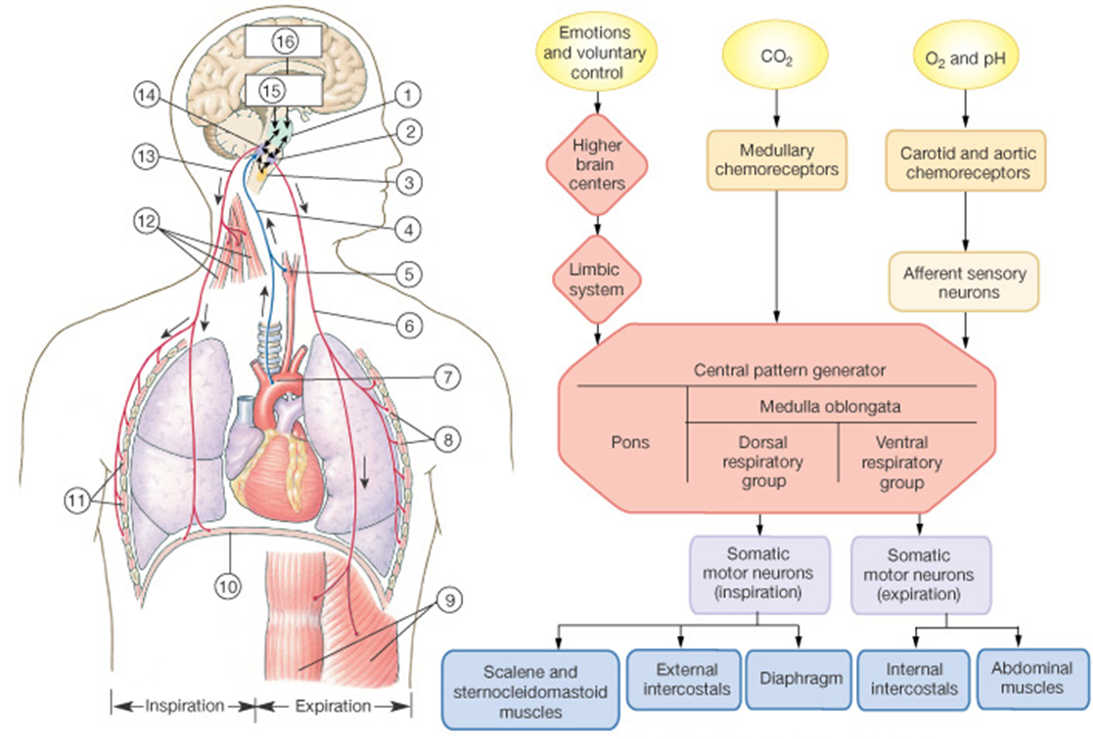
Summary of Control and Balance of the Respiratory System

