Slide 1


CRM Implementation Update
Notes:
Good Morning – so there is a lot going on with this project, and I’m happy to be sharing an update with you all. There has been a lot of progress and some developments, so we want to really make sure everyone is aware of the work being done, as well as the challenges.

Slide 2
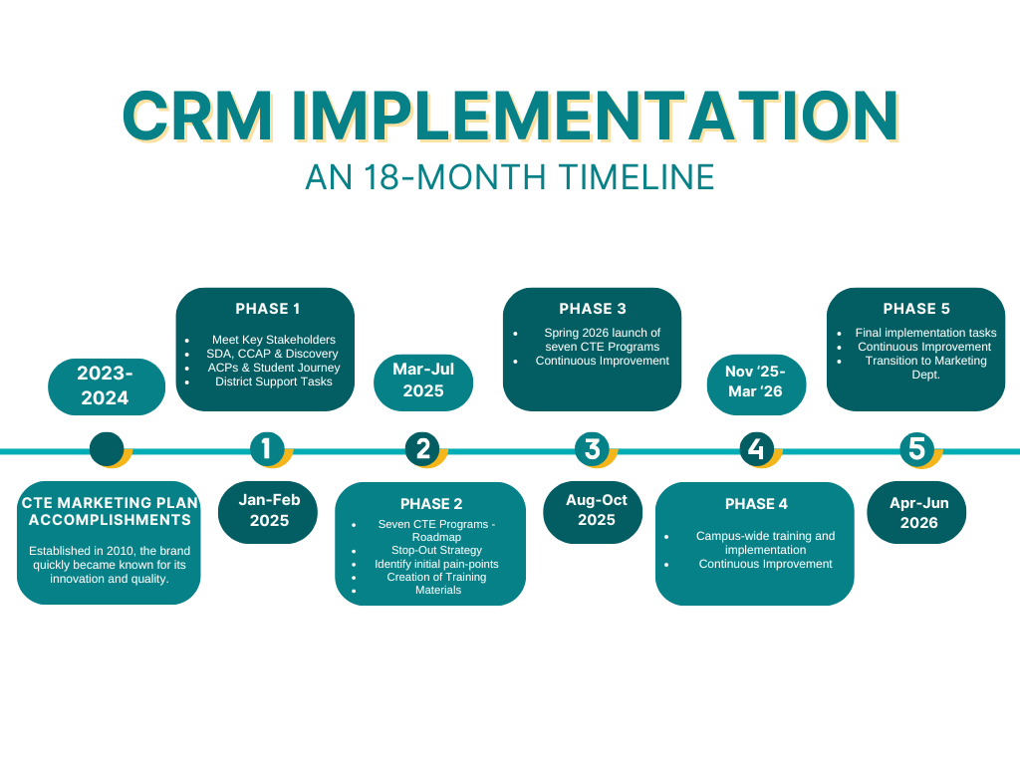
Implementation Update
Notes:
We are on track. I have been meeting with many teams across the Phase 3 areas included the conclusion of work with Outreach, Retention and Promise @100% adoption. Work with Counseling, CLDS, Vet Affairs, DSPS, Fin Aid, EOPS, Admissions, Basic Needs, Promise, Graduation and LEAD have commenced.

Slide 3



Implementation Update
Element451 Functionality
Communication & Engagement
Agentic AI
CANVAS Integration
Notes:
It is important that we understand the primary functions of the CRM:
Engagement and Communication Tool
Agentic AI
LMS Integration

Slide 4
Implementation Update
Functionality for
Miramar College
We are here !
Admissions and Enrollment Nurturing
Event Management
Student Journey Management
Student Data Capturing
Reduce the Noise!
Replace Chatbot Vendor (Ocelot)
Department Level AI Teammates
Proactive Jobs functionality
Monitor Grades
Monitor attendance & class engagement
Early Alert (Retention / Persistence)
Notes:
Important to note:
Let’s remember that Communication and Engagement is where we are right now with this project. Agentic AI and CANVAS integration are updated components of the CRM, and while we are beginning some work in those areas, the initial implementation is centered around communication and engagement tools within the CRM.

Slide 5
Implementation Update
Phase 3
(Aug-Oct. '25)
Dept Adoption:
Finalize FinAid & Counseling; begin integration with LEAD, C&LDS, Admissions, DSPS, EOPS, Veterans, Student Affairs (Graduation), Promise and Scholarships/Dreamers
Phase 4
(Nov '25-Mar '26)
Dept. Adoption:
Athletics, Transfer Ctr, Library/Technology Services, Academic Success Ctr, Basic Needs, Bookstore, STEM/MESA, Health Center, Rising Scholars, CalWorks/CARE
Phase 5
(Apr-Jun '26)
Finalize Academic Campaigns
Finalize Department Campaigns
Creation of Acadmeic Program Campaigns
Creation of Academic Program Campaigns
Notes:
In meeting with departments or academic programs. We go through a 4-step process
Step 1 – Introduce personnel to the goal: targeted, personalized automated communication
Step 2 – Learn business processes of the department and partner on initial CRM usage, reviewing the Messaging lens against their goals and processes
Step 3 – Launch initial project, review results
Step 4 – Train departments primary user (For the aforementioned areas, we are knee-deep between steps 2-3)

Slide 6
Implementation Update
How does that translate?
Counseling
  Student Education Plan Campaign – seeing a 34% increase* in appointments set; fully booked since launch (September 17-current)
Career & Life Design
  Workshops Campaign; Undecided Students - Case Management
Veteran Affairs
  Campaign: Priority Registration; Veterans Week
Financial Aid
  Six Campaigns formed; final revision work pending
EOPS
  Eligibility Requirements Campaign aligned with Program Review Goals
Admissions
  Early work around AI Agent to answer top 15 FAQ inquiries; Graduation
Basic Needs
  Spring Campaign for CAL Fresh
Graduation
  Collaboration between Admissions/Evaluations and Student Affairs
LEAD
  Equity Plan Metrics – DI Populations; Supporting PEARL-MindArch grant work
Plus academics program campaigns/automation
*Source: A. Nelson, Counseling Department
Notes:
To give everyone an idea of the things being worked, I will point to just a couple of items in this list:
-Counseling: 34% increase in 1-hour Ed Plan appts (fully booked)
-Collaborating between Admissions and Student Affairs to bring the graduation and commencement on board with the CRM
-We are also looking to help clear out the Admissions inbox through the use of an AI Agent to answer top 15 most common email inquiries

Slide 7
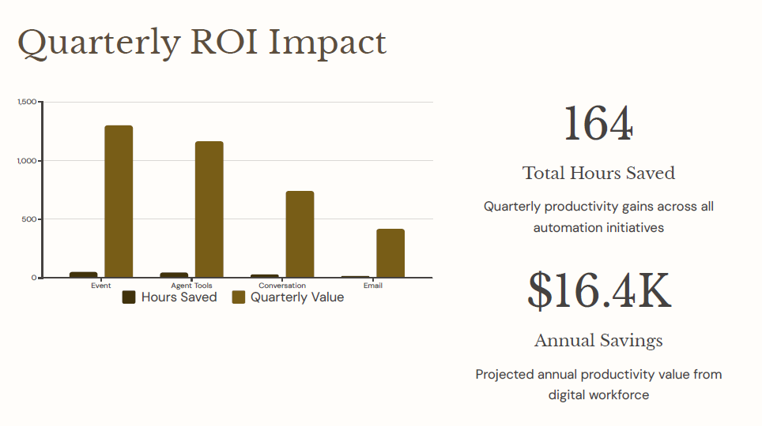
Implementation Update
Initial ROI
Q3 2025 CRM Savings
Notes:
So let me give the breakdown here:
Agent & Conversation/Chat tool (75 hours saved)
Event tool (52 quarterly hours saved)
- SMS campaigns (20 hours saved)
- Email automation (17 hours saved)
Element then takes the number of hours saved and multiply by the national average hourly rate of an admissions representative of approximately $25/hour – coincidentally, not all that outrageous considering the minimum wage increase for hospitality workers in San Diego going up to $25/hour.

Slide 8
Implementation Update
Upgrading “Jimmy the Jet”
Departments | Target | Actual
Outreach | First week October | Launched
Assessment | First week October | Launch 10/6/2025
Promise | First week October | Launch 10/6/2025
Career Services | First week October | Launch 10/6/2025
Evaluations | First week October | Launch 10/6/2025
BTCWI | First week October | Launched
Graduation | First week October | Launch 10/6/2025
Scholarships | First week October | Launch 10/6/2025
Financial Aid | First week October | Launch 10/6/2025
Counseling | First week November | On Target
Notes:
The other development is the replacement of the Chatbot with our first AI Agent – Jimmy the Jet has been upgraded. Chatbots → Limited by pre-programmed flows, often leaving students stuck in loops with partial information.
AI Agents → Use contextual intelligence and decision-making capabilities to adapt, problem-solve, and learn. Think of it this way: chatbots follow instructions, while AI agents act like junior teammates who grow smarter with every interaction. We have replaced the Ocelot version with the AI Agents on these pages, with just three areas left – all of which are on pace to be implemented well before December 2025 when the contract expires.

Slide 9
Implementation Update
Initial ROI
Element 451ROI | Q2 | Q3
Total Hours Saved | 115 | 164
Annual Savings * | $11,200 | $16,400
Ocelot Contract Ends 2025: $62,250 Annually
$78,650
Annual Savings
* Only one department at 100% Adoption
Notes:
Between the savings through marketing automation and the expiration of the Ocelot contract, will see an ROI of $78k

Slide 10
Implementation Update
Engagement &
Primary Term Persistence
Semester | Miramar Students* | Jets JumpStart Attendees**
Fall 2024 | 49% | 87%
Spring 2025 | 39% | 75%
*Source: Public PREDD 2024-2025
**Source: Miramar College Office of Institutional Effectiveness
Notes:
We can also start to see the impact in other ways … I had the office of IE put together a comparison of the Primary Term Persistence of our Jets Jumpstart attendees v. the general college student population. Students who attend the event are persisting at double the rate of the overall student population. While this does represent just a small sample, the results do align with what we all know: when students are engaged, when they build connections and learn about the support available to them, they are more likely to return the next semester.
One idea that we could explore is creating a campaign targeting non-attendees to provide them with the information such as campus events, basic needs, ACP success coaches, ASC and include the Resource Guide to potentially raise the Primary Term Persistence for all students?

Slide 11
Implementation Update
Scratching the Surface
Communication & Engagement
Agentic AI
CANVAS Integration
Equity Plan
VAR
Early Alert: Persistence
Guided Pathways/ACPs
Administrative Bottlenecks
Notes:
Remember – we are primarily taking advantage of about a third of this platform’s capabilities. Imagine when we are able to utilize the entire functionality of the platform, we would have the ability to impact a number of areas here at Miramar College. From the Equity Plan to VAR, Guided Pathways, ACPs and even reduce administrative bottlenecks. But nothing is more enticing than the prospect of instituting an Early Alert system through the use of all three functions of Engagement, Agentic AI and Canvas Integration.

Slide 12
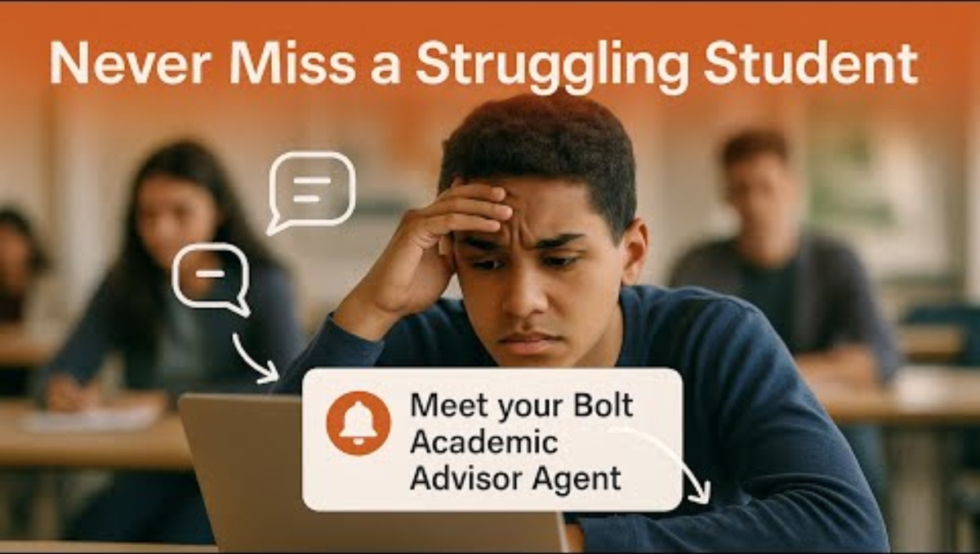
Vision In Action
Implementation Update
Notes:
Here is a brief demonstration of the a fully realized AI Agent, (Play Video)
An AI Agent whose sole job is to monitor a students activity and academic performance to assist in our Persistence efforts, helping students to connect with a Counselor or ACP Success Coach, Basic Needs, or Health Services.
The good news, thanks to the collaborative efforts of some of the folks in this room, we’ve been informed that, in partnership with the District, we will be hosting a pilot of an early alert system for Spring 2026.

Slide 13

Implementation Update
Looking Ahead…
Communication & Engagement
Agentic AI
CANVAS Integration
Student Hub
Notes:
As we look ahead past the initial implementation, we should work to expand the use of all three components of the CRM Platform, having them work in concert to provide personalized, targeted communications toward our Student Success goals such as increasing persistence metrics and capturing student data for VAR; addressing equity gaps for our DI populations; and doing so more efficiently through a Student Hub App we can make available to all our students.

Slide 14
Implementation Update
Phase Four On Deck…
Dept. Adoption:
Athletics, Transfer Ctr, Library/Technology Services, Academic Success Ctr, Basic Needs, Bookstore, STEM/MESA, Health Center, Rising Scholars, CalWorks/CARE
Notes:
But for now the primary focus is on the first iteration of the implementation. On deck for Phase 4 are the areas you see listed here. Meetings are already scheduled for Jeff’s area and Cheryl’s area. I have connected with Linda and Athletics, and will be reaching out to Jacqueline to schedule time with the Public Safety crew.

Slide 15
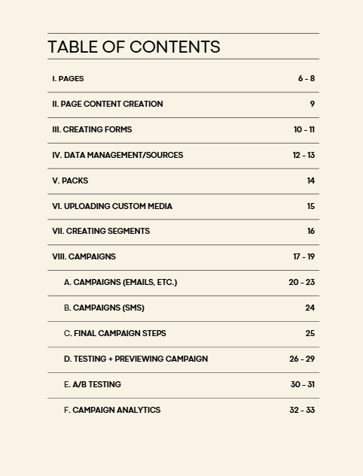
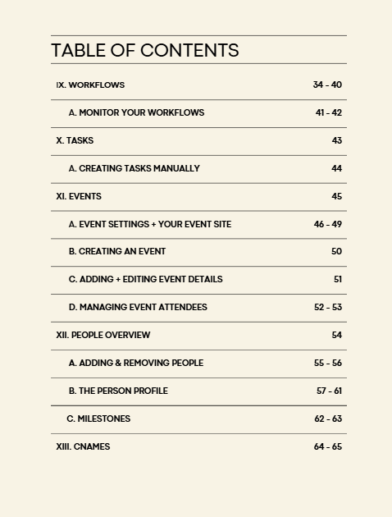
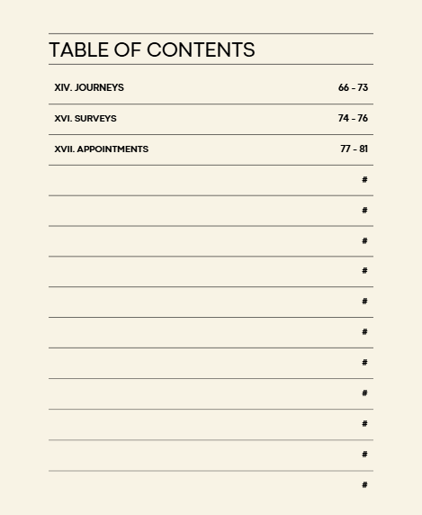

Implementation Update
Formalized Training
Notes:
In addition to the continued departmental expansion, formalized training will begin in November with representatives from the previously mentioned Phase 3 areas. We have an 80-page and growing resource guide that I will be utilizing during training, but participants will of course be keeping them as they begin the adoption process in their areas. I am looking at Friday mornings as a designated time, and still ironing out location.

Slide 16
The Ask
Spread the word:
droberts001@sdccd.edu
Notes:
In the meantime, I am trying to increase the level of communication I am providing around the project. I feel like all I am doing is talking about the project – but I have learned that no matter how I feel about it, there are still folks here who state they do not know enough about the project. If you hear a member of the Miramar College community state as much, contact me. I am now addicted to caffeine and a coffee meeting to discuss the project will always be welcomed.

