Slide 1
Classified Senate Technology Survey Spring 2025
San Diego Miramar College
Office of Institutional Effectiveness

Slide 2
Method
The Classified Senate developed and distributed the survey both online and in paper form, which was handed out at the Classified Service Awards and Year-End Carnival.
A total of 77 classified professionals completed the survey.
The Research Office entered, analyzed, and compiled the results into this report.

Slide 3
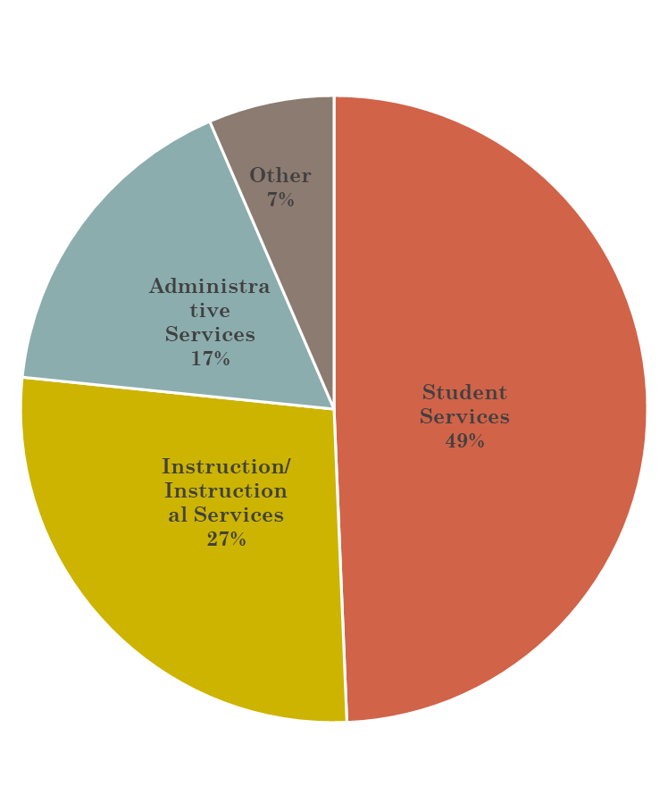
Question 1
Percent Breakdown By Service Division
Which division are you part of?
Total Respondents: 77
Instructional Services: 21
Student Services: 38
Administrative Services: 13
Other: 5

Slide 4
Question 2
Institutional Services
Most respondents use “Office/Conference Hardware” and “Web-Based Software”.
Over half use “Specialized Software” and “Classroom Hardware”.
Student Services
Most respondents use “Office/Conference Hardware” and “Web-Based Software”.
Less than half use “Specialized Software” and “Classroom Hardware”.
Administrative Services
Most respondents use “Office/Conference Hardware” and “Web-Based Software”.
Over half use “Specialized Software” and “Classroom Hardware”.
Other
Most respondents use “Office/Conference Hardware” and “Web-Based Software”.
Less than half use “Specialized Software” and “Classroom Hardware”.
Which of the following types of technologies hardware and software do you regularly use for your job?
Total Respondents: 77
IS Respondents: 21
SS Respondents: 38
AS Respondents: 13
Other Respondents: 5

Slide 5
Instruction Services
Administrative Services
Student Services
Other

Slide 6
Question 3
Institutional Services
Just over 20% of respondents use technology not funded by the college.
Just over 60% do not.
18% were unsure.
Student Services
Over half of respondents use technology not funded by the college.
38% do not.
10% were unsure.
Administrative Services
38% of respondents use technology not funded by the college.
More than 1/2 do not.
8% were unsure.
Other
About 2/3 of respondents use technology not funded by the college.
1/3 do not.
Do you use any technology for your job that was not provided or funded by the college?
IS Respondents: 21
SS Respondents: 38
AS Respondents: 13
Other Respondents: 5

Slide 7
Instruction Services
Administrative Services
Student Services
Other

Slide 8
Question 4
Institutional Services & Administrative Services
Personal Laptop/Computer: Work from home, not enough devices at work, to take notes, meetings, software compatibility
Personal Phone/Table: Emails, phone calls, 2-step verification, serve as camera and mic for virtual meetings
Support Equipment: Comfortable, more efficient, necessary
Software/Online Tools: Necessary for workflow
Student Services
Personal Laptop/Computer: Comfortable, not enough devices
Support Equipment: Macropad allows massive data input
Software/Online Tools: Capcut/Inshot
Other
Personal Laptop/Computer: Student communication
Personal Phone/Table: Necessary due to budget constraints
Which of the following types of technologies hardware and software do you regularly use for your job?
Total Respondents: 25
IS Respondents: 11
SS Respondents: 8
AS Respondents: 4
Other Respondents: 2

Slide 9
Institution Services
Administrative Services
Student Services
Other

Slide 10
Question 5 & 6
Institutional Services
About 10% of respondents had a negative ratings for access to hardware and software.
Around 64% had positive ratings.
Nearly 26% had a neutral rating
Student Services
About 4% of respondents had a negative rating for access to hardware and software.
Around 55% had positive ratings.
Nearly 22% had a neutral rating
Administrative Services
About 5% of respondents had a negative ratings for access to hardware and software.
Around 66% had positive ratings.
Nearly 30% had a neutral rating
Other
About 5% of respondents had a negative ratings for access to hardware and software.
Around 66% had positive ratings.
Nearly 30% had a neutral rating
Which of the following types of technologies hardware and software do you regularly use for your job?
Total Respondents: 77
IS Respondents: 21
SS Respondents: 38
AS Respondents: 13
Other Respondents: 5

Slide 11
Instruction Services
Administrative Services
Student Services
Other

Slide 12
Question 7
Institutional Services
10 of 16 identified “Insufficient training on technology”
9 of 16 identified “Hardware/Software over 3 years old”
6 of 16 identified “Response time for technical support”
6 of 16 identified no technology challenges
Student Services
14 of 24 identified “Hardware/ Software over 3 years old”
8 of 24 identified “Insufficient training on technology”
7 of 8 identified “Limited internet access/connectivity”
10 of 24 identified no technology challenges
Administrative Services
5 of 6 identified “Insufficient training technology”
5 of 6 identified “Lack of funding to purchase technology”
4 of 5 identified “Response time for technical support”
4 of 5 identified “Hardware/Software over 3 years old”
3 of 5 identified “Concerns about decisions”
3 of 5 identified “Limited opportunities for participation”
Other
1 of 3 identified “Hardware/ Software over 3 years old”
1 or 3 identified “Insufficient training on technology”
1 of 3 identified no technology challenges
What are your biggest challenges to technology in your current role?
Total Respondents: 52
IS Respondents: 16
SS Respondents: 24
AS Respondents: 10
Other Respondents: 2

Slide 13
Instruction Services
Administrative Services
Student Services
Other

Slide 14
(Q8) Please elaborate on your response to the previous question: Total Respondents: 9
4 described software challenges:
Outdated, slow, difficult to use, unreliable access
Need Campus Solutions
Program Outages
2 described hardware challenges:
Old, slow / low memory / freezing, unreliable, limits work
Need to use personal devices
1 described a desire for improved tech support:
IT answers need improvement
1 described institutional challenges:
Lack of automation in campus solutions
Prevents student aid
1 described challenges with phone and internet connectivity:
Dropped connections for Wi-Fi

Slide 15
(Q8) Please elaborate on your response to the previous question: Spotlight
A respondent described detailed issues with Campus Solutions:
“The main software we need to run properly is Campus Solutions. Currently, it lacks automation, accuracy and efficiency. It prevents many students from receiving their financial aid in a timely AND if at all. Trust me, I see a lot of students missing their money that they qualified for. The amounts of money is massive; the number of students affected is massive. Everyone in the financial departments are aware of the software issues, but no one wants to push back (well one person I know does so and that person is tagged as a nuisance to district personnel). Payments are being calculated by our CS incorrectly. The values are wrong. The system has safeguards to stop payments to students but they aren't being fixed in the software due to lack to knowledge by tech supporting Financial systems. As a result, payments are withheld from students. Those payments are also qualifiers for additional aid, but since the base aid was never disbursed, the additional aid wasn't awarded. I've seen students lose as much as $14000 in aid for fall and spring combined. To find out how bad the problems are and how many people its affecting all you have to do is ask the Directors for a list of known CS system issues. The directors can estimate the number of students affected by pulling up reports. All three campuses are in the same situation since CS district staff are overseeing the system. Anyways, Deans are award of this too, but none will push back at District. Most students are in the dark but occasionally they ask why their financial awards are lacking, delayed, inaccurate, or missing. Yet another issue is that many supervising personnel aren't technologically knowledgeable, and so they can't articulate problems, and when issues are brought to district all the excuses come out such as, "you all agree on this process", "we don't have the resources to undertake that task", "we'll work on it after we address the other issues". “

Slide 16
(Q8) Please elaborate on your response to the previous question: Total Respondents: 11
3 described software challenges:
Difficulty with Microsoft Teams. Fails/freezes/high-memory usage
Software updates. Requires admin/never updated/Microsoft app issues
G drive trouble/Needs to be saved locally on desktop
2 described hardware challenges:
Old, slow / low memory / freezing, unreliable, limits work
Computers without cameras or mics
Computer switches/changes lost files
1 described a desire for training:
Use/switch between/troubleshoot technology in labs and classrooms
2 described a desire for improved tech support:
IT department not student oriented
1 described institutional challenges:
Need to bring your own computer
1 described challenges with phone and internet connectivity:
Dropped connections for Wi-Fi and landline
Delayed connection

Slide 17
(Q8) Please elaborate on your response to the previous question: Spotlight
A respondent described detailed issues with hardware and software:
“Old hardware: My computer is slow and unreliable, annoying with the "content blocked" popups when I'm not even using the computer (what the heck even is that?!), and the constant notifications that it needs to update Windows even right after I let it update the computer! Other software updates like Office, Outlook, etc can't be done my me (need admin right?) but they never get updated. The computer's internal clock is incorrect (about 6 minutes slow) and it won't let me fix it. I can't have a browser, PDFs, Excel, Outlook, and Word open at the same time (sometimes I need them all at the same time) or the computer says there isn't enough memory. And using high-memory usage apps like Teams is onerous because the application fails/freezes/etc a lot, even if I use the web-based version
Admin: If they were involved in picking PeopleSoft, they shouldn't be allowed to make any other software decisions. Just sayin...
G drive: my files all have to be saved locally to my desktop. This has in the past resulted in significant lost files, both when my computer died, and when it was switched out/upgraded without my knowledge for a newer computer. I did have a backup USB, but it was malfunctioning and the computer couldn't read it. Just knowing who the main point of contact should be for stuff like this would be helpful, since I don't like to bother a bunch of people when I'm not sure who to contact.”

Slide 18
(Q8) Please elaborate on your response to the previous question: Spotlight
A respondent described detailed issues with Teams software:
“No idea how to use the teams phone. I can't send messages via my cell phone unless I turn off Wifi even though I went through all the steps for doing this. I have to use my data to send messages to my colleagues. I can't set up a student outlook account because it drops me into the employee outlook box. All I was told was "that shouldn't happen" but no help with this. Instructors are frustrated that software isn't updated and students can't access the programs they need. Our office computers monitors don't have cameras or sound to participate in Zoom calls.

Slide 19
(Q8) Please elaborate on your response to the previous question: Total Respondents: 6
3 described software challenges:
Lacking Canva, Microsoft app efficiency
2 described hardware challenges:
Old (13 years old), slow
2 described a desire for training:
Microsoft apps
Teams phone
3 described institutional challenges:
Software upgrades require admin rights
Lack of transparency

Slide 20
(Q8) Please elaborate on your response to the previous question: Spotlight
A respondent described detailed issues with institutional procedures:
“The technology department operational decisions lack transparency and don't seem to be data driven. The technology operations management need to listen to the designated experts instead of being reactionary. More advanced, equity and instructional - focused policies are need in the technology department.”
Another respondent describes issues with admin rights:
“We use software that has frequent upgrades but requires administrator rights to do so. Also, there are pieces of hardware and associated software that would greatly enhance our quality as well as capabilities we could offer the campus community. Justifying these purchase to multiple supervisors as well as arbitrary budget constraints means that departments spend their money with outside vendors. This causes more money to flow out of the campus rather than using existing cost-effective services on campus.”
One other respondent describes funding issues:
“My desktop machine was just updated. It is still 5+ years old but 1000% better than my old unit which isn’t saying much. The 30 day trial for Canva expired but no funds to pay for the subscription are available. I’m not aware of department funding for new computers and input for Program Review was not requested. “

Slide 21
(Q8) Please elaborate on your response to the previous question: Total Respondents: 1
1 described software challenges:
Outdated, updates needed
1 described a desire for training:
Training on updated software needed

Slide 22
Q9. If budget or resource constraints were not an issue, what technology improvements would most enhance your job performance? (e.g. new software, updated hardware, training, etc.) Total Respondents: 19
11 described hardware improvements:
New, updated, or upgraded computers (laptop, desktop, notebook, tablet)
5 described software improvements:
New, updated, or upgraded software
3 described training improvements:
In-person/software training
Training for tools (Adobe, Canva)
1 described tech support improvements:
Staff monitor software update need recertification
3 described connectivity improvements:
Wi-Fi
In classrooms and conference rooms

Slide 23
Q9. If budget or resource constraints were not an issue, what technology improvements would most enhance your job performance? (e.g. new software, updated hardware, training, etc.) Total Respondents: 14
11 described hardware improvements:
New, updated, or upgraded computers (laptop, desktop, notebook, tablet)
Support equipment (color printer, digital color press, wide format latex printer, cold laminator, vinyl cutter/plotter, AV equipment, mobile phone, monitors compatible with virtual meetings, hyflex equipment, sitting/standing desks)
2 described software improvements:
Software availability to staff for student support
New software in general
4 described training improvements:
Annual professional development
In-person training
Training for tools (Teams phones)
3 described tech support improvements:
Larger tech support team (general, third-party unit)
Plan for technology support when rolling out new processes, updates, or changes
1 described connectivity improvements:
Conference rooms (e.g. L-108)

Slide 24
Q9. If budget or resource constraints were not an issue, what technology improvements would most enhance your job performance? (e.g. new software, updated hardware, training, etc.) Total Respondents: 9
4 described hardware improvements:
New, updated, or upgraded computers (laptop, desktop, notebook, tablet)
Support equipment (color printer, digital color press, screen print calibrator, wide format latex printer, cold laminator, AV equipment, mobile phone, monitors compatible with virtual meetings)
3 described software improvements:
New, updated, or upgraded software (QuickBooks, Canva subscription)
Microsoft phone bugs

Slide 25
(Q9) If budget or resource constraints were not an issue, what technology improvements would most enhance your job performance? (e.g. new software, updated hardware, training, etc.): Spotlight
A respondent described detailed issues with institutional procedures:
“If budget was not an issue, we would have a digital color press with a finisher capable of making a variety of folded, stapled, punched, and bound documents. The purchase of a screen/print calibrator along with it's software would greatly increase our color quality for all printed items. Our wide format latex printer would be supplemented with a flatbed UV printer capable of printing directly to surfaces, reducing material cost and time for campus sign requests. A cold laminator would provide us with the ability to apply vinyl and protective films to boards and other substrates. A vinyl cutter/plotter would give us the ability to cut complex shapes for stickers/decals as well as cut vinyl lettering for a myriad of applications. Updating outdated signage around campus would become possible with the additions of a laser cutter/engraver and a tabletop CNC router.
Adequate work stations with gpu's, robust cpu's as well as RAM would speed up workflows. This would be necessary if any CNC work was going to be handled. Additionally, CAD software would be needed and requires significant training to use proficiently. A lightweight CRM would speed up order intake, quotes, and end of month billing. Training for using Drupal (the content management system our website runs on) would be useful for adding online order processing as well as regularly updating our website. Adobe certification courses would give our workers valuable training as well as a highly valued document that validates the quality of the work done in our shop. Various print trainings could show us more effective ways of running our operation which would reduce costs and increase value to our campus community.

Slide 26
Q9. If budget or resource constraints were not an issue, what technology improvements would most enhance your job performance? (e.g. new software, updated hardware, training, etc.) Total Respondents: 1
1 described software improvements:
New, updated software

Slide 27
Q10. Are there any other technology-related needs or suggestions you would like to share? Total Respondents: 8
1 described tech support needs/suggestions:
Need well-trained tech support staff
2 described hardware needs/suggestions:
New computers (updated)
Comfortable/adjustable chairs
More equipment
2 described software needs/suggestions:
Student service computers keep bluescreening
Proper CS update/CS software issues
1 described training needs/suggestions:
More opportunities
Training to use PeopleSoft, Campus Solutions
1 described accessibility and awareness needs/suggestions:
Be able to operate services to students

Slide 28
(Q10) Please elaborate on your response to the previous question: Spotlight
A respondent described detailed issues with Campus Solutions:
“We need people that can update CS properly... not just divert blame, stall, and gaslight about system functionality. Okay, so I know i'm sharing software issues based at district but it affects campus and students. New software doesn't help since it constantly needs to be adjusted based on new policies, procedures, and programs. We need people that know how to work in CS so we can operate our services to students!!!!!“

Slide 29
Q10. Are there any other technology-related needs or suggestions you would like to share? Total Respondents: 11
5 described tech support needs/suggestions:
More staff (ICS, IT, AV)
More technology ordered but no additional employees to manage
Desktop/printer issues
1 described hardware needs/suggestions:
Update computers, update AV in classrooms
2 described training needs/suggestions:
Basic troubleshooting for faculty
PeopleSoft training
1 described accessibility and awareness needs/suggestions:
PeopleSoft accessibility. Not hidden under a lot of links

Slide 30
Q10. Are there any other technology-related needs or suggestions you would like to share? Total Respondents: 4
2 described software needs/suggestions:
District wide Canva membership, Grammarly, Microsoft Phone updates
School website poorly maintained
3 described accessibility and awareness needs/suggestions:
More equity and disability focused technology, ADA compliance
Share awareness of resources (e.g. 3D printing)
Department resources seqestuered

Slide 31
Q10. Are there any other technology-related needs or suggestions you would like to share? Total Respondents: 1
“No”

Slide 32
Q11. Do you have any positive experiences with technology on campus that you would like to share? Total Respondents: 12
6 provided general positive feedback:
AV, IT, tech support
Great wifi
“Great experience”
3 shared positive experiences with the speed of service/technology:
“IT so quick
“When we do get new hardware it gets installed great and quickly”
2 shared positive experiences with software and equipment:
“appreciate the tech”
“updated lately”
3 gave shout outs to specific employees:
Carlos, Kurt, Todd
3 described employees’ character positively:
“amazing!”
“great to work with!”

Slide 33
Q11. Do you have any positive experiences with technology on campus that you would like to share? Total Respondents: 14
7 provided general positive feedback:
AV, IT
“Only positive experiences”
“staff always kind
“always helpful”
3 shared positive experiences with the speed of service/technology:
“quick to respond to most classroom emergencies”
“responds as soon as they can”
“issues get fixed in a timely manner”
3 shared positive experiences with software and equipment:
Adobe, Office 365, Microsoft Suite
Newline Boards, smart displays
Upgrades
1 gave shout outs to specific employees:
Todd
3 described employees’ character positively:
“awesome”
“quick”
“pleasure to work with”

Slide 34
Q11. Do you have any positive experiences with technology on campus that you would like to share? Total Respondents: 6
2 provided general positive feedback:
“Most positive”
AV
2 shared positive experiences with the speed of service/technology:
Bugs via IT tickets quick
Hardware replacements done quickly
1 shared positive experiences with software and equipment:
Office upgrade done district wide without asking

Slide 35
Q11. Do you have any positive experiences with technology on campus that you would like to share? Total Respondents: 1
6 gave shout outs to specific employees:
Todd
3 described employees’ character positively:
“has always been helpful”

