Slide 1
The slideshow for this week is still
UNDER CONSTRUCTION

Slide 2
San Diego Miramar College
Academic Senate Meeting
October 21st, 2025
2024-25 Academic Year
Cultivating Community:
Making the invisible visible
Attending for Flex credit? Email rgomez001@sdccd.edu or jbartolo@sdccd.edu
(QR Code for A.S. Webpage)

Slide 3
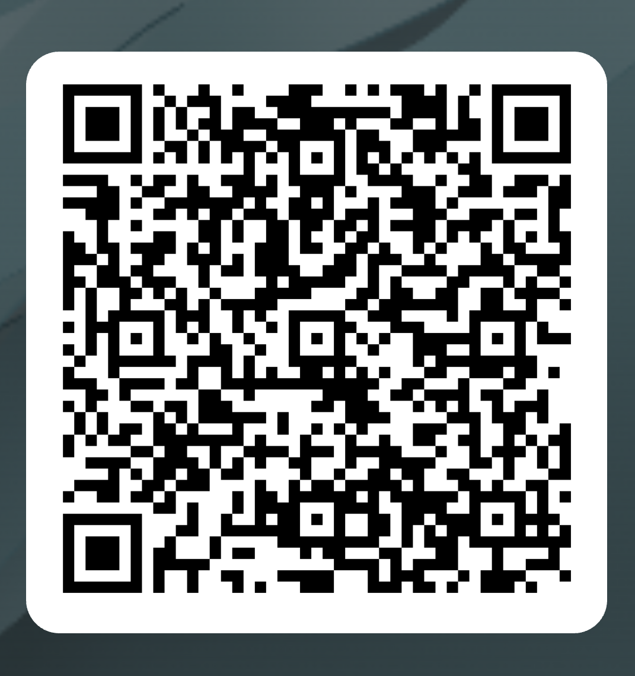
Academic Senate Attendance
October 21st, 2025
2024-25 Academic Year
Please remember to sign in using the QR Code! The sign-in sheet is a secondary option (See Olivia!)
When we reach quorum (23/44) we can get started officially!

Slide 4
2. Agenda Overview
Call to Order
Approval of Agenda & Consent Calendar
  DRAFT Minutes 100725
Land Acknowledgement (Updated)
President's Senate Overview
Public Comments
Action Items
Student Equity Plan 2025-2028
Updating College Mission & Vision Statements
AS Meeting Modality Vote
Discussion Items
  Standing: Curriculum Committee Updates
  Ensuring Senate Representation for All Faculty
  Faculty Contract Hiring List Presentation
  Miramar AI Working Group – AI Policies & Guidelines
Reports:
  Committee Reports
  Special Reports
    Faculty Technology Liaison Report
  Executive Committee Reports
Announcements
Adjournment
A.S. Agenda for 10/21/25 AS Code of Conduct

Slide 5
3. Land Acknowledgment (Updated)
We recognize that San Diego Miramar College sits on the ancestral homeland of the Kumeyaay, Luiseño, Cupeño, and Cahuilla tribes, who have lived in this area for well over 10,000 years, and we honor their past, present, and future connection to this land and its inherent connection to their identity.
We acknowledge our occupation of unceded Kumeyaay land and the violent systemic injustices this has continuously perpetuated for Native peoples of this region. We pay respect to the Indigenous people of San Diego County - past, present, and future - and honor their continuing presence in their homeland and their spiritual beliefs that land does not belong to people; people belong to land.
We also acknowledge that this is merely the beginning, and there is far more work to be done in an attempt to heal all of the injustices and inequities that still exist today and throughout their entire historical diaspora. We commit to moving forward together.
Resources: “Making a land acknowledgment meaningful”; A call for more powerful land acknowledgements
Notes:
Beginning with the Spanish invasion of 1769, continuing through the Mexican Period of 1826 to 1848, and on through the American Period, the Kumeyaay were forced off their ancestral lands. Nearly all of the Kumeyaay lands were taken into private ownership or made U.S. government holdings. Treaties negotiated with 18 California tribes in 1850 to set aside 8.5 million acres in specific tribal lands were never ratified by the United States Senate as a result of opposition by the state of California.

Slide 6
4. President’s Senate Overview
Academic Senate (AS) is a faculty organization whose primary function is to make recommendations to the Board of Trustees on 10+1 aka “academic and professional matters.” (Title 5, Section 53200)
Thank you for your willingness to serve as Senators, representing fellow colleagues, taking info back to departments, deliberating and discussing with them and carrying their suggestions, questions, and recommendation back to the Academic Senate.
Senate Makeup: there is 1 senator for every 4 contract faculty in a department; 7 adjunct senators represent adjunct faculty

Slide 7
4. President’s Senate Overview
10 + 1 comes from California Law: Title 5 § 53200
1. Curriculum, including establishing prerequisites
2. Degree and certificate requirements
3. Grading policies
4. Educational program development
5. Standards or policies regarding student preparation and success
6. College governance structures, as related to faculty roles
7. Faculty roles and involvement in accreditation processes.
8. Policies for faculty professional development activities
9. Processes for program review
10. Processes for institutional planning and budget development
11. Other academic and professional matters as mutually agreed upon

Slide 8
4. President’s Senate Overview
Miramar’s Academic Senate is committed to openness, transparency, and public access to information and will therefore …
Follow the Brown Act
Publicly post notice of meeting 72 hours prior
Include information on place, time, and agenda items with brief descriptions
Record all motions and votes for public record.
Follow Robert’s Rules of Order
Balance discussion and debate with decision making.
Do our best to maintain fair process in whatever modality or environment we meet.

Slide 9
4. President’s Senate Overview
Miramar’s Academic Senate is committed to openness, transparency, and public access to information and will therefore …
Honor our A.S. Code of Conduct
We operate as an open venue for all ideas, thoughts, and personal perspectives, with consideration for the boundaries established in the Code of Conduct.
Remember that your personal interests and valued agenda items may or may not be the same as others in the Senate, and all have the right to be treated respectfully.
Embrace the spirit of diversity, equity, and inclusion.

Slide 10
4. President’s Senate Overview
Voting in-person or on Zoom
After a motion has been made and it has received a second, the A.S. President then restates the motion and opens the floor for discussion
The Secretary will type the resolution out on the projector or shared screen
Once the discussion is complete, Senators will be given one minute to cast their vote (by hand/voice or “Zoom Reactions”)

Slide 11
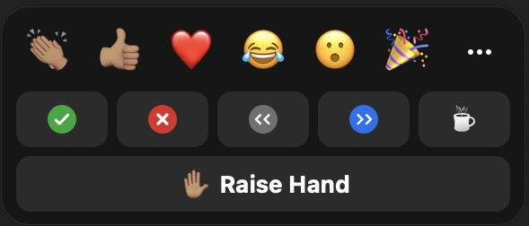
4. President’s Senate Overview
Zoom Reactions for Voting:
Vote “Yes” = Green “Check”
Vote “No” = Red “X”
Vote “Abstain” = “Raise Hand”
Proxy votes = use chat:
  i.e. “Rodrigo Gomez votes yes/no/abstains”
During a vote, the chat should only be used for proxy votes. If a senator has a question, they can send a “direct chat” to the A.S. Vice-President, Carmen Carrasquillo, who will communicate with the A.S President

Slide 12
4. President’s Senate Overview
General use of Zoom “Chat”:
The chat feature is to be used for professional purposes only, i.e. to post questions for facilitator or group consideration or post information requested by the body.
It has been made clear that this space is sometimes used for uncivil discourse and inappropriate conversations. Please refrain from using it for anything other than its professional purpose.
Chat remains open to the Parliamentarian and other meeting hosts throughout the meeting. During "Discussion," the chat feature will be open to the group for the period of Discussion only. Outside of discussion time, private messages can be sent to the Parliamentarian and hosts.

Slide 13
5. Public Comments (10 min)
Limited to 10+1 items that are not on the agenda
  Public Comments on agenda items will take place before the A.S. body discussion begins but after any relevant presentations.
2 min. per speaker, 10 mins. per topic
  Individual speakers may not yield their time to another speaker or spokesperson
To be continued at the end of the meeting if necessary

Slide 14
6. Action Items (Second Reads)
6.1. Student Equity Plan 2025-2028
Nessa Julian (10 mins.)
6.2. Updating College Mission & Vision Statements
David Wilhelm (10 mins.)
6.3. Senate Modality Vote
Rodrigo Gomez (10 mins.)

Slide 15
6. Action Items (Second Reads)
6.1. Student Equity Plan 2025-2028 - Nessa Julian (10 mins.)
Student Equity Plan Executive Summary
Equity Plan Draft
“Since the adoption of our 2022-2025 Student Equity Plan, Miramar has embraced equity as more than a value, but as a practice. We approach our work with greater intentionality and a race-conscious lens that critically examines institutional systems and barriers to redesign programs and services to more effectively support disproportionately impacted student groups. In addressing the barriers/focus areas of our previous plan, we discovered that a focus on race conscious design changed both our approach and action”

Slide 16
6. Action Items (Second Reads)
6.2.1 Miramar College Mission & Vision Statements Update - David Wilhelm (10 mins.)
Current Version | Proposed Changes Version
Mission Statement
San Diego Miramar College's mission is to prepare students to succeed by providing quality instruction and services in an environment that supports and promotes success, diversity, inclusion, and equity with innovative programs and partnerships to facilitate student completion for degrees/certificates, transfer, workforce training, and/or career advancement.
Vision Statement
San Diego Miramar College will be the center of education innovation and services to support our diverse students and community. In keeping with this vision, the college supports and emphasizes the following guiding values:

Slide 17
6. Discussion Items (First Reads)
6.2.2 Miramar College Mission & Vision Statements Update
Access to learning and support services, for all students to successfully achieve their education and career goals
A culture that breaks down barriers, embraces and promotes community through equity, inclusion, civility, responsibility, sustainability, from a global perspective.
A reflection of our community through the diversity of our students, classified professionals, faculty, and administrators
Creativity, innovation, flexibility, and excellence in teaching, learning, and services
The ability to recognize and adapt to opportunities and challenges emerging from a complex and dynamic world
Strategic resource and partnership development to support curriculum and program innovation through collaboration with key stakeholders
Effective participation in governance with respect and professionalism through intentional, purposeful, and effective communication embraced by the college community
Transformative processes that include a culture of evidence, collaborative inquiry, and action for promoting student success

Slide 18
6. Action Items (Second Reads)
6.3.1 AS Meeting Modality Update - Rodrigo Gomez (10 mins)
Technical issues persist in this hybrid format, with some in-person and some remote, and the ongoing interruptions hinder our governance process. The question is whether we should return to fully in-person senate meetings.
City and Mesa went back to fully in-person after pandemic restrictions softened, citing Brown Rule Violations from Senators travelling, cameras not being on, & collegiality as key reasons; Continuing Ed still offers the remote option but also aspires to shift to fully in-person
78 Hours / 110 Hours → Adjunct Faculty participation
Should the decision be made to return to fully in-person, we would do so starting Spring 2026 (for senators to accommodate)

Slide 19
6. Action Items (Second Reads)
6.3.2 AS Meeting Modality Update - Rodrigo Gomez (10 mins)
Items to Consider:
Context for Vote: Returning to Fully In-Person Senate Meetings
Provides additional information for senators to consider, including ways remote attendance puts Brown Act into question + Zoom Chat Responses for an example of how the tech hurts collegiality.
ASRE Recommendation
- Provides additional information for senators to consider, suggesting that eliminating remote attendance cause equity issues.

Slide 20
7. Discussion Items (First Reads)
7.1. Curriculum Committee Updates
Veronica Hartmann (5 mins.)
7.2. Ensuring Senate Representation for All Faculty
Rodrigo Gomez (10 mins.)
7.3. Faculty Contract Hiring List Presentation
Mary Kjartanson (10 mins.)
7.4 Miramar AI Working Group
Rodrigo Gomez (5 mins.)

Slide 21
7. Discussion Items (First Reads)
7.1. Curriculum Committee Updates
Veronica Hartmann (5 mins.)

Slide 22
7. Discussion Items (First Reads)
7.2. Ensuring Senate Representation for All Faculty
Rodrigo Gomez (10 mins.)
Recent department and school realignments have created representation gaps for some contract faculty whose roles are not housed within an existing Academic Senate–represented department. This includes positions such as Career Services and Articulation, which were previously grouped under divisions that no longer exist in the same form.
The issue has been identified and discussed with the VPI and Academic Senate Executive Committee. Possible options include:
  Reinstating a Senator-at-Large or creating a “Catch-All Senator” position.
  Reviewing the Constitution & Bylaws to define eligibility and voting rights for unaligned positions.
  Coordinating with affected areas (e.g., Career Services, Articulation) to ensure proper inclusion.

Slide 23
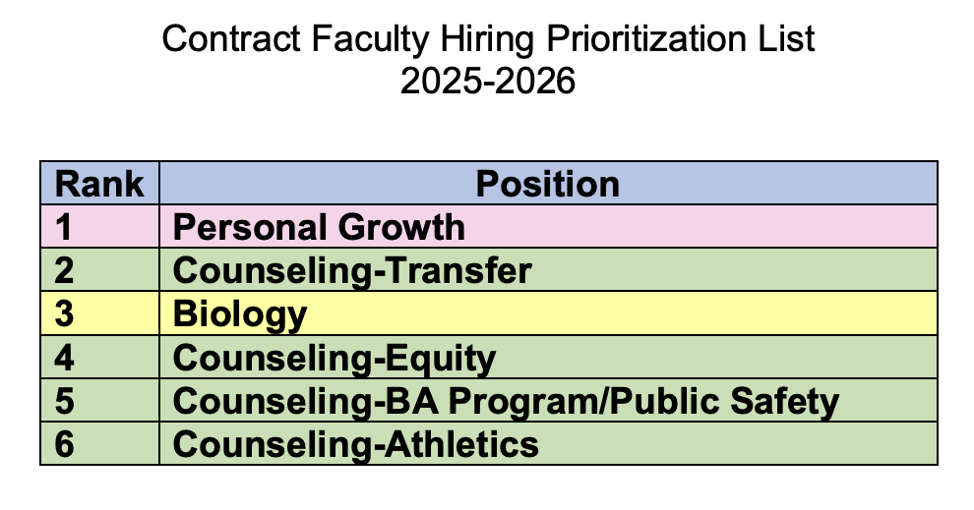
7. Discussion Items (First Reads)
7.3. Faculty Contract Hiring List Presentation
Mary Kjartanson (10 mins.)

Slide 24
7. Discussion Items (First Reads)
7.4. Miramar AI Working Group
Rodrigo Gomez (10 mins.)
MAIN Community of Inquiry/Practice Slides
Miramar College has been a leader in the AI in Education conversation since it started. We are the only college currently with an AI Resolution. In the absence of specific professional development related to AI, I propose the creation of a Miramar working group on AI.
AI Policies & Guidelines
Miramar AI Guidelines Draft

Slide 25
8. Reports
8.1. Committee Reports

Slide 26
8. Reports
8.2. No Special Reports

Slide 27
8.3: Executive Committee Reports
8.3.1: President’s Report
If you have questions that you don’t ask today, I’m available for further discussion via email, face-to-face, or Zoom meetings.
You can also invite me to your department meetings. (Past resource documents can be found on the specific web page created for each A.S. meeting.)

Slide 28
8.3: Executive Committee Reports
8.3.2: President’s Report
1. Adjunct Faculty Shared Governance Funds:
  Working with and upon the recommendation of AFT President Jim Mahler, the four A.S. Presidents agreed that each college would receive 110 hours for the fall 2025 semester at the rate of $50/hour.
  The rate of pay will increase if the total number of hours submitted is less than 440 hours across the district.
  I’ve reviewed my options and created a document that I’ve shared with Adjunct Senators to track the hours that will go to AS & other adjunct governance roles at Miramar.

Slide 29
8.3.3: President’s Report (cont.)
2. AP7211 – Voted down at Miramar College. However, Mesa College has requested an update on our position and looking for the edits that we would like to see to approve it.
The issue had to do with “Chairs” specifically. Original | Updated Version
Faculty Discipline Expert Committee (FDEC) language:
Each college will establish its own Faculty Discipline Expert Committee (FDEC) on an as needed basis. The FDEC will include at least two discipline experts with adequate academic and/or professional experience. The Department Chair and/or Area Dean may also be part of the committee. Upon receipt of an applicant’s Application for Equivalency Determination, the FDEC shall review the submission.

Slide 30
8.3.4: President’s Report (cont.)
State:
Fall Plenary 2025 is coming up (La Jolla)
AI Regional representatives have been selected to lead on AI across California. Miramar is well represented in these conversations.

Slide 31
8.3.5-7 Executive Committee Reports
  Vice-President – Carmen Carrasquillo
  Secretary – Olivia Flores
  Treasurer – Dawn Diskin (please see the following slide)
  Contract Member-at-Large – Kristin Everhart
  Contingent Faculty Member-at-Large – Melissa Wolfson
  Chair of Chairs – Mary Kjartanson

Slide 32
Report 8.3.8: A.S. Treasurer
Please considering enrolling in auto-payroll deduction for a nominal amount per check. Contributions of $2.00 per check make a difference to our students in funding our scholarships and other necessary needs.
Current Balance = $1,101.07

Slide 33
9. Announcements
1 min. time limit each

Slide 34
9.2 Executive Committee
  Your 2025-26 A.S. Executive Committee
  President –Rodrigo Gomez
  Vice-President – Carmen Carrasquillo
  Secretary – Olivia Flores
  Treasurer – Dawn Diskin
  Contract Member-at-Large – Melissa Wolfson
  Contingent Faculty Member-at-Large – Kristen Everhart
  Curriculum Chair – Veronica Hartmann
  Chair of Chairs – Mary Kjartenson

Slide 35
If the calendar was approved earlier, the first meeting of the 2025-26 SDMC Academic Senate is:
Tuesday, November 4, 2025 from 3:30-5:00 pm in M-110 and on Zoom.
Senators wishing to attend remotely can learn more via the
A.S. Senator Remote Attendance Form. Senators wishing to change their attendance to in person should contact rgomez001@sdccd.edu.
10. Adjournment

