Slide 1
The slideshow for this week is still
UNDER CONSTRUCTION

Slide 2
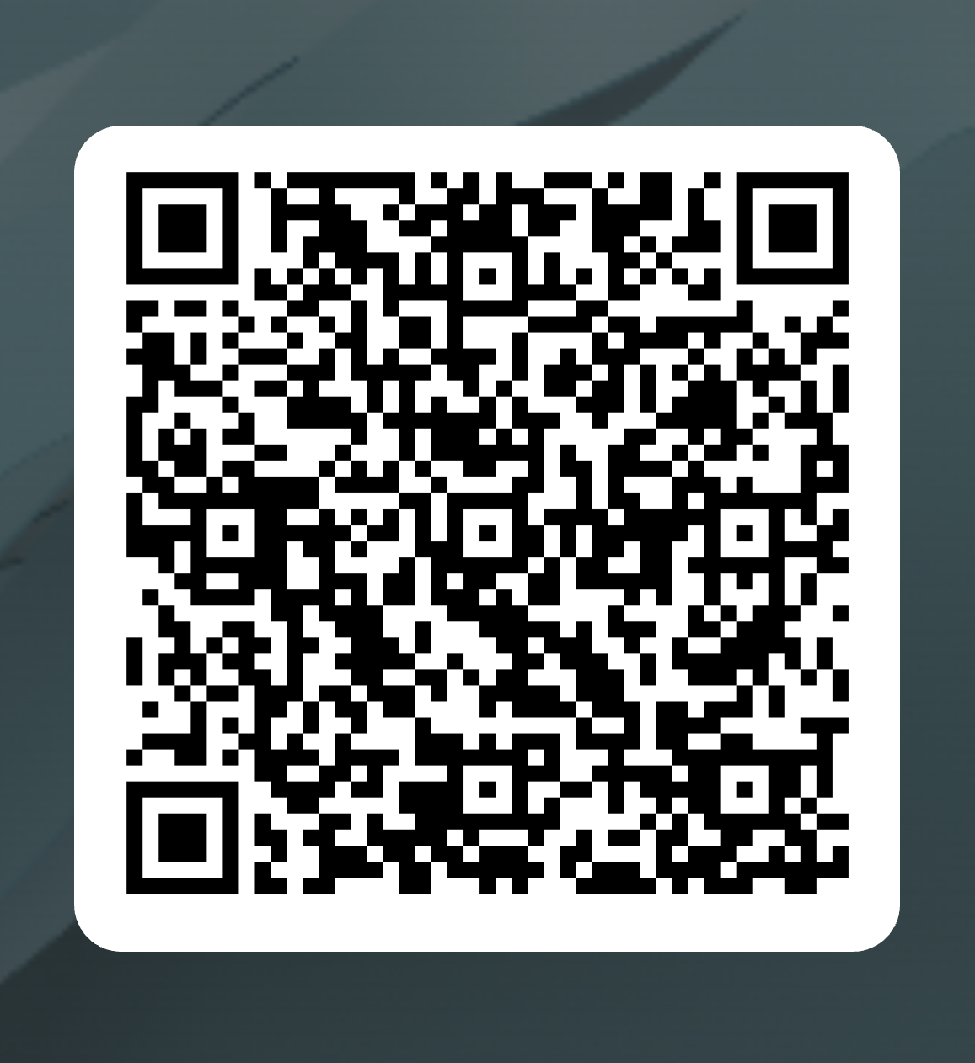
Academic Senate Attendance
October 7, 2025
2024-25 Academic Year
Please remember to sign in using the QR Code! The sign-in sheet is a secondary option (See Olivia!)
When we reach quorum (23/44) we can get started officially!

Slide 3
San Diego Miramar College Upcoming Events
Invest in Success Thursday, October 16, 2025
Tom Ham’s Lighthouse 4:00 p.m. – 8:00 p.m.
Equity Summit Friday, October 24, 2025
TBA 8:30 a.m. – 1:30 p.m.
Campus Forum Monday, October 27, 2025
Zoom 3:00 p.m. – 4:00 p.m.
Native Heritage Month: Flag Raising Event Monday, November 3, 2025
N-Building 12:00 p.m. – 1:00 p.m.
Campus Forum Monday, November 17, 2025
Zoom 3:00 p.m. – 4:00 p.m.
Holiday Luncheon, Wednesday, December 10, 2025
K1-107 11:30 a.m. – 1:00 p.m.
2025-2026 Major Annual Event Calendar

Slide 4
San Diego Miramar College Academic Senate Meeting
October 7, 2025
2024-25 Academic Year
Cultivating Community:
Making the invisible visible
Attending for Flex credit? Email rgomez001@sdccd.edu or jbartolo@sdccd.edu
(QR Code for A.S. Webpage)

Slide 5
2. Agenda Overview
Call to Order
Approval of Agenda & Consent Calendar
DRAFT Minutes 091625
Land Acknowledgement
Public Comments
Action Items
AS Meeting Modality Update
Discussion Items
Standing: Curriculum Committee Updates
Miramar College Mission & Vision Statements Update
Ensuring Senate Representation for All Faculty
Software Approval Diagram Flowchart
SDCCD’s Commitment to Free Speech and Academic Freedom
Student Equity Plan 2025-2028
Faculty Contract Hiring List Presentation
Miramar AI Working Group – AI Policies & Guidelines
Reports:
Committee Reports
Special Reports
Faculty Technology Liaison Report
Executive Committee Reports
AS Resource Document
Announcements
Adjournment
A.S. Agenda for 9/16/25 AS Code of Conduct

Slide 6
3. Land Acknowledgment
Resources: “Making a land acknowledgment meaningful”; A call for more powerful land acknowledgements
Notes:
Beginning with the Spanish invasion of 1769, continuing through the Mexican Period of 1826 to 1848, and on through the American Period, the Kumeyaay were forced off their ancestral lands. Nearly all of the Kumeyaay lands were taken into private ownership or made U.S. government holdings. Treaties negotiated with 18 California tribes in 1850 to set aside 8.5 million acres in specific tribal lands were never ratified by the United States Senate as a result of opposition by the state of California.

Slide 7
4. Public Comments (10 min)
Limited to 10+1 items that are not on the agenda
Public Comments on agenda items will take place before the A.S. body discussion begins but after any relevant presentations.
2 min. per speaker, 10 mins. per topic
Individual speakers may not yield their time to another speaker or spokesperson
To be continued at the end of the meeting if necessary

Slide 8
5. Action Items (Second Reads)
5.1. AS Meeting Modality Update Rodrigo Gomez (5 mins)
Technical issues persist in this hybrid format, with some in-person and some remote, and the ongoing interruptions hinder our governance process. The question is whether we should return to fully in-person senate meetings.

Slide 9
5. Action Items (Second Reads)
5.1. AS Meeting Modality Update
City and Mesa went back to fully in-person after pandemic restrictions softened; Continuing Ed still offers the remote option but also aspires to a fully in-person governance approach
78 Hours / 110 Hours → Adjunct Faculty participation
Should the decision be made to return to fully in-person, we would do so starting Spring 2026 (for senators to accommodate)

Slide 10
6. Discussion Items (First Reads)
6.1. Curriculum Committee Updates
Veronica Hartmann (10 mins.)
6.2. Miramar College Mission & Vision Statements Update
David Wilhelm (5 mins.)
6.3. Ensuring Senate Representation for All Faculty
Rodrigo Gomez (5 mins.)
6.4 Software Approval Diagram Flowchart
Pablo Martin (10 mins)

Slide 11
6. Discussion Items (First Reads)
6.5 SDCCD’s Commitment to Free Speech and Academic Freedom
Rodrigo Gomez (5 mins.)
6.6. Student Equity Plan 2025-2028
Neesa Julian (5 mins.)
6.7. Faculty Contract Hiring List Presentation
Mary Kjartanson (10 mins.)
6.8. Miramar AI Working Group
Rodrigo Gomez (10 mins.)

Slide 12
6. Discussion Items (First Reads)
6.1. Curriculum Committee Updates
Veronica Hartmann (10 mins.)

Slide 13
6. Discussion Items (First Reads)
6.2. Miramar College Mission & Vision Statements Update
David Wilhelm (5 mins.)
Mission Statement
San Diego Miramar College's mission is to prepare students to succeed by providing quality instruction and services in an environment that supports and promotes success, diversity, inclusion, and equity with innovative programs and partnerships to facilitate student completion for degrees/certificates, transfer, workforce training, and/or career advancement.
Vision Statement
San Diego Miramar College will be the center of education innovation and services to support our diverse students and community. In keeping with this vision, the college supports and emphasizes the following guiding values:

Slide 14
6. Discussion Items (First Reads)
6.2. Miramar College Mission & Vision Statements Update
Access to learning and support services, for all students to successfully achieve their education and career goals
A culture that breaks down barriers, embraces and promotes community through equity, inclusion, civility, responsibility, sustainability, from a global perspective.
A reflection of our community through the diversity of our students, classified professionals, faculty, and administrators
Creativity, innovation, flexibility, and excellence in teaching, learning, and services
The ability to recognize and adapt to opportunities and challenges emerging from a complex and dynamic world
Strategic resource and partnership development to support curriculum and program innovation through collaboration with key stakeholders
Effective participation in governance with respect and professionalism through intentional, purposeful, and effective communication embraced by the college community
Transformative processes that include a culture of evidence, collaborative inquiry, and action for promoting student success

Slide 15
6. Discussion Items (First Reads)
6.3. Ensuring Senate Representation for All Faculty
Rodrigo Gomez (5 mins.)
Recent department and school realignments have created representation gaps for some contract faculty whose roles are not housed within an existing Academic Senate–represented department. This includes positions such as Career Services and Articulation, which were previously grouped under divisions that no longer exist in the same form.
The issue has been identified and discussed with the VPI and Academic Senate Executive Committee.
Possible options include:
Reinstating a Senator-at-Large or creating a “Catch-All Senator” position.
Reviewing the Constitution & Bylaws to define eligibility and voting rights for unaligned positions.
Coordinating with affected areas (e.g., Career Services, Articulation) to ensure proper inclusion.

Slide 16
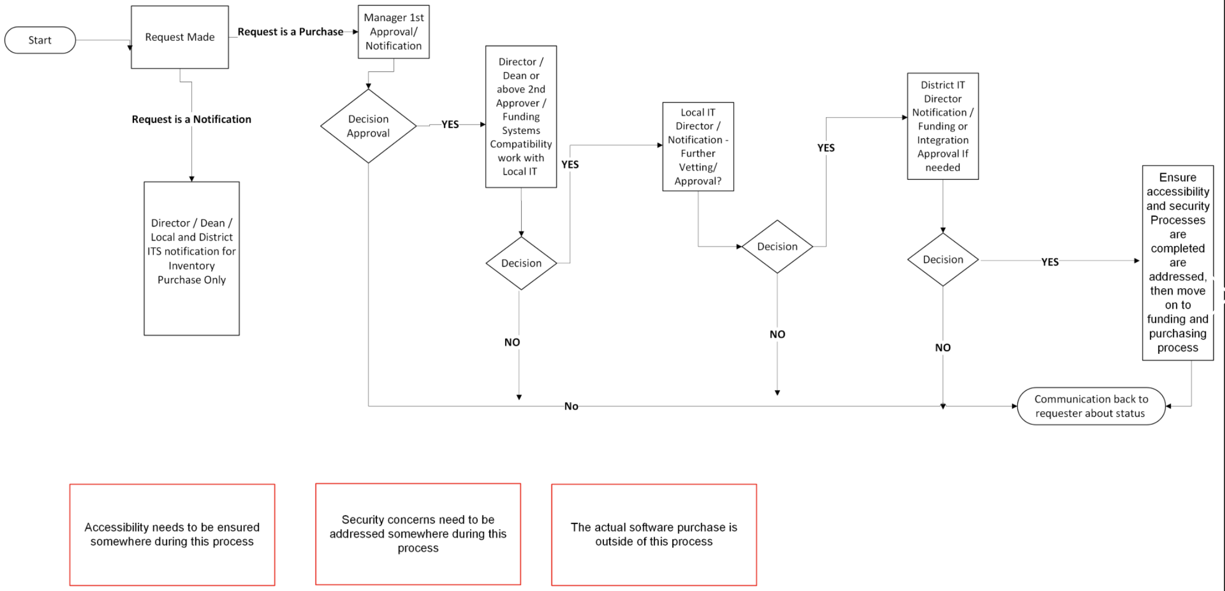
6. Discussion Items (First Reads)
6.4. Software Approval Diagram Flowchart
Pablo Martin (10 mins)

Slide 17
6. Discussion Items (First Reads)
6.5 SDCCD’s Commitment to Free Speech and Academic Freedom
Rodrigo Gomez (5 mins.)
Board Policy 3050 – Civility and Mutual Respect
Boart of Trustees Resolution Supporting Academic Freedom

Slide 18
6. Discussion Items (First Reads)
6.6. Student Equity Plan 2025-2028
Neesa Julian (5 mins.)
Student Equity Plan Executive Summary

Slide 19
6. Discussion Items (First Reads)
6.7. Faculty Contract Hiring List Presentation
Mary Kjartanson (10 mins.)

Slide 20
6. Discussion Items (First Reads)
6.8. Miramar AI Working Group
Rodrigo Gomez (10 mins.)
MAIN Community of Inquiry/Practice Slides
Miramar College has been a leader in the AI in Education conversation since it started. We are the only college currently with an AI Resolution. In the absence of specific professional development related to AI, I propose the creation of a Miramar working group on AI.
AI Policies & Guidelines
Miramar AI Guidelines Draft

Slide 21
7. Reports
7.1. Committee Reports
7.1.1. Faculty Technology Liaison Report– Pablo Martin (10 mins)
Please see the following Technology Report

Slide 22
7. Reports
7.2. No Special Reports

Slide 23
7.3: Executive Committee Reports
7.3.1: President’s Report
The bulk of this report can be found in the SDMC Academic Senate Resource Doc for today’s meeting. If you have questions that you don’t ask today, I’m available for further discussion via email, face-to-face, or Zoom meetings.
You can also invite me to your department meetings. (Past resource documents can be found on the specific web page created for each A.S. meeting.)

Slide 24
7.3: Executive Committee Reports
7.3.1: President’s Report
1. Adjunct Faculty Shared Governance Funds:
Working with and upon the recommendation of AFT President Jim Mahler, the four A.S. Presidents agreed that each college would receive 110 hours for the fall 2025 semester at the rate of $50/hour.
The rate of pay will increase if the total number of hours submitted is less than 440 hours across the district.
I’ve reviewed my options and created this document to break down the hours that will go to AS & other adjunct governance roles at Miramar.

Slide 25
7.3.1: President’s Report (cont.)
2. AP7211 – Voted down at Miramar College. However, Mesa College has requested an update on our position and looking for the edits that we would like to see to approve it.
The issue had to do with “Chairs” specifically. Original | Updated Version
Faculty Discipline Expert Committee (FDEC) language:
Each college will establish its own Faculty Discipline Expert Committee (FDEC) on an as needed basis. The FDEC will include at least two discipline experts with adequate academic and/or professional experience. The Department Chair and/or Area Dean may also be part of the committee. Upon receipt of an applicant’s Application for Equivalency Determination, the FDEC shall review the submission.

Slide 26
7.3.1: President’s Report (cont.)
State:

Slide 27
7.3.3-8 Executive Committee Reports
Vice-President – Carmen Carrasquillo
Secretary – Olivia Flores
Treasurer – Dawn Diskin (please see the following slide)
Contract Member-at-Large – Kristin Everhart
Contingent Faculty Member-at-Large – Melissa Wolfson
Chair of Chairs – Mary Kjartanson

Slide 28
Report 7.3.4: A.S. Treasurer
Please considering enrolling in auto-payroll deduction for a nominal amount per check. Contributions of $2.00 per check make a difference to our students in funding our scholarships and other necessary needs.
Current Balance = $1,101.07

Slide 29
8. Announcements
1 min. time limit each

Slide 30
7.3.3-8 Executive Committee
Your 2025-26 A.S. Executive Committee
President –Rodrigo Gomez
Vice-President – Carmen Carrasquillo
Secretary – Olivia Flores
Treasurer – Dawn Diskin
Contract Member-at-Large – Melissa Wolfson
Contingent Faculty Member-at-Large – Kristen Everhart
Curriculum Chair – Veronica Hartmann
Chair of Chairs – Mary Kjartenson

Slide 31
If the calendar was approved earlier, the first meeting of the 2025-26 SDMC Academic Senate is: Tuesday, October 21, 2025 from 3:30-5:00 pm in M-110 and on Zoom. Senators wishing to attend remotely can learn more via the A.S. Senator Remote Attendance Form. Senators wishing to change their attendance to in person should contact rgomez001@sdccd.edu.
9. Adjournment

