Slide 1
Protection of the Brain
The Skull
Cranial Meninges
Cerebrospinal Fluid
Blood-Brain Barrier

Slide 2
Cranial Meninges - 3-layer protective membrane
1. Dura Mater - Composed of two layers:
a) Periosteal (Endosteal) – outer layer attaches to bone.
b) Meningeal – inner layer, closer to brain.
(These two layers fused, except to enclose the dural sinuses)
Composed of dense irregular connective tissue.
2. Arachnoid Layer - ‘spider’ web-like layer.
Composed of loose/fibrous connective tissue.
3. Pia Mater - delicate, follows convolutions.
Composed of an outer collagen layer, & inner epithelial elastic and reticular fiber layer.

Slide 3
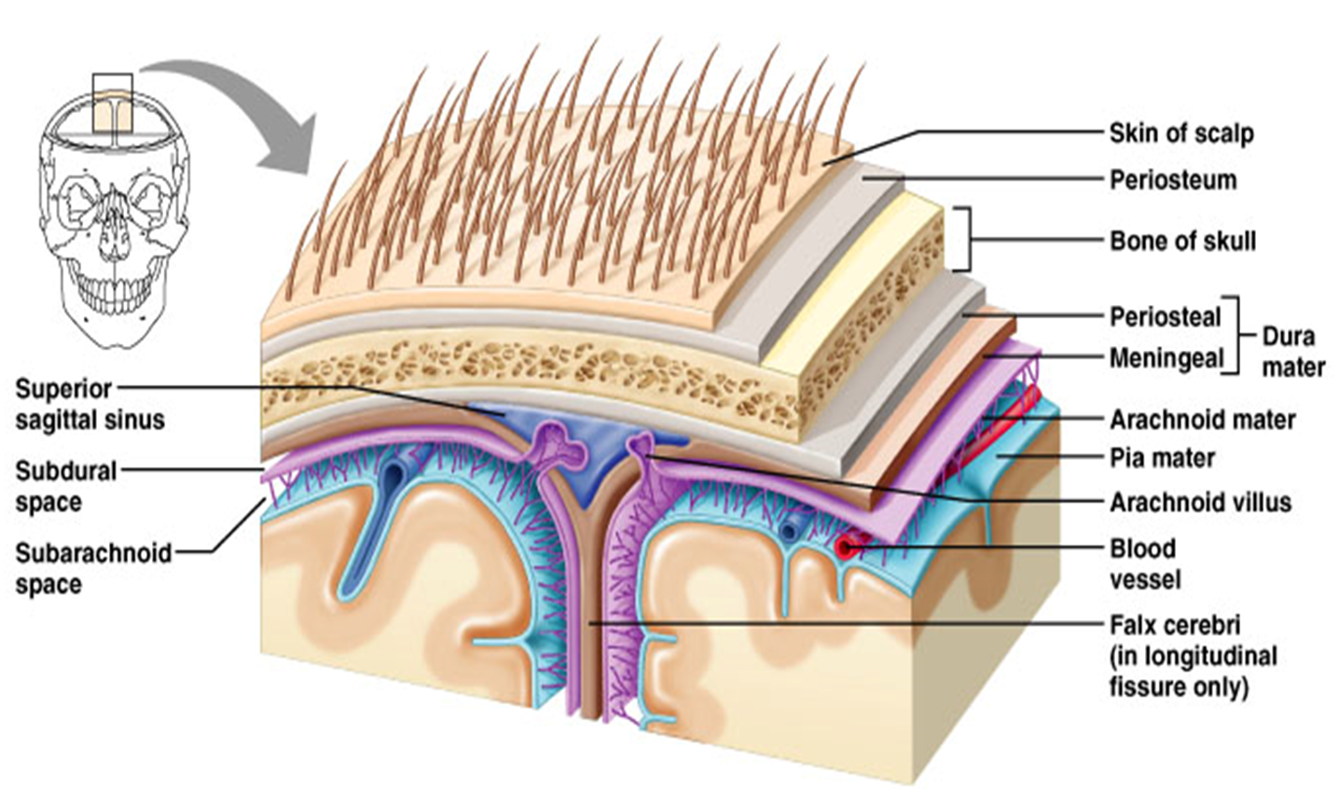
The Arrangement of the Cranial Meningeal

Slide 4
Cranial Meningeal Spaces
Epidural space
Potential space superior to dura mater.
Subdural space
Potential space between dura & arachnoid mater.
Subarachnoid space
Filled with CSF
Contains the blood vessels supplying brain.

Slide 5
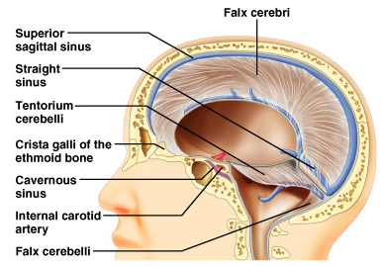
The Sinuses = Large Veins (in cardiovascular system)

Slide 6
Cerebrospinal Fluid (CSF)
Roles of CSF:
1. Cushions and insulates delicate nervous tissue.
2. Gives Buoyancy to the brain (“floats” in CSF).
3. Exchange of gases (O₂ and CO₂), nutrients and
wastes.
*CSF formed in the choroid plexuses in ventricles of brain

Slide 7
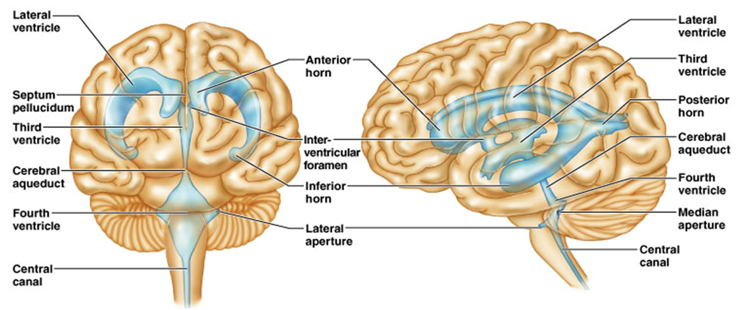
CSF Circulates in:
Chambers, Spaces, and the Central Canal.
Anterior view of Ventricles
Lateral view of Ventricles

Slide 8
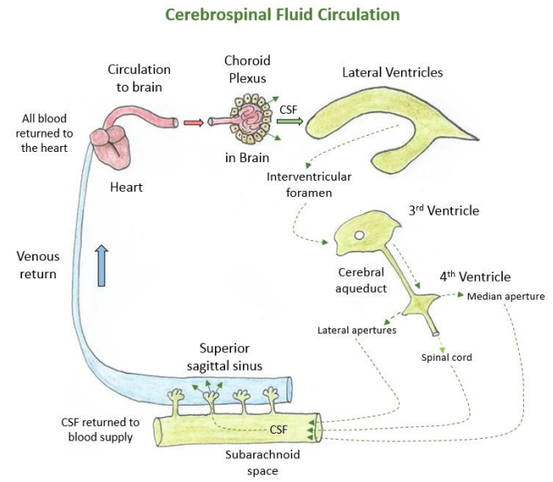
Arachnoid
villi

Slide 9
CSF Circulation

Slide 10
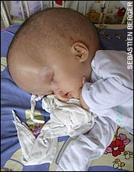
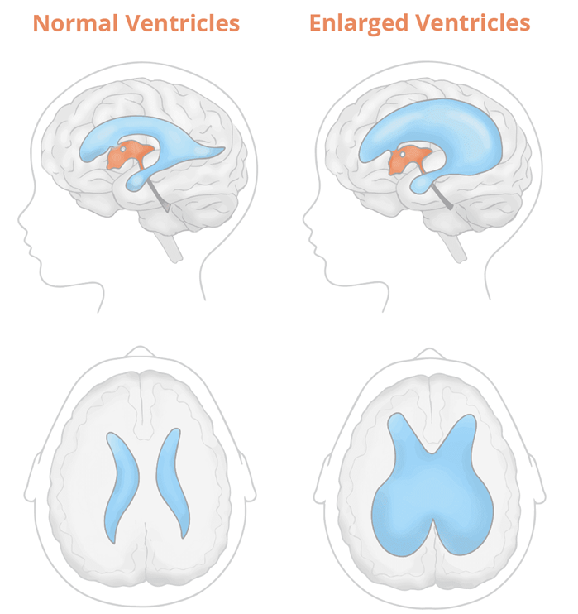
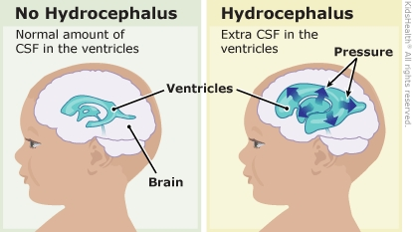
Hydrocephalus

Slide 11
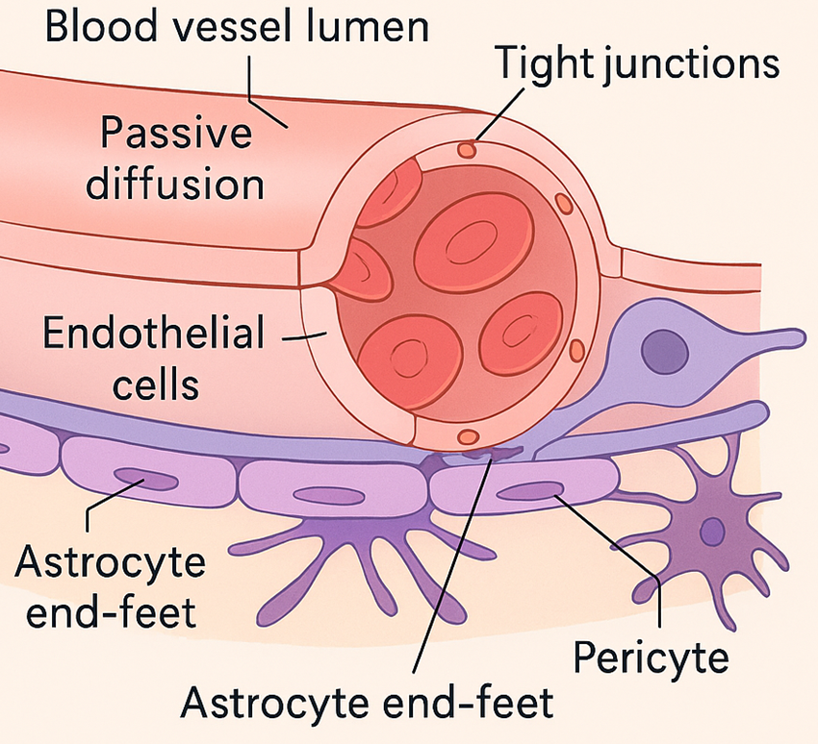
Blood Brain Barrier (BBB)
A restrictive barrier around blood vessels in the brain
(created by astrocytes).
Prevents most blood-borne toxins from entering the brain but not an absolute barrier.
Gases O₂, CO₂, nutrients like glucose can pass. Plus alcohol, nicotine, and anesthetics.
Dopamine? L-Dopa?

Slide 12
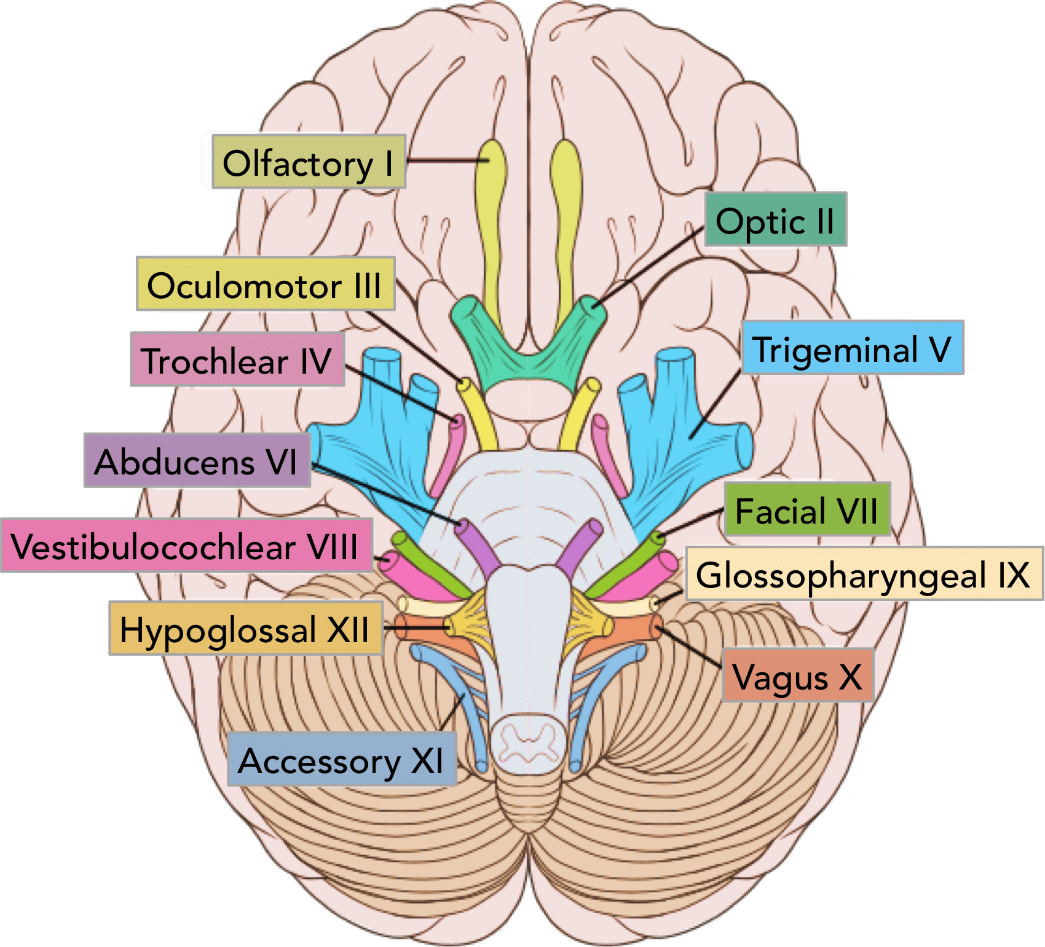
The 12 Pairs of Cranial Nerves
Descriptive Numeric Names

Slide 13
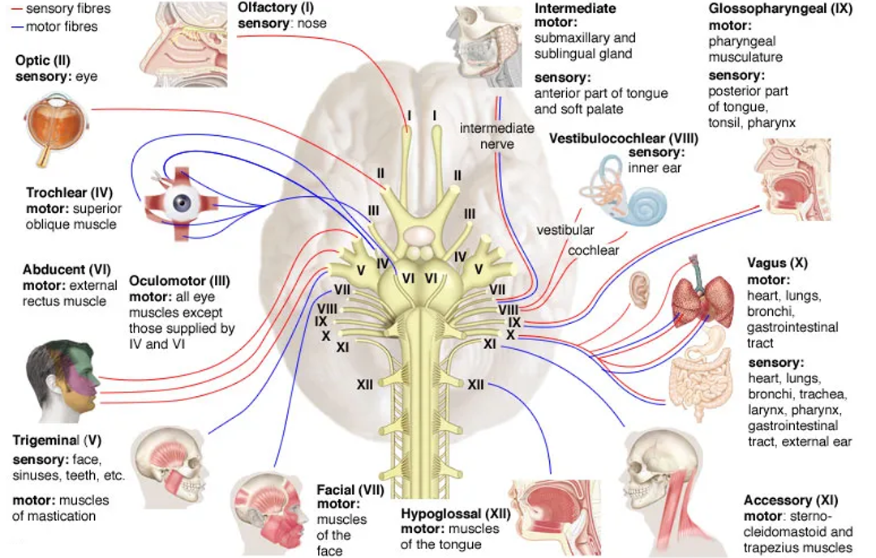

Slide 14
Cranial Nerves | Origins | Innervation | General Functions
Olfactory N. I (s) | Cerebrum, olfactory tract and bulb. From nasal mucosa through the olfactory foramina into olfactory bulb. | The nasal mucosa. | Sense of smell (from nose) to the Temporal lobe for perception.
Optic N. I II (s) | From optic disc enters the skull via optic canal on way to optic chiasm. | Photoreceptors Rods and Cones of Retina. | Transmits visual information from the eyes to occipital lobe for perception.
Oculomotor N. III (m) | From midbrain exits skull and enters orbit via superior orbital fissure. | 4 extrinsic ocular muscles; ciliary muscle, sphincter pupillae muscle. | Controls movement of eyeball. Constriction of pupil. Controls levator palpebrae superioris, and lens.
Trochlear N. IV (m) | From midbrain exits skull and enters the orbit via superior orbital fissure. | Superior oblique muscle of the eye. | For inferolateral rotation (down and out) movement of eyeball.
Trigeminal N. V (b) | From pons, has 3 branches: Ophthalmic N. superior orbital fissure Maxillary N. foramen rotundum Mandibular N. foramen ovale | Muscles and tissues of the head, and face, sinuses, and teeth. | Sensations of forehead, orbits and nose; cheek, upper lip; lower lip, buccal and mandible. Muscles of mastication (chewing).
Abducens N. VI (m) | From pons, exits skull via the superior orbital fissure. | Lateral rectus muscle of the eye. | Abducts the eyeball (looking laterally).

Slide 15
Cranial Nerves | Origins | Innervation | General Functions
Facial N. VII (b) | From pons, leaves brain via stylomastoid foramen. Part of Parasympathetic division. | Facial muscles. Tastebuds, lacrimal and sublingual, submandibular salivary glands. | Muscles of facial expression. Taste for anterior 2/3 of tongue. Generates tears and saliva.
Vestibulocochlear N. VIII (s) | Pons and medulla oblongata, it is incoming from the internal auditory canal. | The inner ear, both the vestibular complex (utricle and saccule); and the cochlear for hearing. | Vestibular branch: Conveys info to the vestibular complex regarding relative position of the head with the body to maintain balance (equilibrium). Cochlear branch: Sends sound info from the inner ear (cochlea) to auditory cortex temporal lobe.
Glossopharyngeal N. IX (b) | Leaves brain from medulla oblongata via jugular foramen. Part of the Parasympathetic division. | Laryngeal and pharyngeal muscles for swallowing; parotid salivary gland. Posterior one-third of tongue. Carotid bodies within the carotid sinus. | Elevates larynx and pharynx when swallowing, dilates pharynx during swallowing and speech. Responsible for ‘gag reflex’. For taste sensation posterior 1/3 of tongue. Detects dissolved gas levels in carotid bodies of carotid sinus.
Vagus N. X (b) | Leave brain from medulla oblongata, exits skull via jugular foramen. Significant (75%) part of the Parasympathetic division. | Acts on the tongue, pharynx, laryngeal muscles that control the voice, the heart, and gastrointestinal system. | Controls thoracic abdominal viscera, laryngeal and pharyngeal muscles. Sensation of epiglottis; regulates heart and digestive tract. Also has gag reflex.
Accessory N. XI (m) | From medulla oblongata and from spinal cord. Exits the skull via jugular foramen. | Sternocleidomastoid and trapezius muscles. Small laryngeal muscles. | For head rotation, flexion, lateral flexion, and extension of head. Plus, elevation of shoulders.
Hypoglossal N. XII (m) | From medulla oblongata, exits brain via hypoglossal foramen. | Intrinsic and extrinsic tongue muscles. | Controls muscles of food mixing, swallowing and muscles of speech, and sound creations in mouth.

Slide 16
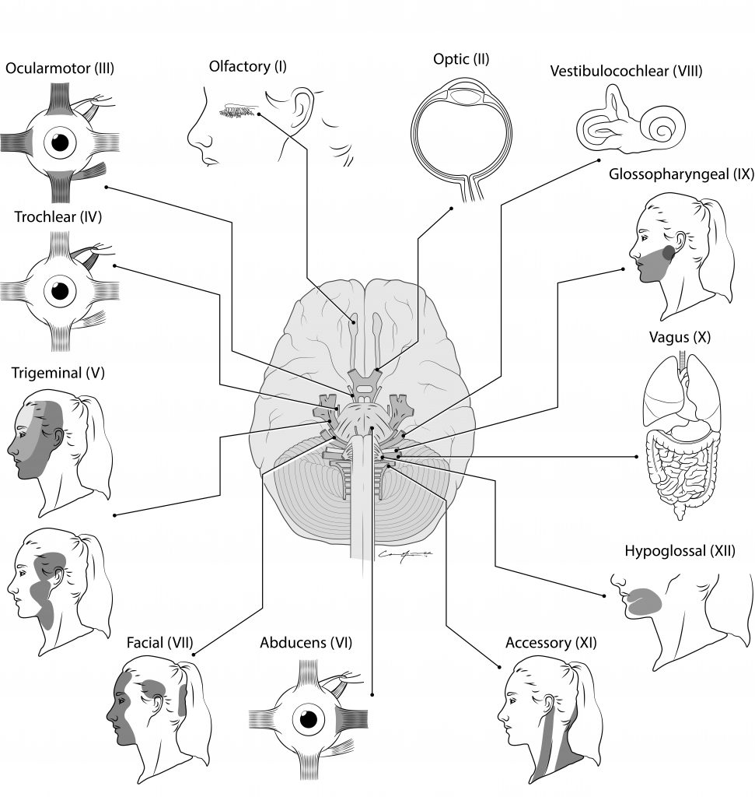
Testing the 12 Cranial Nerves

