Slide 1
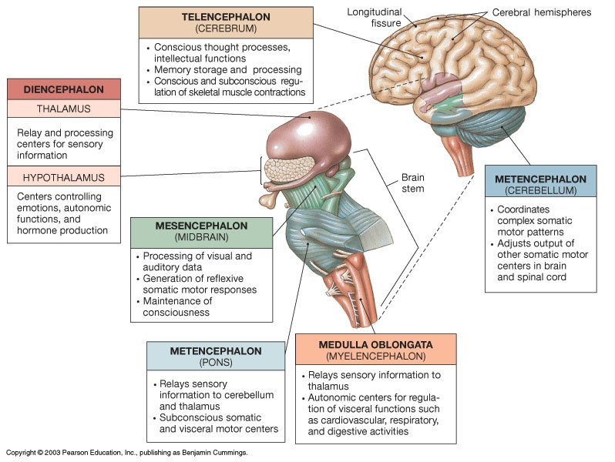
The Brain and
its Regions
①
EPITHALAMUS
②
④
③
⑤
⑥

Slide 2
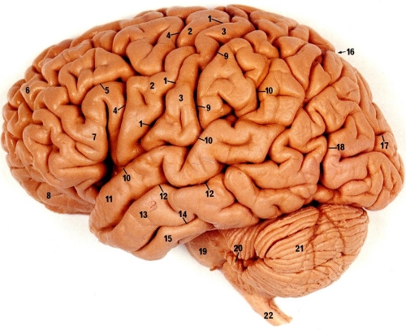
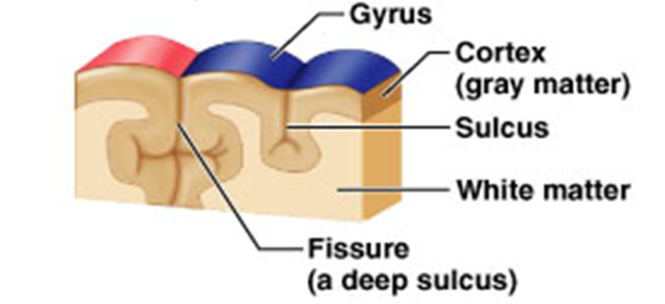
Sulci (sulcus) – grooves on surface of cerebrum.
Gyri (gyrus) – fold of brain tissue between sulci.
Fissure - deep groove, separating hemispheres.
3 kinds of cerebral functional areas
Sensory areas
Association areas
Motor areas

Slide 3
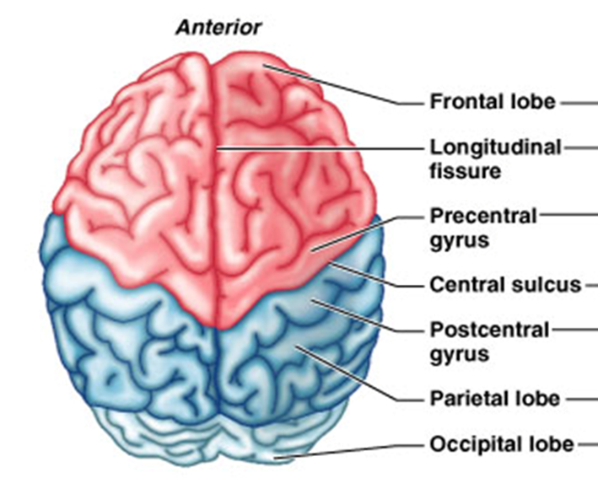
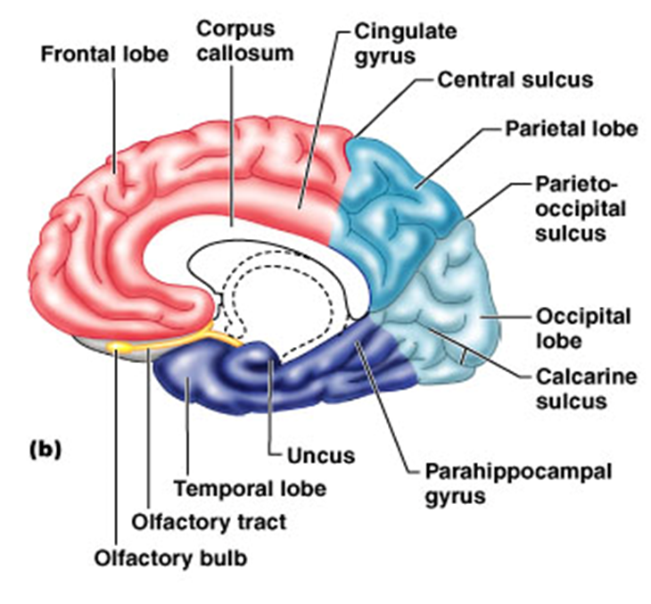
General Anatomy of Cerebrum
Two Hemispheres - Left and Right.
2 significant gyri: Precentral gyrus (motor).
Postcentral gyrus (sensory).

Slide 4
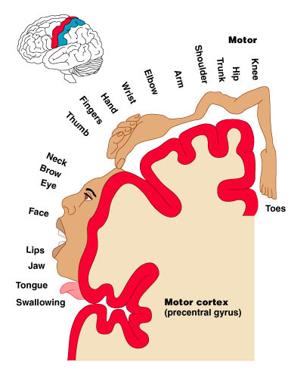
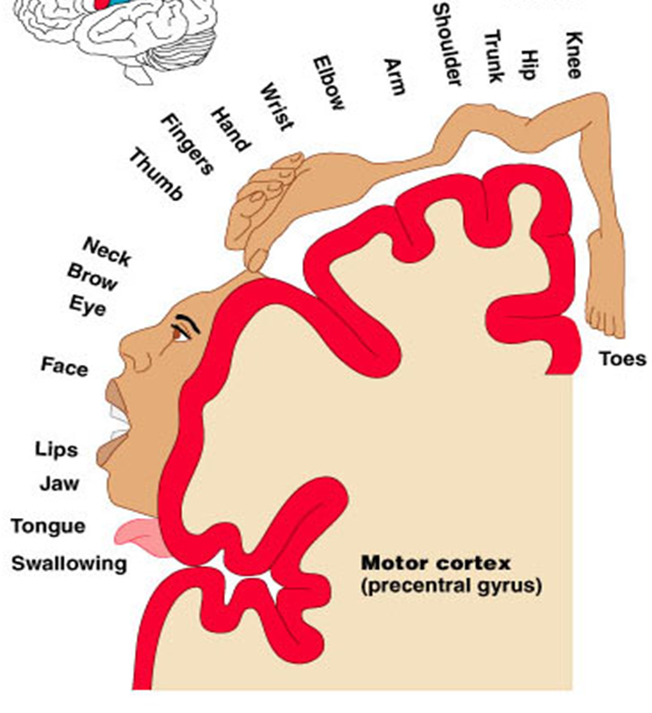
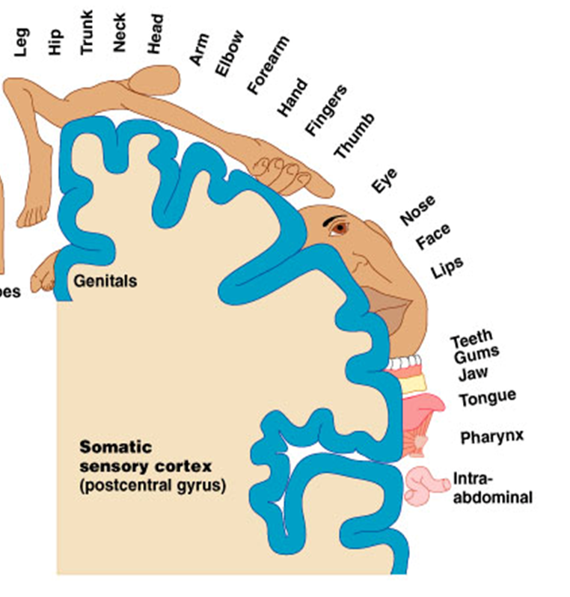
Homunculus - Motor and Sensory

Slide 5
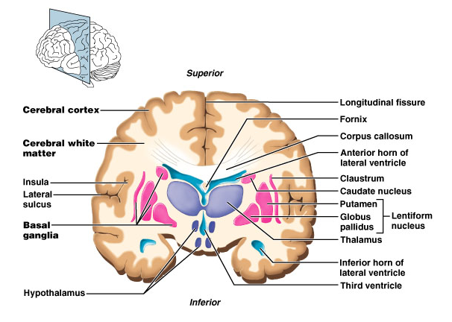
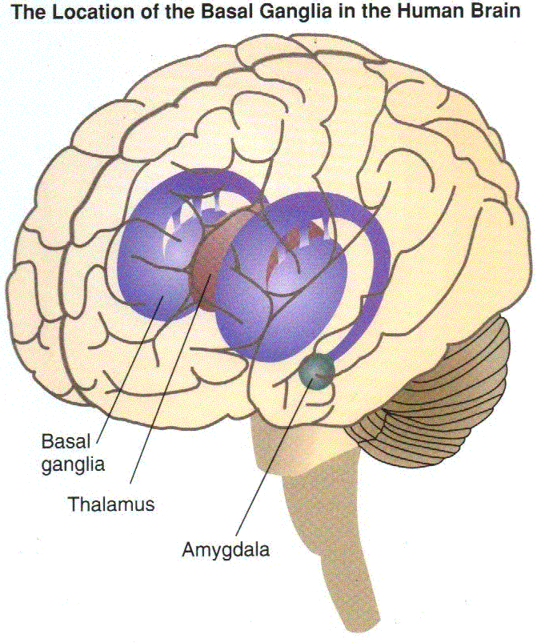
Cerebral (Basal) Nuclei
Consists of 5 pairs of Nuclei
1. Caudate nucleus
2. Putamen
3. Globus pallidus
4. Subthalamic nucleus
5. Substantia nigra
The cerebral (basal) nuclei are groups of subcortical nuclei deep within white matter.
Key Role: Primarily to fine-tune voluntary body movements.
Process/signal from cerebral cortex -> conveys instructions to thalamus -> then relays back to cortex, -> finally sends to skeletal muscles via tracts of the pyramidal motor system.

Slide 6
Functions of the Cerebrum
In General - our conscious mind, enables us to:
Be aware of ourselves and sensations.
Initiate and control voluntary movements.
Speak, communicate, reason, remember, predict and understand.
Cerebrum has 5 Lobes
Frontal Lobe - memory, planning, emotional and behavior regulation, language (impulse control), personality, voluntary body movement.
Parietal Lobe - somatic sensory perception, spatial awareness.
Temporal Lobe - auditory and olfactory perception. Language & emotions.
Occipital Lobe - visual perception, visual memory.
Insula Lobe - visceral perception, fear and empathy, gustatory cortex.

Slide 7
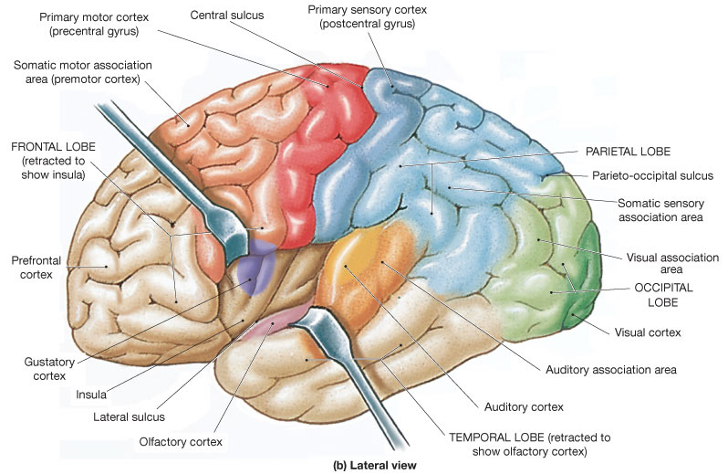
Cerebral Lobes

Slide 8
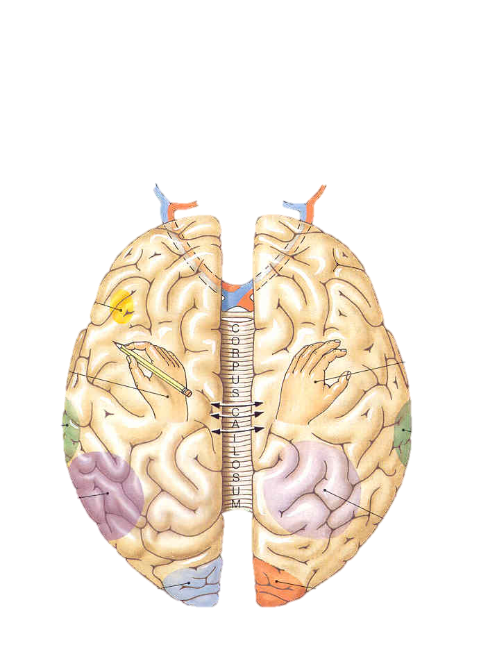
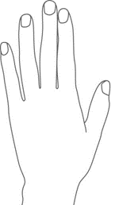
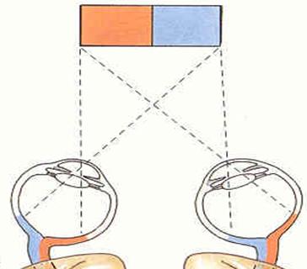
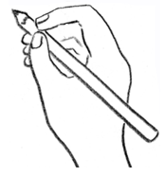
Broca’s area
Prefrontal cortex
Prefrontal cortex
Speech
center
Writing
(right-handed)
Analysis
by touch
Auditory cortex
(right ear)
Auditory cortex
(left ear)
Wernike’s area
General interpretive center (language and math)
Spatial visualization
and analysis
Visual cortex
(right visual field)
Visual cortex
(left visual field)
Left
Hemisphere
Right
Hemisphere
Decussation: A crossing of nerve fibers from one side of the CNS to the other.

Slide 9
The Limbic System = “Emotional Brain”
Disparate (dispersed) Anatomical Location
(within cerebral and diencephalon)
Includes: Cingulate gyrus, hippocampus and amygdala. The fornix connects the 2 hemispheres of limbic system.
Cingulate gyrus
Allows us to shift between thoughts.
Interprets pain as unpleasant.
Amygdala
Detects menacing glances from others.
Emotional recognition of faces.
Hippocampus
Consolidation of new memories (storage & retrieving)
Navigation and Spatial Orientation.

Slide 10
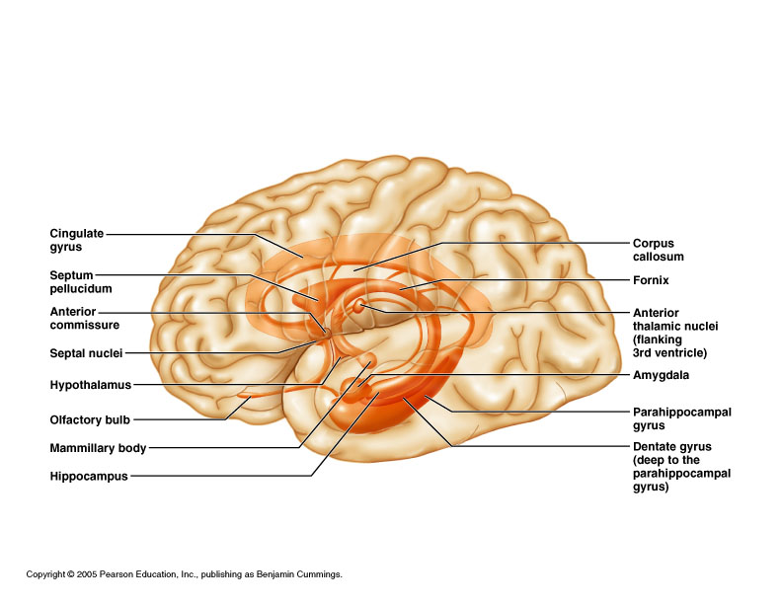
Anatomical Structures of the Limbic System

Slide 11
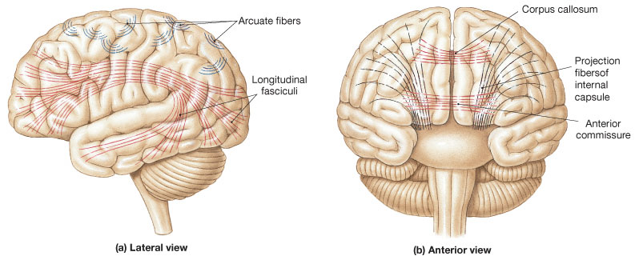
The major groups of axon fibers and tracts
of the central white matter.
a) Association Fibers
b) Commissural Fibers
c) Projection Fibers

Slide 12
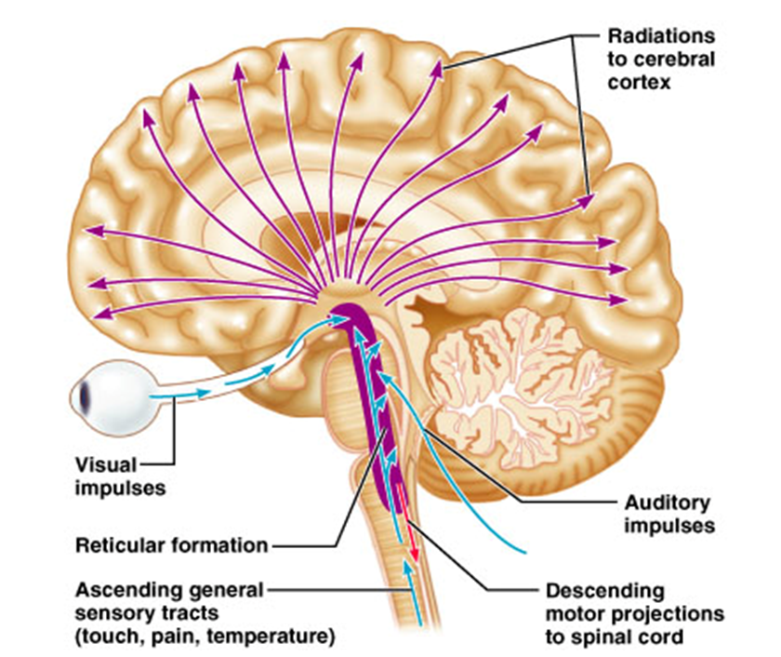
The Reticular System - widespread connections, ideal for arousal of the brain as a whole.
The Reticular
Activating
System (RAS)
Maintains consciousness
and alertness.
Functions in sleep and
arousal from sleep.
Pons and MO

Slide 13
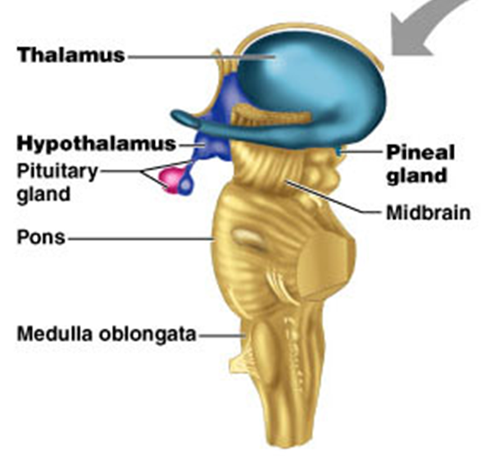
Regions below the Cerebrum
②
Diencephalon
= 1) Epithalamus, 2) Thalamus and 3) Hypothalamus
1) Epithalamus
- Includes the pineal gland (body).
Secretes hormone melatonin, under
influence of the hypothalamus.
Note: The significant Blue Light emitted from tv, computer and phone screens blocks the hormone melatonin, therefore suppressing your body's ability to prepare for sleep.
*Dimethyl-tryptamine (DMT) is also released from Pineal gland.

Slide 14
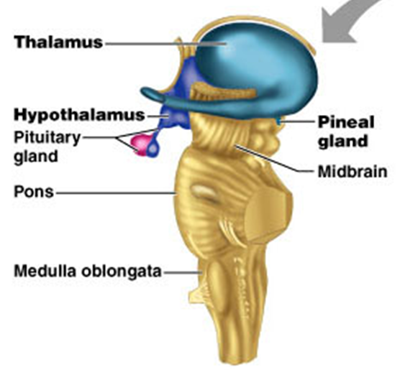
2) Thalamus
Makes up 80% of the diencephalon.
Nuclei organize and amplify
or tone down signals.
Afferent impulses
converge on thalamus.
Many thalamic nuclei act as the “gateway” to cerebral cortex for sensory input.
What is the 1 Sensory exception?

Slide 15
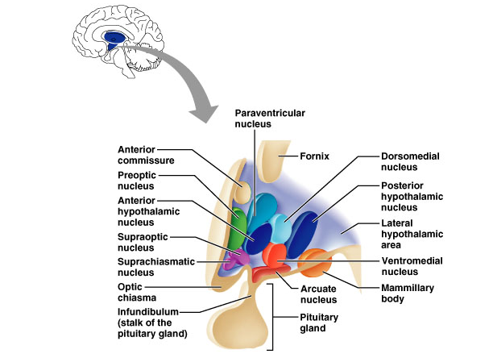
3) Hypothalamus
Main visceral control center of the body
Adrenal gland
T_{b} and Sexual
Dimorphism
Heart Rate and BP
Shivering
Sweating
Thirst and
Hunger
Posterior
Pituitary
Satiety
Circadian
rhythms
Olfaction and
Memory
Feeding

Slide 16
Functions of the Hypothalamus
1. Regulation of body temperature (T_{b})
(Nuclei: body thermostat, sweating, shivering)
2. Regulation of hunger and thirst sensations
(Nuclei: Feeding, satiety, thirst)
3. Regulation of sleep-wake cycles
(Nuclei: Circadian rhythms/melatonin release)
4. Control of the Endocrine System
(Nuclei: Controlling endocrine glands)
5. Controls Autonomic Nervous System (ANS)
(Nuclei: Heart rate and blood pressure)
Overall: Controls many important behaviors via emotional responses and formation of memory => Limbic system and the ANS.

Slide 17
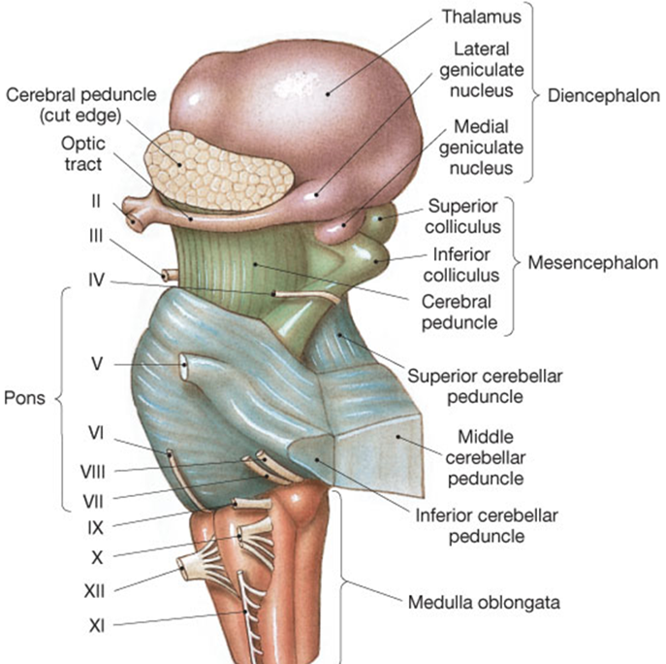
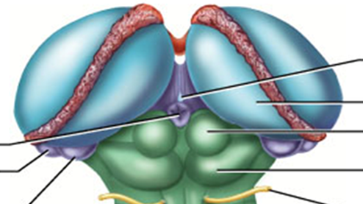
③
Midbrain
Substantia nigra
(black substance)
Relay to Skeletal Muscle
Corpora quadrigemina
(‘four bodies’, 2 pairs)
Superior colliculi
=> nuclei that act in visual reflexes.
Inferior colliculi
=> nuclei that act in auditory reflexes.

Slide 18
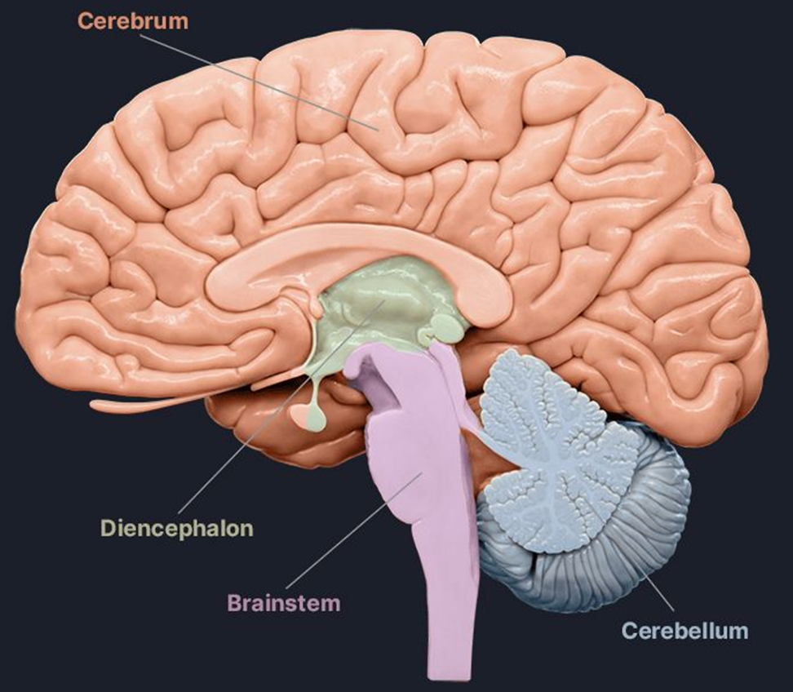
The Brain Stem = Midbrain, Pons and Medulla Oblongata
Corpus
callosum
①
Fornix
Parietooccipital sulcus
②
③
④
⑤
Arbor
vitae
Folia
⑥
Vermis
The cerebellum has 2 hemispheres connected by the vermis

Slide 19
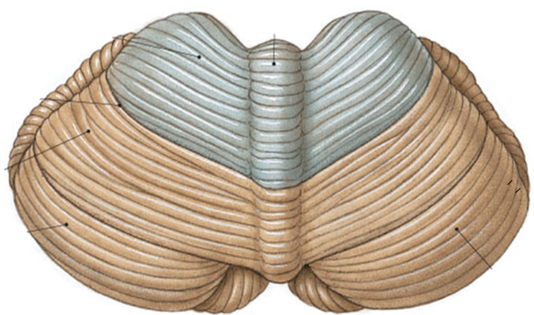
Functions of Cerebellum
Located dorsal to the pons and medulla
1) Controls postural reflexes:
Coordinates rapid, automatic adjustments of muscles in body to maintain equilibrium.
2) Produces skilled movements:-
Implements complex actions for fine tuned movements and refines learned routines until action becomes routine.

Slide 20
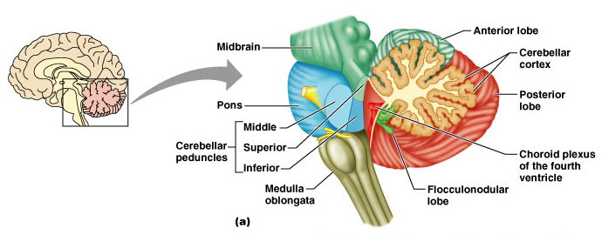
The Superior, Middle and Inferior Cerebellar Peduncles
Tracts connecting Cerebellum to Brainstem and Cerebrum
Superior - carries outgoing motor commands (+ sensory) info up to midbrain & thalamus.
Middle - relays vast amounts of incoming info from cerebrum to cerebellum.
Inferior - transmits sensory info from the body and spinal cord to the cerebellum, particularly for posture and balance.

Slide 21
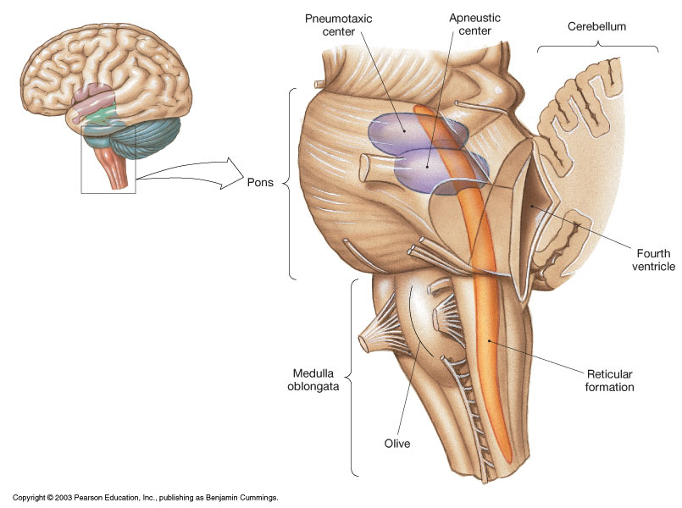
Pons
* Contains the pontine
respiratory centers.
⑤
* Contains the nuclei
of cranial nerves
V, VI, and VII

Slide 22
The Medulla contains:
Much of the reticular formation
Nuclei influence autonomic functions
⑥
Vital centers of MO:
1) Cardiac Control Center
2) Respiratory Control Center
3) Vasomotor Control Center
Also contains centers for hiccupping, sneezing,
swallowing, vomiting and coughing.

