Slide 1
Can faculty afford full time work at SDCCD?
Irena Stojimirovic, PhD
Physics and Astronomy Professor
Mesa College Physical Sciences Dep. Co-Chair istojimi@sdccd.edu

Slide 2

Prof. Joseph Martinez, San Diego Mesa College’s
first - and only - tenure track Hispanic physics faculty member.
The failure of the current contract faculty compensation
structure and its consequences is illustrated by his story.

Slide 3
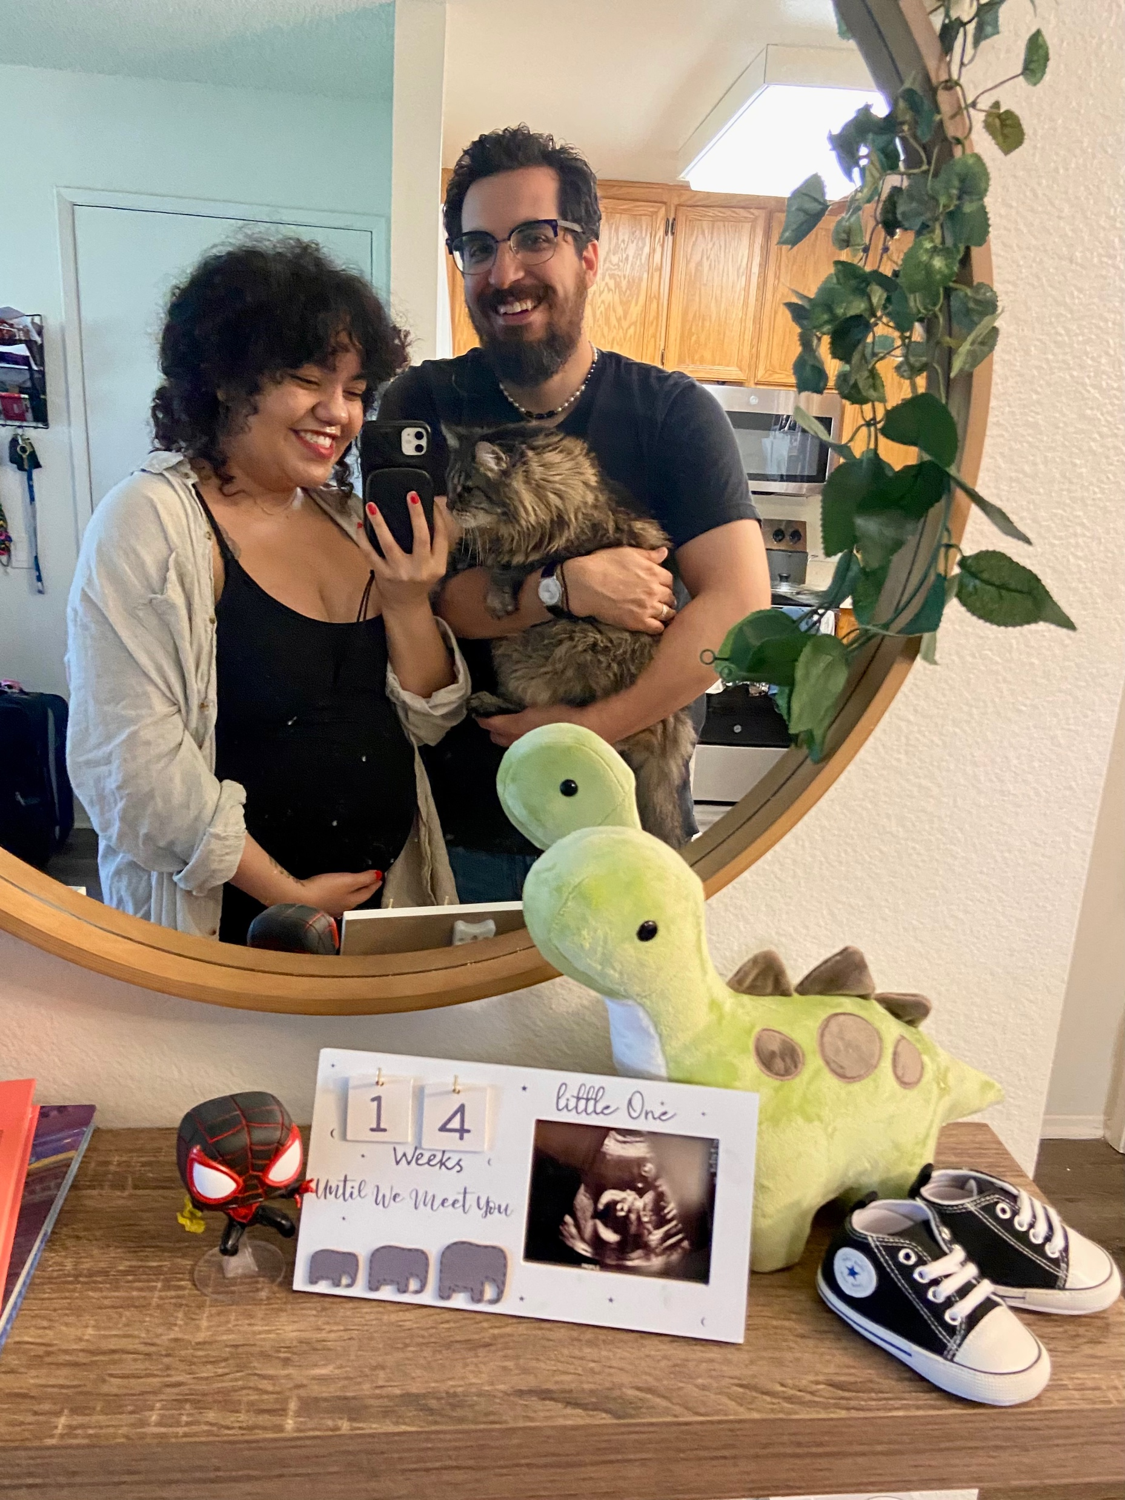
SoCal native, MS in Physics from UC Irvine.
Valued by everyone. Open to feedback, collaborative approach, showed continued growth. Taught well and could teach a wide variety of physics classes. Innovative mastery grading. Great asset for the department.
In his office 8—5 every day, door wide open, working with anyone who needed help. Students’ evaluations praised support and availability.
Started STEM BookClub that was super popular.
Great communicator, very thoughtful and considerate. Bakes great holiday cookies.

Slide 4


While Joseph was a faculty at Mesa College, his rent increased more than his salary – stayed at $69,334.
He had to downsize to a one bedroom place with his wife. Was considering downsizing to a studio.
After first year he started looking for another job – CC in Victorville paid more than Mesa.
Joseph left and now has the same job but with $37,000 extra at Chaffey with significantly lower cost of living.
This is more than 50% higher salary than at Mesa.
Credit for teaching experience + higher salaries.

Slide 5
Salary Comparison (out of 72 colleges)
 | MA +0 years | MA + 5
2017 | 36 | 55
2018 | 42 | 60
2019 | 47 | 61
2020 | 52 | 63
2021 | 54 | 63
2022 | 55 | 65
2023 | 60 | 64
Out of 72 colleges in CA, SDCCD pay for their incoming faculty with an MS degree lower than 83% of schools. With 5 years of experience teaching, SDCCD pay ranks lower than 89% of other colleges.
https://www.cft.org/faculty-salary-comparisons
STEM faculty from historically underrepresented groups are more likely to enter the classroom without a doctorate, often due to systemic barriers in higher education.

Slide 6
Department of Labor Statistics for physicists
Percentile | 10% | 25% | 50% | 75% | 90%
Hourly | 38.92 | 54.14 | 74.85 | 89.58 | 111.99
Annual | 80,950 | 112,610 | 155,680 | 186,330 | 232,940
Last available data for 2023

Slide 7
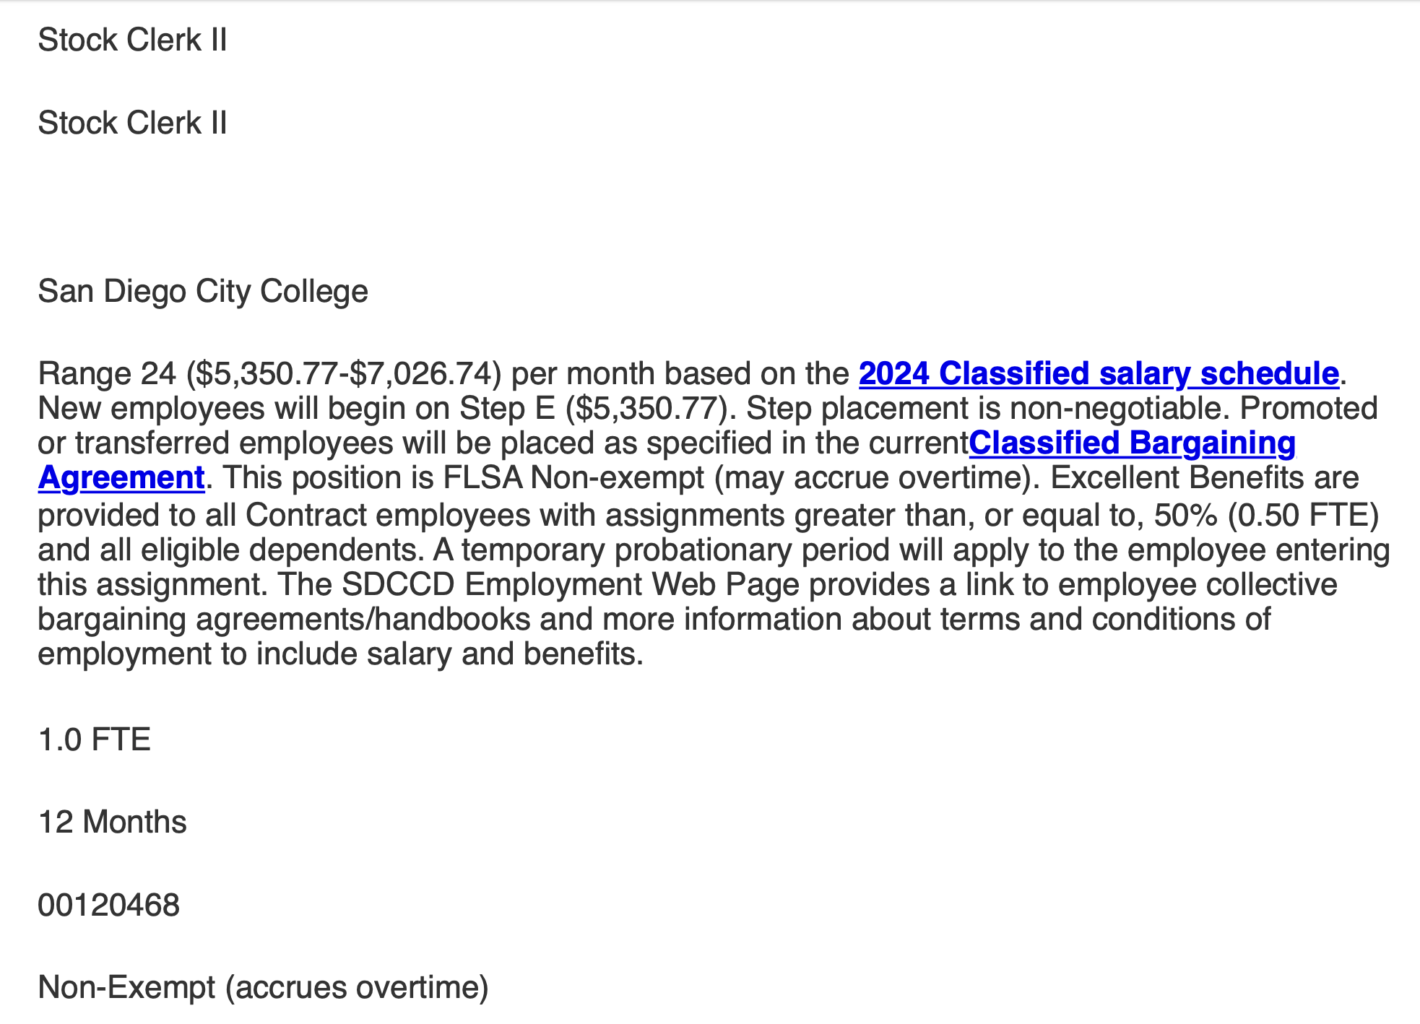
Qualifications for the job – high school diploma, no experience
Annual compensation: 5,350.77X12=$64,209.24
Living wage – entry salary

Slide 8
 | 1 | 2 | 3 | 4 | 5 | 6 | 7
A | $6,248.85 | $6,567.28 | $6,895.64 | $7,240.42 | $7,602.44 | $7,982.57 | $8,381.70
B | $6,420.68 | $6,747.88 | $7,085.27 | $7,439.53 | $7,811.51 | $8,202.09 | $8,612.19
C | $6,597.26 | $6,933.44 | $7,280.12 | $7,644.12 | $8,026.33 | $8,427.64 | $8,849.03
D | $6,778.70 | $7,124.11 | $7,480.32 | $7,854.34 | $8,247.05 | $8,659.40 | $9,092.38
E | $6,965.11 | $7,320.03 | $7,686.03 | $8,070.33 | $8,473.85 | $8,897.54 | $9,342.42
F | $7,156.65 | $7,521.33 | $7,897.39 | $8,292.26 | $8,706.88 | $9,142.22 | $9,599.33
G | $7,353.46 | $7,728.16 | $8,114.57 | $8,520.30 | $8,946.32 | $9,393.63 | $9,863.31
H | $7,555.68 | $7,940.69 | $8,337.72 | $8,754.61 | $9,192.34 | $9,651.96 | $10,134.55
I | $7,763.45 | $8,159.06 | $8,567.01 | $8,995.36 | $9,445.13 | $9,917.39 | $10,413.25
J | $7,976.96 | $8,383.43 | $8,802.60 | $9,242.73 | $9,704.87 | $10,190.11 | $10,699.62
K | $8,196.32 | $8,613.98 | $9,044.67 | $9,496.91 | $9,971.75 | $10,470.34 | $10,993.86
L | $8,421.71 | $8,850.86 | $9,293.40 | $9,758.07 | $10,245.98 | $10,758.28 | $11,296.19
M | $8,653.31 | $9,094.26 | $9,548.97 | $10,026.42 | $10,527.74 | $11,054.13 | $11,606.84
N | $8,891.28 | $9,344.35 | $9,811.57 | $10,302.15 | $10,817.25 | $11,358.12 | $11,926.02
O |  |  |  | $10,585.46 | $11,114.73 | $11,670.47 | $12,253.99
P |  |  |  |  |  | $11,991.40 | $12,590.97
Q |  |  |  |  |  | $12,321.17 | $12,937.23
R |  |  |  |  |  | $12,660.00 | $13,293.00
S |  |  |  |  |  | $13,008.15 | $13,658.56

Slide 9
Summary from 9/9 AFT Meeting
Currently ~55% allocated to faculty salaries from RAF.
Proposals can be made but not without another group taking a smaller allocation.
Example of proposed idea: revised salary schedule based on promotion vs taking PD courses
Jim: Faculty can ask for a bigger allocation but must be prepared to really fight for it – i.e. go on strike
Unresolved question: How is Palomar making it work? With MQ they start at $77k and 40 steps, caps at $141k

Slide 10
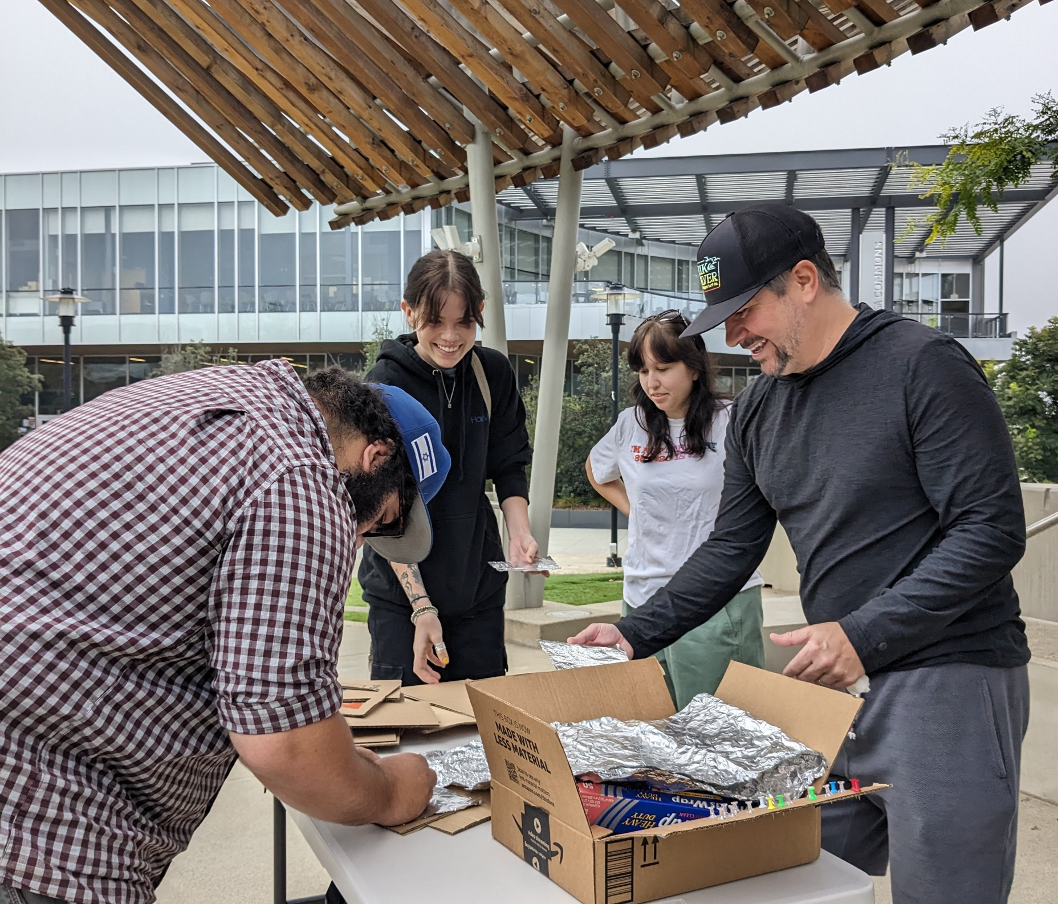
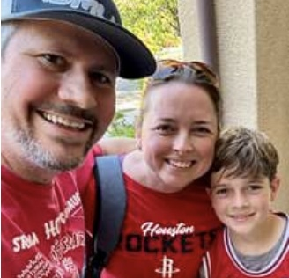
Retention crisis and an equity failure – more case studies
Our recently hired Astronomy faculty – Prof. Walter Thompson
Holds a MS degree in Astrophysics from John Hopkins University
17 years of experience as a full-time community college professor and honors program coordinator.
Despite his extensive experience, he started at 69k.
His starting salary was about 10% lower than at his previous position in Houston, cost of living in San Diego is about 60% higher.
Moved to SD because of his wife’s biotech job.

Slide 11
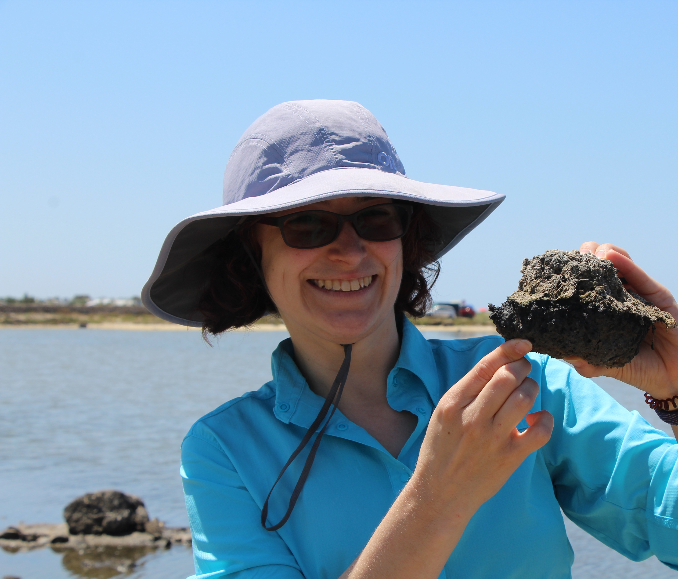
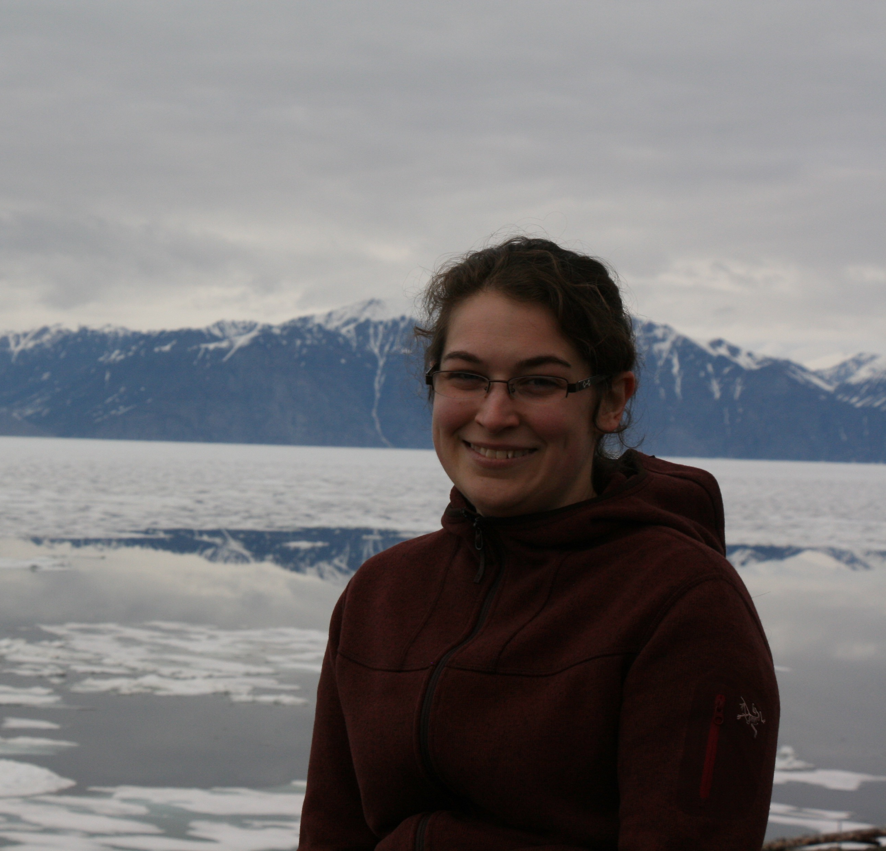
Retention crisis and an equity failure – more case studies
Our recently hired Geology faculty – Dr. Ashley Manning Berg
Mesa’s first female geology faculty.
5 years of experience as a full-time University professor and many more years of teaching.
Ashley moved from Chattanooga, TN where the cost of living is 64% lower. She started at $88,490 and should have started at $127,000 in San Diego to have an equivalent salary.
Moved to SD to be closer to her husband, geology professor at CC in Orange county.
City College had full time geology faculty position, but husband didn’t apply because he would take a $40k pay cut.

Slide 12
Retention crisis and an equity failure – conclusions
The current compensation structure hampers SDCCD's ability to attract and retain qualified STEM faculty, leading to:
Low number applicant pools. We mostly hire faculty who come to San Diego for family reasons.
Reduced diversity among faculty, impacting representation and inclusivity. We have reached the brink of a crisis which, should it continue, would only serve to further homogenize the faculty body. Or have no faculty at all.
Increased faculty turnover, disrupting student learning and program continuity.
Diminished reputation and competitiveness of SDCCD's STEM programs.
Burnout among the remaining faculty from inequitable distribution of administrative tasks, loss of new ideas and perspectives, increased work on hiring committees.

Slide 13
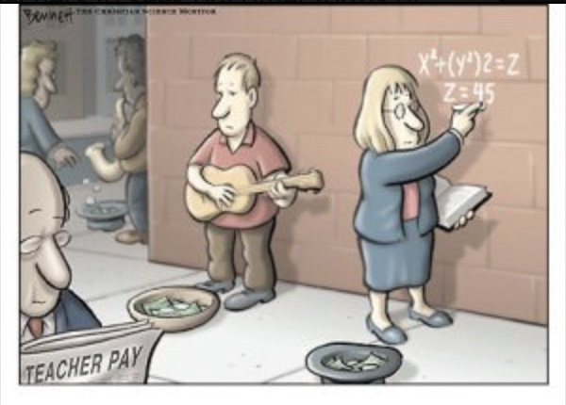
Call to Action
Reevaluate and Adjust the Faculty Salary Scale:
  Ensure that starting salaries for STEM faculty reflect their qualifications, state standards and SD cost of living.
Implement Credit for Prior Experience:
  Recognize and compensate prior teaching and industry experience in salary determinations.
Share your story:
Invitation to the meeting with AFT President Jim Mahler on 9/9 at 4pm in MS 411 at Mesa College.

Slide 14
Retention crisis and an equity failure – more case studies
Prof. Danica Moore – chemistry
Prof. Thu (Tiffy) Nguyen – biology

Slide 15
Salary Increase 2024
 | 1 | 2 | 3 | 4 | 5 | 6 | 7
A | $253.02 | $265.92 | $279.21 | $293.17 | $307.83 | $323.23 | $339.39
B | $259.98 | $273.23 | $286.89 | $301.23 | $316.30 | $332.12 | $348.72
C | $267.13 | $280.74 | $294.78 | $309.52 | $325.00 | $341.24 | $358.31
D | $274.48 | $288.46 | $302.89 | $318.04 | $333.93 | $350.63 | $368.17
E | $282.03 | $296.40 | $311.22 | $326.78 | $343.12 | $360.27 | $378.29
F | $289.78 | $304.55 | $319.77 | $335.76 | $352.56 | $370.18 | $388.69
G | $297.75 | $312.92 | $328.57 | $345.00 | $362.25 | $380.36 | $399.37
H | $305.94 | $321.53 | $337.60 | $354.49 | $372.21 | $390.82 | $410.36
I | $314.35 | $330.37 | $346.89 | $364.23 | $382.45 | $401.57 | $421.64
J | $323.00 | $339.45 | $356.43 | $374.25 | $392.96 | $412.61 | $433.24
K | $331.88 | $348.79 | $366.23 | $384.54 | $403.76 | $423.96 | $445.16
L | $341.01 | $358.38 | $376.30 | $395.11 | $414.88 | $435.62 | $457.40
M | $350.38 | $368.24 | $386.65 | $405.98 | $426.28 | $447.60 | $469.98
N | $360.02 | $378.36 | $397.28 | $417.15 | $438.00 | $459.91 | $482.90
O | $0.00 | $0.00 | $0.00 | $428.62 | $450.05 | $472.56 | $496.18
P | $0.00 | $0.00 | $0.00 | $0.00 | $0.00 | $485.54 | $509.82
Q | $0.00 | $0.00 | $0.00 | $0.00 | $0.00 | $498.90 | $523.85
R | $0.00 | $0.00 | $0.00 | $0.00 | $0.00 | $512.62 | $538.25
S | $0.00 | $0.00 | $0.00 | $0.00 | $0.00 | $526.72 | $553.06

Slide 16
Inverse Salary Increase 2024
 | 1 | 2 | 3 | 4 | 5 | 6 | 7
A | $540 | $523 | $510 | $500 | $492 | $487 | $483
B | $512 | $499 | $489 | $482 | $476 | $472 | $470
C | $488 | $479 | $472 | $466 | $462 | $460 | $458
D | $468 | $461 | $456 | $452 | $450 | $449 | $449
E | $451 | $446 | $442 | $440 | $439 | $439 | $440
F | $436 | $433 | $431 | $430 | $430 | $431 | $432
G | $423 | $421 | $420 | $420 | $421 | $423 | $426
H | $412 | $411 | $411 | $412 | $414 | $417 | $420
I | $402 | $403 | $404 | $405 | $408 | $411 | $415
J | $394 | $395 | $397 | $399 | $402 | $406 | $411
K | $386 | $388 | $391 | $394 | $397 | $402 | $407
L | $379 | $382 | $385 | $389 | $393 | $398 | $404
M | $374 | $377 | $381 | $385 | $390 | $395 | $401
N | $369 | $372 | $377 | $381 | $387 | $392 | $399
O |  |  |  | $378 | $384 | $390 | $397
P |  |  |  |  |  | $388 | $395
Q |  |  |  |  |  | $387 | $394
R |  |  |  |  |  | $386 | $394
S |  |  |  |  |  | $385 | $393

Slide 17
