Slide 1



CRM Implementation Update
September 2, 2025
Notes:
Good Morning – so there is a lot going on with this project, and I’m happy to be sharing an update with you all. This time, I’m going into the weeds a little more to really make sure everyone is aware of the work being done, and the challenges both right now and moving forward.

Slide 2
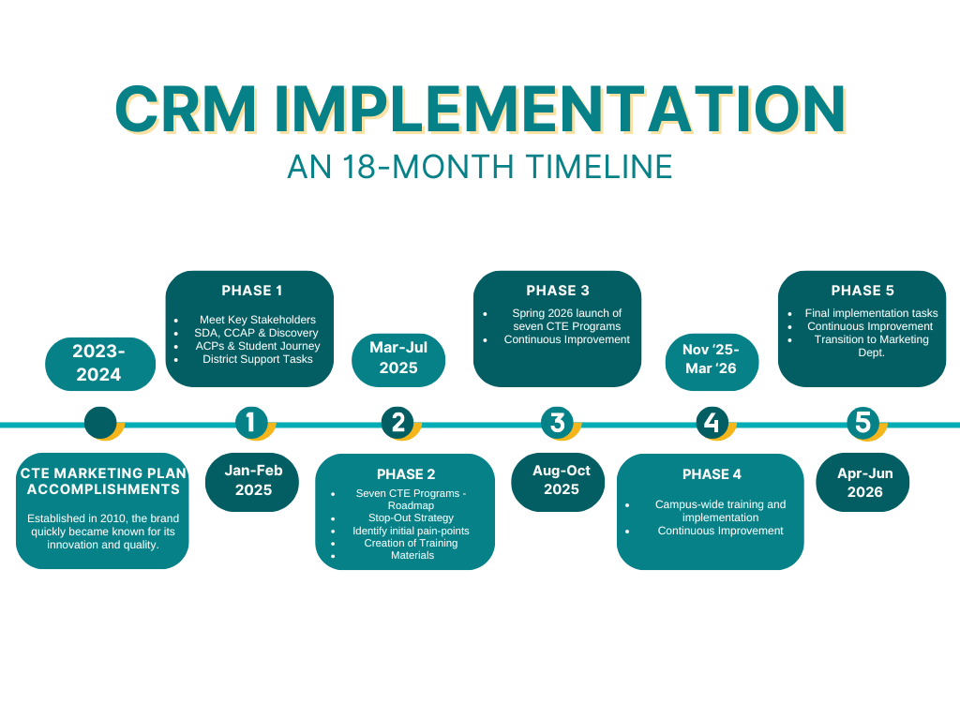
Implementation Update

Slide 3
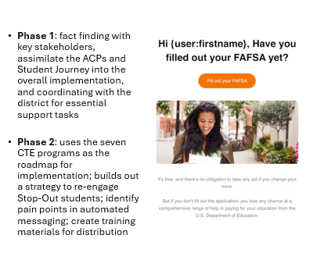
Implementation Update

Slide 4
Implementation Update
Program Communication Campaigns
Program | Campaign Status
Paralegal Studies | Completed
Automotive Studies | Completed
Personal Training | Completed
Yoga Teacher Training | Completed
Communication Studies | Completed
Child Development | Completed
Diesel Technology | Completed

Slide 5
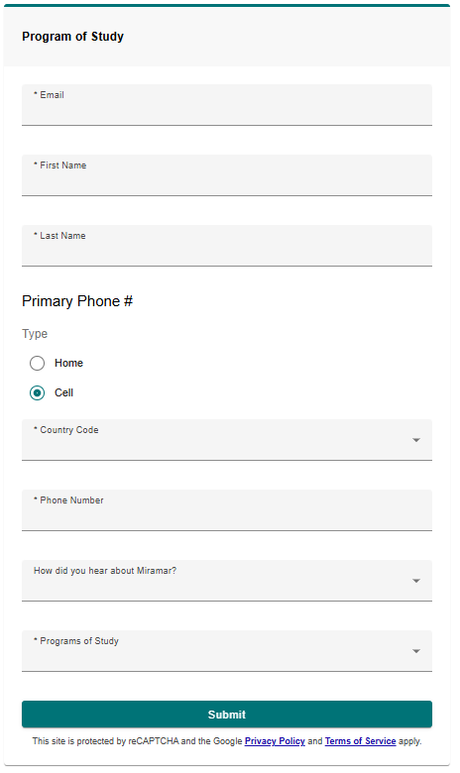
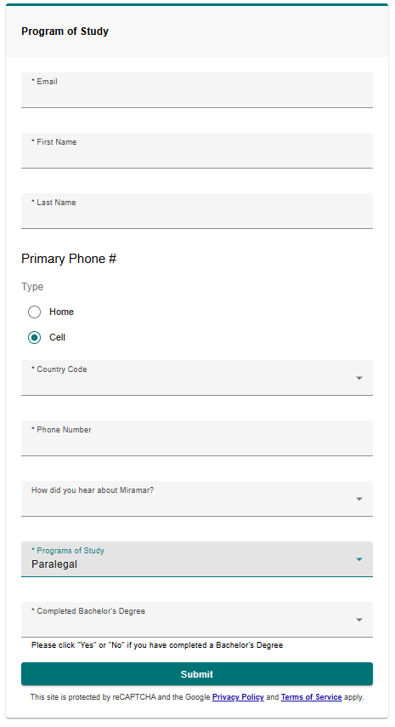
Implementation Update
Smart Form = Smart Time

Slide 6
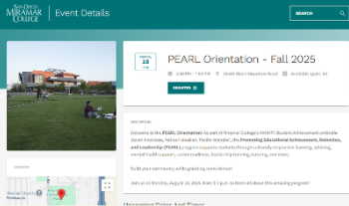
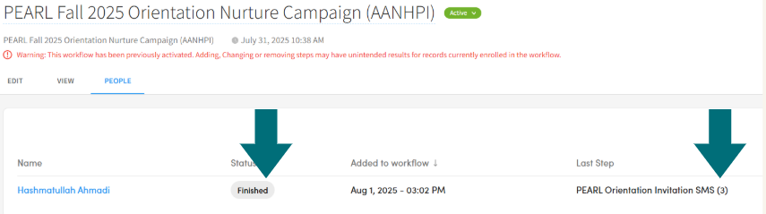
Implementation Update
PEARL Orientation

Slide 7
Implementation Update
Phase 3…
Phase 3 (Aug-Oct): Transition of Ocelot to CRM Chat functions, Finalize FA, LEAD and Counseling integration and begin initial efforts with DSPS, Promise, Veterans and more areas
Continuous Improvement: Identify, document and refine approaches and lessons learned…

Slide 8
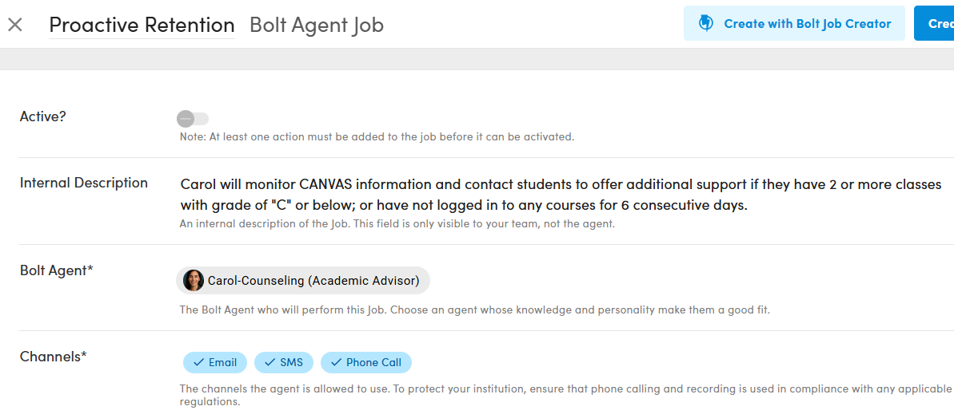
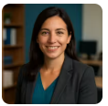

Implementation Update
Retention/Persistence

Slide 9
Implementation Update
Phase 3
(Aug-Oct. '25)
Phase 4
(Nov '25-Mar '26)
Phase 5
(Apr-Jun '26)
Creation of Academic Program Campaigns
Creation of Acadmeic Program Campaigns
Finalize Academic Campaigns
Dept Adoption:
Finalize FinAid & Counseling; begin integration with LEAD Office, C&LDS, Records, DSPS, EOPS, Veterans, Promise and Dreamers
Dept. Adoption:
Athletics, Transfer Ctr, Graduation, Library/Technology Services, Academic Success Ctr, Basic Needs, Bookstore, STEM/MESA, Health Center,Rising Scholars, CalWorks/CARE, Student Affairs
Finalize Department Campaigns

Slide 10



Implementation Update
18 MONTHS
10 Months and counting…

Slide 11
Implementation Update
QUESTIONS?
DISCUSSION?
Dan Roberts
droberts001@sdccd.edu
https://calendly.com/droberts001/crm-feedback-meetings
Thank You

