Slide 1
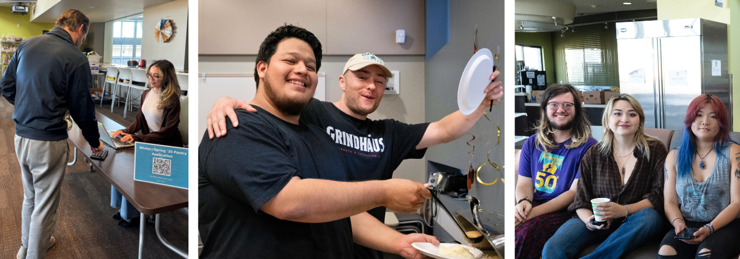

Jet Fuel Resource Center Supporting Student Success through Basic Needs Services Shelly Parks, LCSW, Basic Needs Coordinator

Slide 2
Understand Basic Needs are Varied
56%
of students at 2-year colleges report having low or very low food security
69%
of students cut the size of their meals or skip eating at least once per week
27%
of students were unable to pay housing costs in-full within the last year
28%
of students were unable to pay utility costs in-full within the last year
43%
of full-time students work with ~33% working more than 20 hours per week
71%
of part-time students work with over 50% working more than 35 hours per week
Source: “Combating Food Insecurity on Community College Campuses,” Illinois Community College Board; ““Mission Critical,” Center for Community College Student Engagement (2022); “Food Security at Urban Universities,” Coalition of Urban Serving Universities (2021).

Slide 3
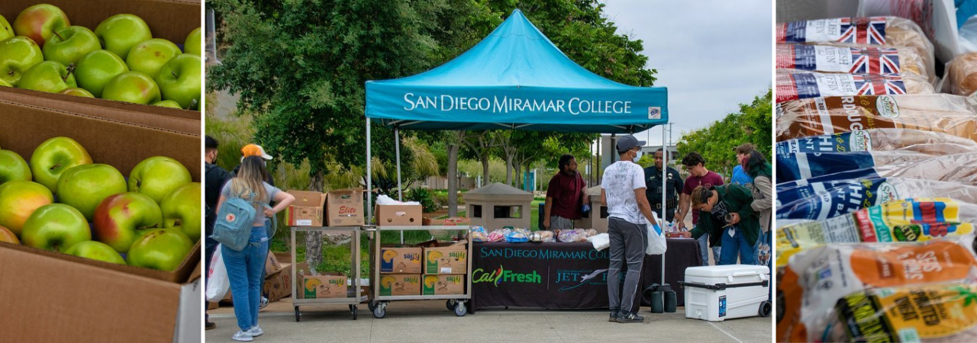
Service Model Overview

Slide 4
Jet Fuel Resource Center
Services & Partnerships
Jet Fuel Food Pantry
Feeding San Diego, San Diego
Food Bank, CostCo
Facilities
Financial Wellness Workshops
CalCoast Credit Union
Financial Aid
Next Up
Rising Scholars
CalFresh Enrollment Clinics
San Diego
Food Bank,
County of San Diego
EOPS
Retail Rescue
Aldi, Smart & Final, Sprouts (x2), Target
Health Services
Athletics
Really, Really FREE Farmer's Market
Feeding San Diego
CE Basic Needs
Health Services
Pantry Pickup Lockers

Slide 5
Jet Fuel Resource Center
Services & Partnerships
Flight Suit Clothing Closet
Career & Life Design
(coming in Oct)
Locker Assignment & Shower Access
Aquatics & Hourglass Field
Technology Access
Miramar Library
1:1 Counseling / Case Management
TBH
211 San Diego
Direct Aid to Students
Financial Aid
Diesel, Dreamers, EMT/Fire, Pride, STEM

Slide 6
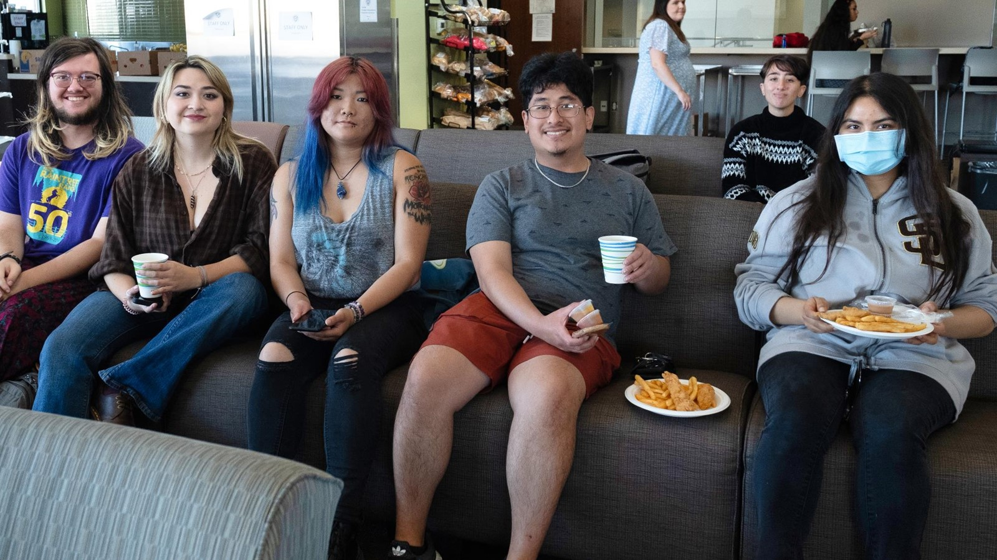
Our Students

Slide 7
94%
Of basic needs students participate in at least one affinity group, academic support, or student services program
25%
Are currently in the Promise Program
14%
Utilize Disability Support Program & Services (DSPS)
26%
Receive assistance through EOPS, CalWORKs, CARE, or NextUP
13%
Identify as belonging to the LGBTQ+ community
4%
Have been impacted by the justice system
15%
Are active duty, a veteran, or a military dependent
73%
Have submitted a FAFSA® or CADAA for financial aid

Slide 8







ACP Representation
5%
15%
17%
7%
3%
30%
8%
15% of students have reported that they are undecided or do not know which ACP their major falls under.
Source: Spring 2025 Pantry Use Form (N = 424)

Slide 9
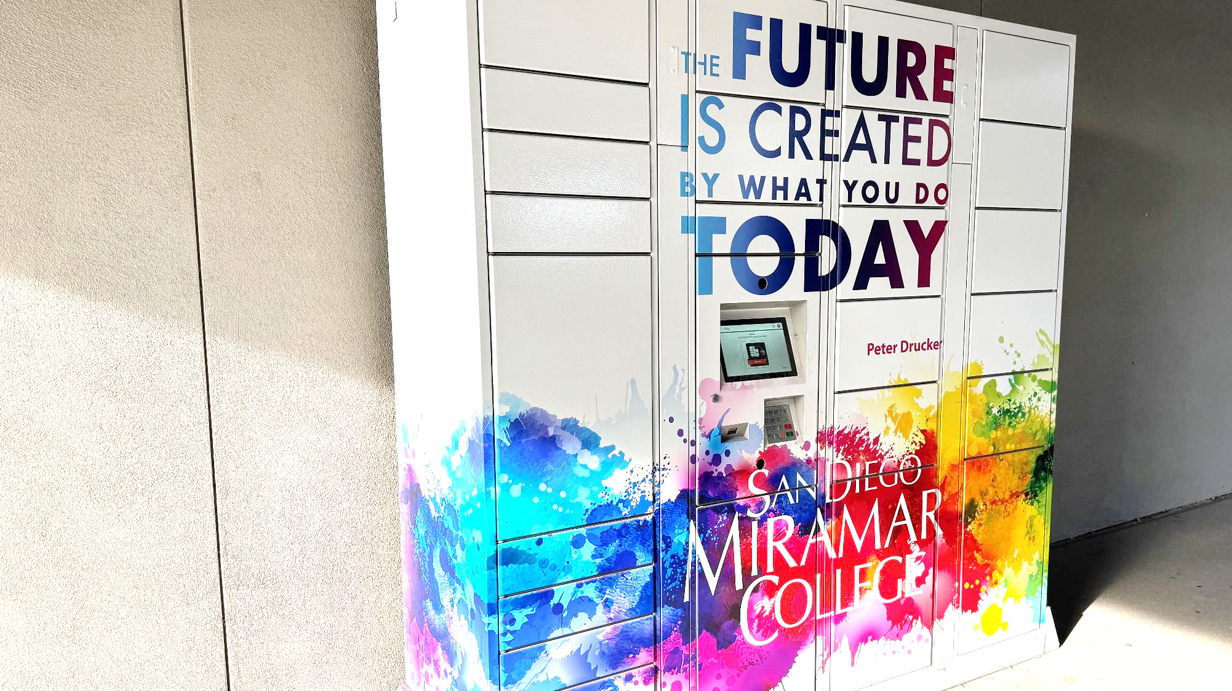
Recent Renovations

Slide 10

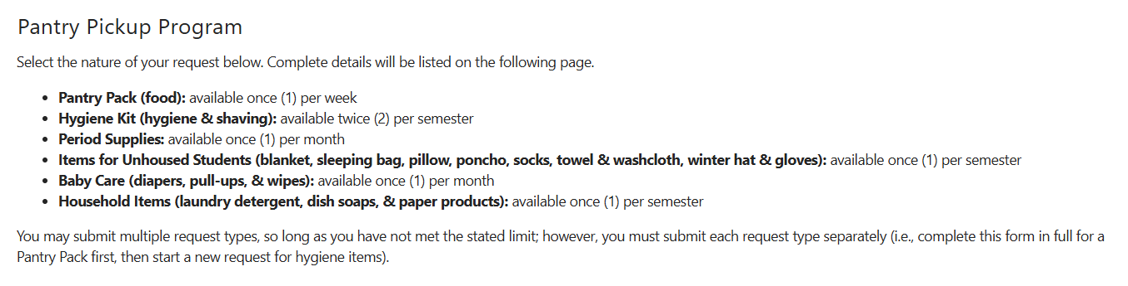
Improved Access (24/7)
New since
Spring 25
(located in S5 - Science)

Slide 11
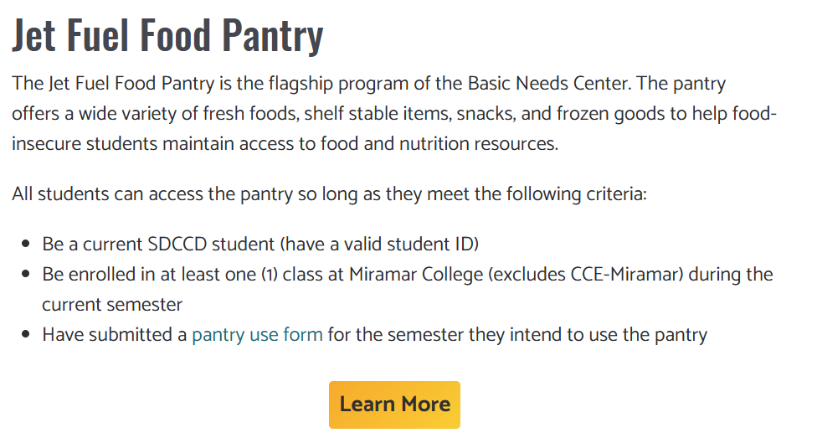
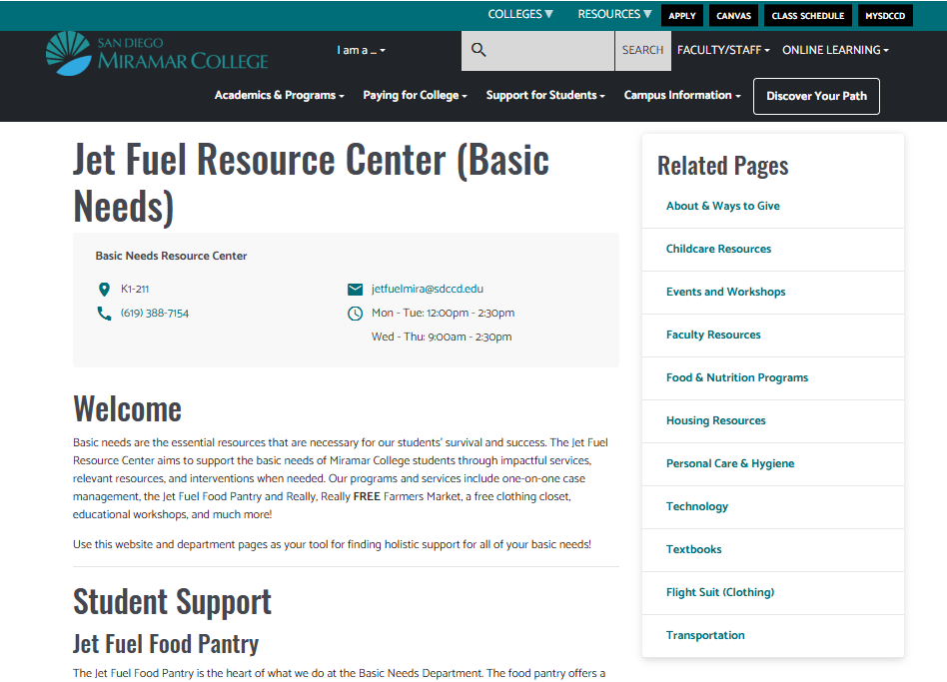
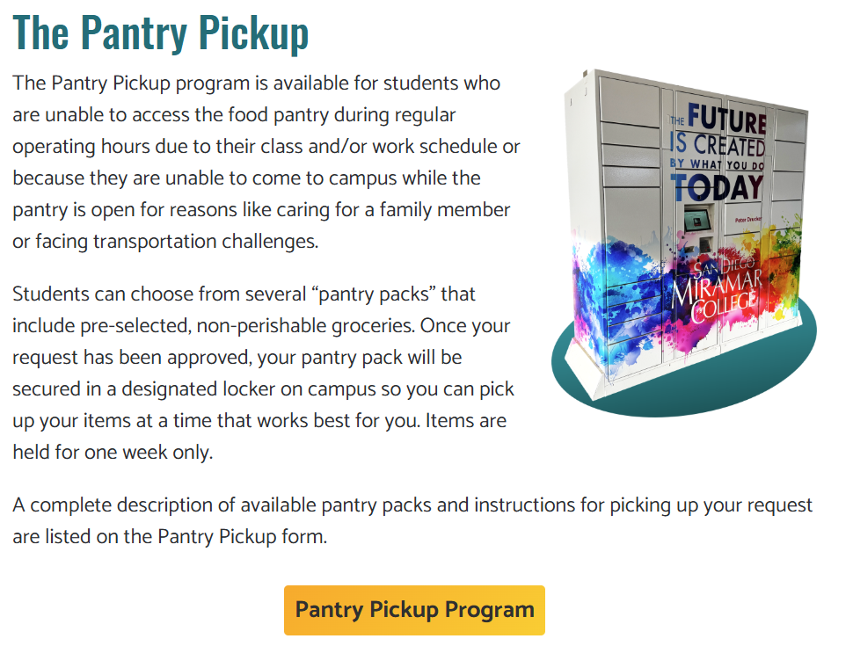
Updated Basic Needs Website
Page 5
https://sdmiramar.edu/basicneeds

Slide 12


Leveraging Software | Connecting Students
1:1 Basic Needs Counselor
(Case Management)
Resource Connection
Flight Suit (clothing closet)
CalFresh Enrollment Clinics
Financial Wellness workshops
And more
Jet Fuel Food Pantry

Slide 13
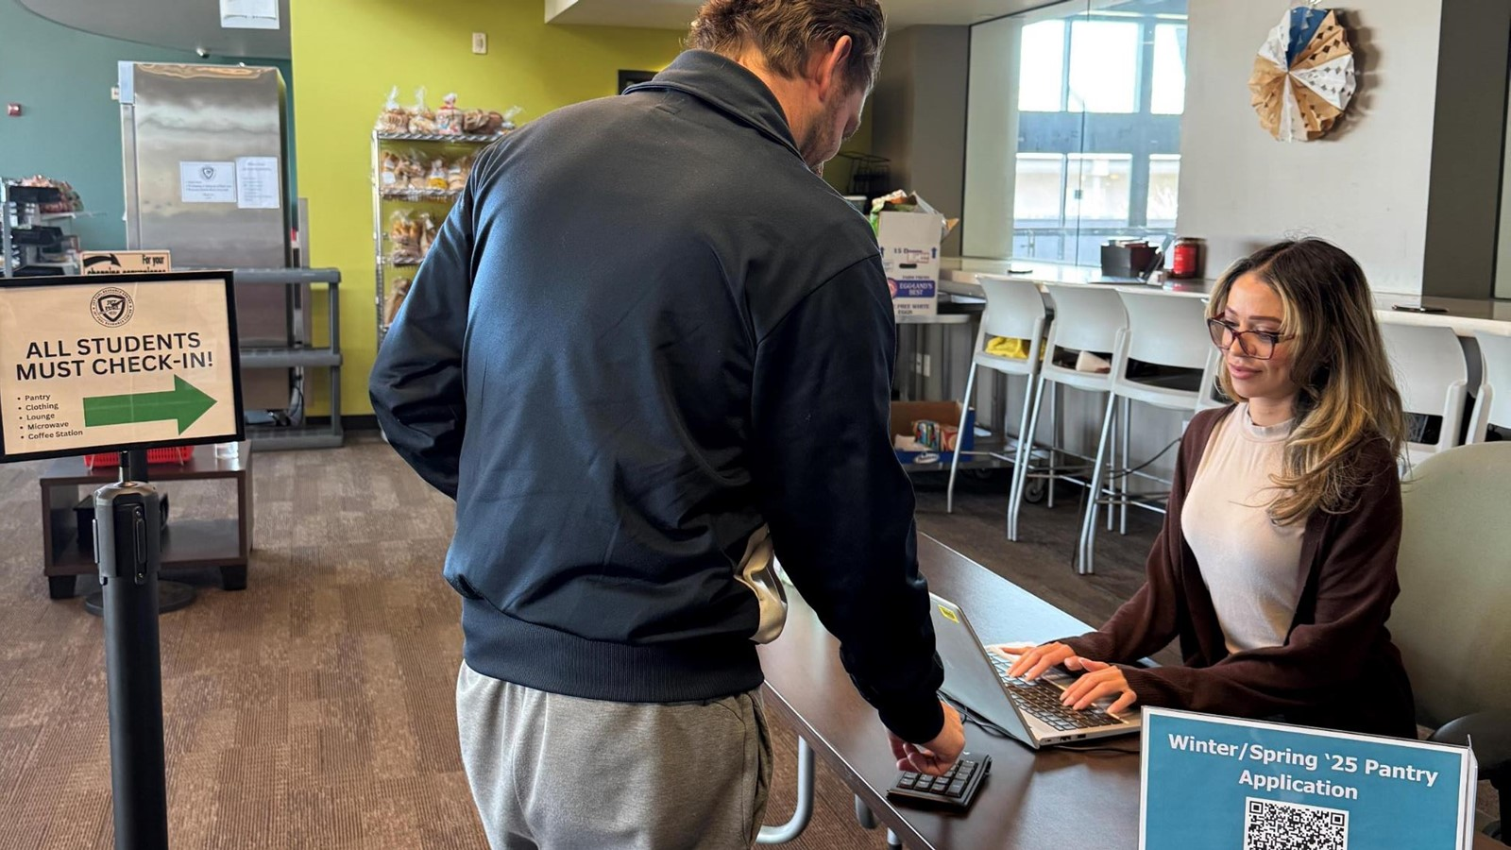
Be the Bridge

Slide 14
Identify Possible Basic Need Challenges
Indicative Behaviors
69%
of food-insecure students consider dropping out of college
Missing class or skipping extra-curricular activities
Foregoing textbooks and/or classroom supplies
Poor or declining academic performance
Dropping classes
Overtly expressing a challenge to meeting their needs
Not performing as well in academics as otherwise possible
Signs & Symptoms
Physical: fatigue, slumped posture, growling stomach, exaggerated gestures
Emotional: mood swings, atypical demeanor, sadness / anger
Cognitive: confusion, difficulty recalling or remembering information
Source: “Mission Critical: The Role of CCs in Meeting Student’s Basic Needs,” Center for Community College Student Engagement (2022).

Slide 15
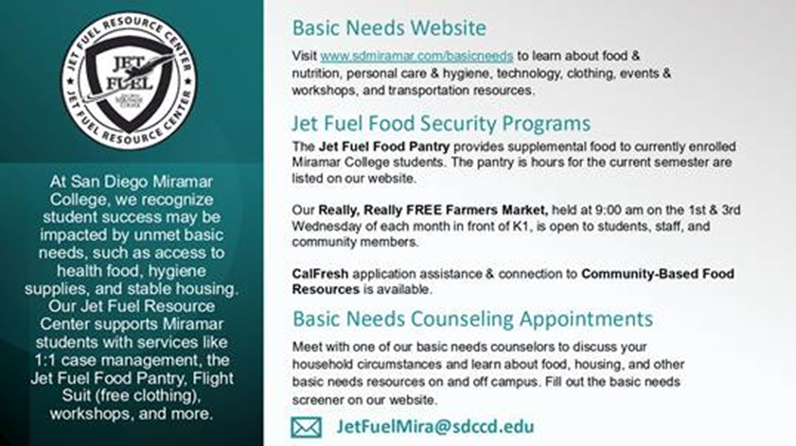
Faculty Resources
Syllabus Statement
Being able to meet your basic needs is foundational to your success as a student at Miramar College. If you are having difficulty affording food, lack a stable place to live, or are struggling to meet another need, the campus has resources for you. Our Jet Fuel Resource Center supports Miramar students with services like 1:1 case management, the Jet Fuel Food Pantry, Flight Suit (free clothing), workshops, and more.
Please contact the Basic Needs Team JetFuelMira@sdccd.edu for information on how to get support or view more information at https://sdmiramar.edu/services/basicneeds/faculty-resources.
Basic Needs Slide
Source: www.sdmiramar.edu/services/basicneeds/faculty-resources

Slide 16

Faculty Resources
Classroom Presentations
Basic Needs Video
Invite Basic Needs to do a 10-minute classroom presentation to your students; email Margot Salgado msalgado@sdccd.edu to schedule.
Consider sharing this 2-minute video with students during your first weeks of class to ensure all students are aware of the Jet Fuel Resource Center's services.
https://www.youtube.com/watch?v=AhapHu6rj1Q
Source: www.sdmiramar.edu/services/basicneeds/faculty-resources

Slide 17
How Else Can I Help?
Information Sharing
Be informed of and promote campus departments and events. Students are most connected to you, help them connect to services available to them.
Engage
Participate in campus events to build relationships across departments.
Referrals
Located in K1-208 (offices) & K1-211 (Jet Fuel Resource Center)
Email JetFuelMira@SDCCD.edu
Call (619) 388-7154

Slide 18

Listen Well & Refer Effectively
Be Proactive
Include Basic Needs statement in syllabus
Normalize usage of the Basic Needs Center (food pantry, counseling) in classroom discussions
Invite Basic Needs staff into your classroom for brief presentations
Attend and encourage students to attend Basic Needs workshops
Manage Expectations
Understand program eligibility criteria (ask us to deliver flyers or pamphlets)
Approach students with empathy—not pity—through a trauma-informed lens
Call-out systemic inequalities and validate the student’s current challenge
Do NOT say “Basic Needs can help with that!”
Instead, say “I’m going to refer you to Basic Needs who may be able to provide you referrals to available resources.”

Slide 19
How Else Can I Help?
Donate Your Time
Our team can always use extra hands at the Really, Really FREE Farmer's Market – 1st & 3rd Wednesdays from 9:00 am – 11:00 am. All Faculty and Staff are welcome to help.
Donate In-Kind
Clean out your closet twice per year and donate any clean business attire to the Flight Suit (clothing closet). High need items are shoes, ties, belts, blazers, and button-up shirts.
Donate Financially
Financial donations of any amount are leveraged at the 2 local food banks to buy 10 pounds of food for every $1. Your donation is tax-deductible through the Miramar College Foundation. Learn more at https://sdmiramar.edu/basicneeds/about

Slide 20
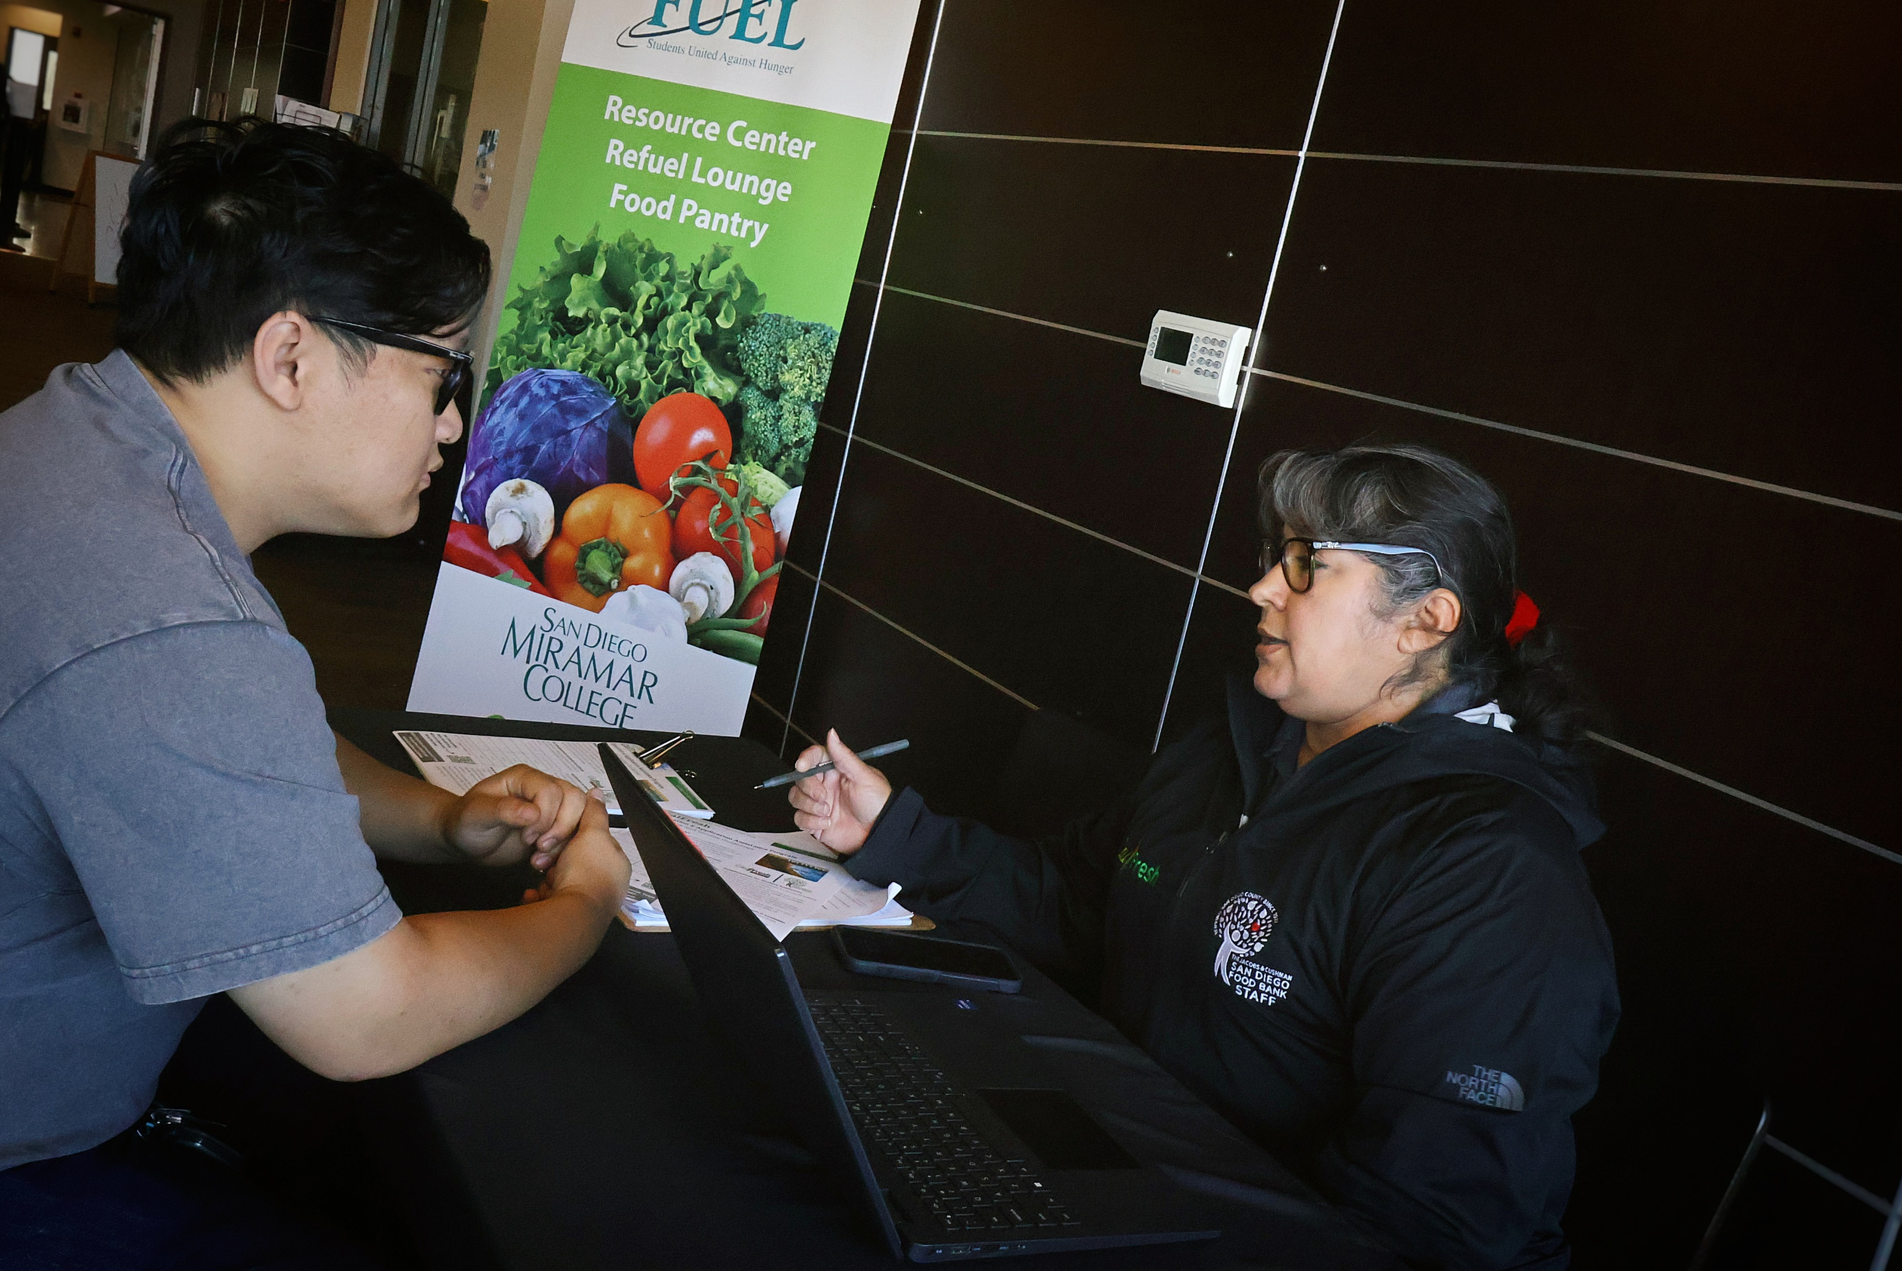
Q&A

Slide 21
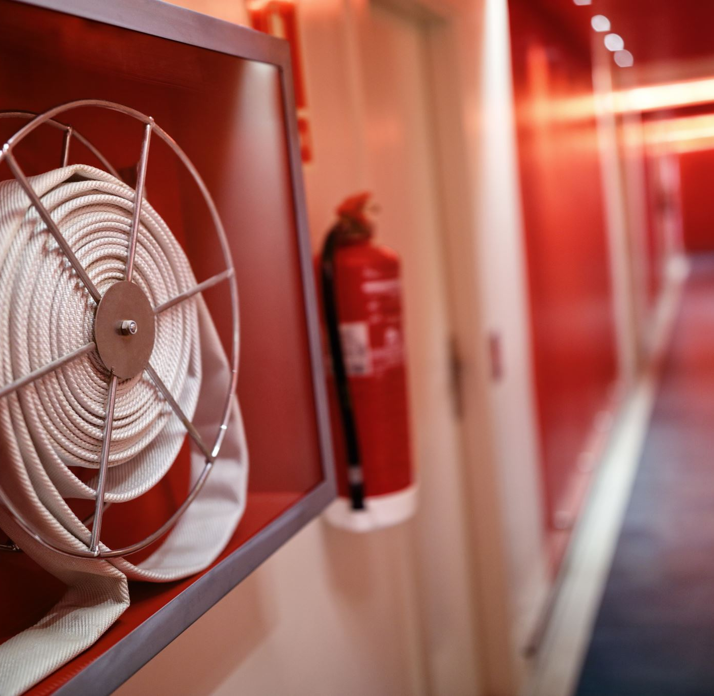


Emergency Funds

Slide 22
Impact Grants
Emergency Defined
A serious, unexpected, and often dangerous situation that creates an acute financial need requiring intervention, e.g., emergency housing situations (eviction, roommate issues, rental issues), significant food insecurity, emergency automotive issues.
Grant Purpose
To safeguard students from dropping out or failing due to unforeseen financial crises. To be eligible, a student must have a temporary financial need resulting from an unanticipated expense or emergency.
Basic Needs cannot support an ongoing expense or any expense anticipate with cost of attendance.
Timeline, At-a-Glance
Student must complete screener and meet with Basic Needs Counselor / Case Manager
Situation must meet emergency definition, student must meet eligibility criteria, distribution approved by committee / interdepartmental coordination (Basic Needs, Financial Aid, Accounting, etc.)
If approved, student receives aid within 1–2 weeks; grants are NOT immediate relief!

Slide 23
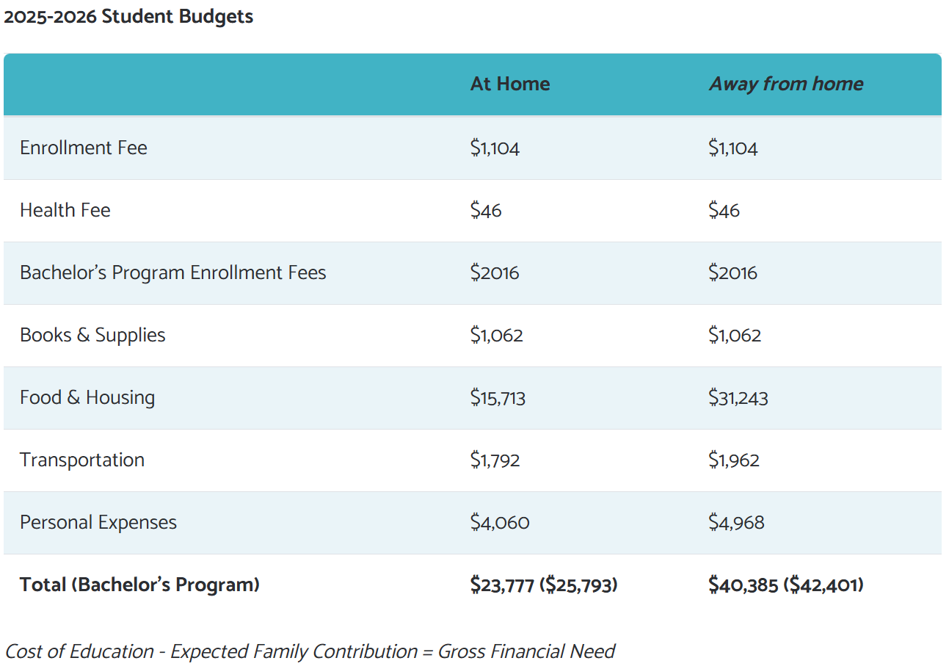
Cost of Attendance

