Slide 1
The slideshow for this week is still
UNDER CONSTRUCTION

Slide 2
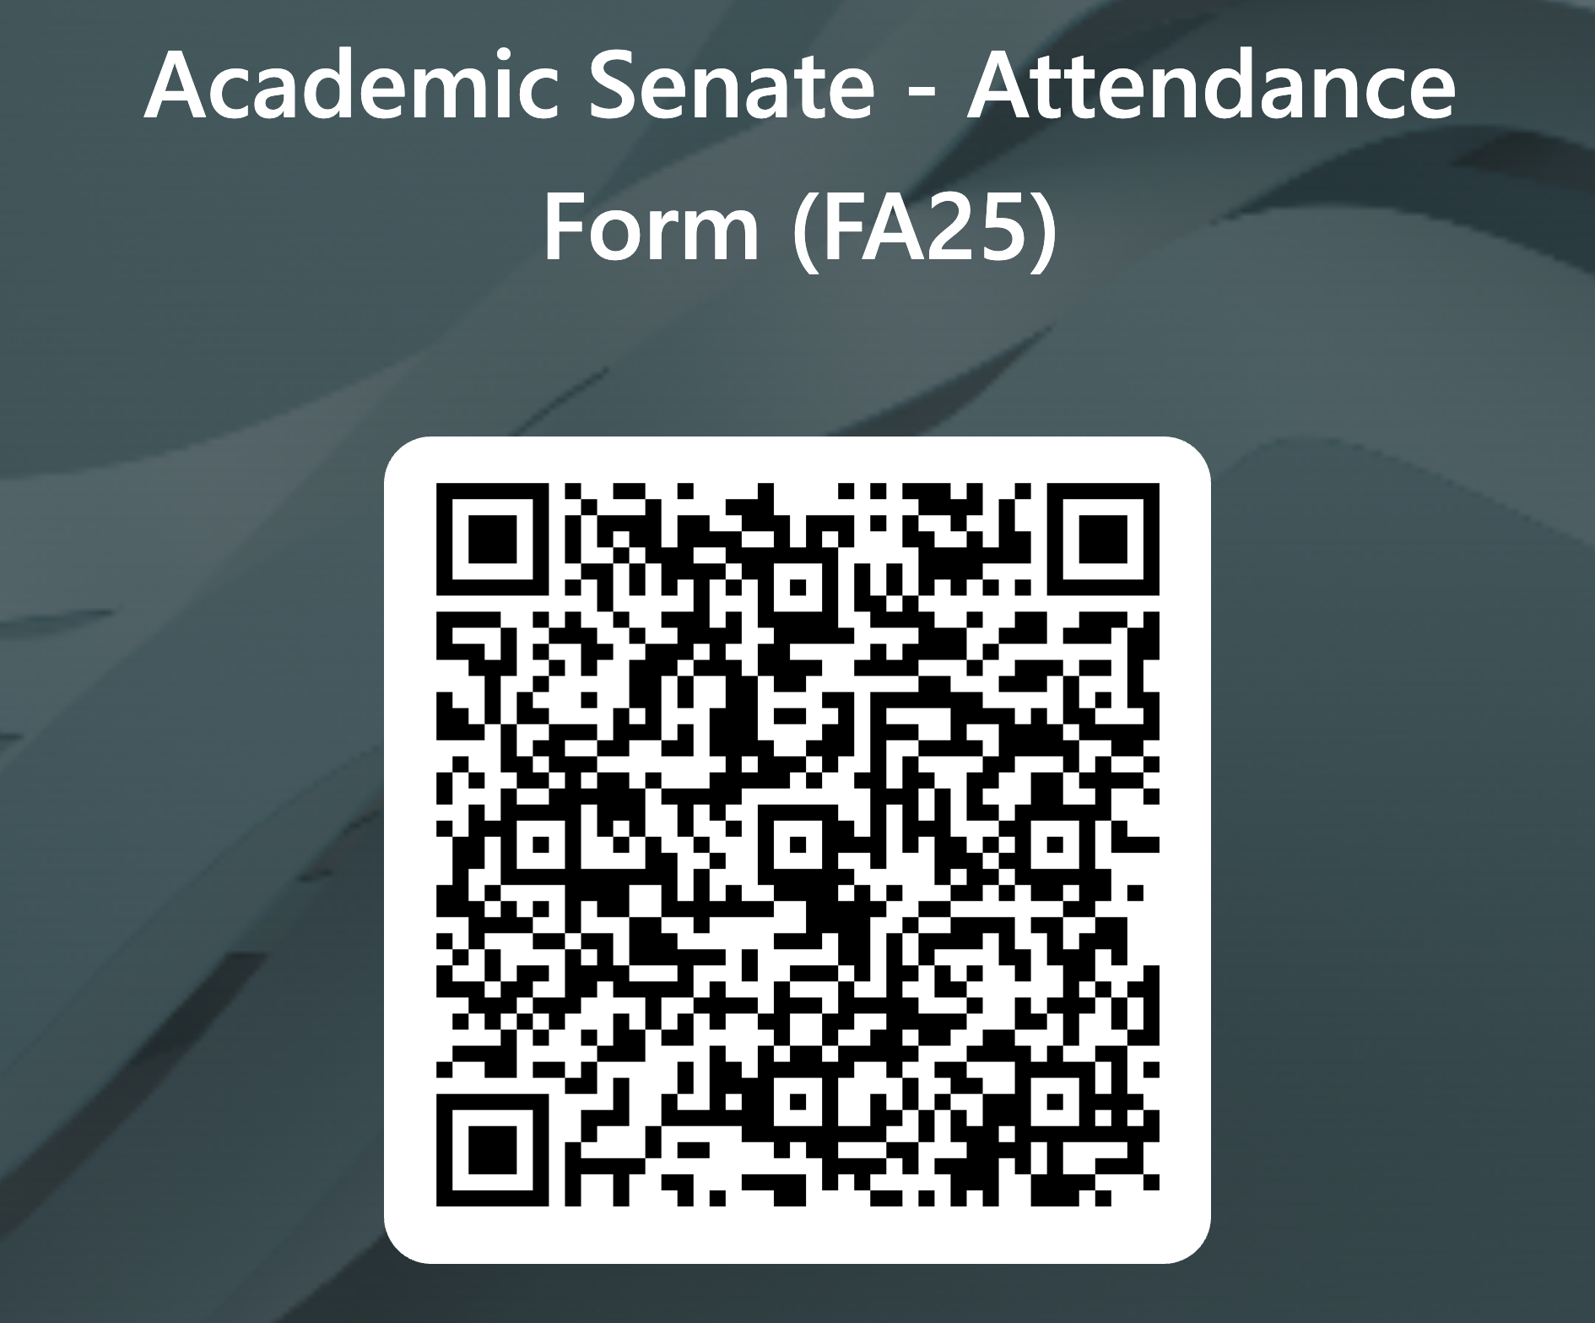

Slide 3
San Diego Miramar College Upcoming Events
Campus Forum Monday, September 22, 2025
L-105 Auditorium 3:00 p.m. – 4:00 p.m.
LGBTQ+ History Month: Flag Raising Event Wednesday, October 1, 2025
N-Building 11:00 a.m. – 12:00 p.m.*
Invest in Success Thursday, October 16, 2025
Tom Ham’s Lighthouse 4:00 p.m. – 8:00 p.m.
Equity Summit Friday, October 24, 2025
TBA 8:30 a.m. – 1:30 p.m.
Campus Forum Monday, October 27, 2025
Zoom 3:00 p.m. – 4:00 p.m.
Native Heritage Month: Flag Raising Event Monday, November 3, 2025
N-Building 12:00 p.m. – 1:00 p.m.
2025-2026 Major Annual Event Calendar

Slide 4
San Diego Miramar College
Academic Senate Meeting
September 16, 2025
2024-25 Academic Year
Cultivating Community:
Making the invisible visible
Attending for Flex credit? Email rgomez001@sdccd.edu or jbartolo@sdccd.edu
(QR Code for A.S. Webpage)

Slide 5
2. Agenda Overview
Call to Order
Approval of Agenda & Consent Calendar
  DRAFT Minutes 052025
Land Acknowledgement
Public Comments
Action Items
Second Read: Second Read: Miramar College Technology Plan
Updating Minimum Qualifications: Adding Filipino Studies to Ethnic Studies
  Submission: Revision FILI 2509
  Support Letters: ASCCC API Caucus | FANHS Director | Region 10
Discussion Items
  Standing: Curriculum Committee Updates
  CRM Implementation Update – Element 451
  Miramar AI Working Group
Reports:
  Committee Reports
    Basic Needs Taskforce
  Special Reports
    Puente/Umoja Update
    Faculty Salaries & Retaining Faculty Update
  Executive Committee Reports
    AS Resource Document
Announcements
Adjournment
A.S. Agenda for 9/16/25 AS Code of Conduct

Slide 6
3. Land Acknowledgment
Resources: “Making a land acknowledgment meaningful”; A call for more powerful land acknowledgements
Notes:
Beginning with the Spanish invasion of 1769, continuing through the Mexican Period of 1826 to 1848, and on through the American Period, the Kumeyaay were forced off their ancestral lands. Nearly all of the Kumeyaay lands were taken into private ownership or made U.S. government holdings. Treaties negotiated with 18 California tribes in 1850 to set aside 8.5 million acres in specific tribal lands were never ratified by the United States Senate as a result of opposition by the state of California.

Slide 7
4. Public Comments (10 min)
Limited to 10+1 items that are not on the agenda
  Public Comments on agenda items will take place before the A.S. body discussion begins but after any relevant presentations.
2 min. per speaker, 10 mins. per topic
  Individual speakers may not yield their time to another speaker or spokesperson
To be continued at the end of the meeting if necessary

Slide 8
5. Action Items (Second Reads)
5.1. Miramar College Technology Plan
Pablo Martin (10 mins)
5.2. Updating Minimum Qualifications: Adding Filipino Studies to Ethnic Studies | Support Letters: ASCCC API Caucus | FANHS Director | Region 10
Mara Palma-Sanft (5 mins)

Slide 9
5. Action Items (Second Reads)
5.1. Second Read: Miramar College Technology Plan
The draft plan sets out a roadmap for technology infrastructure, software/hardware procurement, support services, and training—ensuring faculty have tools to teach effectively and students have access to reliable digital resources.
Aligns with 10+1 areas such as:
      Educational program development (curriculum & delivery)
      Standards & policies for student preparation & success
      Faculty professional development
      Governance structures (faculty involvement in tech decisions)

Slide 10
5. Action Items (Second Reads)
5.2. Updating Minimum Qualifications: Adding Filipino Studies to Ethnic Studies
The proposal explicitly adds Filipino Studies (FILI) to the AAPI discipline in the ASCCC MQ Handbook—affirming the distinct history and contributions of Filipino Americans, advancing equity and visibility in Ethnic Studies, and aligning with statewide curriculum and transfer goals.
Support Letters: ASCCC API Caucus | FANHS Director | Region 10
    Cast Vote*

Slide 11
6. Discussion Items (First Reads)
6.1. Curriculum Committee Updates – Veronica Hartmann (10 mins.)
Firstly, let’s welcome our new Curriculum Chair, Veronica Hartmann from General Counseling!
6.2. CRM Implementation Update – Element 451 – Dan Roberts (10 mins.)
  Implementation Update Slideshow
6.3. Miramar AI Working Group – Rodrigo Gomez (5 mins.)
  Miramar AI Network

Slide 12
6. Discussion Items (First Reads)
6.2. CRM Implementation Update – Element 451 – Dan Roberts
Element 451 Slides
Element 451 is a customer relationship management (CRM) system adopted districtwide to better coordinate student services, communication, and data. The goal is to provide early alert and proactive intervention tools (counseling, tutoring, and financial aid).
Faculty Impact:
Informs student success and preparation (10+1).
Raises questions of how faculty will use or interface with CRM tools.
Ties to ACCJC Standards on institutional effectiveness and learning support.

Slide 13
6. Discussion Items (First Reads)
6.2. CRM Implementation Update – Element 451 (cont.)
Email sent to the DL
meeting scheduled with my VPs for 9/5, who will then be going to the district with a plan for a smaller pilot of the CANVAS Integration, bypassing all the required steps previously ourliones
I am still going through the steps set forth by district anyway so that there's no lost time there - faculty buy-in will be obtained on 9/2
As for list of CA clients already integrated or Demos, I would like to give the Miramar Leadership the opportunity to make their case and get this going. If the long way around to this integration is the only way to go, I will let you know

Slide 14
6. Discussion Items (First Reads)
6.3. Miramar AI Working Group – Rodrigo Gomez (5 mins)
MAIN Community of Inquiry/Practice Slides
Miramar College has been a leader in the AI in Education conversation since it started. We are the only college currently with an AI Resolution. In the absence of specific professional development related to AI, I propose the creation of a Miramar working group on AI.
ASCCC – AI currently dominate academic conversations:
  Different campuses are adding their voice, and I think Miramar should add our voice through a Senate working group on AI in Education
  MAIN –Miramar AI Network - cohort has already started meeting at the library and will continue to do so on specific dates: next one is 9/25/26

Slide 15
7. Reports
7.1. Committee Reports
7.1.1. Basic Needs Taskforce – Shelly Parks (10 mins)
Please see the following Basic Needs Slideshow
Faculty Request:
  Consider including the link to Jet Fuel Resource Center on syllabi or other spaces in courses: https://sdmiramar.edu/basicneeds
  Interested in this area? Join the Advisory Team!

Slide 16
7. Reports
7.2. Special Reports
7.2.1. Puente/Umoja Update – Adrian Gonzales (10 mins)
Program Implementation & Executive Summary
7.2.2. Faculty Salaries & Retaining Full-Time Faculty – Jae Calanog (10 mins)
Salary & Full Time Work Slideshow

Slide 17
7.2.1. Puente/Umoja Update
  PUENTE is a cohort-based support program aimed at boosting college access, transfer, and degree outcomes for historically underrepresented / educationally disadvantaged students. It pairs transfer-level English (or Math) with Personal Growth courses, plus counseling, mentoring, and faculty/staff professional development.
  UMOJA (a Kiswahili word meaning “unity”) is a community and culturally responsive learning program designed to enhance the educational experiences of African American/Black students and others committed to diversity, equity, and inclusion.

Slide 18
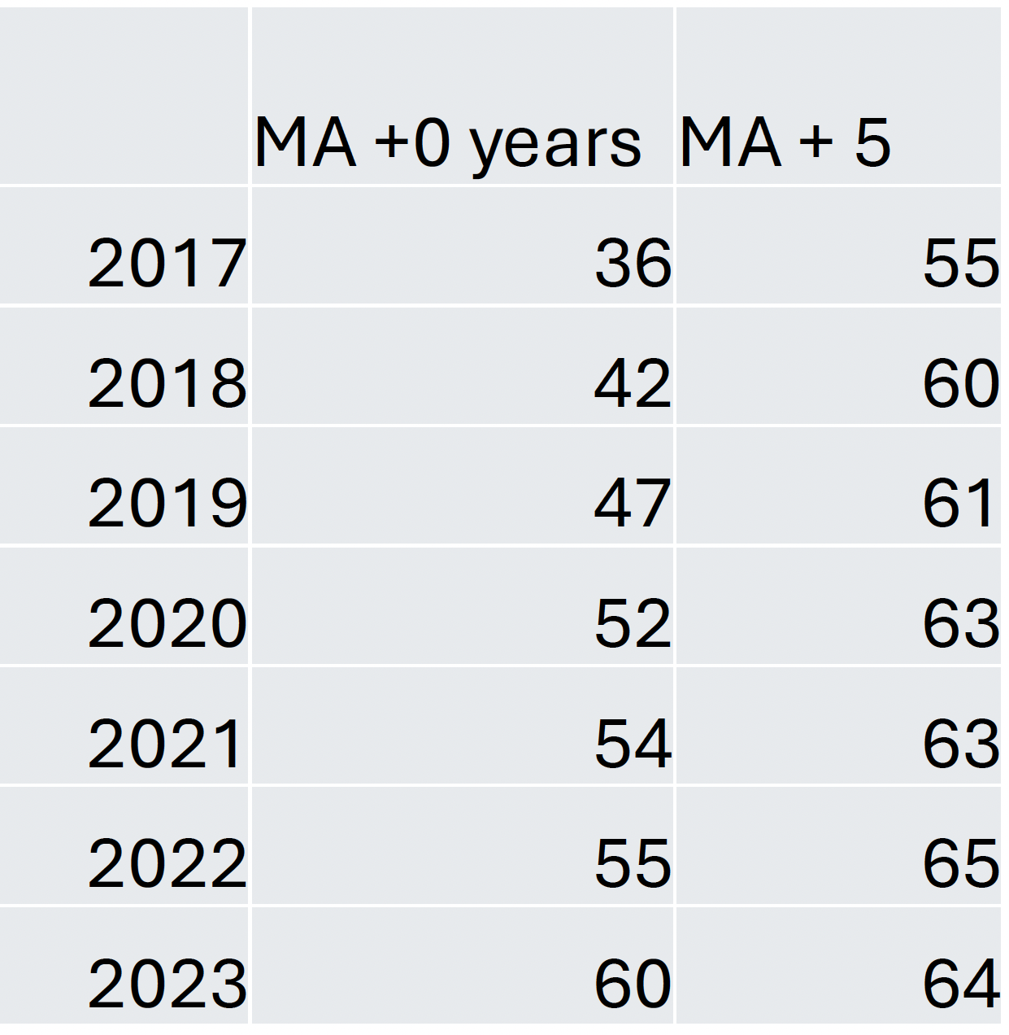
7.2.2. Salary & Full-Time Work Update
  Out of 72 colleges in CA, SDCCD pay for their incoming faculty with an MS degree lower than 83% of schools. With 5 years of experience teaching, SDCCD pay ranks lower than 89% of other colleges.
  CFT Guide for Faculty Salary Comparison Studies
  STEM faculty from historically underrepresented groups are more likely to enter the classroom without a doctorate, often due to systemic barriers in higher education.

Slide 19
7.3: Executive Committee Reports
7.3.1: President’s Report
The bulk of this report can be found in the SDMC Academic Senate Resource Doc for today’s meeting. If you have questions that you don’t ask today, I’m available for further discussion via email, face-to-face, or Zoom meetings.
You can also invite me to your department meetings. (Past resource documents can be found on the specific web page created for each A.S. meeting.)

Slide 20
7.3: Executive Committee Reports
7.3.1: President’s Report
1. Adjunct Faculty Shared Governance Funds:
  Working with and upon the recommendation of AFT President Jim Mahler, the four A.S. Presidents agreed that each college would receive 110 hours for the fall 2025 semester at the rate of $50/hour.
  The rate of pay will increase if the total number of hours submitted is less than 440 hours across the district.
  I’ll be reviewing the options to make my decision on this.

Slide 21
7.3.1: President’s Report (cont.)
2. AP7211 – Voted down at Miramar College. However, Mesa College has requested an update on our position and looking for the edits that we would like to see to approve it.
The issue had to do with “Chairs” specifically. Original | Updated Version
Faculty Discipline Expert Committee (FDEC) language:
Each college will establish its own Faculty Discipline Expert Committee (FDEC) on an as needed basis. The FDEC will include at least two discipline experts with adequate academic and/or professional experience. The Department Chair and/or Area Dean may also be part of the committee. Upon receipt of an applicant’s Application for Equivalency Determination, the FDEC shall review the submission.

Slide 22
7.3.1: President’s Report (cont.)
3. Updates from the 9/09/25 meeting of College Council (link to the recording is currently unavailable):
  2025-2026 Major Annual Event Calendar (slide 4)
  Puente/Umoja Update
State:
The Academic Senate for California Community Colleges (ASCCC) annually seeks nominations for faculty members to fill two (2) seats on the Board of Governors. (“Board of Governors Call for Applications.pdf”)
I attended the 2025 Faculty Leadership Institute. I highly recommend it
2025 Fall Plenary Session is in La Jolla, Thu, Nov 6 2025, 8am - Sat, Nov 8 2025, 5pm. Let us know if you’re interested in attending!

Slide 23
7.3.3-8 Executive Committee Reports
  Vice-President – Carmen Carrasquillo
  Secretary – Olivia Flores
  Treasurer – Dawn Diskin (please see the following slide)
  Contract Member-at-Large – Kristin Everhart
  Contingent Faculty Member-at-Large – Melissa Wolfson
  Chair of Chairs – Mary Kjartanson

Slide 24
Report 7.3.4: A.S. Treasurer
Please considering enrolling in auto-payroll deduction for a nominal amount per check. Contributions of $2.00 per check make a difference to our students in funding our scholarships and other necessary needs.
Current Balance = $953.57

Slide 25
8. Announcements
1 min. time limit each

Slide 26
7.3.3-8 Executive Committee
  Your 2025-26 A.S. Executive Committee
  President –Rodrigo Gomez
  Vice-President – Carmen Carrasquillo
  Secretary – Olivia Flores
  Treasurer – Dawn Diskin
  Contract Member-at-Large – Melissa Wolfson
  Contingent Faculty Member-at-Large – Kristen Everhart
  Curriculum Chair – Veronica Hartmann
  Chair of Chairs – Mary Kjartenson

Slide 27
If the calendar was approved earlier, the first meeting of the 2025-26 SDMC Academic Senate is:
Tuesday, October 7, 2025 from 3:30-5:00 pm in M-110 and on Zoom.
Senators wishing to attend remotely can learn more via the
A.S. Senator Remote Attendance Form. Senators wishing to change their attendance to in person should contact rgomez001@sdccd.edu.
9. Adjournment

