Slide 1
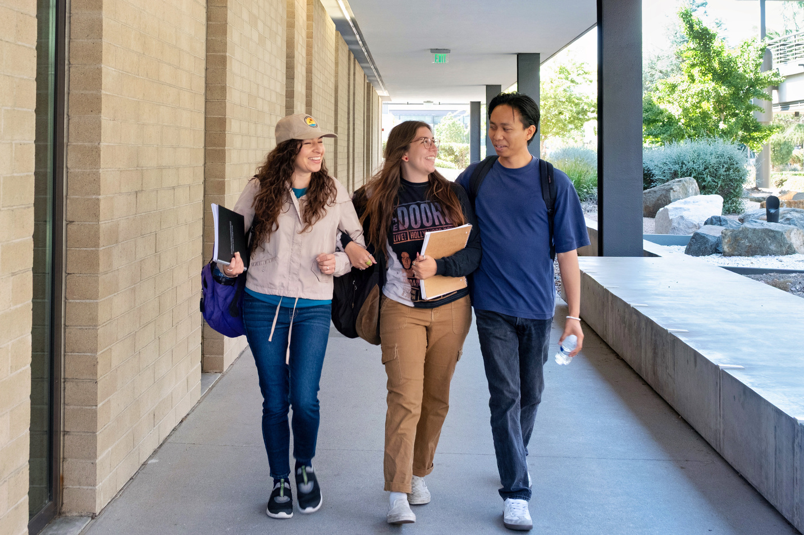
Fall 2025
PROMISE ORIENTATION

Slide 2
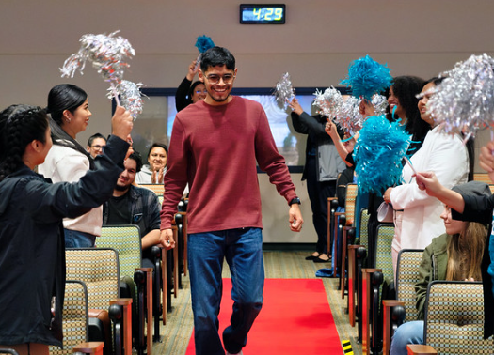

AGENDA
Meet the Team
Community Building Activity
Student Resources
Requirements & Eligibility
Upcoming Events

Slide 3
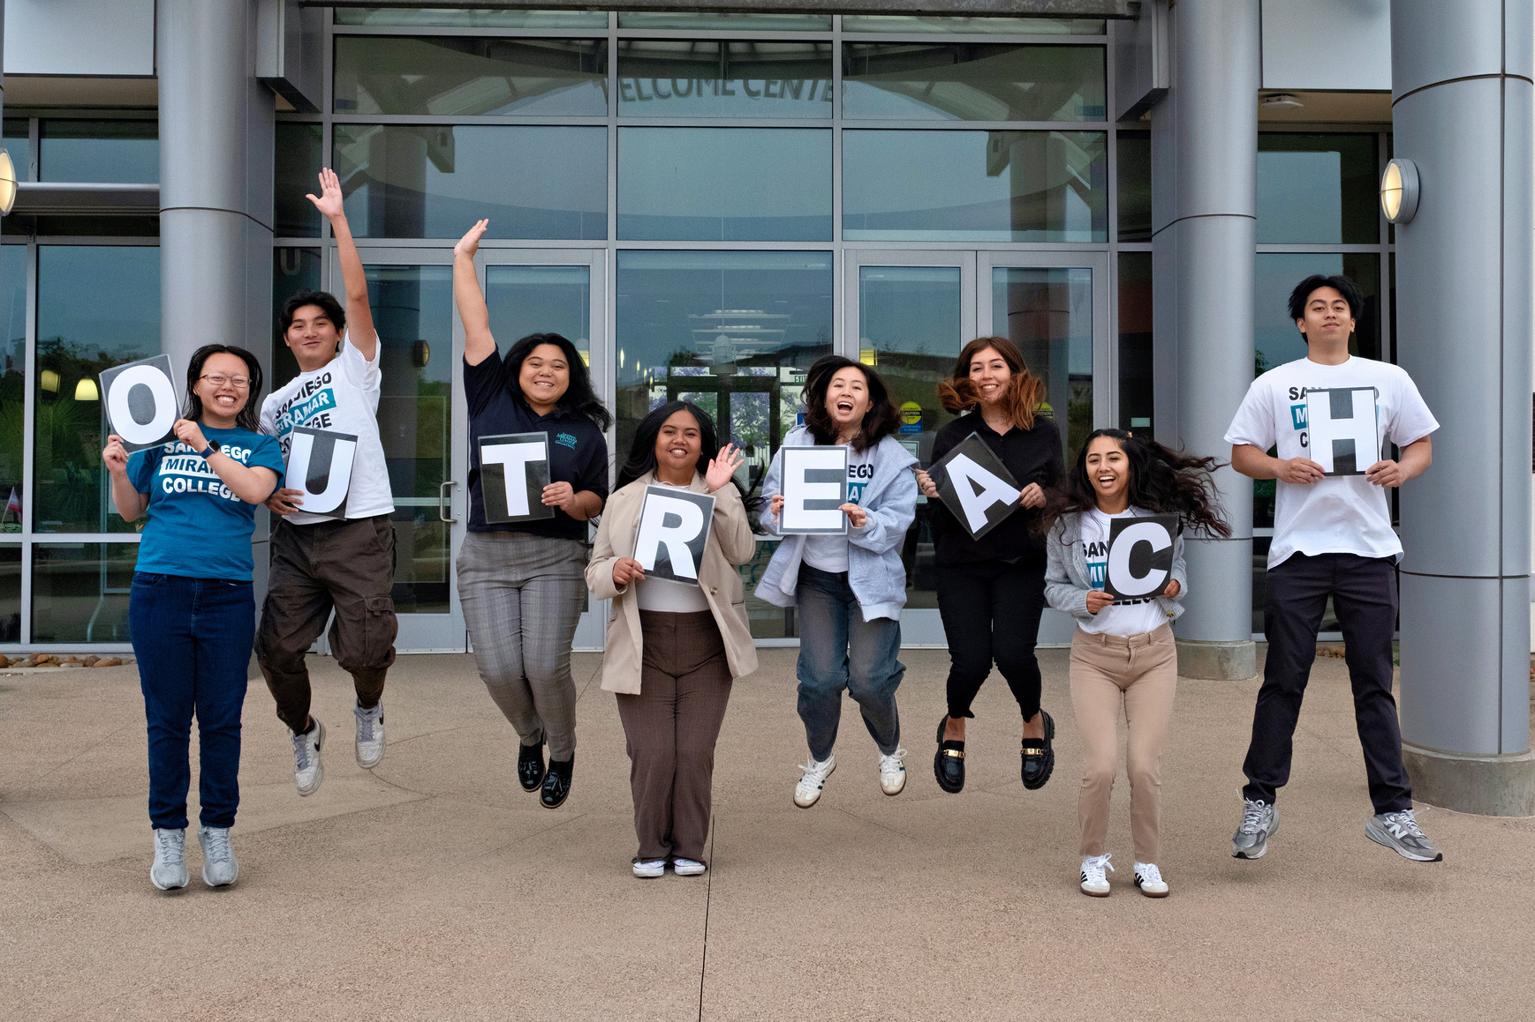
MEET THE TEAM
P
r
!
r
o
i
s
m
e
Notes:
Project Assistant

Slide 4
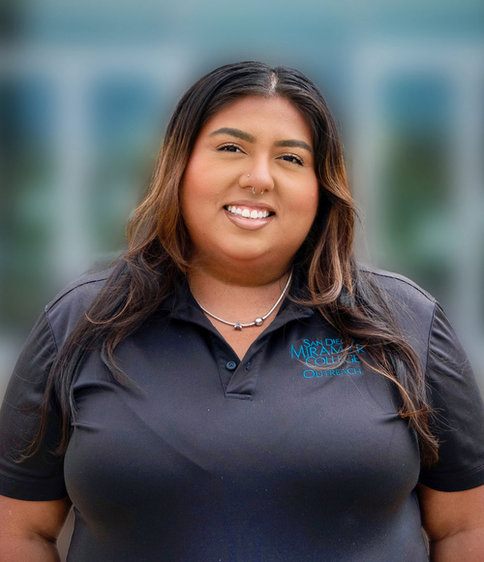
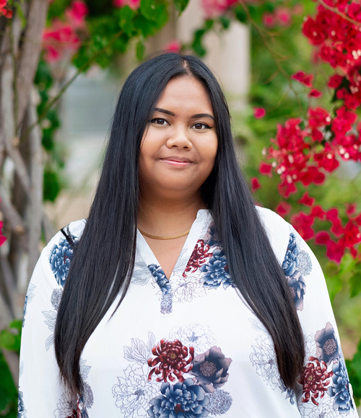
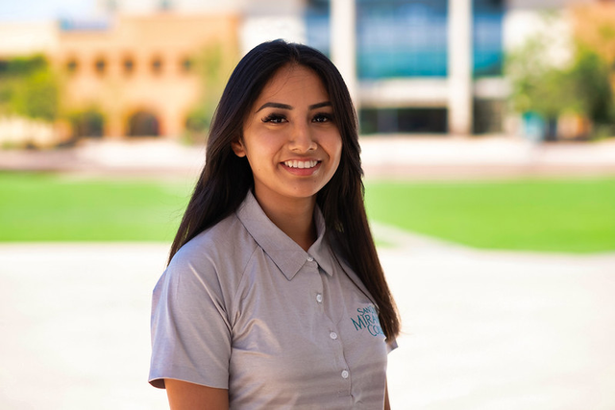
Meet the Team
Ana Hernandez
Denise Duarte
She/Her
Project Analyst
Jasmine DeVera
She/Her/Ella
Project Analyst
She/Her
Project Analyst

Slide 5
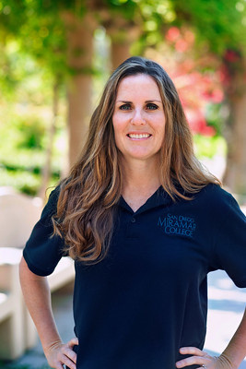
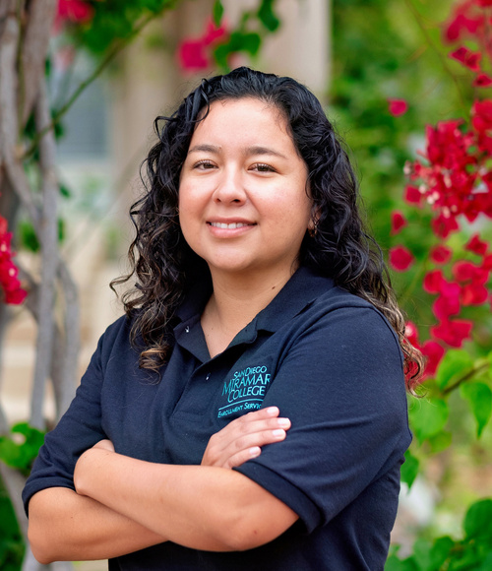
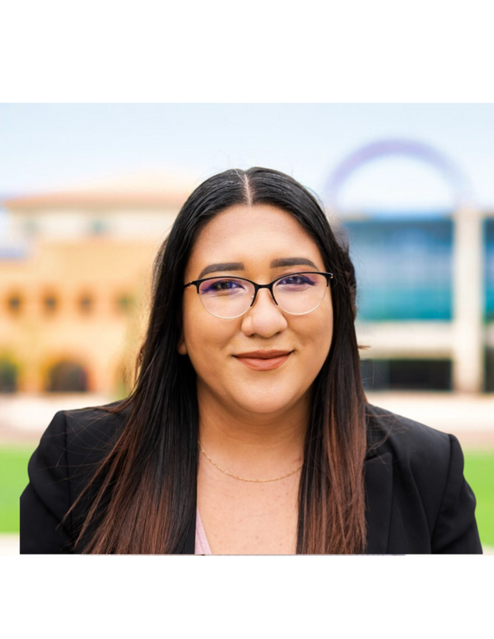
Meet the Team
Meredith McGill
Daniela Perez Padilla
She/Her
Acting Student Services Support Officer
Chantal Hernandez
She/Her/Ella
Student Services Technician
She/Her(s)/Ella
Acting Outreach Coordinator

Slide 6
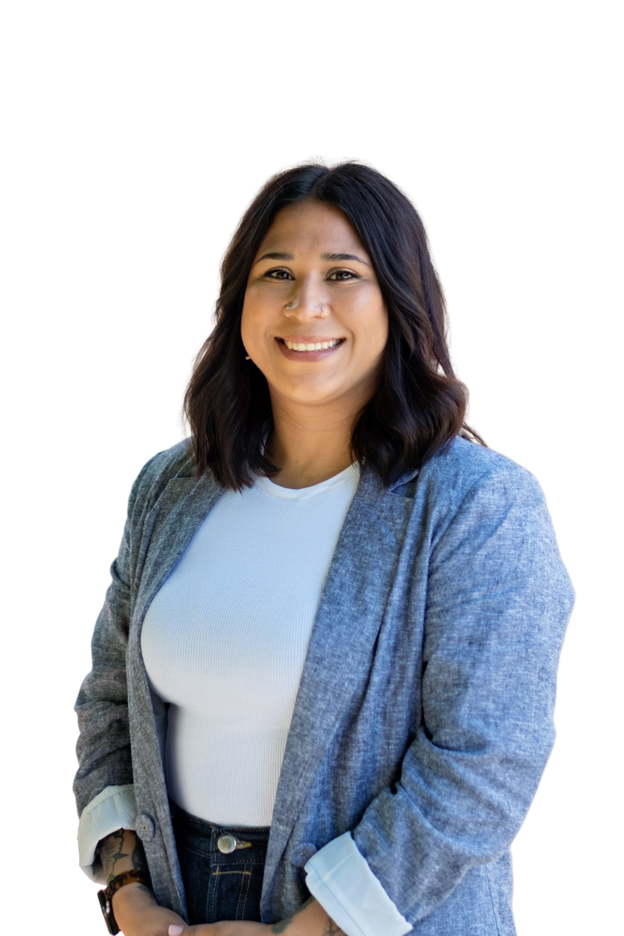
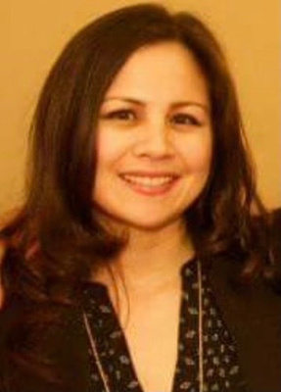
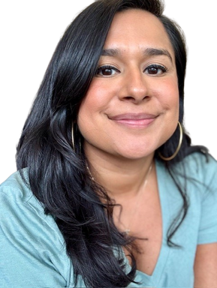
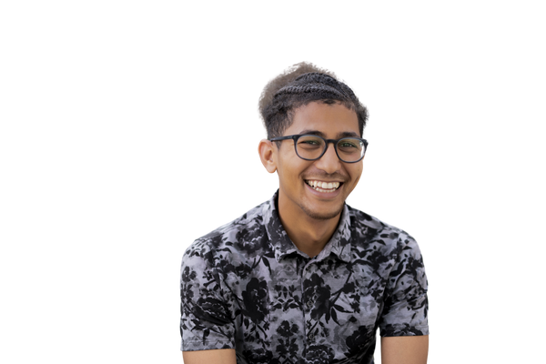
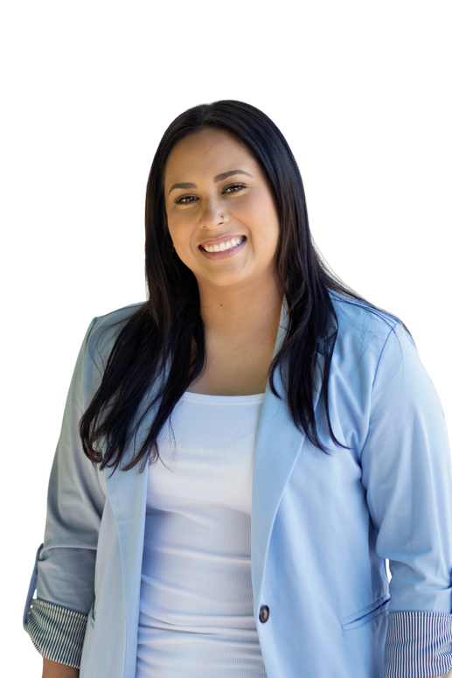
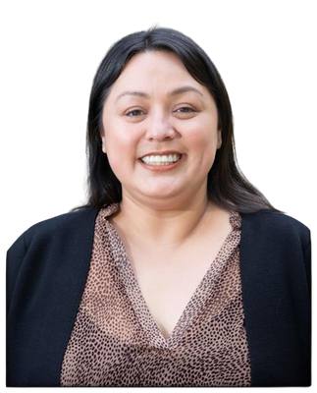
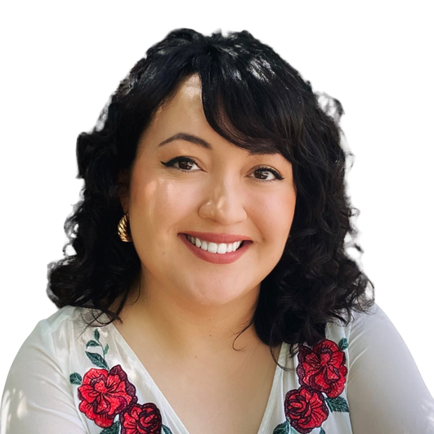
Meet our Counselors
Gabriela Cordova
MaryAnn Guevarra
She/Her(s)
Counselor
Laura Marin
She/Her
Counselor
She/Her(s)
Counselor
Arleen Palafox
Maggie Munoz
Jon Ng
Jacqueline Ovalle
She/Her(s)
Counselor
She/Ella/They
Counselor
He/Him
Counselor
She/Hers
Counselor

Slide 7

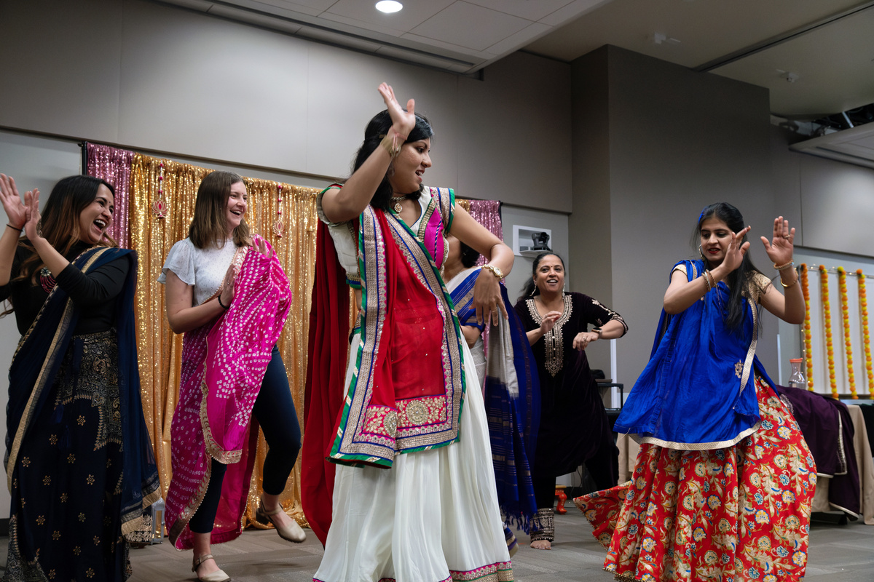
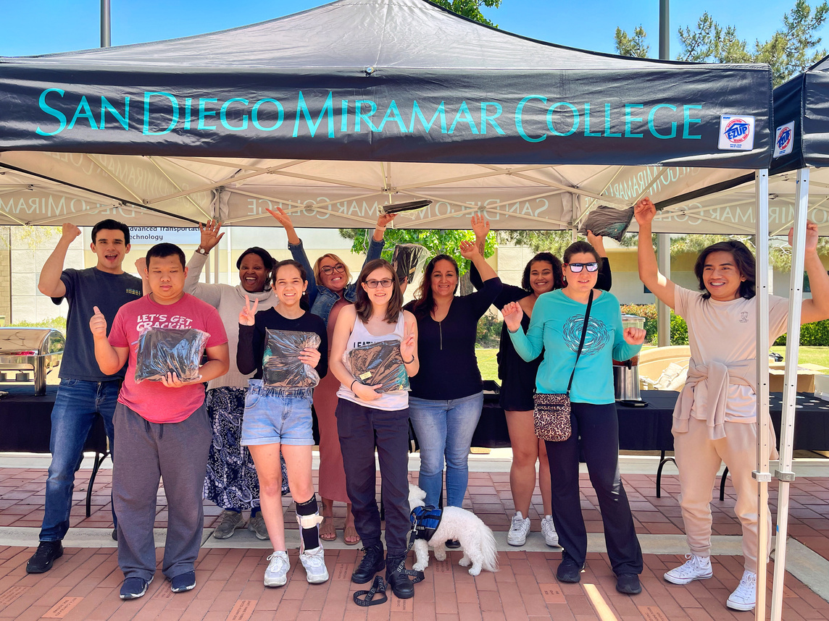



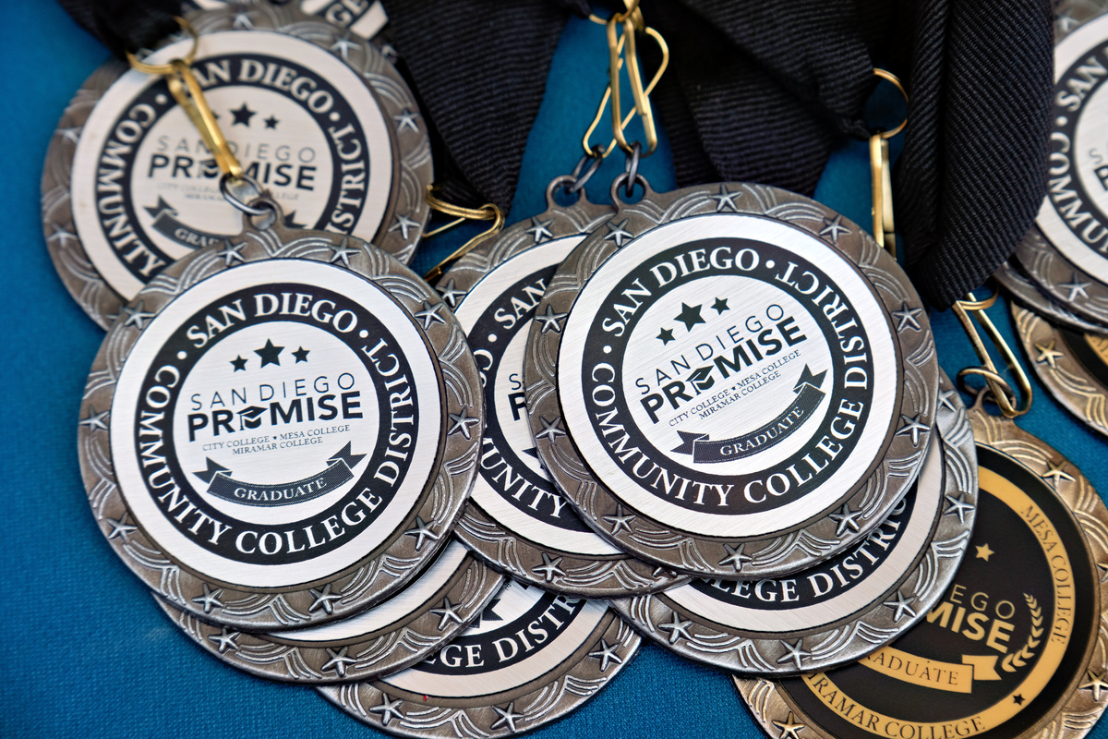
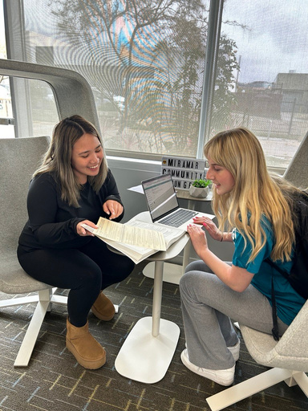
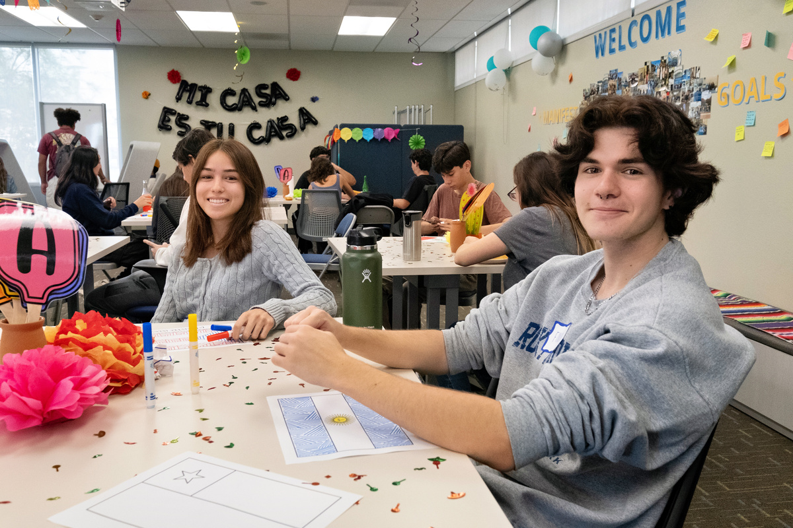
Content: Meredith
STUDENT CIRCLE OF SUPPORT
ADMINISTRATORS
STUDENT ORGANIZATIONS
ACADEMIC SUCCESS
CENTER (TUTORING)
FAMILY
HEALTH SERVICES
YOU
CLASSMATES
PROFESSORS
FRIENDS
EOPS
COUNSELORS
DSPS
PROMISE PROGRAM
Notes:
Diane

Slide 8
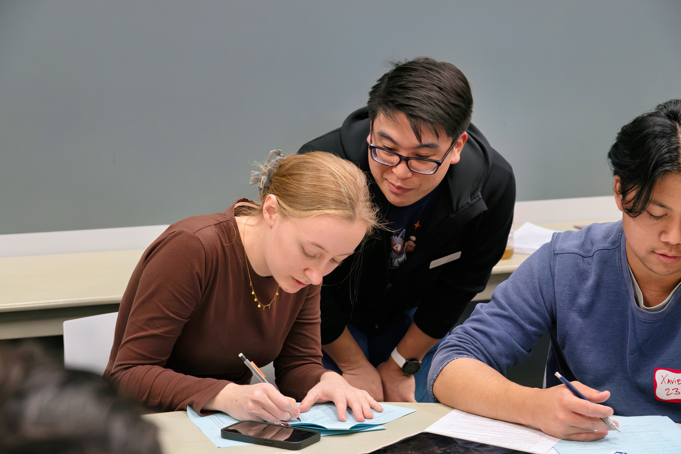
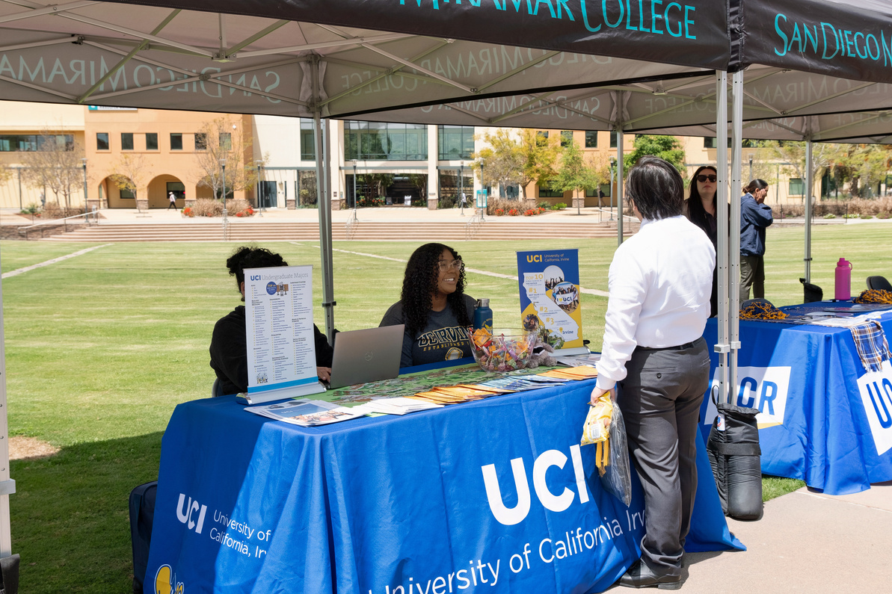
Campus Resources
CAREER & LIFE DESIGN CENTER
TRANSFER CENTER
  Career Exploration
    What Can I Do With This Major?
  Resume & Cover Letter
  Interview Preparation
  University Admissions guidance
  Transfer Process
  Transfer Fairs
  Workshops
Notes:
More exciting and encouraging for students to attend
Jon

Slide 9
UC Transfer Admission Guarantee (TAG) and CSU Transfer Student Planner (TSP) Registration Reminder
If you're planning to transfer to a UC or CSU campus via a guaranteed admissions program, don't forget to complete your
TSP APPLICATION FOR CSU SCHOOLS
(TAG) APPLICATION FOR UC SCHOOLS
  Due October 31, 2025 to participate in the program)
  Take advantage of priority registration and transfer support services.
  Due September 30, 2025 for Fall 2026 admission
Notes:
More exciting and encouraging for students to attend
Jon

Slide 10
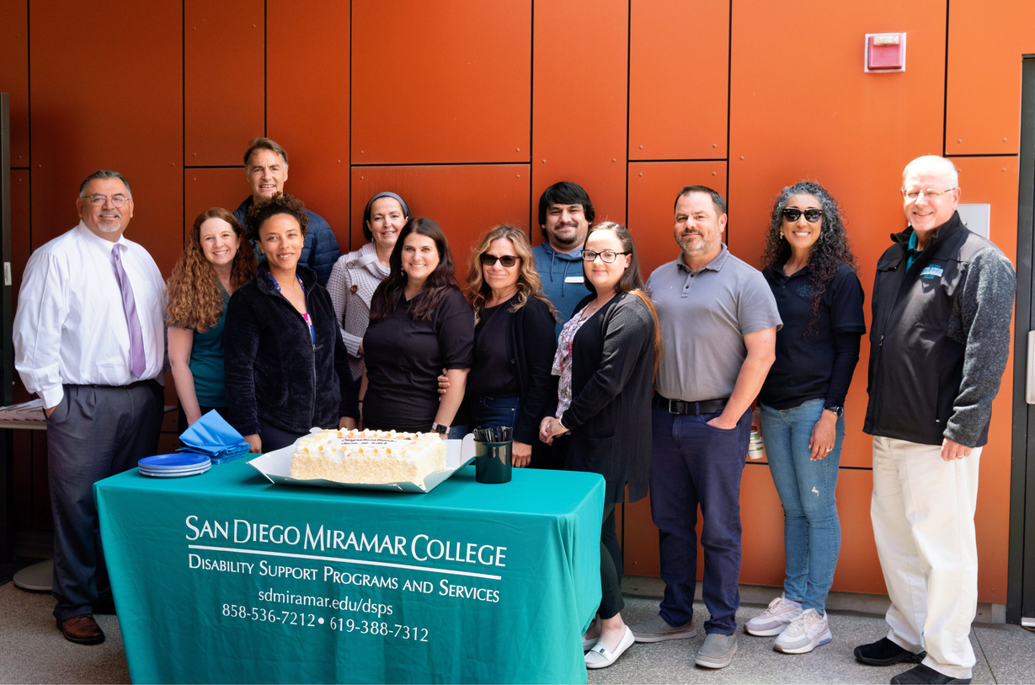

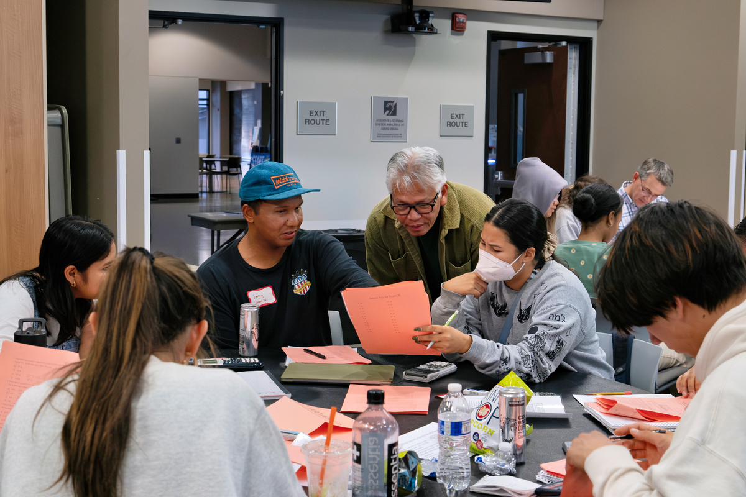
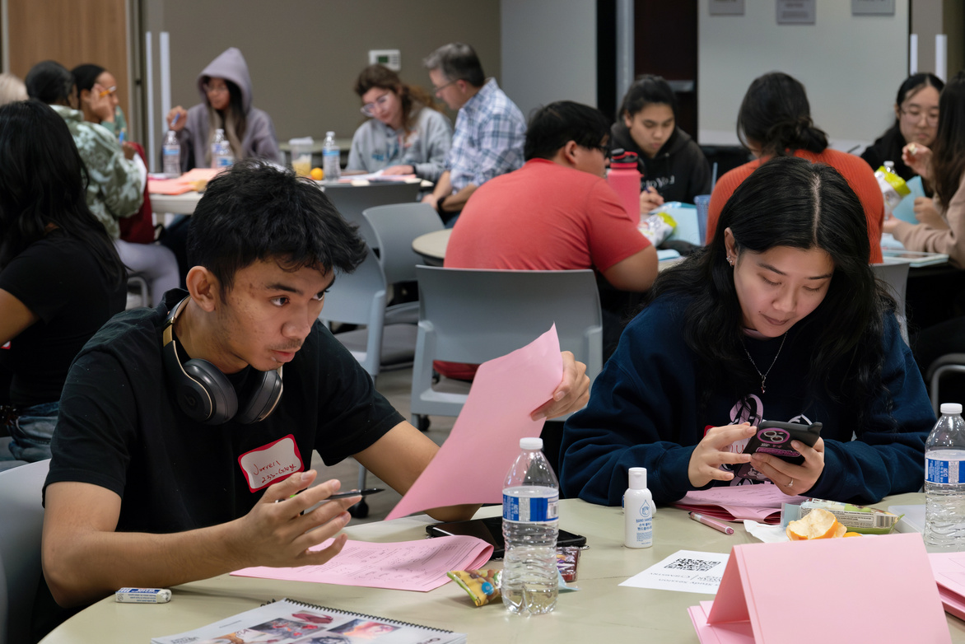
Campus Resources
DISABILITY SUPPORT PROGRAMS
& SERVICES (DSP&S)
  Adaptive Technology
  Alternate Media
  Note Taking Assistance
  Specialized Counseling
sdmiramar.edu/services/dsps
ACADEMIC SUCCESS CENTER (ASC) L-101
  Tutoring (In-Person & Online)
  Study Rooms Available
  Math Lab (M-210)
    M-210
  WELL (Writing English Language Lab)
  STEM Center (S6-112i)
sdmiramar.edu/services/asc
Notes:
More exciting and encouraging for students to attend
Jon

Slide 11
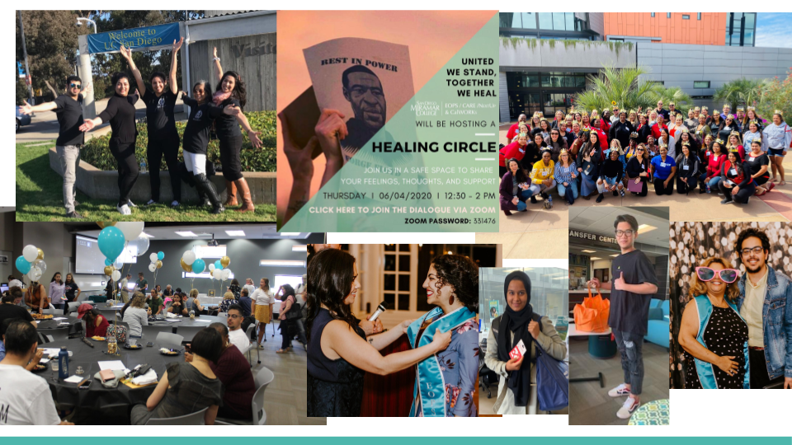
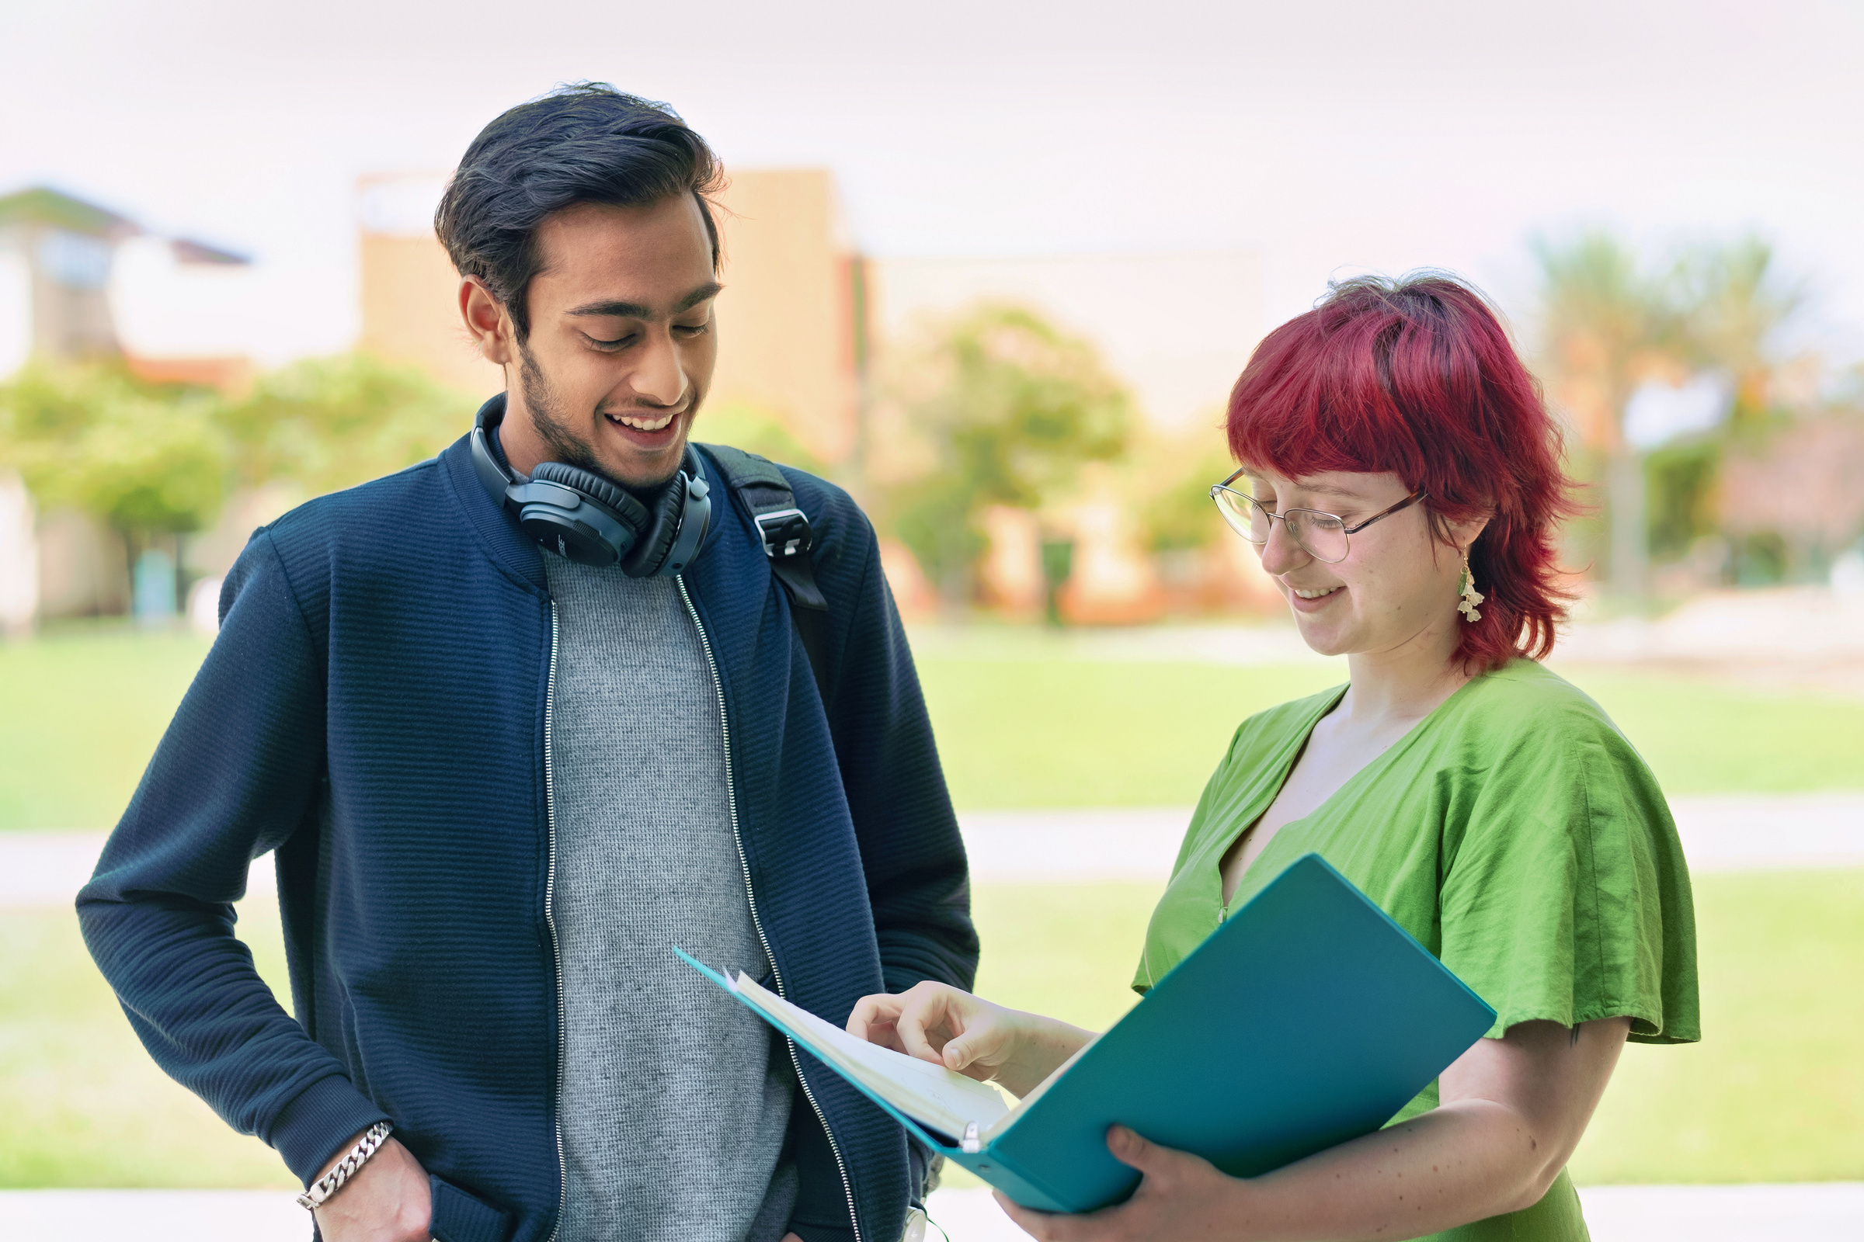

Campus Resources
EXTENDED OPPORTUNITIES PROGRAMS & SERVICES (EOP&S)
  Financial relief & counseling
  CalWorks- Cash Aid
  NextUp- Foster Youth
  CARE- Single Parents
  Rising Scholars- Justice Impacted
  Basic Needs- Jet Fuel Pantry
sdmiramar.edu/services/eops
DREAMERS SUPPORT SERVICES
  Programs and services to empower undocumented and immigrant students
  Financial aid & 1-on-1 support
  Events and Workshops
  FREE Legal Aid & DACA Renewal Assistance
sdmiramar.edu/dreamers
Notes:
More exciting and encouraging for students to attend
Jon

Slide 12




LEAD office
PROMOTING EDUCATIONAL ACHIEVEMENT, RETENTION, & LEADERSHIP (PEARL)
  Program to empower Asian American, Native Hawaiian, Pacific Islander students
  Academic & Mental Counseling
  Paired courses taught through AANHPI perspective
  Tutoring & Peer Mentoring
bit.ly/PEARLFall2025
NATIVE AMERICAN STUDENT SUCCESS PROGRAM
(NASSP)
  Program to support Native American descent, identify as Native American/Alaska Native, and or have tribal affiliation/membership
  Book grants & stipends
  Gas cards
  Events and Workshops
NASSSP Interest Form
Notes:
More exciting and encouraging for students to attend
Jon

Slide 13




Requirements & Eligibility
ATTEND A PROMISE
ORIENTATION
Each semester:
Attend a campus engagement event each semster
Enroll in at least 12 units*
Submit Progress Report
(Due Early October/March)
Complete a comprehensive education plan by May 2026
Meet with any counselor
(Promise,EOPS or DSPS)
*Unless you have an approved DSP&S Waiver or Reduced Units Petition
Notes:
Emphasize that any counselor meeting counts!!
Jon

Slide 14


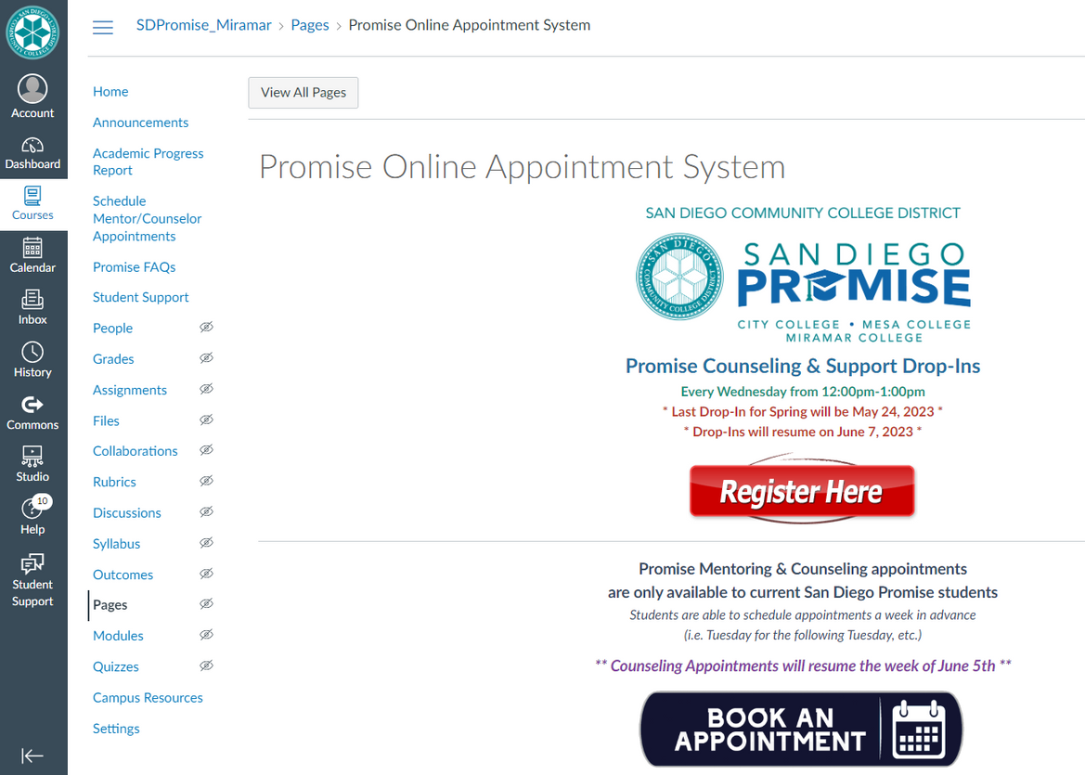

Promise Retention Counseling
How to book appointments:
PROMISE CANVAS PAGE
Appointments open 1 week in advance
Notes:
Ana

Slide 15

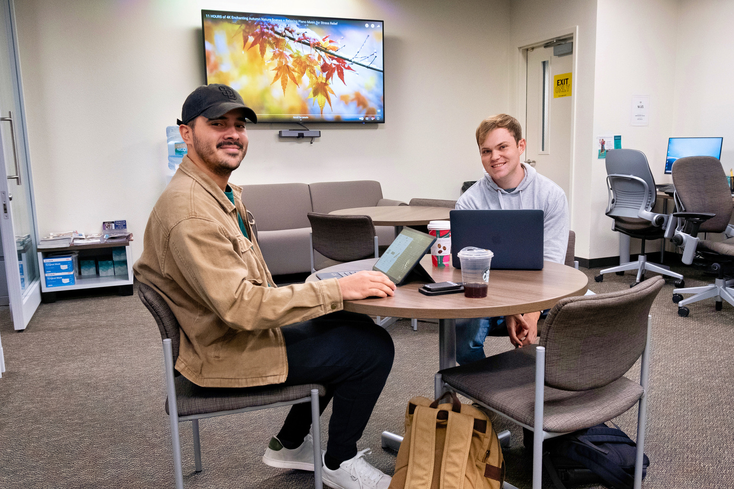
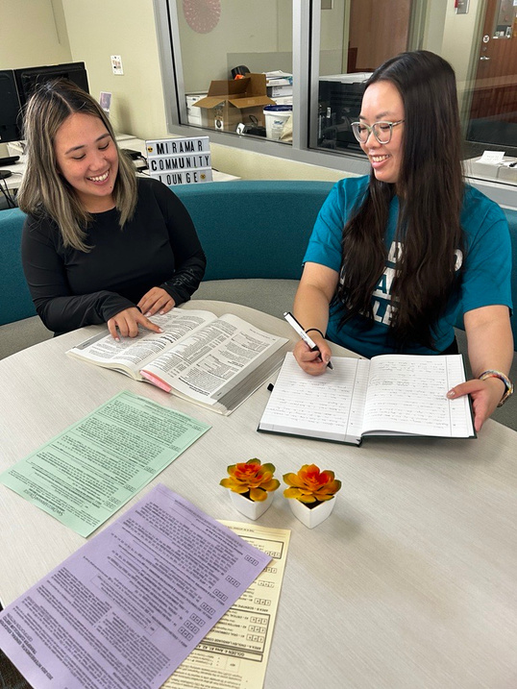
General Counseling
General Counseling Department
https://sdmiramar.edu/services/counseling
Types of Appointments:
  Comprehensive 1 hr appointments
  Quick Connect 10-Minute Meetings
  Counseling Sessions (30 mins)
Appointments open two weeks in advance
Notes:
Ana

Slide 16

promise laptops
Our office has limited laptops available to students that qualify.
If you need a laptop, please reach out to our team by emailing us at:
sdpromisemiramar@sdccd.edu
*First come first served basis
NEED A LAPTOP TO DO SCHOOL WORK?
Notes:
Reminder that Promise Laptops does go against student's financial aid
Ana

Slide 17
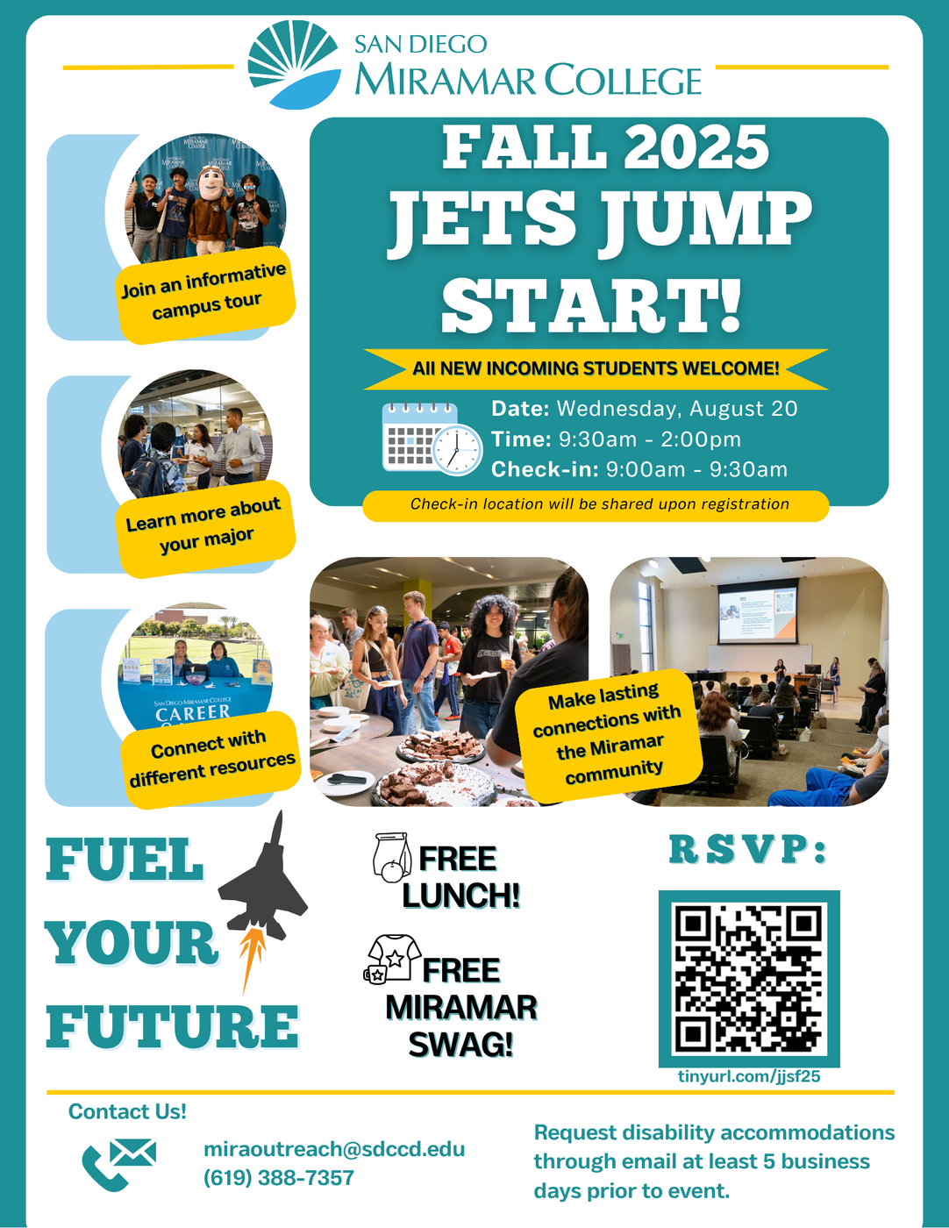
Notes:
Theron

Slide 18
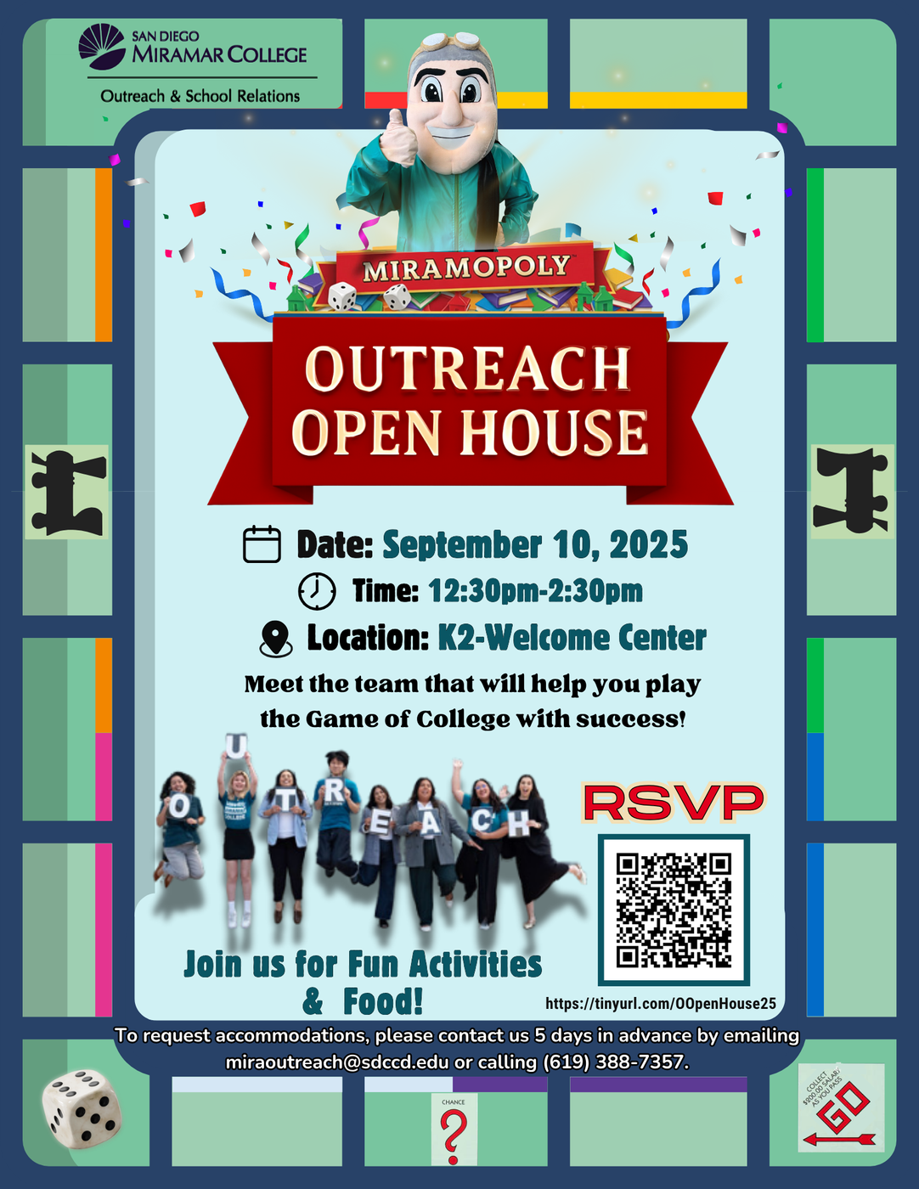
Notes:
Theron

Slide 19
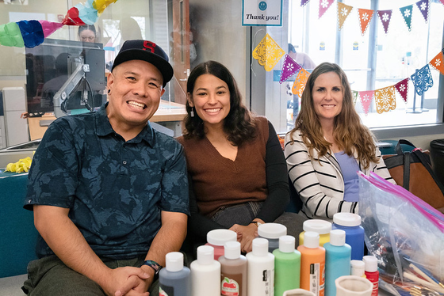
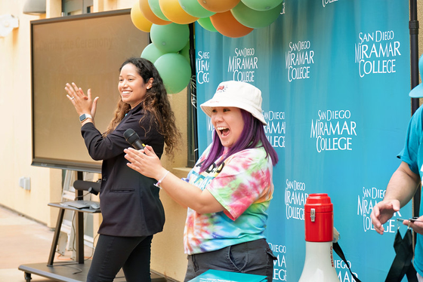

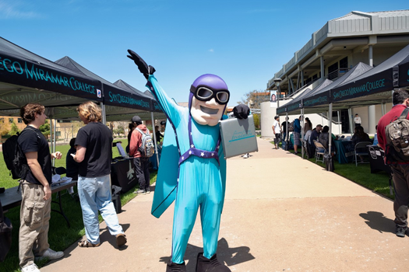
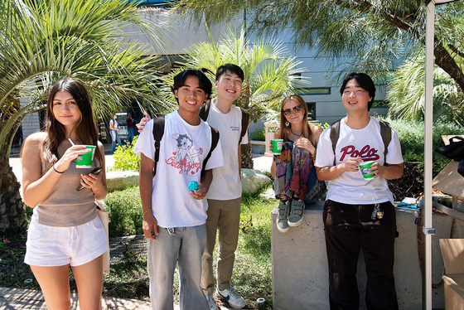
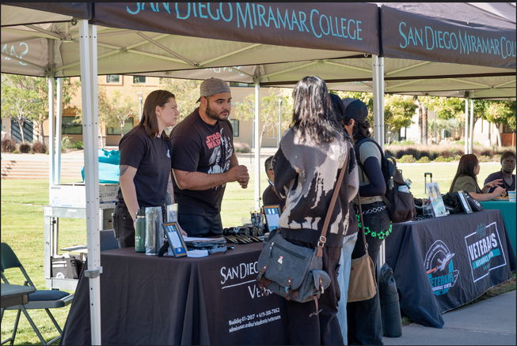
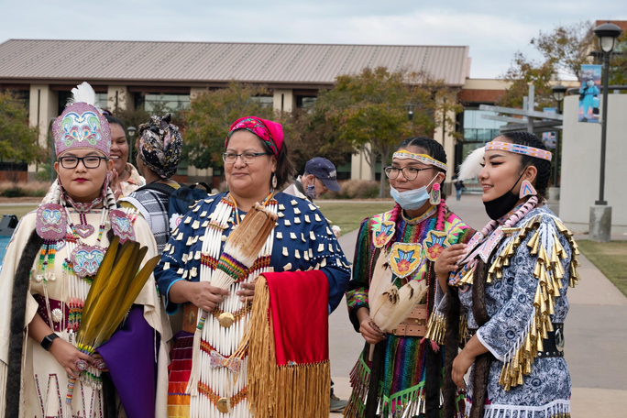


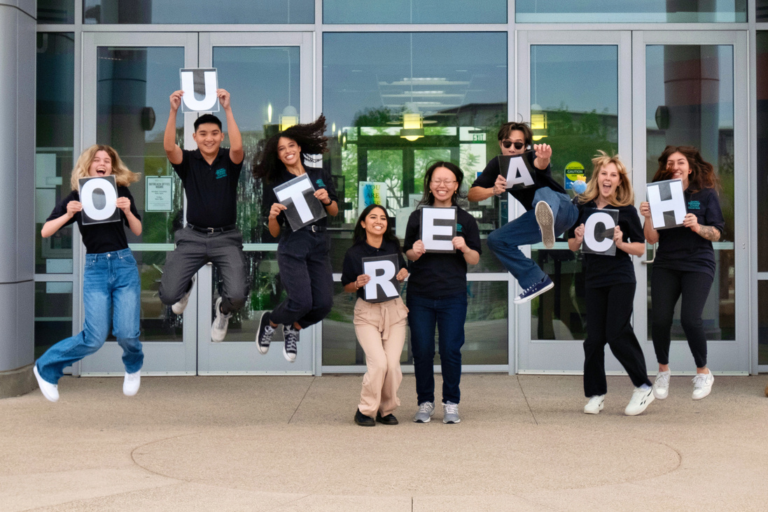
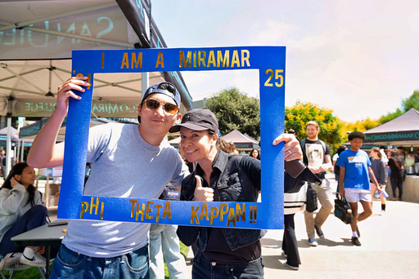
Social Media
FOLLOW US!
Give us a Follow on both Instagrams!
@sdpromise_miramar
@miramaroutreach
Notes:
Ana H: Needs to update

Slide 20
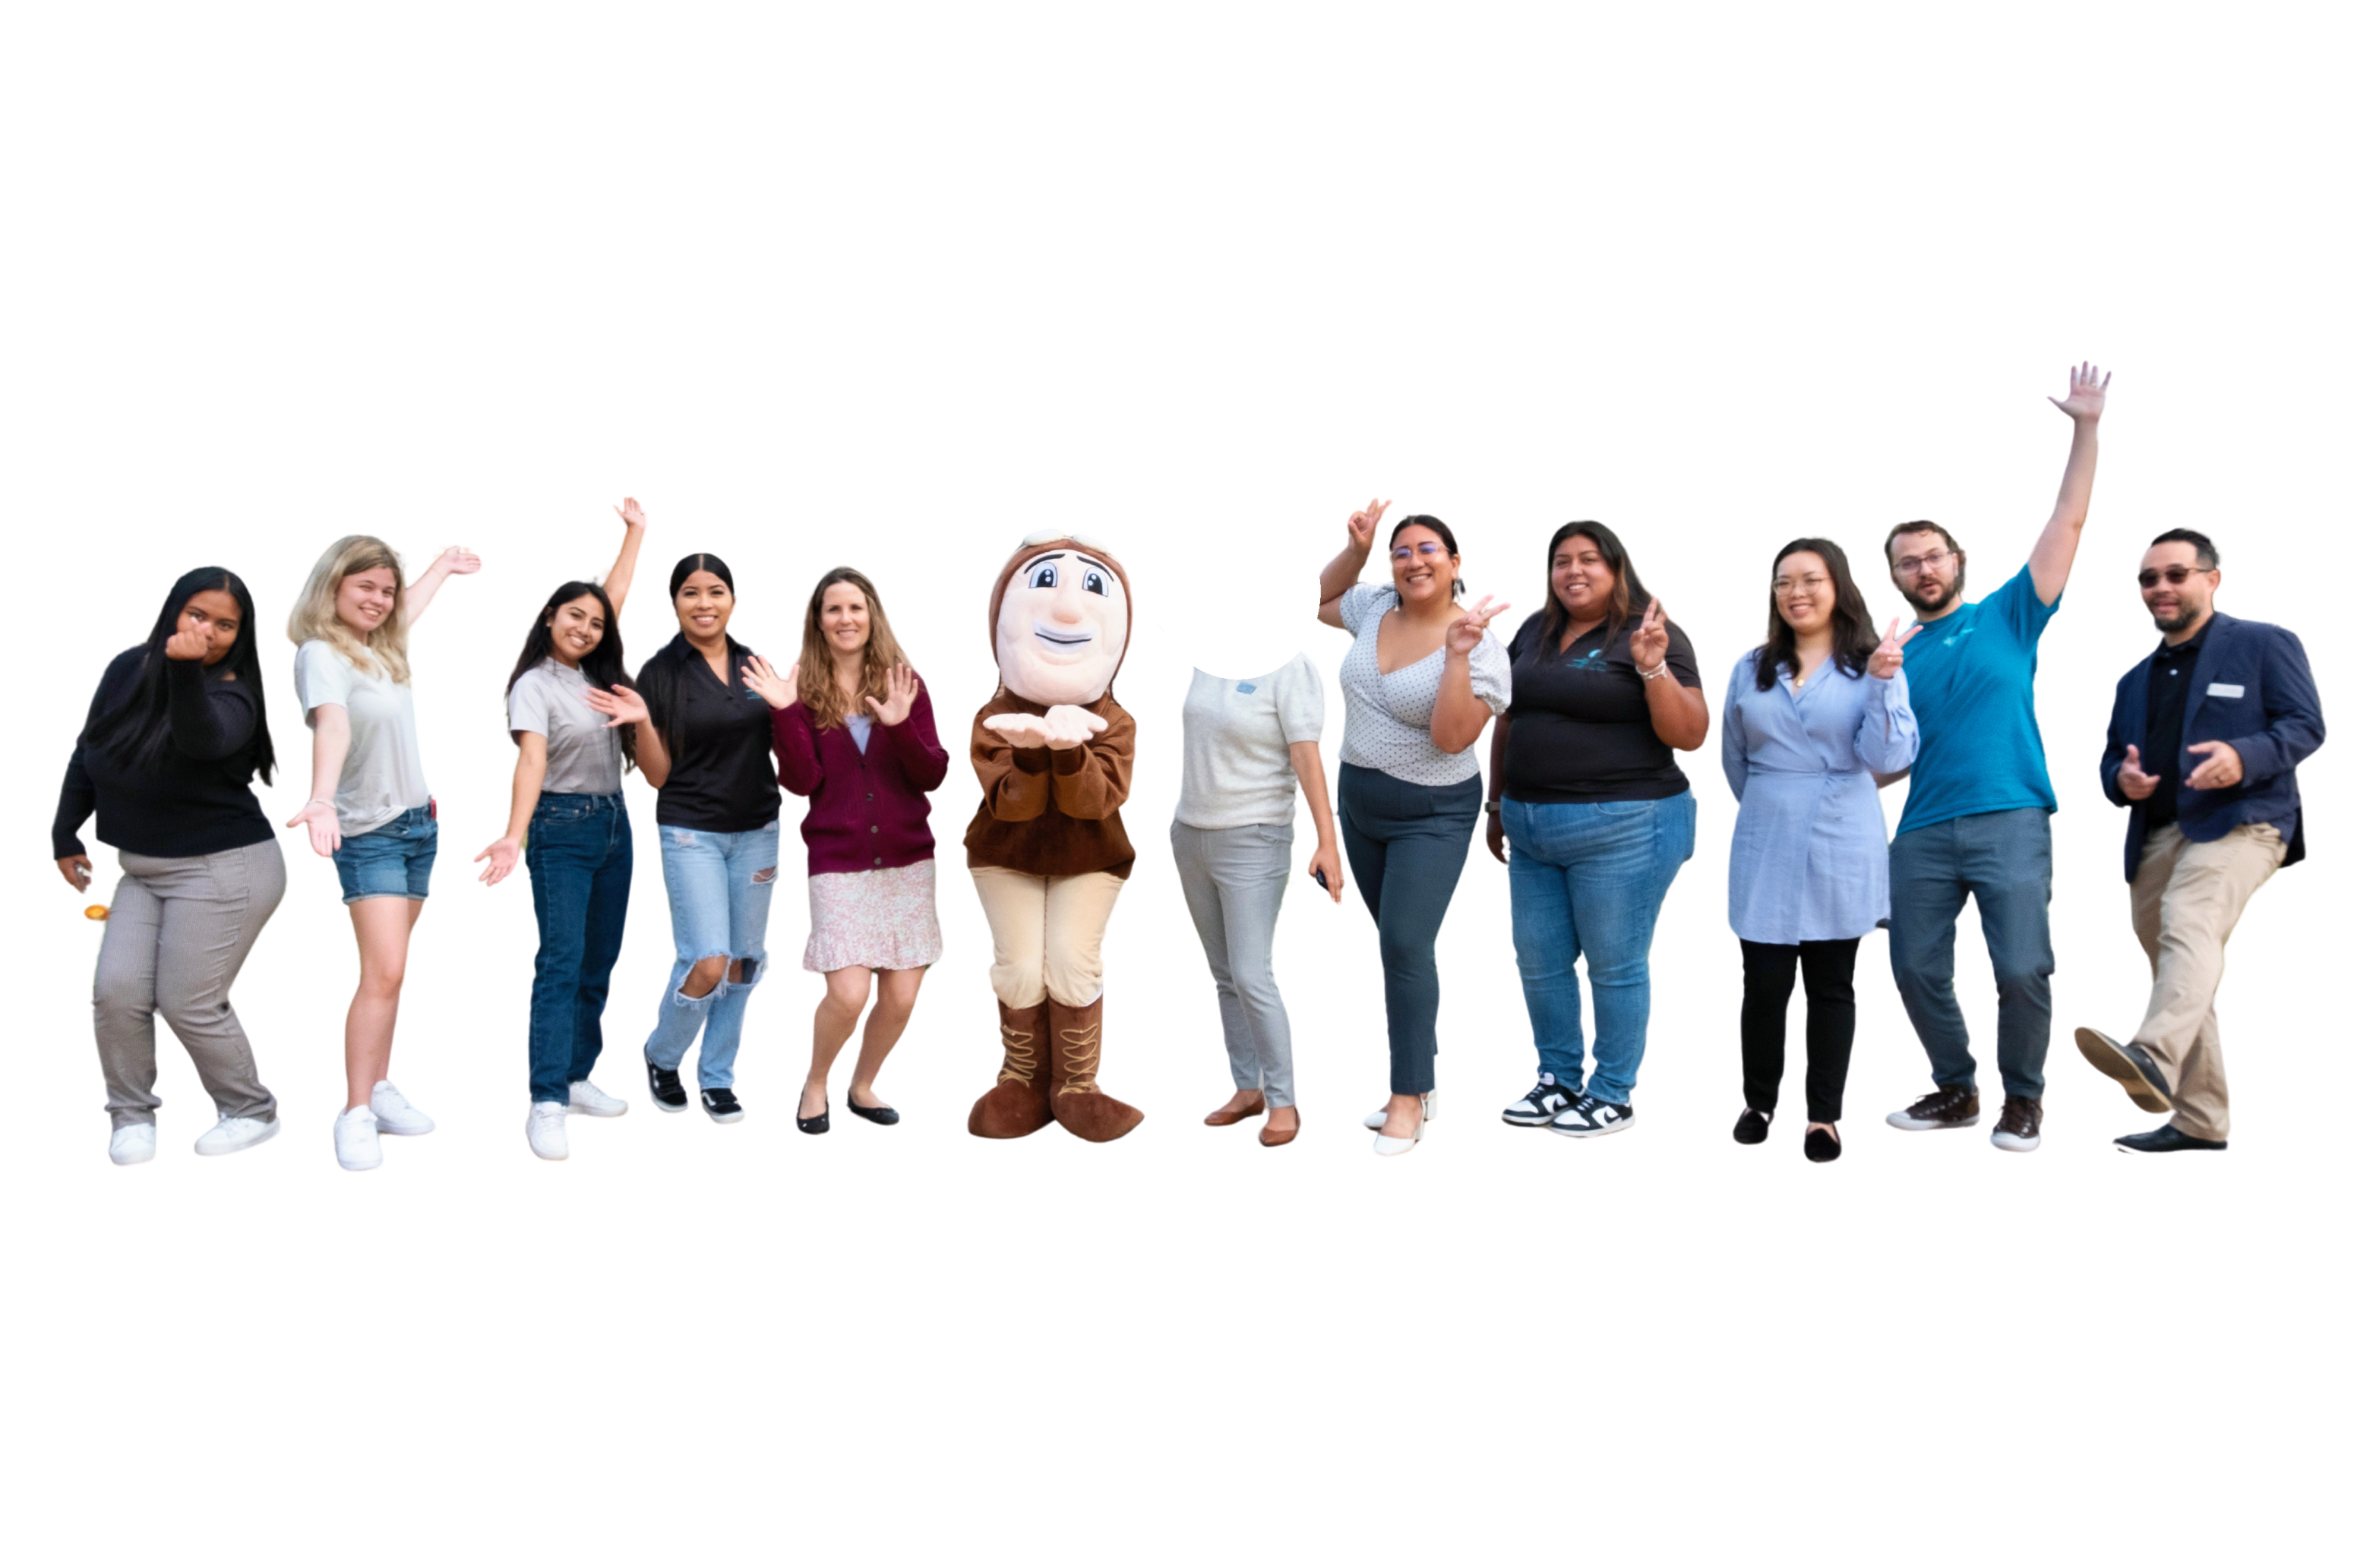
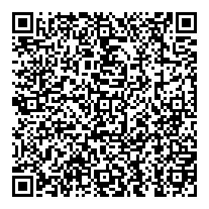

give us feedback!
We would appreciate if you take the time to fill out this quick feedback survey!
Thank you :)
tinyurl.com/PromiseSurvey25
Notes:
Dulce

Slide 21
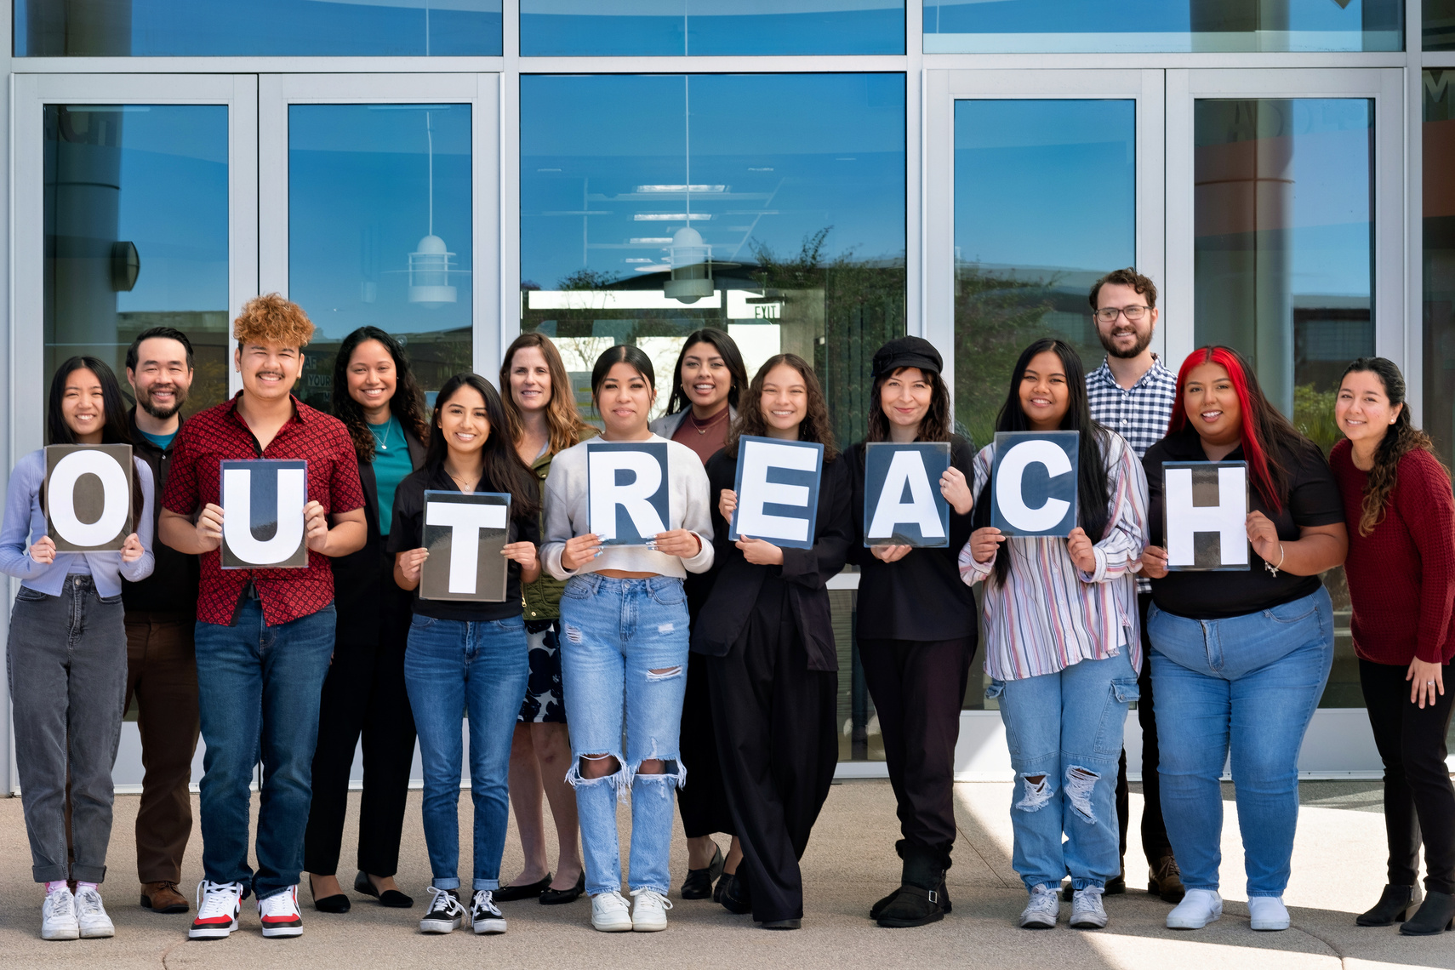




HOW TO CONTACT US:
MIRAMAR PROMISE PROGRAM
10440 Black Mountain Road
San Diego, CA 92126
P
M
I
S
E
!
(619) 388-7357
R
O
sdpromisemiramar@sdccd.edu
@miramaroutreach
@sdpromise_miramar
We look forward to seeing you on campus!
Notes:
Dulce

