Slide 1
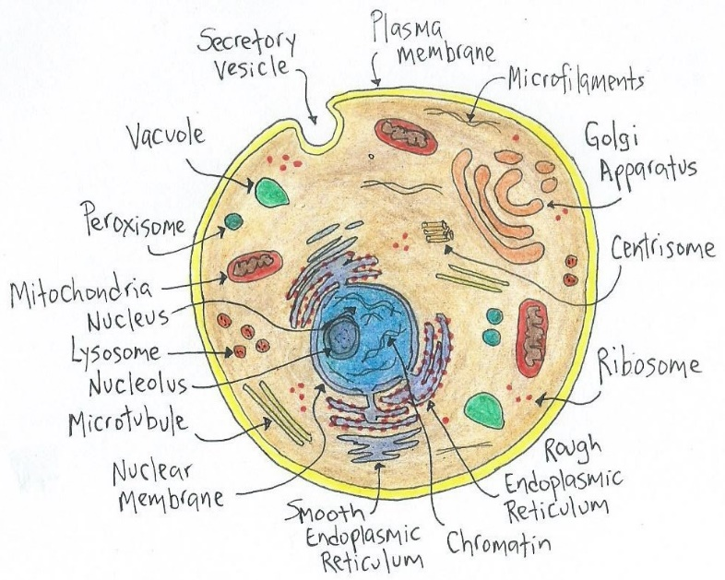
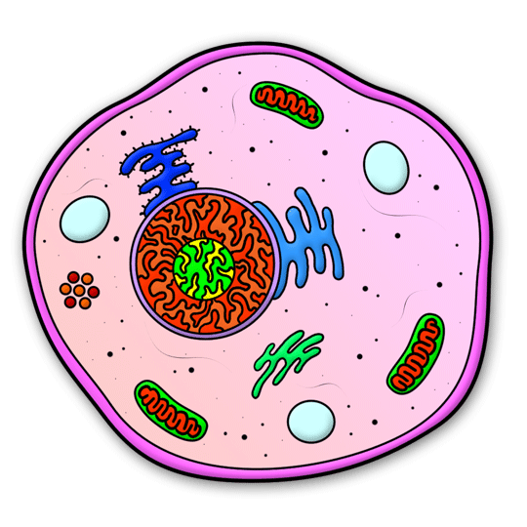
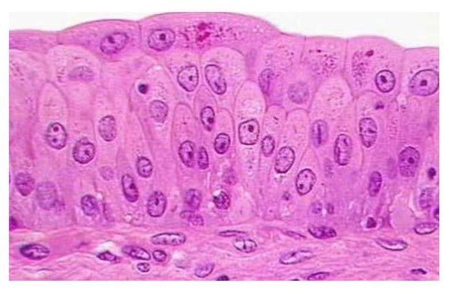
Cells and the Cell Membrane
Apparently 50 to 60 Trillion cells in the Human Body!
About 200 different cell types in the Human Body.
e.g.,
hepatocytes
osteocytes
osteoblasts
chondroblasts
erythrocytes
neurons
Combine to make only 4 different Tissues in the Human Body.

Slide 2
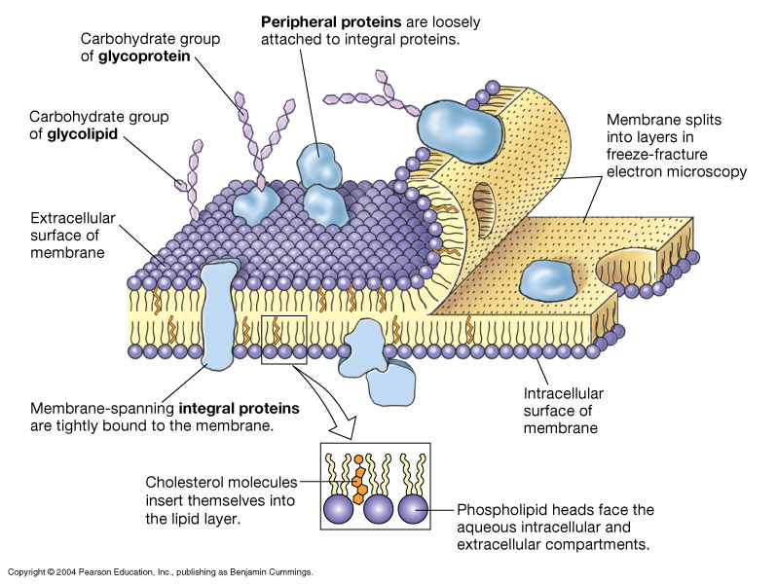
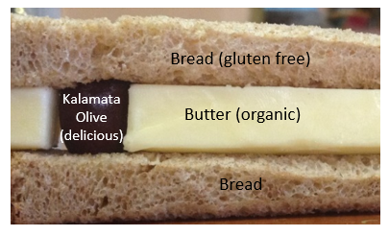
Plasma Membrane Model – Phospholipid Bilayer
“Butter sandwich with olives”

Slide 3
Components of Typical Plasma Membrane
Lipids
~50%
Proteins
~50%
1) Phospholipids
1) Peripheral
(Associated)
(75%)
2) Cholesterol
2) Integral
(Membrane Spanning)
(20%)
3) Glycolipds
3) Glycoproteins
(5%)

Slide 4
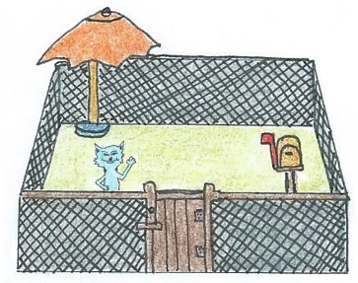
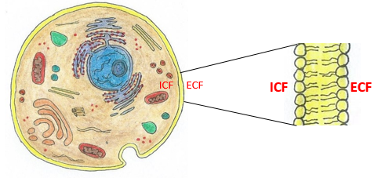
Roles of the Plasma Membrane
1.
2.
3.
4.

Slide 5
Factors Influencing Molecule Permeability
Membrane is “semipermeable” or selectively permeable.
How is it that some thing gets across the plasma membrane and others may not?
There are 3 main factors determining if a molecule can easily pass directly through the plasma membrane or not.
1. Size of molecule.
2. Polarity (Lipid Solubility) of molecule.
3. Charge of molecule.

Slide 6
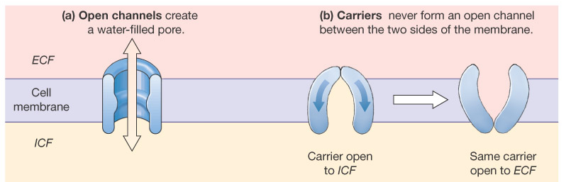
Protein Transporters
1) Channels
2) Carriers
a) Open
b) Gated*
*triggered to open

Slide 7
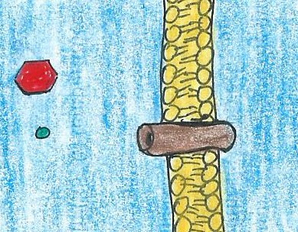
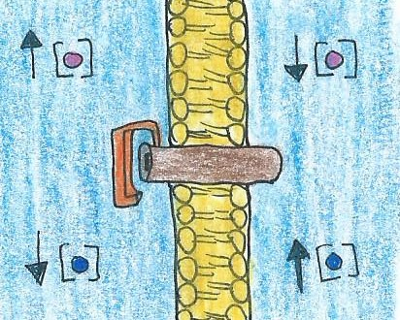
1) Protein Channels
What goes through a Channel?
Small ions (K⁺, Na⁺, Cl⁻, Ca²⁺)
Water (H₂O)
Fast!
Not always specific.
Why? Which way?
Down Concentration Gradient.
a) Open
ECF ICF
+
b) Gated
ECF ICF
Types of Gated Channels?
Chemically Gated Channels:
Voltage-Gated Channels:
Mechanically Gated Channels:

Slide 8
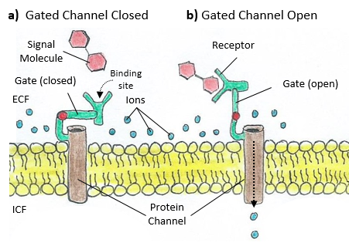
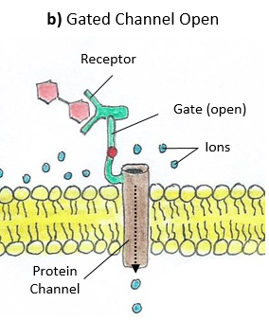
Gated Protein Channels
The charged particle entering the cell
sends an electrical signal

Slide 9
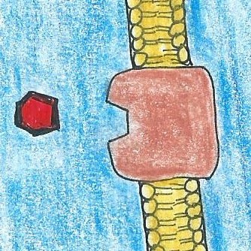
2) Protein Carriers
ECF ICF
What goes through a Carrier?
Larger molecules.
(but not macromolecules)
Polar molecules.
Slower than channels.
Usually very specific.
Why? Which way?
Because they need help getting across the membrane!
Down Concentration Gradient.
Or Up Concentration Gradient if ATP can be used.
Properties of Carriers:
Specificity
Competition
Saturation

Slide 10
Cell Transport Mechanisms
Passive
Active
1) Diffusion
1) Primary (Direct)
2) Facilitated
Diffusion
2) Secondary (Indirect)
3) Filtration
3) Vesicular

Slide 11
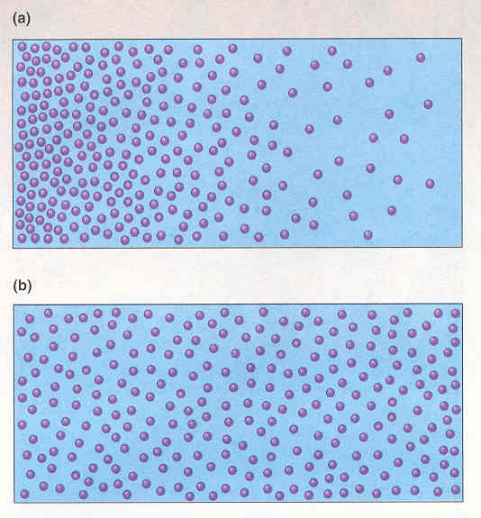
Diffusion

Slide 12
Define Diffusion:
State 6 factors that influence the Rate of Diffusion
(include how the factor specifically influences the rate)
1)
2)
3)
4)
5)
6)
Define Osmosis:

Slide 13
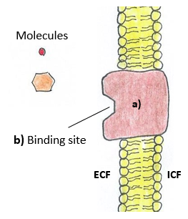

Facilitated Diffusion
This occurs when a molecule is moving Down its Concentration Gradient, but it needs help getting across the membrane. Its transport (diffusion) is “facilitated” by a protein carrier.
The glucose molecule is high in the ECF and low in the ICF, thus moves Down its Concentration Gradient using the protein carrier to get across the membrane.

Slide 14
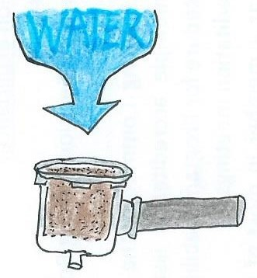
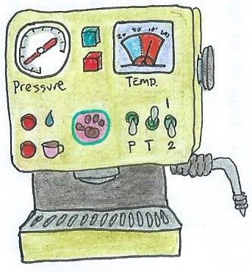
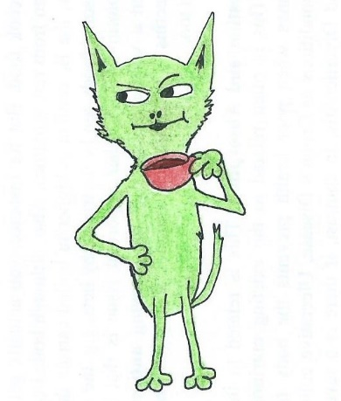
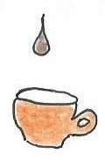
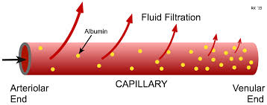
Filtration
When Hydrostatic Pressure (HP) pushes water and solutes across a membrane. Considered passive.
The H₂O pushing on the walls of its container is the driving force.
Think of making coffee…
The coffee grinds sit in the filter as water pushes against it.
Only H₂O and smaller solutes are pushed through the filter, this is called the Filtrate!
Filter
The large coffee grounds (like cells and proteins) are too big and remain behind.
In the body this happens in Blood Vessels.
Filtration is the net movement of water and solutes across a membrane from the HP of the fluid. It generates Filtrate.

Slide 15
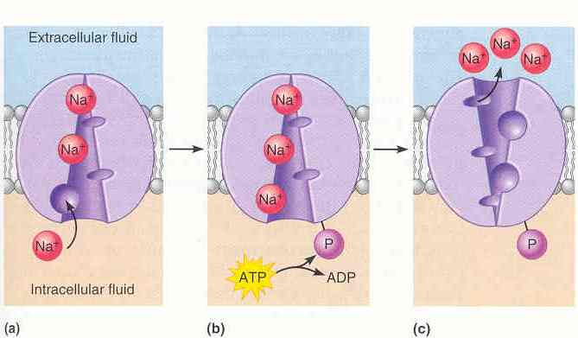
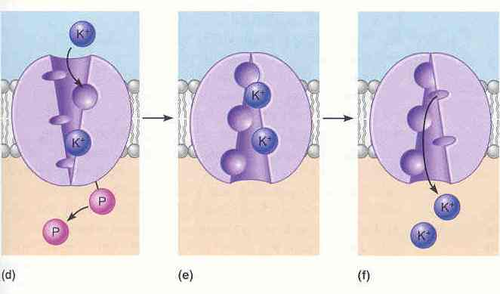
Primary Active Transport: The Na⁺/K⁺ Pump
Antiport

Slide 16
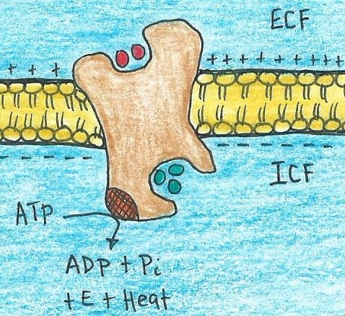
The Na⁺/K⁺ Pump
(The Na⁺/K⁺ ATPase)
↑Na⁺
↓K⁺
In what direction is
Na⁺ being moved?
Up!
In what direction is
K⁺ being moved?
Up!
↓Na⁺
↑K⁺
Therefore, ATP is needed, and it is used Directly.

Slide 17
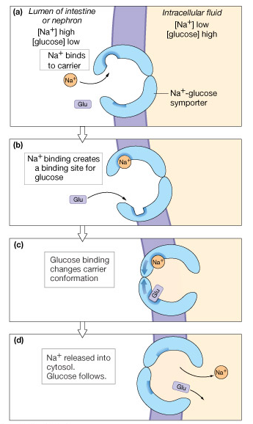
Secondary Active
(Indirect):
e.g., the Na⁺/Glucose
transporter
Symport

Slide 18
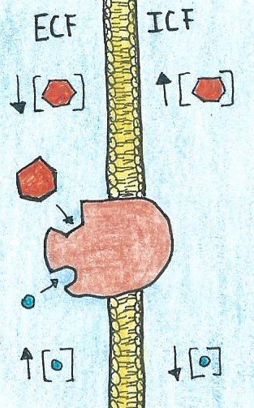
The Na⁺/Glucose Symport
In what direction is
Na⁺ being moved?
Down!
Glucose
In what direction is
Glucose being moved?
Up!
So ATP is needed, and it is now used Indirectly.
+
Na⁺
Where is the ATP coming from?

Slide 19
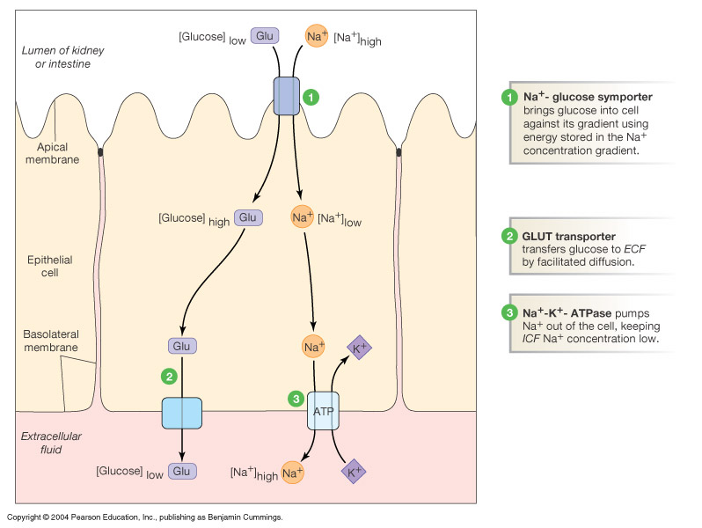
Summary of Transport Proteins
H₂O
Lipids
Ions

Slide 20
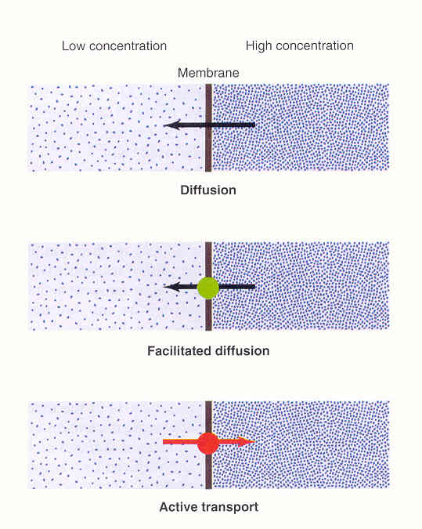

Slide 21
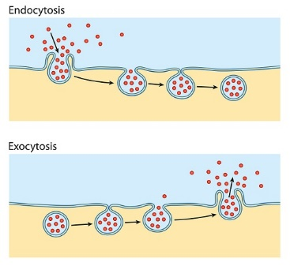
Vesicular Transport
Role: To move large macromolecules or large quantities of a molecule across the plasma membrane. Vesicles are like mini lipid bilayer bubbles (see below). Active transport, directly requires E (in the form of ATP) for maneuvering of cytoskeleton and the vesicles.
Vesicle: A small, fluid-filled spherical organelle enclosed by a lipid bilayer
Endocytosis
(Bringing into the cell)
and
Exocytosis
(Releasing out of the cell)
Vesicle
Vesicle

Slide 22
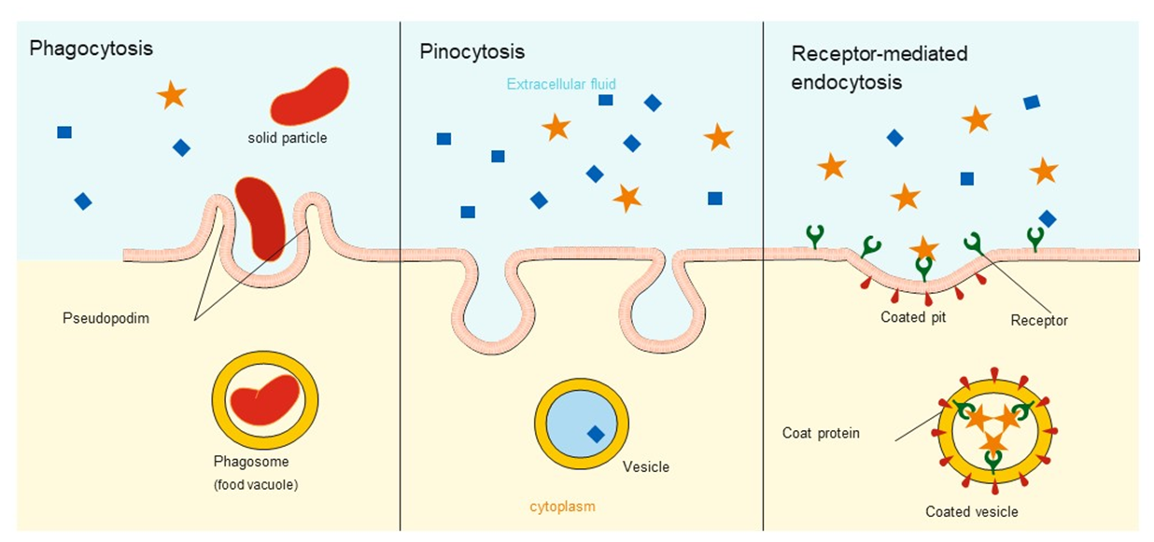
There are 3 types of Endocytosis:
Pinocytosis
Phagocytosis
Receptor-Mediated Endocytosis

Slide 23
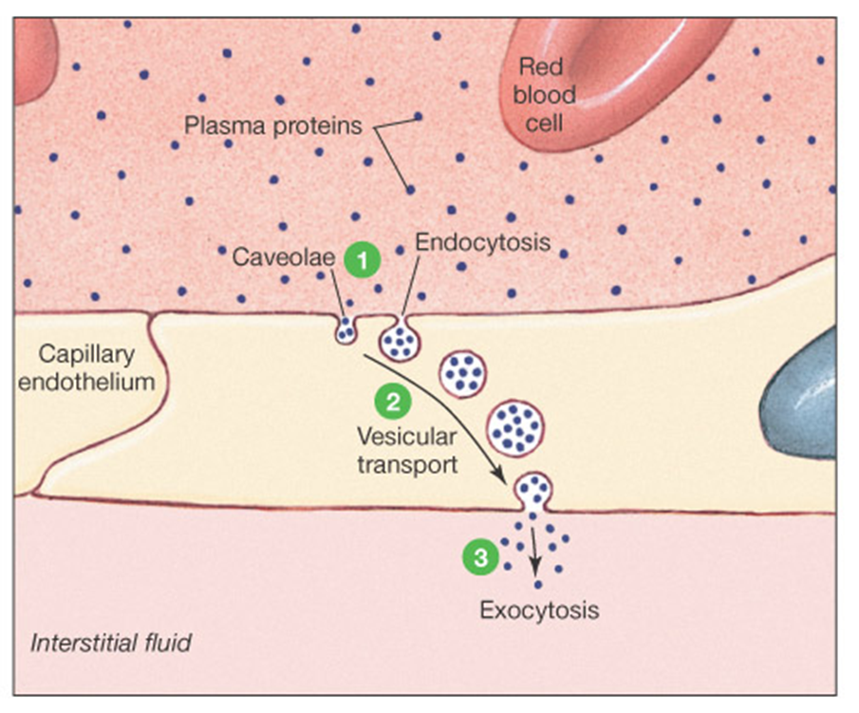
Transcytosis = movement across the cell!
This can occur by the various methods we have seen.
e.g., inside a vesicle as seen below.
① Specific contact triggers formation of vesicles and then endocytosis
② The filled vesicles can then cross the cell with help from the cytoskeleton
③ Vesicles contact plasma membrane and are exocytosis is triggered, and material is released into interstitial fluid.

Slide 24
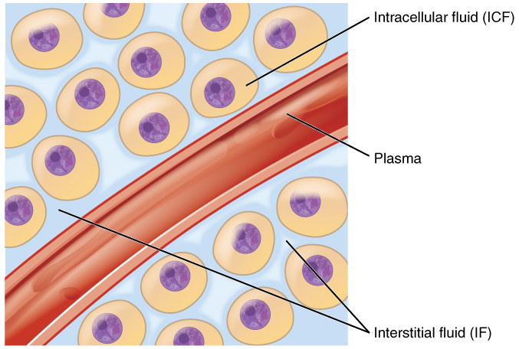

There are 3 Tissue Compartment Volumes of the Body
There are different solutions within the different ‘tissue compartments’ of the body.
There is intracellular fluid (ICF) and extracellular fluid (ECF).
ICF is the solution found inside cells.
ECF is the solution found outside of cells (it’s the fluid cells are bathed in).
The ECF can be further divided into:
Plasma, which is the fluid component of blood; and
Interstitial fluid, which is the fluid found in the interstitial spaces of body (in between cells).
Tissue
Intracellular Fluid (ICF)
(inside cells)
Cells in Tissue
Plasma
(inside blood vessels)
Blood Vessel
in Tissue
Interstitial Fluid
(in between cells)

Slide 25
Table Showing averages of concentrations (mM) for the common elements of solutions in the 3 Tissue Compartment Volumes.
Element | Plasma | Interstitial Fluid | Intracellular Fluid
 | (Concentrations in mM)
Na⁺ | 140 | 140 | 15
K⁺ | 5 | 5 | 140
Cl⁻ | 110 | 110 | 7
Ca²⁺ | 1 | 1 | 0.0001*
HCO₃⁻ | 24 | 24 | 10
P_{i} | 2 | 2 | 40
Protein | 1.2 | 0.2 | 4**
Amino Acids | 2 | 2 | 8
Glucose | 5.6 | 5.6 | 4
*In muscle cells, calcium ions (Ca²⁺) are stored intracellularly in the sarcoplasmic reticulum (SR).
**Depend on type and activity of cell and number of organelles.

Slide 26
How are the 3 Compartment Different?
Comparison of relative concentrations in the 3 Tissue Compartments.
 | Relative Concentrations in Tissue Compartments
Ion/ Molecule | Plasma | Interstitial Fluid | Intracellular Fluid
K⁺ | ↓ | ↓ | ↑
Na⁺ | ↑ | ↑ | ↓
Cl⁻ | ↑ | ↑ | ↓
Ca²⁺ | ↑ | ↑ | ↓*
HCO₃⁻ | ↑ | ↑ | ↓
Proteins (Pro⁻s) | ↑↑ | ↓↓ | ↑↑
*In muscle cells, calcium ions (Ca²⁺) are stored intracellularly in the sarcoplasmic reticulum (SR).

Slide 27
Transcapillary Fluid Dynamics
↑HP
(plasma in capillary)
↓HP
arterial
end
venous
end
↑↑ COP
↑↑ COP
Filtration
Reabsorption
↓HP
↓↓ COP
(interstitium)
Cells
(ICF)
= fluid movement
HP = Hydrostatic Pressure (force of a fluid on walls of its container)
COP = Colloid Osmotic Pressure (force generated by proteins in solution)

Slide 28

Review of Mechanisms
Review
Large polar molecule
Small charged particle
+
Small non-charged molecule
Small gas molecule
Large non-polar molecule
ECF ICF

Slide 29
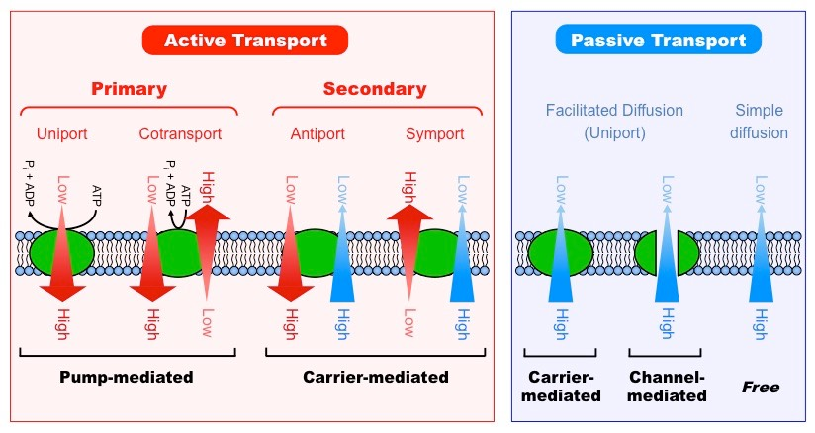
Summary of Types of Transport

Slide 30
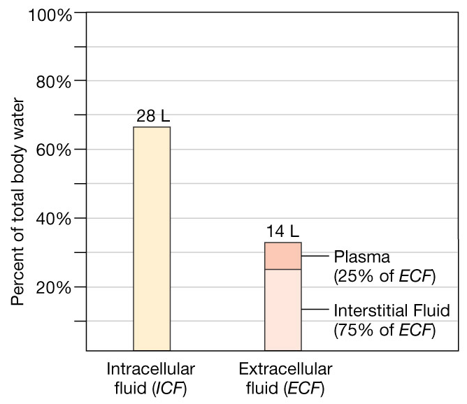
Distribution of Water and Solutes in the
Body Compartments
Inside cells
About 70% of body weight is water
67% is intracellular (ICF)
33% is extracellular (ECF)
  8% plasma
  25% interstitial

